Slide 1
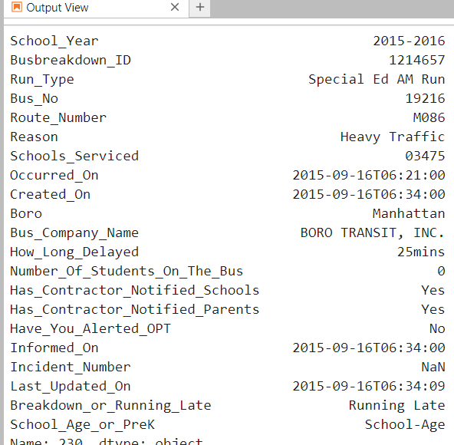
NYC Bus Breakdown Data

Slide 2
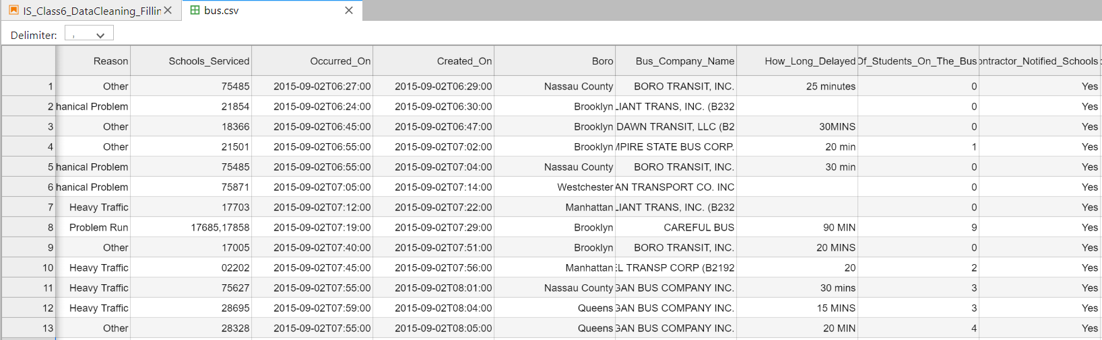
How much time does it typically take between a bus delay/breakdown and it being reported?
On average, how long are the bus delays/breakdowns?
How many delays/breakdowns did First Steps Bus Company have during the 2016-2017 versus the 2017-2018 school year?

Slide 3
What bus company had the most Mechanical Problems in this dataset?
How many incidents are recorded where more than one school is affected by a bus delay or breakdown?
What are the number of occurrences, by month, that a delay is caused by Heavy Traffic? Display this using a bar chart.

Slide 4
Data Cleaning
Information Systems

Slide 5
Class Objectives
Understand the importance of data cleaning
Apply data cleaning techniques to facilitate data analysis

Slide 6
Data cleaning (or data cleansing)
What is it?
discovering and then correcting and/or removing of errors and/or inconsistencies in a dataset
Why do it?
its correcting/removing actions result in data sets that have consistency across records
this allows data to be analyzed, questions about data to be answered, etc.
Notes:
Markdown: HTML, LaTex,

Slide 7
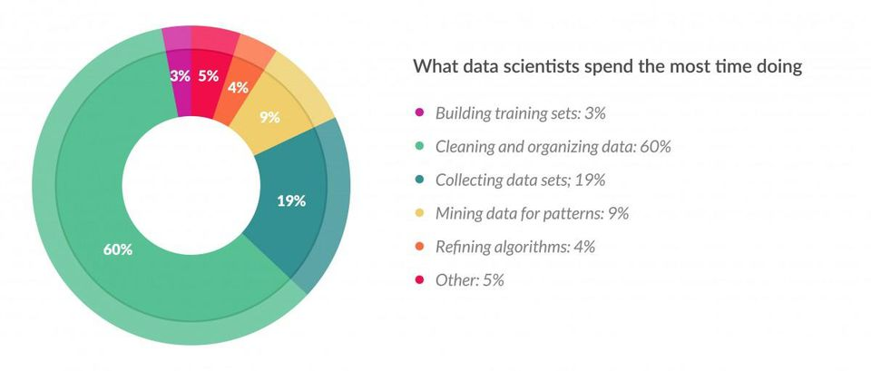
Source: https://www.forbes.com/sites/gilpress/2016/03/23/data-preparation-most-time-consuming-least-enjoyable-data-science-task-survey-says/#755cd9316f63

Slide 8
Data cleaning
Type of errors
  Missing records
  Duplicate records
  Nonsensical entries
  Inconsistent entries
  Formatting
  And more…
  How did these errors occur?
Notes:
Markdown: HTML, LaTex,

Slide 9
Data cleaning
Missing records
What could be some reasons for missing records?
Name | DOB | Income | Martial Status
John Smith | 5/4/1973 | NaN | Single
Mary Johnson |  | $70,000 | Married
Joe Wu | 4/22/1990 | $55,000 | unknown

Slide 10
Data cleaning
Missing records
Easy techniques for dealing with missing records:
  Delete rows with any missing value
  Delete columns with many missing values
Other advanced techniques exist (e.g. imputation), outside the scope of this class
Caution:
Realize that you are usually making some assumption about the data no matter how you deal with the missing records
Always communicate how you dealt with missing records

Slide 11
Data cleaning
Duplicate Records
What could be some reasons for duplicate records?
Technique for dealing with duplicate records is to delete the duplications
Name | DOB | Income | Martial Status
John Smith | 5/4/1973 | $60,000 | Single
John Smith | 5/4/1973 | $60,000 | Single

Slide 12
Data cleaning
Nonsensical Entries
What could be some reasons for nonsensical entries?
Techniques for dealing with nonsensical entries:
  Fix them appropriately, if possible
  Treat them the same as you would missing records
Name | DOB | Income | Martial Status
John Smith | 23 | $60,000 | Single
Mary Johnson | 5/4/1973 | -500 | Married

Slide 13
Data cleaning
Inconsistent Entries
What are the inconsistencies?
What could be some reasons for inconsistent entries?
Technique for dealing with inconsistent entries: put all entries in a column in the same format
Name | DOB | Income | Martial Status
John Smith | 5/4/1973 | 50K | Single
Johnson, Mary | 7 Jan 2000 | $70,000 | Married
Joe Wu | April 22, 1990 | 55000 | S

Slide 14
Data cleaning
Formatting
Name | DOB | Income | Martial Status
John Smith | 5/4/1973 | “25,000” | Single
Mary Johnson | 1/7/2000 | “70,000” | Married
Joe Wu | 4/22/1990 | “55,000” | Divorced
This will be something you need to identify as the data scientist. For ex,
  Need last name separate
  Need DOB as a dateTime datatype
  Need income as an integer
Technique for dealing with formatting: determine columns and datatypes needed and adjust accordingly.

Slide 15
Data cleaning
Have we done some data cleaning with any of the datasets we’ve already worked with?
  311 calls
  Bike Path
  Baby Names
  Accidental Drug Deaths
  NFL
  Billboard

Slide 16
Practice – Data Cleaning
For the duration of class, you will work in groups to clean the “NY Bus Breakdown and Delays” dataset, taken from kaggle.com.
Overview of data:
“The Bus Breakdown and Delay system collects information from school bus vendors operating out in the field in real time. Bus staff that encounter delays during the route are instructed to radio the dispatcher at the bus vendor’s central office. The bus vendor staff are then instructed to log into the Bus Breakdown and Delay system.”
https://www.kaggle.com/new-york-city/ny-bus-breakdown-and-delays

Slide 17
Practice – Data Cleaning
In your groups:
Familiarize yourselves with the data (visit the website provided)
Read the question given to your group
Determine what information you need in order to answer the question and come up with a plan of attack
Attempt to answer the question
  you will likely come across some issues with the data that require you to clean the data
  attempt to clean the data as necessary to answer your question;
    you may use the class notes or the Internet to search for techniques, functions, or methods that will help
When your Instructor indicates, drop your group's Jupyter Notebook in the Canvas Data Cleaning assignment page (about 20 minutes before class ends) and briefly present
Notes:
Think through assumptions and justify choices
A key objective of this is communicating what you are doing.

Slide 18
Practice – Data Cleaning
Objectives:
Work with real data and practice your data cleaning skills
Articulate what you have done in a 2-3 minute presentation at the end of class today
Notes:
No right or wrong answers
Articulate what you are doing and why
Can use anything we learned or any other ideas you have, as long as it makes sense
We are not trying to answer the NY DOT’s questions, but we are using them to guide us in our data cleaning step

Slide 19
Practice – Data Cleaning
Presentation
Present to the class:
  your group’s Question
  Data cleaning issues you faced
  Data cleaning techniques you used to address issues
  your group’s Findings
State any assumptions you made along the way
You may use your group's Jupyter Notebook during your presentation.

Slide 20
Practice – Data Cleaning
Group 1: How much time does it typically take between a bus delay/breakdown and it being reported?
Group 2: On average, how long are the bus delays/breakdowns? (*** hard ***)
Group 3: How many delays/breakdowns did First Steps Bus Company have during the 2016-2017 versus the 2017-2018 school year?
Group 4: What bus company had the most Mechanical Problems in this dataset?
Group 5: How many incidents are recorded where more than one school is affected by a bus delay or breakdown?
Group 6: What are the number of occurrences, by month, that a delay is caused by Heavy Traffic? Display this using a bar chart.

Slide 21
Some useful pandas commands
df[‘New Column']=pd.to_datetime(df[‘Old Column’])
convert a column of date-like string entries to Timestamp data types
mySeries.isnull()
df.dropna()
df.dropna(axis=1)
df.fillna(0), df.fillna(aDict)
df.drop_duplicates()
df[someColumn] = df[someOtherColumn].map(someDict)
df.replace(oldValue,newValue) e.g. newValue=NaN
pd.cut(mySeq,binsList)
Check out these additional pandas references:
https://tomaugspurger.github.io/modern-5-tidy.html
http://pandas.pydata.org/pandas-docs/stable/user_guide/missing_data.html

Slide 22
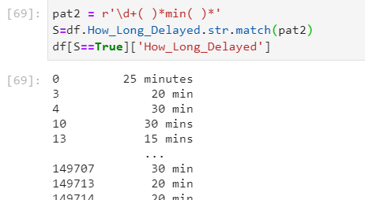
Regular Expressions
Not required in this class but can be very useful for data cleaning
See for example: http://automatetheboringstuff.com/2e/chapter7/
0 or more blank spaces
1 or more digits
the letters “min”
This “pattern” pat2 will scoop up all the entries that have a number followed by “min”
and you will be able to access the number

