Slide 1


Slide 2
Jupyter
What is it?
  Interactive Notebook
  Contains both Python code and Markdown (rich text); can include graphs produced by your code, pictures that enhance your report, etc.
    Use Markdown as narrative text (different than Python comments)
online Markdown editor: https://dillinger.io/
useful for learning and writing Markdown
let’s take a quick look
Notes:
Markdown: HTML, LaTex,

Slide 3
Jupyter
Why use it?
  Its readability makes it great for presenting work
  Can include exploratory phase
    Can leave in code, even if not part of your final product to show your thought process
  You can write code in snippets (“cells”)
    Faster: eliminates the need to rerun entire program
    Visualization: see the data as you work
Notes:
Markdown: HTML, LaTex,

Slide 4
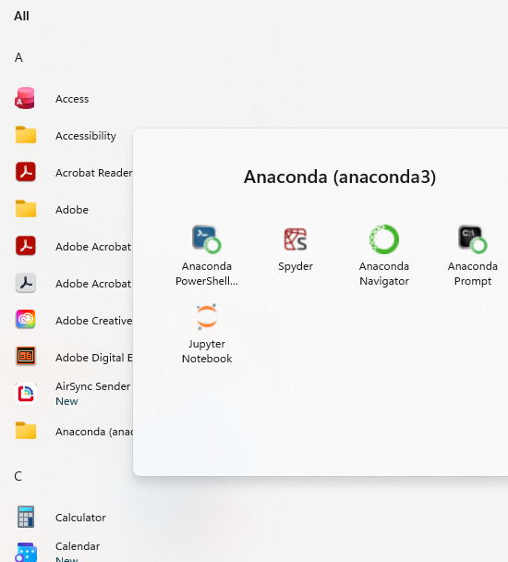
Jupyter (cont’d)
How do you launch it?
  Installation – already done if you have Anaconda (from CML)
  Open terminal / command prompt and enter:
  jupyter notebook
  OR search for Jupyter Notebook in your start menu →
or use the newer, more flexible
Jupyter Lab – not shown in these slides
but we will show in class

Slide 5
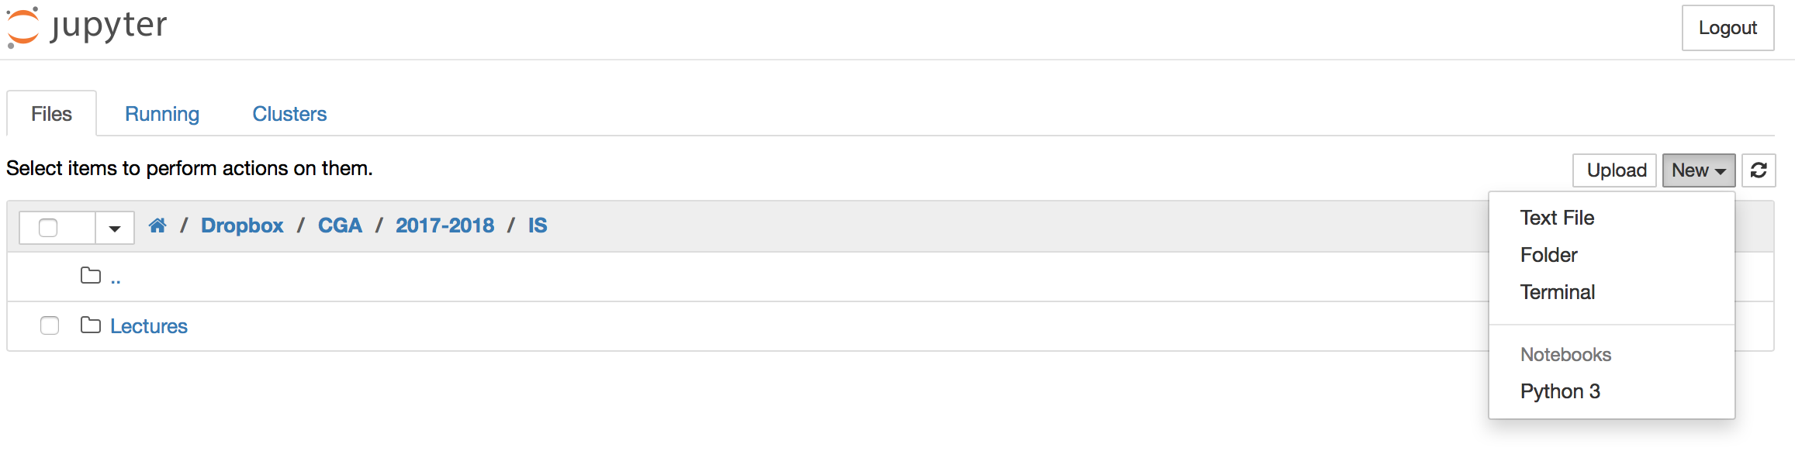
Jupyter – Try it
Launch Jupyter
  Navigation will open in your web browser
  (Note: you do NOT need internet access to use Jupyter)
Create a path to save your IS files in
Open a new ipynb

Slide 6
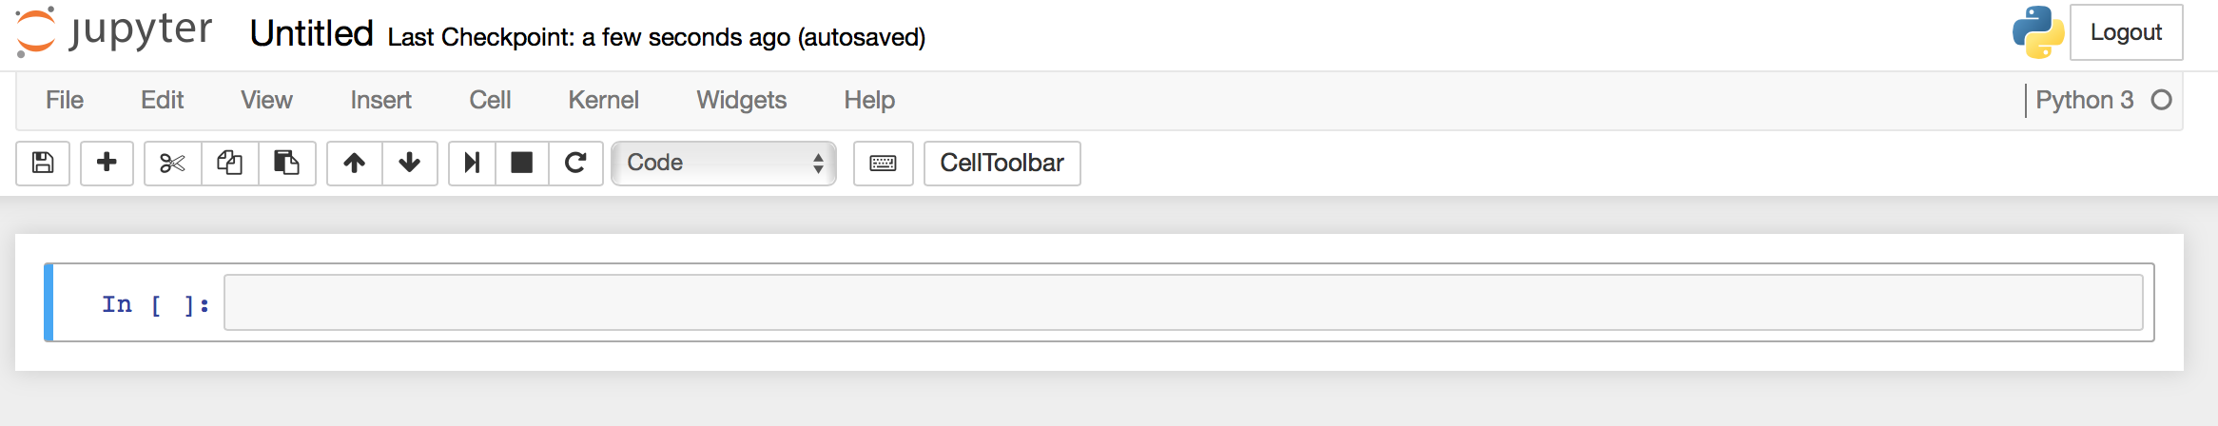
Jupyter – Try it
This will open a new .ipynb file. You can change the name of the file here.
The cell type can be change
You can add a cell using the + button in the toolbar

Slide 7

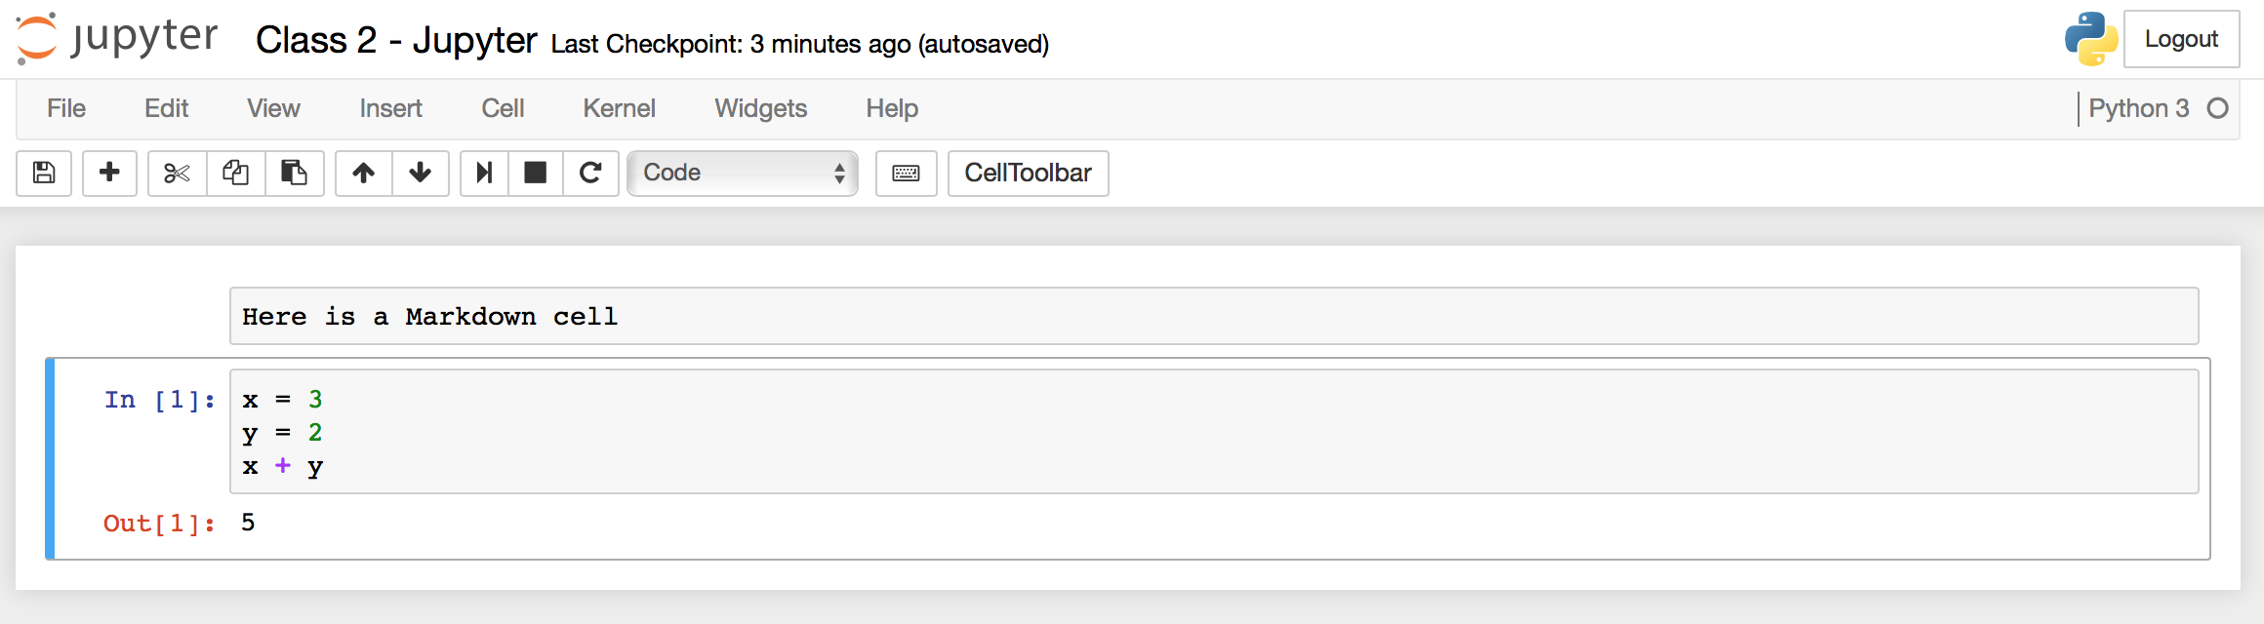
Jupyter – Try it
Control + Enter OR to execute cells
In[#] and Out[#] indicates the order in which the cell was executed
  Note: ORDER MATTERS!
From toolbar can also: save, copy/cut cells, rearrange cells, interrupt kernel, restart kernel

Slide 8
Jupyter – You Try
Work on the Jupyter worksheet in Homework 1 for the remainder of class; whatever you do not finish complete for homework.

