Slide 1
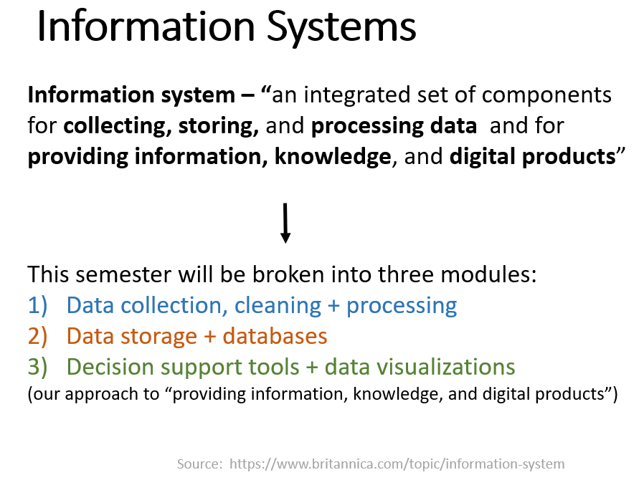
Flashback to Day 1 of this Course

Slide 2
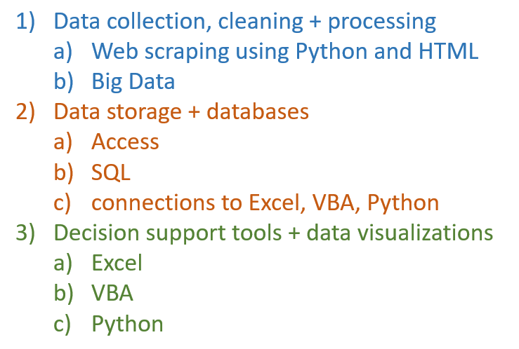
More from Day 1:
Some Course Tools & Approaches
We are here now

Slide 3
Module 3:
Decision Support Systems
AND DATA VISUALIZATION
Today:
Introduction
Begin Tutorial C
Next class:
Continue Tutorial C
Begin HW 7
After that:
VBA

Slide 4
Decision Support System
Decision Support System (DSS) is a computer program that can represent a problem a user needs to solve
Program accepts input from user OR accesses data in system’s files
Program runs input and any other necessary data through the model
Program outputs information the user needs to solve a problem
Notes:
Sometimes the program will recommend a solution to the problem

Slide 5
Decision Support System
DSS can be thought of as “what if” analysis
Coast Guard accession model: How big should the class of 2031 be?
  Factors at play:
  What if the economy is good/bad?
  What if the preceding classes are small/large?
  What if the historic retention rate at CGA Is high/low?
  What if the OCS classes are small/large?
DSS inform decisions / policy for decision makers

Slide 6
Decision Support System
Can be written in software or any programming language that lets a programmer represent a problem
We will be using Microsoft Excel to build a DSS

Slide 7
Prescriptive Analytics Example: Electric power portfolio optimization
An example DSS from day 1
An electric power utility must generate and/or obtain power to meet its customers' demand.
The utility has a set of options from which to fill its power “portfolio".
Utilities generally optimize their portfolios in the sense of minimizing cost subject to numerous constraints.

Slide 8
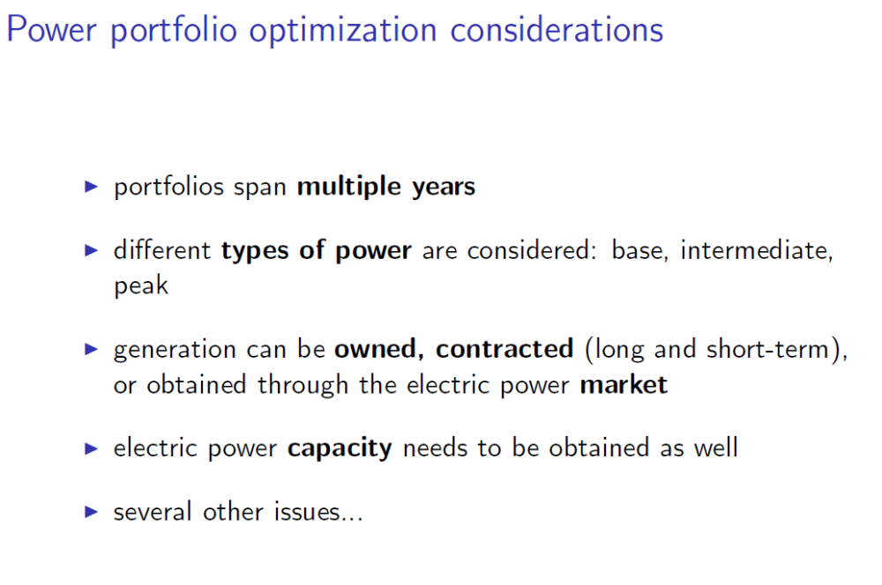

Slide 9
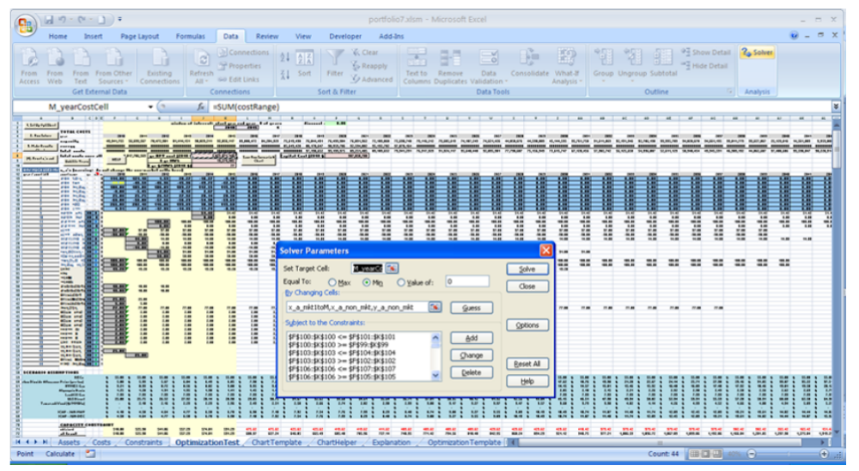
Formulated as Mixed Integer Program (see Lin Opt)
Decision Variables: x_{a} =megawatts (MW) to purchase of asset a, etc.
Fairly complicated objective function and numerous constraints...
Decision support system implemented in Excel using VBA (this course)
Notes:
Information system, vba, dss, visual analytics

Slide 10
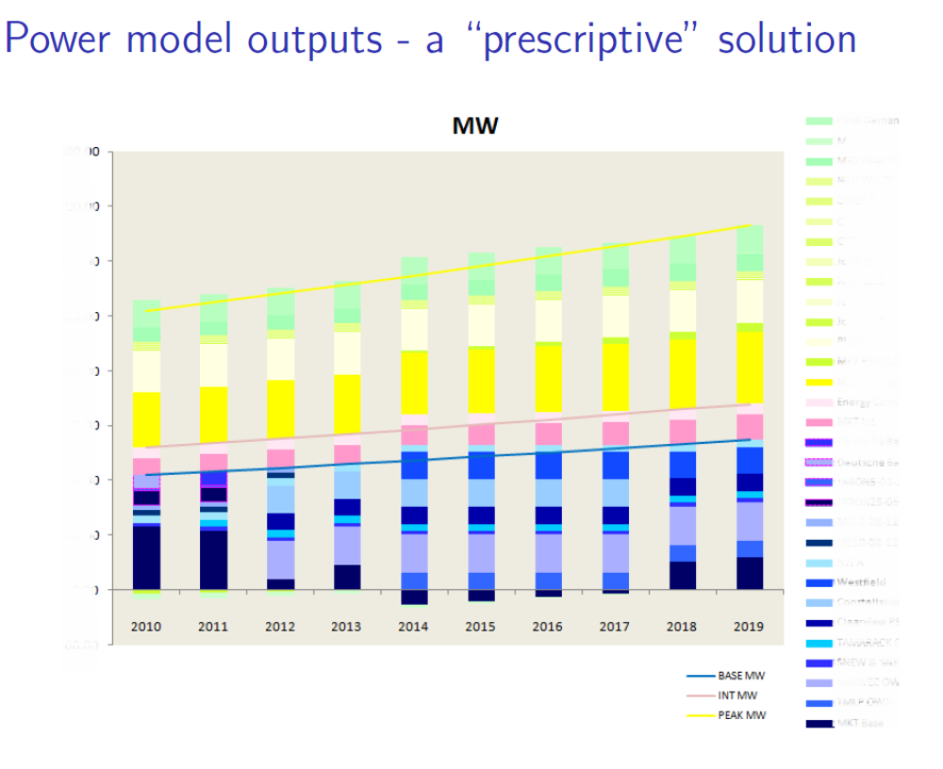
Notes:
visual analytics

Slide 11
Building a DSS: Tutorial C
Tutorial C:
A company makes strategic decisions based on:
  its net income and
  cash flow
Senior management wants to know these for the next two years. You generate them based on:
  Year 1 data
  Economic outlook
  Trend of cost of goods

Slide 12
Building a DSS: Tutorial C
You develop a DSS tool that enables user to:
see outputs as various what if input variables are changed
make informed decisions
HW 7:
Complete this DSS
Create another one (case 6 in your textbook)
Read section on Pivot Tables
Inputs economic outlook cost of goods trends | Outputs net income cash on hand

Slide 13
Start Tutorial C
Info & Hints
4 parts
  see list on p89
  only required to do 1st 2 (so pp 89-101)
To make it more educational,
  instead of copying the formulas straight from the book, try to figure out what the formula is going to be based on the descriptions
  E.g. sales = units sold * sales price per unit
In Scenario Manager, to get better row labels in the summary, give those cells names in the name manager.
TutC.xlsx skeleton file available on Canvas in case you want to start from there

