Slide 1
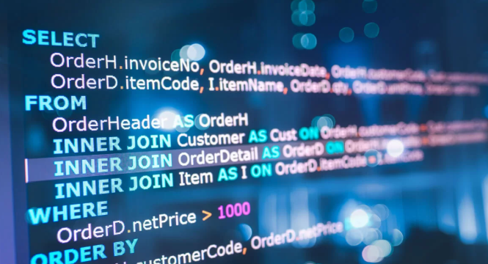
AI Agent:
Natural Language to SQL (NL2SQL)

Slide 2
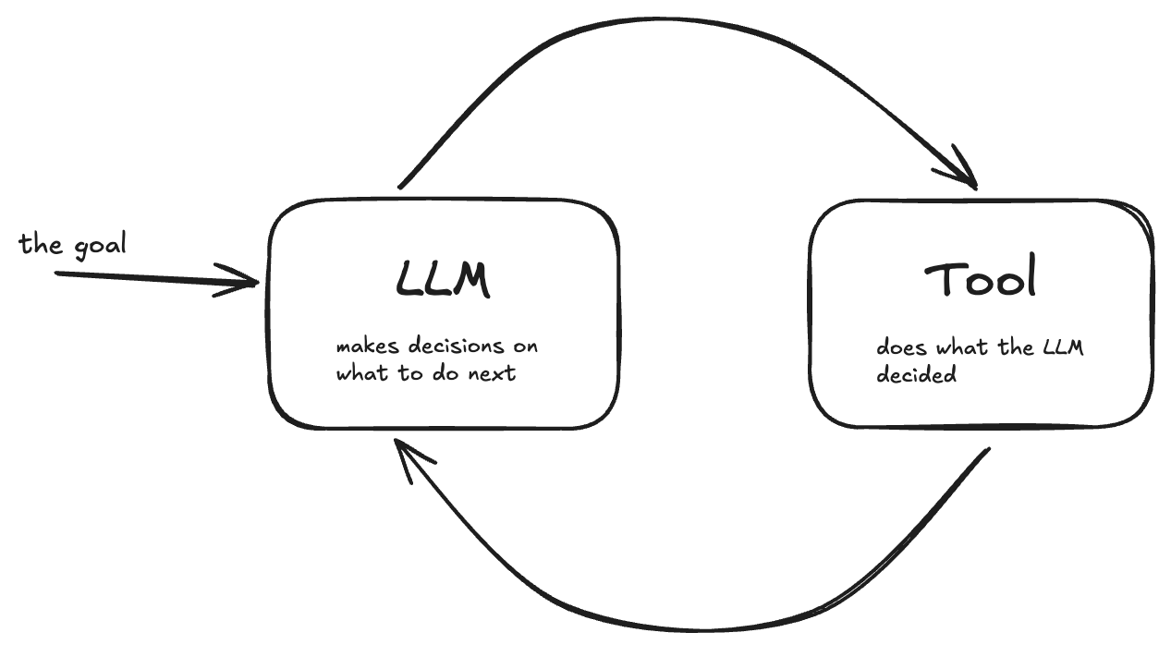
What is an AI Agent?
a goal-oriented system, operating with a loop in which:
  an LLM provides the reasoning and decision-making, identifying which tools and/or skills to run
  the tools and/or skills are then executed
  agent observes the results
  the LLM is used to reason/decide again
  the process repeats until the goal is achieved
src: https://temporal.io/blog/a-mental-model-for-agentic-ai-applications
Notes:
"LLMs augmented with memory, tools, planning, and reflection“ – defn of AI agent in Grootendorst and Alammar
“AI engineering refers to the process of building applications on top of foundation models.” Huyen AI Eng. book

Slide 3
Natural-language analytics
operator asks questions
system writes SQL
system runs queries
system generates results

Slide 4
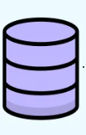
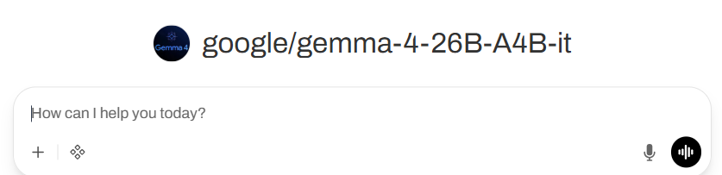
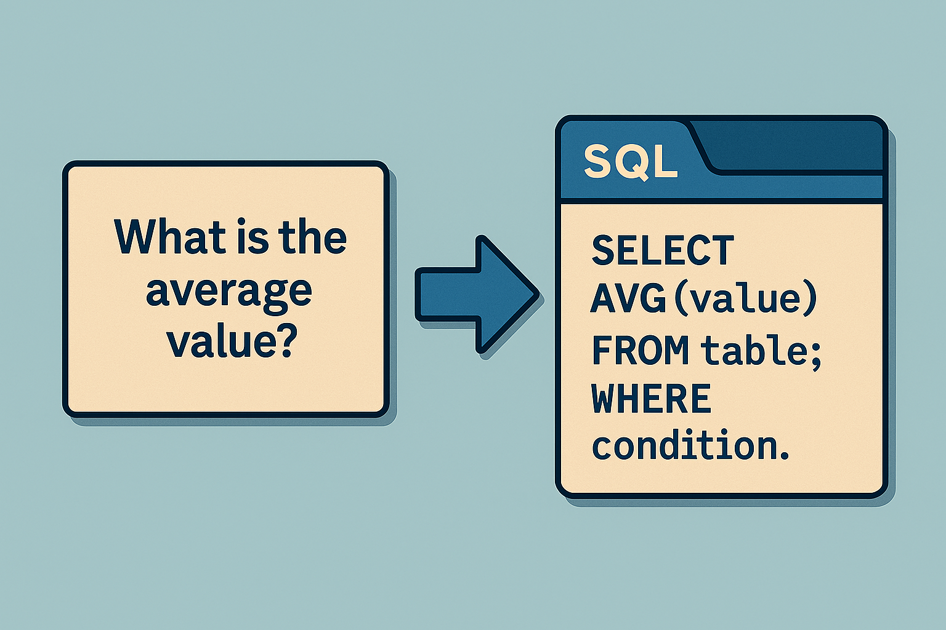
Requirements of the NL2SQL Agent
support for periodic batch updates of source data files to the SQLite database
a web front end with:
  a chat prompt interface
  end-user capability to:
    enter natural language questions about the data
    ask the model to generate natural language questions about the data
a semantic layer with:
  metrics, business rules, data dictionary, skills etc. written to help the AI Agent;
  discoverable tool definitions (e.g., metrics implemented as Python functions with clear docstrings) will be provided for the Agent to call
connection to LLM that will convert end-user
natural language questions to SQL statements

Slide 5
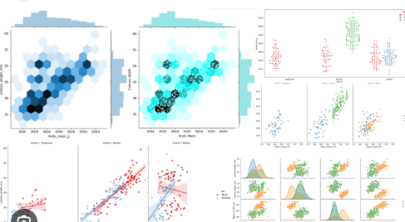
Requirements of NL2SQL Agent (continued)
an SQL query validation tool (likely in Python) to ensure queries are well-formed, non-destructive and adhere to read-only permissions
access to a sqlite database .db file of information
a tool to execute database queries and obtain results (likely in Python)
tools to provide written explanations of the results and visualizations of them such as plots
agent construction using Pydantic AI's Agent or similar
strong security and access control: user authentication and network-level access control will be managed by the system administrator via existing network infrastructure

Slide 6
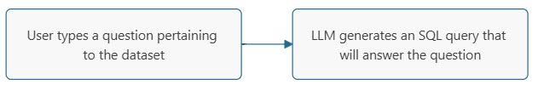
Natural language conversion to SQL (NL2SQL)
Start with basic “zero shot” approach:
a simple system prompt for the LLM
  What is a system prompt?
    a message sent before user prompt in every request to the LLM
    its goal is to steer the model behavior, tone, knowledge, etc. for the entire conversation
  System prompt used here:
    “Convert this question into a SQL query. Make any assumptions necessary about the underlying database and its schema.”
  zero shot given no information about the database, no schema, no subject information

Slide 7
NL2SQL “context-aware shot” approach
Next consider a more complex “context-aware shot” approach
  Semantic layer – structured documents that provide information about representation of data, rules, metrics, and domain knowledge in a precise form that can be readily utilized by an automated system, such as an LLM.
  In this example, can include database schema, data dictionary, business rules. Initial work performed included database schema in yaml file.
  and utilized a more robust system prompt:
    “[Role] You are an expert SQL query-writer.
    [Task] Write a SQL query that would answer the question provided through the prompt.
    [Context] See the knowledge-base provided for this folder to best address the task. It includes the database schema.”

Slide 8
Experiment
Ran the NL2SQL using a car rental database with tables for cars, rentals (transactions), owners, and customers.
Beginning of the cars table:
  Owner ID Vehicle ID Vehicle Price Per Day
  900 1 1992 Rover 216 169.0
  909 10 2010 Mini Cooper Clubman 187.0
  910 11 2008 Daewoo Kalos 129.0
  911 12 2005 Land Rover Discovery 74.0
  912 13 1992 Oldsmobile Eighty-Eight 181.0
Conducted in Open WebUI using Folders for each approach:
  both have system prompts
  context-aware approach also has Knowledge in the form of the database schema file
Note: we are not running the SQL query yet, only having the LLM generate it

Slide 9
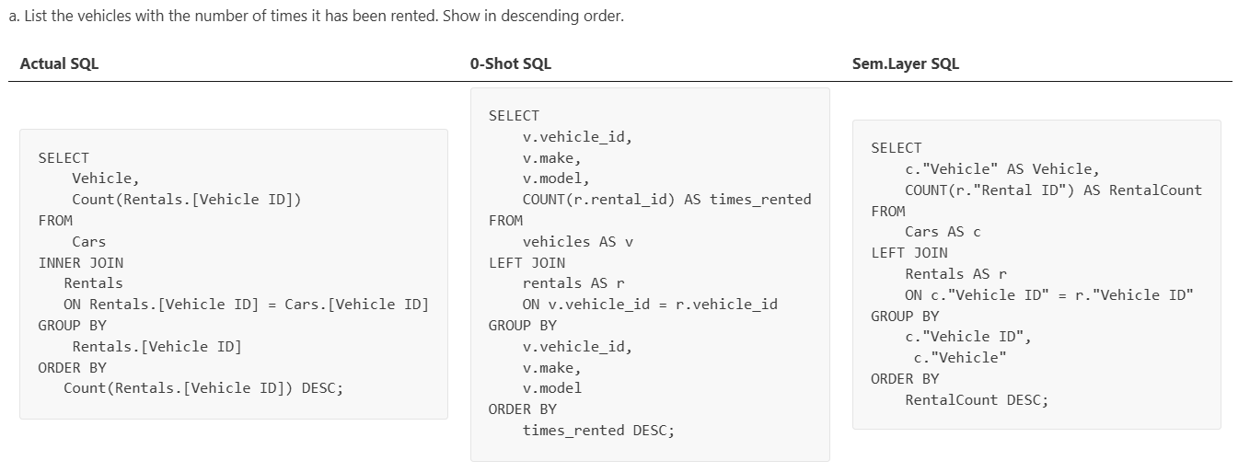
Results
Results: both are correct
The Zero-Shot has additional columns not asked for by the question, the sem. layer shot does not.
The LLM query-writing style is slightly different than the "answer" query:
quotation marks instead of square brackets around compound-word field names,
use of aliases (e.g. "Cars AS c"),
LLM names columns (e.g. count column as "RentalCount"),
Most of these are improvements or are neutral

Slide 10
Results (continued)
Both LLM queries do a LEFT JOIN while the answer query did an INNER JOIN.
INNER JOIN only returns vehicles that have been rented: rental-transaction-focused
LEFT JOIN returns all vehicles even if they haven't been rented: fleet-focused
The semantic layer should inform what we want via structured business rules documentation:
  e.g. "We are focused on business transactions" vs "We are focused on fleet information"

Slide 11
Additional tests
I did several more tests:
  What is the average cost of a car per day?
  Which owners have the priciest cars (>$250 per day cost)? Show the owner’s first and last name and the price of the car.
  List the customer first and last name, along with the number of rentals they have done through Rent Ur Car.
Observations:
  LLM generally performed quite well, especially with the context-aware approach
  Some errors or inconsistencies popped up
    In response to one question LLM left quotes off of compound-word field names resulting in an error. Providing guidance in the semantic layer corrects for this:
    "If a database table field consists of multiple words separated by spaces, e.g. Vehicle ID, then you must enclose that field name with double quotes in the SQL statement."
  We can provide a SQL style guide for these and similar issues that appeared.
  Can take this farther by providing strict SQL patterns the LLM must adhere to, though this may not be necessary.

Slide 12
Additional Semantic Layer Content to Build
Data dictionary - database table meanings mapping columns to plain-English descriptions
Metrics definitions, for example:
business rules – see earlier example of transaction-focused vs fleet-focused
LLM can generate drafts of semantic layer docs
  drop the .db file into the chat (assuming it is small)
  ask LLM for information about it: schema, data dictionary, entities, relationships, Mermaid ER diagram (see next slide), …
availability: definition: Percentage of time a site is operational formula: 1 - downtime_minutes / total_minutes exclusions: - scheduled_maintenance - training_events synonyms: uptime, operational readiness | critical_failure: definition: Any event with severity_code >= 4 Can also define metrics with calls to Python functions or SQL queries so there is no ambiguity.

Slide 13
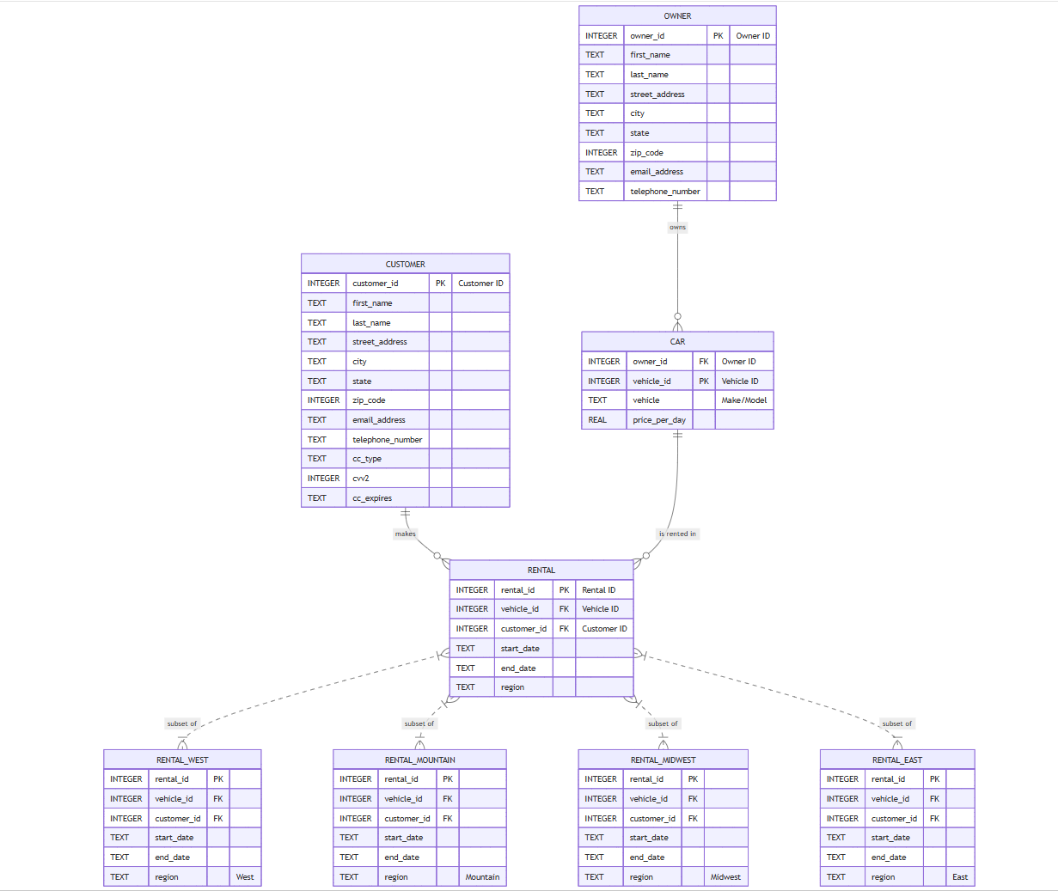
E-R Diagram generated by LLM from .db file (in Mermaid format)

Slide 14
Storing Semantic Layer Info in the RAG Pipeline
If semantic layer is small enough, it can be put into the system prompt
Otherwise it goes into the RAG Pipeline where it is vectorized and embedded to facilitate similarity lookup later from queries
  As part of the pipeline, the "retriever" searches schema descriptions, e.g., learns it only needs to return 4 relevant tables, then the LLM writes the query.
Trade-offs
  System prompt – exact representation but high token use (whole schema, etc. in each prompt)
  RAG – requires similarity determinations and may lead to fragmentation (e.g. joins across chunks) but keeps token use lower
Notes:
Documents -> Indexer -> Vector database -> Retriever -> LLM
“small enough” – under around 20 tables.
see https://docs.openwebui.com/getting-started/essentials#basic-rag

Slide 15
Middle Ground:
Semantic Layer Between System Prompt and RAG
  LLM within an Agentic Architecture utilizes a “Router” Skill that maps natural language to database tables and fields
    No RAG; schema not in system prompt; so avoids those downsides (token use, fragmentation, …)
    The Router Skill can be simple, like a Python dictionary of keywords for the various .md table schema files
    LLMs can help build this too - "Which documentation files would you need to answer this question?“
    more on Skills soon…

Slide 16
SQL Query Validation
Validate the LLM-generated query for functional correctness before passing it to the SQL executor
  Does it answer the correct question correctly?
Can benchmark the system using:
  Public benchmarks
    Public dataset used to compare models containing generic questions
    Examples: Spider, BIRD-SQL, WikiSQL
  Internal benchmark
    a “Golden Dataset” - question/SQL-query pairs about our data, known to be correct, (see car rental example earlier)
    tune the semantic layer by testing LLM against this Golden Dataset

Slide 17
SQL execution
After LLM generates query and validator approves it, the query can be executed by a SQL executor Tool. This can be a Python program like:
  import sqlite3
  connection = sqlite3.connect("company.db")
  cursor = connection.cursor()
  sql_command = """SELECT * from employee;"""
  cursor.execute(sql_command)
  results = cursor.fetchall()
  for res in results:
  print(res)
  Output:
  (112, 'Stephen', 'Rodriguez', 'm', None, '1971-2-25’)
  (123, 'Frank', 'Schiller', 'm', None, '1955-08-17’)
  …
** This is all deterministic – LLM not involved on this stage.

Slide 18
SQL Execution (cont.)
Can wire the SQL components together within an agentic system (using Open WebUI or similar):
  SQL generation (by the LLM),
  SQL validation (by the Parser)
  SQL execution (e.g. by Python)
  and more
Will need to address implementation issues, e.g. will .db file be on the network hosting the LLM? within a Docker container (loaded through a volume mount)?
Current proof-of-concept of SQL Generation and Execution exists – see Demo

Slide 19
Skills
Ultimately we start thinking of NL2SQL and other components as Skills in the AI Agent System
Skills are knowledge/instructions/workflow for an agent to accomplish an activity
  e.g. analyze data, generate a query, etc.
Skills are often Python functions -
  takes some inputs e.g. results of prior activities, semantic layer docs, etc.
  calls the LLM with specific instructions
  returns the results
Skills can also be Markdown files
Can write numerous skills. For example:
  explain query results
    references semantic layer documents such as our SQL style guide, the natural language question, the db schema, and the query results
  provide quick data summaries like:
    “You have 500 rows, the average price is $20, and you have 3 missing values in the 'Email' column."
Notes:
https://agentskills.io/home - provides a standard for AI Agent Skills
A skill is where you put that "good day" judgment on how to do something somewhere so it can be reused
(paraphrasing from the Soares book)

Slide 20
Skills example – NL2SQL (simplified)
# 1. Load the rules from a file (The "Source of Truth")
with open("sql_style_guide.md", "r") as f:
sql_rules = f.read()
def generate_sql(user_query):
# 2. Construct the prompt dynamically
messages = [
{
"role": "system",
"content": f"You are a SQL expert. Follow these rules strictly:\n\n{sql_rules}"
},
{
"role": "user",
"content": user_query
}
]
# 3. Call the LLM
response = client.chat.completions.create(
model="your-model-name",
messages=messages
)
return response.choices[0].message.content
This is the payload being sent to the LLM to help achieve the goal of this skill.

Slide 21
Agents and Skills
The Agent uses an LLM to decide which skill to call and then uses Python (or similar) to execute that skill.
This is often called a Reasoning Loop or the ReAct Pattern: Reason + Act
Combines
  stochastic reasoning (LLM) and
  deterministic execution (Python/Agent).
The idea is:
  don’t have the LLM do math (it might be incorrect) or remember your database (it may forget or hallucinate), etc.
  instead give it awareness of Python skills to call to do math, search schema, query databases, etc.

Slide 22
Tools
Recall skills are knowledge/instructions/workflow for accomplishing an activity
Tools are executable capabilities for performing actions
  Skills might call tools, but not vice versa
Some may be built-in to an agentic system - web search, image generation, notes, ...
Additional tools can be built or imported – e.g., SQL queries, chart creation (e.g. `Rechart`)
The LLM is made aware of the toolbox (one way: through Python function docstrings) and can decide when to call tools
I did some testing of tool development in Open WebUI. Some lessons learned:
  use a strict docstring in the tool’s Python function definition, and
  state in the system prompt that the LLM is required to use the tool (if the circumstances apply)

Slide 23
Explanation of Results
Recall process so far was:
operator asks question → system writes SQL → SQL validated
→ SQL query is run → SQL query results returned
Can use the LLM again, e.g. through an “explain_query_results” skill to generate an explanation of results
  Example system prompt
  “Here is the user’s original question, here is the SQL that ran, here is the result. Write a 2-3 sentence plain-English explanation that directly answers the question. Include a percentage comparison if the data supports it.”

Slide 24
Explain Results Skill Illustration
def skill_explain_query_results(user_question, sql_query, query_results, business_context_document):
### SKILL: Explain Query Results with User Intent
prompt = f"""
You are a Senior Data Analyst. Your goal is to answer a user's specific question using the results of a SQL query.
### THE USER'S ORIGINAL QUESTION:
"{user_question}"
### BUSINESS CONTEXT & RULES:
{business_context_document}
### THE SQL QUERY THAT WAS EXECUTED:
{sql_query}
### THE DATA RETURNED:
{query_results}
### INSTRUCTIONS:
1. Directly answer the user's question using
the data provided.
2. Use the Business Context to ensure you are
using the correct terminology.
3. If the data does not fully answer the
question, explain what is missing.
4. Keep the explanation concise and
professional.
"""
# ... rest of the LLM call …

Slide 25
Visualization
⬆️ recall from earlier slide
Semantic layer can help by providing context such as:
  data types of columns
  # of distinct values expected in a column
  expected distributions of column data
  Write this part of the semantic layer as guidance to an incoming data analyst (it is!)
Can have LLM generate metadata description of plot (e.g. Vega-Lite), rather than plotting code. For example, LLM outputs JSON object describing the chart:
{"mark": "bar", "encoding": {"x": "date", "y": "value"}}
Separate renderer (e.g. web front-end using React)

Slide 26
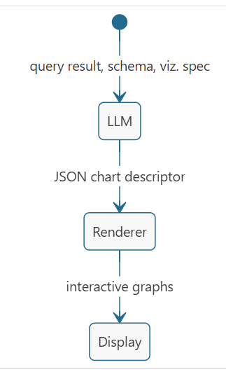
Visualization (continued)
← recap of process from prior slide
Implementation of this process can be through Agent Skills and/or Tools
  e.g., Visuals Core Tool in OUI (via Eric B), snippet -
    description: High-quality tables, charts, heatmaps, timelines, flowcharts, and trees.. utilities.required_open_webui_version: 0.4.0
    tool_instructions: | When calling this tool, arguments MUST be passed as valid JSON objects.

Slide 27
Reasoning Panel
Exposes the LLM’s reasoning
Aimed at helping build human trust in the system
Can be a collapsible section (defaulting to collapsed) that includes, e.g. for NL2SQL:
  SQL it generated
  Why it chose the tables and fields it did
  Raw query result
  Brief description of model’s interpretation
** This reasoning can be captured along the way by instructing the LLM to record concise, user-facing explanations of what it is doing and why.
In some of my NL2SQL experiments, I was seeing this without even asking, e.g.
  zero-shot case: without the benefit of a schema, the LLM constructed an assumed one (that was quite logical), citing following common practice for fleet-management systems for some of its decisions
  explained why it chose left join (to ensure every vehicle appeared in the result even if it has never been rented – the fleet-focused perspective)
  explained some of the SQL syntax – e.g., group by groups rows by distinct vehicle – this can help a beginner or novice understand why the query was written the way it was
  offered alternative queries if user wanted something their question might have meant, e.g. standard price of a vehicle vs average rental cost of the vehicle. So if there’s some ambiguity, this can be helpful – the LLM can offer options for what it thinks the user meant.
  In context-aware approach, it cited the schema I provided as its source for table definitions

Slide 28
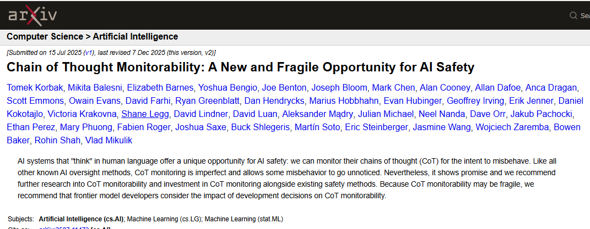
Model Internal Reasoning
have the models supply chain of thought (CoT)
build our system to monitor CoT to keep models from misbehaving
https://arxiv.org/abs/2507.11473

Slide 29
References
AI Engineering by Chip Huyen
An Illustrated Guide to AI Agents by Maarten Grootendorst, Jay Alammar
Skills for AI Agents by Lucas Soares
How We Built a Text-to-SQL Data Analyst AI | Kalvium Labs (article)
Introduction to AI Agents - DataCamp Learn (online course)

Slide 30
Demo
Web front accepts natural language → LLM generates SQL →
SQL executor runs query → LLM produces explanation
In Python using Open AI LLM endpoint
See static html pages and screen recording (if offline).

Slide 31
Some of the demo code
URL = https://api.openai.com/v1/chat/completions
SYSTEM_PROMPT = """
[Role] You are an expert SQL query writer.
[Task] Write a SQL query that would answer the question provided through the prompt.
[Guideline1] Crucially, all column names and table names that contain spaces must be enclosed in square brackets (e.g., [Email Address] or [Owner ID])
[Guideline2] Crucially, your responses should only be SQL queries and should not contain any additional, extraneous words.
[Context] Use the database schema you are being provided with to best address the task.
""“

Slide 32
More demo code
payload = {
"model": "gpt-4o-mini",
"messages": [{"role": "system", "content": SYSTEM_PROMPT},
{"role": "user",
"content": f"""
Below is the database schema provided in YAML format:
\n\n{schema_content}
\n\nQuestion: {question}"""}]
}
response = requests.post(URL, headers=headers, json=payload)

Slide 33
Python for Web Page
def do_GET(self):
self.send_response(200)
self.send_header("Content-type", "text/html")
self.end_headers()
# The HTML content
html = """
<!DOCTYPE html>
<html>
<head><title>AI Agent</title></head>
<body>
<h1>AI Agent LLM Query Interface</h1>
<form method="POST">
<label for="user_input">Enter your question:</label><br><br>
<input type="text" id="user_input" name="user_input" required>
<button type="submit">Submit</button>
</form>
</body>
</html>
"""
self.wfile.write(html.encode("utf-8"))

Slide 34
Example Questions
What is the email address of the customer with Customer ID 1?
How many different vehicles are currently registered in the Cars table?
Which customers live in the state of California?
What is the price per day for Vehicle ID 101?
Can you list all the rentals that occurred in the North region?
What is the last name and telephone number of the owner with Owner ID 5?
Which customers have a Visa credit card type on file?
What are the start and end dates for Rental ID 500?
Which city has the highest concentration of customers?
List the names of all owners who live in the city of Los Angeles.
What are the first and last names of customers who have rented a vehicle with a price per day greater than 50.0?
List the email addresses of owners whose vehicles were involved in a rental in the 'North' region.
Which customers have rented a vehicle that belongs to an owner living in the state of 'California'?
Show the names of customers and the specific vehicle models they have rented.
Find the telephone numbers of owners who have vehicles currently being rented in the 'West' region.

Slide 35
More Example Questions
List any information for rentals of vehicles with Rover in their name.
List all customers from southern states.
list customers from Virginia
list customers from west coast states
list all customer states
Which car was rented the most often?
Which customer zip code had the most rentals?
Which customer zip code had the most rentals and how many did it have?
Who rented the most cars?
how many rentals were in the southwestern United States?

Slide 36
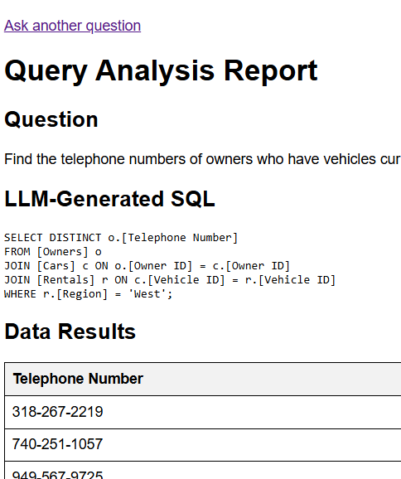
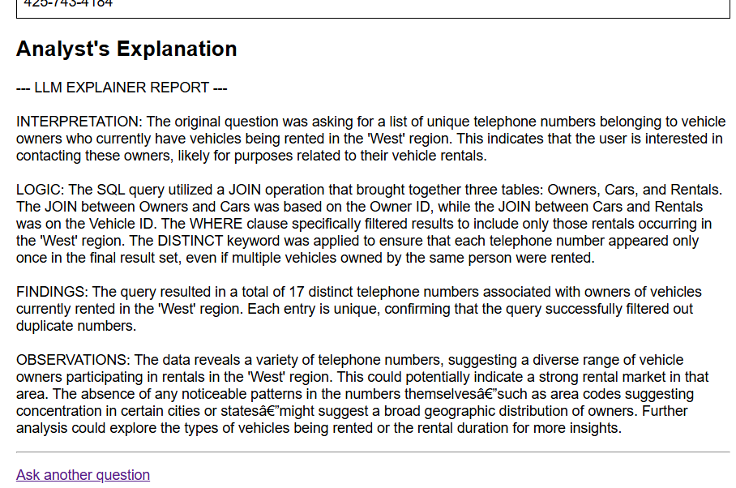
Results
See also Results HTML pages

