Slide 1
Access tutorial

Slide 2
Next up - Learn by reading & doing
YOU work through Tutorial B in the textbook
Start in class today, finish for HW 5
Tutorial B introduces you to these basics of Access:
  queries,
  forms and
  reports
  through an example.
Learning on your own
  I will not be teaching this material.
  You are being tasked with learning it on your own through this Tutorial. Read the book very carefully.
  See Troubleshooting on pages 49-51
  Feel free to ask me any questions you may have.
Note: There is much more functionality in Access that what is in the Tutorial.

Slide 3
Tutorial B - Parts
Section # of pages
Creating Tables 5
Creating Queries 16
Seven Practice Queries 4
Creating Reports 5
Importing Data 3
Making Forms 2
Forming Relationships 1
Troubleshooting Common Problems 3
As you work through the examples, make educated guesses and try them before reading the recipes in the book.

Slide 4
Access Query
A query is a question you ask about the data stored in a database table.
Access responds by displaying the data according to your question.
For example
  if you want to see all the customers from New York …
  … you formulate a query to display only the records whose state field matches with NY
Access provides GUI to create queries
Queries are implemented as SQL statements
  SQL = Structured Query Language
  More on SQL next week…

Slide 5
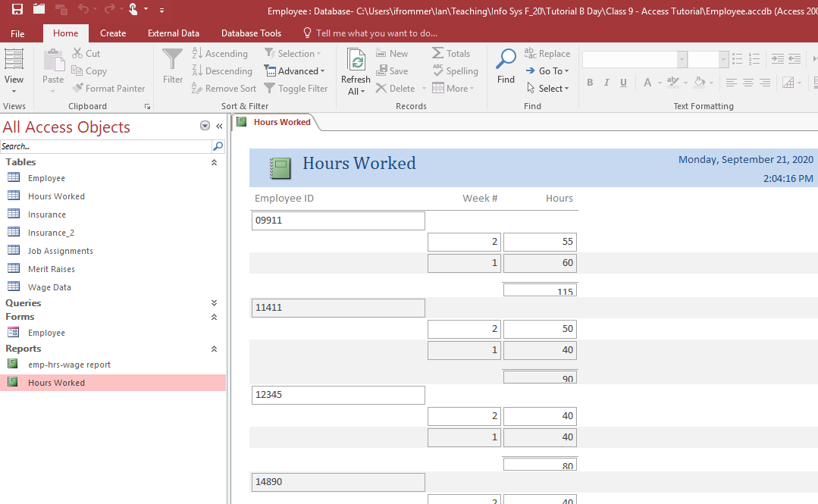
Access Report
You can create a report, which is a printed version of your data, that is formatted according to your specifications.

Slide 6
Access Report (cont)
Data in a report can come from a single table or multiple tables
Report can be based on a table or on a query
  if based on a query, it will contain the same fields that were selected for the query
Access provides a GUI to format the report

Slide 7
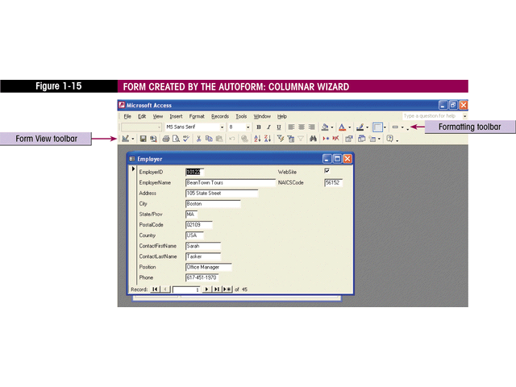
Access Form
A form allows you to view your data one record at a time in a way that makes it easy to enter or use the data

Slide 8
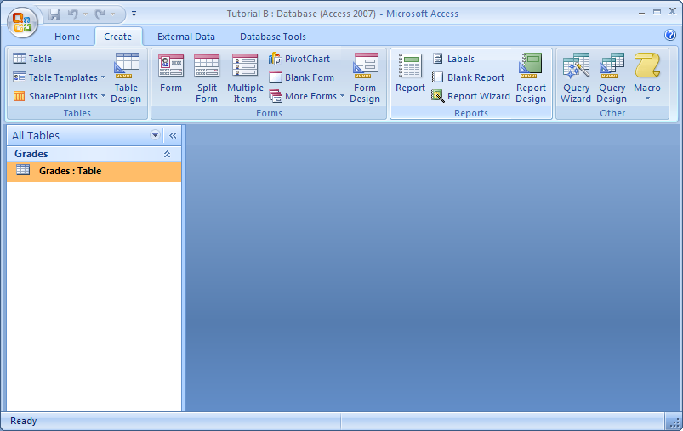
Creating Tables, Forms,
Reports and Queries
Use Access’ ‘Create’ tab – it has a creation tool for each type of item

Slide 9
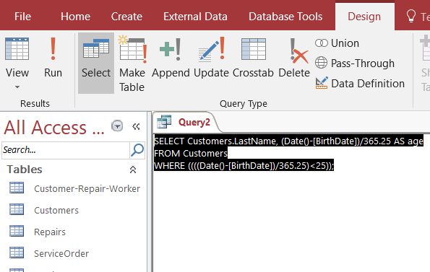
Optional for now -
As you’re familiarizing yourself with Queries in Access, notice that there is a “SQL View”
“SQL View” allows you to see the SQL statements generated in the background.
Choose “SQL View” in order to see the SQL statements generated by your queries

Slide 10
Additional resources in Course Repo
  Access Tables.ppt
  Access Queries.ppt **
  Access Forms.ppt
  Access Advanced Queries.ppt
  Access User Interface.ppt
    ** Switchboard in Access– not used this semester, but cool to know about
Notes:
Show some of these, at least *’d ones

Slide 11
Tutorial Tips
Save often
When quitting, select, File : Close.
To import Excel data if you are using Access 2019:
  Click External Data tab
  Click New Data Source in the Import & Link group
  In drop-down list, choose From File – Excel
  Browse to find file you want to import
    I posted employee.xlsx and insurance.xlsx to course repo to save you the trouble of typing all those records in
  Make sure first radio button is selected to import the source data in a new table in the current database

Slide 12
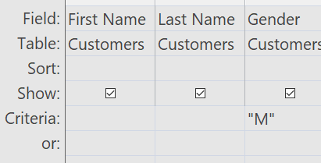
More Access Tips
General
  Can save a table in a database as its own file – do save as : save object as. Seems useful – can reuse a table in multiple databases.
  Try out various tasks on the Access ribbons, experiment, figure out what they do, as with learning any program
Query
  query-design – each column is a field / table pair with optional criteria.
    e.g. to get employee last names for employees living in MD and showing their last name and state, need column for last name and state with MD in the criteria for state (or can not show state as well).
  To use multiple criteria, use or field in latter criteria as in:
  Can link tables through a query – known as joining, we
  will be doing more of this soon
  Can create new columns to show that are functions of
  existing ones. E.g. the 10% raise query
  Right-click query column to adjust properties like format of column (e.g. I changed 10% raise column to currency)

Slide 13
Even More Access Tips
Totals query – this is like groupby & aggregate in pandas
  Can perform the following functions: sum, count, average, min, var, stdev, where (field has specific criteria)
  Click Totals (sigma icon) button in Create toolbar – adds Total row to query.
  To change name of column heading in resulting query, prefix the Field in the query with the desired name and : .
Parameter query – basic idea: instead of specifying one of the fields in the query, you allow the user to input it in an input box
Reports
  Can sort – click ‘group & sort’ then ‘add a group’ button to choose what to sort by
  Can get totals, etc.
  Can toggle between ‘layout view’ for editing and ‘report view’ for viewing.
  Staircase effect- to avoid, drag 1st field entry up a row
  On hw ex., needed to run a query to combine fields from different tables and then make a report off of this.

Slide 14
Still More Access Tips
Date – can get today’s date via Date() and can do date arithmetic.
Forms
  On the tutorial, if you have trouble getting the book’s instructions to work with the subform, try this:
  After clicking the subform button as instructed, click and drag below the last field in the form creating a white rectangle.
  Then open up the properties sheet, click on the Data tab
  Change Source object to the table with the info needed (Hours Worked in this case)
  Then in the Link Master Fields, chose Employee ID.

