Slide 1
SQL – Part II
Joins

Slide 2
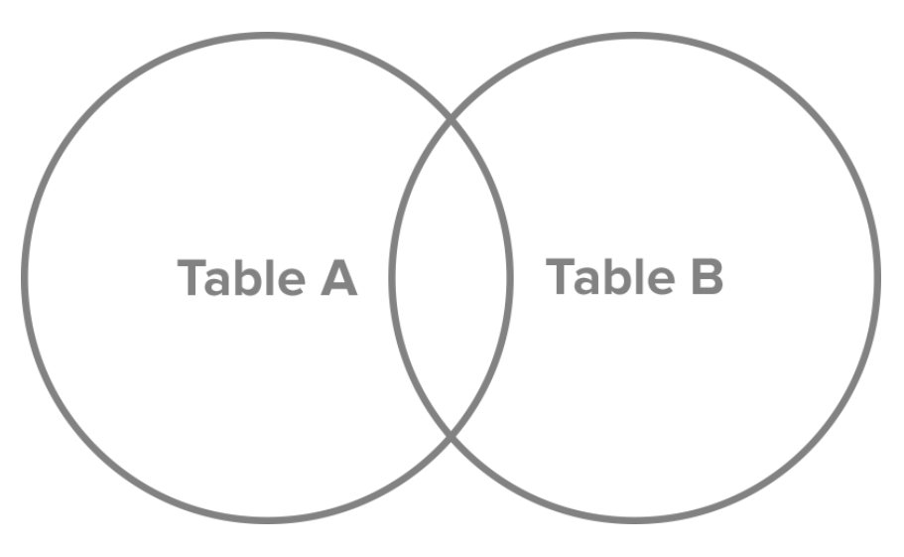
Joins
So far: SQL statements that involve only one table
Joins allow us to query from multiple tables
Consider this visual representation of table A and table B, which are connected through primary and foreign keys.
http://www.sql-join.com/sql-join-types

Slide 3
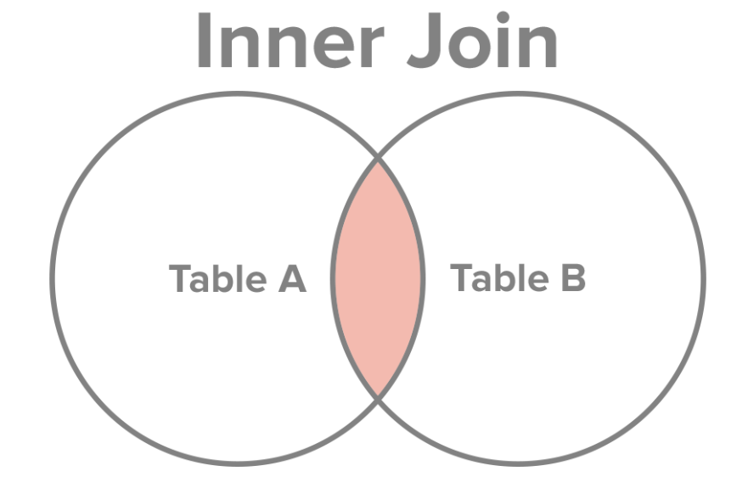
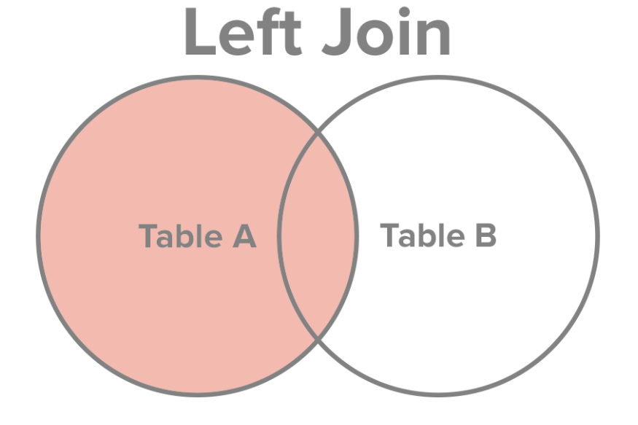
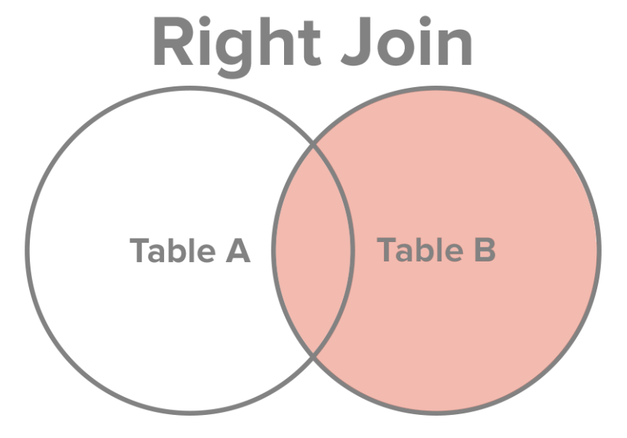
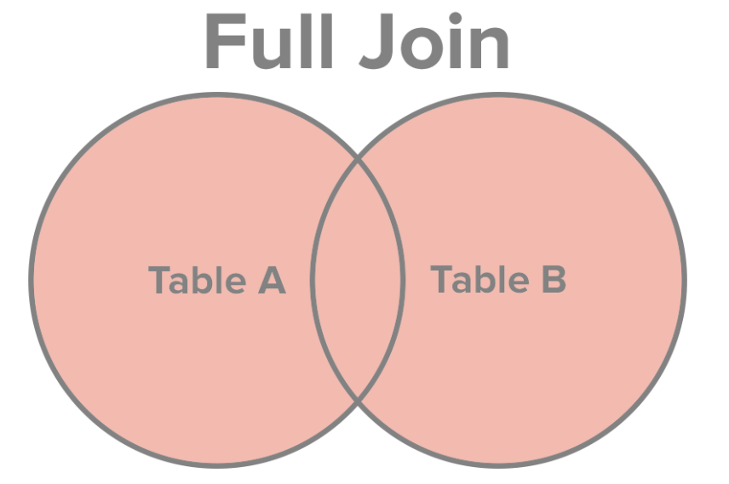
Joins
Notes:
“Outer Join” is R/L Join

Slide 4
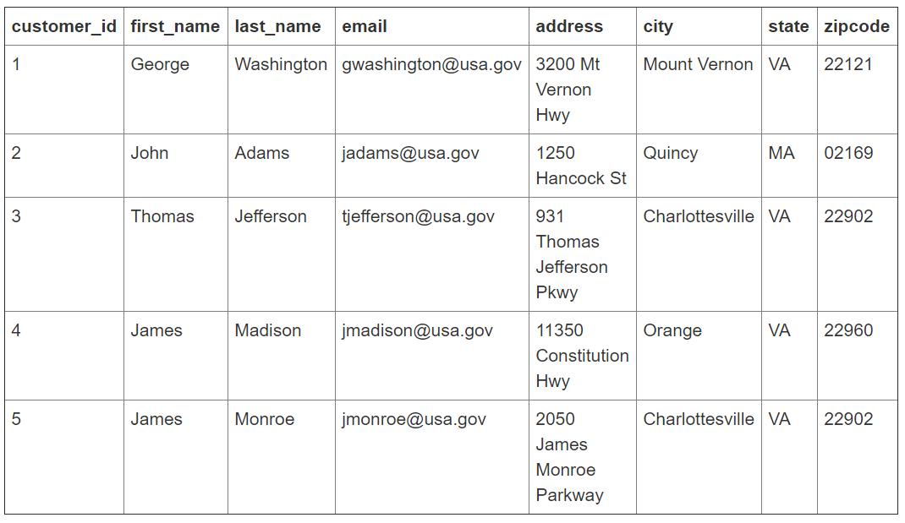
Joins
Customers Table

Slide 5
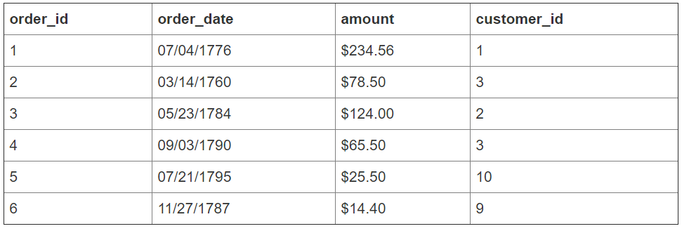
Joins
Orders Table
See presidents_join_example.accdb

Slide 6
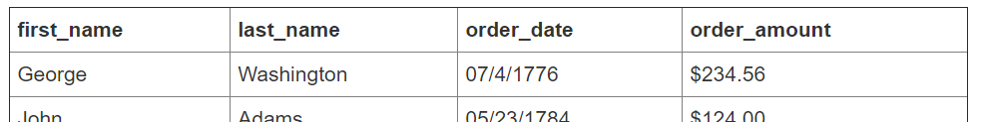
Suppose a query is to return (see table below):
customer last name,
customer first name
order date
order amount.
How many rows will the resulting query contain and why?
Think of how more than one answer could be correct while the underlying data remains unchanged.
Notes:
Primary – foreign key? – Customer ID
Note that (1) not every customer in our customers table has placed an order and (2) there are a few orders for which no customer record exists in our customers table.

Slide 7
Inner Join
Returns records for which:
  value of the key joining the tables exists in both tables
Customer table |  |  | Order table
customer_id |  |  |  | customer_id
1 |  |  |  | 1
2 |  |  |  | 2
3 |  |  |  | 3
4 |  |  |  | 3
5 |  |  |  | 9
 |  |  |  | 10

Slide 8
INNER JOIN–
customers table
to
orders table
ON
customer_id field
Notes:
Primary – foreign key? – Customer ID
Note that (1) not every customer in our customers table has placed an order and (2) there are a few orders for which no customer record exists in our customers table.

Slide 9
Inner Join: SQL and Result
List of customers who placed an order and the details of the order they placed
SELECT first_name, last_name, order_date, order_amount
FROM Customers
INNER JOIN Orders
ON Customers.customer_id = Orders.customer_id
;
*** be sure you know what’s going on here ***
Try it out in presidents_join_example.accdb
Notes:
SELECT [First Name], Hours
FROM Employee
INNER JOIN [Hours Worked]
ON Employee.[Employee ID] = [Hours Worked].[Employee ID];

Slide 10
Left Join
Returns records for which:
  value of the key joining the tables exists in the first (aka “left”) table
  (even if it does not exist in the second (aka “right”) table)
Customer table |  |  | Order table
customer_id |  |  |  | customer_id
1 |  |  |  | 1
2 |  |  |  | 2
3 |  |  |  | 3
4 |  |  |  | 3
5 |  |  |  | 9
 |  |  |  | 10

Slide 11
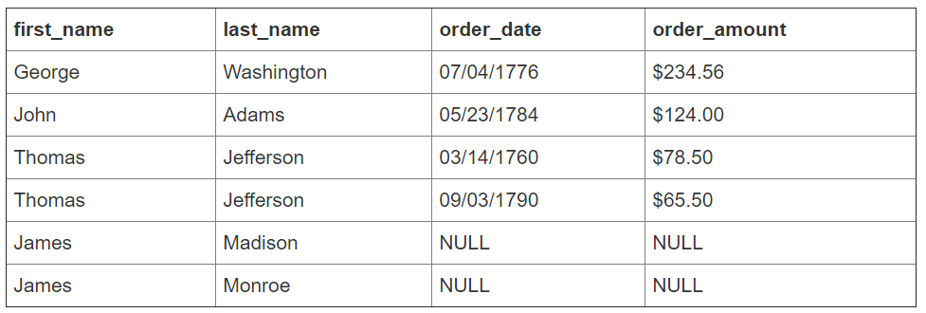
Left Join: SQL and Result
List of all customers, appended with order information
SELECT first_name, last_name, order_date, order_amount
FROM Customers
LEFT JOIN Orders
ON Customers.customer_id = Orders.customer_id
;
*** Records for these customer id’s existed only in left table.
So no values for them exist in the right table, hence they are shown as “NULL”.

Slide 12
Right Join
Returns records for which:
  value of the key joining the tables exists in the second (aka “right”) table
  (even if it does not exist in the first (aka “left”) table)
Customer table |  |  | Order table
customer_id |  |  |  | customer_id
1 |  |  |  | 1
2 |  |  |  | 2
3 |  |  |  | 3
4 |  |  |  | 3
5 |  |  |  | 9
 |  |  |  | 10

Slide 13
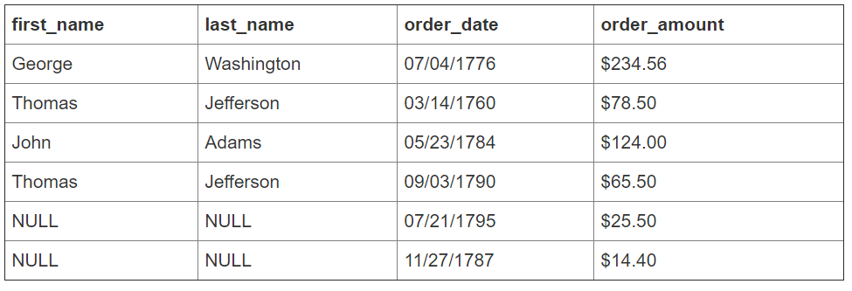
Right Join: SQL and Result
List of all orders, appended with customer information
SELECT first_name, last_name, order_date, order_amount
FROM Customers
RIGHT JOIN Orders
ON Customers.customer_id = Orders.customer_id
;

Slide 14
Full Join
Returns all records from both fields being joined
  even if a value of the key joining the tables does not exist in the table
Customer table |  |  | Order table
customer_id |  |  |  | customer_id
1 |  |  |  | 1
2 |  |  |  | 2
3 |  |  |  | 3
4 |  |  |  | 3
5 |  |  |  | 9
 |  |  |  | 10

Slide 15
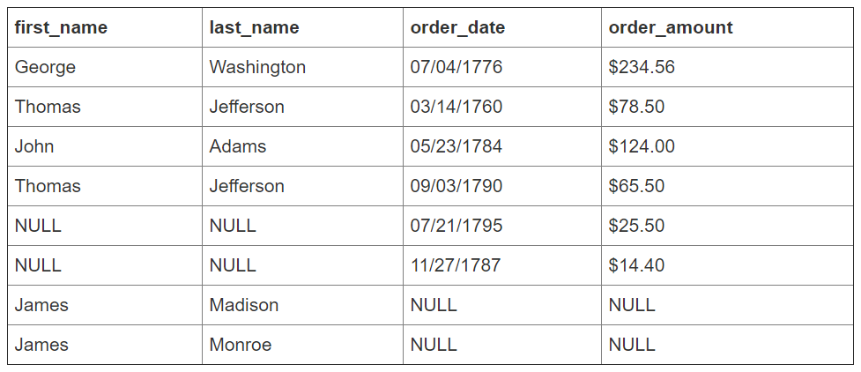
Full Join: SQL and Result
List of all customers and orders
SELECT first_name, last_name, order_date, order_amount
FROM Customers
FULL JOIN Orders
ON Customers.customer_id = Orders.customer_id
;

Slide 16
Full Join
NOTE: Access SQL does not have FULL JOIN
To achieve a FULL JOIN in Access:
combine a LEFT JOIN and RIGHT JOIN using UNION
SELECT first_name, last_name, order_date, order amount
FROM Customers
LEFT JOIN Orders
ON Customers.customer_id = Orders.customer_id;
UNION
SELECT first_name, last_name, order_date, order amount
FROM Customers
RIGHT JOIN Orders
ON Customers.customer_id = Orders.customer_id
;

Slide 17
You Try
Open the Employee.accdb file from last class and consider the following SQL statement:
SELECT *
FROM Employee
________ JOIN [Hours Worked]
ON Employee.[Employee ID] = [Hours Worked].[Employee ID];
What do you expect to happen when the blank is filled with:
  INNER
  LEFT
  RIGHT
  FULL (remember in Access you’ll need to do a LEFT JOIN, RIGHT JOIN, and UNION to get a full join)

Slide 18
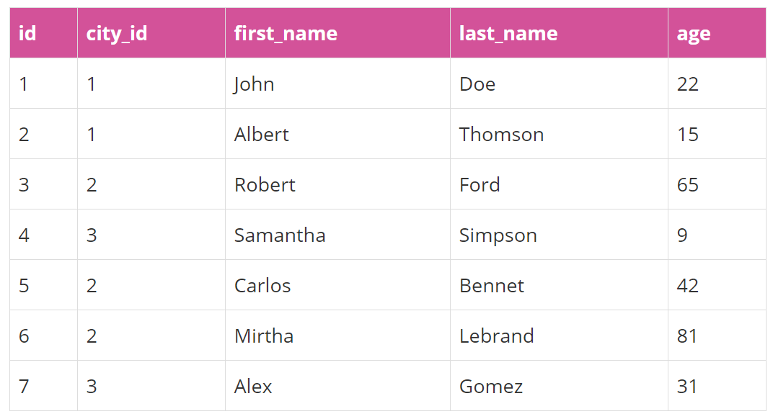
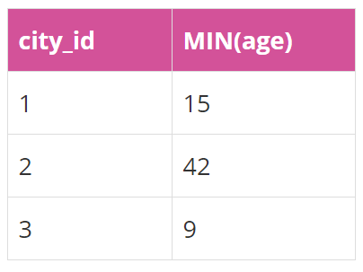
Joins, Aggregate, and Group By
Recall using Aggregate functions (e.g. MIN) and GROUP BY, we did:
Suppose we want the city name. We need a JOIN.
Open cities_example.accdb
SELECT city_id, MIN(age)
FROM users
GROUP BY city_id;
Notes:
SELECT
cities.cityname, MIN(users.age)
FROM
cities
JOIN
users ON cities.id = users.city_id
GROUP BY cities.cityname

Slide 19
Joins, Aggregate, and Group By
Before:
SELECT city_id, MIN(age)
FROM users
GROUP BY city_id;
After:
SELECT cityname, MIN(users.age)
FROM users
INNER JOIN cities
ON cities.id = users.city_id
GROUP BY cityname;
This aggregates information in a column (using MIN) and summarizes across joined tables by using the GROUP BY statement.
Note: to include more fields besides city_name, include the field name in both the SELECT and GROUP BY statements
Notes:
SELECT
cities.cityname, MIN(users.age)
FROM
cities
JOIN
users ON cities.id = users.city_id
GROUP BY cities.cityname

Slide 20
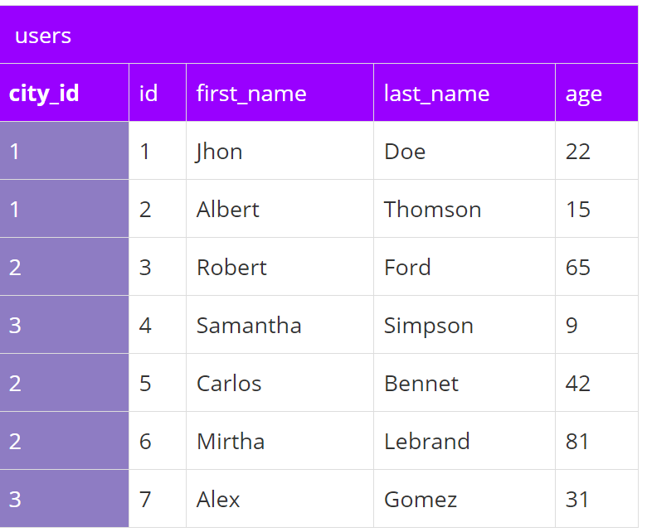
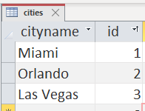
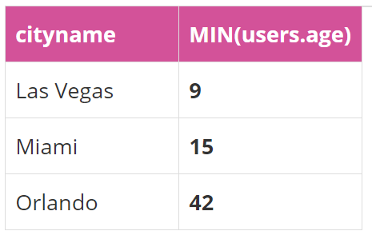
Joins, Aggregate, and Group By
SELECT cityname, MIN(users.age)
FROM users
INNER JOIN cities
ON cities.id = users.city_id
GROUP BY cityname;
https://academy.vertabelo.com/blog/beginners-guide-sql-aggregate-functions/

Slide 21
Joins, Aggregate, and Group By
HAVING
Works similar to the WHERE statement, which filters by row; the HAVING statement filters by group
Example:
SELECT city_name, MIN(users.age)
FROM cities
INNER JOIN users
ON cities.id = users.city_id
GROUP BY cities.city_name
HAVING MIN(users.age) < 20;
i
Notes:
SELECT
cities.cityname, MIN(users.age)
FROM
cities
JOIN
users ON cities.id = users.city_id
GROUP BY cities.cityname

Slide 22
Joins, Aggregate, and Group By
SELECT cityname, MIN(users.age)
FROM cities
INNER JOIN users
ON cities.id = users.city_id
GROUP BY cityname, users.age
HAVING MIN(users.age) < 20;

Slide 23
You Try
Write a SQL statement that:
Returns the first and last name of employees, and the hours worked
Returns the first and last name of employees, and the hours worked, if they worked > 40 hours (in any week)
Returns the first and last name of employees, and the total hours worked
Returns the first and last name of employees, and the total hours worked, if they worked > 80 total hours
Notes:
1) SELECT [First Name], [Last Name], Hours
FROM Employee
INNER JOIN [Hours Worked]
ON Employee.[Employee ID] = [Hours Worked].[Employee ID];
2) SELECT [First Name], [Last Name], Hours
FROM Employee
INNER JOIN [Hours Worked]
ON Employee.[Employee ID] = [Hours Worked].[Employee ID]
WHERE Hours > 40;
3) SELECT [First Name], [Last Name], Sum(Hours)
FROM Employee
INNER JOIN [Hours Worked]
ON Employee.[Employee ID] = [Hours Worked].[Employee ID]
GROUP BY [First Name], [Last Name];
4) SELECT [First Name], [Last Name], Sum(Hours) AS TotalHrs
FROM Employee
INNER JOIN [Hours Worked]
ON Employee.[Employee ID] = [Hours Worked].[Employee ID]
GROUP BY [First Name], [Last Name]
HAVING Sum(Hours) > 80

