Slide 1
JavaScript
Internship @
Silver Oak University
By : Prof. Jignasha Rajput

Slide 2
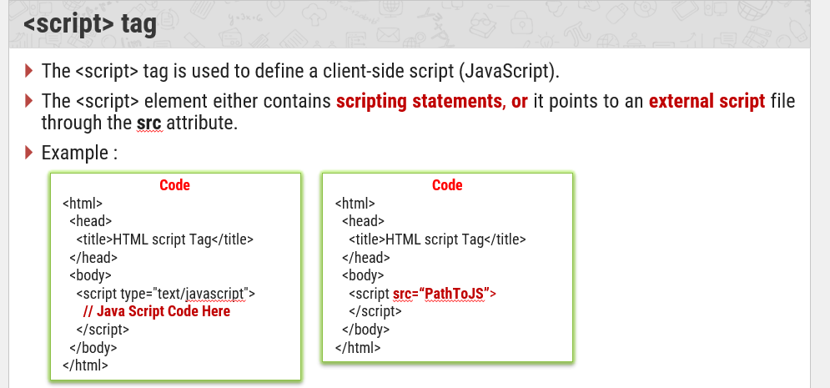

Slide 3
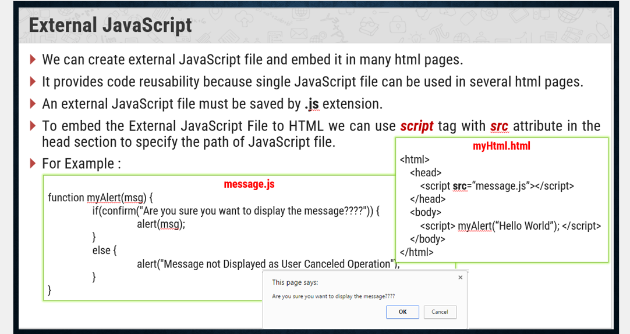

Slide 4
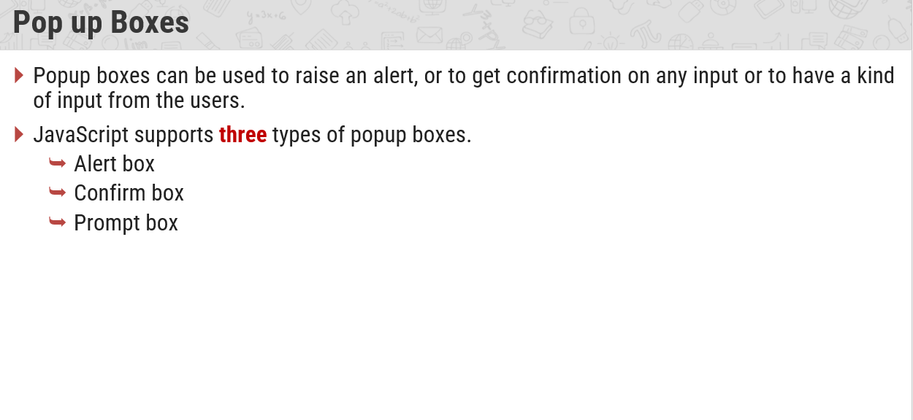

Slide 5
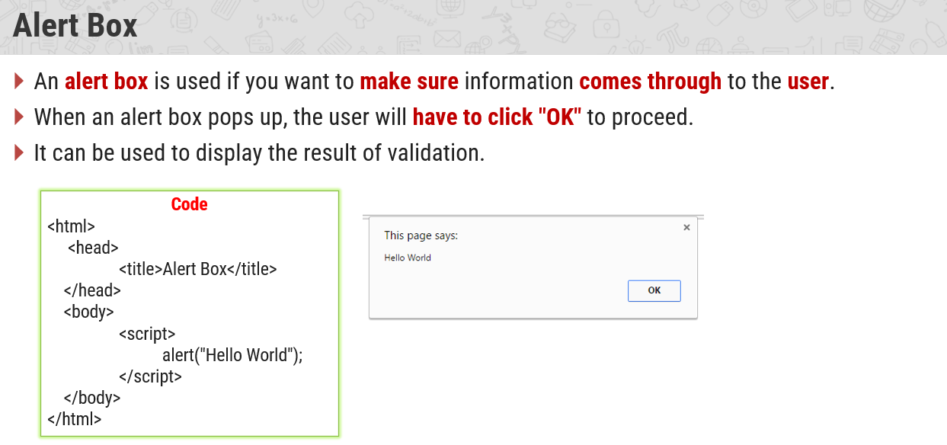

Slide 6
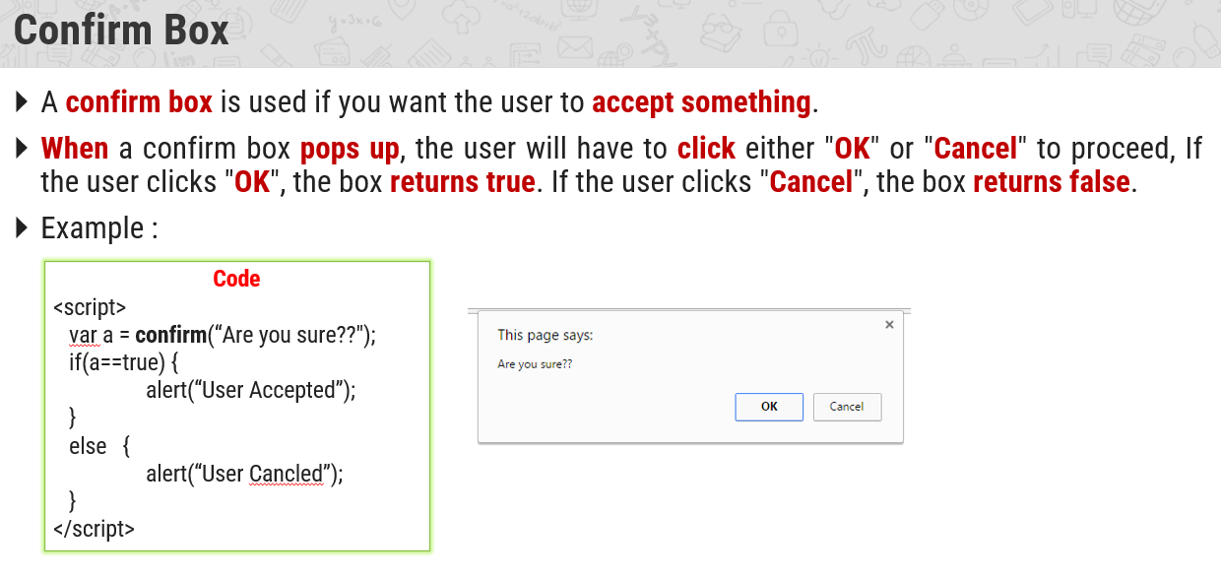

Slide 7
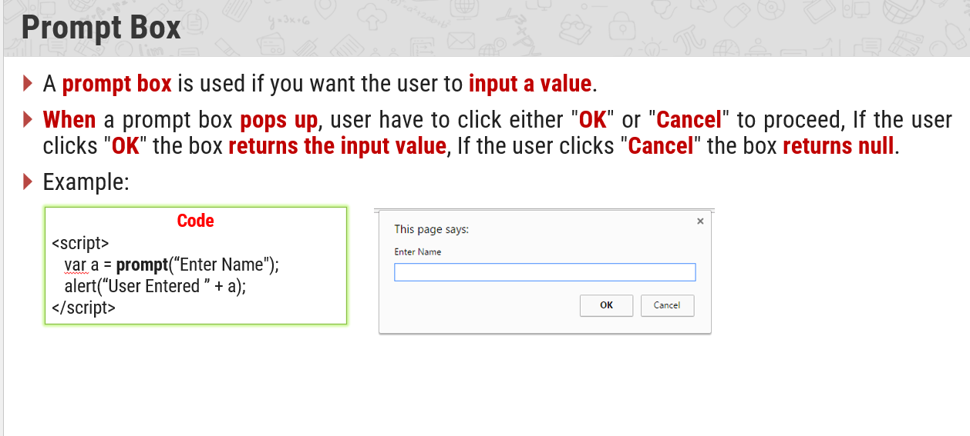

Slide 8
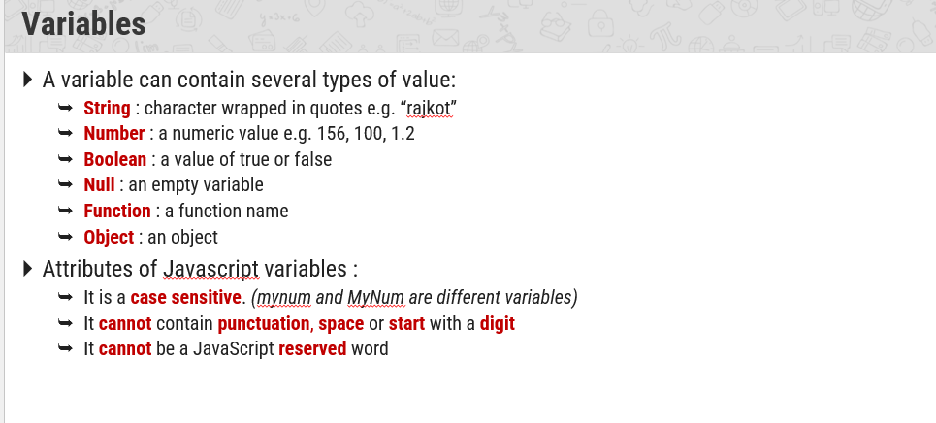

Slide 9
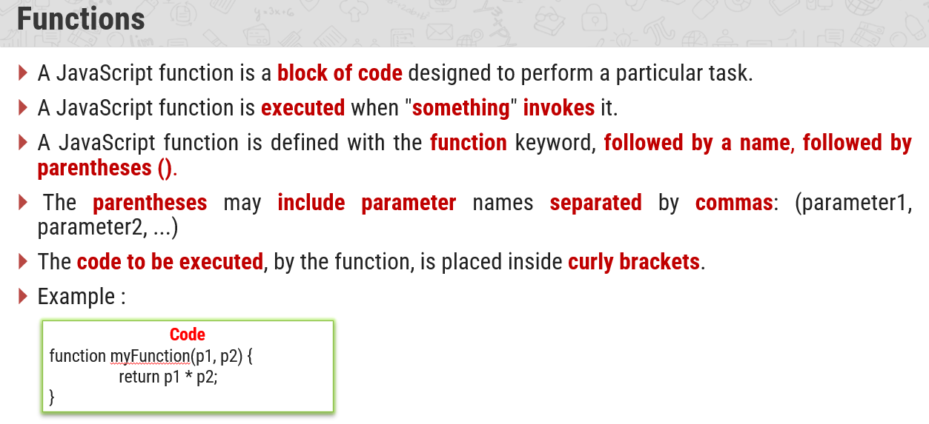

Slide 10
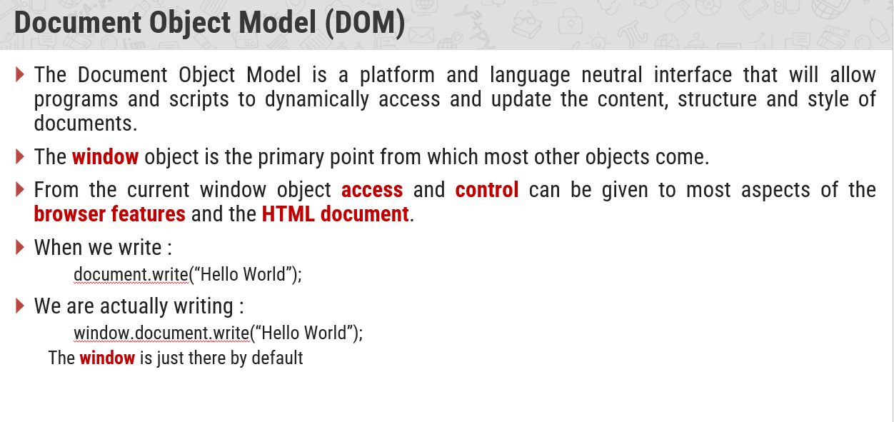

Slide 11
JavaScript - HTML DOM Methods
The HTML DOM can be accessed with JavaScript (and with other programming languages).
In the DOM, all HTML elements are defined as objects.
The programming interface is the properties and methods of each object.
A property is a value that you can get or set (like changing the content of an HTML element).
A method is an action you can do (like add or deleting an HTML element).

Slide 12
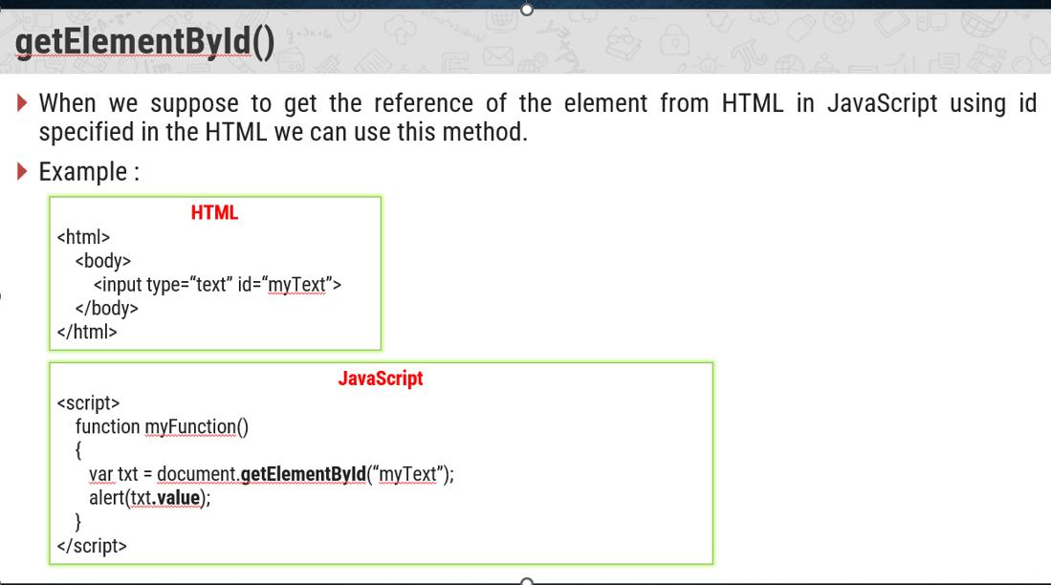

Slide 13
<!DOCTYPE html>
<html>
<body>
<h2>My First Page</h2>
<p id="demo"></p>
<script>
document.getElementById("demo").innerHTML = "Hello World!";
</script>
</body>
</html>

Slide 14
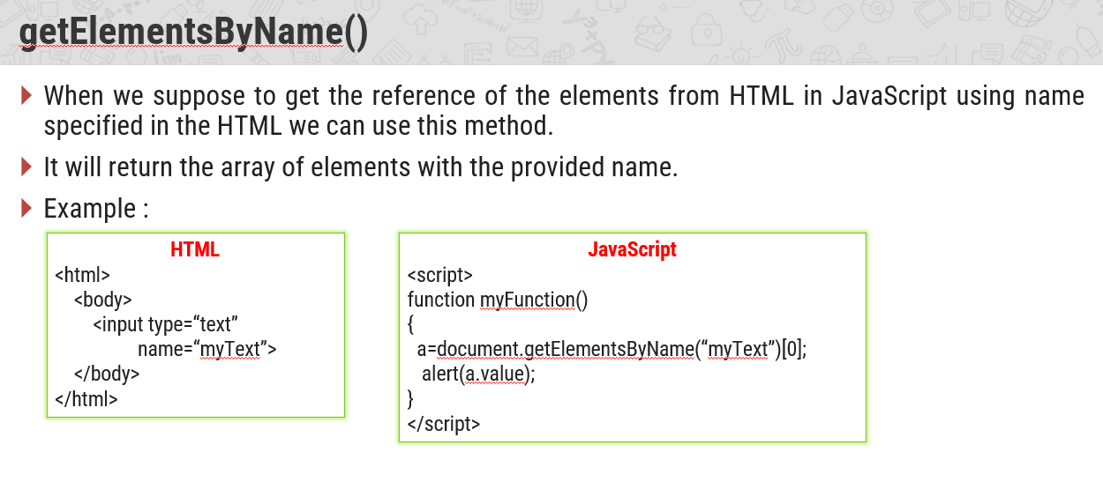

Slide 15
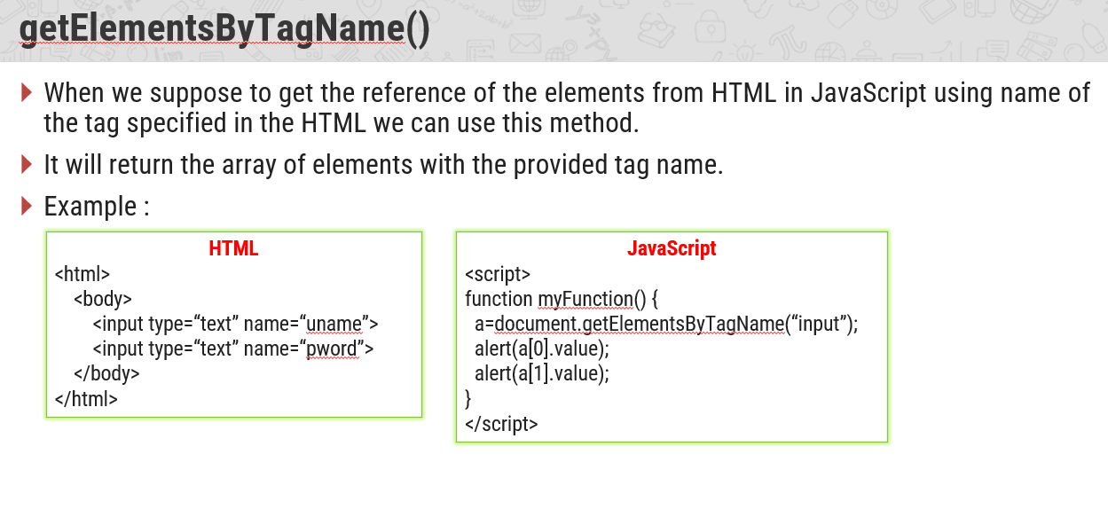

Slide 16
