Slide 1
JQUERY | INTRODUCTION
By:- Prof. Jignasha Rajput

Slide 2
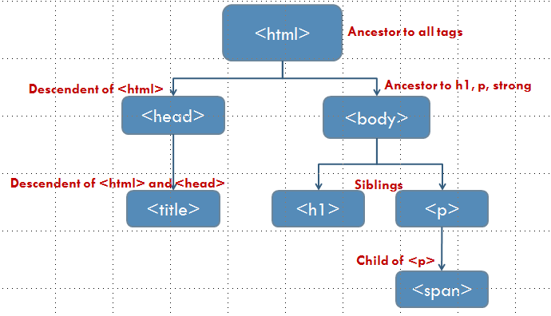
jQuery
Open source JavaScript library
Simplifies the interactions between
  HTML document, or the Document Object Model (DOM), and
  JavaScript.
JAVASCRIPT
Jquery Cookbook, 2010

Slide 3
HTML Tree - DOM
<html>
<head>
<title>My Web Page</title>
</head>
<body>
<h1>Main Topic</h1>
<p>
A web page about the days of the week, specifically<strong>Tuesday.</strong>
</p>
</body>
</html>

Slide 4
HTML Tree - DOM
<html>
Ancestor to all tags
Descendent of <html>
Ancestor to h1, p, strong
<head>
<body>
Descendent of <html> and <head>
Siblings
<title>
<h1>
<p>
Child of <p>
<span>

Slide 5
Why use jQuery
It’s open source. It’s free.
It’s small (18 KB minified).
It normalizes differences between web browsers.
It’s documented.
It’s currently tested and optimized for development on modern browsers (Chrome IE , Opera, Safari, Firefox).
It’s powerful.
It’s adopted by large organizations.
Learning curve is not steep.
Jquery Cookbook, 2010

Slide 6
The jQuery Foundation
Can be broken down into three concepts:
  Finding elements (via CSS selectors) and doing something with them (via jQuery methods)
  Chaining multiple jQuery methods
  Using jQuery wrapper set and implicit iteration
Jquery Cookbook, 2010

Slide 7
1. Find some elements and do something with them
Locate a set of elements in the DOM, and then do something with that set of elements.
Scenario – suppose we wanted to
hide a <div> from user
put new text content into the hidden <div>,
change style of the <div>, and
make hidden <div> visible again.
Jquery Cookbook, 2010

Slide 8
1. Find some elements and do something with them
<script>
//hide all divs on the page
jQuery('div').hide();
//update the text contained inside of all divs
jQuery('div').text('This is content for the DIV element');
//add class attribute with value of updatedContent to all divs
jQuery('div').addClass("updatedContent");
//show all divs on the page
jQuery('div').show();
</script>
Jquery Cookbook, 2010

Slide 9
<!doctype html>
<html>
<head>
<script src="http://code.jquery.com/jquery1.9.1.min.js"></script>
</head>
<body>
<div>This is existing content</div>
<script>
  //hide all divs on the page
  jQuery('div').hide();
  //update the text contained inside of all divs
  jQuery('div').text('This is content for the DIV element');
  //add a class attribute of updatedContent to all divs
  jQuery('div').addClass("updatedContent");
  //show all divs on the page
  jQuery('div').show();
</script>
</body>
</html>
Jquery linked library and script at end of document

Slide 10
<!doctype html>
<html>
<head>
<script type="text/javascript" src="js/jquery.min.js"></script>
</head>
<body>
<div>This is old content</div>
<script>
  //hide all divs on the page
  jQuery('div').hide();
  //update the text contained inside of all divs
  jQuery('div').text('This is new content');
  //add a class attribute updatedContent to all divs
  jQuery('div').addClass("updatedContent");
  //show all divs on the page
  jQuery('div').show();
</script>
</body>
</html>
Jquery local library and script at end of document

Slide 11
1. Find some elements and do something with them
What we did:
Use jQuery function (jQuery()) to find all the <div> elements in the HTML page
Use jQuery methods to do something with them (e.g., hide(), text(), addClass(), show()).
  Methods | .hide(), .text(), .addClass(), .show()
Jquery Cookbook, 2010

Slide 12
2. Chaining
jQuery allows methods (e.g., hide(), text(), addClass(), show(), etc.) to be chained.
Find element once and then chain operations onto that element.
Jquery Cookbook, 2010

Slide 13
2. Chaining
Can apply endless chain of jQuery methods on elements that are selected using jQuery function.
Cuts down on processing overhead by selecting a set of DOM elements only once, to be operated on numerous times by jQuery methods
Jquery Cookbook, 2010

Slide 14
Not Chained
Chained
jQuery('div').hide();
jQuery('div').text('This is new content');
jQuery('div').addClass("updatedContent");
jQuery('div').show();
jQuery('div')
.hide()
.text('new content')
.addClass("updatedContent")
.show();
Chained
jQuery('div').hide().text('new content').addClass("updatedContent").show();

Slide 15
3. The jQuery wrapper set
DOM elements from an HTML page are wrapped with jQuery functionality.
Wrapper set will contain one DOM element; other times it will contain several.

Slide 16
<!doctype html>
<html>
<head>
<script src="http://code.jquery.com/jquery1.9.1.min.js"></script>
</head>
<body>
<div>This is content</div>
<div>This is content</div>
<div>This is content</div>
<div>This is content</div>
<script>
  jQuery('div').hide().text('new content').addClass("updatedContent").show();
</script>
</body>
</html>
Jquery wrapped set
jQuery scans page and places all <div> elements in wrapper set so that the jQuery methods are performed on each DOM element in the set: implicit iteration

Slide 17
<!doctype html>
<html>
<head>
<script src="http://code.jquery.com/jquery1.9.1.min.js"></script>
</head>
<body>
<div>This is old content</div>
<div>This is old content</div>
<div>This is old content</div>
<div>This is old content</div>
<script>
  repeat (i==numofDivs) begin
    $ (‘div’). hide();
  end
</script>
</body>
</html>
Jquery wrapped set. It is like jQuery is performing a repeat loop.
jQuery scans page and places all <div> elements in wrapper set so that the jQuery methods are performed on each DOM element in the set: implicit iteration

Slide 18
jQuery function
$(document).ready()
jQuery(document).ready()

Slide 19
Executing jQuery/JavaScript Coded After the DOM Has
Loaded but Before Complete Page Load
ready() event handler method
$(document).ready() or jQuery(document).ready()
Included in your web pages after the stylesheet.
Necessary if JavaScript has to be embedded in the document flow at the top of the page and encapsulated in the <head> element.

Slide 20
Executing jQuery/JavaScript Coded After the DOM Has
Loaded but Before Complete Page Load
$(document).ready(function() {
  $('div').hide().text('new content').addClass("updatedContent").show();
});

