Slide 1



ＡＩ ＆ Ｂｉｇ Ｄａｔａ
Ｃ Programming (W14)
Welcome!!
Please check attendance individually.
(Mobile App)
miricanvas.com
Notes:
001 분반 보강 날짜 확인 (3/12)

Slide 2

ＡＩ ＆ Ｂｉｇ Ｄａｔａ
Things to do today
01
Lecture Notes (Ch.16, CH.17)
02
03

Slide 3
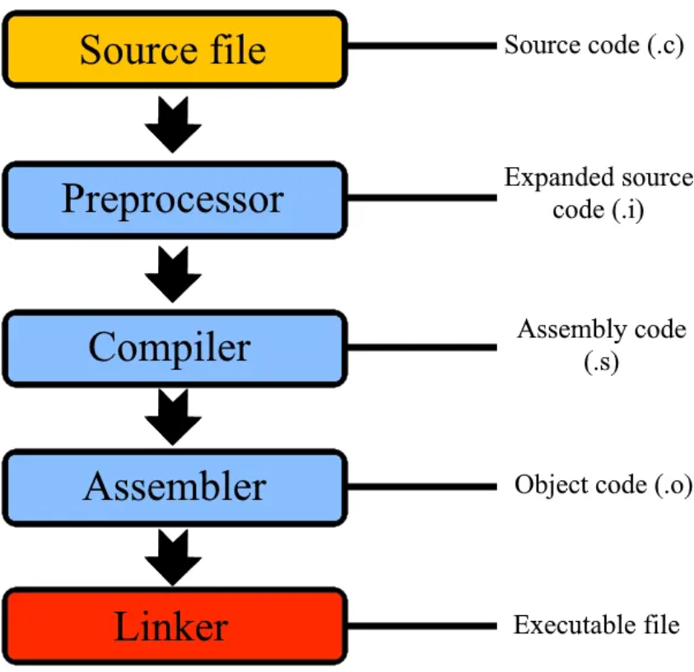
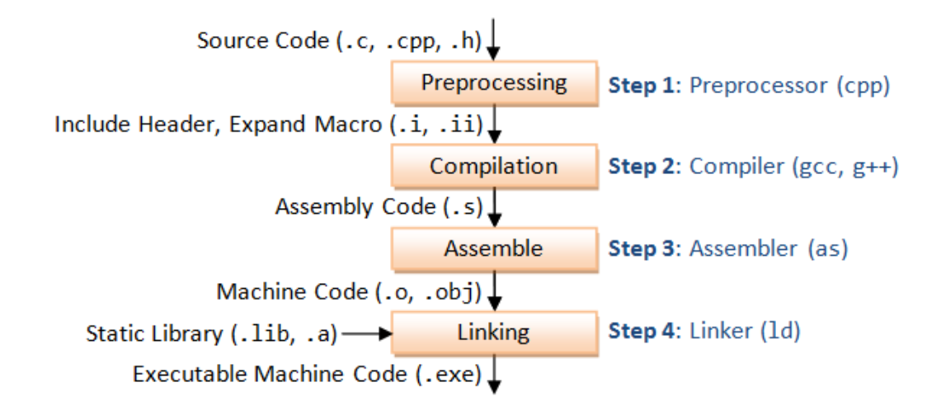
Compile/Build Process
ＡＩ ＆ Ｂｉｇ Ｄａｔａ
The Compile Process is the sequence of steps that a compiler follows to convert source code (written in a high-level language like C, C++, or Java) into machine code (binary instructions that a computer can execute).
Source code : https://github.com/lattera/glibc/tree/master/stdio-common
Notes:
These four steps can be broadly referred to as the compilation process, but strictly speaking, only the compile stage is sometimes referred to as compile.
We will call the process of building an executable file from a source file in a broad sense the compile process.

Slide 4
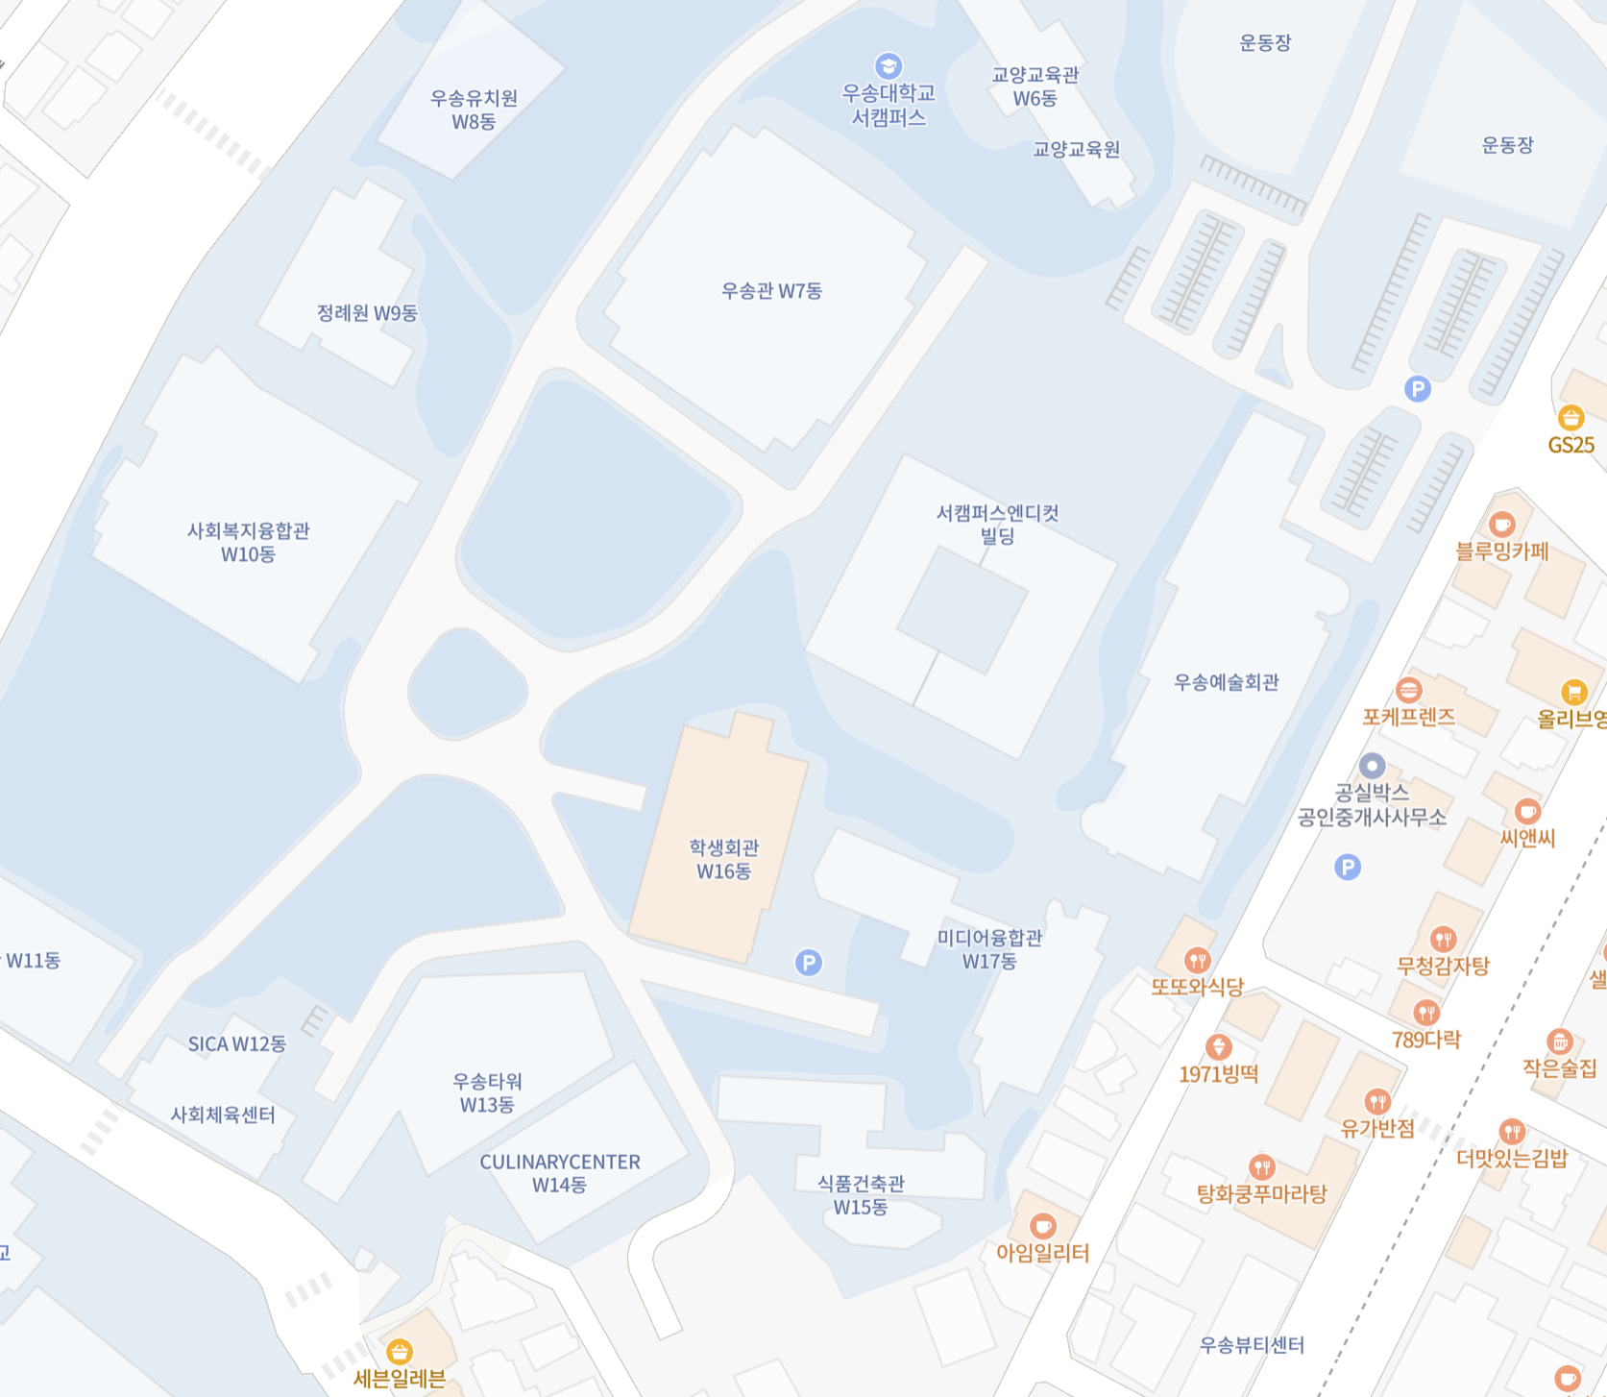
ＡＩ ＆ Ｂｉｇ Ｄａｔａ
Schedule of final exam
 | C-001(Mon) | C-002(Tue) | C-003(Wed)
Final exam | 2025-12-16
 | 2025-12-15 (no class) | 2025-12-16 | 2025-12-17 (no class)
Room |  | W16 501-1
Course evaluation
W16: Student Union
From the 3rd floor, turn right and take either the elevator
or the stairs up to the 5th floor.
When you reach the 5th floor,
you will see two large halls in front of you.
The room is the one on the left.
- Attendance: 20%
- Practices : 20%
- Mini-Project: 20%
- Final exam: 40% (Open book)

Slide 5
ＡＩ ＆ Ｂｉｇ Ｄａｔａ
Cheating Policy
No computer, no phone, no extra material allowed.
Only A4 2 pages written by yourself are allowed, and
A4 2 pages must be submitted together with the exam answer sheet after the final exam. (Expect 90 Mins)
If you look at other people's answer sheets or discuss together during the exam, it will be considered cheating and you will receive 0 point for the final exam.

Slide 6
ＡＩ ＆ Ｂｉｇ Ｄａｔａ
See you next week!
DO NOT miss a final exam
miricanvas.com

