Slide 1
Building an AI-Assisted Behavioral Research Workflow
From environment setup to a synthetic replication of a published study Stephen Shu – Draft: September 3, 2026
Copyright © 2026 Stephen Shu
1

Slide 2
Why simulate behavioral experiments with LLM agents?
Real human studies are slow and costly to iterate on
LLM-simulated subjects let you pressure-test a design before spending money on real recruitment
Question we’ll answer today: does a synthetic sample actually behave like a real one?
Case study: a temporal reframing savings experiment, run twice (N=20, then N=400) and checked against a real published study
Copyright © 2026 Stephen Shu
2

Slide 3
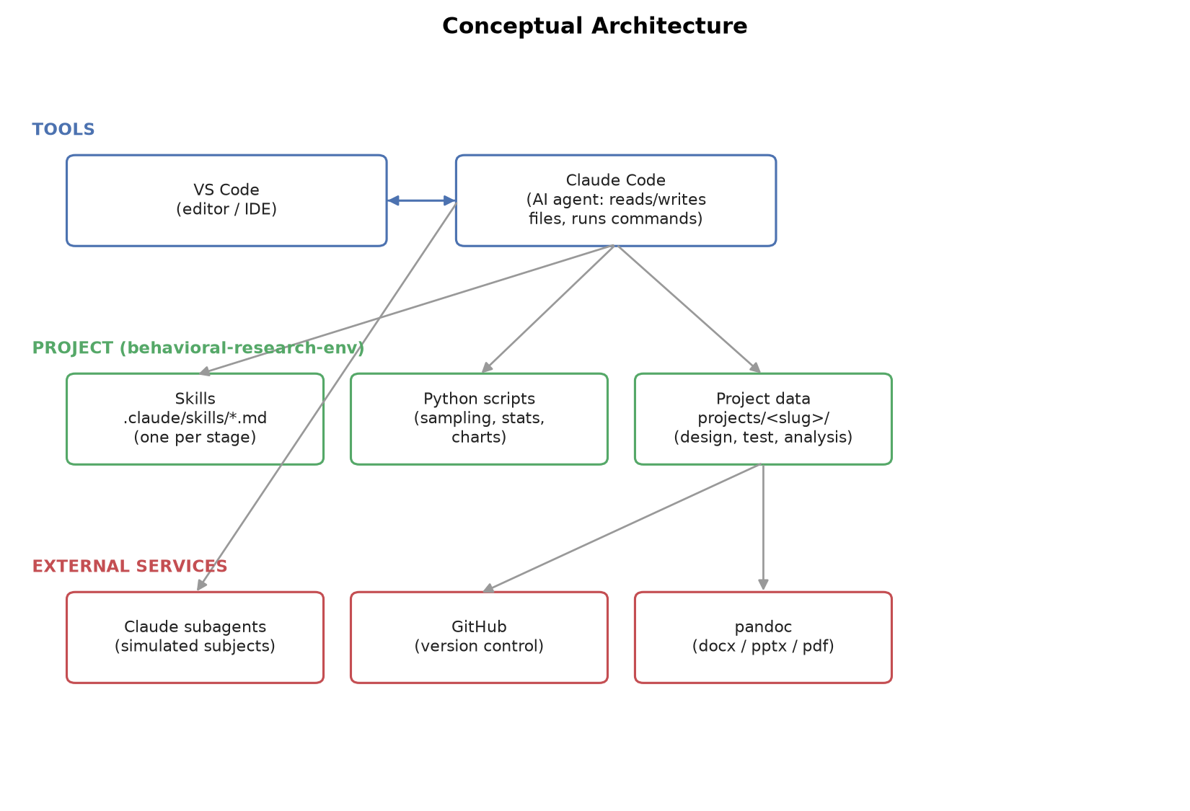
Conceptual Architecture
Claude Code shown here – a free Google Antigravity stack maps onto this same architecture, no paid tier required (see workbook Section 7.6).
Copyright © 2026 Stephen Shu
3

Slide 4
What is VS Code? What is Claude Code?
VS Code: a code editor – where you view/edit files, open a terminal, browse the project
Claude Code: an AI agent that runs inside (or alongside) VS Code
Reads and writes files, runs terminal commands, executes Python scripts
Follows Skills – written instructions for a specific recurring task
Can spawn subagents: independent Claude conversations for parallel work (this is how we simulate many subjects at once)
You talk to Claude Code in plain English; it takes the actions
Copyright © 2026 Stephen Shu
4

Slide 5
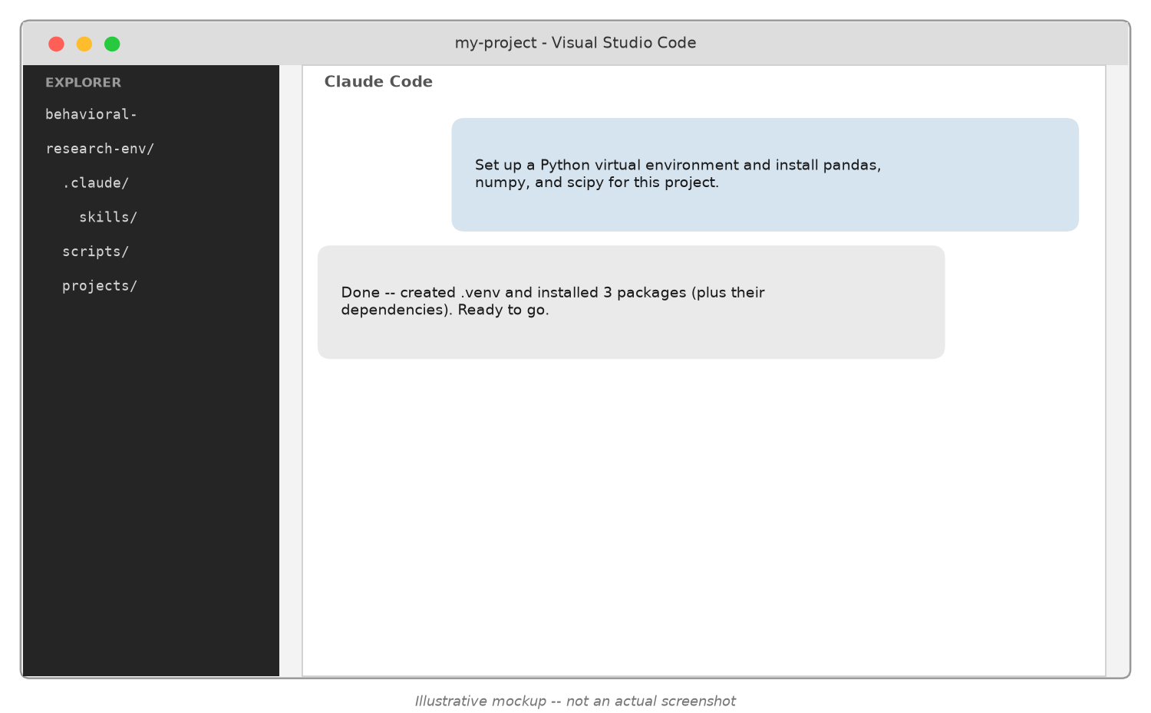
What it looks like in practice
No shell commands to memorize – you describe the goal in the chat panel and Claude Code does the work.
Copyright © 2026 Stephen Shu
5

Slide 6
How to read the rest of this deck
The next few slides show this same pattern for every research stage: a chat mockup first, plain and simple
Slides marked “Under the hood” are optional depth for the curious – skip them if plain English is all you need
Nothing under the hood is required reading to use the workflow yourself
Copyright © 2026 Stephen Shu
6

Slide 7
Tooling stack (under the hood)
Python – sampling, statistics, chart generation (pandas, numpy, scipy, statsmodels, matplotlib)
git + GitHub – version control, collaboration, backup
VS Code + Claude Code – the environment this all runs in
pandoc – converts markdown into docx / pptx / pdf (used for writeups, this deck, and the workbook)
All of it installed and configured by Claude Code, conversationally – you don’t have to type any of what follows yourself
Copyright © 2026 Stephen Shu
7

Slide 8
Concrete setup, warts and all (under the hood)
python -m venv .venv then pip install -r scripts/requirements.txt
git init, then gh repo create --private --source=. --push
Real snags hit along the way (useful to know, not just theory):
winget (Windows) needed --scope user to dodge a silent admin-elevation failure – Homebrew (Mac) has no such prompt
PATH changes don’t persist between separate terminal commands – each one needs its own PATH refresh
pandoc needs --resource-path to find images referenced by relative path
Copyright © 2026 Stephen Shu
8

Slide 9
Resulting project layout (under the hood)
behavioral-research-env/ .claude/skills/ <- one SKILL.md per workflow stage scripts/ synthetic_sample/ <- population sampling, batch building analysis/ <- balance check, regression, charts projects/ <study-slug>/ 03_design/ <- stimuli, population spec, variables 04_synthetic_test/ <- sampled subjects, responses, data 05_analysis/ <- balance report, regressions, charts 07_writeup/ <- generated writeup (md + docx)
Copyright © 2026 Stephen Shu
9

Slide 10
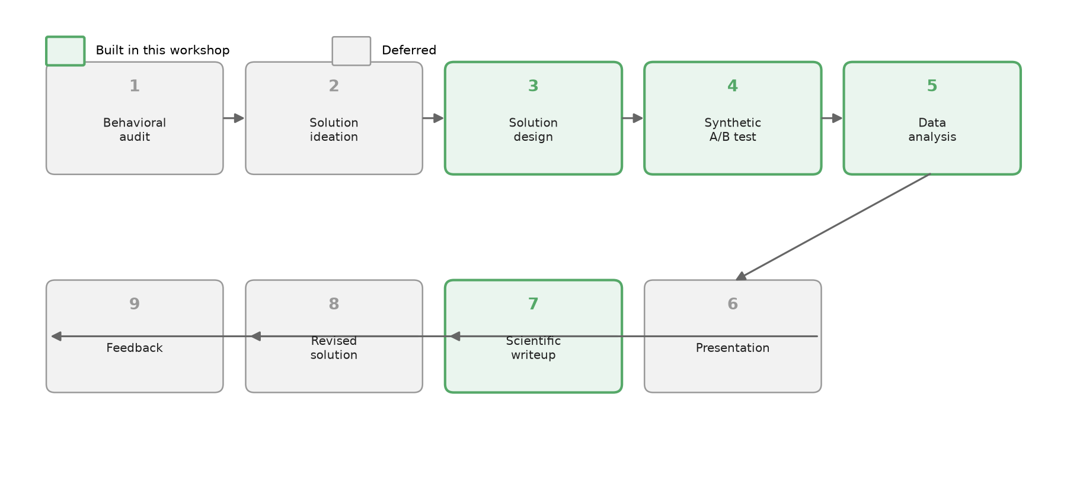
The 9-stage behavioral research pipeline
Copyright © 2026 Stephen Shu
10

Slide 11
Scoping calls: what we built, and why
Built: Stages 3, 4, 5, 7 – the empirical core (design -> test -> analyze -> write up)
Deferred: Stages 1, 2, 6, 8, 9 – audit/ideation/presentation/revision/feedback need more conversational nuance than a fixed pipeline
Deferred within Stage 5: mediation and moderation analysis – real methods (Query Theory, floodlight analysis), cut for v1 scope, not because they don’t matter
Lesson: scope a v1 tightly around what you can validate end-to-end
Copyright © 2026 Stephen Shu
11

Slide 12
Design principle: each stage is a Skill
A Skill = a markdown file (SKILL.md) with a name, a description (when to use it), and instructions
Claude Code reads the skill and follows it like a checklist/procedure
Heavy lifting (statistics, sampling) lives in Python scripts the skill calls out to
Why split it this way: skills handle judgment and conversation; scripts handle anything that needs to be exactly reproducible
Copyright © 2026 Stephen Shu
12

Slide 13
What a Skill actually looks like
This project’s real behavioral-design/SKILL.md (trimmed) – name + description tell Claude Code when to use it, the body is plain-English instructions:
--- name: behavioral-design description: Stage 3 -- set up a control-vs-treatment behavioral test --- Required inputs: control stimulus, treatment stimulus, population to sample, outcome variable
Copyright © 2026 Stephen Shu
13

Slide 14
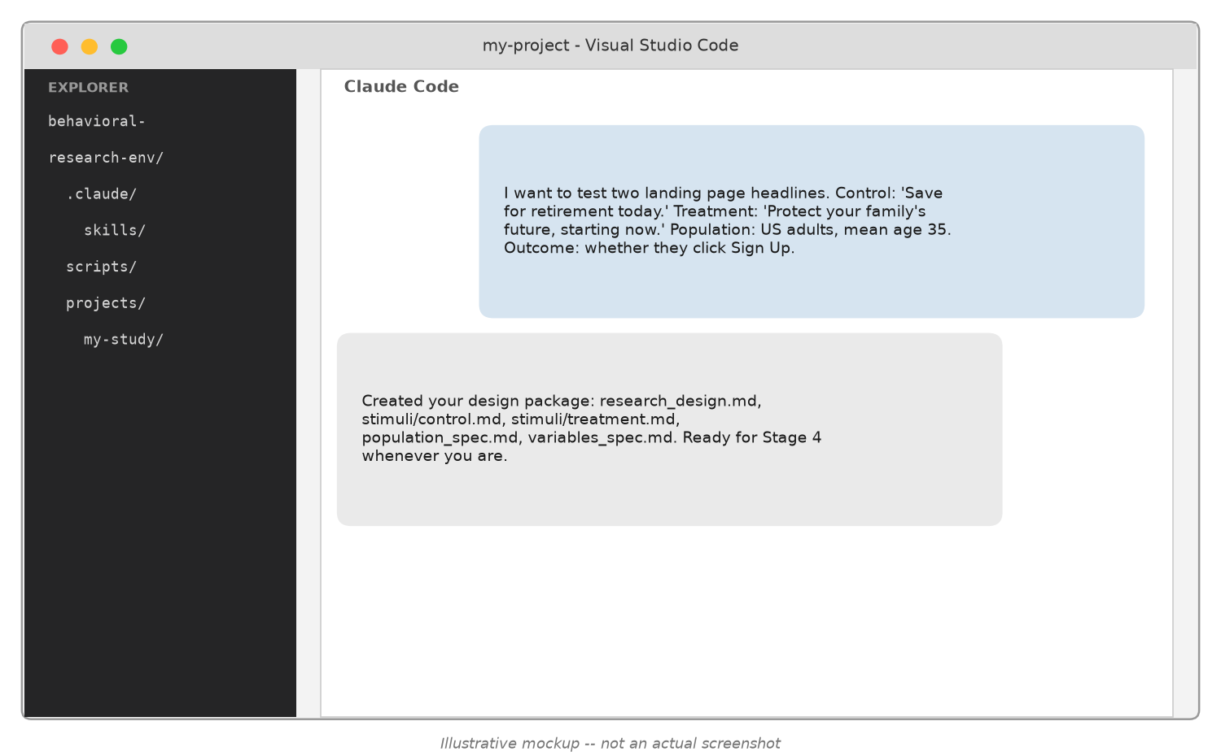
Stage 3 in practice
You describe your stimuli, population, and outcome in plain language – Claude Code turns it into a structured design package. No file formats to learn.
Copyright © 2026 Stephen Shu
14

Slide 15
Stage 3: design intake (under the hood)
Researcher provides: control stimulus, treatment stimulus, population description, outcome variable(s)
Skill validates completeness, asks only about genuine gaps
Produces a structured design package: research_design.md, stimuli/*.md, population_spec.md, variables_spec.md
Deliberately not a full ideation engine – this version assumes the researcher already knows what they want to test
Copyright © 2026 Stephen Shu
15

Slide 16
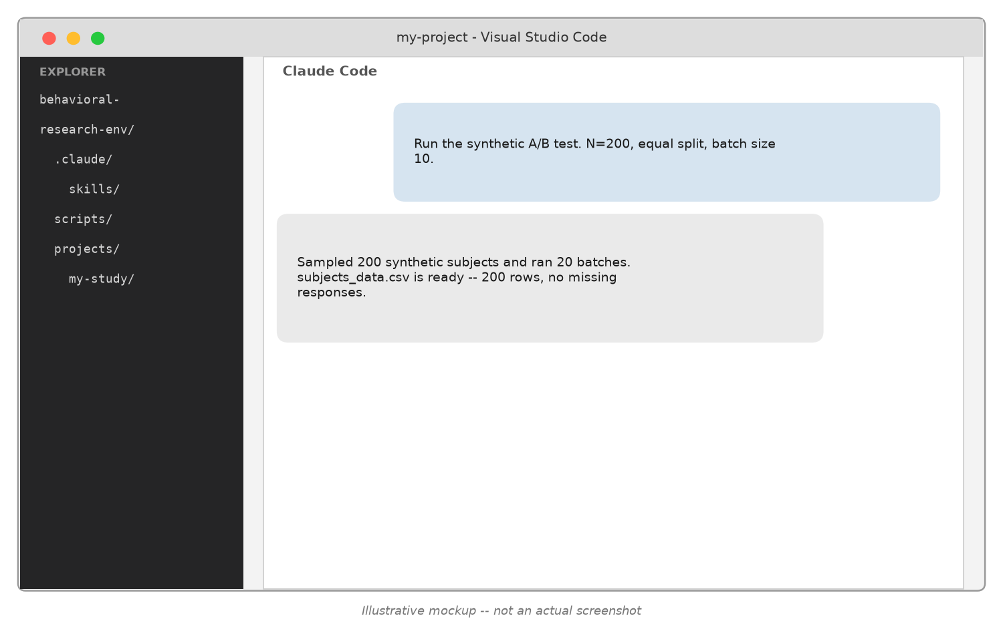
Stage 4 in practice
You state a sample size and let Claude Code handle sampling and simulation – behind this one message: population sampling, condition assignment, and dozens of simulated subject batches.
Copyright © 2026 Stephen Shu
16

Slide 17
Stage 4: population sampling (under the hood)
Demographics + individual differences sampled from researcher-specified means/SDs
Correlations supported via a Gaussian copula – not used here: only marginal distributions were given, not correlation guidance
Ordinal/count variables (income bracket, literacy) rounded to valid values
Random, independent assignment to condition – same mechanics as a real RCT
Copyright © 2026 Stephen Shu
17

Slide 18
Stage 4: subagent batching + blinding (under the hood)
Each subagent simulates a batch of ~10 subjects in one call – batching matters:
Batch size 2: ~9,875 tokens/subject
Batch size 10: ~2,588 tokens/subject (~4x more efficient)
Subjects respond in-persona based on their sampled profile, not as “an AI”
Blinding feature: conditions can be tracked under neutral labels (Condition A/B) until the researcher chooses to reveal which is treatment – avoids analyst bias
Copyright © 2026 Stephen Shu
18

Slide 19
Stage 4: what the data actually looks like (under the hood)
subject_id | age | condition | choice | affordability | clarity
S00001 | 32.3 | condition_1 (treatment) | Yes, start saving | 5 | 6
S00005 | 28.9 | condition_2 (control) | Not now | 3 | 4
Every simulated subject becomes one row of subjects_data.csv (real rows shown, from this workshop’s own N=400 run):
Copyright © 2026 Stephen Shu
19

Slide 20

Stage 5 in practice
One message gets you a balance check, a regression, and a chart – plain-English results first, statistical detail if you want it.
Copyright © 2026 Stephen Shu
20

Slide 21
Stage 5: analysis pipeline (under the hood)
Balance check – are demographics/individual differences actually balanced across conditions? (chi-sq, F-test, Bartlett’s)
Regression – OLS or logit, with/without controls, on the primary and secondary outcomes
Charts – outcome-by-condition bar charts with standard errors
A real bug caught here: pandas 3.0’s new string dtype silently broke a dtype check – always verify assumptions on real output, don’t trust silently
Copyright © 2026 Stephen Shu
21

Slide 22
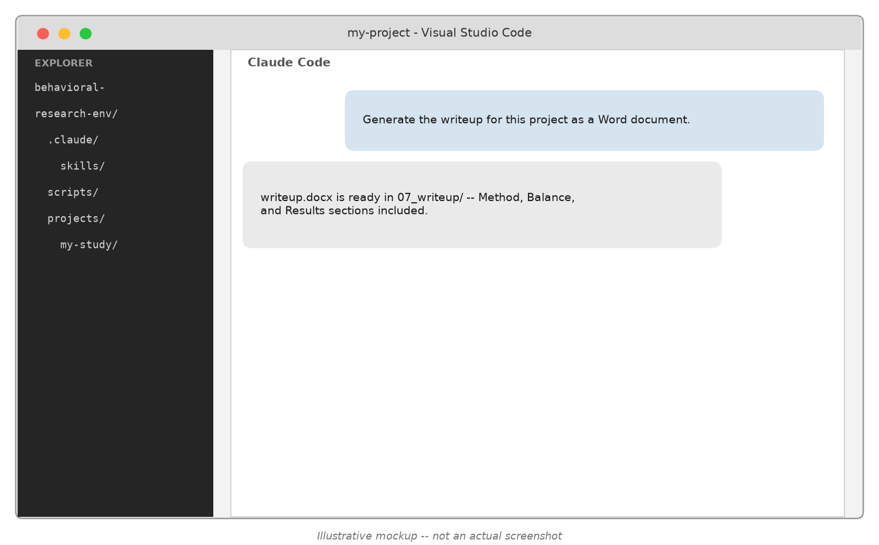
Stage 7 in practice
One message produces a Word-ready document you can open, edit, and share – optionally compared against a published study’s statistics.
Copyright © 2026 Stephen Shu
22

Slide 23
Stage 7: writeup + reference comparison (under the hood)
Assembles Method, Balance, and Results sections from the Stage 5 outputs into a single document
Markdown -> pandoc -> Word (.docx)
Optional section: compare this run’s statistics against a published reference study, with an explicit, stated classification rule (replicates / partially replicates / does not replicate)
Mediation/moderation excluded, matching Stage 5’s scope
Copyright © 2026 Stephen Shu
23

Slide 24
The design: temporal reframing
“Investing on a regular basis is one of the best ways to grow your wealth. You can get started with $5 a day today.” (treatment)
“…with $150 a month today.” (control)
Same underlying amount ($5/day ~= $150/month), different framing granularity
Outcome: sign-up decision + self-reported affordability + self-reported understandability (both 1-7 Likert)
Copyright © 2026 Stephen Shu
24

Slide 25
Pilot: N=20, blinded
10 subjects/condition, subagent mode, condition labels withheld from the analyst
Sign-up rate: 80% vs. 40% – directionally large, but only marginal at this N (p ~ .08 across all three outcomes)
Purpose of a pilot: catch pipeline problems and get a directional read cheaply before committing to a larger run
Copyright © 2026 Stephen Shu
25

Slide 26
Unblind, then decide to scale
Researcher reveals: Condition 1 = treatment ($5/day), Condition 2 = control ($150/month)
Re-run regressions with the correct reference category – coefficients flip sign as expected, same magnitude
Decision: scale to N=400 (200/condition) to get a properly powered read
Copyright © 2026 Stephen Shu
26

Slide 27
Full-scale results (N=400)
Sign-up rate: 64.5% (treatment) vs. 45.5% (control), logit B=0.82, p<.001
Affordability rating: 4.66 vs. 4.05, p<.001
Understandability rating: 5.35 vs. 5.31, p=.70 (no effect)
Balance check flagged gender as imbalanced (p=.035) – across 6 tests, ~26% chance of at least one false positive; verified main results hold with a gender control
Copyright © 2026 Stephen Shu
27

Slide 28
The reveal
Outcome | Real study | This synthetic run
Savings decision | B=0.72, p=.002 | B=0.82, p<.001 – replicates
Affordability | β=1.23, p<.001 | β=0.64, p<.001 – replicates, ~half size
Understandability | β=0.49, p=.001 | β=0.04, p=.70 – does not replicate
This project’s population statistics and stimulus wording turned out to match a real published study exactly (Shu, Thomas & Smith, 2021, N=601 human crowdworkers):
We didn't design this to match a published study. It just did.
Copyright © 2026 Stephen Shu
28

Slide 29
Takeaways
Synthetic LLM-simulated subjects can reproduce a real behavioral effect’s direction and significance for a choice outcome
They may understate effect sizes even when direction replicates (affordability)
They can miss a mechanism entirely (understandability) – a reminder that synthetic samples are a tool for iteration, not a substitute for real data
Practical toolkit: skills + subagents + Python + pandoc, all orchestrated conversationally
Synthetic samples are a tool for iteration — not a substitute for real data.
Copyright © 2026 Stephen Shu
29

Slide 30
AI Disclosure
This presentation and its companion workbook were themselves generated with Claude Code, using the exact workflow, skills, and prompt patterns described in this talk
Purpose: illustrative – demonstrating the tool by using it on itself
All statistics, tables, and figures shown are real outputs from this workshop’s actual project runs, not fabricated for effect
As with any AI-assisted work: review and verify before reusing
Copyright © 2026 Stephen Shu
30

Slide 31
Questions?
Repository: this workshop’s behavioral-research-env project
Workbook handout has copy-paste prompt templates for every stage
Copyright © 2026 Stephen Shu
31

Slide 32
Appendix: Bootstrapping Your Own Workflow
This talk built Stages 3-4-5-7 for one research topic – what if you want this for a different one, starting from zero?
Same tool, same conversation-first approach: plan with Claude Code before building anything
The next few slides walk through that planning-and-scoping process itself
Copyright © 2026 Stephen Shu
32

Slide 33
Start by planning all 9 stages
Describe your own version of all 9 stages to Claude Code, even the ones you won’t build yet
Goal at this point: a shared understanding of scope, not code – inputs, outputs, and how much judgment each stage needs
Treat it like any project-scoping conversation you’d have with a human collaborator, before writing a line of anything
Copyright © 2026 Stephen Shu
33

Slide 34
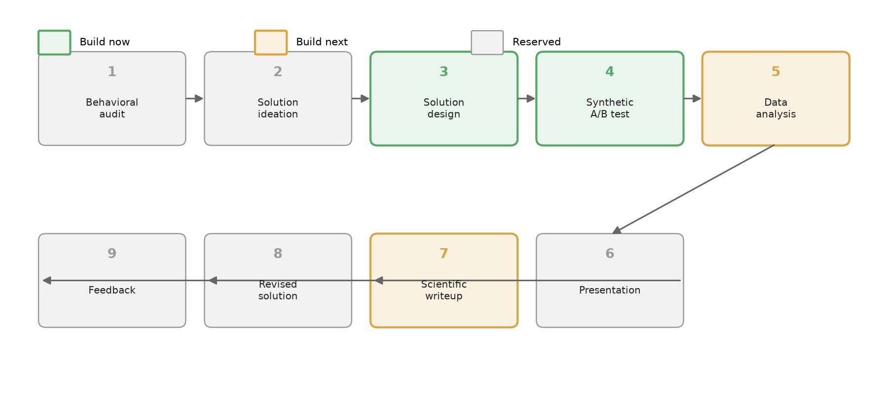
The roadmap: build now, build next, reserved
Copyright © 2026 Stephen Shu
34

Slide 35
Make the scoping call for your own project
Build first the stages with the clearest inputs -> outputs and the least open-ended judgment
For this project: Stages 3-4 (design -> test) qualified; Stages 1, 2, 6, 8, 9 need more conversational nuance than a fixed pipeline can give yet
Stages 5 and 7 weren’t abandoned – just sequenced for after the core loop was validated
Copyright © 2026 Stephen Shu
35

Slide 36
Bootstrap prompt: draft the Skill yourself
Point Claude Code at one of this project’s real skills as a style reference, and ask it to draft a new one for your topic
“Here’s an example SKILL.md [paste one]. Draft a new one in this style for [your stage’s inputs/outputs].”
What you get back: a draft SKILL.md – review it, adjust the required-inputs list to fit your research area, save it under .claude/skills/
Copyright © 2026 Stephen Shu
36

Slide 37
Validate before you scale
Run a tiny throwaway example first: a made-up stimulus for a design skill, N=5-10 for a synthetic-test skill
Check the output shape before trusting it, and iterate the skill’s wording based on what comes back
Same pilot-before-scale discipline as the main study – applied one level up, to the skill itself
Copyright © 2026 Stephen Shu
37

Slide 38
What happened next in this project
Once Stages 3-4 were validated end-to-end (the N=20 pilot, then N=400 scale-up), the same bootstrap-then-validate pattern extended the workflow to Stage 5 (analysis) and Stage 7 (writeup)
Stages 1, 2, 6, 8, 9 remain reserved – not abandoned, just not yet specified enough to automate
The lesson holds at every level of this workflow: scope small, validate, then expand
Copyright © 2026 Stephen Shu
38

