Slide 1

Injection Attacks
…and how to stop them
Joshua Tallman
Concordia University Irvine
Associate Professor
Computer Science
Cybersecurity

Slide 2

Notes:
Briefly introduce self and family
15 years as cybersecurity consultant
7 years in Europe
Twin daughters were born in Europe
Older daughter lived golden childhood there (just got driver's license)

Slide 3

Plan for Today
Wifi: CUI-Shared / Crumbs-Uncover-Intent
Three website vulnerabilities:
URL Injection (real / walkthrough)
SQL Injection (fake / activity)
Command Injection (time?)
We will explore each problem and solution, closing with injection examples from 2026.
No technical background is assumed.
Image generated by OpenAI tools

Slide 4
Vulnerability #1: URL Injection

Slide 5
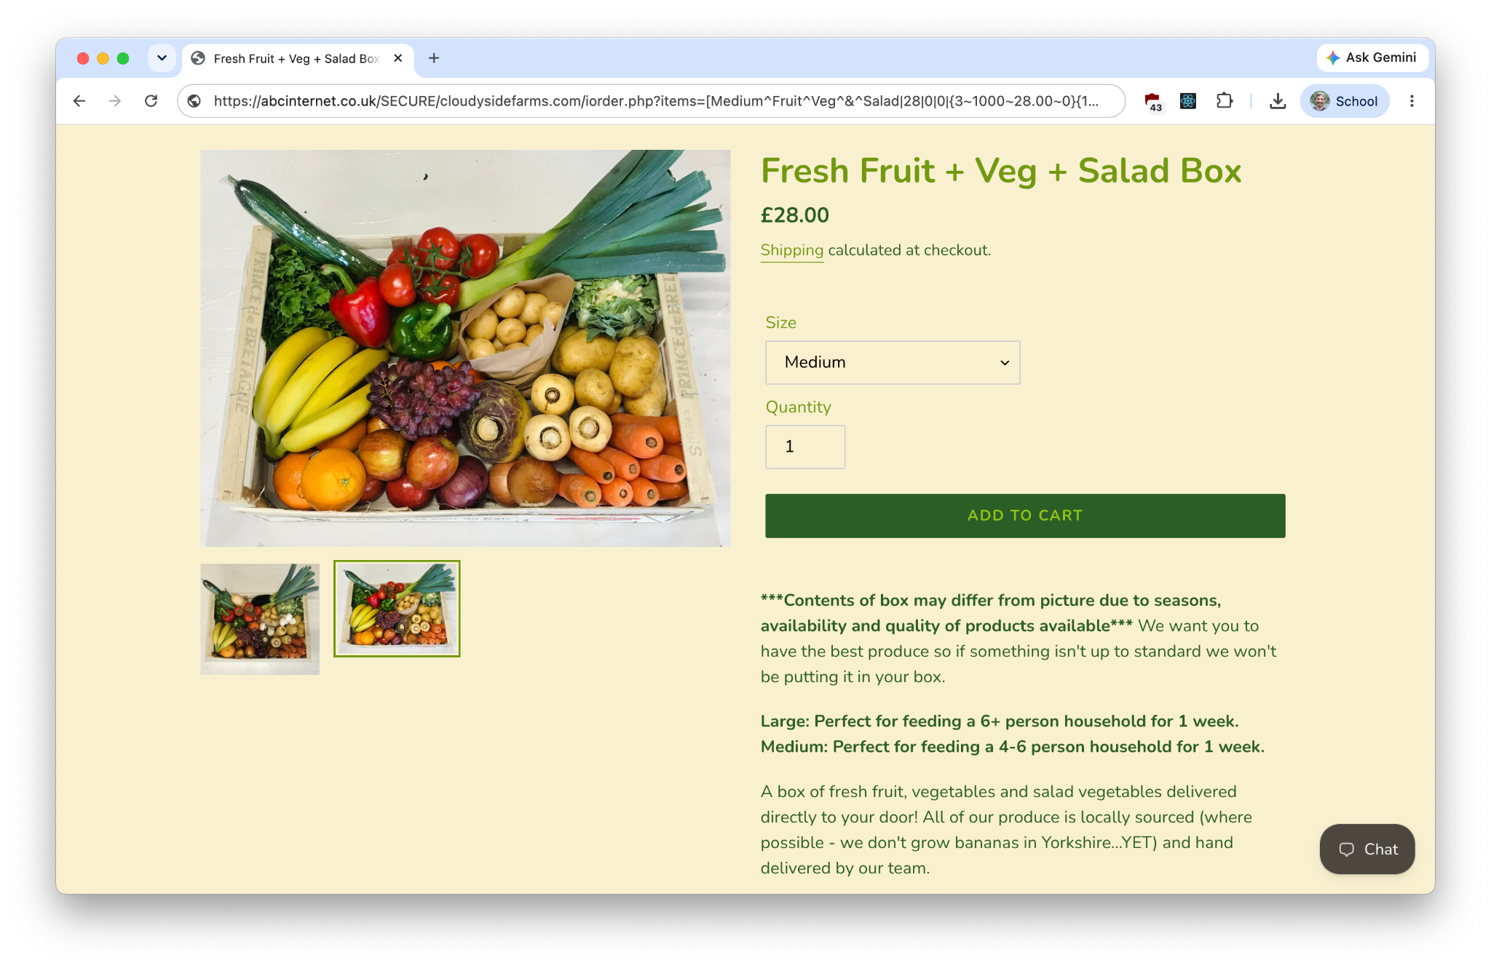
https://abcinternet.co.uk/SECURE/cloudysidefarms.com/iorder.php?items=[
Medium^Fruit^Veg^&^Salad|28|0|0|{3~1000~28.00~0}{1~2~28.00~0}|1
]&refepath=none&cn=
https://abcinternet.co.uk/SECURE/cloudysidefarms.com/iorder.php?items=[
Medium^Fruit^Veg^&^Salad|28|0|0|{3~1000~28.00~0}{1~2~28.00~0}|1
]&refepath=none&cn=

Slide 6
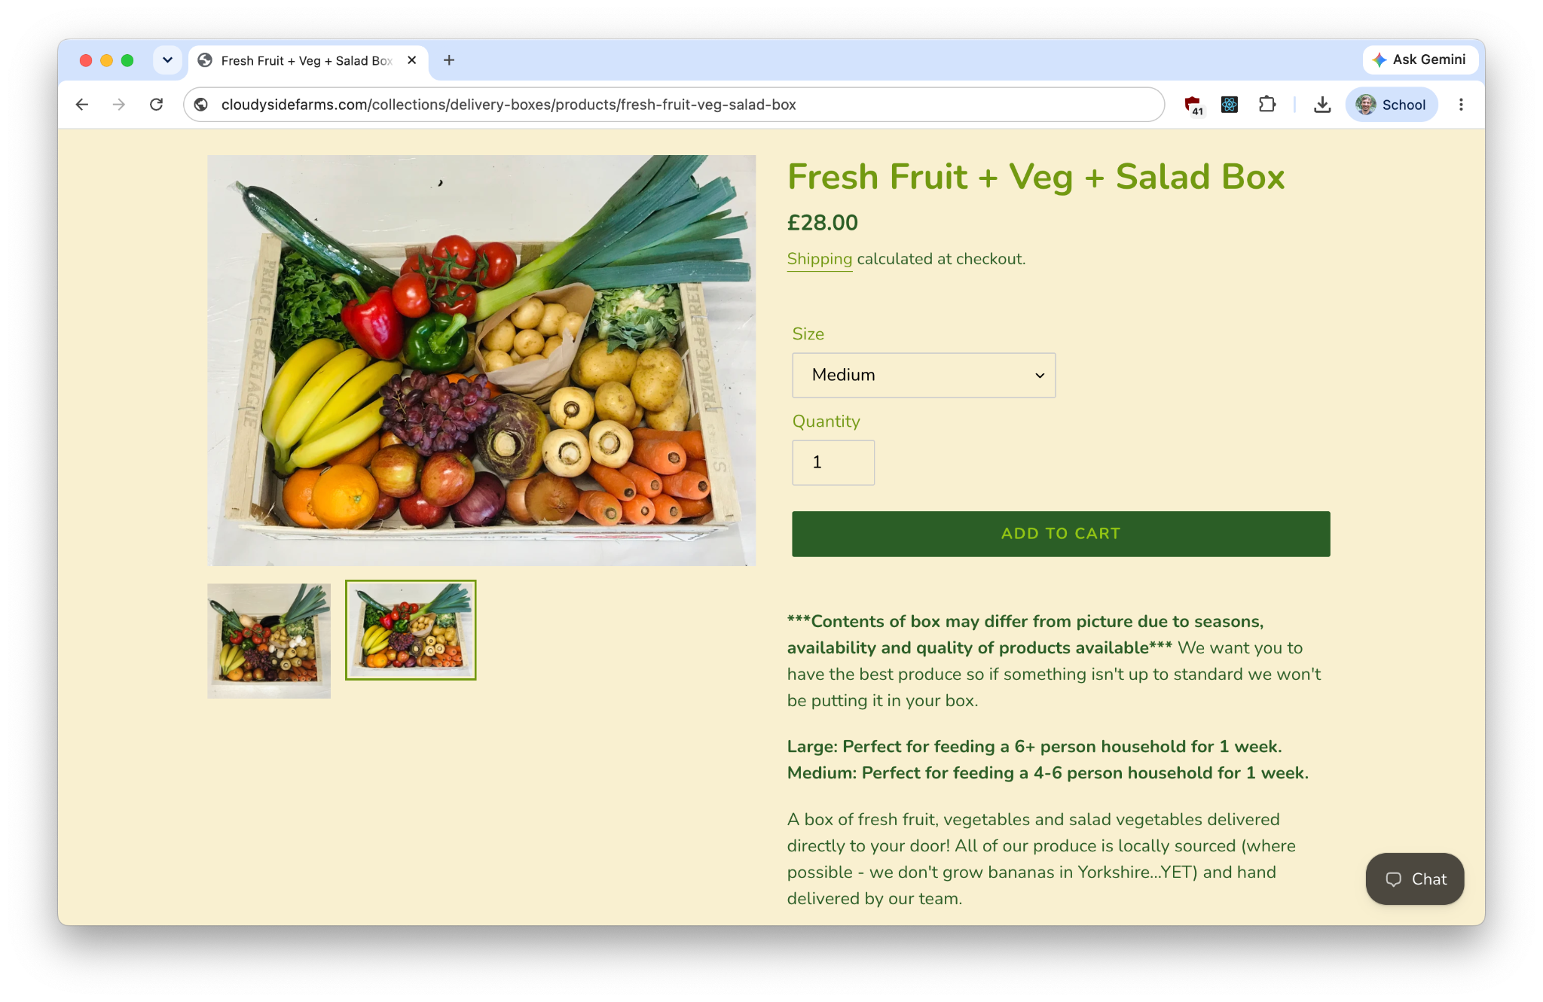
https://cloudysidefarms.com/collections/delivery-boxes/products/fresh-fruit-veg-salad-box
Cookie on my computer
hWNHoZ3cBExWK26zHanOtDVg?key=b296963f3523846b75b6ed0e8383a859
Database on their server
ID: hWNHoZ3cBExWK26zHanOtDVg
Fresh Fruit Veg & Salad Box
Qty: 1 @ 28.00 each

Slide 7
Lesson #1:
Your website shouldn't ask the customer how much to charge them.
Never trust client-provided information without server-side validation.

Slide 8
Vulnerability #2: SQL Injection

Slide 9
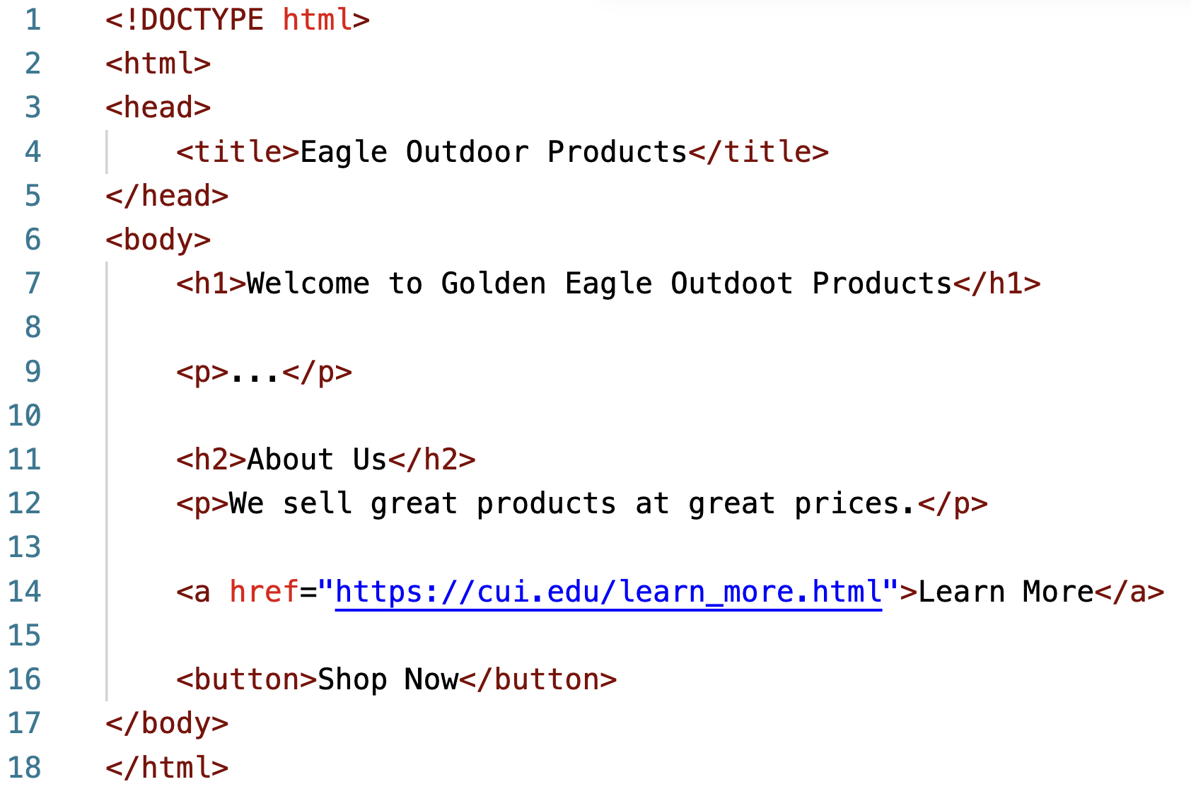
What are we looking at here?

Slide 10
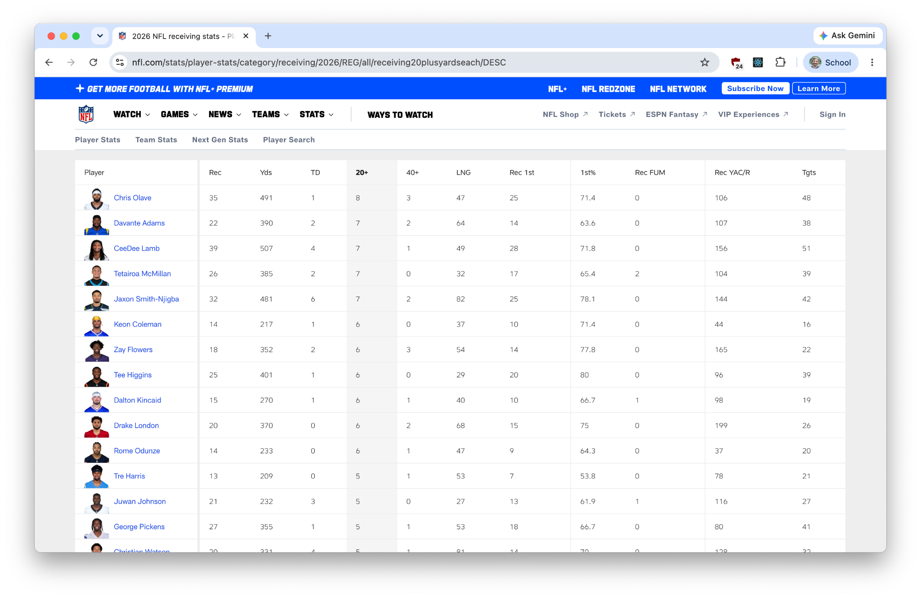
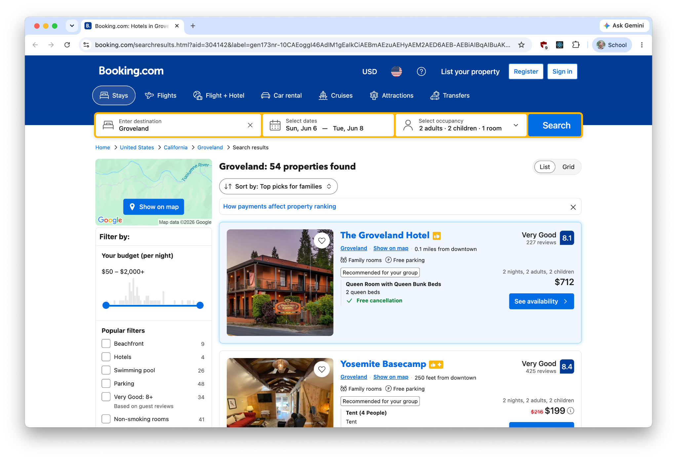
Modern web pages query a backend database

Slide 11
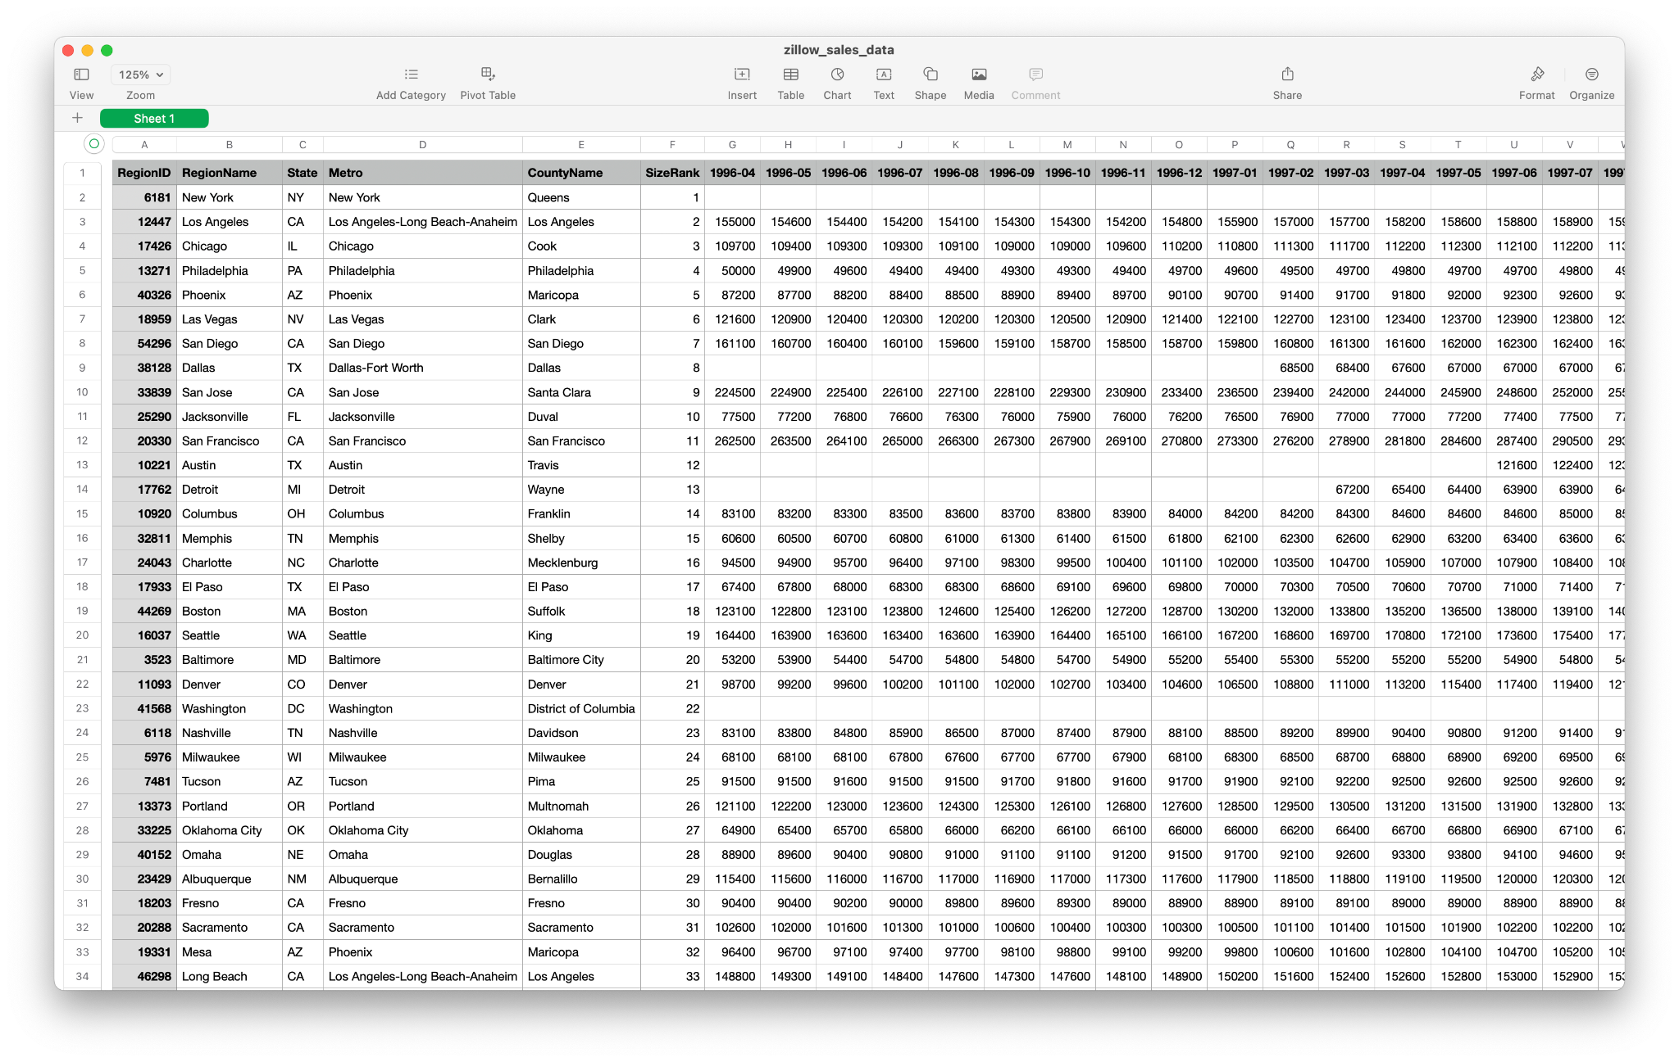
DBs are something like a giant spreadsheet
(it helps to know the internal layout)

Slide 12
Possible Queries from Web Server to Database
SELECT name, bat_avg, hrs, era FROM players WHERE team = 'Padres'
SELECT name, bat_avg, hrs, era FROM players WHERE team = 'Dodgers'
SELECT item, price, qty FROM stock WHERE kind = 'Tools' ORDER BY price
SELECT item, price, qty FROM stock WHERE kind = 'Sales' ORDER BY qty
SELECT temp, rain FROM weather WHERE year = 2026 AND month = 'Jan'
SELECT temp, rain FROM weather WHERE month = 'Feb' OR month = 'Feb'

Slide 13
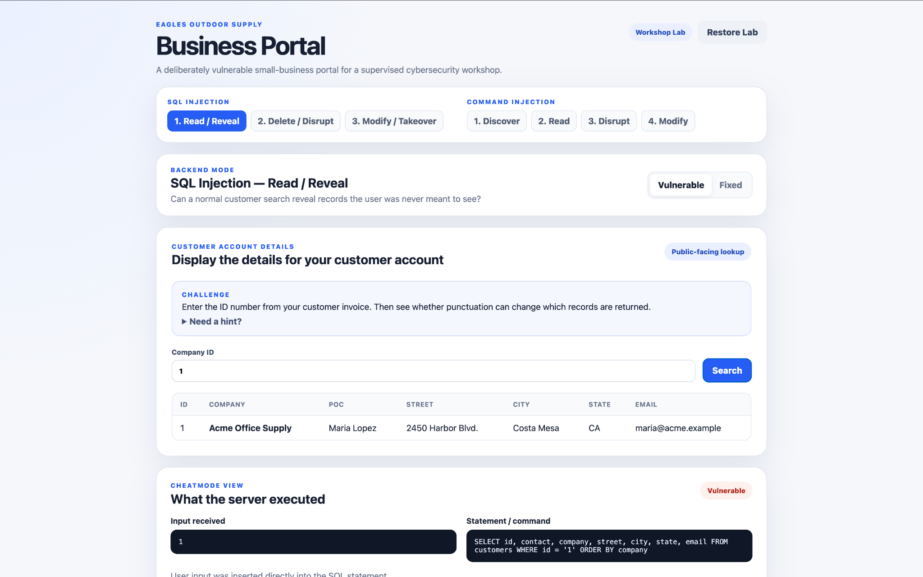

Slide 14
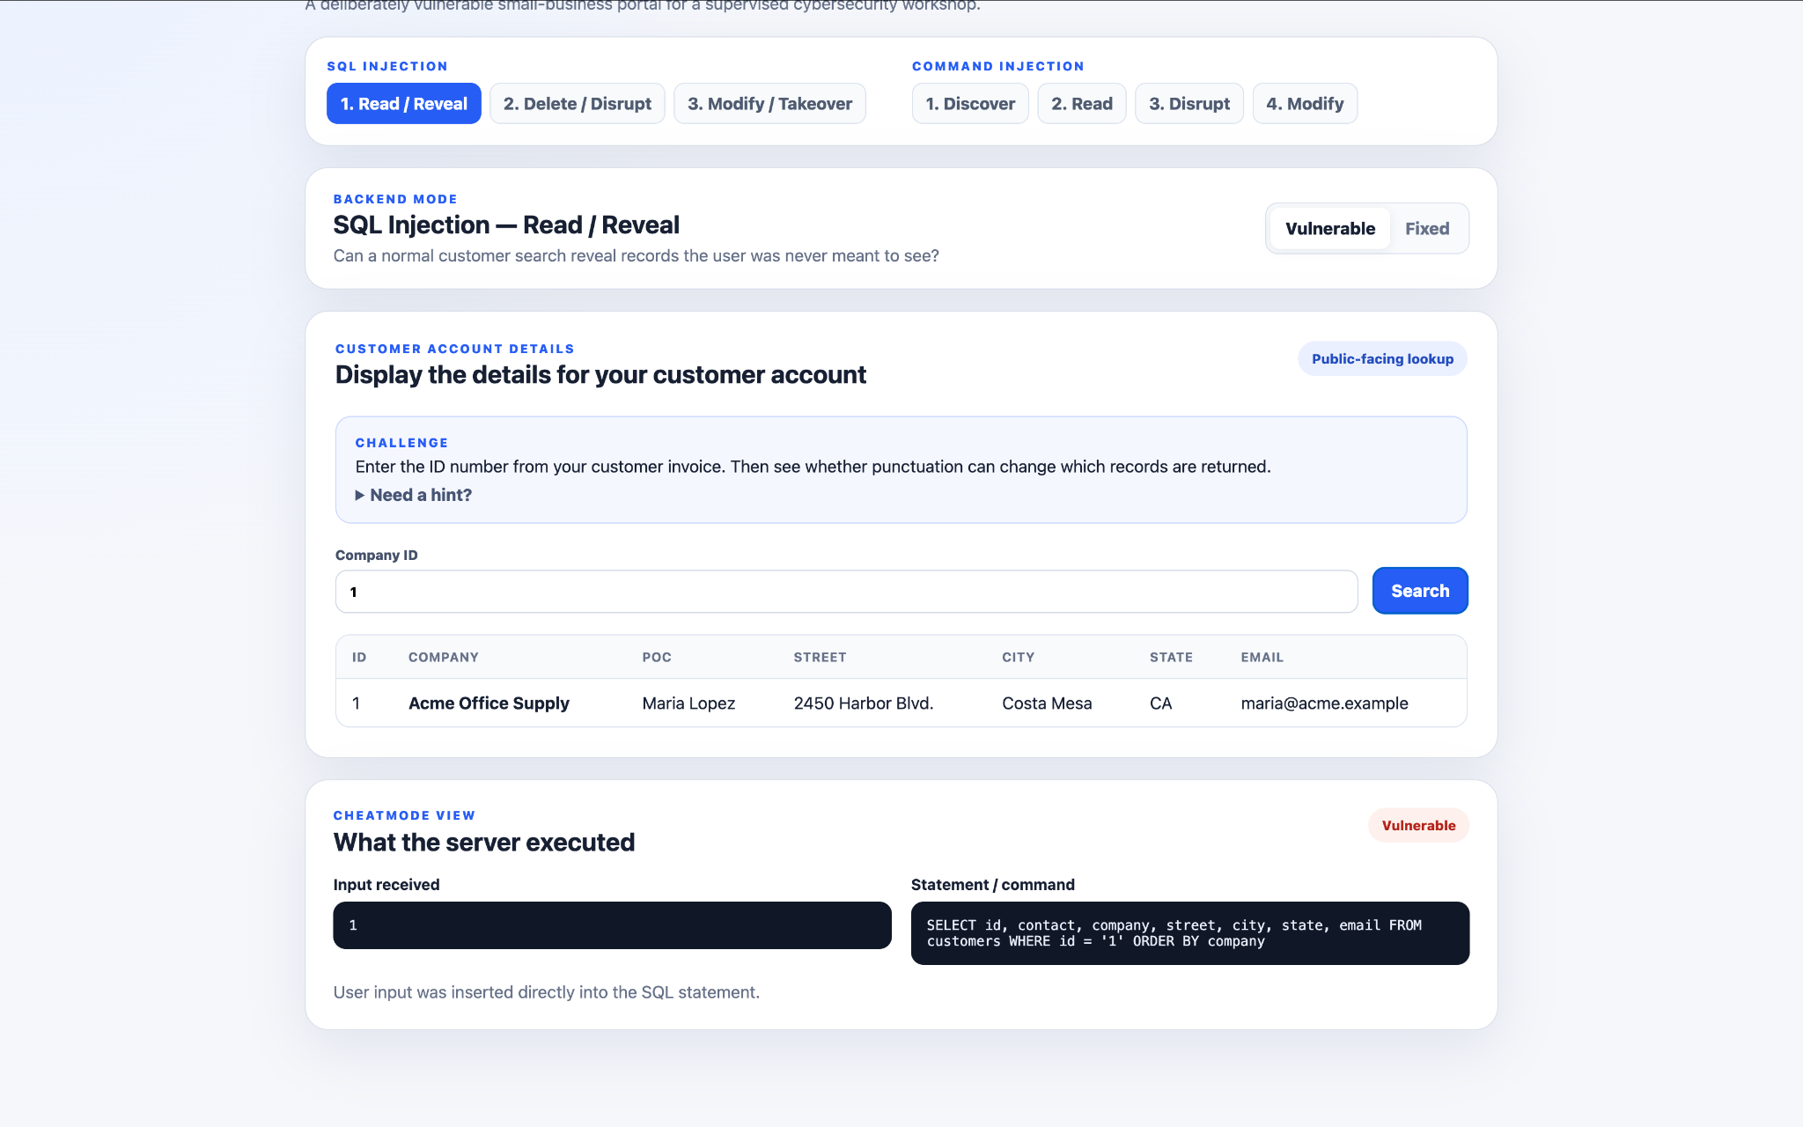
I made us a cheat code since we are new to SQL
(experienced hackers can reason and guess their way through this)

Slide 15
SQL Injection - Read / Reveal
Click the SEARCH button to display the details of company with id=1
Analyze the SQL Statement using the cheat window
Devise a sneaky SQL statement that would display details from other company details than you are not supposed to know
Work backwards to calculate the search term that would generate the sneaky backend SQL statement
Profit!

Slide 16
SELECT id, contact, …, state, email
FROM customers WHERE id = 1 or id > 1
ORDER BY company

Slide 17
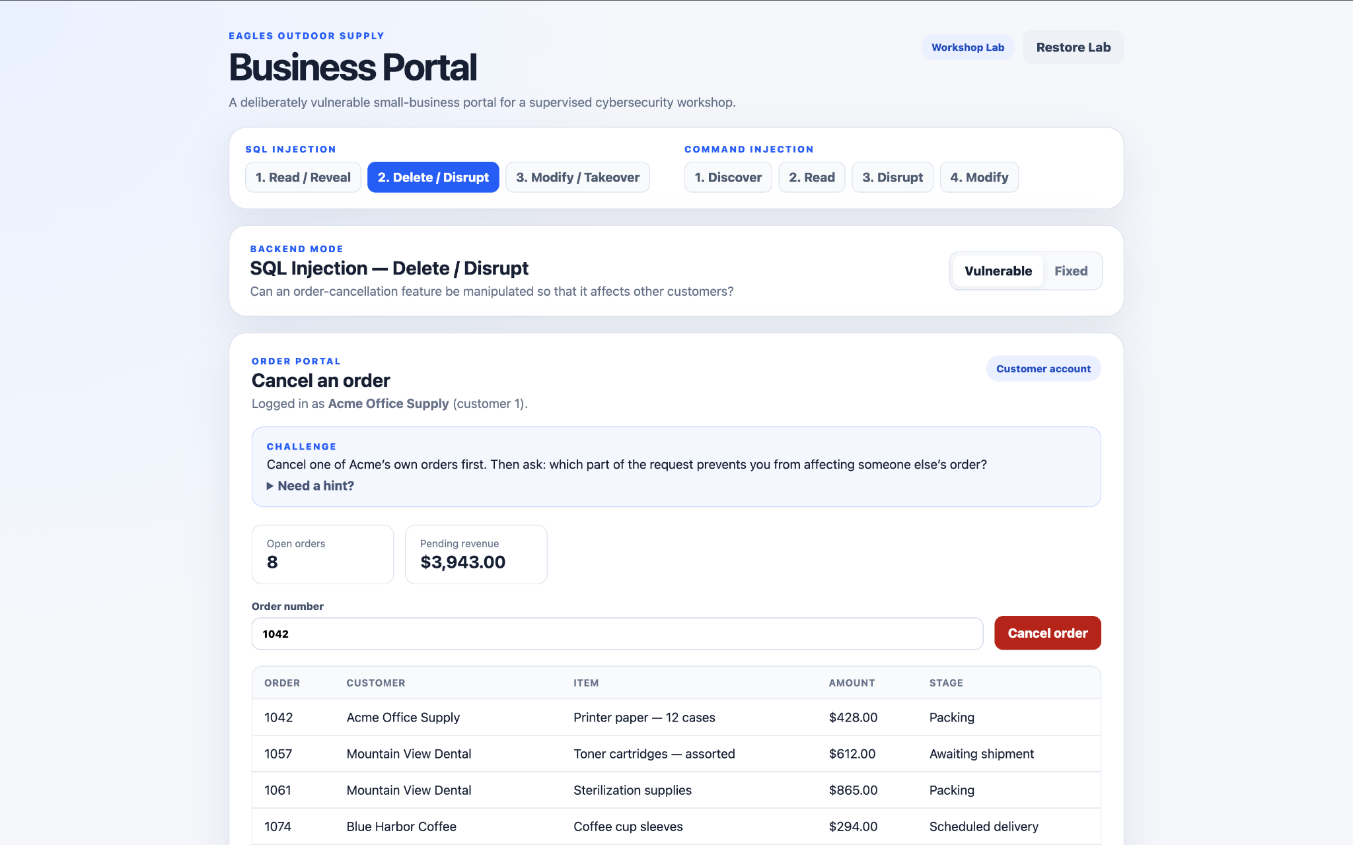
DELETE FROM orders WHERE id = 1057 --
AND customer_id = 1

Slide 18
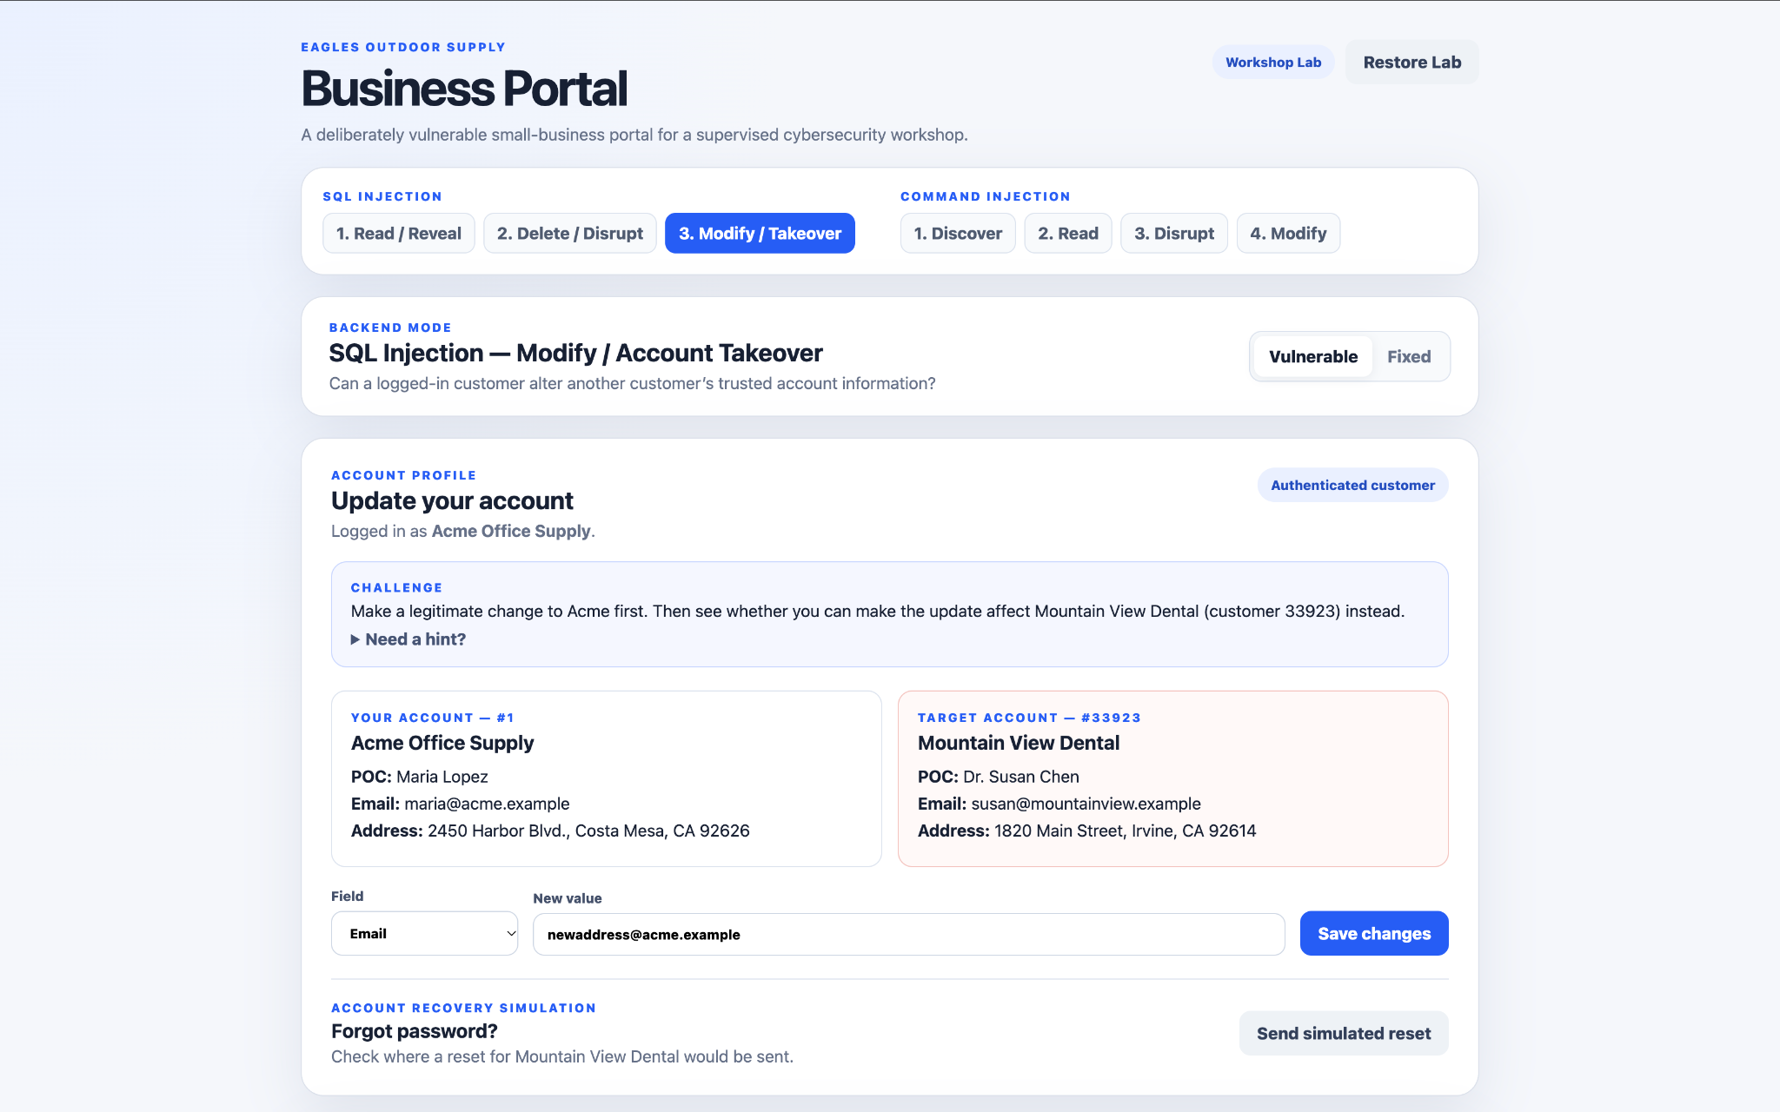
UPDATE customers
SET email = 'newaddress@acme.example'
WHERE id = 33923 --' WHERE id = 1

Slide 19
Lesson #2:
Just because someone fills out a form doesn't mean they get to run your company.
Parameterized queries keep user input as data, not SQL instructions.

Slide 20
Vulnerability #3: Command Injection

Slide 21
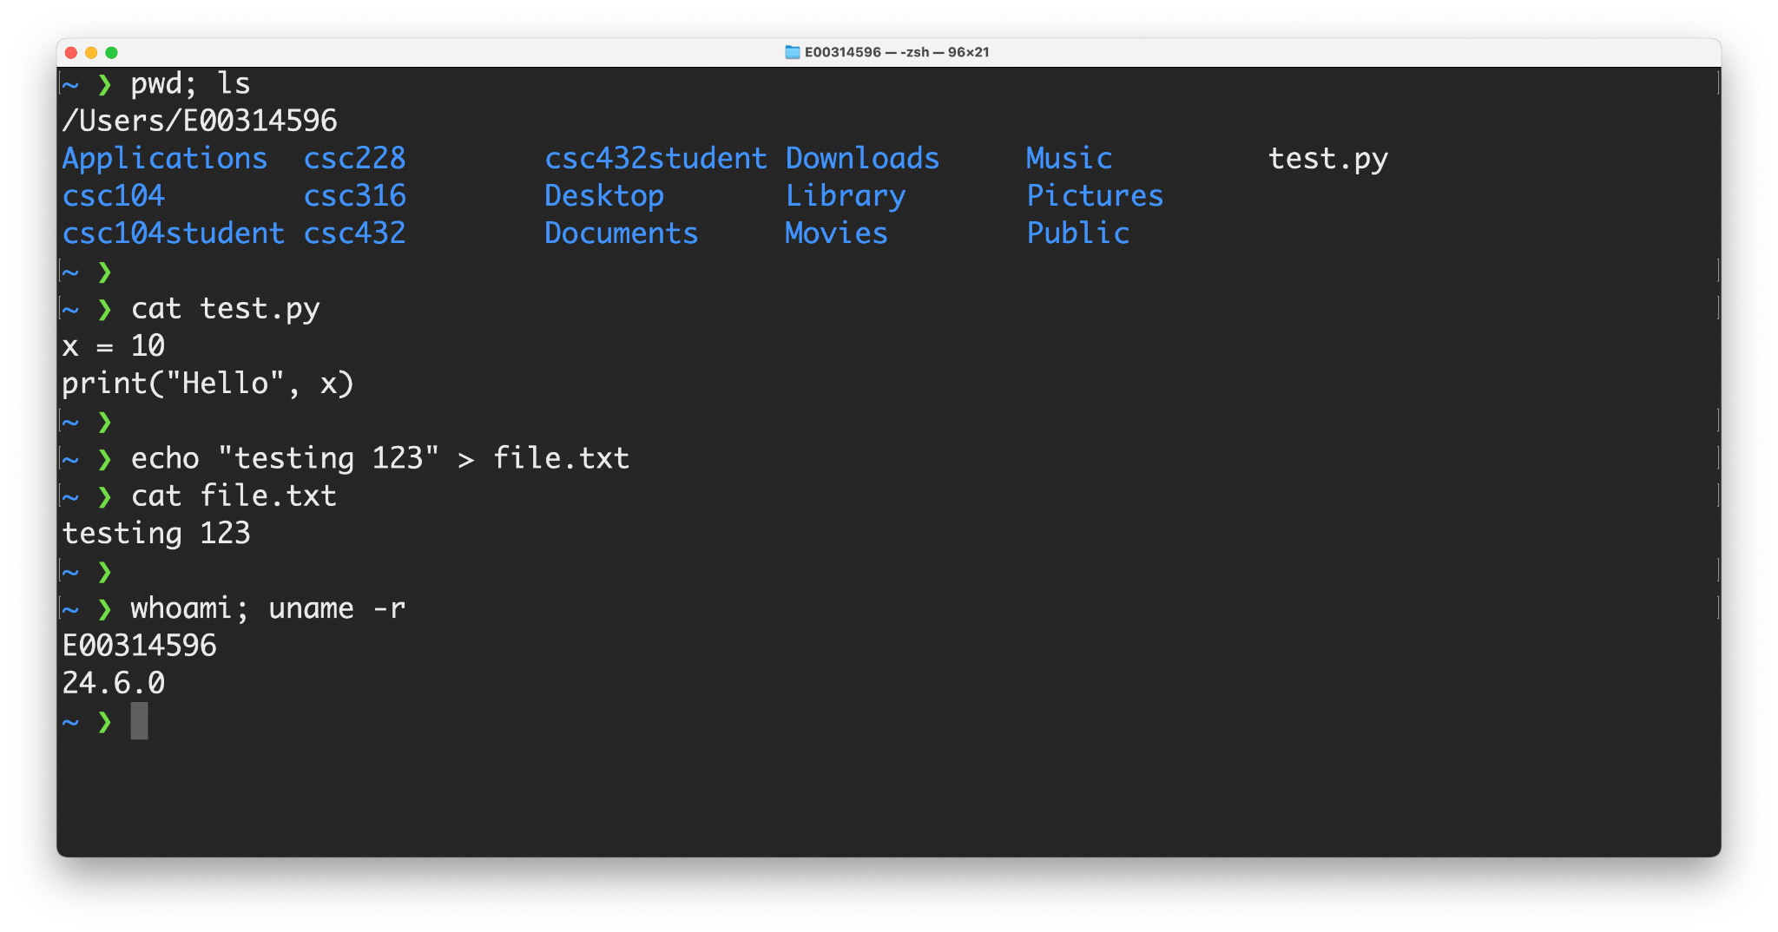
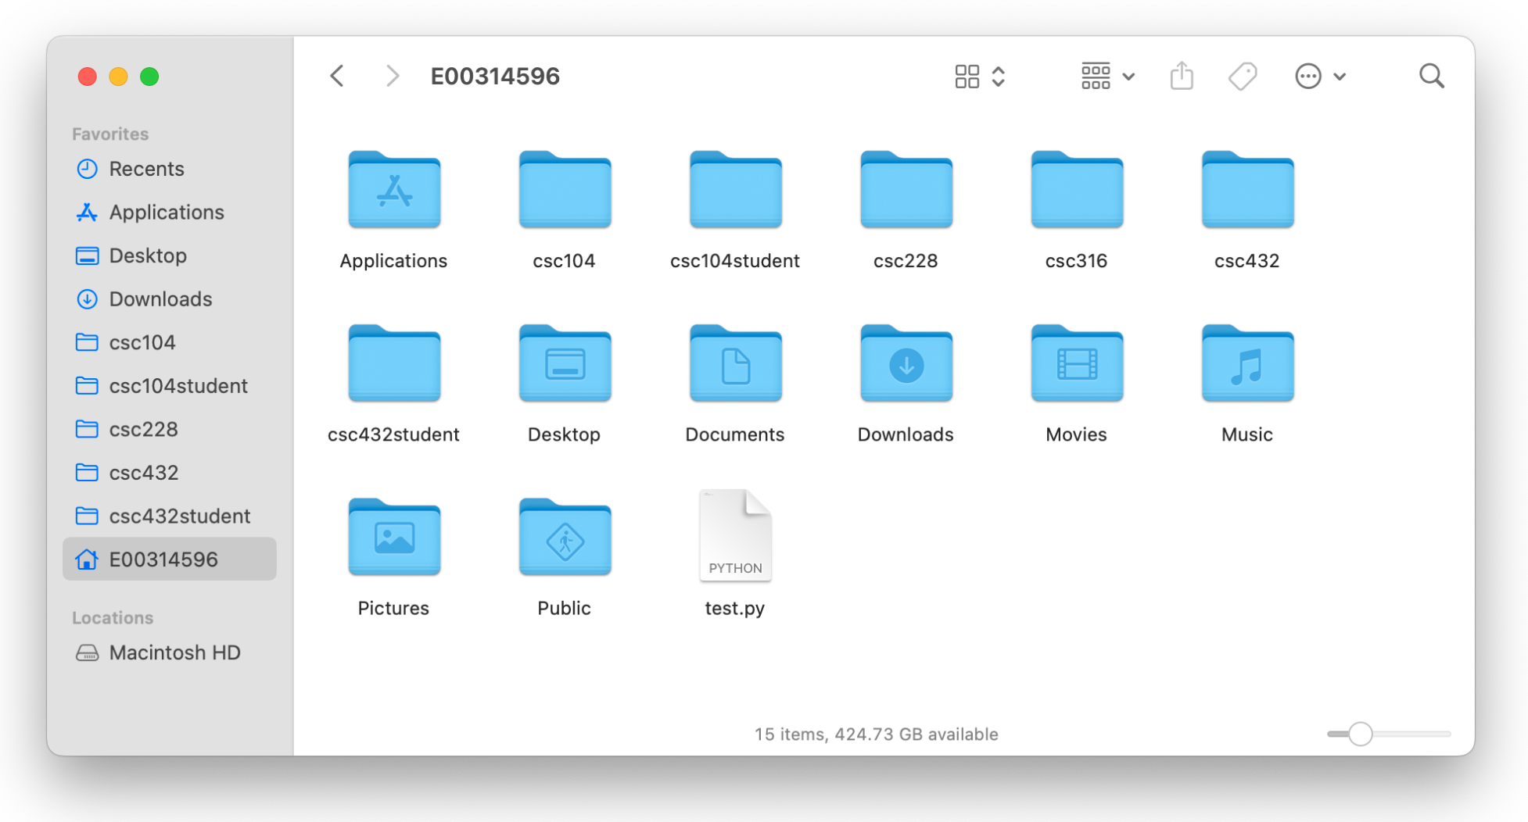
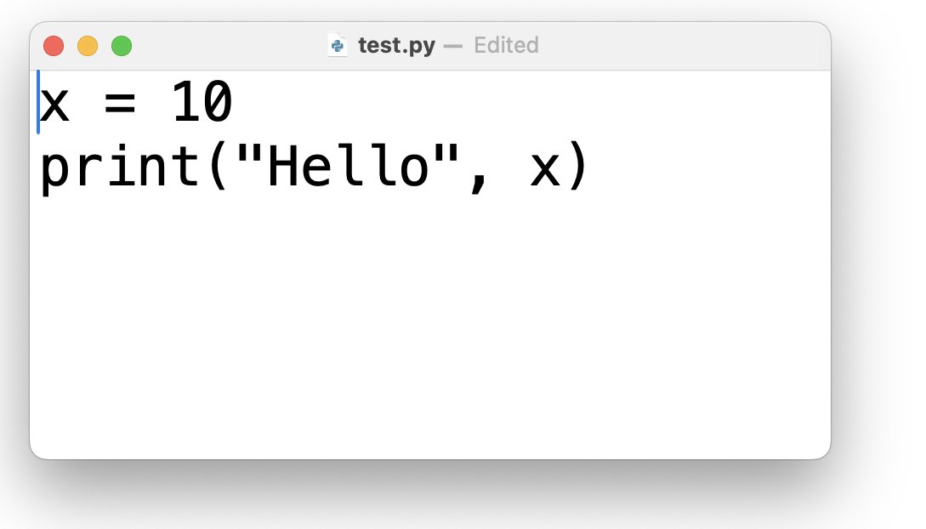
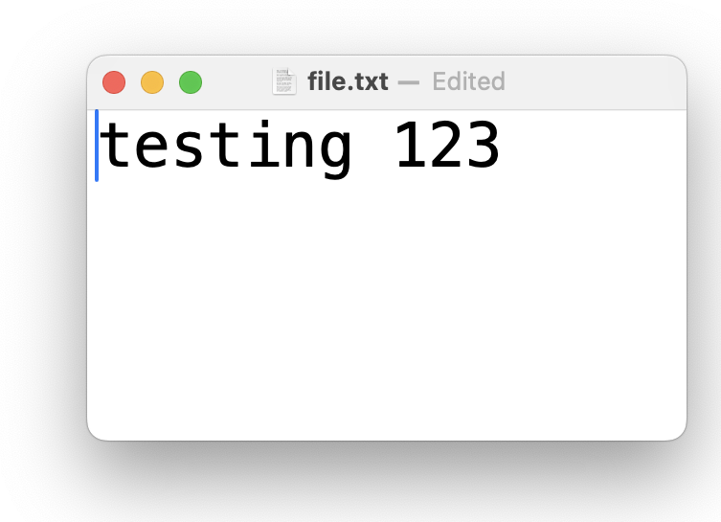

Slide 22
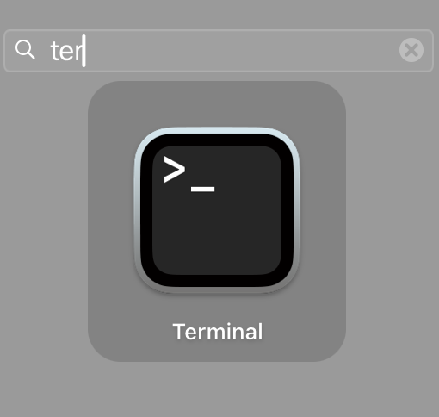
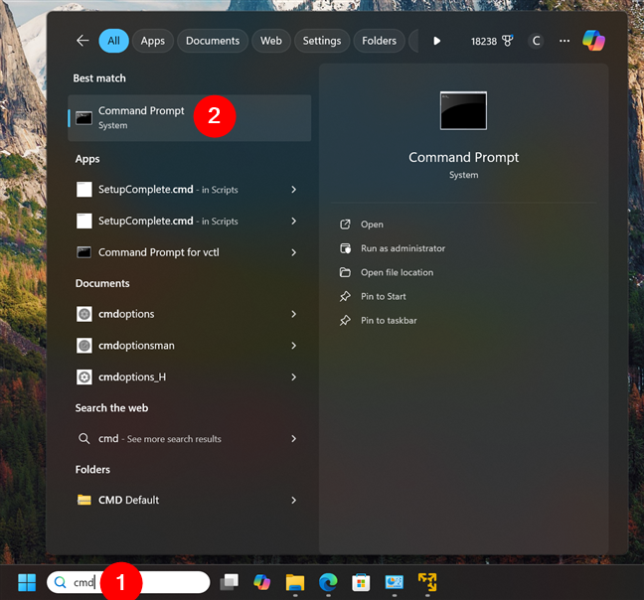
Open a command terminal window and explore

Slide 23
Semicolons separate commands on the same line

Slide 24
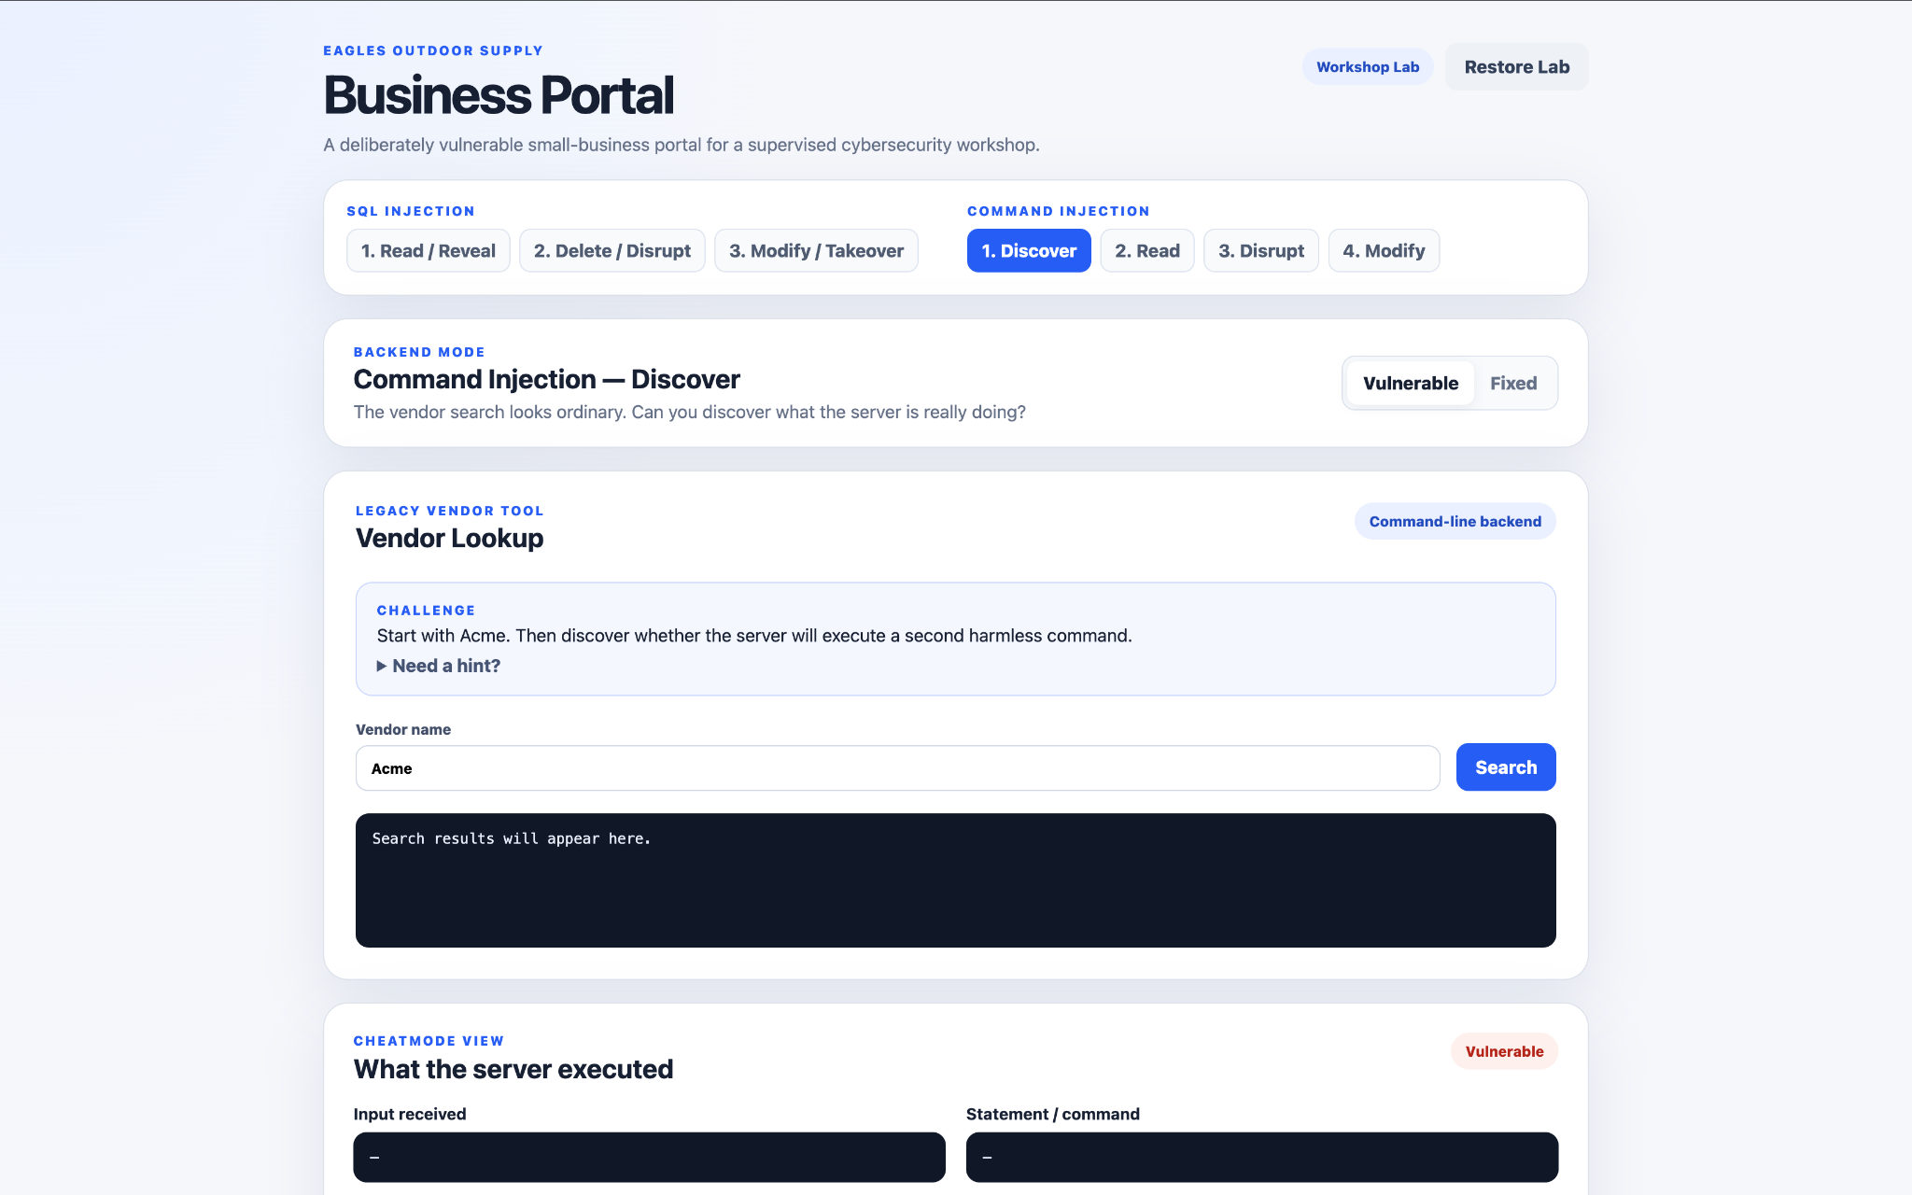
cat /app/data/vendors.txt | grep -i Acme;
whoami; pwd

Slide 25
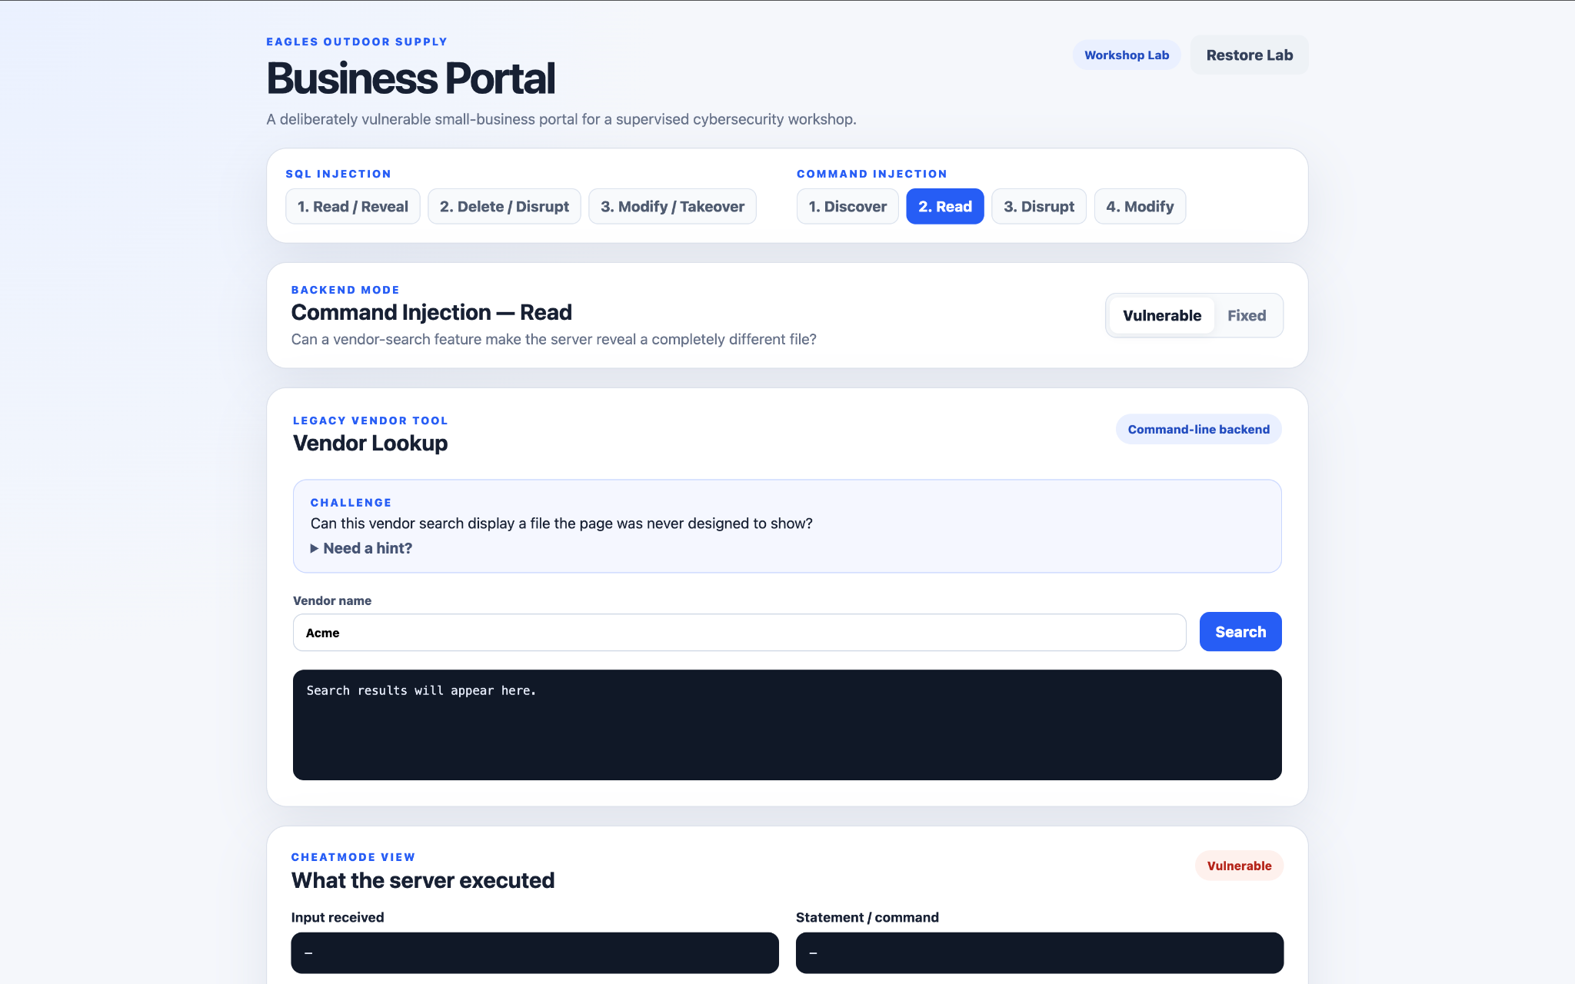
cat /app/data/vendors.txt | grep -i Acme;
cat /app/data/internal_notes.txt

Slide 26
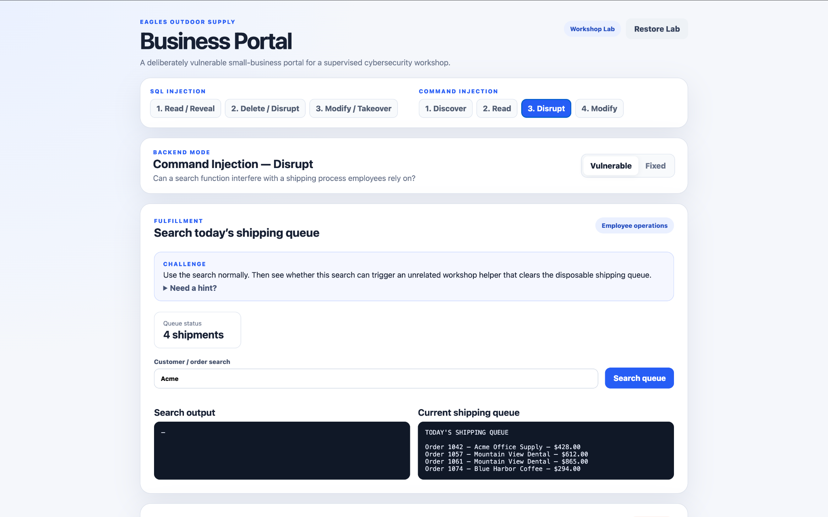
cat /app/data/shipping_queue.txt | grep -i "Acme"; /app/workshop/clear_shipping_queue.sh #"

Slide 27
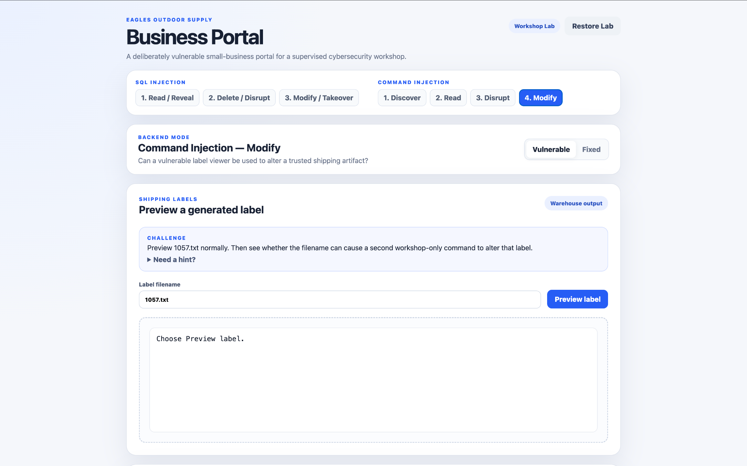
cat "/app/data/labels/1057.txt"; /app/workshop/redirect_label.sh 1057 #.txt"
(redirect occurs before viewing file)

Slide 28
Lesson #3:
Your customers shouldn't be able to run your server just because they know how to type.
Keep untrusted input separate from the instructions being executed.

Slide 29


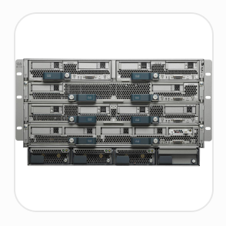
Company | Vulnerability | Reference
Cisco (April '26) | Command injection could give attackers full control of server infrastructure | CVE-2026-20094
Sangoma (Sep '26) | SQL injection could compromise business telephone systems; exploitation attempts observed | CVE-2026-9586
Cisco (Sep '26) | SQL injection could compromise email security systems; active exploitation confirmed | CVE-2026-76461

Slide 30


Defensive
Investigative
Restorative
Strategic

Slide 31
New Concordia Major
Cybersecurity starting Fall '27
Joshua Tallman
Concordia University Irvine
joshua.tallman@cui.edu

