Slide 1
Really "Simple" LLMs
Recurrent Neural Networks
and
Long Short-Term Memory Networks
in eight slides (really it’s five slides)

Slide 2
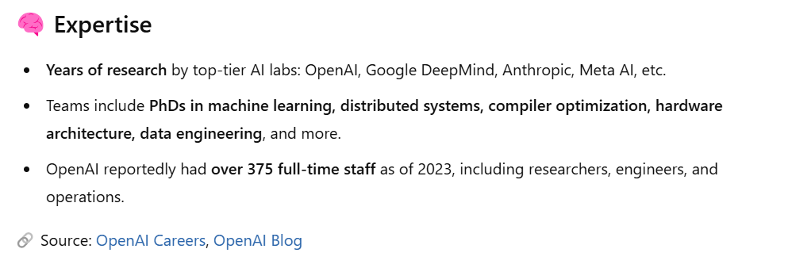
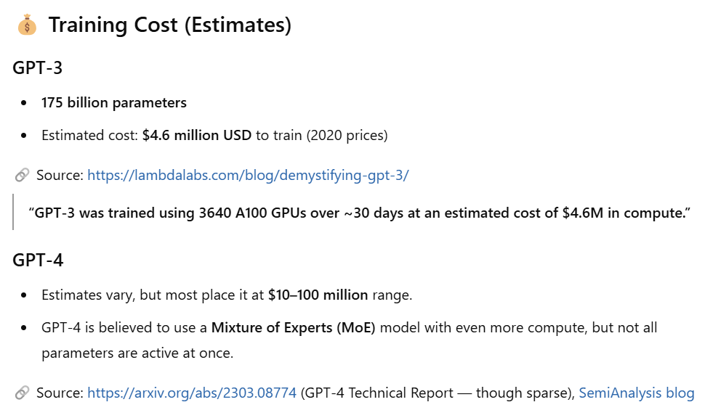
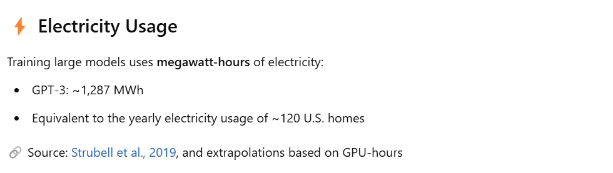
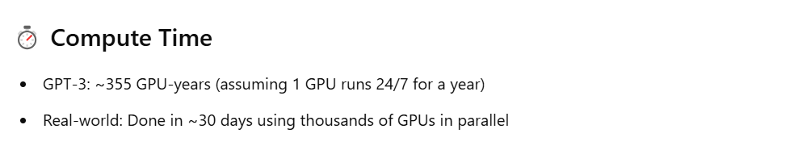
The Us vs. Them Trap
It’s something like the our engineer spending two weeks building a rocket and then watching NASA or SpaceX and wondering why ours can’t fly to mars.

Slide 3
Acknowledgements
I learned about LSTMs and RNNs from these blog articles and my goal is mostly to retell some important parts of their work in 30 minutes
Andrej Karpathy’s Blog (AI researcher at Tesla and OpenAI) https://karpathy.github.io/2015/05/21/rnn-effectiveness/
Colah’s Blog (a researcher at Google) https://colah.github.io/posts/2015-08-Understanding-LSTMs/
I asked ChatGPT for clarification on some technical details and then somewhat checked its answers against other respected blog articles

Slide 4
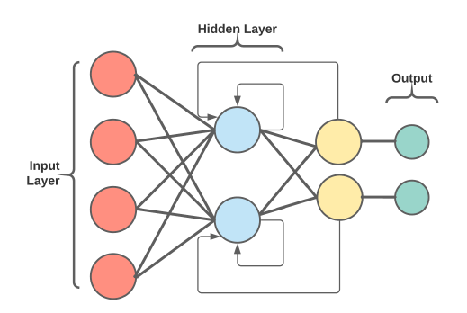
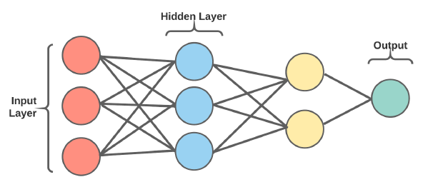
Typical RNN Architecture
Traditional MLP Architecture
Stacked "Deep" RNN Architecture
https://www.researchgate.net/publication/361681838_Sentiment_Analysis_of_Public_Social_Media_as_a_Tool_for_Health_-Related_Topics

Slide 5
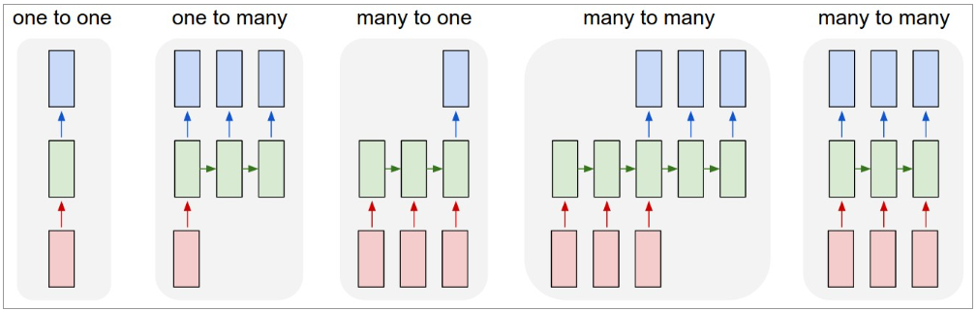
Recurrent Network Types
Red: Input Vector(s)
Green: RNN State
Blue: Output Vector(s)
RNN diagrams unfold left to right to represent the passage of time, showing how the network processes one input at each time step.
Image Classification
(not RNN)
Image Captioning
Sentiment Analysis
Language Translation
Video Classification
https://karpathy.github.io/2015/05/21/rnn-effectiveness/

Slide 6
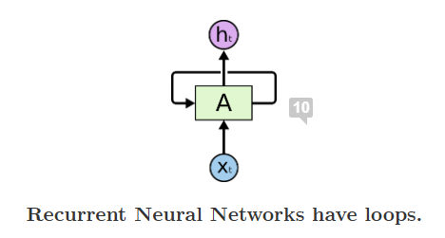
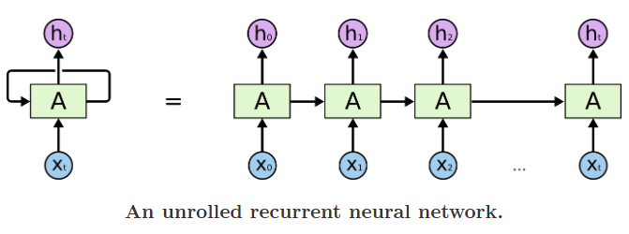
But node A also includes (1) forget, (2) input, and (3) output gates
https://colah.github.io/posts/2015-08-Understanding-LSTMs/

Slide 7
Predicting “The cat in the hat.”
Step | Input Words (3) | Predicted Word | Possible Internal Memory State
1 | "The" | "cat" | Starting noun, expect subject
2 | "The cat" | "in" | Cat is common subject (animal)
3 | "The cat in" | "the" | Anticipates location next
4 | "cat in the" | "hat" | Strong memory of common phrase
5 | "in the hat" | "." | Sentence is likely complete
6 | "the hat." | "<END>" | End of sentence – reset state

Slide 8
Long Short-Term Memory Recurrent Neural Network
Cell State is the primary memory mechanism. It stores an emergent, learned summary of the text sequence thus far. It might include grammar, semantics, context, etc. For example:
______________
______________
______________
______________
____ is a gate with the sigmoid activation function [0, 1]. It blocks (0), passes (1), or partially passes (in-between).
_______ has a sigmoid-like form, but with output values [-1, 1]. Negatives values are suppressed, positive values enhanced, and zeros are neutral.
h_{t}
NN Node
Cell State
C_{t-1}
C_{t}
h_{t-1} and x_{t} are concatenated together
h_{t-1}
h_{t}
x_{t}
3. The _____________ gate determines which parts of the cell state to pass on to the output. Part o_{t} weakens or strengthens the values as a filter. The tanh(C_{t} ) term is the actual values set to an appropriate range [-1, 1].
1. The ______________ gate allows each individual element of the cell state to be forgotten (0), remembered (1), or some-where between.
2. The _____________ gate chooses new values to add to the cell state. Part i_{t} decides the elements to update and Ĉ_{t} is a vector of candidates.

