Slide 1

Project 1: Image Compression by Clustering
Compress images by converting each pixel from a 24-bit RGB value to an index from a color palette.
Color palette is chosen by an unsupervised learning model created for each individual picture.
Gives a comic book effect if the palette chooses bright colors (not part of project)

Slide 2
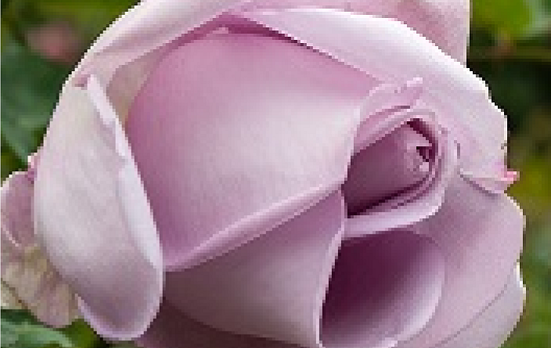

Slide 3
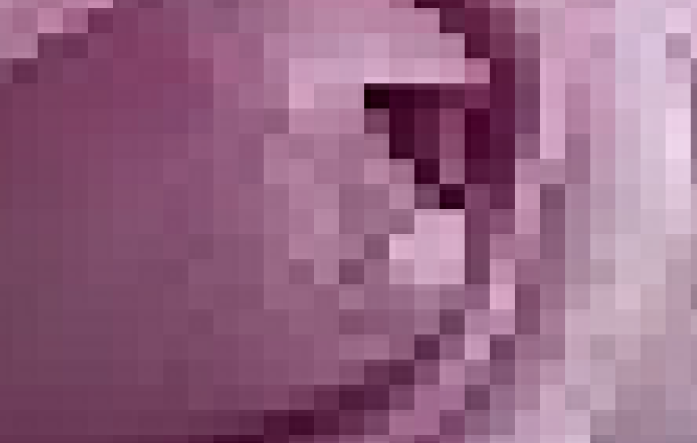



108, 62, 88
112, 65, 91
120, 71, 97

Slide 4



73, 8, 40
33, 0, 13
38, 0, 22

Slide 5




211, 190, 198
198, 185, 194
211, 200, 208

Slide 6



79, 106, 75
82, 106, 80
80, 105, 75

Slide 7
108, 62, 88
112, 65, 91
120, 71, 97
211, 190, 198
198, 185, 194
211, 200, 208
79, 106, 75
82, 106, 80
80, 105, 75
73, 8, 40
33, 0, 13
38, 0, 22

Slide 8
Replace every pixel with the index of a color from the palette.
RGB value is stored as three 8-bit unsigned integers (3 bytes per pixel)
0-255, 0-255, 0-255
For four colors, palette index is 2-bit
unsigned integer (4 pixels per byte)
454 x 324 image is 147,096 pixels
147,096 x 3 = 441 kB
147,096 / 4 = 37 kB
108, 62, 88
211, 190, 198
79, 106, 75
73, 8, 40

Slide 9
Image Compression
Q: How do I find the colors in the palette? A: Clustering Algorithm (easier)
Q: What image format do I use to ? A: Create our Own (harder)

Slide 10
File Formats
Most image formats contain file signature, header information with the dimensions and other such metadata, and the pixels.
Signature: 'KMC:’
Dimensions: width (uint16), height (uint16)
Palette: sixteen RGB values (48 bytes total)
Pixels: palette index for each color (one nibble per pixel)
Read/write to files in byte-sized chunks, so you must read two pixels at a time (one byte) and then use bit masking operations to extract each pixel number (e.g., | & << >>)… pretty simple with Vectorized Operations

