Slide 1
Digit Recognition w/ KNN

Slide 2
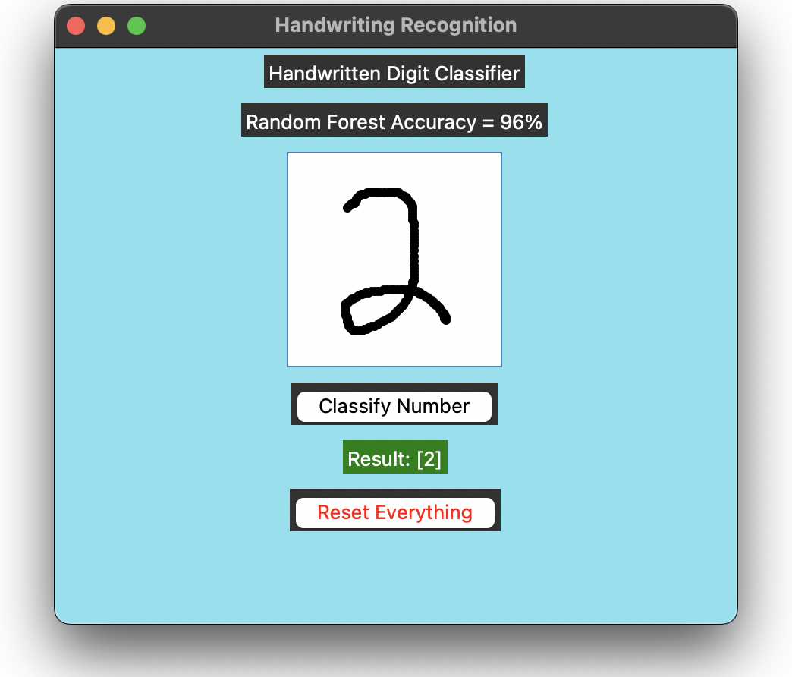

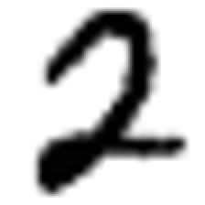

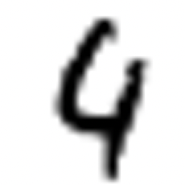



Slide 3
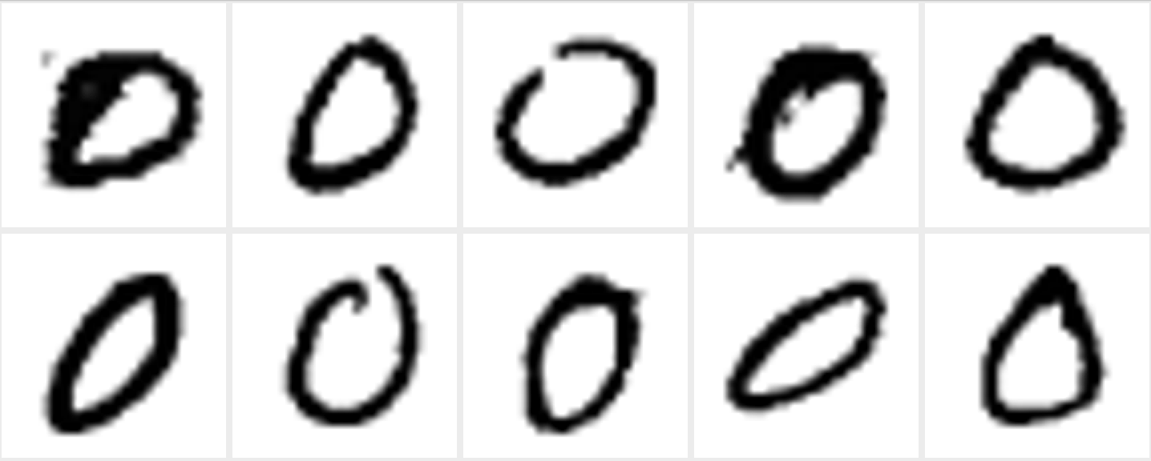
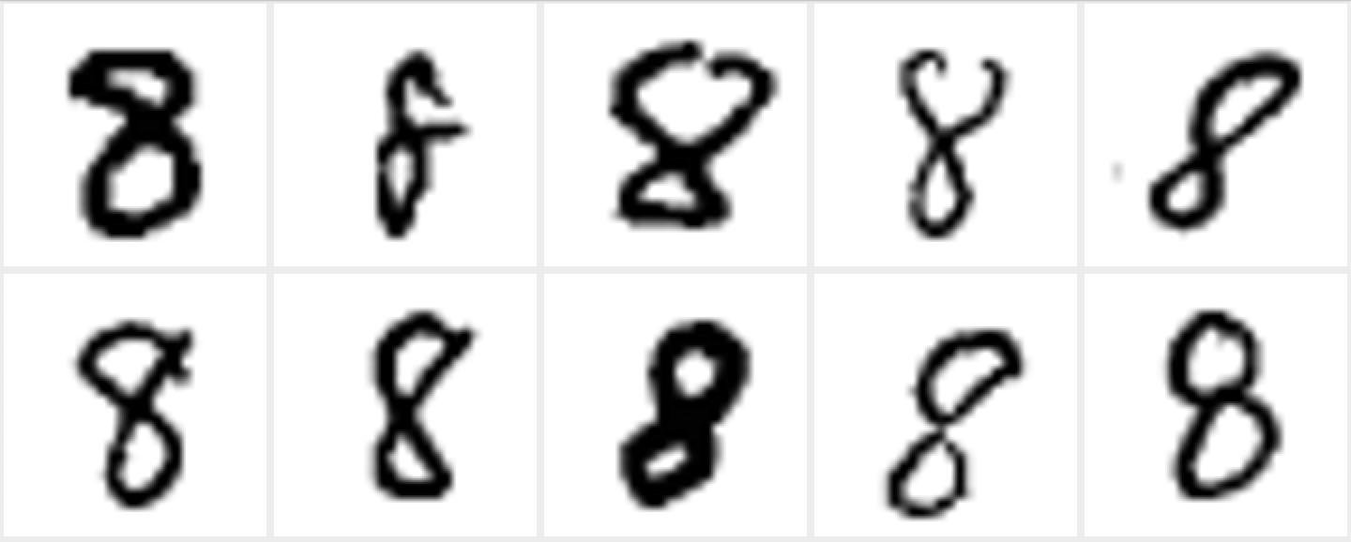
MNIST Dataset
Dataset of 70,000 labeled digits compiled by ANN researchers who combined and normalized two NIST datasets
US Census Bureau & High School Students
Every digit is centered
Normalized grayscale
Resized 28x28 for 728 features
0
8
Notes:
Modified National Institute of Standards and Technology
Yann LeCun, Corinna Cortes, and Christopher Burges

Slide 4
MNIST Dataset
from sklearn.datasets import fetch_openml
import numpy as np
# Download from internet
mnist = fetch_openml('mnist_784', version=1, as_frame=False)
X = mnist.data.astype(np.uint8)
y = mnist.target.astype(np.uint8)
# Cache locally to save time? Something like this...
np.savetxt('mnist.csv', np.column_stack((y, X)), delimiter=',', fmt='%d')

Slide 5
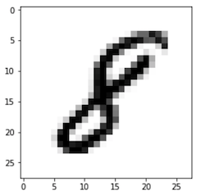
Training Data Zoomed In
X: 28x28 image in grayscale
White pixels are 0 (0.0)
Black pixels are 255 (1.0)
Gray pixels are in middle
Y: the number 8

Slide 6
0 0 0 0 0 0 0 0 0 0 0 0 0 0
0 0 0 0 0 0 0 0 0 0 0 0 0 0
0 0 0 0 0 0 0 0 0 0 0 0 0 0
0 0 0 0 0 0 0 0 0 0 0 0 0 0
0 0 0 0 0 0 0 0 0 0 0 0 0 0
0 0 0 0 0 0 0 0 0 0 0 0 0 0
0 0 0 0 0 0 0 0 0 0 31 0 0 0
0 0 0 0 0 0 0 0 0 0 255 0 0 0
0 0 0 0 0 0 0 0 0 10 255 0 0 0
0 0 0 0 0 0 0 0 0 112 163 0 0 0
0 0 0 0 0 0 0 0 0 214 51 0 0 0
0 0 0 0 0 0 0 0 92 204 0 0 0 0
0 0 0 0 0 0 0 0 235 41 0 0 0 0
0 0 0 0 0 0 0 41 224 0 0 0 0 0
0 0 0 0 0 0 0 163 112 0 0 0 0 0
0 0 0 0 0 0 20 235 31 0 0 0 0 0
0 0 0 0 0 0 133 153 0 0 0 0 0 0
0 0 0 0 0 20 235 51 0 0 0 0 0 0
0 0 0 0 0 82 184 0 0 0 0 0 0 0
0 0 0 0 0 214 82 0 0 0 0 0 0 0
0 0 0 0 61 224 0 0 0 0 0 0 0 0
0 0 0 0 92 143 0 0 0 0 0 0 0 0
0 0 0 0 0 0 0 0 0 0 0 0 0 0
0 0 0 0 0 0 0 0 0 0 0 0 0 0
0 0 0 0 0 0 0 0 0 0 0 0 0 0
0 0 0 0 0 0 0 0 0 0 0 0 0 0
0 0 0 0 0 0 0 0 0 0 0 0 0 0
0 0 0 0 0 0 0 0 0 0 0 0 0 0
Training Data As Numbers
X: 28x28 image in grayscale
Image is labeled training data
Blue color is for highlighting only
Some zeroes have been omitted
There are many other 28x28 images, covering all of the digits
Y: the number 1

Slide 7
0 0 0 0 0 0 0 0 0 0 0 0 0 0
0 0 0 0 0 0 0 0 0 0 0 0 0 0
0 0 0 0 0 0 0 0 0 0 0 0 0 0
0 0 0 0 0 0 0 0 0 0 0 0 0 0
0 0 0 0 0 0 0 0 0 214 112 0 0 0
0 0 0 0 0 0 0 0 82 253 151 0 0 0
0 0 0 0 0 0 0 0 102 254 91 0 0 0
0 0 0 0 0 0 0 0 183 213 10 0 0 0
0 0 0 0 0 0 0 51 233 183 0 0 0 0
0 0 0 0 0 0 0 152 252 102 0 0 0 0
0 0 0 0 0 0 0 173 192 0 0 0 0 0
0 0 0 0 0 0 41 253 151 0 0 0 0 0
0 0 0 0 0 0 203 254 151 0 0 0 0 0
0 0 0 0 0 0 203 253 151 0 0 0 0 0
0 0 0 0 0 51 253 244 40 0 0 0 0 0
0 0 0 0 0 173 252 162 0 0 0 0 0 0
0 0 0 0 0 254 253 102 0 0 0 0 0 0
0 0 0 0 82 253 252 102 0 0 0 0 0 0
0 0 0 11 173 254 253 41 0 0 0 0 0 0
0 0 0 51 252 253 130 0 0 0 0 0 0 0
0 0 0 113 253 255 50 0 0 0 0 0 0 0
0 0 0 193 252 253 50 0 0 0 0 0 0 0
0 0 0 193 253 142 0 0 0 0 0 0 0 0
0 0 0 71 212 20 0 0 0 0 0 0 0 0
0 0 0 0 0 0 0 0 0 0 0 0 0 0
0 0 0 0 0 0 0 0 0 0 0 0 0 0
0 0 0 0 0 0 0 0 0 0 0 0 0 0
0 0 0 0 0 0 0 0 0 0 0 0 0 0
Input to Model As Numbers
X: 28x28 image in grayscale
Image was drawn in the window
Red color is for highlighting only
Some zeroes have been omitted
Y: Unknown

Slide 8
0 0 0 0 0 0 0 0 0 0 0 0 0 0
0 0 0 0 0 0 0 0 0 0 0 0 0 0
0 0 0 0 0 0 0 0 0 0 0 0 0 0
0 0 0 0 0 0 0 0 0 0 0 0 0 0
0 0 0 0 0 0 0 0 0 214 112 0 0 0
0 0 0 0 0 0 0 0 82 253 151 0 0 0
0 0 0 0 0 0 0 0 102 254 91 0 0 0
0 0 0 0 0 0 0 0 183 213 10 0 0 0
0 0 0 0 0 0 0 51 233 183 0 0 0 0
0 0 0 0 0 0 0 152 252 102 0 0 0 0
0 0 0 0 0 0 0 173 192 0 0 0 0 0
0 0 0 0 0 0 41 253 151 0 0 0 0 0
0 0 0 0 0 0 203 254 151 0 0 0 0 0
0 0 0 0 0 0 203 253 151 0 0 0 0 0
0 0 0 0 0 51 253 244 40 0 0 0 0 0
0 0 0 0 0 173 252 162 0 0 0 0 0 0
0 0 0 0 0 254 253 102 0 0 0 0 0 0
0 0 0 0 82 253 252 102 0 0 0 0 0 0
0 0 0 11 173 254 253 41 0 0 0 0 0 0
0 0 0 51 252 253 130 0 0 0 0 0 0 0
0 0 0 113 253 255 50 0 0 0 0 0 0 0
0 0 0 193 252 253 50 0 0 0 0 0 0 0
0 0 0 193 253 142 0 0 0 0 0 0 0 0
0 0 0 71 212 20 0 0 0 0 0 0 0 0
0 0 0 0 0 0 0 0 0 0 0 0 0 0
0 0 0 0 0 0 0 0 0 0 0 0 0 0
0 0 0 0 0 0 0 0 0 0 0 0 0 0
0 0 0 0 0 0 0 0 0 0 0 0 0 0
0 0 0 0 0 0 0 0 0 0 0 0 0 0
0 0 0 0 0 0 0 0 0 0 0 0 0 0
0 0 0 0 0 0 0 0 0 0 0 0 0 0
0 0 0 0 0 0 0 0 0 0 0 0 0 0
0 0 0 0 0 0 0 0 0 0 0 0 0 0
0 0 0 0 0 0 0 0 0 0 0 0 0 0
0 0 0 0 0 0 0 0 0 0 31 0 0 0
0 0 0 0 0 0 0 0 0 0 255 0 0 0
0 0 0 0 0 0 0 0 0 10 255 0 0 0
0 0 0 0 0 0 0 0 0 112 163 0 0 0
0 0 0 0 0 0 0 0 0 214 51 0 0 0
0 0 0 0 0 0 0 0 92 204 0 0 0 0
0 0 0 0 0 0 0 0 235 41 0 0 0 0
0 0 0 0 0 0 0 41 224 0 0 0 0 0
0 0 0 0 0 0 0 163 112 0 0 0 0 0
0 0 0 0 0 0 20 235 31 0 0 0 0 0
0 0 0 0 0 0 133 153 0 0 0 0 0 0
0 0 0 0 0 20 235 51 0 0 0 0 0 0
0 0 0 0 0 82 184 0 0 0 0 0 0 0
0 0 0 0 0 214 82 0 0 0 0 0 0 0
0 0 0 0 61 224 0 0 0 0 0 0 0 0
0 0 0 0 92 143 0 0 0 0 0 0 0 0
0 0 0 0 0 0 0 0 0 0 0 0 0 0
0 0 0 0 0 0 0 0 0 0 0 0 0 0
0 0 0 0 0 0 0 0 0 0 0 0 0 0
0 0 0 0 0 0 0 0 0 0 0 0 0 0
0 0 0 0 0 0 0 0 0 0 0 0 0 0
0 0 0 0 0 0 0 0 0 0 0 0 0 0

Slide 9
0 0 0 0 0 0 0 0 0 0 0 0 0 0
0 0 0 0 0 0 0 0 0 0 0 0 0 0
0 0 0 0 0 0 0 0 0 0 0 0 0 0
0 0 0 0 0 0 0 0 0 0 0 0 0 0
0 0 0 0 0 0 0 0 0 0 0 0
0 0 0 0 0 0 0 0 0 0 0
0 0 0 0 0 0 0 0 60 0 0 0
0 0 0 0 0 0 0 0 245 0 0 0
0 0 0 0 0 0 0 173 255 0 0 0
0 0 0 0 0 0 0 10 163 0 0 0
0 0 0 0 0 0 0 214 51 0 0 0
0 0 0 0 0 0 92 204 0 0 0 0
0 0 0 0 0 0 235 41 0 0 0 0
0 0 0 0 0 0 212 224 0 0 0 0 0
0 0 0 0 0 81 112 0 0 0 0 0
0 0 0 0 0 232 73 31 0 0 0 0 0
0 0 0 0 0 120 51 0 0 0 0 0 0
0 0 0 0 233 17 51 0 0 0 0 0 0
0 0 0 172 69 0 0 0 0 0 0
0 0 0 39 48 0 0 0 0 0 0 0
0 0 0 192 31 0 0 0 0 0 0 0
0 0 0 160 110 0 0 0 0 0 0 0
0 0 0 0 0 0 0 0 0 0 0
0 0 0 0 0 0 0 0 0 0 0
0 0 0 0 0 0 0 0 0 0 0 0 0 0
0 0 0 0 0 0 0 0 0 0 0 0 0 0
0 0 0 0 0 0 0 0 0 0 0 0 0 0
0 0 0 0 0 0 0 0 0 0 0 0 0 0
0 0 0 0 0 0 0 0 0 0 0 0 0 0
0 0 0 0 0 0 0 0 0 0 0 0 0 0
0 0 0 0 0 0 0 0 0 0 0 0 0 0
0 0 0 0 0 0 0 0 0 0 0 0 0 0
0 0 0 0 0 0 0 0 0 214 112 0 0 0
0 0 0 0 0 0 0 0 82 253 151 0 0 0
0 0 0 0 0 0 0 0 102 254 0 0 0
0 0 0 0 0 0 0 0 183 213 0 0 0
0 0 0 0 0 0 0 51 233 0 0 0
0 0 0 0 0 0 0 152 252 0 0 0
0 0 0 0 0 0 0 173 192 0 0 0
0 0 0 0 0 0 41 253 0 0 0 0
0 0 0 0 0 0 203 254 0 0 0 0
0 0 0 0 0 0 203 0 0 0 0 0
0 0 0 0 0 51 253 0 0 0 0 0
0 0 0 0 0 173 0 0 0 0 0
0 0 0 0 0 254 0 0 0 0 0 0
0 0 0 0 82 0 0 0 0 0 0
0 0 0 11 173 41 0 0 0 0 0 0
0 0 0 51 252 0 0 0 0 0 0 0
0 0 0 113 50 0 0 0 0 0 0 0
0 0 0 193 50 0 0 0 0 0 0 0
0 0 0 193 253 142 0 0 0 0 0 0 0 0
0 0 0 71 212 20 0 0 0 0 0 0 0 0
0 0 0 0 0 0 0 0 0 0 0 0 0 0
0 0 0 0 0 0 0 0 0 0 0 0 0 0
0 0 0 0 0 0 0 0 0 0 0 0 0 0
0 0 0 0 0 0 0 0 0 0 0 0 0 0
Compare the input to each sample in the training data… which samples match best?
Background pixels common to both
Digit pixels from training sample only
Digit pixels from new input only
Overlapped digit pixels
Sum all of the numbers and lowest score wins

Slide 10
0 0 0 0 0 0 0 0 0 0 0 0 0 0 0 0 0 0 0 0 0 0 0 0 0 0 0 0
0 0 0 0 0 0 0 0 0 0 0 0 0 0 0 0 0 0 0 0 0 0 0 0 0 0 0 0
0 0 0 0 0 0 0 0 0 0 0 0 0 0 0 0 0 0 0 0 0 0 0 0 0 0 0 0
0 0 0 0 0 0 0 0 0 0 0 0 0 0 0 0 0 0 0 0 0 0 0 0 0 0 0 0
0 0 0 0 0 0 0 0 0 0 0 0 0 0 0 0 0 0 0 0 0 0 0 0 0 0 0 0
0 0 0 0 0 0 0 0 0 0 0 0 0 0 0 0 0 0 0 0 0 0 0 0 0 0 0 0
0 0 0 0 0 0 0 0 0 0 0 0 0 0 0 0 0 0 0 0 0 0 0 0 0 0 0 0
0 0 0 0 0 0 0 0 0 0 0 0 0 0 0 0 0 0 0 0 0 0 0 0 0 0 0 0
0 0 0 0 0 0 0 0 0 0 0 0 0 24 93 73 0 0 0 0 0 18 58 142 206 53 0 0
0 0 0 0 0 0 0 0 0 0 0 0 0 123 253 184 64 64 79 142 192 234 253 253 253 209 0 0
0 0 0 0 0 0 0 0 0 0 0 0 105 250 253 253 254 253 253 253 253 254 253 253 208 75 0 0
0 0 0 0 0 0 0 0 0 0 0 71 254 254 254 254 255 249 246 193 158 129 80 30 10 0 0 0
0 0 0 0 0 0 0 0 0 0 0 214 253 253 180 93 63 44 32 0 0 0 0 0 0 0 0 0
0 0 0 0 0 0 0 0 0 12 147 254 253 253 86 0 0 0 0 0 0 0 0 0 0 0 0 0
0 0 0 0 0 0 0 0 0 153 253 254 253 253 245 128 0 0 0 0 0 0 0 0 0 0 0 0
0 0 0 0 0 0 0 0 45 251 253 254 243 213 253 198 0 0 0 0 0 0 0 0 0 0 0 0
0 0 0 0 0 0 0 0 15 100 158 50 0 55 242 254 55 0 0 0 0 0 0 0 0 0 0 0
0 0 0 0 0 0 0 0 0 0 0 0 0 36 245 253 80 0 0 0 0 0 0 0 0 0 0 0
0 0 0 0 0 0 0 0 0 0 0 0 21 161 253 238 40 0 0 0 0 0 0 0 0 0 0 0
0 0 0 0 0 0 0 0 0 0 0 4 146 253 253 129 0 0 0 0 0 0 0 0 0 0 0 0
0 0 0 0 0 0 0 60 15 0 0 41 253 253 213 11 0 0 0 0 0 0 0 0 0 0 0 0
0 0 0 0 0 0 200 254 254 254 179 230 254 211 45 0 0 0 0 0 0 0 0 0 0 0 0 0
0 0 0 0 0 0 152 221 227 253 253 254 239 66 0 0 0 0 0 0 0 0 0 0 0 0 0 0
0 0 0 0 0 0 0 0 9 92 127 127 86 0 0 0 0 0 0 0 0 0 0 0 0 0 0 0
0 0 0 0 0 0 0 0 0 0 0 0 0 0 0 0 0 0 0 0 0 0 0 0 0 0 0 0
0 0 0 0 0 0 0 0 0 0 0 0 0 0 0 0 0 0 0 0 0 0 0 0 0 0 0 0
0 0 0 0 0 0 0 0 0 0 0 0 0 0 0 0 0 0 0 0 0 0 0 0 0 0 0 0
0 0 0 0 0 0 0 0 0 0 0 0 0 0 0 0 0 0 0 0 0 0 0 0 0 0 0 0

Slide 11
0 0 0 0 0 0 0 0 0 0 0 0 0 0 0 0 0 0 0 0 0 0 0 0 0 0 0 0
0 0 0 0 0 0 0 0 0 0 0 0 0 0 0 0 0 0 0 0 0 0 0 0 0 0 0 0
0 0 0 0 0 0 0 0 0 0 0 0 0 0 0 0 0 0 0 0 0 0 0 0 0 0 0 0
0 0 0 0 0 0 0 0 0 0 0 0 0 0 0 0 0 0 0 0 0 0 0 0 0 0 0 0
0 0 0 0 0 0 0 0 0 0 0 0 0 0 0 0 0 0 0 0 0 0 0 0 0 0
0 0 0 0 0 0 0 0 0 0 0 0 0 0 0 0 0 0 0 0 0 0 0 0 0
0 0 0 0 0 0 0 0 0 0 0 0 0 0 0 0 0 0 0 0 0 0 0 0 0
0 0 0 0 0 0 0 0 0 0 0 0 0 0 0 0 0 0 0 0 0 0 0 0 0 0
0 0 0 0 0 0 0 0 0 0 0 0 0 24 0 0 0 0 18 58 142 206 53 0 0
0 0 0 0 0 0 0 0 0 0 0 0 0 123 64 79 142 192 234 253 253 253 209 0 0
0 0 0 0 0 0 0 0 0 0 0 0 105 250 254 253 253 253 253 254 253 253 208 75 0 0
0 0 0 0 0 0 0 0 0 0 0 71 254 255 249 246 193 158 129 80 30 10 0 0 0
0 0 0 0 0 0 0 0 0 0 0 214 253 63 44 32 0 0 0 0 0 0 0 0 0
0 0 0 0 0 0 0 0 0 12 147 254 253 0 0 0 0 0 0 0 0 0 0 0 0
0 0 0 0 0 0 0 0 0 153 253 254 0 0 0 0 0 0 0 0 0 0 0 0
0 0 0 0 0 0 0 0 45 251 253 254 198 0 0 0 0 0 0 0 0 0 0 0 0
0 0 0 0 0 0 0 0 15 100 158 50 254 55 0 0 0 0 0 0 0 0 0 0 0
0 0 0 0 0 0 0 0 0 0 0 253 80 0 0 0 0 0 0 0 0 0 0 0
0 0 0 0 0 0 0 0 0 0 238 40 0 0 0 0 0 0 0 0 0 0 0
0 0 0 0 0 0 0 0 0 0 253 129 0 0 0 0 0 0 0 0 0 0 0 0
0 0 0 0 0 0 0 60 15 0 213 11 0 0 0 0 0 0 0 0 0 0 0 0
0 0 0 0 0 0 200 254 254 254 45 0 0 0 0 0 0 0 0 0 0 0 0 0
0 0 0 0 0 0 152 221 227 253 66 0 0 0 0 0 0 0 0 0 0 0 0 0 0
0 0 0 0 0 0 0 0 9 92 0 0 0 0 0 0 0 0 0 0 0 0 0 0 0
0 0 0 0 0 0 0 0 0 0 0 0 0 0 0 0 0 0 0 0 0 0 0 0 0 0 0 0
0 0 0 0 0 0 0 0 0 0 0 0 0 0 0 0 0 0 0 0 0 0 0 0 0 0 0 0
0 0 0 0 0 0 0 0 0 0 0 0 0 0 0 0 0 0 0 0 0 0 0 0 0 0 0 0
0 0 0 0 0 0 0 0 0 0 0 0 0 0 0 0 0 0 0 0 0 0 0 0 0 0 0 0
0 0 0 0 0 0 0 0 0 0 0 0 0 0
0 0 0 0 0 0 0 0 0 0 0 0 0 0
0 0 0 0 0 0 0 0 0 0 0 0 0 0
0 0 0 0 0 0 0 0 0 0 0 0 0 0
0 0 0 0 0 0 0 0 0 214 112 0 0 0
0 0 0 0 0 0 0 0 82 253 151 0 0 0
0 0 0 0 0 0 0 0 102 254 91 0 0 0
0 0 0 0 0 0 0 0 183 213 10 0 0 0
0 0 0 0 0 0 42 160 183 0 0 0 0
0 0 0 0 0 0 101 68 38
0 0 0 0 0 80 61
0 0 0 0 13 1 103
0 0 0 0 50 74 58 0 0
0 0 50 167 151 0 0 0 0 0
0 0 202 0 1 88 0 0 0 0 0
0 70 41 91 0 0 0 0 0
0 254 198 140 0 0 0 0
0 0 0 82 253 116 143 0 0 0 0
0 0 0 11 173 233 92 8 0 0 0 0
0 0 0 51 248 107 234 0 0 0 0 0
0 113 212 2 203 1 0 0 0 0 0
14 22 1 161 0 0 0 0 0 0
60 1 97 0 0 0 0 0 0 0
0 56 85 66 0 0 0 0 0 0 0 0
0 0 0 0 0 0 0 0 0 0 0 0 0 0
0 0 0 0 0 0 0 0 0 0 0 0 0 0
0 0 0 0 0 0 0 0 0 0 0 0 0 0
0 0 0 0 0 0 0 0 0 0 0 0 0 0

