Slide 1
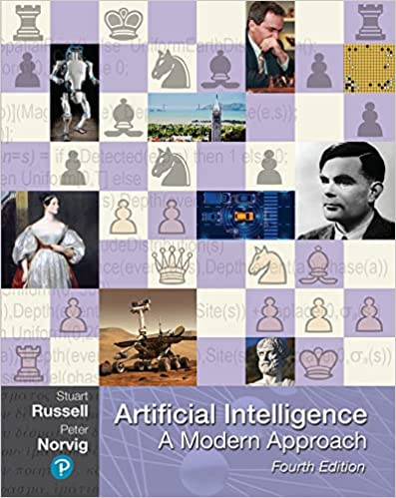














The exciting new effort to make computers think … machines with minds, in the full and literal sense.
Haugeland 1985
The study of the computations that make it possible to perceive, reason, and act.
Winston 1992
Machines that perform functions that require intelligence when performed by people.
Kurzweil 1990
Computational Intelligence is the study of the design of intelligent agents.
Poole, et al. 1998

Slide 2




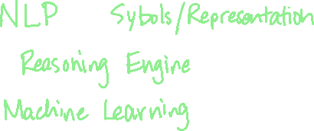

Acting Like Humans – The Turing Test

Slide 3
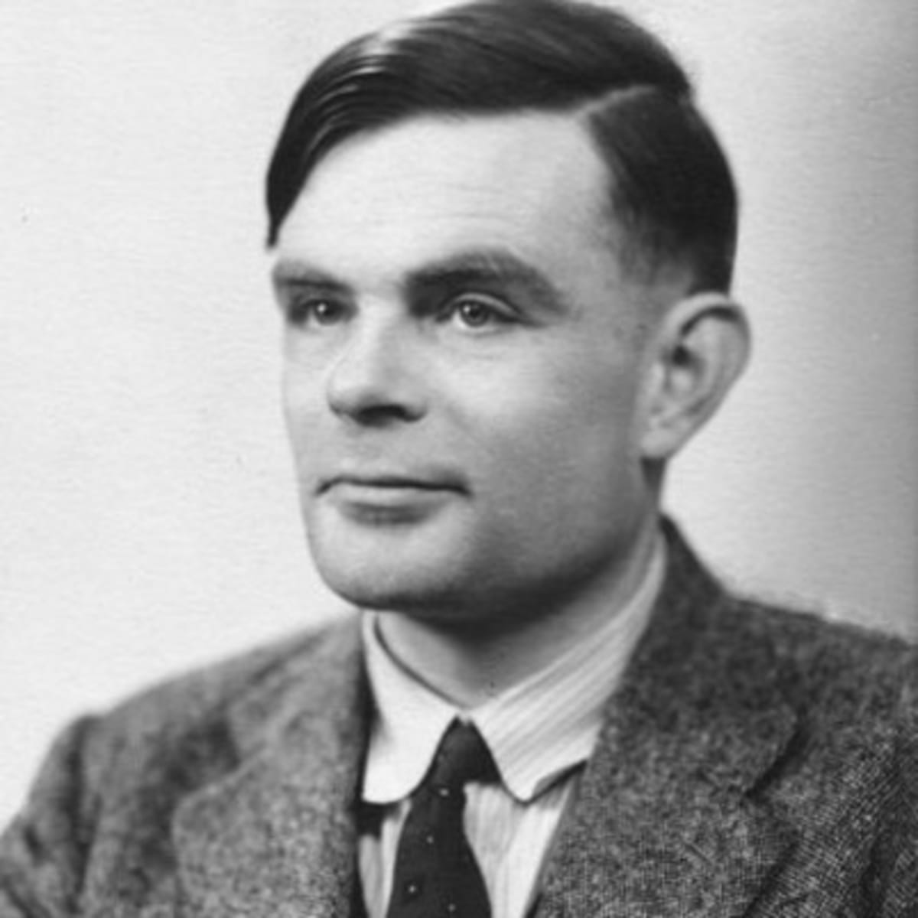
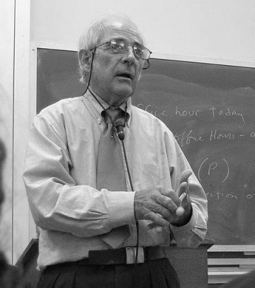




The quest for “artificial flight” succeeded when the Wright brothers and others stopped imitating birds and learned about aerodynamics. Aeronautical engineering texts to do not define the goal of their field as making “machines that fly so exactly like pigeons that they can fool even other pigeons.”
Russell & Norvig

Slide 4
Philosophy - 428 B.C.
Can formal rules be used to draw conclusions? Logic and Induction Aristotle – syllogisms for reasoning: premise to conclusion Hobbes – reasoning like math: “add and subtract in silent thoughts”
How does the mental mind arise from a physical brain? Dualism / Materialism Descartes – more to the mind than just nature
What is the source of knowledge? Locke – “nothing is in understanding, which is not first in the senses” Hume – induction as a basis for learning

Slide 5
Mathematics – 800 A.D.
What are the formal rules to draw valid conclusions? Boole – Boolean logic
What can be computed? Euclid – Greatest Common Denominators Algorithm al-Khowarazmi – Algebra Hilbert – algorithm for deciding logical propositions with natural numbers??? Gödel – Incompleteness Theorem (some truth statements cannot be computed)
How do we reason with uncertain information? Fermat, Pascal, Bernoulli, Laplace, … Bayes – conditional probabilities

Slide 6
Economics – 1776 A.D.
Decisions that maximize the payoff Scotsman A. Smith – An Inquiry into the Nature and Causes of Wealth of Nations.
What to do when there’s competition Decision Theory and Game Theory von Neumann and Morgenstern – The Theory of Games and Economic Behavior
How do we handle delayed gratification? Satisfacting – decisions that are good enough

Slide 7
Neuroscience – 1861 A.D.
How do brains process information? Paul Broca – studied loss of speech in brain-damaged people Camillo Golgi – observed individual neurons Santiago Ramon y Cajal – analyzed brain structures
Psychology – 1879 A.D.
Study of mind and behavior Started with “introspection” experiments but matured to behaviorism Computer models help understand psychological models (memory, language, etc.)

Slide 8
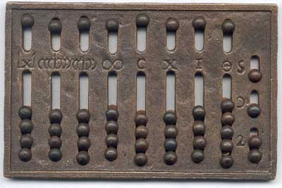
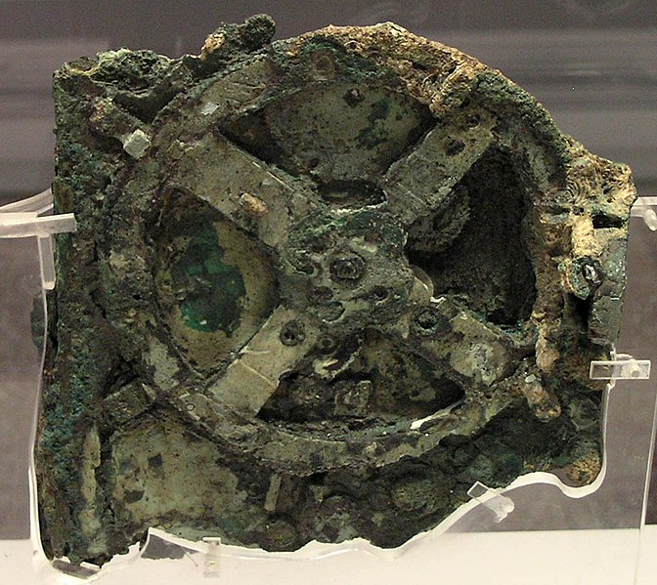
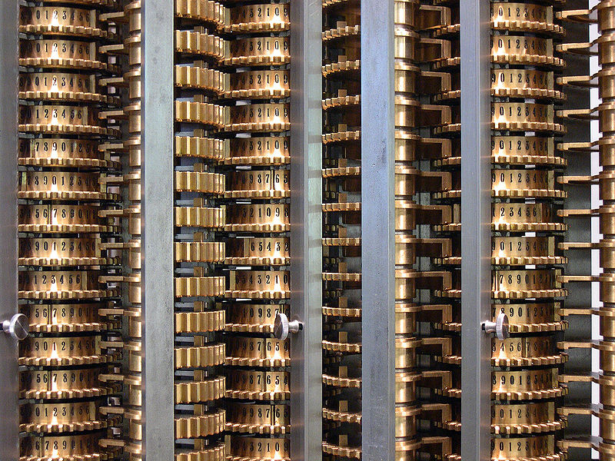
Computer Engineering – 1940 A.D.
How can we build an efficient computer? Abacus counting device from Babylon in 2400 BC Antikythera mechanism from Greece in 100 BC Charles Babbage – Difference and Analytical Engine Alan Turing – Colossus WWII Konrad Zuse – Z-3 Programmable Computer von Neumann – Modern computer architecture (aka CSC 324)
Computer Software “AI also owes a debt to the software side of computer science… But this is one area where the debt has been repaid: work in AI has pioneered many ideas that have made their way back to mainstream computer science… time sharing, linked list data type, personal computers with windows and mice…”

Slide 9
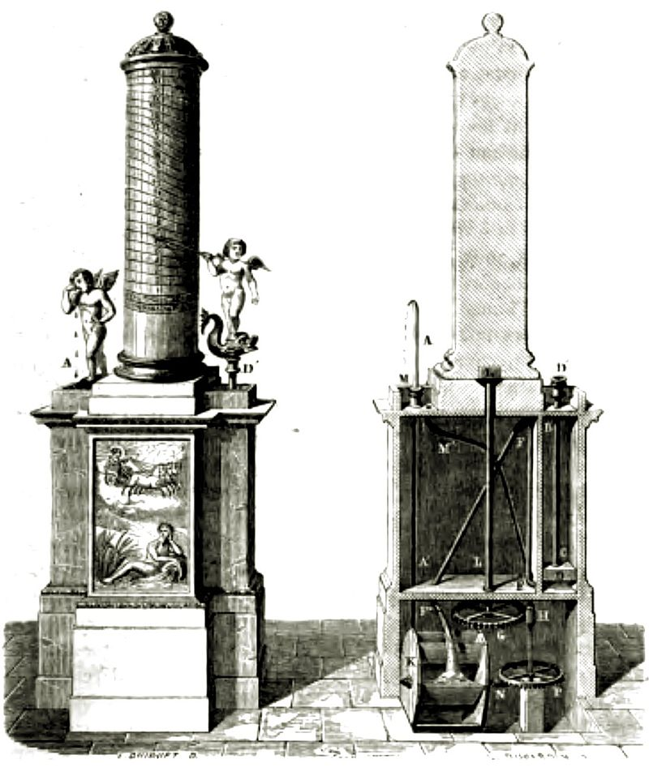
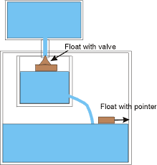
Control Theory and Cybernetics – 1948 A.D.
How do artifacts operate under their own control? Feedback loops and sensors Ktesibios of Alexandria – self-controlling water clock Norbert Wiener – biological & mechanical control systems that work towards objective function (with von Neumann)
Linguistics – 1957 A.D.
Relationship between language and thought How do you represent knowledge? Need structure, subject matter, context… Computational Linguistics / Natural Language Processing

Slide 10
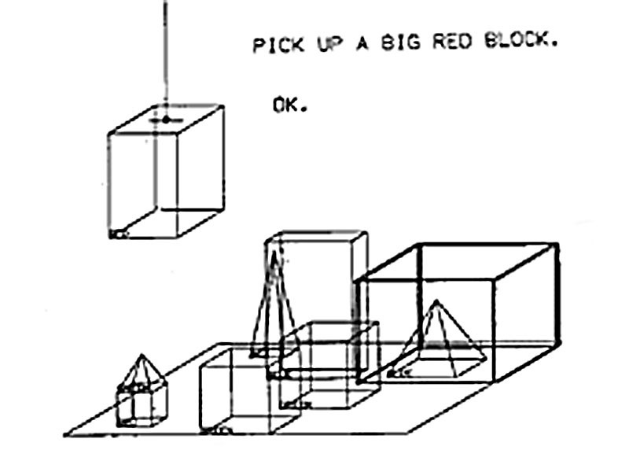
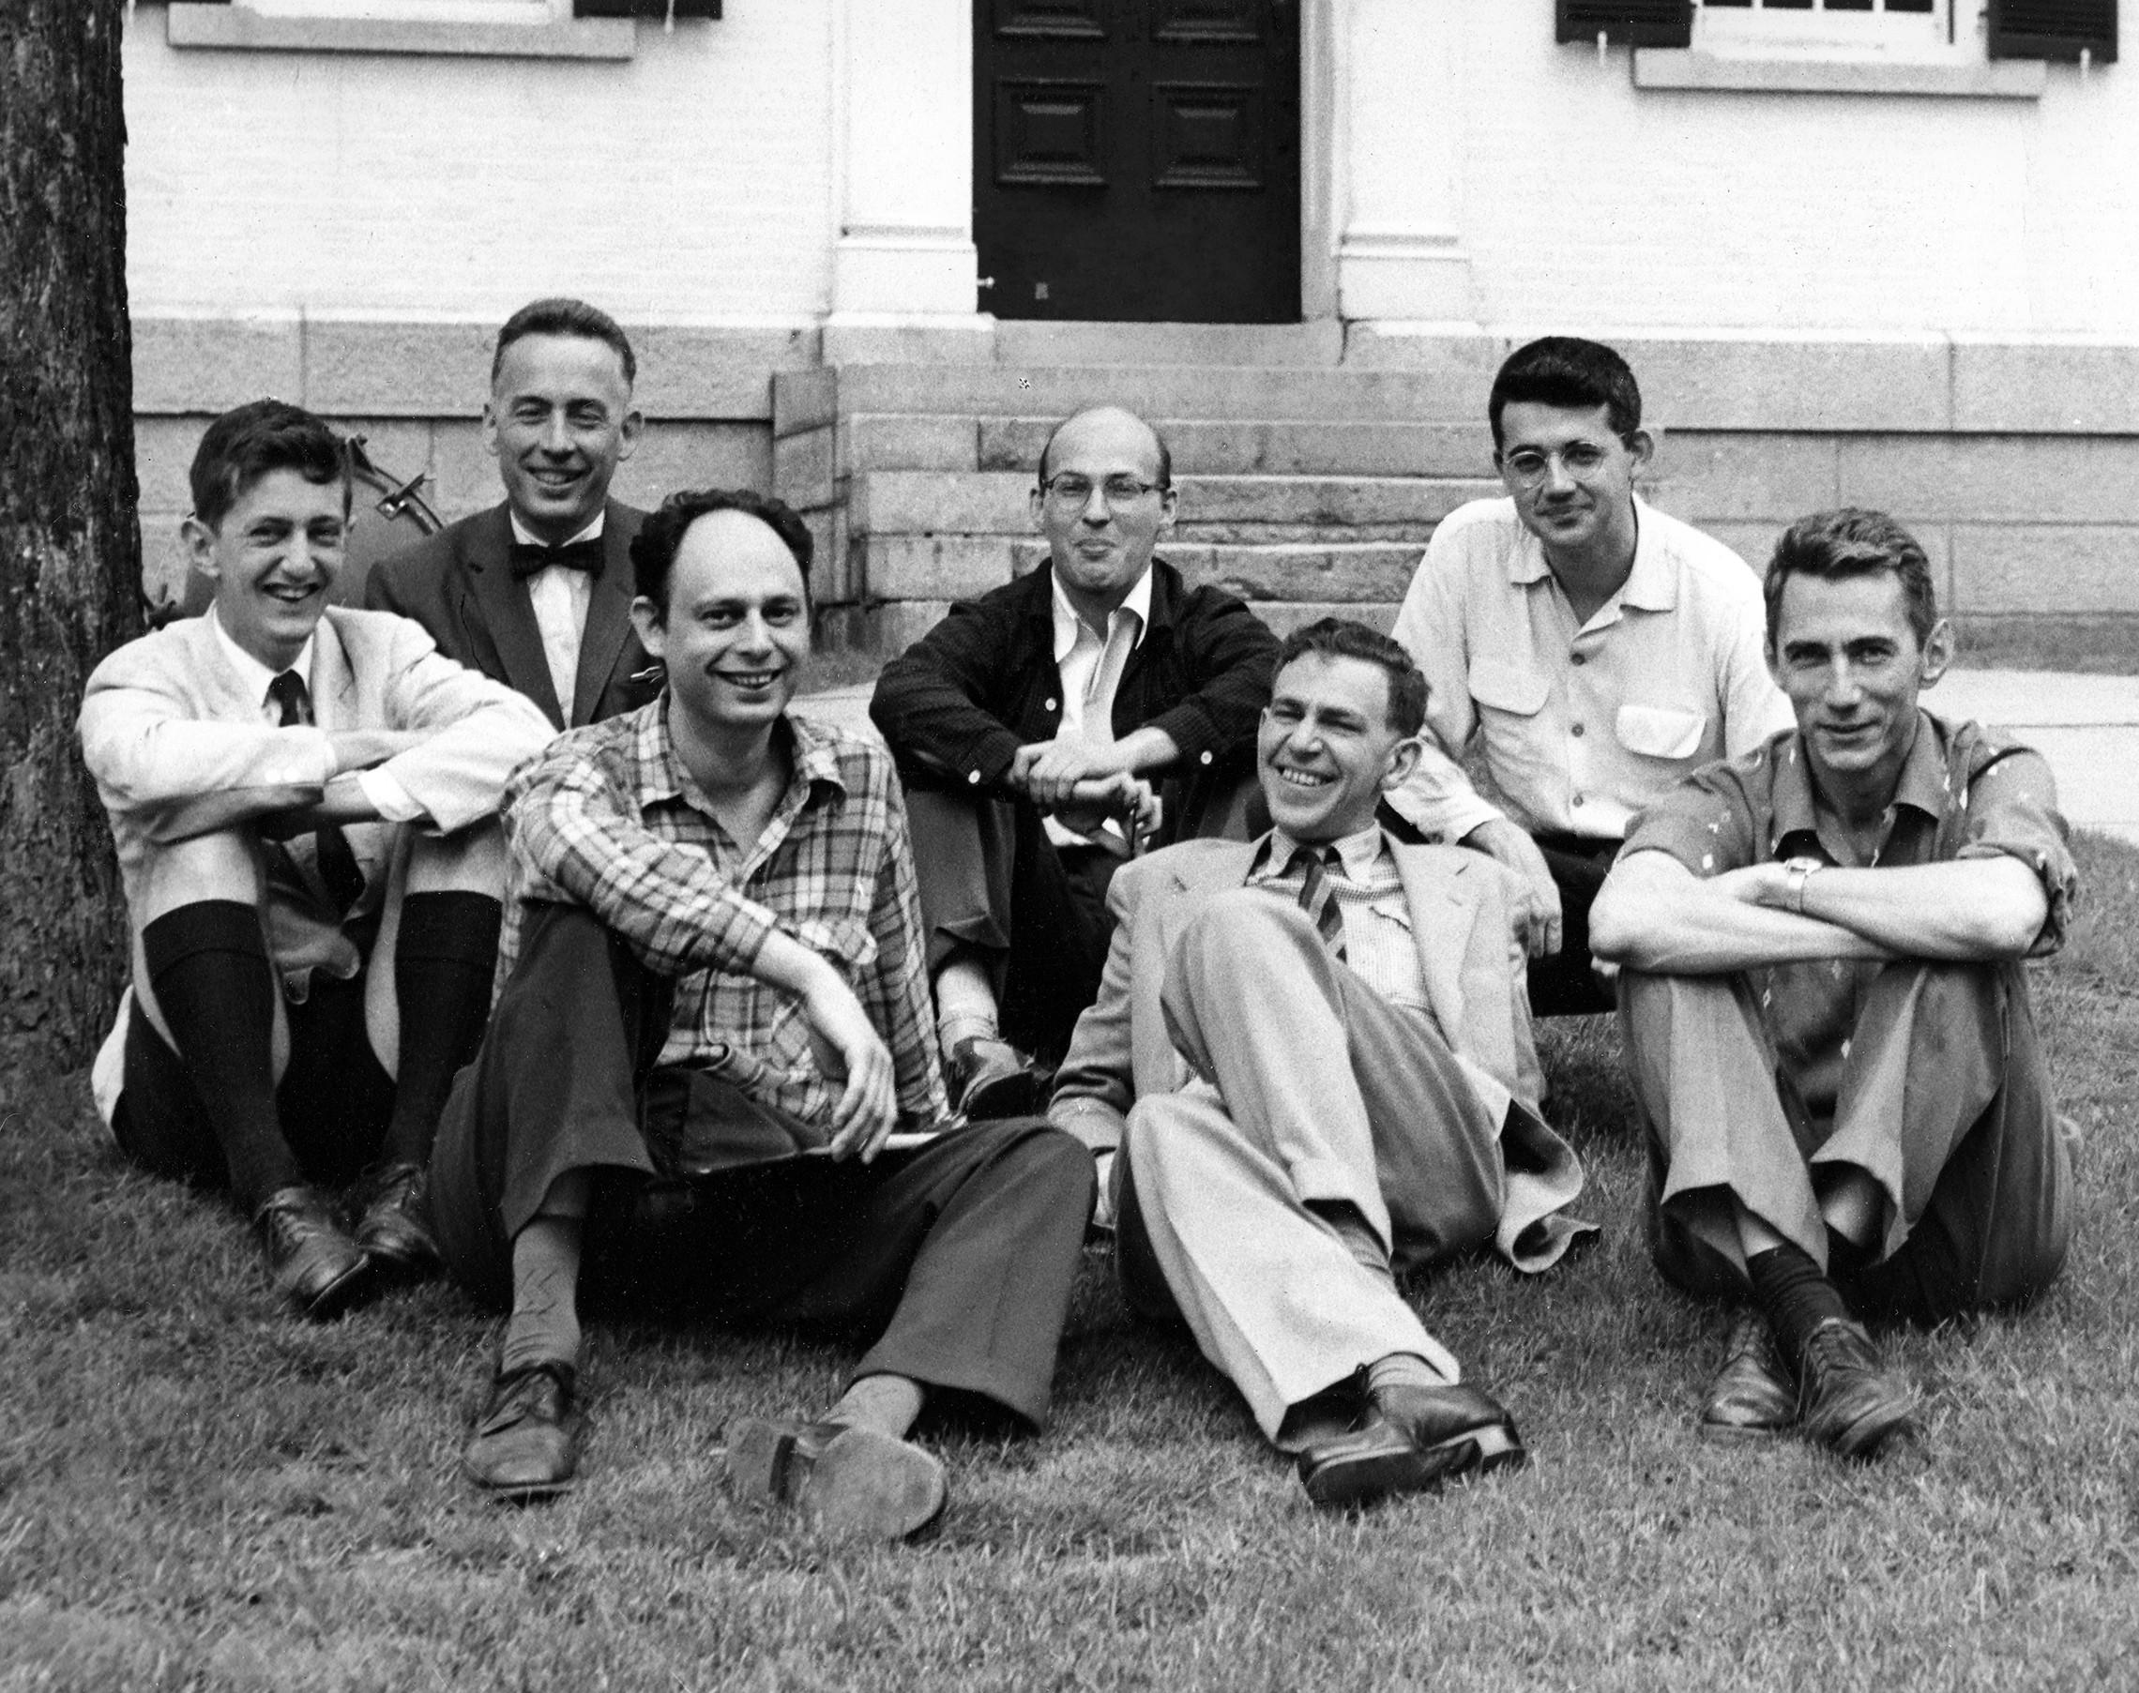
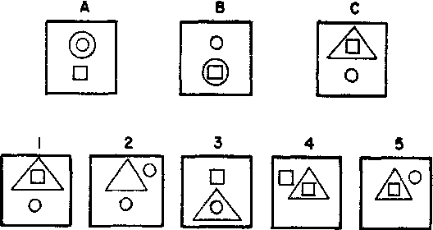
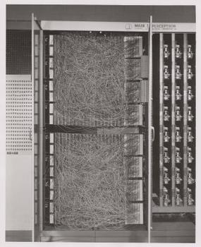
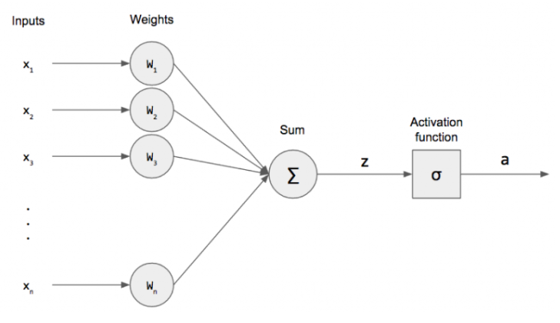








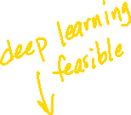

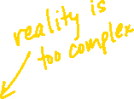


John McCarthy, Marvin Minsky, Claude Shannon, Nathaniel Rochester, Trenchard More, Arthur Samuel, Ray Solomonoff, and Oliver Selfridge…

Slide 11
Coming up soon:
Clustering
Scikit-Learn
KMeans Algorithm
DBSCAN Algorithm
Normalization and Standardization
Image Compression

