Slide 1






Sample ML Problem – Gravity of the Situation
Basic Vocabulary – Mushroom Data Set
Types of Machine Learning (we differentiate 3)
Unsupervised
Supervised
Reinforcement
The Machine Learning Pipeline
Why all the 2-D Examples?

Slide 2
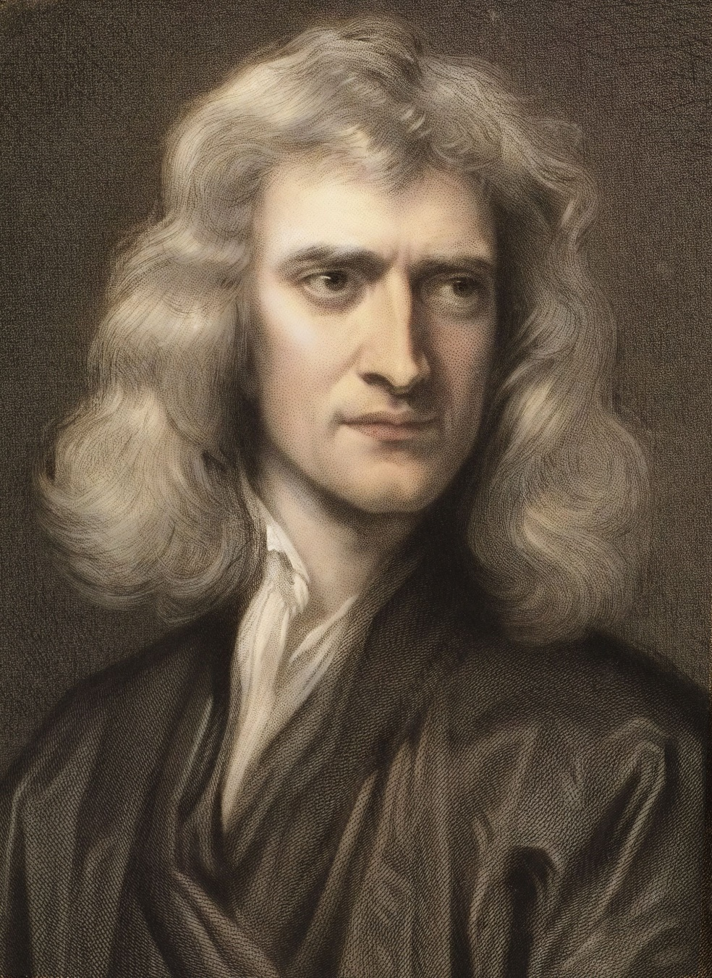


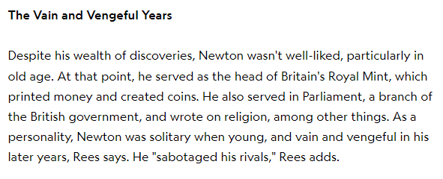


















Slide 3
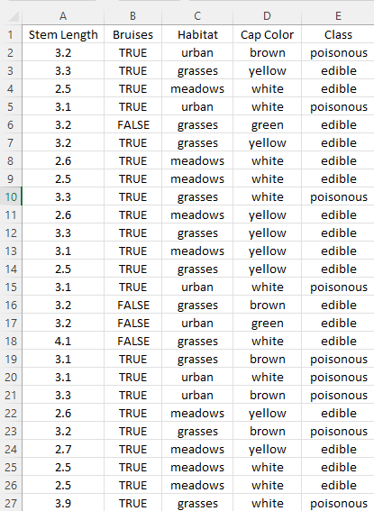




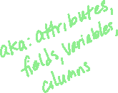






Slide 4
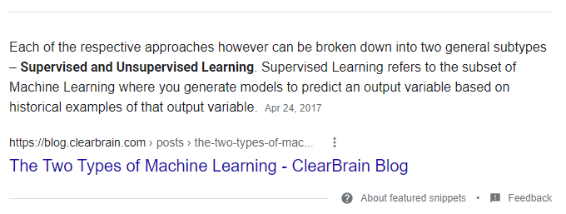
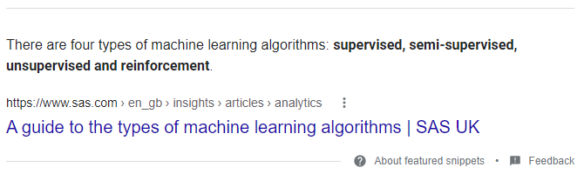
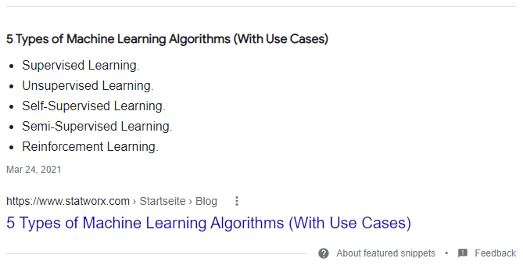
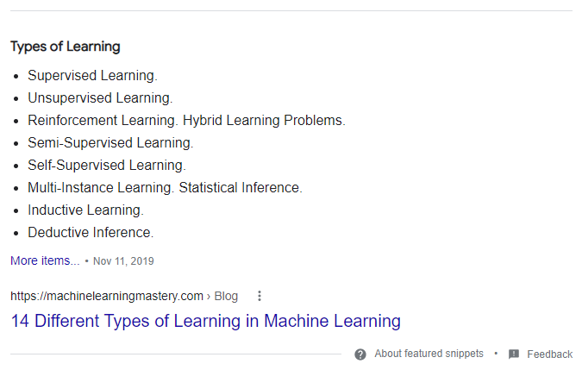
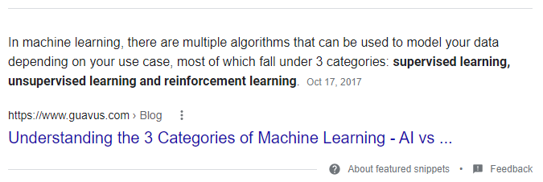





Hey Google: What are the _____ types of machine learning?

Slide 5





























Slide 6


Slide 7
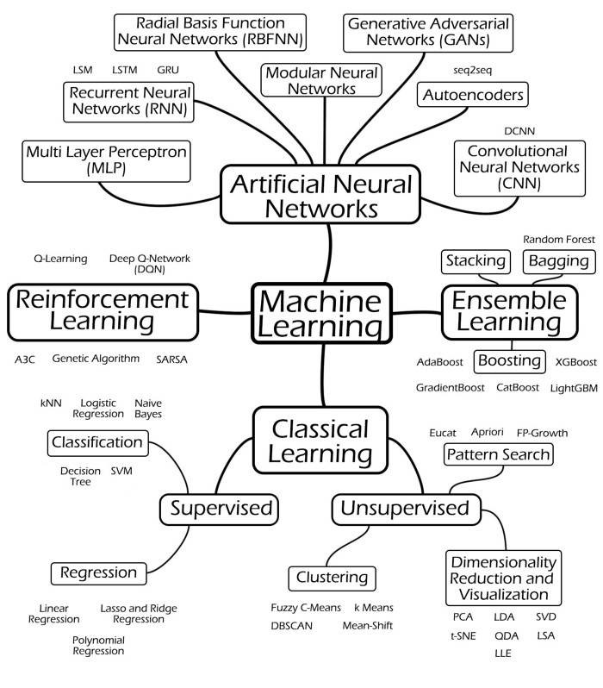
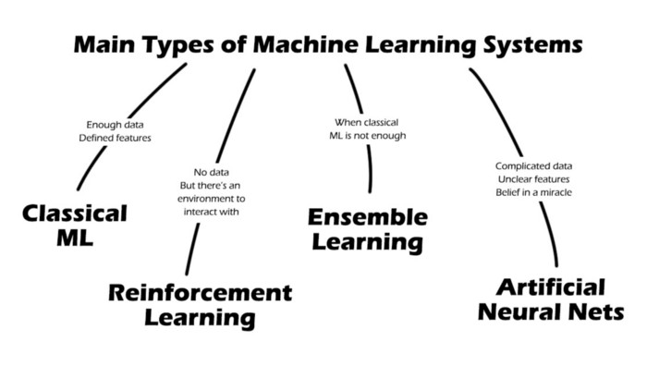

Bardh Rushiti – Navigating the World of ML

Slide 8





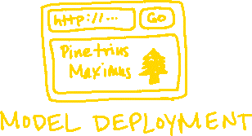







Slide 9
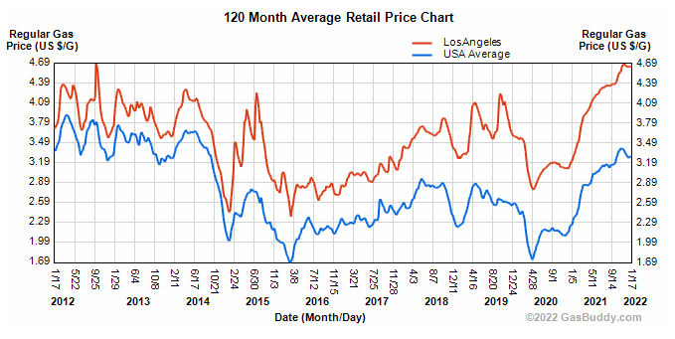
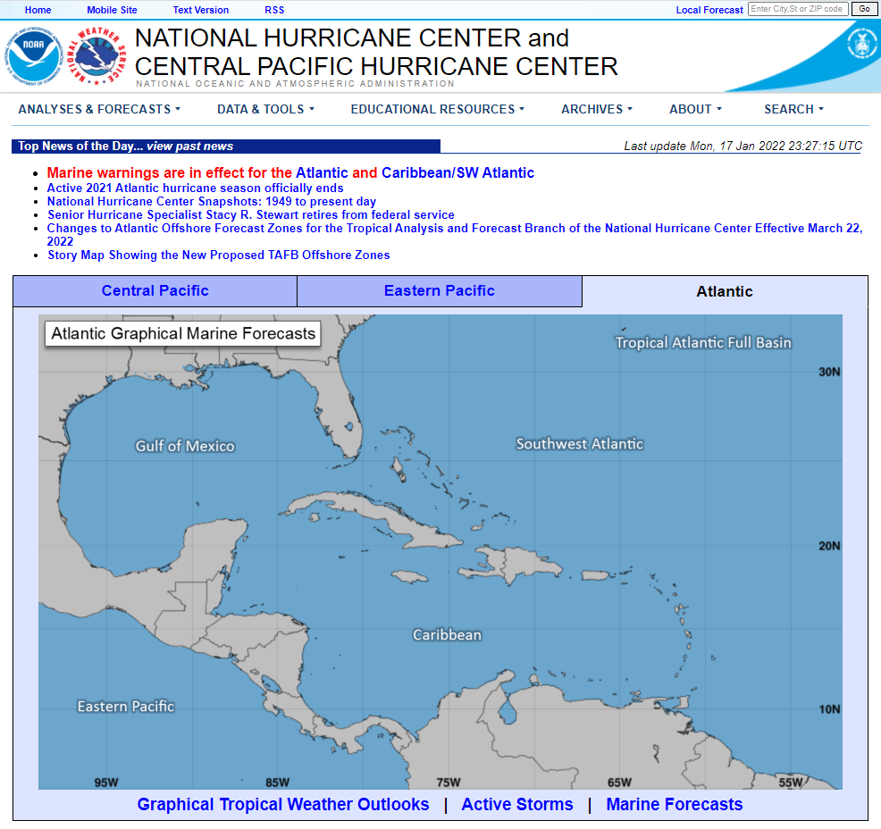
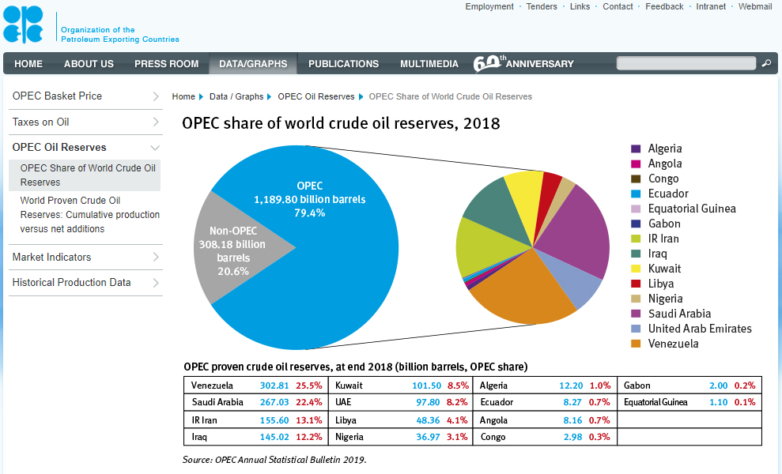

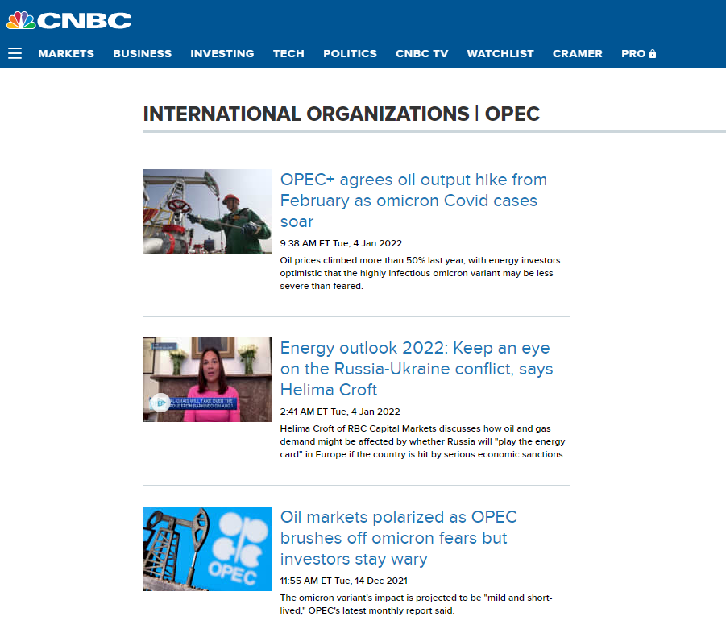
Data Collection – Gas Price Predictions

Slide 10
Feature Engineering
Feature Extraction
Cartesian coordinates → polar coordinates
Raw dates → time elapsed since X
COVID cumulative #s → daily numbers → 7-day rolling average
Email text → total length and keywords
Feature Selection
Predicting academic success: GPA, sports, music, job, sleep, diet, favorite TV shows, name of pet
Sports predictions: records, injury report, home/away, time zone, game style, mascot type, team colors, home city, indoor/outdoor, date

Slide 11







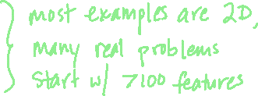






Slide 12
Coming up soon:
Clustering
Scikit-Learn
KMeans Algorithm
DBSCAN Algorithm
Normalization and Standardization
Image Compression

