Slide 1
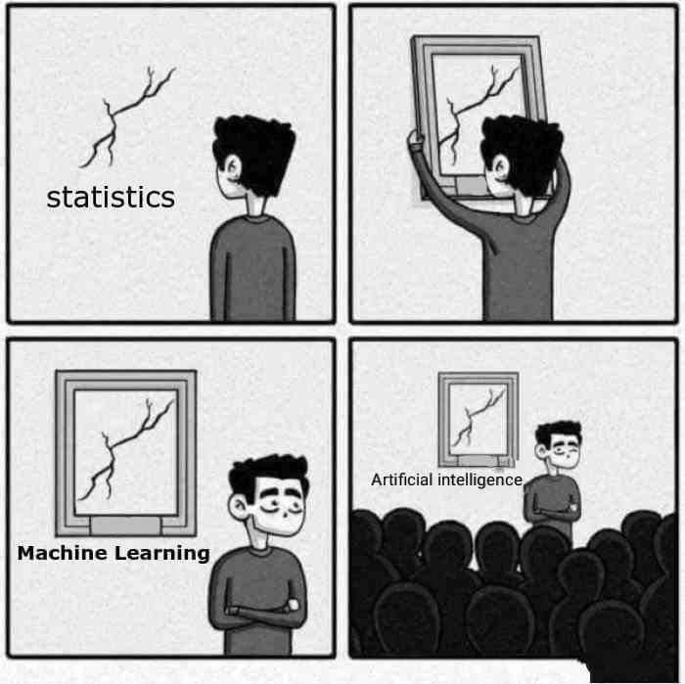
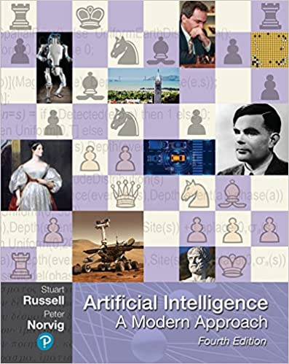













Slide 2

What is artificial intelligence?
in·tel·li·gence
the ability to acquire and apply knowledge and skills.
ar·ti·fi·cial
made or produced by human beings rather than occurring naturally, especially as a copy of something natural.

Slide 3





Slide 4
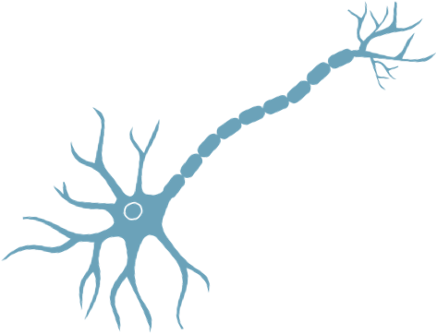

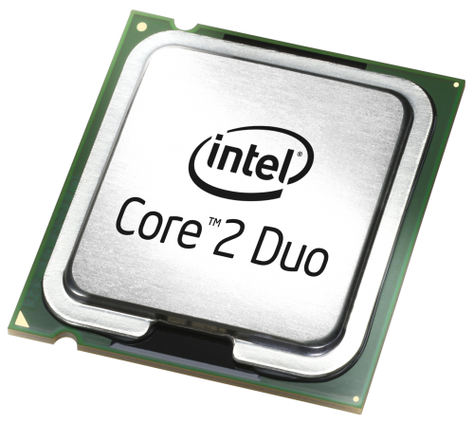
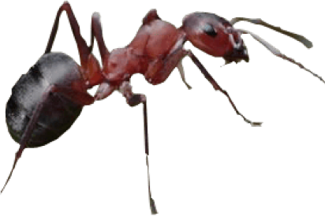
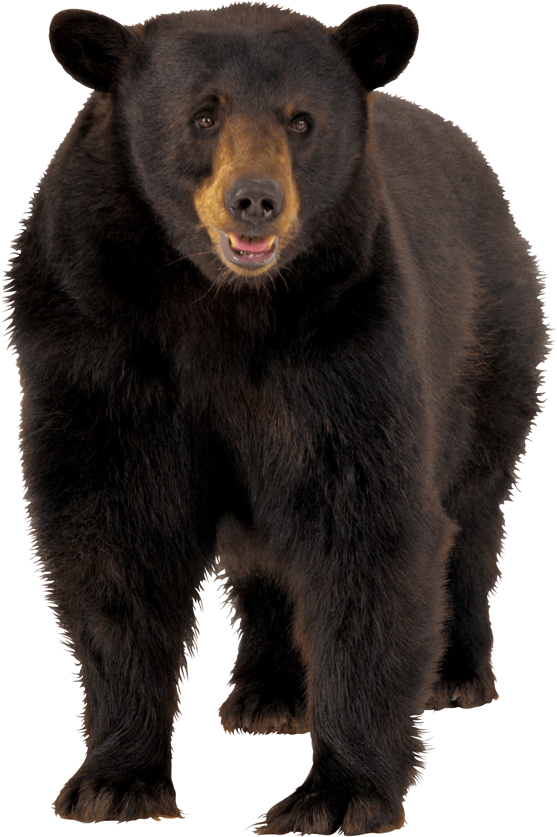
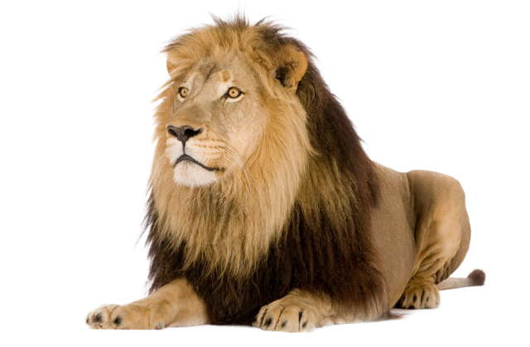
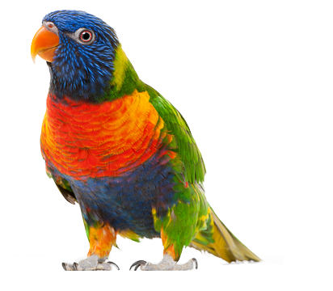

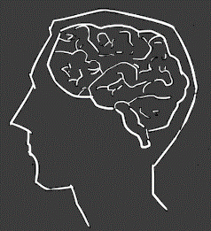
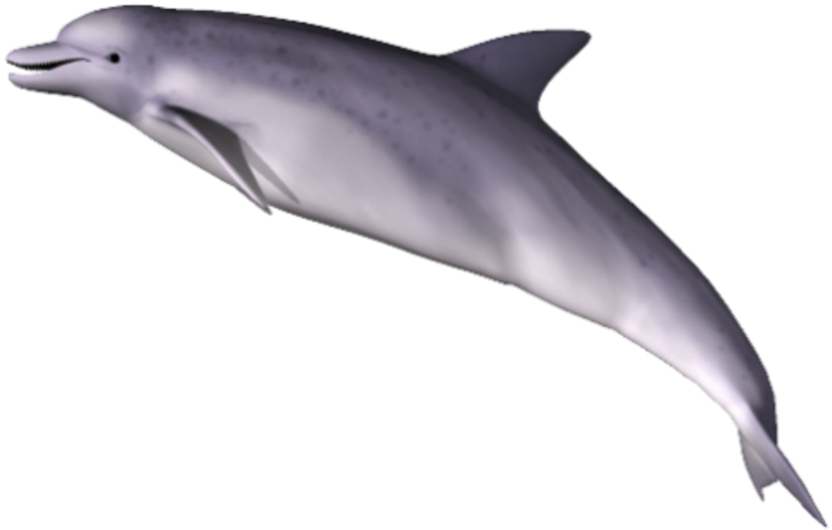
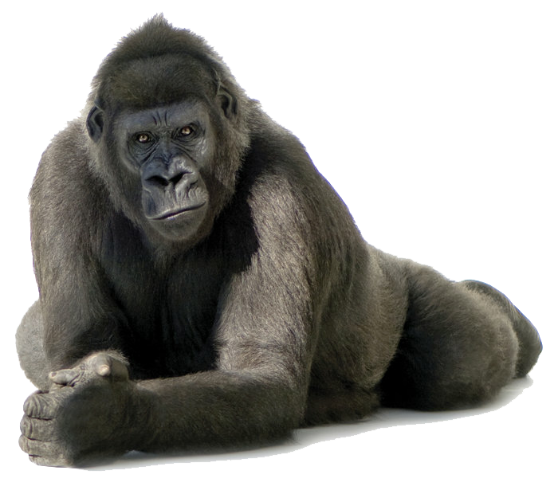
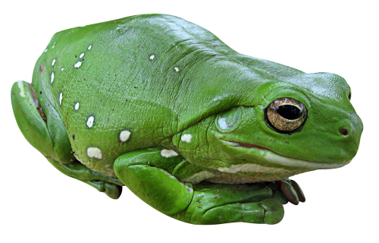




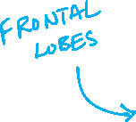












Slide 5









Slide 6







Slide 7
Am I Machine Learning or Not?
Toaster detects shade of the bread and pops based on dial setting
Database of stoplight pictures and label if Green Yellow Red
Truck scale beneath Amazon loading dock that knows max load
Truck scale that weighs load and is told whether truck crashed/broke
Smart bomb with fins and GPS that steers itself to target
Randomly navigated bomb with # military / civilian casualties
Adaptive cruise control
Aircraft autopilot systems

Slide 8


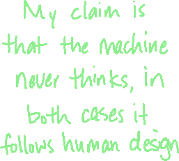




Slide 9
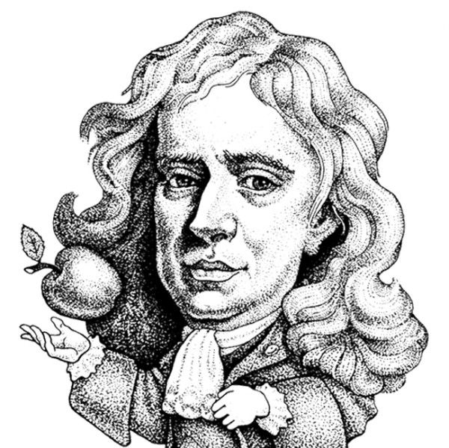
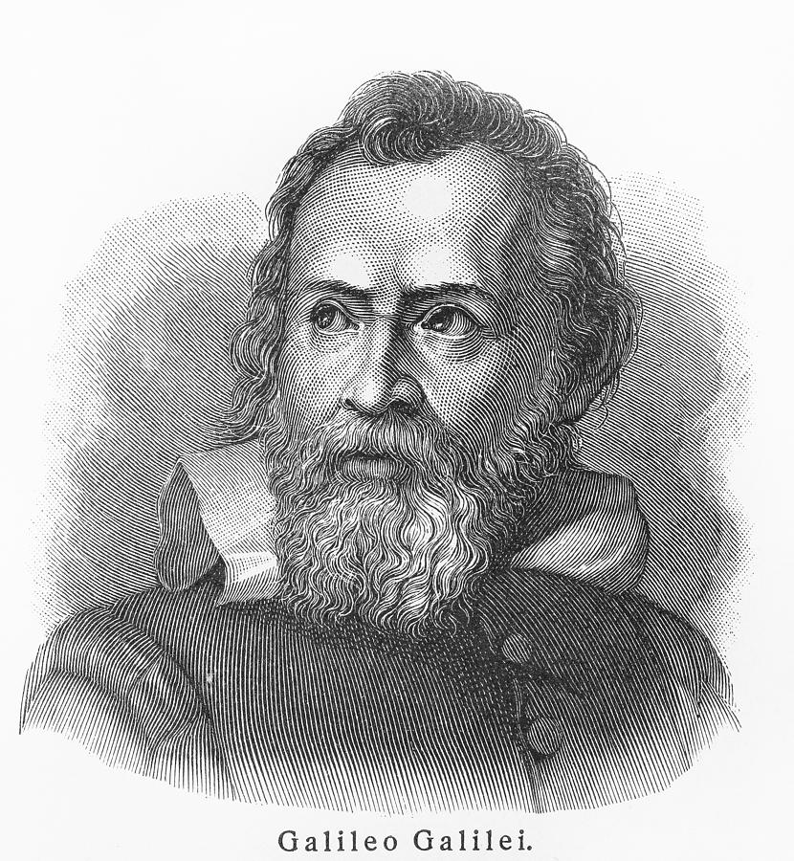
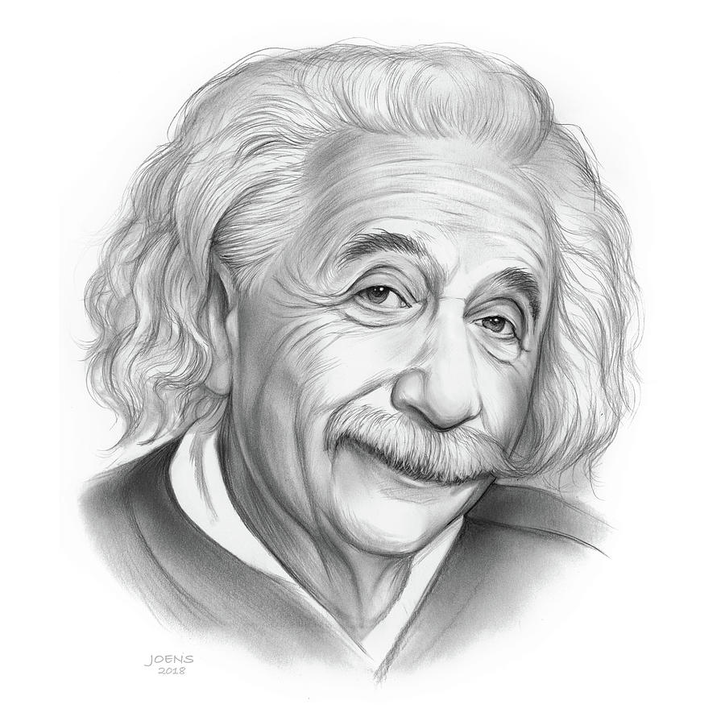








Slide 10
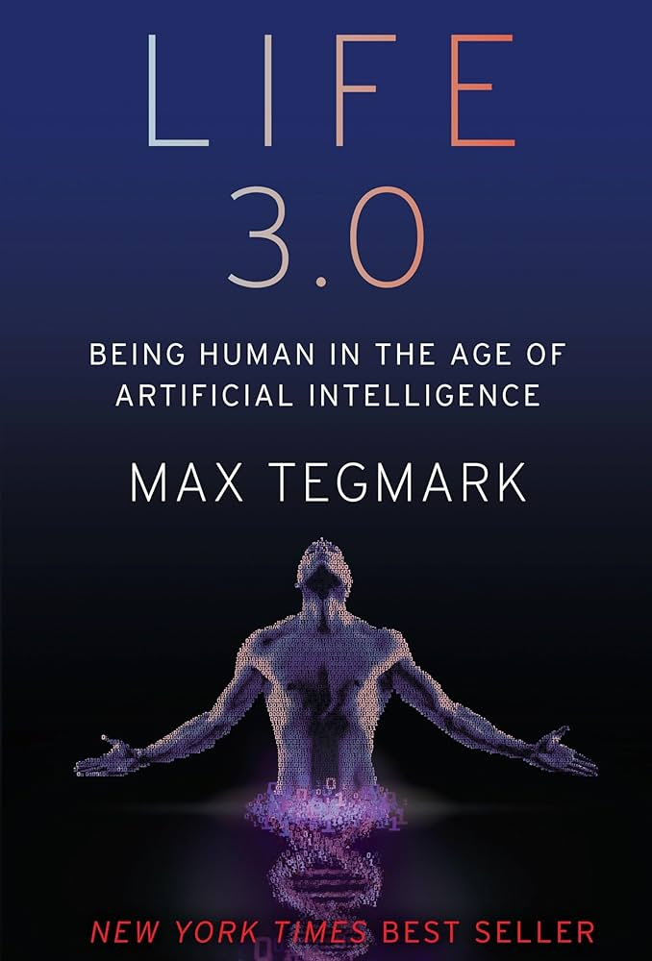
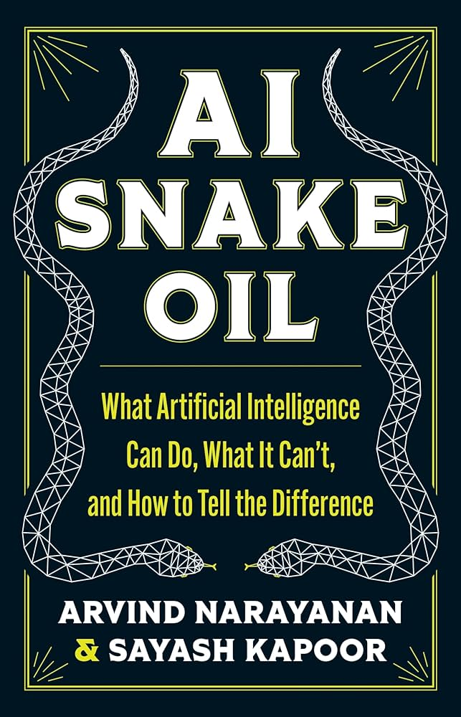
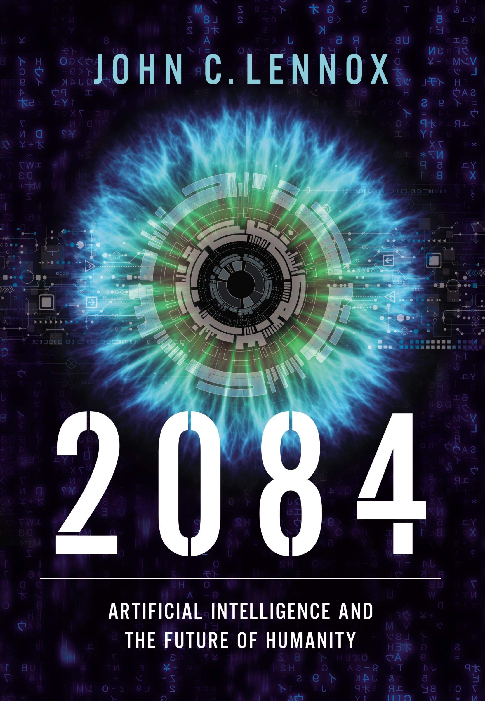
Future: (likely) Surpasses Humans
Readings: A few excerpts
Future: Depends on Type of AI
Readings: 2/3 of the book
Future: Deceptively Capable AI
Readings: 3/4 of the book
MIT Physicist
Religion: Naturalism
Princeton Computer Scientist
Religion: Unclear
Oxford Mathematician
Religion: Christian

Slide 11

Reading and Journal Assignments
Usually read one chapter per week
Write a one-page journal entry for each chapter
Graded for thought process and wrestling with difficult ideas, not eloquence
No Generative AI allowed, even as a grammar assistant
Write directly in Canvas “Quiz” without closing tab
Example:
Write a journal entry that explores where humanity is headed in the future and how AI will affect it. What are the main problems affecting society/humanity now and how do we anticipate ML helping these problems (e.g., health, morality, social, economic, environmental)? Do you think there are any ways that ML will set us back further?
Paper at the end of the semester that is based on these journal entries and is a summary of your thoughts on AI/ML – it will be less restrictive.

Slide 12
Regular Homework Assignments
Assigned after each class session, usually due before the next session.
Vocabulary
Research
Worksheet
Programming
Notebooks
Intended to reinforce smaller concepts and build towards projects.

Slide 13
Theme Verse
“My thoughts are nothing like your thoughts,” says the Lord. “And my ways are far beyond anything you could imagine. For just as the heavens are higher than the earth, so my ways are higher than your ways and my thoughts higher than your thoughts.
Isaiah 55:6-9
Seek the Lord while you can find him. Call on him now while he is near. Let the wicked change their ways and banish the very thought of doing wrong. Let them turn to the Lord that he may have mercy on them. Yes, turn to our God, for he will forgive generously.

Slide 14
