Slide 1
Regression Models
Machine Learning that predicts continuous numerical values

Slide 2
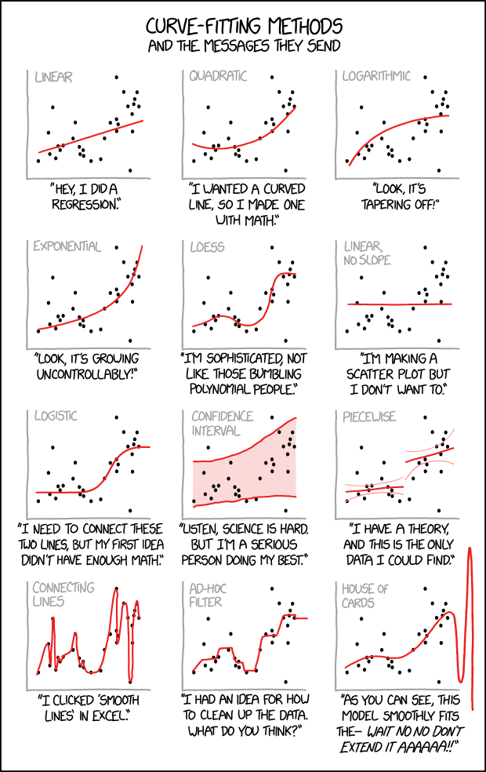
https://xkcd.com/2048/
Our simple examples will show 1 feature datasets (e.g., 1 independent variable)

Slide 3
Ordinary Least Squares

Slide 7
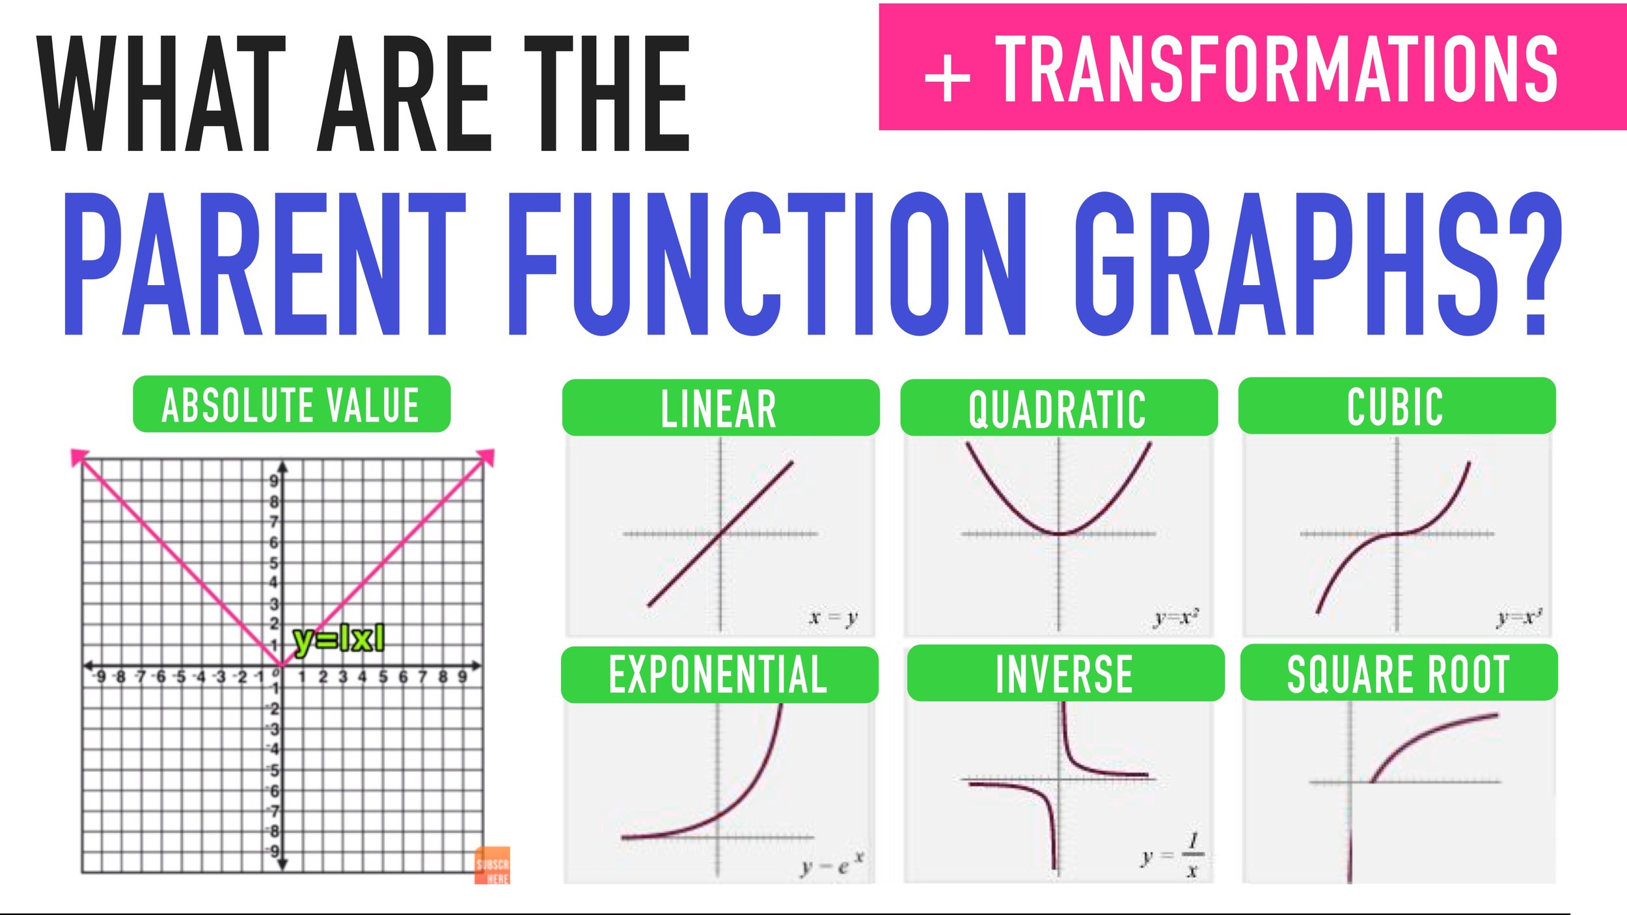
Types of Regression Models
Most regression models follow the basic function families
Linear
Quadratic
Cubic
…
Polynomial
Exponential growth
Exponential decay
Logarithmic
Sigmoid
Etc.
https://www.mashupmath.com/blog/parent-function-graphs-explained

Slide 8
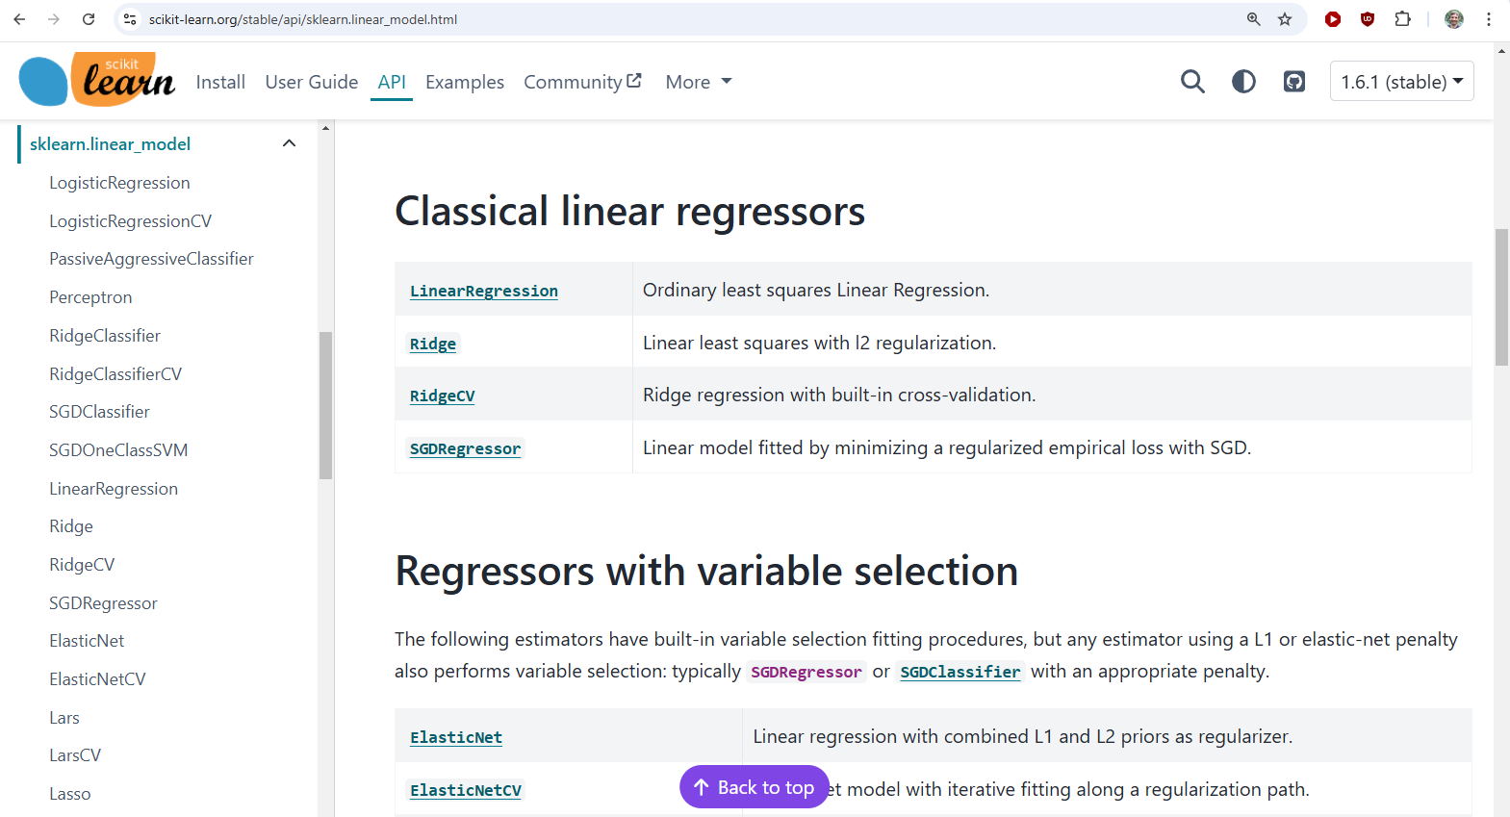

Slide 9
Regression with SKLearn
All SKLearn Regression models are based on linear regression
Non-linear models transform the inputs into a linear representation
This adds a bunch of new variables but SKLearn does this internally from sklearn.preprocessing import PolynomialFeatures from sklearn.linear_model import LinearRegression poly = PolynomialFeatures(degree=3, include_bias=False) X_poly = poly.fit_transform(X) model = LinearRegression() model.fit(x_poly, y)

Slide 10
Polynomial to Linear Transformation

