Slide 1
Ensemble Models
Tim Smith, PhD

Slide 2
Agenda
Classifiers
Ensemble models
Voting classifier
Bagging
Random Forest
Boosting algorithms
Regressors

Slide 3

Wisdom of Crowds
Asking a question to a crowd
Aggregate the answers

Slide 4
Ensemble Models
Use the results of a bunch of models
Random Forest approach:
Training set
Dec.Tree 1
Predicted="1"
Dec.Tree 2
Dec.Tree 3
Predicted="0"
Predicted="1"
Sample 1
One possible reconciliation: Use "voting" (i.e., simple majority)
Predicted="1"
2
Sample 3

Slide 5
Ensemble Models
Even if each model is "weak", the ensemble can be very accurate!
Be careful: models should be sufficiently diverse!
How to build diverse models?
1) Use different algorithms (so they make different errors)
2) Use the same algorithm on different random training subsets

Slide 6
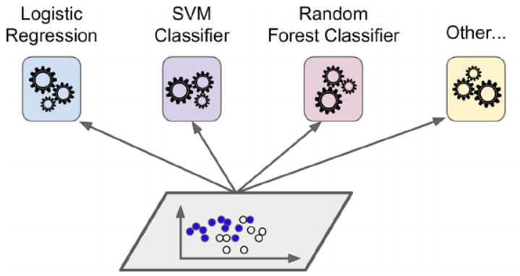
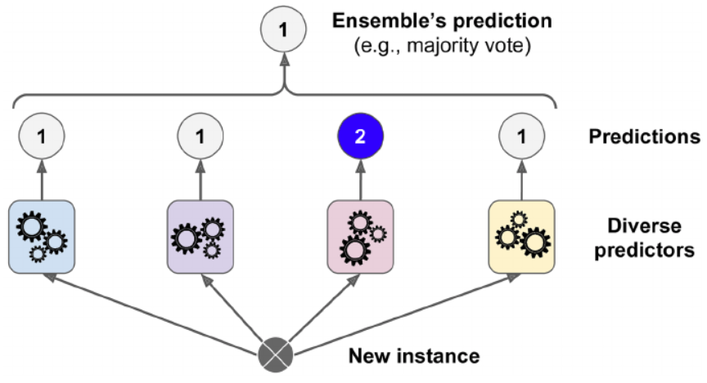
Voting Classifier
Use different algorithms on the entire training data
Aggregate the predictions using “voting”
See: VostingClassifer and VotingRegressor
Decision
Tree

Slide 7
Voting Classifier
Hard vs. Soft voting
Soft voting
(highest average probability*)
Hard voting
(simple majority)
Prob=0.52
Prob=0.54
Prob=0.60
Prob=0.58
Prediction = 1
Prob 1 = 0.5467
Prob 2 = 0.60
Prediction = 2
* Make sure each classifier has the predict_proba() method

Slide 8
Stacking Classifier
Original Data
Predictions
Estimator (logistic regression is commonly used)
Predictions
Prediction = 1

Slide 9
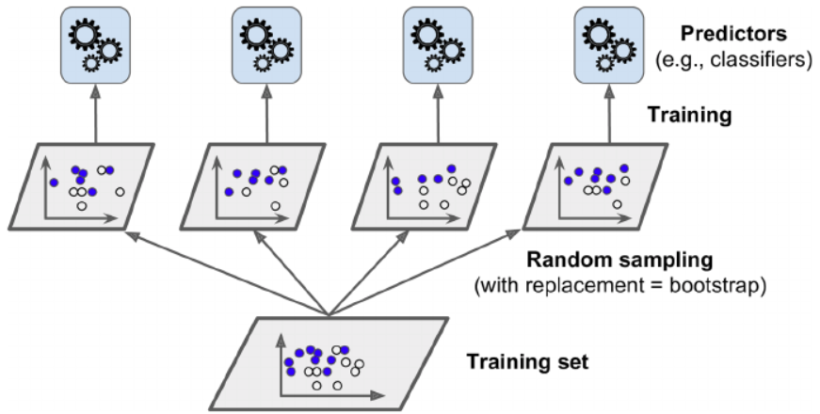
Bagging
Use the same predictor (e.g., decision tree)
Bagging: use different random subsets WITH replacement
Short for "bootstrap aggregating"
Final prediction is hard voting, but soft voting is also possible.

Slide 10
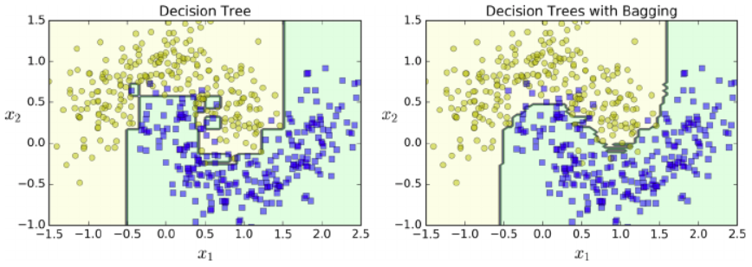
Bagging
500 trees

Slide 11
Random Patches and Random Subspaces
Random Patches:
Sample from the training instances
Sample from the training features (i.e., inputs)
Random Subspaces:
Keep all training instances
Sample from the features
(There are SciKit parameters to do both)
Sde BaggingClassifer & BaggingRegressor

Slide 12
Random Forest
The same as using a decision tree with "bagging"
Can do both classification and regression
RandomForestClassifier()
RandomForestRegressor()
Two sets of hyperparameters:
Decision tree (e.g., max_depth)
Ensemble (e.g., n_estimators (number of decision trees))

Slide 13
Extra-Trees
"Extremely Randomized Trees"
Add further randomness:
Splitting rules are not based on reduction in most impurity
Rather, splitting rules are randomly selected
Takes average or result
Trains much faster
See: ExtraTreesClassifier & ExtraTreesRegressor

Slide 14
Feature Importance
Random forests provide feature importance
How much does a feature reduce impurity compared to others?
Since there are many trees, this is a weighted average!
If a feature is not used in any tree, it has 0 importance
See: feature_importances_

Slide 15
Boosting
Refers to converting weak learners to a strong one (using ensemble)
Trains predictors sequentially (as opposed to simultaneously)
Each predictor corrects the predecessor
Two types:
Adaptive boosting (AdaBoost)
Gradient boosting
See: AdaBoostClassifier, AdaBoostRegressor, GradientBoostingClassifier, GradientBoostingRegressor

Slide 16
AdaBoost
Can be used for:
Classification (AdaBoostClassifier)
Regression (AdaBoostRegressor)
Works with “instance weights” in both cases
Default algorithm: decision tree (with max_depth = 1)
Also called a "decision stump"
Performs only one split for each predictor
(Default algorithm can be changed)

Slide 17
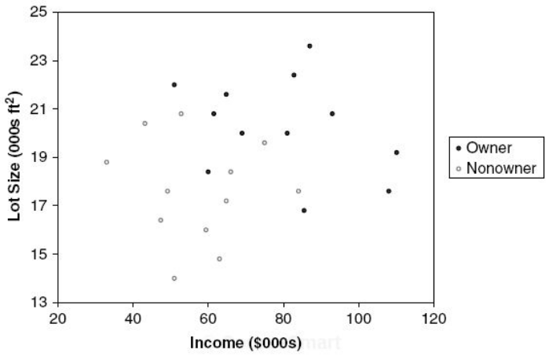
AdaBoostClassifier
What are “instance weights”?
In the beginning, each instance has a weight of 1/n
After training, weights of misclassified instances are “boosted”
These weights determine how to do the split in the decision stump
Decision Stump (max_depth = 1)
Owners: 12
Non-owners: 12
Lot size
≤19
>19
Owners: 3
Non-owners: 9
Owners: 9
Non-owners: 3

Slide 18
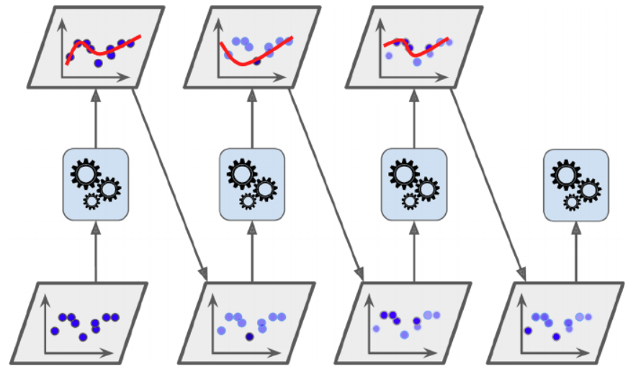
AdaBoostClassifier
Each subsequent predictor focuses on "underfitted" instances in the predecessor
For classification:
Train
Identify misclassified instances
Increase their relative weights
Train a new model
Repeat 2-4
Stop: if max_number is reached, OR perfect model is achieved.
Use the same training data set (with adjusted weights)

Slide 19
AdaBoostClassifier
What are “predictor weights”?
Each model has a different weight “α” (based on its accuracy on weighted training set)
The higher the accuracy, the higher the weight
Predictions:
Each model makes a prediction
Calculate weighted predictions using α’s
Find the majority of weighted predictions
α₁
α₂
α₃

Slide 20
Gradient Boosting
Uses decision trees
Also called Gradient Boosting Trees
Can be used for:
Classification (GradientBoostingClassifier)
Regression (GradientBoostingRegressor)
Similar to AdaBoost but does not weigh instances!
Instead: Fits the new predictor to the “residual error” made by previous predictor (y_{actual} – y_{predicted})

Slide 21
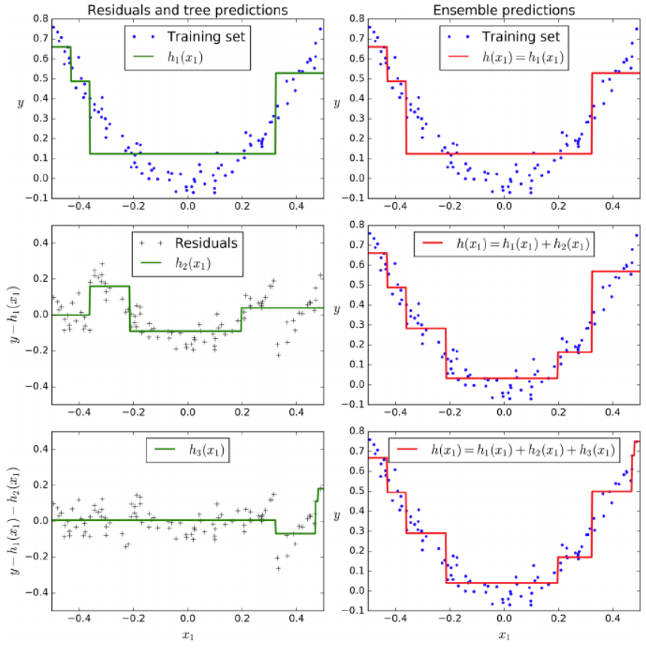
GradientBoostingRegressor Example

Slide 22
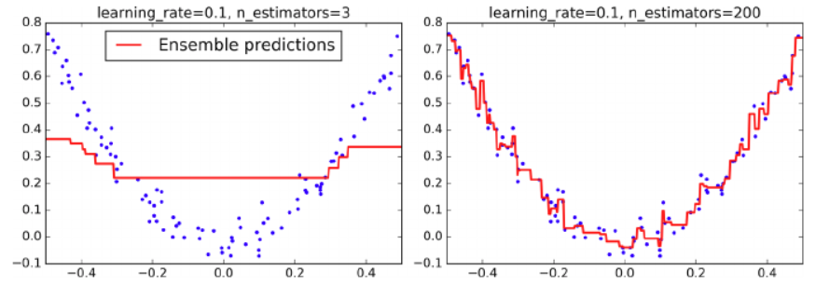
GradientBoostingRegressor
Learning rate:
If low, you need more trees.
Better generalization
This is called “shrinkage”
Underfitting
Overfitting
Use "early stopping" to avoid overfitting
(i.e., stop when validation error dips)

Slide 23
Stochastic Gradient Boosting
Gradient Boosting has a "subsample" parameter
1.0 is the default option (which means the entire data set)
If set to less than 1.0, then that much is sampled
E.g., subsample = 0.25 trains each tree on randomly selected 25% of data
Setting the subsample to less than 1.0 performs Stochastic Gradient Boosting

Slide 24
What about Regression tasks?
All ensemble models also have a regressor
In this case, the average of all individual regressor is the final prediction

Slide 25
Voting Regressor
Simple average
Training set
Dec.Tree Reg
Predicted="$200"
SGD Reg
SVM Reg
Predicted="$150"
Predicted="$160"
All sample
Take the simple average
Predicted="$170"

Slide 26
Voting Regressor
Weighted average
Training set
Dec.Tree Reg
Predicted="$200"
SGD Reg
SVM Reg
Predicted="$150"
Predicted="$160"
w=0.3
w=0.6
w=0.1
All sample
Take the weighted average
Predicted=0.3x200 + 0.6x150 + 0.1*160
= 166

Slide 27
Ensemble Models
What is the advantage of ensemble models?
What is the disadvantage of ensemble models?

Slide 28
Summary
Classifiers
Ensemble models
Voting classifier
Bagging
Random Forest
Boosting algorithms
Regressors

