Slide 1
ISM 6564
Text Analytics
Dr. Tim Smith

Slide 2
Agenda
Matrix Representations of a given corpus
A corpus is a set of documents
Tokenization of a document
Tokens are collections of characters; think of these like ‘words’
Problem of High Dimensionality
Representations of documents can require a large number of columns (aka dimensions)
Examples of using machine learning modeling on text

Slide 3
Determining Text Similarity

Slide 4
Matrix representations of text corpus
If we are to use text in machine learning, we need to encode our text into numeric values that can be processed by our machine learning models
Three simple examples are One-Hot Encoding, Count Vectors, and Term Frequency.
Boolean Frequency (aka One-Hot Encoding)
Term Frequency adjusted for Document Length
Term Frequency (Count)
ID | Pediatricians | Should | Carefully
1 | 1 | 1 | 1
2 | 0 | 1 | 0
(etc.)
ID | Pediatricians | Should | Carefully
1 | 9 | 6 | 1
2 | 0 | 13 | 0
(etc.)
ID | Pediatricians | Should | Carefully
1 | 0.09 | 0.06 | 0.01
2 | 0 | 0.257 | 0
(etc.)

Slide 5
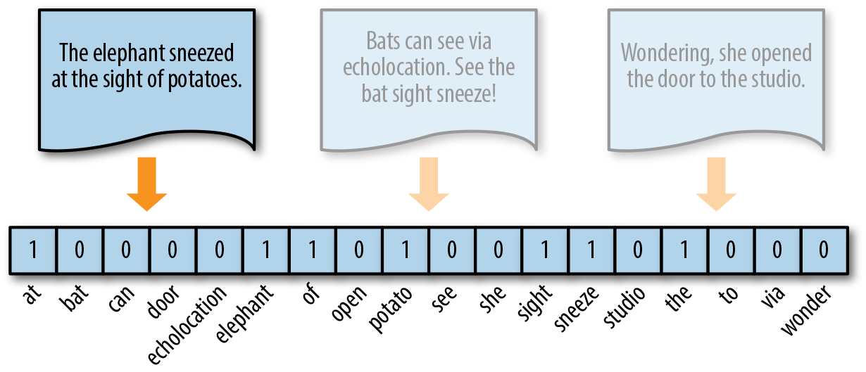
Boolean Frequency (One-Hot Vector)
How it works:
Replace count vector with a Boolean vector to indicate the presence(1) vs absence (0) of a term in the dictionary, rather than their counts.
Frequent tokens get no extra weight, which reduces imbalance in token distribution.
More effective for small documents (text messages, tweets) with not many repeated elements.
Implementation:
Same as count vectors, with a binary transformation.
Question:
Can you think of a possible ML application?
One-hot vector: [1, 0, 0, 0, 0, 1, 1, 0, 1, 0, 0, 1, 1, 0, 1, 0, 0, 0]

Slide 6
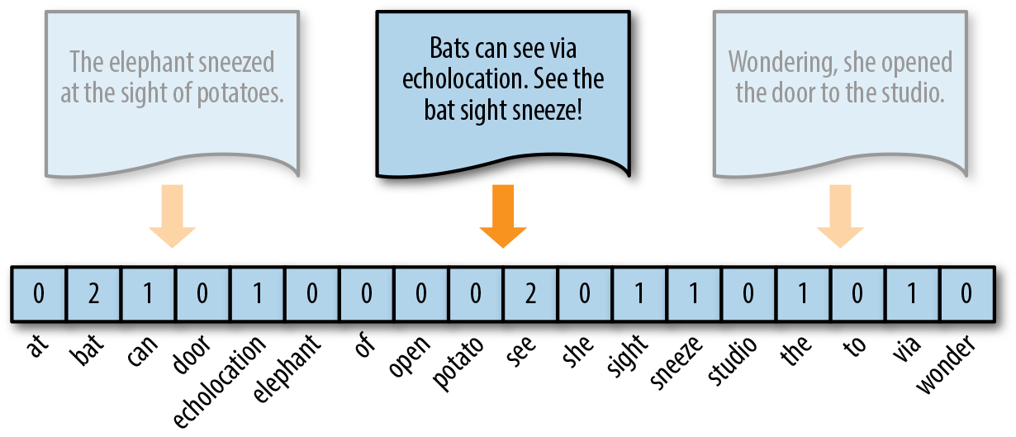
Term Frequency/Count
How it works:
Create a dictionary consisting of all unique words (terms) in a corpus; the size of all document vectors equal the size of the dictionary.
Count how many times each term in this dictionary appears in each document in the corpus.
Improve representation by removing stop words, lemmatizing, using n-grams, etc.
Implementation:
In NLTK: vectorize( )
In Scikit-Learn: CountVectorizer( )
Gensim: doc2bow( )
Question:
What happens as we add more documents to this corpus?
Count vector: [0, 2, 1, 0, 1, 0, 0, 0, 0, 2, 0, 1, 1, 0, 1, 1, 1, 0]

Slide 7
Term Frequency Adjusted
How it works:
Create a dictionary consisting of all unique words (terms) in a corpus; the size of all document vectors equal the size of the dictionary.
Count how many times each term in this dictionary appears in each document in the corpus and divide by the total number of words in that document.
Improve representation by removing stop words, lemmatizing, using n-grams, etc.
Implementation:
In Scikit-Learn: CountVectorizer( )
Question:
What happens as we add more documents to this corpus?
… then, divide by the number of words in the document...
Count vector: [0, 2/10, 1/10, 0, 1/10, 0, 0, 0, 0, 2/10, 0, 1/10, 1/10, 0, 1/10, 1/10, 1/10, 0]

Slide 8
Logarithmically Scaled Term Frequency
How it works:
Replace each count vector with a value (weight) that is decreasing rate such that increasingly more frequent terms across the corpus of documents receive less weight than less frequent terms.
A term occurring 10 times in a document is probably not 10 times more relevant.
y = 1 + log₁₀(tf)

Slide 9
Recap: Matrix representations of text corpus
One-Hot Encoding
If a word exists in a text, 1, otherwise 0
Problem: All words are equally important
This makes it difficult to differentiate between documents
Term Frequency
How many times does a given word occur in a document
Problem: Some documents have more words than others
Similar documents in content can have very different term frequency vectors
Term Frequency Adjusted
What percentage of words in a document are a given word
Problem: The highest-frequency words are not informative.
You can remove stop words to address this, but high-frequency, unimportant words remain.
Logarithmically scaled frequency
Increasing frequency of words has an incrementally smaller impact
Problem: There isn’t any comparison of frequency relative to how rare the word is across other documents.
The solution to these problems…
Term Frequency with Inverse Document Frequency

Slide 10

Term Frequency
$$tf\left(t, d\right)= f_{t,d}$$
Given a word (t) in document (d)
The term frequency is just the number of times this word t occurs in document (d)
tf(“house”, D1) = 10
tf(“house”, D2) = 1000
… This doesn’t mean the house is more meaningful in D2, as D2 could be a much larger document.

Slide 11

… we therefore ‘soften’ the effect of large frequencies…
$$tf\left(t,d\right)=\log_{10}(f\left(t,d\right)+1)$$
Doesn’t need to be base 10
We add one just in case f(t,d) turns is zero.
tf(“house”, D1) = log₁₀(10+1) = 1.041
tf(“house”, D2) = log₁₀(1000+1) = 3.000
Though the frequency of house is 100 times greater in D2 than D1, the updated tf results is less than 3x larger.

Slide 12
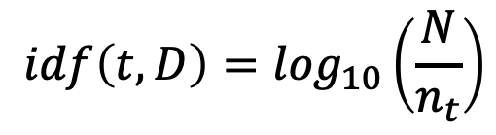
Inverse Document Frequency
Helps us regulate how important a term in a document is
$$idf\left(t,D\right)=\log_{10}\left(\frac{N}{n_{t}}\right)$$
N is the number of documents
n_{t} is the number of documents t appears in
Given term (t) and corpus (D)
The fewer documents that t appears in, the higher the IDF value will be, and the more weight it will give the word.

Slide 13

TF-IDF
$$w_{t,d}=tf\left(t, d\right) ∗idf(t, D)$$
The more frequent a term appears in a given document
The fewer times it appears in other documents
The higher it’s TF-IDF value

Slide 14
What can we do with these matrix representations of text?
We can use these matrix representations of text as features/input to our models.
Using these representations allows us to use ML techniques such as:
K-nn,
Decision Trees
Random Forests
AdaBoost
XGBoost
SVC/SVM
Naïve Bayes
Neural Networks
Etc.
We can also combine matrix representations with other columnar data to help improve our predictive modeling (for instance, we could have features that indicate a category of document, or source, etc.)

Slide 15
What other uses for matrix representations?
Similarity Search
Searching through data for similar items is a common operation in databases, search engines, and many other applications.
Finding similar items based on fixed numeric criteria is very straightforward using a query language:
SELECT * students WHERE grade > 95;
What happens when we have text?
We can use the techniques learned thus far!

Slide 16

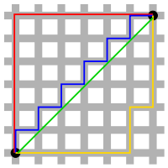

Measuring Similarity
y
Euclidian distance:
Shortest distance among two vectors (based on Pythagoras’ Theorem)
Manhattan distance:
Absolute difference of Cartesian coordinates.
Cosine similarity:
Cosine of the angular distance between two vectors:
x
d(x, y) =
cos(θ)
v_{i} is the count for word v in context i
w_{i} is the count for word w in context i

Slide 17
Cosine Similarity Example
Which pairs of words are most similar?
cosine(apricot,
information)
cosine(digital,
information)
cosine(apricot,
digital)
cos (0) = 1 → Vectors point in the same direction; words most similar
cos(180) = -1 → Vectors point in opposite directions; words opposite of each other
cos(90) = 0 → Vectors are perpendicular;
words are unrelated
 | large | data | computer
apricot | 1 | 0 | 0
digital | 0 | 1 | 2
information | 1 | 6 | 1
=
=
=
Visualizing cosines (angles)
=

Slide 18
Using distance measures to determine similarity
There are many other distance measures, but Cosine similarity is most frequently used for text.
This is partly because cosine similarity is less affected by differences in magnitude.
Follow along with the professor as he reviews example notebooks.

Slide 19
Extracting ‘tokens’ from Documents

Slide 20
Tokenization
So far, we’ve been seeing documents as collections of words. In machine learning we represent documents as collections of tokens.
How to identify tokens?
Use delimiters:
Space
Tab
New line
Symbols: ( ) < > ? !
Punctuation: . , : ; - ' "
Not all punctuation create tokens:
$1,000.50
U.S.A.
isn't or D'angelo
(813)555-4578

Slide 21
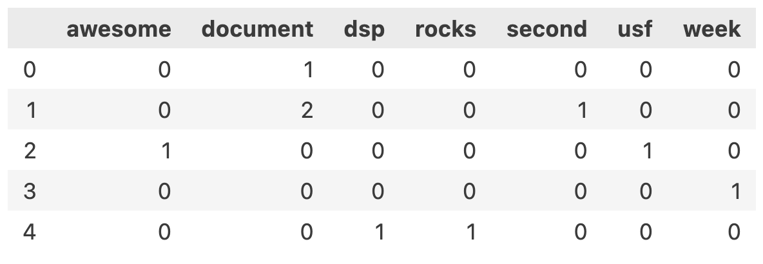
from sklearn.feature_extraction.text import CountVectorizer
import numpy as np
corpus = np.array([
'This is the!@# # first document.’,
'This Document 123 is the second document.’,
'USF is awesome!’,
'What week is this?’,
'DSP Rocks!'
])
# CountVectorizer will covert to lowercase, remove punctuation, and remove stop words - to
# remove other things, such as numbers, use the token_pattern parameter
vectorizer = CountVectorizer(stop_words='english', lowercase=True, token_pattern="[^\W\d_]+")
# [^\W\d_]+ not Word, not digit, not underscore -- see: https://regexr.com/
X = vectorizer.fit_transform(corpus)
df = pd.DataFrame(X.toarray(), columns=vectorizer.get_feature_names_out())
df

Slide 22
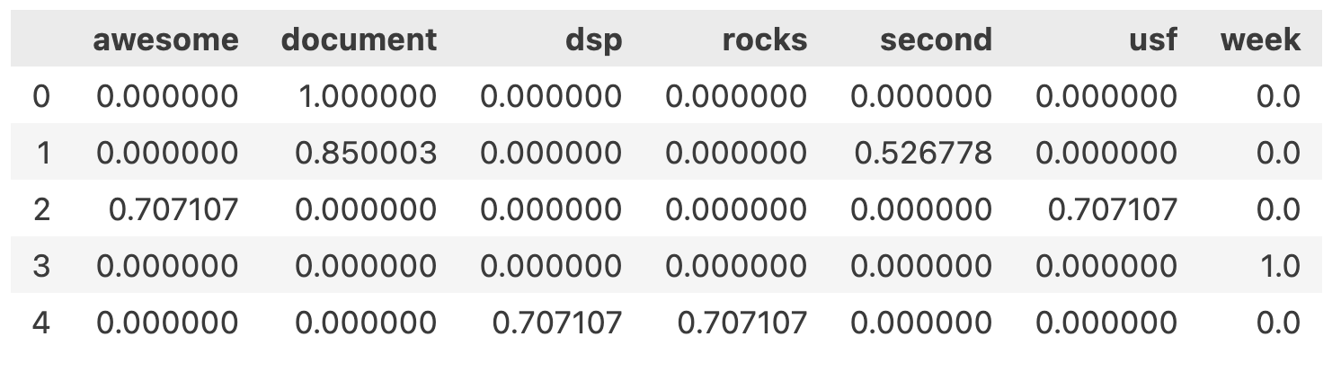
from sklearn.feature_extraction.text import TfidfVectorizer
# Like CountVectorizer, TfidfVectorizer will covert to lowercase, remove punctuation, and remove
# stop words - to remove other things, such as numbers, use the token_pattern parameter
vectorizer = TfidfVectorizer(stop_words='english', lowercase=True, token_pattern="[^\W\d_]+")
X = vectorizer.fit_transform(corpus)
df = pd.DataFrame(X.toarray(), columns=vectorizer.get_feature_names_out())
Df

Slide 23
Tokenization
Every token is in term-by-document matrix!!!
(Is this desirable/undesirable?)

Slide 24
Tokenization
How to reduce the number of tokens:
Conduct stemming
Conduct lemmatization
Eliminate stopwords
Correct misspelled tokens
Identify named-entities (part-of-speech tagging)

Slide 25
1. Stemming
A simple heuristic that removes the ends of words
Extract the root:
predictable, prediction → predict
different, differential, differing → differ

Slide 26
2. Lemmatization
Group those words together that have the same root or lemma
The words might have different inflections or derivatives of meaning
Example: Elimination of singular/plural, present/past:
boy, boy's, boys → boy
giving, gives, gave → give
be, are, was, were, been → to be

Slide 27
3. Stopwords
Stopwords: tokens that have little meaning
A, an, the, it, they, of, and, for, …
Little to NO predictive ability
Usually eliminated!

Slide 28
4. Use a Dictionary
Correct spelling errors:
seperate, separate → separate
fundemental, fundamental → fundamental
Create your own dictionary:
FLA, FL, Flor → Florida
Fall, fal, fell, feel, felt, feal, fel → fall
Use synonyms:
slip, take a spill, found on the floor → fall

Slide 29
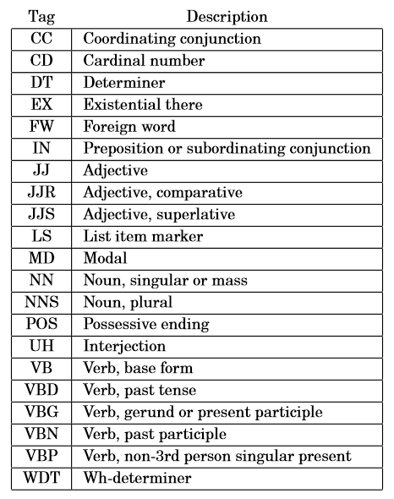
5. Part-of-Speech Tagging
Helps identify "phrases" (two or more tokens)

Slide 30
5. Part-of-Speech Tagging
Part-of speech tagging helps in two ways:
1) Eliminate certain phrases:
"as well as"
"even if"
"for all that"
2) Identify named-entities
"University of South Florida"
"United States of America"
Other named-entities that are helpful: names, organizations, countries, currencies, locations, date, time, percentage, etc.

Slide 31
Resulting Table
Transformed table:
A very LARGE table where
Each document is a single row
Each term is a single column
The values are tf-idf
Problem: there are thousands of columns!!!

Slide 32
Singular Value Decomposition (SVD)
Dimension reduction technique!
Same as Principal Components Analysis (PCA)
Also called “Latent Semantic Analysis” in text analysis
10,000 columns (dimensions) → 100 SVDs
Each SVD is a linear combination of the original columns

Slide 33
Singular Value Decomposition
We will only require an understanding of SVD as a tool:
SVD will reduce the number of dimensions of our data.
Term-by-document matrixes can be very large. SVD allows analysts to construct a much smaller representation of this data as linear combinations.
These linear combinations or “weighted sums ” can be used to more efficiently train predictive models.
To understand SVD deeply, see pages 935-947 of the following book (available online from the USF library)
Practical Text Mining and Statistical Analysis for Non-Structured Text Data Applications
Miner, Gary D ; Elder, John, IV ; Fast, Andrew ; Hill, Thomas ; Nisbet, Robert ; Delen, Dursun
Saint Louis: Elsevier Science & Technology; 2012

Slide 34
Summary
ID | News story
1 | Pediatricians should carefully evaluate kids with …
2 | Voters should register by …
(etc.)
ID | pediatrician | care | …
1 | 0.016 | 0 | …
2 | 0 | 0.057 | …
Etc.
ID | SVD1 | SVD2 | …
1 | 0.15 | -0.03 | …
2 | 0.24 | 0.76 | …
Etc.
From unstructured to structured
From structured to SVDs
NOW WHAT???

Slide 35
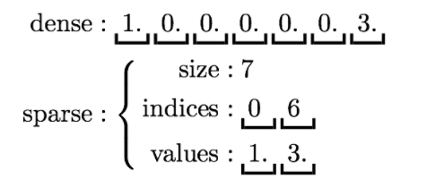
NOTE: Sparse Vector
Some ML/AI libraries will represent vectors with many zeros as a sparse vector representation.
A sparse vector is represented by a scalar and two parallel arrays: indices and values. Zero entries are not stored:

Slide 36
Happy Learning!

