Slide 1
Feature Extraction: From Words to Linguistics
Tim Smith, Ph.D.
E-mail: smith515@usf.edu
Copyright 2023, Dr. Tim Smith
Portions are copyrighted by Anol Bhattacherjee. Used with permission.

Slide 2
Outline
Feature extraction:
What is it
Why we do it
Text vectorization:
Word count vectors
One hot vectors
Weighted vectors
Vectorizing a corpus of documents:
DTM (document term matrix)
TF-IDF
1. Problem definition
2. Building a text corpus
3. Text cleaning/preprocessing
4. Feature extraction
5. Text vectorization
7. Insights & Recommendations
6. Text analysis (NLP)

Slide 3
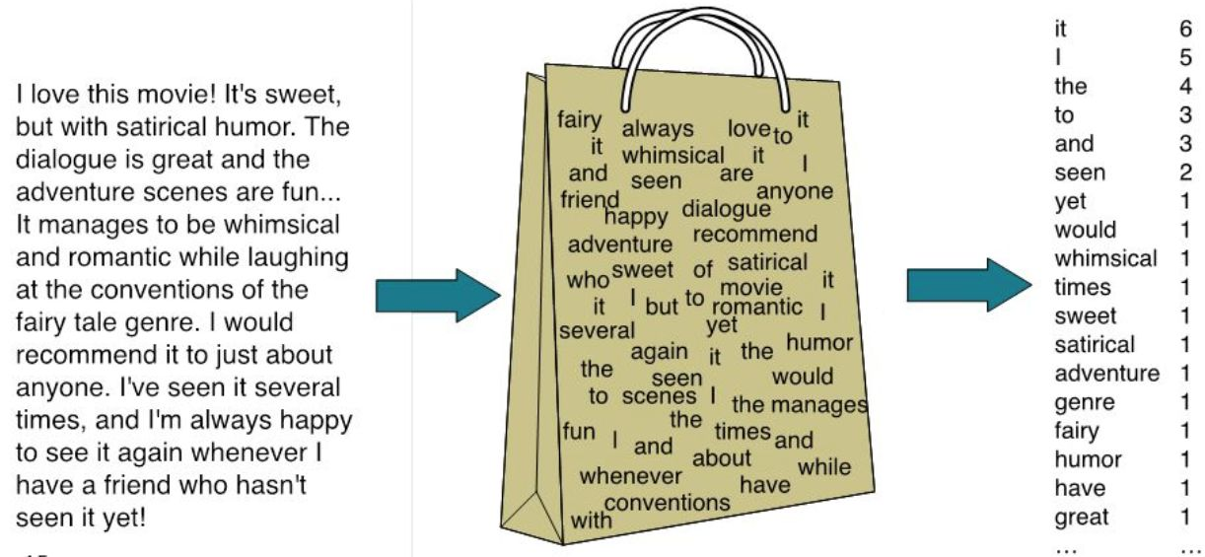
So far, we’ve treated text as a ‘bag of words’
We identify and collect data using downloading, scraping, or Web-API’s
JSON, XML, CSV, RDBMs, Selenium, Requests, Beautiful Soup, Scrapy
We address any encoding issues.
ASCII? UTF8? UTF16? ISO8859-1?
We isolate words using a tokenizer.
NLTK
We remove tokens that we are not interested in:
Stop words
Words of short length (i.e., 1 or 2 characters)
We normalize text:
Stemming
lemmatization
We include metadata (when necessary for our analysis):
For example, presential party affiliation.
We analyze text using the following methods:
Word Frequency
Sentiment
We visualize results using:
Bar plots
Wordclouds
From this analysis, we can answer questions such as:
What are the themes within a text?
What is the overall sentiment in the text?
How complex (or simple) is the text?

Slide 4
Feature Extraction
How can we ‘know more’ about a given text?
Parts of Speech
Meaning of words
Prediction or Clustering using ML
To accomplish this, we will need to understand:
POS Tagging
Word Embedding
Document Term Matrix
TF-ID
Today: We will explore two major topics:
POS Tagging
Turning words into numbers (which is required if we are to use ML)

Slide 5
Extracting POS (Parts of Speech) and Named Entity Features

Slide 6
Feature Extraction and Linguistics
What is linguistics:
The study of language and its structure, including the study of morphology, syntax, phonetics, and semantics
Words are usually not good (meaningful) features for understanding language; the same word can have multiple meanings, and different words can gave the same meaning.
Why do we need this:
A document can have tens of thousands of meaningless words, creating a high-dimensional input matrix for ML models.
ML algorithms perform better if we denoise text data by extracting fewer, more meaningful features.

Slide 7
Parts of Speech (POS) Tagging
What is POS tagging:
Marking up each word in a text corpus with its corresponding part of speech (e.g., nouns, verbs, adjectives, etc.), based both on the definition of the word and its context of use.
Some words can represent multiple parts of speech depending on its use, e.g., the word “dog” means something different in “President Trump’s term was dogged with controversies.”
Tag sets:
Nine parts of speech in English:
Noun, verb, article, adjective, preposition, pronoun, adverb, conjunction, and interjection.
However there are many sub-categories :
Nouns: NN for singular common nouns, NNS for plural common nouns, NP for singular proper nouns.
Development of POS tag sets:
Brown corpus tagged manually in the 1960s, from 1 million words of English prose, taken from 500 random samples (publications), each 2,000+ word long, based on grammatical rules.
Stochastic approaches developed in the 1980s, including Hidden Markov models, dynamic programming models, etc.

Slide 8
Noun Phrases
A group of 2+ words that includes a head noun (or pronoun) and its modifiers:
Examples: 'The quick brown fox jumps over the lazy dog’.
Usually includes a modifier (a, the), one or more adjectives (quick, brown), and a head noun (fox).
May be more complex:
We saw a man in a dark trench coat leave the building.
This man has a nice smile, but he's got iron teeth.
I don't have a bank account, because I don't know my mother's maiden name.
Every man of courage is a man of his word.
The best defense against the atom bomb is not have it at all.
Anyone who wants the presidency so much that he'll spend two years organizing and campaigning for it is not to be trusted with the office. (the head word “anyone” is a pronoun).
Verb-phrases:
A syntactic unit composed of at least one verb and its dependents (objects, complements, and other modifiers) but not the subject.
Mary saw the man through the window. Joe has finished his homework.
modifiers

Slide 9
Named Entity Recognition (NER)
What are named entities:
Names of people, organizations, location, time, quantity, monetary value, etc.
E.g., President Joe Biden, White House, New York, Google, 9:25 a.m., $1 million.
“European authorities fined Google a record $5.1 billion on Wednesday for abusing its power in the mobile phone market and ordered the company to alter its practices.”
Types of named entities:
Person, Organization, Time, Location (GPE), and Work of art (e.g., Hamlet, Jurassic Park).
Why do we need NER:
To answer many real-world questions such as:
Which companies were mentioned in the news article?
What specified products were mentioned in user complaints or reviews?
Which tweets mentions the name of a person or a location?.
To categorize customer support requests.
In content classification.
In search and recommendation engines (as keywords).

Slide 10
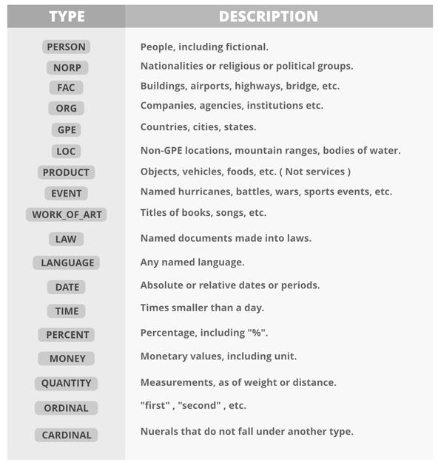
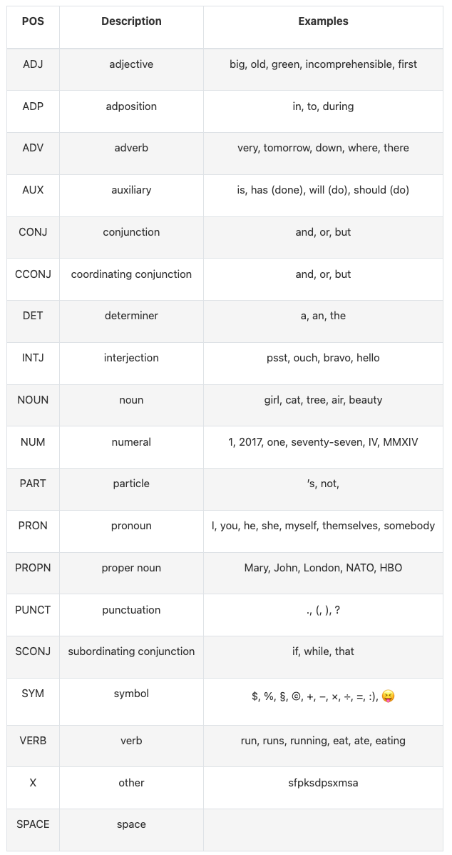
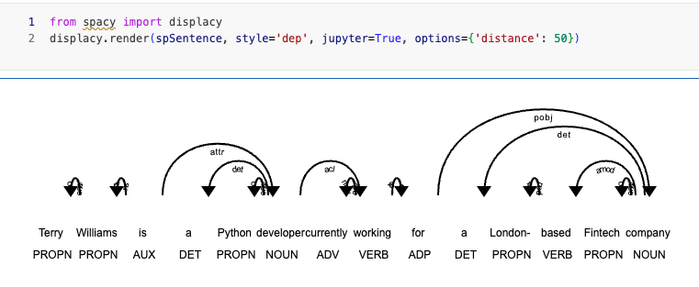
Spacy Example NER and POS

Slide 11
NLP Libraries in Python
NLTK (Natural Language Toolkit):
Oldest and most well-known NLP library with many third-party extensions.
Complex to learn and use (Textblob is a more intuitive interface).
Feature rich, but quite slow.
Popular for education and research.
No integrated word vectors.
Does not support deep learning models (needs Scikit-Learn, Keras, or Tensorflow).
Multilingual, with growing language support.
spaCy:
The fastest NLP framework; uses Cython engine written in C.
Most popular for large-scale industry-strength applications.
Easy to learn and use; more object-oriented than other libraries.
Minimal with limited options; provides only one algorithm for each task.
Built-in word vectors and some deep learning support.
Gensim:
Works with large datasets.
Supports word vectorization and deep learning.
Well-optimized for unsupervised text modeling.
Does not support the full NLP pipeline; should be used with NLTK or Spacy.
Others…
CoreNLP
TextBlob
AllenNLP
Polyglot
Scikit-learn
Pattern
PyNLPI (pronounced pineapple)
For a more in-depth review and comparison

Slide 12
Transforming Text to Numeric Features

Slide 13
Feature Extraction: “Text to Numbers”
Why do we need this:
ML algorithms require numeric inputs; they cannot process text or strings in their raw form; it must be converted into a set of numbers.
What is a feature:
An attribute (or a combination of attributes) shared by all independent units on which we wish to do analysis or prediction.
Feature engineering in text analytics:
Words in a sentence can be represented by:
their counts (frequency of occurrence), presence vs. absence, weighted counts
Or, by a similarity vector
If the ordering of words is not preserved, it is a bag of words approach

Slide 14
Applications
What can we do with text features:
Classification: Spam filtering, sentiment analysis.
Clustering: Group documents based on text similarity.
Topic modeling: Identify central themes in a corpus.
Document matching: Matching jobs, advertisements, etc.
Recommender systems: Recommending movies, books, etc.
Text summarizing.
Text generation: Chatbots.
Machine translation.

Slide 15
Converting Text to Vectors
Count-based vectorization
Similarity-based vectorization
Words represented by a simple function of counts (or presence) of nearby words
The “workhorse” of text analytics
Vectors are sparse
Techniques:
Count vector
One-hot vector
TF-IDF vector
Words representation is created by training a classifier to identify distances between words, relationships between words, etc.
Computationally intensive
Vectors are dense
Techniques:
Continuous bag of words
Skip-grams

Slide 16
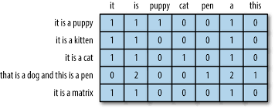
Count-Based Vectorization
features/tokens/terms
Documents
Document vectors
Word counts
Document-Term Matrix (DTM)
[a “bag of words” (BOW) approach]

Slide 17
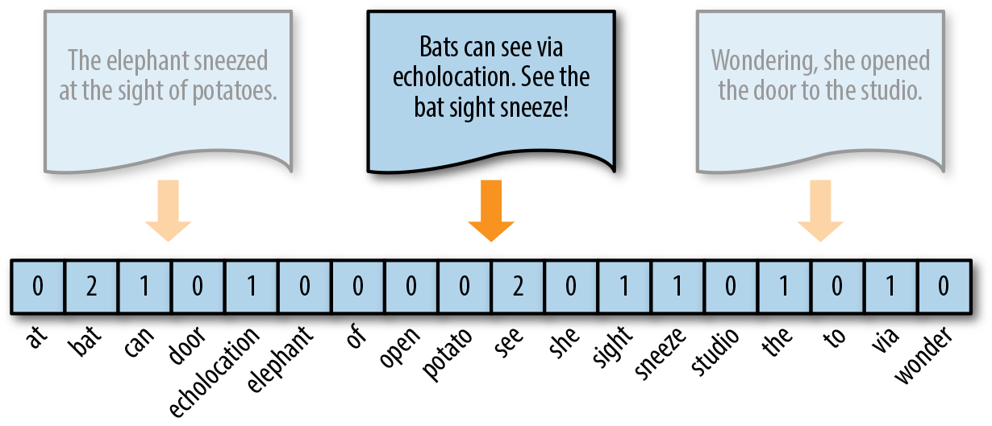
Count Vectors
How it works:
Create a dictionary consisting of all unique words (terms) in a corpus; the size of all document vectors equal the size of the dictionary.
Count how many times each term in this dictionary appears in each document in the corpus.
Improve representation by removing stop words, lemmatizing, using n-grams, etc.
Implementation:
In NLTK: vectorize( )
In Scikit-Learn: CountVectorizer( )
Gensim: doc2bow( )
Question:
What happens as we add more documents to this corpus?
Count vector: [0, 2, 1, 0, 1, 0, 0, 0, 0, 2, 0, 1, 1, 0, 1, 1, 1, 0]

Slide 18
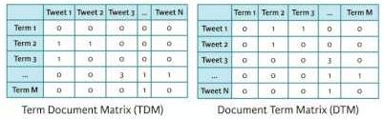
Vectorizing a Corpus of Documents

Slide 19
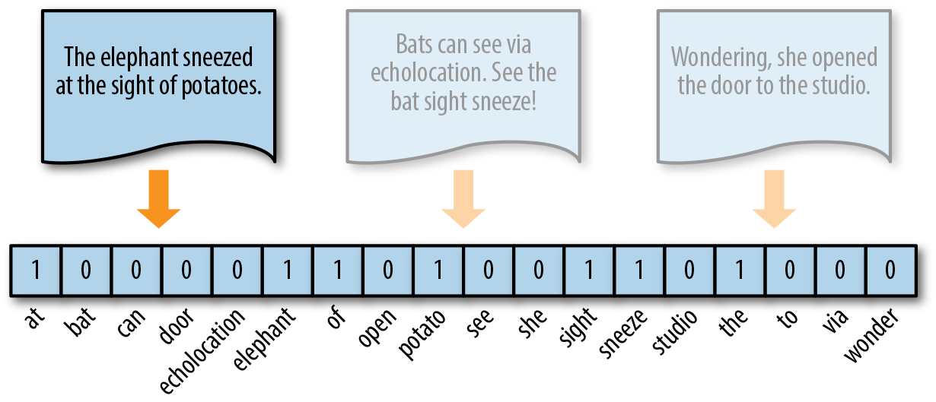
One-Hot Vector
How it works:
Replace count vector with a Boolean vector to indicate the presence(1) vs absence (0) of a term in the dictionary, rather than their counts.
Frequent tokens get no extra weight, which reduces imbalance in token distribution.
More effective for small documents (text messages, tweets) with not many repeated elements.
Implementation:
Same as count vectors, with a binary transformation.
Question:
Can you think of a possible ML application?
One-hot vector: [1, 0, 0, 0, 0, 1, 1, 0, 1, 0, 0, 1, 1, 0, 1, 0, 0, 0]

Slide 20
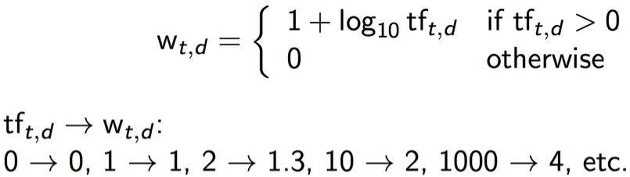
Weighted Count Vectors
How it works:
Replace each count vector with a value (weight) that is decreasing rate such that more frequent terms across the corpus of documents receive less weight than less frequent terms.
A term occurring 10 times in a document is definitely more relevant than a term occurring only once, but is probably not 10 times more relevant.
Weight of term t in d:
y = 1 + log₁₀(x)
1.3
1.3

Slide 21
Term Frequency–Inverse Document Frequency
How it works:
Count, one-hot, and weighted count vectors view each document in a corpus independently, without considering the occurrence of terms across documents.
Instead of weighting terms within a document, TF-IDF weights them with inverse frequency of occurrence across documents such that more frequent terms receive less weight.
Example:
Consider a corpus of sports documents. Terms like “player” and “scores” may be frequently referenced across all documents, but are less relevant for distinguishing between documents.
Less-frequent terms such as “pitcher,” “strike-outs,” and “first base” are more informative (for a document on baseball) than a generic “player” and should get higher weights.
Documents on similar sports like baseball and cricket may have more common terms like “runs”, “innings”, and “umpire” than baseball and tennis (“love”, “ace”).
Extremely rare terms (e.g., “LBW”, “Yorker”, “strike-out”, “ace”) should get the highest weights.

Slide 22
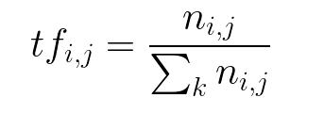
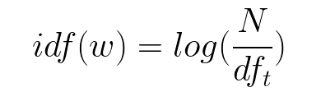
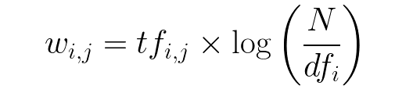

Computing TF-IDF
Term Frequency:
Frequency of a token in each document in the corpus.
TF = number of times a token appears in a doc / total number of words in that doc
Inverse Document Frequency:
Weight assigned to tokens across all documents in a corpus.
Rare tokens (high IDF score) are more valuable than frequent tokens.
IDF = log(number of docs / number of docs a token appears in)
TF-IDF:
An inverse weighting mechanism to weigh down frequent tokens and scale up rare tokens.
TF-IDF = TF x IDF
Implementation:
Scikit-Learn: TfidfVectorizer( )
Gensim: TfidfModel( )

Slide 23
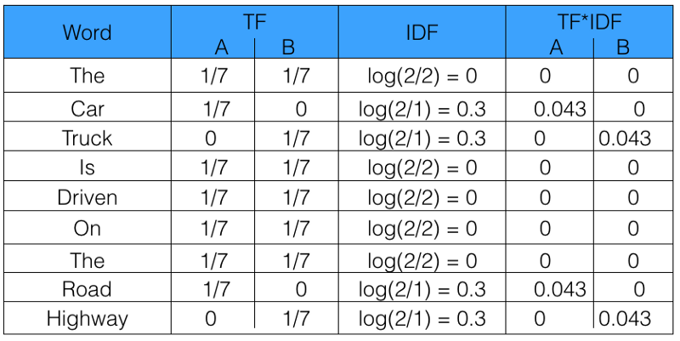
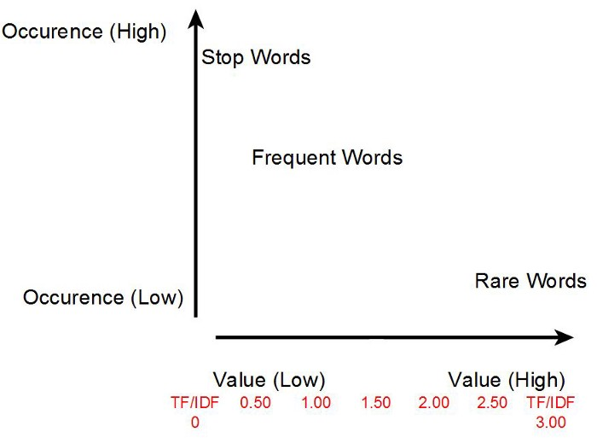
TF-IDF Example
Consider a corpus with two sentences:
Document A: The car is driven on the road.
Document B: The truck is driven on the highway.
Stop words (“the”, “is”, “on”) get zero weights.
More informative words:
Document A: ‘car’, ‘road’.
Document B: ‘truck’, ‘highway’.

Slide 24



TF-IDF Variants
TF-IDF:
A variant of TF-IDF variant:
Popular in information retrieval (e.g., Google search) for matching queries to documents.
Log average:
Augmented IF-IDF:
w_{i, j} = (1 + log (t f_{i, j}))
w_{t, d} =
w_{t, d} = x

Slide 25
TF-IDF in Python
Using Scikit-Learn
Using Gensim
# Creating count vectors/DTM/BOW
# fit() method creates dictionary, transform() creates dtm
# fit_transform() does both in a single step
from sklearn.feature_extraction.text import CountVectorizer
vectorizer = CountVectorizer()
dtm = vectorizer.fit_transform(my_docs) print(vectorizer.vocabulary_)
dtm.shape
print(dtm.toarray())
print(vectorizer.inverse_transform(dtm))
# Creating TF-IDF
from sklearn.feature_extraction.text import TfidfVectorizer
vectorizer = TfidfVectorizer()
tfidf = vectorizer.fit_transform(my_docs)
print(tfidf.toarray())
# Gensim takes tokenized docs, not text strings
# Creating dictionary
from gensim.corpora.dictionary import Dictionary
dictionary = Dictionary(tokenized_docs)
dictionary.token2id
len(dictionary.token2id)
# Creating count vectors/DTM /BOW
dtm = [dictionary.doc2bow(doc) for doc in tokenized_docs]
doc_term_matrix:
# Creating TF-IDF
from gensim.models.tfidfmodel import TfidfModel
tfidf = TfidfModel(dtm)
for doc in tfidf_matrix[doc_term_matrix]:
print([[dictionary[i], np.around(freq, decimals=2)] \
for i, freq in doc])

Slide 26
Overview of Text Vectorization Methods
Vectorization Method | Function | Good For | Considerations
Count/Frequency | Counts term frequencies | Bayesian models | Works best if the most frequent terms are the most informative
One-Hot Encoding | Binarizes term occurrence (0, 1) | Neural networks (inputs to word embedding models) | All words equidistant, so normalization* is very important
TF–IDF | Normalizes term frequencies across documents | General purpose | Works best if moderately frequent terms are representative of document topics
*Normalization includes removal of punctuations, stop-word removal, stemming/lemmatization, etc.
Source: Tony Ojeda, Rebecca Bilbro, Benjamin Bengfort, Applied Text Analysis with Python, O'Reilly Media, 2018

Slide 27
Limitations of BOW Models
Ignores the ordering of words in a document, and hence, the meaning of text.
John is taller than Mary and Mary is taller than John are assigned the same vectors.
Captures presence/frequency of words, not their similarity.
Synonyms are coded as different words, even if they mean the same. Had the author used the same word instead of its synonym, count frequency would have changed.
Dimensionality explosion:
If we have a corpus of 1 million documents, each with about 1000 words (average 6 bytes/word including spaces/punctuation, means 6GB of data), and 500,000 distinct terms, we have a matrix of 500,000 x 1 million = half a trillion cells.
Sparsity:
Most of the entries in a TF-IDF matrix (~99%) are zeros, which is computationally inefficient.
Though, ML libraries such as tensorflow and pyTorch have ‘sparse tensors that store and process these more efficiently.

Slide 28
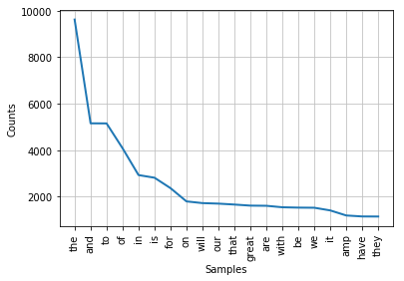
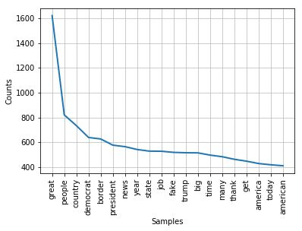
Sparsity in 6400+ Donald Trump’s Tweets
Before stop word removal
(Word count = 182,165)
After stop word removal
(Word count = 101,357)
Stop word removal reduces sparsity but does not eliminate it

Slide 29
The Sparsity Problem with Count Vectors
What it is:
With millions of documents and thousands of words per document, a count vector matrix may have hundreds of millions of mostly zero values, which is computationally inefficient.
How to address this problem?
Normalizing:
Cleaning punctuations, special characters.
Dropping stop words .
Stemming or lemmatization.
How to identify unique or rare words?
POS tagging: Nouns (and verb-noun or adjective-noun bigrams) have more informational content.
Named entity recognition preserves nouns with special meaning (e.g., White House, New York).
A matter of trade-off:
We need enough high-value unique words to distinguish documents as well as sufficient common words to group documents (clustering).

Slide 30
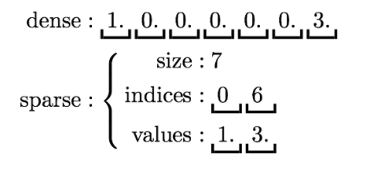
Sparse Vector
Some ML/AI libraries will represent vectors with many zeros as a sparse vector representation.
A sparse vector is represented by a scalar and two parallel arrays: indices and values. Zero entries are not stored:

Slide 31
What Can We Do With TF-IDF
Supervised Learning
Unsupervised Learning
Classification:
Binary/Multi-class:
K Nearest Neighbor
Decision tree
Naïve Bayes
Logistic regression
Support vector machines
Bagging models:
Random Forest
Boosting models:
XGboost, Adaboost
Neural networks:
Perceptron/shallow NN
Deep Neural Nets
Convolutional Neural Net
RNN: LSTM, GRU
Regression:
Linear:
OLS
GLM
Poisson
WLS
2SLS
SUR
Non-linear:
Logit/probit
Polynomial
Ridge, Lasso, Splines
Time-series analysis
Survival analysis
Clustering:
K Means
Hierarchical cluster analysis
Mutridimensional scaling
Association rule mining:
Market-based analysis
Dimensionality reduction:
Principal components*
SVD (LSA/LSI*)
t-SNE
LDA*
Reinforcement Learning
Agent Based Modeling

