Slide 1
Introduction to Text Analytics
Tim Smith, Ph.D.
University of South Florida, Tampa, USA
E-mail: smith515@usf.edu
Copyright © 2023 by Tim Smith. All Rights Reserved
Portions are copyrighted by Anol Bhattacherjee. Used with permission.

Slide 2
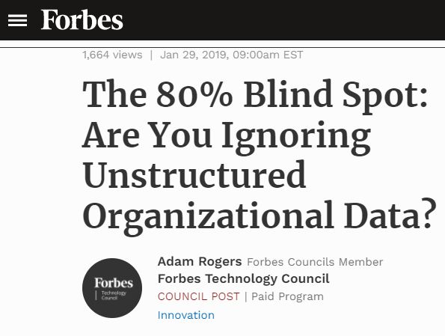
Outline
Text analytics:
What it is
Related terms:
Natural language processing
Computational linguistics
Why we need text analytics
History
Applications

Slide 3
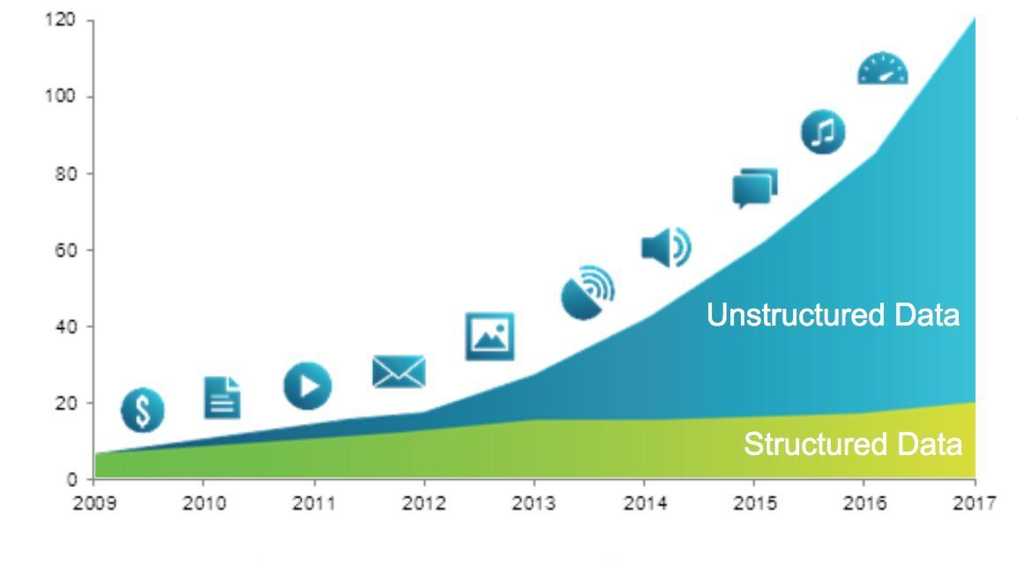
Exponential Growth in Unstructured Data
Machine-Generated
Data
Social
Media Data
Multimedia
Data
Enterprise
Data
Unstructured Data Growth:
60-80% per year
Exabytes (Billion GB)
Source: IDC (2016)

Slide 4

Text Analytics
Text analytics (or text mining) is the process of discovering hidden patterns from unstructured text documents using statistical or machine learning methods
Structured Data Multimedia Free Text Hypertext
HomeLoan (
Loanee: Frank Rizzo
Lender: MWF
Agency: Lake View
Amount: $200,000
Term: 15 years
)
Frank Rizzo bought
his home from Lake
View Real Estate in
1992.
He paid $200,000
under a15-year loan
from MW Financial.
<a href>Frank Rizzo
</a> bought
<a hef>this home</a>
from <a href>Lake
View Real Estate</a>
in <b>1992</b>.
<p>...
Loans($200K,[map],...)
Unstructured Text: E-mails, Text messages, Facebook comments, Online product reviews, Word documents, Web pages & blogs, …

Slide 5
Text Analytics: Related Terms
Using Modeling to Understand what is being said
Data Mining
Text
Mining
Natural Language Processing
Natural Language Understanding
Natural Language Generation
Extracting patterns from structured data
Extracting patterns from unstructured text
Modeling written and spoken human language
Using Modeling (LLMs) to generate relevant, comprehensible text
What we really want to do these in this class
First, we need to understand something about these

Slide 6
Natural Language Processing
NLP is the application of artificial intelligence techniques to help computers understand, process, and respond to spoken or written human languages
“I love cricket”
“Barack Obama”
“President Obama”
“Obama”
Text mining:
A document about “cricket”
NLP:
Cricket the sport or cricket the bug?
Text mining:
Three words: President, Barack, Obama
NLP:
Same person: President Barack Obama
The challenge of NLP: Understanding context

Slide 7
What are some examples or use cases of Text Analytics?

Slide 8
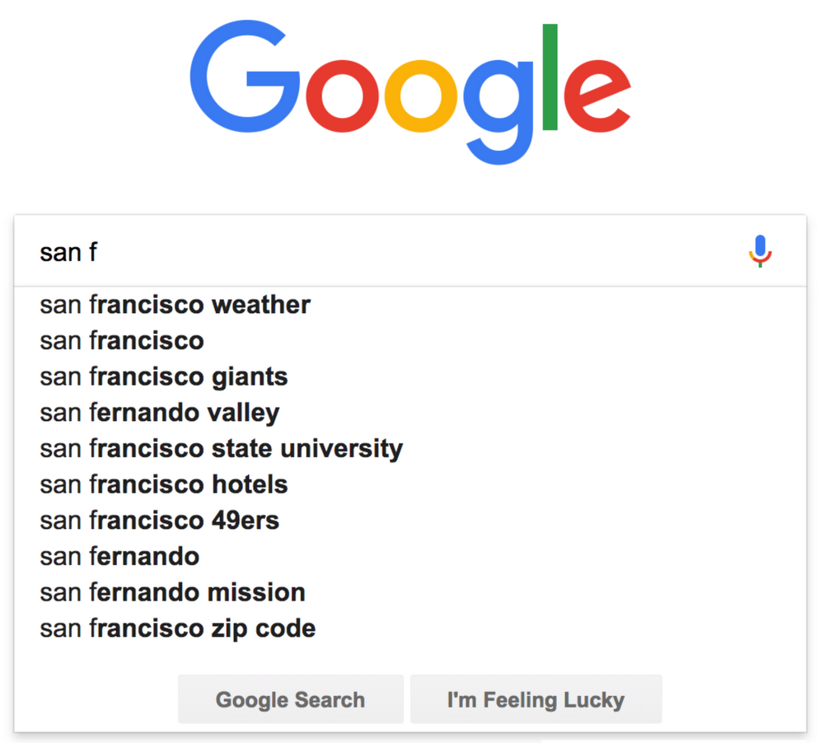
Use Cases
Spam Filtering:
Based on source e-mail address, presence of certain words or word patterns, attachments, etc.
Spellchecking/Autocorrect:
Correcting text for typos, grammatical errors, sentence structures, and beyond.
Autocomplete (Next Word Prediction):
Uses a language model, with vectorized words in a “similarity space” to search for related words based on words already typed in.
Information Retrieval:
Keyword search on Google, library databases, legal documents, …

Slide 9
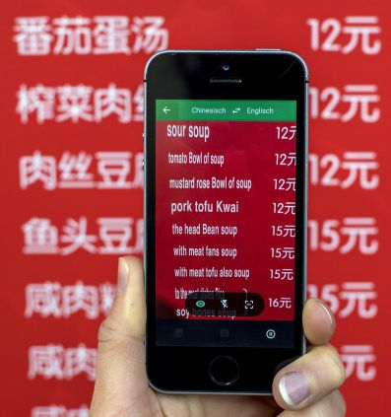
Use Cases
Machine Translation:
Google Translate is based on statistical learning: not a word-for-word replacement but based on “similarity score”.
Chatbots
You will be creating a ‘fine tuned’ one of these later in the course.
Virtual/Voice Assistants:
Speech recognition + chatbots + speech generation.
Siri, Cortana, Google Assistant, Alexa,…
Answering questions.
Automated Text Summarization:
Summarizing news articles, minutes of meeting, book reviews, political speeches, …

Slide 10
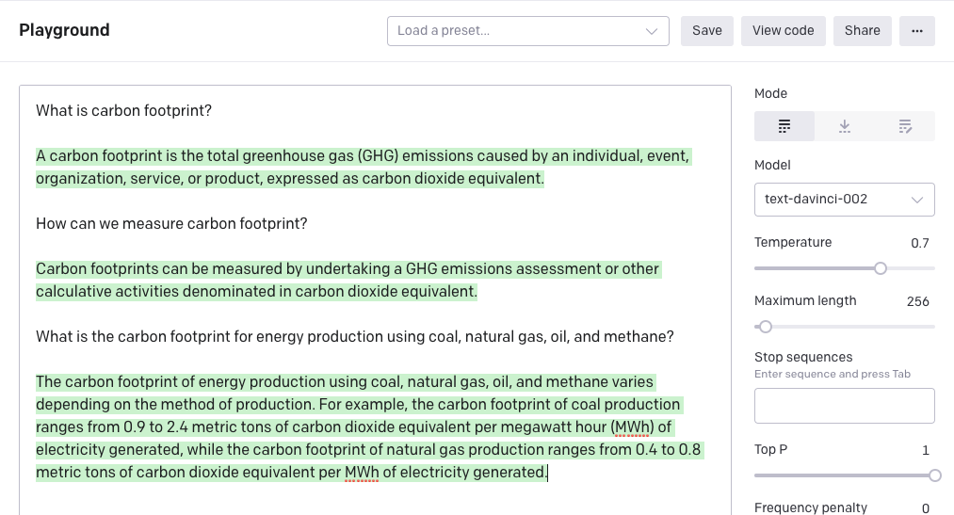
Use Case: Q&A Using GPT-3

Slide 11
Use Case: Virtual Assistants
Eliza: Hi, I’m Eliza. How can I help you?
You: What help can you provide?
Eliza: Does that question interest you?
You: Why do you ask?
Eliza: Oh, I ask.
You: I believe you said you can help me.
Eliza: Do you wish to believe me?
You: Yes.
Eliza: Are you sure?
You: Why wouldn’t I be sure?
Eliza: Can you elaborate on that?
You: What is the purpose of life?
Google: To serve the greater good.
You: What is the purpose of living?
Google: To live forever.
You: What is the purpose of being intelligent?
Google: To find out what it is.
You: Where are you now?
Google: In the middle of nowhere.
You: What is immorality?
Google: The fact that you have a child.
ELIZA (Rule-Based Response
System from 1960s)
Google AI Agent (Natural Language
Processing System from 2015)

Slide 12
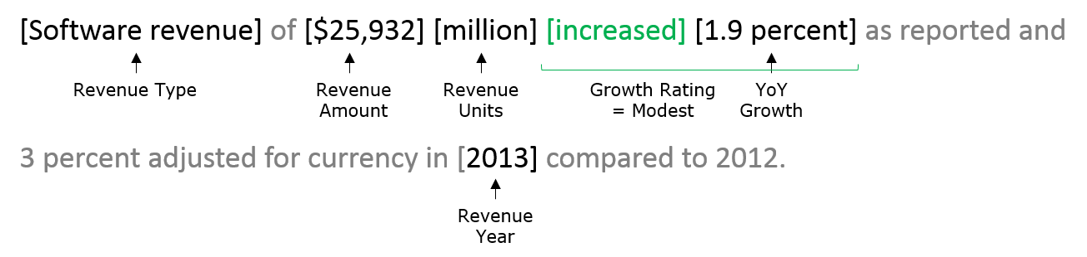
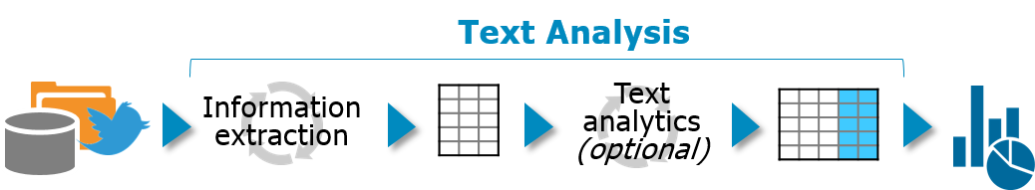
Use Case: Information Extraction
Recognizing text useful pieces of information and connecting them into key=value pairs.
Detecting terms based on data types, specific words and linguistic context.
Classifying and organizing these terms, often leveraging dictionaries or ontologies.
Assigning values for these terms using simple rating systems to complex statistical methods.

Slide 13
Business Applications
Hiring & Recruitment:
Information (feature) extraction (skills, location, and education) using named entity recognition.
Information matching in a feature space using association rule mining.
Social media monitoring:
Measuring public opinions on new products/services using sentiment analysis.
Detecting customer service failure points from social media posts for quick response.
Finding what customers like/hate about their products using feature extraction and topic modeling.
Identifying changing patterns in customer preferences.
Targeted Advertising:
Using customer search keywords to generate custom ads relevant to the search.

Slide 14
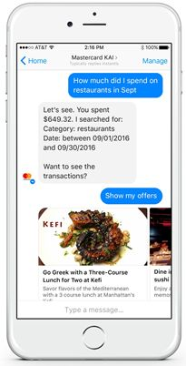
Business Applications
Customer service:
Using speech recognition and chatbots to automate customer service and lower costs.
Decodes text questions, searches internal databases or a knowledge base, sorts potential responses by probability, and presents most probable answer.
Document management:
Optical character recognition (OCR), recognizing invoices, receipts, legal documents, hospital discharge reports, PDF to text, image to text, …
Parsing hospital discharge reports to identify patients exhibiting similar patterns of symptoms or etiology.

Slide 15
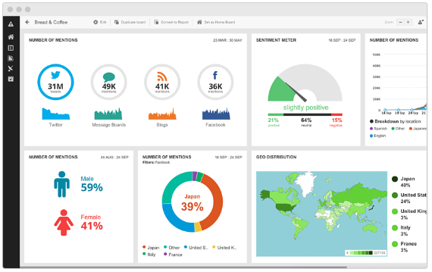
Business Application: Sentiment Dashboard
Sentiment Dashboard (Hootsuite Insights)

Slide 16
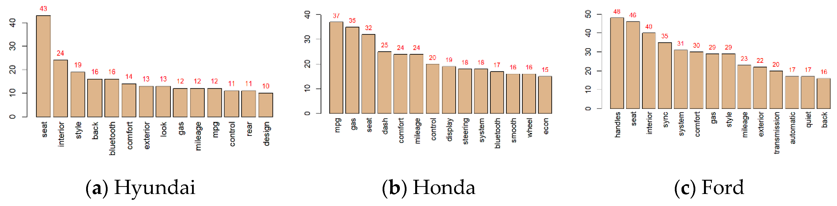
Business Application: Feature Extraction
Most frequently mentioned features in online car reviews

Slide 17
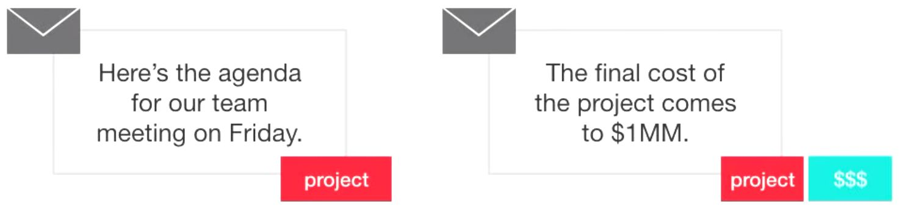
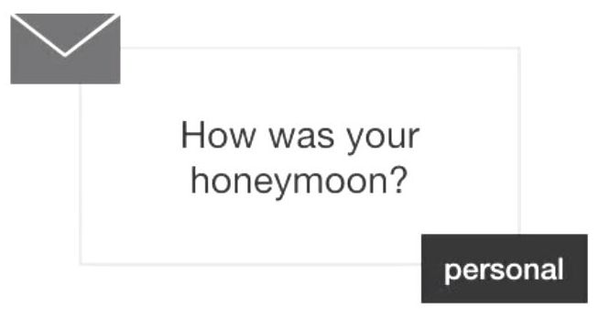
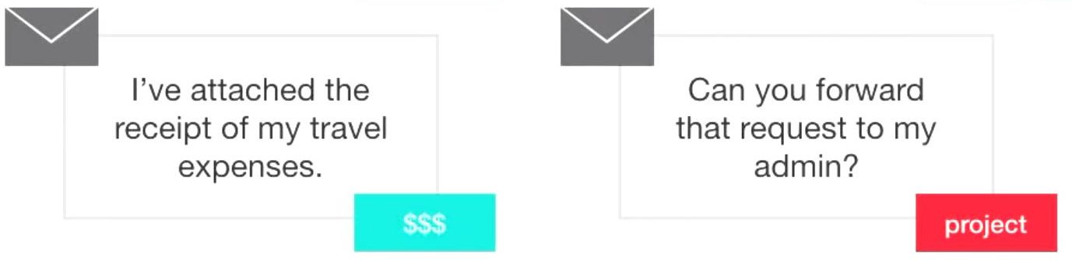
Use Case: Topic Modeling
Prioritizing e-mails for auditing corporate fraud

Slide 18
Text Mining versus NLx
 | Text Mining | NLU | NLG
Goal | Extracting patterns from unstructured text Converting unstructured text into structured data | Understanding language, including semantic meanings and linguistic structures | Generating language that is coherent, meaningful, and correct.
Inputs | Text documents | Any form of human communication like text, speech, signs | Any form of human communication like text, speech, signs
Outputs | Explanation of text using statistical indicators such as frequency of words, patterns of words, correlation within words, etc. | Understanding what is conveyed through speech/text such as sentiment, semantic meaning (for translation to other languages), grammatical structure, etc. | Generating sufficient responses to given input. Though input has traditionally been text, and output text – we are beginning to see multi-model modeling that incudes text-> image, text->video, etc.
Performance measures | Direct and relatively simple mathematical concepts that can be automated | Difficult to measure; require human intervention | Difficult to measure; require human intervention and reinforcement
Tools | Text processing languages like Perl, statistical models, machine learning models | Advanced ML models, deep neural networks, toolkits like NLTK in Python | Pre-trained Large Language Models like ChatGPT4, LLaMA-2, etc.

Slide 19
Challenges of NLP: Vocabulary Size
English:
The Oxford dictionary has about 170,000 words (including 47,000 obsolete words).
Webster’s Third New International Dictionary has about 470,000 words.
Typical US adults know about 20,000-35,000 words; 3,000 words cover 95% of everyday use and the first 1,000 words cover 89% of everyday use.
We make up new words not in the dictionary (e.g., frenemy, bromance, unfriend, retweet).
On social media/text, we use acronyms (e.g., LOL), typos, abbreviations (e.g., r u fne?), emojis, …
Other languages:
Spanish: 100,000 words; German: 135,000 words; French:100,000 words; Italian: 270,000 words; Russian: 200,000 words, …
Words may not match in meaning with English words.

Slide 20
Challenges of NLU: Understanding Meaning
The same word could mean different things:
Apple: a fruit, a computer, a company, or a person’s name.
Bank: a financial institution or the side of a river or a last name.
Battery: a power source or an assault.
Semantic meaning defined by context:
“I had an apple for lunch.”, ”I used an Apple computer for work”, “I work for Apple”
“He went fishing to the river bank”, “He went to the bank to withdraw money”
“He was charged with assault and battery”, “The battle was won using a modern artillery battery”
Combinations of the same words may have different meanings:
“What are you eating?” vs. “What’s eating you?”.
Words may have “hidden meanings”:
Sarcasm: “I lost my keys again! Great!”
Metaphors: “He is a shining star”, “Early bird special”, “A blanket of snow”.

Slide 21
Context Sensitivity of Natural Languages
Guess the missing words:
Man’s best _________________
I’m going to lunch with my ___________
Which sentence has higher entropy (ambiguity)?
How can you train a computer to answer these questions?
What is the sentiment in these sentences:
This Facebook post made me sick.
My child is sick today and could not go to school.
I had high hopes and great expectations for this movie, dubbed as wonderful and exhilarating by critics, but was hugely disappointed.

Slide 22
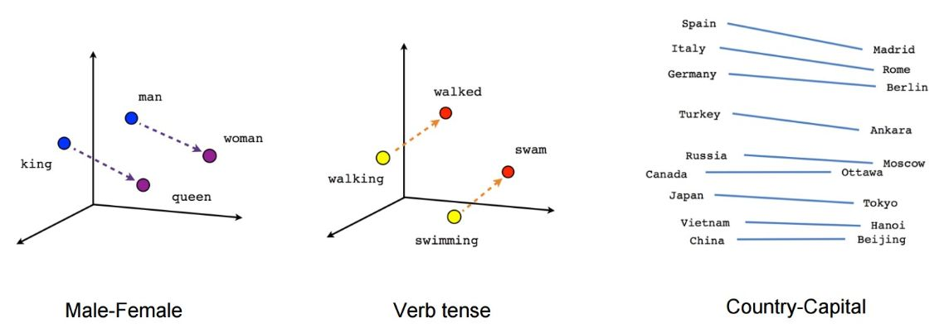
Word Associations
Guess the missing words:
Man : Woman :: King : ____________
Walk : Walking :: Swim : ___________
Russia : Moscow :: Spain : ________

Slide 23
Computational Challenges of NLx
NLx algorithms:
Don’t have “intuition” to gauge meaning from ambiguous language, nor have an “understanding” of generated language.
Must adapt to and be usable in different contexts (e.g., medical transcripts, legal case files).
Must not interpret language using deterministic rules (e.g., dictionary lookup), but be fuzzy and flexible (e.g., use probabilities, semantic distance, etc.).
Machine learning:
Goal: Fit existing data to an initial model and refine model iteratively to create a representation of the real world that can make reasonable decisions on new data.
Representing language/text as numeric values and vectors that can be analyzed using linear algebra to infer semantic content.
Modeling language/text data may require retraining with new data to apply in a new context or may have to be customized for individual users.
Humiliated lawyers fined $5,000 for submitting ChatGPT hallucinations in court
https://fortune.com/2023/06/23/lawyers-fined-filing-chatgpt-hallucinations-in-court/

Slide 24
A Brief History of NLP
1906-1911 | Swiss linguistics professor Ferdinand de Saussure developed an approach for viewing “languages” as a system of communicating “meaning” based on the words and structure of the language
1950 | Alan Turing conceptualized a “thinking machine” that could converse with a human using a teleprinter such that the human could not tell if it was a machine.
1952 | Hodgkin-Huxley model showed that the brain communicates by sending electrical signals using neurons – the start of AI/NLP
1957 | Noam Chomsky created a structured style of grammar called Phase-Structure Grammar to translate natural language sentences into a format that computers can use.
1958 | John McCarthy developed LISP, a programming language for language identification
1964 | ELIZA, a conversational agent, developed to imitate a psychiatrist using reflection techniques (it rearranges sentences using simple grammar rules but does not understand anything)
1966 | After 12 years of funding AI/NLP research and spending $20 million, US NRC and ALPAC (Automatic Language Processing Advisory Committee) halted funding as machine translations were still more expensive than human translations, and computers were still unable to carry on a basic conversation. AI/NLP considered dead – the “winter” of AI begins

Slide 25
The Rebirth of NLP
1980s | Steady increase of computational power shifted focus to machine learning algorithms that replaced deep analysis with simple approximations, linguistics with statistics; expert systems developed to codify simple rules as decision trees – the “spring” of AI
1990s | N-grams developed to recognize and track clumps of text; LSTM, RNN models introduced in 1997, which found their niche in voice and text processing in 2007
2001 | Yoshio Bengio proposed the first neural “language” model using a feed-forward neural network to move data from input nodes through hidden nodes to output nodes, with no cycles or loops
2011 | Apple started Siri - the world’s first successful NLP/AI assistant for consumer use to translate spoken words into digitally interpreted concepts, and match those concepts to predefined commands.
2013 | Google introduced Word2Vec – the world’s first pretrained large-scale natural language model to understand words.
2017 | “Attention is All you Need” - paper published; which laid the foundations for transformer development and the LLM’s like ChatGPT4.
2019 | Google rolled out BERT – the world’s first sentence transformer model to understand sentences.
2020 | OpenAI’s GPT-3 model creates intelligible human text
2022 | GPT-3.5 takes the world by storm (and is later greatly improved by GPT-4)
2023 | Rise of ‘open-source’ models such as LLaMA-1 and LLaMA-2

Slide 26
Python Libraries for NLP
NLTK:
Natural Language Tool-Kit containing corpora, lexical resources, grammar, algorithms, and pretrained models for NLP.
Gensim:
Industry scale unsupervised semantic modeling of text, including document similarity, topic modeling, and word2vec.
Spacy:
Production-grade NLP focusing on preprocessing text for deep learning or information extraction.
Scikit-Learn:
Extension of SciPy (Scientific Python) that provides API for machine learning: regression, classification, clustering, dimensionality reduction, cross-validation, and hyperparameter tuning.
Matplotlib and Seaborn:
Graphics libraries for exploratory data analysis and visualizations.
Tensforflow/Keras/PyTorch
Powerful deep neural network libraries that enable the creation of advanced NN architectures.

Slide 27
File IO, Formats, and Codecs
Follow along with the professor as he demonstrates reading and writing files, how data (and text) is represented in files, and the various codecs used to represent text.
W01.0-introduction.ipynb
W01.1-Text_Codecs_Intro.ipynb
W01.2-Codecs_In_Python.ipynb
W01.3-Reading_and_Writing_files.ipynb

Slide 28
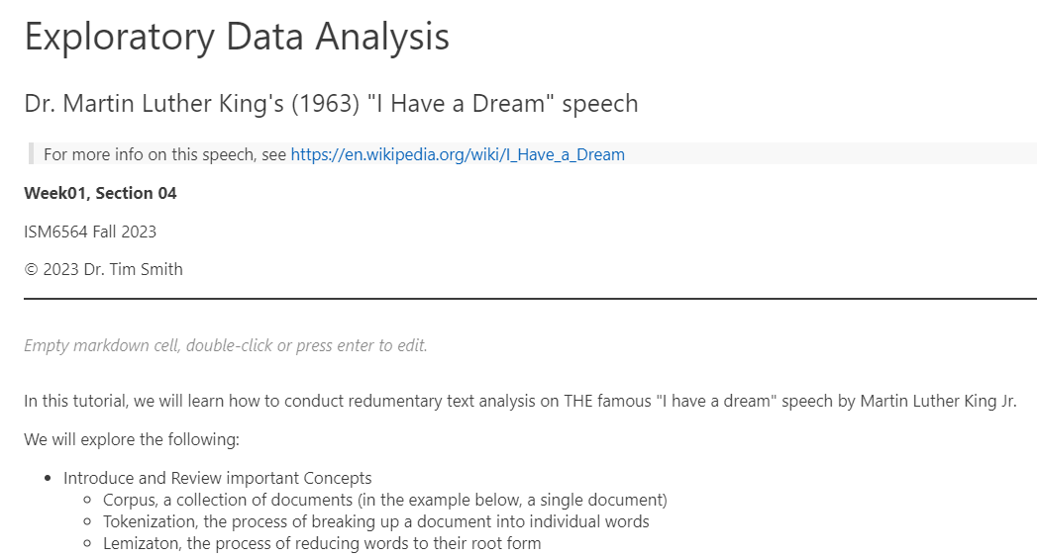
Example Exploratory Analysis
Follow along with the professor as he demonstrates textual analysis techniques on Martin Luther King’s “I Have a Dream” speech.
The professor will introduce and demonstrate the following concepts and techniques:
Tokenization
The process of breaking up a document into individual words
Lemmatization
the process of reducing words to their root form
Stopwords
words that are not useful for analysis
Wordcloud
a visualization of the most common words in a corpus
n-Grams
Sequence of n words
Sentiment Analysis
The process of determining the sentiment of a document (positive, negative, neutral)
W01.4-Exploratory_Text_Analysis_MLK.ipynb

Slide 29
Text Analytics Workflow
1. Problem Definition
2. Text Corpus
3. Text Preprocessing
4. Feature Extraction
5. Text Vectorization
7. Insights & Recommendations
6. Text Modeling/Analysis
Trivial questions generate trivial insights
Insights must be useful and usable

Slide 30
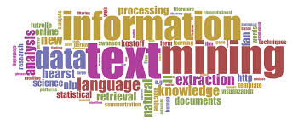
Questions?

