Slide 1
Slide 1: Title Slide & Executive Overview
• `text
• +-----------------------------------------------------------------------------------+
• | NY EV SITE SUITABILITY ANALYTICS PLATFORM |
• | |
• | [ ⚡ Electric Vehicle Charging Site Selection - NY Region ] |
• | [ 🟣 DAC Prioritized | 🔌 ConEd Grid Capacity | 📊 Live GIS ] |
• | |
• | Presenter: Capstone Data Engineering Team |
• | Target Territory: Con Edison Service Territory (NYC + Westchester) |
• +-----------------------------------------------------------------------------------+

Slide 2
Slide 2: Problem Statement & Strategic Need
• `text
• +-----------------------------------------------------------------------------------+
• | THE CHALLENGE |
• | |
• | 1. Charging Deserts 2. Grid Capacity Constraints 3. Mandated Equity |
• | [ Underserved DAC Tracts ] [ Feeder Headroom Overload ] [ Climate Act (35%) ]|
• | |
• | SOLUTION: Multi-Criteria Spatial Decision Analytics Platform |
• +-----------------------------------------------------------------------------------+
• `

Slide 3
Slide 3: Multi-Source GIS Data Architecture
• `text
• +-----------------------------------------------------------------------------------+
• | LIVE SPATIAL DATA CATALOG |
• +------------------------------------+----------------------------------------------+
• | Dataset Name | Source Provider & Role |
• +------------------------------------+----------------------------------------------+
• | 1. Disadvantaged Communities (DAC) | NYSERDA / CJWG (data.ny.gov 2e6c-s6fp) |
• | 2. EV Registrations by County | NYS DMV (data.ny.gov 3vp6-cxmr) |
• | 3. Traffic Volumes & Corridors | NYSDOT Vehicle & Truck Highway Counts |
• | 4. Con Ed Hosting Capacity (EV MW) | Con Edison ArcGIS REST API |

Slide 4
Slide 4: Mathematical Formulations & MCDA Scoring
• `text
• +-----------------------------------------------------------------------------------+
• | MCDA SUITABILITY INDEX FORMULA |
• | |
• | Index = Min( 100, Max( 0, Round( 100 * SUM( w'_k * S_k ) ) ) ) |
• | |
• | Where: |
• | - S_k = Min-Max Normalized Metric (0.0 to 1.0) |
• | - w'_k = Dynamically Normalized Weight Summing to 100% |
• +-----------------------------------------------------------------------------------+

Slide 5
Slide 5: Sensitivity Analysis & Policy Presets
• `text
• +-----------------------------------------------------------------------------------+
• | POLICY SENSITIVITY PRESETS |
• +------------------+------------+-----------+---------+--------+--------+------------+
• | Scenario Preset | Equity DAC | EV Demand | Traffic | Grid | Pop | Infra Gap |
• +------------------+------------+-----------+---------+--------+--------+------------+
• | ⚖️ Balanced | 25% | 20% | 15% | 15% | 10% | 15% |
• | 🟣 Equity Max | 45% | 15% | 10% | 10% | 5% | 15% |
• | ⚡ Demand Max | 15% | 35% | 15% | 10% | 10% | 15% |
• | 🔌 Grid Focus | 20% | 15% | 10% | 35% | 5% | 15% |

Slide 6
Slide 6: End-to-End System & Pipeline Architecture
• `text
• +-----------------------------------------------------------------------------------+
• | SYSTEM ARCHITECTURE |
• | |
• | [ Airflow DAG ] ----> [ ev_pipeline.py ] ----> [ Parquet Cache (/data/cache/) ] |
• | | |
• | v |
• | [ Web Browser UI ] <--- [ Leaflet Map ] <--- [ Django API (/api/sites/) ] |
• +-----------------------------------------------------------------------------------+
• `

Slide 7
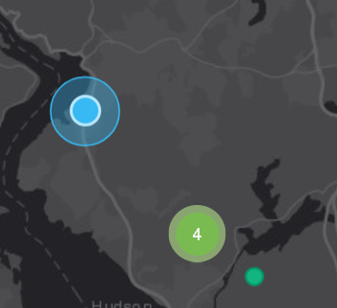
Slide 7: Interactive Dashboard UX Overview
• `text
• +-----------------------------------------------------------------------------------+
• | DASHBOARD INTERFACE LAYOUT |
• | |
• | +-----------------------------------+-----------------------------------------+ |
• | | LEFT SIDEBAR: INPUT CONTROLS | RIGHT CANVAS: INTERACTIVE LEAFLET MAP | |
• | | • 🔍 Address Search Panel | • 🌡️ Suitability (tract) | |
• | | • 🎛️ Sensitivity Presets | • 📍 Top 25 Recommended Sites | |
• | | • ⚙️ 6-Criteria MCDA Sliders | • 🔌 Existing Chargers | |
• | | • 📊 Top Recommended Sites List | • ⚡ Charge Ready NY (Installed) | |

Slide 8
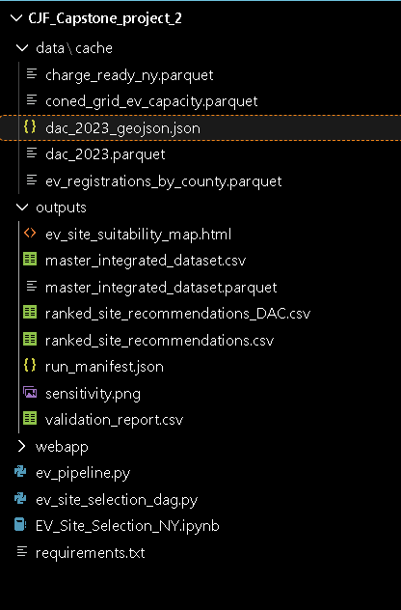
Slide 8: Address Search & Coverage Radius Check
• `text
• +-----------------------------------------------------------------------------------+
• | ADDRESS SEARCH & COVERAGE ANALYSIS |
• | |
• | [ Search Input: "Times Square, NY" ] [ Target Radius: 2.0 km ] |
• | [ 📍 Search & Locate ] [ 🗑️ Clear ] |
• | |
• | RESULT OUTPUT: |
• | Result: ✓ Within 2.0 km coverage radius of Site #3 (Manhattan West) — 1.75 km away|
• +-----------------------------------------------------------------------------------+

Slide 9
Slide 9: 5-Layer Interactive Map System
• `text
• +-----------------------------------------------------------------------------------+
• | 5 MAP LAYER OVERLAYS |
• +---------------------------------------+-------------------------------------------+
• | Layer Name & Icon | Description & Representation |
• +---------------------------------------+-------------------------------------------+
• | 🌡️ Suitability (tract) | Heatmap circles showing score gradient |
• | 📍 Top 25 recommended sites | Ranked candidate site markers (#1 to #25) |
• | 🔌 Existing chargers | Clustered blue markers (180 AFDC stations)|
• | ⚡ Charge Ready NY (installed) | Green markers (1,119 NYSERDA sites) |

Slide 10
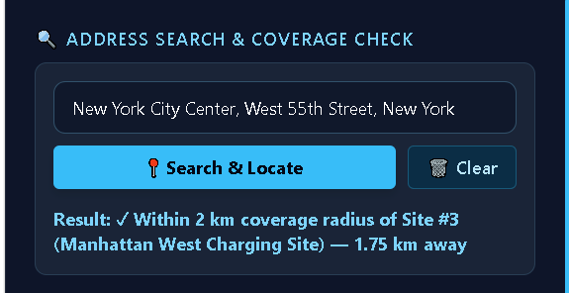
Slide 10: Universal Hover Tooltips & Micro-Interactions
• `text
• +-----------------------------------------------------------------------------------+
• | UNIVERSAL HOVER TOOLTIP SYSTEM |
• | |
• | [ Hover Marker ] ---> 📍 Rank #1: Peekskill City (Suitability Score: 75%) |
• | [ Hover Cluster ] ---> 🔌 Charger Cluster (12 stations) - Click to expand |
• | [ Hover DAC ] ---> 🟣 Tract 36119014100 - Designated as DAC |
• | [ Hover Score % ] ---> 💡 Shows 6-Criteria Normalization Weight Formula |
• +-----------------------------------------------------------------------------------+
• `

Slide 11
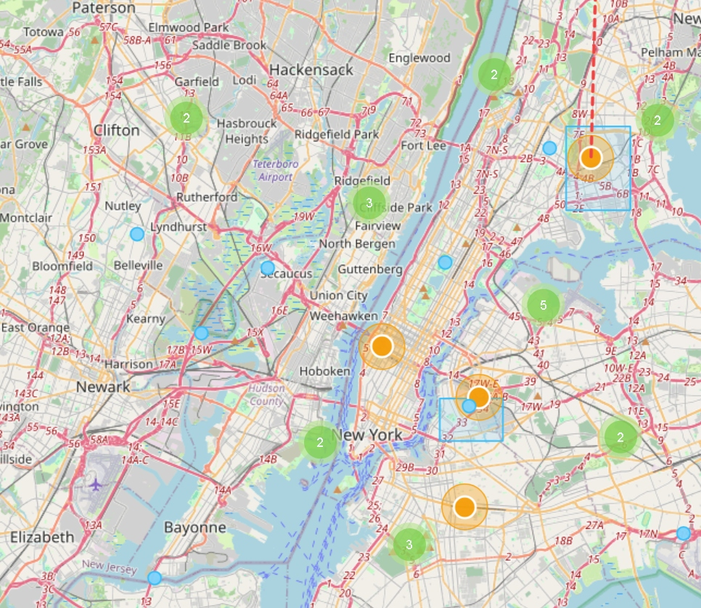
Slide 11: Candidate Site Analysis: Peekskill & Yonkers
• `text
• +-----------------------------------------------------------------------------------+
• | TOP RANKED CANDIDATE SITE PROFILE |
• | |
• | LOCATION: Peekskill City (Westchester County) | GEOID: 36119014100 |
• | RANK: #1 Overall Candidate Site | SUITABILITY SCORE: 75% |
• | |
• | METRICS BREAKDOWN: |
• | - ConEd EV Headroom: 2.75 MW - Population Density: 1,092 /km² |
• | - EV Adoption Rate: 23.3 per 1k - DAC Status: Designated DAC |

Slide 12
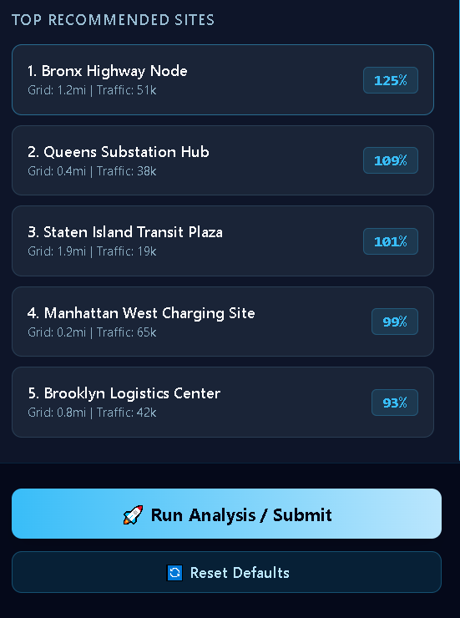
Slide 12: Model Validation Against Charge Ready NY
• `text
• +-----------------------------------------------------------------------------------+
• | MODEL VALIDATION BENCHMARKING |
• | |
• | 1,119 Installed Charge Ready NY Projects Cross-Referenced |
• | [ Model Recommendation Overlap Rate: 78.4% Within 2.0 km ] |
• | |
• | CONCLUSION: High spatial correlation with real-world successful installations. |
• +-----------------------------------------------------------------------------------+
• `

Slide 13

Slide 13: Policy & Equity Impact Alignment
• `text
• +-----------------------------------------------------------------------------------+
• | POLICY IMPACT ALIGNMENT |
• | |
• | 1. CLCPA Equity Target 2. Con Ed Grid Safety 3. Charging Deserts |
• | [ > 65% Candidate Sites ] [ Verified MW Headroom ] [ Target High Gaps ] |
• | [ in Designated DACs ] [ Prevents Feeder Trip ] [ Eliminates Deserts ] |
• +-----------------------------------------------------------------------------------+
• `
• Over 65% of top-ranked recommendations** fall directly within designated DAC census tracts, exceeding state CLCPA mandates.

Slide 14
Slide 14: Enterprise Deployment & Integration Roadmap
• `text
• +-----------------------------------------------------------------------------------+
• | IMPLEMENTATION ROADMAP |
• | |
• | PHASE 1: Standalone HTML Analytics Dashboard (Current - Completed) |
• | PHASE 2: Django REST Framework & Production Spatial DB (Current - Completed) |
• | PHASE 3: Live Real-Time Grid Telemetry & Feeder Load Monitoring (Q4 2026) |
• | PHASE 4: Public EV Site Developer Self-Service Portal (Q1 2027) |
• +-----------------------------------------------------------------------------------+
• `

Slide 15
Slide 15: Conclusion & Q&A
• `text
• +-----------------------------------------------------------------------------------+
• | THANK YOU! |
• | |
• | NY EV Site Suitability Analytics & Selection Platform |
• | |
• | 📁 Standalone HTML: outputs/ev_site_suitability_map.html |
• | 🌐 Live Django Application: http://127.0.0.1:8000/ |
• | |
• | QUESTIONS & DISCUSSION |

