Slide 1
Adversarial Search
Chapter 6
Section 1 – 4

Slide 2
Games
Perfect information (Zero sum games ):
  -deterministic, fully observable environments in which there are two agents whose actions must alternate and in which the utility values at the end of game are always equal and opposite
Imperfect information game
Multiplayer games
Non-zero-sum games
Stochastic games

Slide 3
Games
Multi-agent environments
  Need to consider actions of other agents
Other agents introduce contingencies
  [move(A1,A2), if[position(WQ,A6)] then move(A2,B2) else move(C3,C8)]
Cooperative vs. competitive
  Competitive environments give rise to adversarial search problems

Slide 4
Outline
Optimal decisions
α-β pruning
Imperfect, real-time decisions

Slide 5
Game theory
Definition of move and an algorithm for finding it
Techniques to choose a good move when time is limited e.g pruning
State-of-the-art game playing fair against human opposition

Slide 6
Games vs. search problems
"Unpredictable" opponent → specifying a move for every possible opponent reply
Time limits → unlikely to find goal, must approximate

Slide 7
Game as a Search Problem
Initial state
  Initial board position, identify the player to move
Successor function
  Returns list of (move, state) pairs, each indicating a legal move and the resulting state
Terminal test
  Determines when the game is over
Utility function
  Numeric value for terminal states
  E.g. Chess +1, -1, 0
  E.g. Backgammon +192 to -192

Slide 8

Game tree
(2-player, deterministic, turns)
MAX’s job is to use the search to determine the best move

Slide 9
Game Trees
Each level labeled with player to move
  Max if player wants to maximize utility
  Min if player wants to minimize utility
    Opponent
Each level represents a ply
  Half a turn
Represents what happens with competing agents

Slide 10
Optimal Decisions
MAX wants to maximize utility, but knows MIN is trying to prevent that
  MAX wants a strategy for maximizing utility assuming MIN will do best to minimize MAX’s utility
Consider minimax value of each node
  Utility of node assuming players play optimally

Slide 11
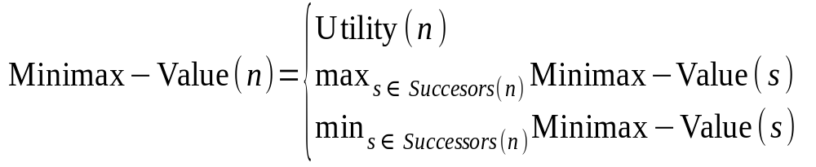
Minimax Value
Defined as
Terminal
Max
Min

Slide 12
Minimax Algorithm
Calculate minimax value of each node recursively
  Depth-first exploration of tree
Game tree (aka minimax tree)
Max node
Min node

Slide 13

Minimax
Perfect play for deterministic games
Idea: choose move to position with highest minimax value
= best achievable payoff against best play
E.g., 2-ply game:

Slide 14

Minimax algorithm

Slide 15
Extension to Multiple Players
Layering in game tree iterates through players
  A, B, C, A, B, C, …
A vector of values is maintained
  The move that maximizes the value for the player determines the path

Slide 16
Multiple players example
A
(2,2,6)
B
(2,2,6)
(1,5,2)
C
(2,2,6)
(6,1,2)
(1,5,2)
(5,4,5)
A
(2,2,6)
(4,2,3)
(6,1,2)
(7,4,1)
(5,1,1)
(1,5,2)
(7,7,1)
(5,4,5)

Slide 17
Properties of minimax
Complete? Yes (if tree is finite)
Optimal? Yes (against an optimal opponent)
Time complexity? O(b^{m})
Space complexity? O(bm) (depth-first exploration)
For chess, b ≈ 35, m ≈100 for "reasonable" games
→ exact solution completely infeasible

Slide 18
Alpha-Beta Pruning
Improvement on minimax algorithm
  Effectively cut exponent in half
Prune or cut out large parts of the tree
Computes the correct minimax decision without even looking at EVERY node in the game tree
Pruning: cutting away the braches that cannot possibly influence final decision

Slide 19
Alpha-Beta Pruning
Basic idea
  Minimax-Value(root)
    = max(min(3,12,8), min(2,x,y), min(14,5,2))
    = max(3,z,2) z = min(2,x,y) ≤ 2
    = 3
  Don’t have to evaluate nodes (or subtrees) x and y at all

Slide 20
Alpha-Beta Pruning
α - value of best (highest value) choice for MAX
β - value of best (lowest value) choice for MIN
If at a MIN node and value <= α, stop looking, because MAX node will ignore
If at a MAX node and value >= β, stop looking because MIN node will ignore

Slide 21

α-β pruning example

Slide 22

α-β pruning example

Slide 23

α-β pruning example

Slide 24

α-β pruning example

Slide 25

α-β pruning example

Slide 26
Properties of α-β
Pruning does not affect final result
Good move ordering improves effectiveness of pruning
With "perfect ordering," time complexity = O(b^{m/2}) → doubles depth of search
A simple example of the value of reasoning about which computations are relevant (a form of metareasoning)

Slide 27

Why is it called α-β?
α is the value of the best (i.e., highest-value) choice found so far at any choice point along the path for max
If v is worse than α, max will avoid it
  → prune that branch
Define β similarly for min

Slide 28

The α-β algorithm

Slide 29

The α-β algorithm

Slide 30
Resource limits
Suppose we have 100 secs, explore 10⁴ nodes/sec
→ 10⁶ nodes per move
Standard approach:
cutoff test:
  e.g., depth limit (perhaps add quiescence search)
evaluation function
  = estimated desirability of position

Slide 31
Alpha Beta pruning
Purely depth first
Depth is usually not practical
Effectiveness depends on the order in which the successors are examined
Suggestion: use heuristic evaluation function that may turn nonterminal nodes into terminal leaves

Slide 32
Real-Time Decisions
In game playing systems, time is not unlimited
  Chess limits total time for moves
  People won’t wait 10 hours for the computer to make a decision
Two modifications to basic game tree
  Evaluation function - heuristic measure of utility
  Cutoff test - determines when to use evaluation function

Slide 33
Evaluation Functions
Returns an estimate of the expected utility of the game from a given position
Function should order terminal states in the same way at true utility function
Quick computation
For nonterminal states, function should correlate closely with chances of winning from that state

Slide 34
Evaluation Functions
Function design depends on identifying features
  Characteristics that distinguish classes of states
  E.g. In checkers, # of black, # of red checkers, distance to opponents home row, # of immediate jumps, etc.

Slide 35
Evaluation functions
For chess, typically linear weighted sum of features
Eval(s) = w₁ f₁(s) + w₂ f₂(s) + … + w_{n} f_{n}(s)
e.g., w₁ = 9 with
f₁(s) = (number of white queens) – (number of black queens), etc.

Slide 36
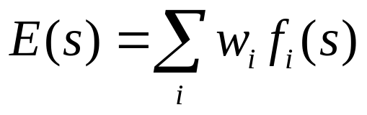
Evaluation Functions
Given a class of states, each class has a proportion of winning, losing, draw states
  E.g. 60% winning, 30% losing, 10% draw
This is used to create an expected value or weighted average for utility
  (0.6 * 1) + (0.3 * -1) + (0.1 * 0) = 0.3

Slide 37
Cutting Off Search
Simple approach
  Limit depth of the search
  if Cutoff-Test(s, depth) then return E(s)
Problems
  Cutoff test might be applied in unfavorable situations
  May stop before available time is used
    Iterative deepening, go until time is elapsed

Slide 38
Quiescence
Suppose evaluation function captures only # of each color
  Appears red has advantage
  Ignores fact that black can double jump to win
Only apply eval func in quiescent positions
  E.g. Only apply if black has no jumps

Slide 39
Other Considerations
Horizon effect
  Opponent move causes serious damage and is unavoidable
  Is only detected after several plies
Singular extensions
  Expand a move that is clearly better than all other moves
Forward pruning
  Prune away branches without any computation
  E.g. symmetric moves

Slide 40
Cutting off search
MinimaxCutoff is identical to MinimaxValue except
  Terminal? is replaced by Cutoff?
  Utility is replaced by Eval
Does it work in practice?
b^{m} = 10⁶, b=35 → m=4
4-ply lookahead is a hopeless chess player!
  4-ply ≈ human novice
  8-ply ≈ typical PC, human master
  12-ply ≈ Deep Blue, Kasparov

Slide 41
Deterministic games in practice
Checkers: Chinook ended 40-year-reign of human world champion Marion Tinsley in 1994. Used a precomputed endgame database defining perfect play for all positions involving 8 or fewer pieces on the board, a total of 444 billion positions.
Chess: Deep Blue defeated human world champion Garry Kasparov in a six-game match in 1997. Deep Blue searches 200 million positions per second, uses very sophisticated evaluation, and undisclosed methods for extending some lines of search up to 40 ply.
Othello: human champions refuse to compete against computers, who are too good.
Go: human champions refuse to compete against computers, who are too bad. In go, b > 300, so most programs use pattern knowledge bases to suggest plausible moves.

Slide 42
Summary
Games are fun to work on!
They illustrate several important points about AI
perfection is unattainable → must approximate
good idea to think about what to think about

