Slide 1

ODI Cricket Match Analysis
Name- Akash Kushwah
Registration No.- 11803007
Course Code- INT 217
Course Name- Introduction to data management

Slide 2
Introduction
Data Management- Data management is the practice of collecting, keeping, and using data securely, efficiently, and cost-effectively. The goal of data management is to help people, organizations, and connected things optimize the use of data.
Excel- Excel is a powerful program for data analysis and documentation. It is a spreadsheet program, which contains several columns and rows, where each intersection of a column and a row is a cell

Slide 3
Functions use in project
SUMIFS: =SUMIF (range, criteria, [sum_range])
SUM: =SUM(number1, [number2], ...)
COUNTIFS: =COUNTIFS (range1, criteria1, [range2], [criteria2], ...)
AVERAGE: AVERAGE(number1, [number2], ...)
MIN: =MIN (number1, [number2], ...)
MAX: =MAX (number1, [number2], ...)
ROWS: =ROW ([reference])
SUMPRODUCTS: =SUMPRODUCT (array1, [array2], ...)
IF: =IF (logical_test, [value_if_true], [value_if_false])

Slide 4
More function use in project
Hyperlink
Pivot tables
Conditional formatting
Pivot charts
Slicers

Slide 5
Data Visualization
Types of charts use in this project
Line chart
Donut chart
Column chart
Bar chart
Donut and pie chart

Slide 6

Front page in project

Slide 7
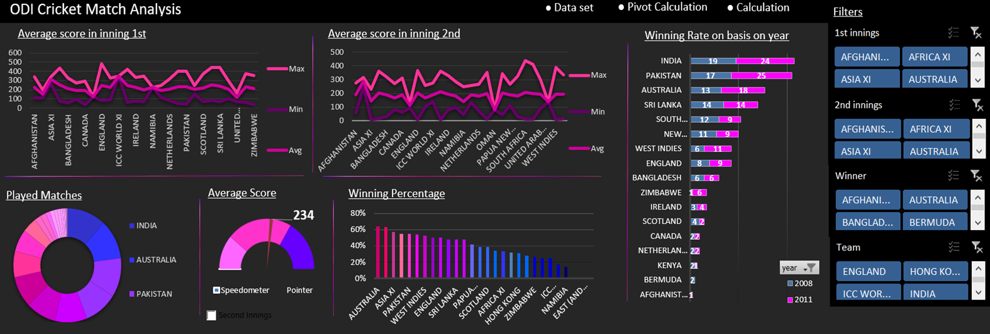
Dashboard
Dashboard is used to display overviews of large data tracks. It use dashboard elements like tables, charts, and gauges to show the overviews.

Slide 8
Conclusion
Starting match year: 1971
Last match year: 2019
Winner who bat first: 2085
Winner who bat second: 1952
Total played matches: 4037
Average score in inning first: 234
Average score in inning second: 199

Slide 9
Thank you

