Slide 1
MINES | MEGN 301 — Mechanical Integration and Design
Systems Engineering Foundations
Concept Generation
& Early Design
IDEATION TECHNIQUES, CONCEPT SCREENING, PROTOTYPING, AND FEASIBILITY
Notes:
Welcome to Concept Generation and Early Design for MEGN 301. This module covers the creative phase of engineering — generating ideas, systematically exploring the design space, screening and selecting the best concepts, and validating them through prototyping before committing to detailed design. The key discipline is diverge-then-converge: first generate as many ideas as possible without judgment, then systematically evaluate and select using objective criteria. Most student teams generate too few concepts too quickly, committing to the first idea that seems reasonable. This module teaches you to resist that impulse and explore the space before narrowing it.
ALIGNMENT NOTE — This module corresponds to Chapter 3 of your Master Reference Document and supports Sprint 2 (PDR — trade studies, FMEA) and Sprint 3 (CDR — detailed design, manufacturing review). Trade studies now live here because you cannot evaluate options that do not yet exist.
BOTTOM LINE: Generate many concepts before evaluating any. Use your functional decomposition as the morphological chart skeleton, screen with Pugh, select with a weighted decision matrix, assess risk with FMEA, and document everything. Your trade study is the traceable evidence that you made a rational engineering decision, not a gut call.
FINAL NOTES — Key updates in the final compiled document: (1) FMEA warning reframed as 'FMEA as an Active Design Tool' — focuses on professional practice rather than checkbox avoidance. (2) RPN non-linearity clarification added: RPN is a ranking tool, not a linear scale — an RPN of 200 is not 'twice as bad' as 100. (3) Sensitivity analysis guidance strengthened: if changing one weight by 10% flips the winner, your decision is not robust. (4) Plan B components tied to CDR BOM deliverable. (5) Strategic resin selection ($15/kg ABS vs $38/kg Nylon) with project-specific guidance.

Slide 2






MINES | MEGN 301
Learning outcomes
Apply divergent ideation techniques (brainstorming, SCAMPER, morphological charts, bio-inspired design) to generate 20+ concepts
Screen concepts systematically using Pugh matrices and select finalists using weighted decision matrices
Create concept sketches and functional mockups that communicate design intent to stakeholders and team members
Build proof-of-concept prototypes to de-risk critical technical uncertainties before committing to detailed design
Assess concept feasibility across four dimensions: technical, economic, schedule, and operational
Produce a PDR-ready package: block diagram, preliminary BOM, trade study reports, risk register, and proof-of-concept results
MINES | MEGN 301 — Mechanical Integration and Design
Notes:
Six learning outcomes covering the full concept generation and early design process.

Slide 3
01
Generating
concepts
Brainstorming, SCAMPER, morphological charts, and bio-inspired design
MINES | MEGN 301 — Mechanical Integration and Design
Notes:
Section 1 covers divergent ideation — generating as many concepts as possible before evaluating any of them.
REVERSE ENGINEERING — Before generating new concepts, reverse engineer your COTS product to understand how existing solutions work. Systematic disassembly process: (1) Document as-received state with photos, (2) Disassemble systematically, documenting each step, (3) Identify components, materials, and manufacturing methods, (4) Analyze the architecture with a block diagram, (5) Assess design decisions — why did they make these choices?, (6) Identify integration opportunities and constraints for your add-on system.
NON-DESTRUCTIVE CONSTRAINT — You must return the COTS product undamaged. No drilling, cutting, or gluing. Your add-on must interface through existing features: screw holes, connectors, friction fits, clamps, or custom brackets.

Slide 4
MINES | MEGN 301
Brainstorming — rules for effective ideation
Goal: generate 50+ ideas in 30 minutes. Quantity produces quality — the best ideas often come after the obvious ones are exhausted.
Defer Judgment
No criticism, evaluation, or 'that won't work' during ideation. Negative reactions shut down creative thinking. Mark ideas for later evaluation but never dismiss them in the moment.
Go for Quantity
Set a target (50+ ideas). Research shows that the most creative ideas tend to appear in the second half of a brainstorming session — after the obvious solutions are exhausted.
Build on Others
'Yes, and...' thinking. Take a teammate's idea and extend, combine, or invert it. The best concepts often emerge from combining fragments of multiple ideas.
Encourage Wild Ideas
Impractical ideas often contain kernels of insight. 'What if it were powered by hamsters?' might lead to thinking about kinetic energy harvesting.
Sketch, Don't Just Talk
Words are ambiguous; sketches are concrete. Rough sketches on sticky notes communicate spatial relationships, mechanisms, and scale that words cannot.
MINES | MEGN 301 — Mechanical Integration and Design
Notes:
Five rules for effective brainstorming. The most important insight is that quantity drives quality — research consistently shows the best ideas appear in the second half of ideation sessions. Defer judgment completely during generation. Build on others' ideas. Encourage wild ideas for their seed value. And sketch rather than just talk — spatial ideas lose fidelity when reduced to words.

Slide 5
MINES | MEGN 301
SCAMPER — systematic idea triggers
Apply each trigger to your existing concept or a competitor's product to systematically generate variations.
S
Substitute
What material, component, or process can be replaced? What if we used plastic instead of metal? Solar instead of battery?
C
Combine
Can two functions be merged? Can the sensor and transmitter share a board? Can the enclosure also serve as the heat sink?
A
Adapt
What else is like this? What can be borrowed from another industry? How do medical devices solve this same problem?
M
Modify / Magnify
Make it bigger, smaller, lighter, stronger. What if the wall thickness doubled? What if it weighed half as much?
P
Put to Other Use
Can this component serve a second purpose? Can the structural frame also route wiring? Can the lid also be the mounting bracket?
E
Eliminate
What can be removed? What is not essential? Can we eliminate a fastener by using a snap-fit? Can we remove a PCB by integrating onto one board?
R
Reverse / Rearrange
Flip it, mirror it, turn it inside out. What if the motor drove from the opposite end? What if the user interface were on the bottom?
MINES | MEGN 301 — Mechanical Integration and Design
Notes:
SCAMPER provides seven systematic triggers for generating variations on existing concepts. Unlike brainstorming which relies on free association, SCAMPER forces you to ask specific questions that often reveal non-obvious improvements.

Slide 6
MINES | MEGN 301
Morphological charts — systematic combination
How It Works
List all system functions as rows (from your functional decomposition). For each function, brainstorm 3-5 possible implementations as columns. A complete concept is formed by selecting one option from each row. A 5-function × 4-option chart produces 1,024 possible concepts.
Why It's Powerful
Morphological charts prevent tunnel vision by systematically exploring combinations you would never consider through free brainstorming. They ensure every function has multiple implementation options evaluated.
Best Practices
Use your functional decomposition as the row headings — this ensures the chart covers all required functions. Include at least 3 options per function. Draw paths through the chart to define specific concepts. Name each concept for reference in screening.
MINES | MEGN 301 — Mechanical Integration and Design
Notes:
Morphological charts are the most powerful systematic concept generation tool. They connect directly to functional decomposition — the rows are your functions, the columns are implementation options for each function. Drawing a path through the chart creates a complete concept.

Slide 7
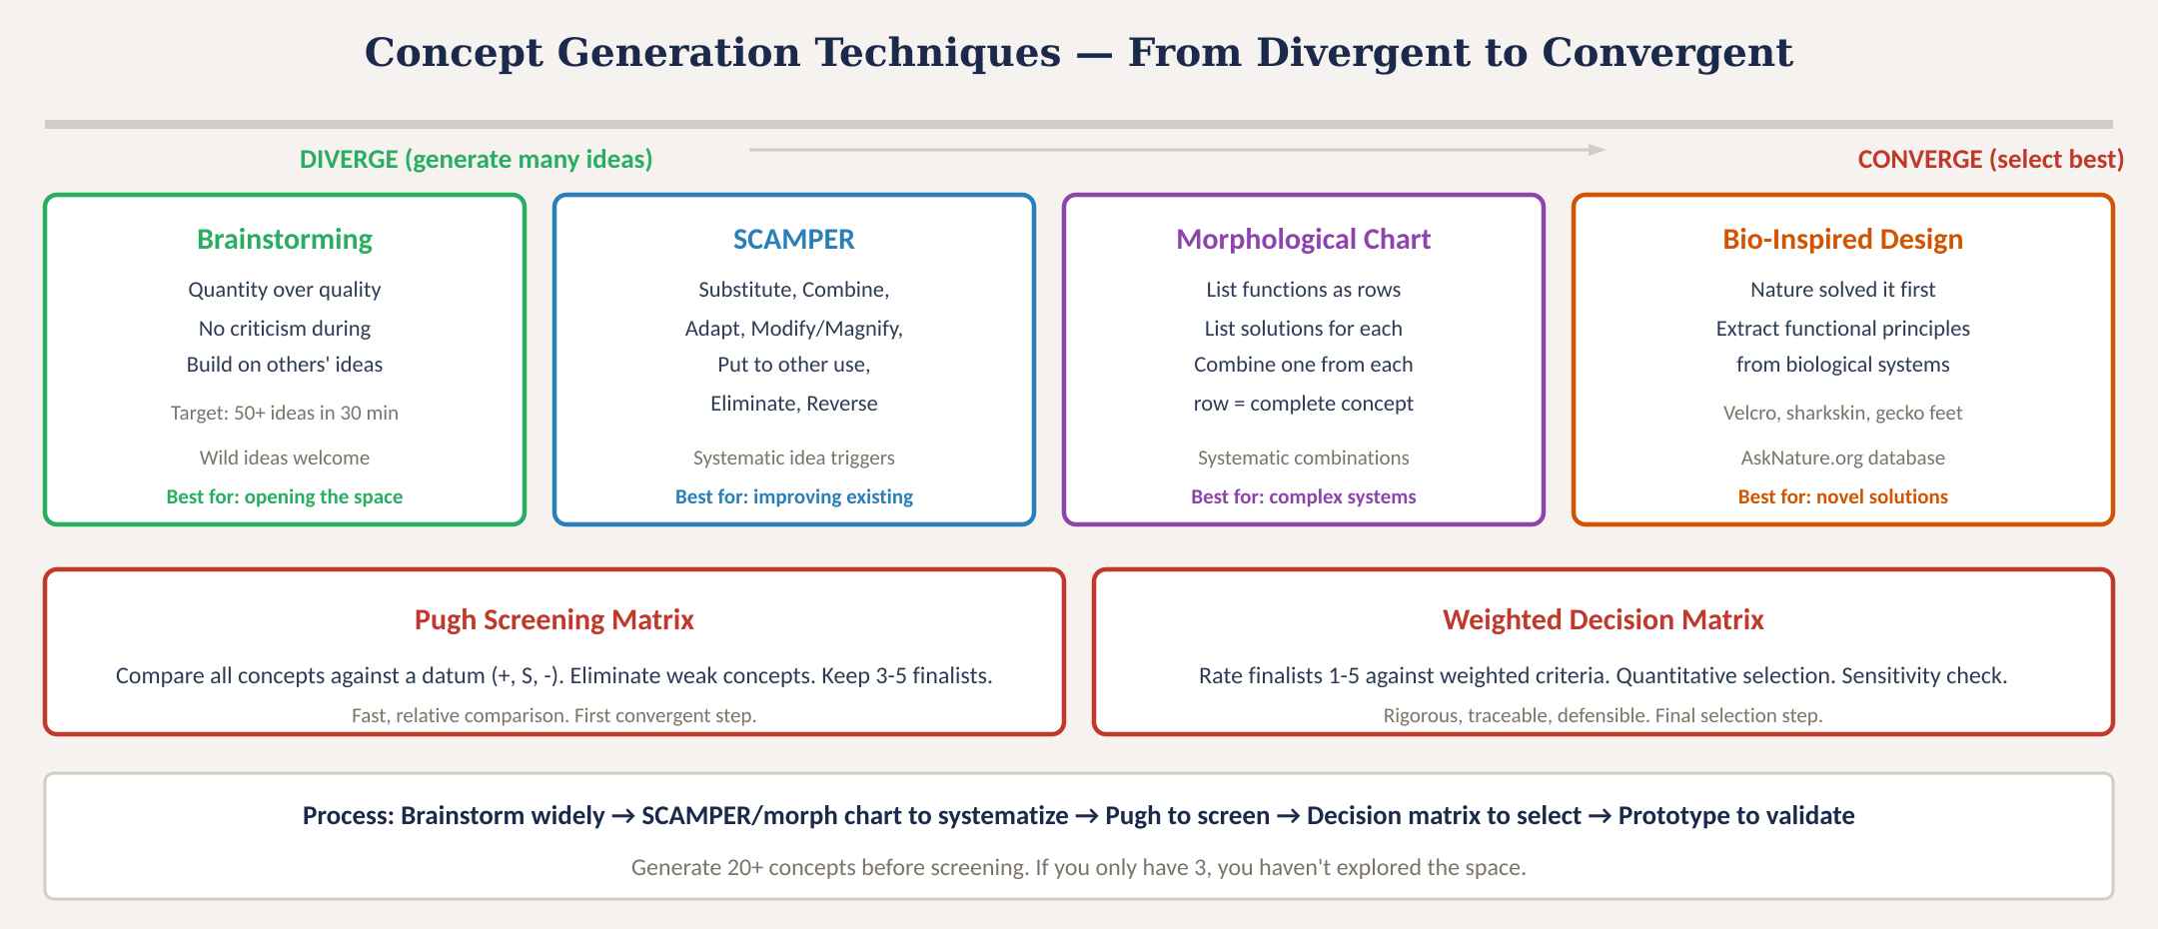
Concept generation techniques
Fig. 1: Four divergent techniques and two convergent tools — generate widely, then select systematically
MINES | MEGN 301 — Mechanical Integration and Design
Notes:
Figure 1 shows the diverge-converge pipeline with four generation techniques and two screening tools.

Slide 8
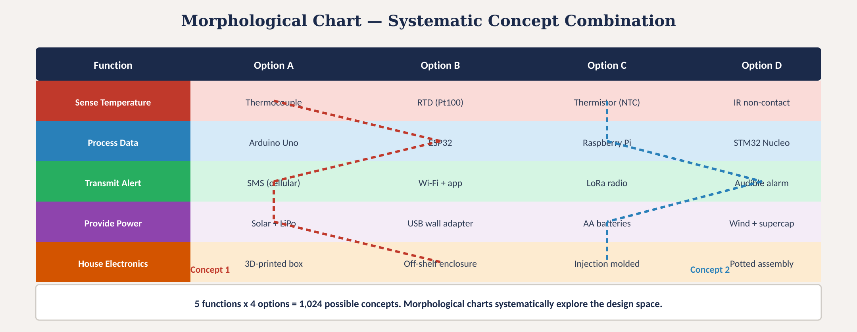
Morphological chart — worked example
Fig. 2: Five functions × four options = 1,024 possible concepts. Two concept paths shown.
MINES | MEGN 301 — Mechanical Integration and Design
Notes:
Figure 2 shows a morphological chart for a greenhouse monitoring system with five functions and four options each, producing 1,024 possible concept combinations. Two specific concept paths are traced.

Slide 9
02
Screening &
selection
Pugh screening, weighted selection, and concept down-selection
MINES | MEGN 301 — Mechanical Integration and Design
Notes:
Section 2 covers the convergent phase — systematically reducing many concepts to the best one.
FMEA AS A DESIGN TOOL — The FMEA belongs at PDR (Sprint 2), not after the build. Timing is intentional: results should influence design decisions. For each component/function/interface: identify failure modes, assess effects, rate Severity × Occurrence × Detection = RPN. Focus design effort on highest-RPN items. A good FMEA results in at least 2-3 concrete design changes.
SAFETY HAZARD FLAG — Any failure mode with Severity ≥ 8 gets mandatory mitigation regardless of overall RPN. Your instructor expects you to identify and address safety hazards in your FMEA and discuss them in your final report.
RISK MATRIX — Likelihood (1-5) × Consequence (1-5) = RPN. Red zone (RPN ≥ 12) requires active mitigation before proceeding. Yellow zone (6-11) needs monitoring. Green zone (≤ 5) is accepted.

Slide 10
MINES | MEGN 301
Two-stage concept selection
Stage 1: Pugh Screening
Stage 2: Weighted Decision Matrix
Purpose: Quickly eliminate clearly inferior concepts.
Method:
1. Choose one concept as the datum (baseline)
2. Rate every other concept vs datum:
+ (better), S (same), - (worse)
3. Sum pluses and minuses
4. Concepts with net negative: eliminate
5. Concepts with net positive: advance
No weights, no numbers — fast relative comparison. Best when you have 8-15 concepts to narrow to 3-5.
Tip: Try multiple datums. If the winner changes, your criteria need refinement.
Purpose: Make a rigorous, quantitative final selection from 3-5 finalists.
Method:
1. Define criteria from requirements
2. Assign weights (sum to 1.0)
3. Rate each option 1-5 with evidence
4. Score = raw × weight
5. Sum weighted scores → winner
6. Sensitivity check: ±0.05 on weights
The gold standard for defensible design decisions. Present at PDR/CDR.
Tip: If the margin is < 0.3 points, prototype both finalists before committing.
MINES | MEGN 301 — Mechanical Integration and Design
Notes:
Two-stage selection process: Pugh to screen many concepts down to a few finalists, then weighted decision matrix for rigorous final selection.

Slide 11
MINES | MEGN 301
Concept sketching and communication
Why Sketch?
Sketches are the universal language of engineering design. A rough sketch communicates spatial relationships, scale, and mechanism that paragraphs of text cannot. Sketch early, sketch often. Every concept should have at least one sketch before screening.
What to Include
Show the overall form, key mechanisms, user interaction points, and scale reference (human hand, coin, or ruler). Annotate with function labels, material callouts, and critical dimensions. Multiple views (front, side, section) for 3D concepts.
Levels of Fidelity
Level 1: Napkin sketch (10 seconds) — captures the core idea. Level 2: Annotated sketch (5 minutes) — adds labels, dimensions, materials. Level 3: Functional mockup (1-2 hours) — cardboard, foam, or 3D-printed proof of form/fit.
Presenting Concepts
At PDR, present 3-5 concept sketches side by side with your Pugh matrix results. Show the stakeholder what each concept looks like, how it works, and why the winning concept was selected. Visual comparison is far more persuasive than text-only descriptions.
MINES | MEGN 301 — Mechanical Integration and Design
Notes:
Concept sketching is the most undervalued skill in engineering education. A 10-second sketch communicates more than a paragraph of text. Three fidelity levels match different stages of the process.
DESIGN DOCUMENTATION FOR CDR — BOM: Include everything — electronic components, fasteners, wire, 3D-printed parts with material cost. Add a 'Plan B' column for critical sole-source components. WIRING DIAGRAMS: Every wire with color, gauge, length; every connector with part number and pinout. FLOWCHARTS: Main loop, ISRs, state machines, error handling. CAD: Material spec, tolerances, manufacturing notes.
DFM AT CDR — All polymer components must be designed for injection molding even if prototyped via 3D printing. Draft angles, uniform walls, proper ribs/bosses, identified parting lines. Manufacturing Design Review evaluates against the DFM checklist.
STRATEGIC RESIN SELECTION — Elegoo ABS-Like at $15/kg for structural enclosures. Siraya Tech Blu Nylon-Like at $38/kg only for gears, snap-fits, or parts needing high toughness. Can save $20-40 of project budget.
FREE SUPPLIES — Bulk wire (18 & 24 AWG), heat shrink, perf boards are FREE in BBW160 from TAs. Do not waste budget on these items.
SPRING BREAK TRAP — Spring Break begins March 24. Campus shipping, machine shop, and labs are CLOSED. If a component fails during Sprint 4 demos (Mar 10-12), order the replacement IMMEDIATELY. Plan procurement so critical components arrive before March 21.

Slide 12
03
Prototyping &
feasibility
Proof of concept, rapid prototyping, and four-lens feasibility assessment
MINES | MEGN 301 — Mechanical Integration and Design
Notes:
Section 3 covers prototyping to validate concepts and feasibility assessment across four dimensions.

Slide 13
MINES | MEGN 301
Prototyping for concept validation
A prototype answers a specific question. Define the question BEFORE you build.
Proof of Concept (PoC)
Answers: 'Does the physics work?' Bench-level test of the critical technical risk. A sensor on a breadboard measuring accuracy. A motor driving a load through a gearbox. No enclosure, no aesthetics — just the core function. Build the PoC for the riskiest element first.
Form/Fit Prototype
Answers: 'Does it fit the space and the user's hand?' 3D-printed or foam-core mockup at full scale. Tests ergonomics, clearances, mounting, and visual appearance. No functional electronics — just shape, size, and feel.
Looks-Like / Works-Like
Answers: 'Can the team build the full system?' Combines form and function but may use non-production materials or processes. The prototype you demonstrate at CDR. Should satisfy most requirements but may have workarounds for difficult ones.
Minimum Viable Product
Answers: 'Does the stakeholder accept it?' The simplest version that delivers core value. Used for validation testing with real users. Identifies gaps between what you built and what the stakeholder actually needs.
MINES | MEGN 301 — Mechanical Integration and Design
Notes:
Four prototype types, each answering a different question. Build the proof of concept for the highest-risk element first.

Slide 14
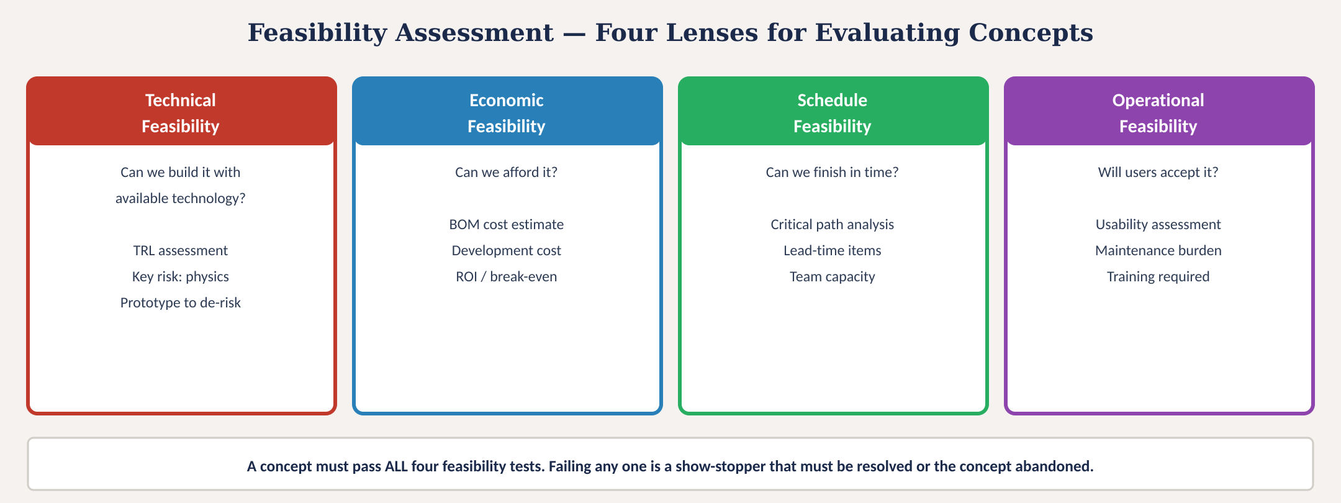
Feasibility assessment — four lenses
Fig. 4: Technical, economic, schedule, and operational feasibility — a concept must pass all four
MINES | MEGN 301 — Mechanical Integration and Design
Notes:
Figure 4 shows the four feasibility lenses. A concept must pass all four — failing any one is a show-stopper.

Slide 15
MINES | MEGN 301
Risk identification and technology readiness
Risk Register
A living document listing every identified risk with: description, probability (1-5), impact (1-5), risk score (P×I), mitigation strategy, and owner. Start at concept selection; update through the project. The top 5 risks should be discussed at every team meeting.
Technology Readiness Level (TRL)
NASA's 9-level scale from basic research (TRL 1) to flight-proven (TRL 9). For student projects: TRL 4-5 (lab validation) is typical for PoC. TRL 6-7 (relevant environment) is the goal for FDR. Components below TRL 4 are high risk and need PoC testing.
De-Risking Strategy
Address the highest-risk elements first. Build PoC prototypes for uncertain technologies before committing to full design. Never save the hardest problem for last — if it fails late, you have no time to pivot.
Buy vs Build
For every function, ask: can we buy an off-the-shelf module, or must we build custom? Buy reduces risk, accelerates schedule, and shifts responsibility to the vendor. Build gives you control but adds risk and development time. Default to buy unless custom is justified.
MINES | MEGN 301 — Mechanical Integration and Design
Notes:
Risk identification and TRL assessment. Address the highest risks first through PoC prototyping. Default to buy over build unless custom is justified.

Slide 16
04
Early design &
PDR preparation
Preliminary architecture, BOM, and design review readiness
MINES | MEGN 301 — Mechanical Integration and Design
Notes:
Section 4 covers transitioning from concept selection to preliminary design — the deliverables needed for PDR.

Slide 17
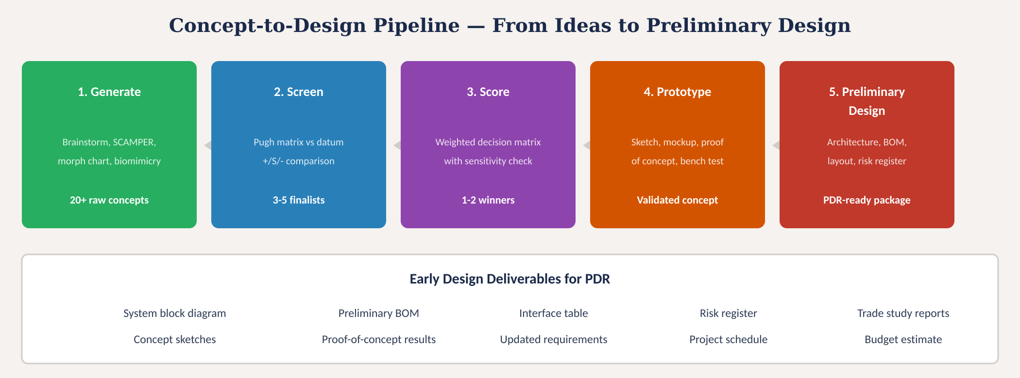
Concept-to-design pipeline
Fig. 3: Five-stage pipeline from concept generation through preliminary design with PDR deliverables
MINES | MEGN 301 — Mechanical Integration and Design
Notes:
Figure 3 shows the complete pipeline with deliverables at each stage.

Slide 18

MINES | MEGN 301
PDR deliverables checklist
A complete PDR package demonstrates that your concept is feasible and your plan is executable.
Problem statement (5-element, solution-agnostic, baselined)
Stakeholder register with power/interest classification
Requirements document (15-25 system-level, with IDs, types, V&V methods)
Concept generation evidence (brainstorm notes, morphological chart, sketches)
Trade study reports (Pugh screening + weighted decision matrix)
Winning concept description with annotated sketches or CAD renders
System block diagram with all modules, interfaces, and power rails
Preliminary BOM with vendor, cost, and lead time for major items
Proof-of-concept results for the highest-risk technical element
Risk register with top-5 risks, probability, impact, and mitigations
Project schedule with milestones, critical path, and team assignments
Budget estimate with contingency (15-20% recommended)
MINES | MEGN 301 — Mechanical Integration and Design
Notes:
Twelve-item PDR checklist covering every deliverable needed for a successful preliminary design review.

Slide 19

MINES | MEGN 301
Common concept generation mistakes
'First idea wins' — committing to the first concept without exploring alternatives. Generate 20+ concepts before screening. If you only have 3, you haven't explored the space.
'Designing in a vacuum' — generating concepts without reference to requirements. Every concept must satisfy the problem statement. Review requirements before and after ideation.
'Analysis paralysis' — spending so long evaluating that you never build anything. Time-box your screening: 1 hour for Pugh, 2 hours for decision matrix. Then prototype.
'Skipping the PoC' — jumping from concept selection to full CAD design without validating the critical technical risk. If the core physics doesn't work, the CAD is worthless.
'Sunk cost bias' — continuing with a failing concept because you already invested time. Kill bad concepts early. The morphological chart gives you alternatives already explored.
'Solo ideation' — one person generating all concepts. Diverse perspectives produce better results. Include non-engineers, stakeholders, and fresh eyes in brainstorming.
MINES | MEGN 301 — Mechanical Integration and Design
Notes:
Six common mistakes in concept generation.

Slide 20

MINES | MEGN 301
Practical tips
Use the morphological chart as your primary generation tool — it connects directly to your functional decomposition and guarantees systematic exploration.
Sketch every concept, even bad ones. A sketch makes a concept concrete enough to evaluate. Pin sketches to the wall for the team to see simultaneously.
Build the PoC in week 1 of design — not week 6. Target the single highest-risk element. If it fails, you have time to pivot. If it works, you have confidence to proceed.
Run the trade study BEFORE buying components. Once you purchase parts, you are psychologically committed. The decision matrix should precede the purchase order.
Create a risk-vs-value plot for your top 3 concepts: x-axis = technical risk, y-axis = stakeholder value. The ideal concept is high value, low risk.
Document your concept generation evidence. At PDR, reviewers ask 'what else did you consider?' Your brainstorm notes, morphological chart, and Pugh matrix answer this question.
MINES | MEGN 301 — Mechanical Integration and Design
Notes:
Six practical tips for concept generation and early design.

Slide 21
MINES | MEGN 301
Applying in your projects
1
Week 1: Complete functional decomposition. Build morphological chart with 3-4 options per function. Brainstorm to fill gaps.
2
Week 1-2: Sketch all concepts (at least 10). Run Pugh screening to narrow to 3-5 finalists.
3
Week 2: Run weighted decision matrix on finalists. Select winning concept. Document trade study.
4
Week 2-3: Build proof-of-concept prototype for highest-risk element. Test against critical requirements.
5
Week 3-4: Develop system block diagram, preliminary BOM, interface table, and risk register.
6
Week 4: Compile PDR package. Rehearse presentation. Present to review panel.
MINES | MEGN 301 — Mechanical Integration and Design
Notes:
A practical 4-week workflow from functional decomposition through PDR.

Slide 22
MINES | MEGN 301
Bio-inspired design and analogical thinking
Bio-Inspired Design
Nature has solved engineering problems through 3.8 billion years of evolutionary optimization. Extract the FUNCTIONAL PRINCIPLE, not the biological form. Velcro from burdock burrs (hooking mechanism). Sharkskin from dermal denticles (drag reduction). Gecko tape from van der Waals adhesion (dry adhesion). Use AskNature.org to search by function.
Analogical Reasoning
Look at how OTHER INDUSTRIES solve similar functional problems. Medical devices solve miniaturization; aerospace solves lightweight structures; automotive solves mass production. Ask: 'Who else has solved the function of [sense/actuate/filter/seal/connect]?' The best solutions often come from outside your domain.
TRIZ
The Theory of Inventive Problem Solving identifies 40 inventive principles derived from analysis of millions of patents. When you face a design contradiction (improving one parameter worsens another), TRIZ suggests specific resolution strategies. Useful for breaking deadlocks in concept generation.
MINES | MEGN 301 — Mechanical Integration and Design
Notes:
Three advanced ideation approaches: bio-inspired design, cross-industry analogical reasoning, and TRIZ for resolving design contradictions.

Slide 23
MINES | MEGN 301
Key takeaways
(1)
Diverge then converge: generate 20+ concepts using brainstorming, SCAMPER, morphological charts, and bio-inspired design BEFORE evaluating any of them.
(2)
Morphological charts connect functional decomposition to concept generation — list functions as rows, options as columns, draw paths to define concepts.
(3)
Two-stage selection: Pugh matrix to screen many concepts to 3-5 finalists, then weighted decision matrix for rigorous final selection with sensitivity check.
(4)
Prototype the highest-risk element FIRST. If the core physics works, proceed with confidence. If it fails, pivot early when alternatives are still available.
(5)
Feasibility must pass four tests: technical (can we build it?), economic (can we afford it?), schedule (can we finish in time?), and operational (will users accept it?).
References: [1] Ulrich & Eppinger, Product Design & Development, 7th ed., 2020. [2] Otto & Wood, Product Design, Prentice Hall, 2001. [3] Pahl & Beitz, Engineering Design, Springer, 2007. [4] AskNature.org, Biomimicry Institute.
MINES | MEGN 301 — Mechanical Integration and Design
Notes:
Five key takeaways for concept generation and early design.

Slide 24
Concept Generation
& Early Design
"The best way to have a good idea is to have a lot of ideas."
— Linus Pauling
Explore widely. Evaluate systematically.
Prototype the risk. Then commit.
MINES | MEGN 301 — Mechanical Integration and Design
Notes:
Closing slide with Pauling quote emphasizing the importance of generating many ideas before selecting.

