Slide 1
MINES | Capstone Design
Mechanical Engineering Fundamentals
Electrical & Fluid
System Connectors
TERMINALS, FITTINGS, AND CONNECTION METHODS FOR ENGINEERING DESIGN
Notes:
Welcome to this presentation on electrical and fluid system connectors, part of the Mechanical Engineering Fundamentals series for the Capstone Design Program. This module covers the essential knowledge you need as a junior mechanical engineer for selecting and specifying the terminals, fittings, and connection methods you will encounter when integrating sensors, actuators, power systems, hydraulic circuits, and pneumatic controls into your capstone designs. We cover two primary domains: electrical connectors including contact types, termination methods, and specifications; and fluid system connectors including pipe threads, tube fittings, and quick-connect couplings. By the end of this module, you should be able to identify common connector types across both domains, interpret their specifications, and make informed design choices.
ALIGNMENT NOTE — This module corresponds to Chapter 7 (Electrical & Fluid Connectors) of your Master Reference Document. It is Part II technical reference material — consult it when your project involves connectors, wiring harnesses, or fluid connections. Connector specifications appear in your ICDs (Chapter 2) and are verified during integration testing (Chapter 5).
FINAL NOTES — This module aligns with Chapter 7 of the final compiled document. The Glossary in the back matter defines all connector-related terms (ICD, IP rating, NPT, BSPP, BSPT). Cross-reference: connector specifications appear in your ICDs (Ch 2), are verified during integration testing (Ch 5), and are documented in your BOM and wiring diagrams (Ch 3/CDR deliverables).

Slide 2





MINES | Capstone Design
Learning outcomes
Classify electrical connectors by connection type (wire-to-wire, wire-to-board, board-to-board) and select termination methods
Interpret key electrical specifications: current rating, voltage rating, IP rating, contact resistance, and mating cycles
Distinguish between fluid connector standards (NPT, BSP, JIC, compression) and their sealing mechanisms
Recognize common failure modes for both electrical and fluid connections and design mitigations
Apply systematic selection criteria to specify connectors for your capstone design
MINES | Capstone Design
Notes:
Five learning outcomes for this module. First, classify electrical connectors by their connection type — wire-to-wire, wire-to-board, and board-to-board — and select the appropriate termination method for each. Second, interpret key electrical specifications including current rating, voltage rating, IP ingress protection rating, contact resistance, and rated mating cycles. Third, distinguish between the major fluid connector standards — NPT, BSP, JIC, and compression fittings — and understand how each achieves a seal. Fourth, recognize common failure modes for both electrical and fluid connections and know how to design mitigations against them. Fifth, apply a systematic selection framework to specify connectors for your capstone design projects.

Slide 3
01
Electrical
connectors
Contact types, termination methods, and specifications
MINES | Capstone Design
Notes:
Section 1 covers electrical connectors — the components that create separable electrical connections between wires, cables, and circuit boards. As a mechanical engineer, you will regularly specify electrical connectors for sensors, actuators, power systems, and control electronics. Understanding how connectors work, what specifications matter, and how to select the right termination method is essential for any system that involves electronics.

Slide 4
MINES | Capstone Design
Electrical connector fundamentals
Anatomy
Every connector has three basic elements: (1) Contacts — the conductive pins and sockets that carry current, typically phosphor bronze or beryllium copper with gold or tin plating; (2) Housing — the insulating body (nylon, PBT, LCP) that positions and protects contacts; (3) Termination — the method connecting wire to contact [1].
Gender Convention
Male (plug/header): pins protrude. Female (receptacle/socket): pins are received. In wire-to-wire assemblies, one cable has the plug, the other the receptacle. In wire-to-board applications, the board-mounted header is typically male [1].
Keying & Polarization
Connectors use physical features — key slots, asymmetric shapes, color coding, or different contact arrangements — to ensure correct mating orientation and prevent incorrect connections. Always specify keyed connectors in designs with multiple similar-looking connections to prevent damage from misassembly [1].
MINES | Capstone Design
Notes:
Every electrical connector has three basic elements. Contacts are the conductive pins and sockets that carry current when mated. They are typically phosphor bronze or beryllium copper, plated with gold for low contact resistance and corrosion resistance, or tin for cost-sensitive applications. The housing is the insulating body — usually nylon, PBT, or liquid crystal polymer — that positions contacts precisely and protects them from the environment and from each other. The termination is the method that connects the wire to the contact, and this is where the real design decisions happen. Gender convention: the male side, also called the plug or header, has pins that protrude. The female side, the receptacle or socket, receives the pins. In wire-to-wire assemblies, one cable terminates in a plug and the other in a receptacle. In wire-to-board applications, the board header is typically male. Keying and polarization prevent incorrect mating. Connectors use physical features like key slots, asymmetric housing shapes, color coding, or different contact arrangements to ensure correct orientation. This is a critical safety feature — always specify keyed connectors in designs with multiple similar-looking connections to prevent damage from incorrect assembly.

Slide 5
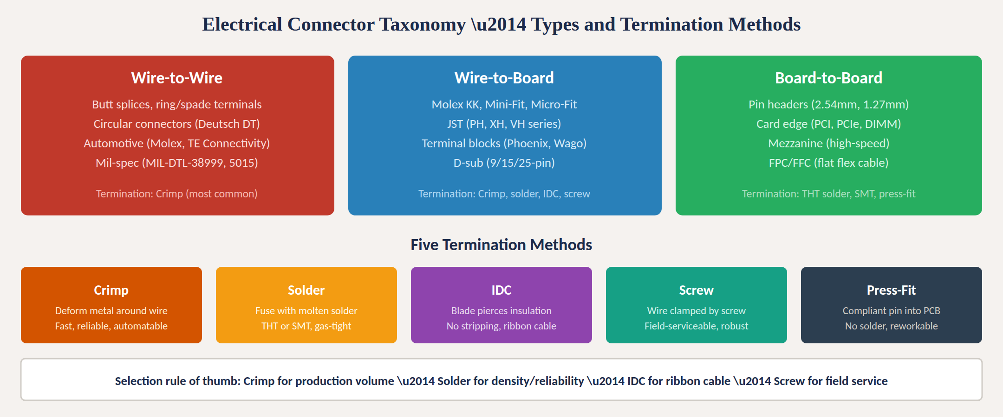
Connector types and termination methods
Fig. 1: Electrical connector taxonomy by connection type with five termination methods [1], [2]
MINES | Capstone Design
Notes:
Figure 1 organizes electrical connectors into three families by what they connect. Wire-to-wire connectors join two cable assemblies together. Common types include butt splices and ring or spade terminals for single wires, circular connectors like the Deutsch DT series used extensively in automotive and off-highway equipment, automotive-style housings from Molex and TE Connectivity, and mil-spec connectors like MIL-DTL-38999 and MIL-DTL-5015 for defense applications. Crimp termination dominates this category. Wire-to-board connectors join cables to printed circuit boards and represent the largest and most diverse category. Molex KK, Mini-Fit, and Micro-Fit series are industry workhorses. JST PH, XH, and VH series are common in consumer electronics. Terminal blocks from Phoenix Contact and Wago are used for power and industrial control. D-sub connectors remain common for serial communications and instrumentation. Multiple termination methods are available. Board-to-board connectors link PCBs together. Pin headers at 2.54mm and 1.27mm pitch are the simplest. Card edge connectors handle expansion and memory. Mezzanine connectors serve high-speed applications. The five termination methods are crimp, solder, IDC, screw, and press-fit, summarized at the bottom of the figure.

Slide 6
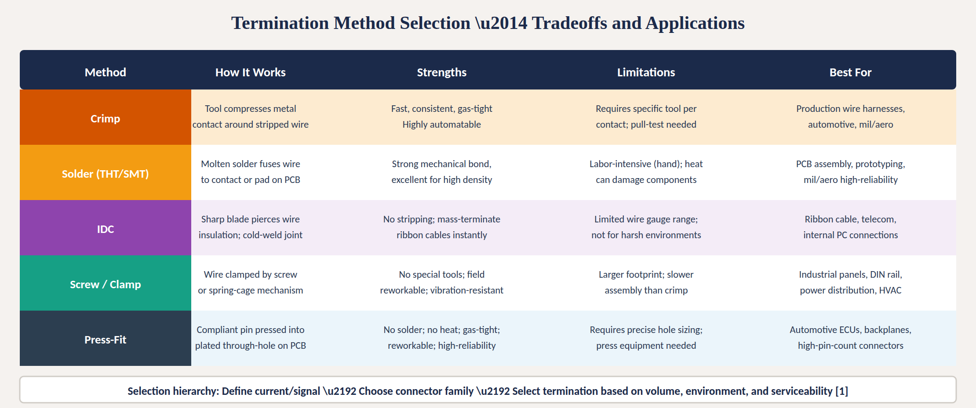
Termination method selection
Fig. 2: Termination tradeoff matrix — mechanism, strengths, limitations, and best applications [1], [2]
MINES | Capstone Design
Notes:
Figure 2 provides a detailed comparison of the five termination methods. Crimping uses a dedicated tool to compress a metal contact around a stripped wire, creating a gas-tight cold weld. It is fast, consistent, and highly automatable — the standard for production wire harnesses in automotive, military, and aerospace applications. The limitation is that each contact family requires its specific crimp tool, and pull-testing is needed to verify quality. Soldering fuses wire to contact or PCB pad using molten solder, creating a strong mechanical bond with excellent electrical properties. Through-hole technology passes pins through the board for wave soldering; surface-mount technology places components directly on pads. Solder is labor-intensive for hand work but highly automated in production. It is the standard for PCB assembly and high-reliability applications. IDC or insulation displacement uses a sharp blade that pierces the wire insulation to make a cold-weld gas-tight connection without stripping. It enables mass termination of ribbon cables in a single press operation. IDC is limited in wire gauge range and is not suited for harsh environments. Screw and clamp terminals secure stripped wire by tightening a screw or engaging a spring cage. They require no special tools and are field-reworkable with just a screwdriver, making them ideal for industrial panels, DIN rail, power distribution, and HVAC systems. Press-fit uses compliant pins pressed into plated through-holes on a PCB without solder. The pin deforms to create a gas-tight joint. Press-fit requires precise hole sizing and press equipment but delivers high reliability and is reworkable, making it standard for automotive ECUs and high-pin-count backplane connectors.

Slide 7
MINES | Capstone Design
Key electrical connector specifications
When specifying an electrical connector, define these parameters in your design documentation:
Current Rating
Maximum continuous current per contact (amps). Depends on contact size, material, and plating. Derate for multi-pin loaded connectors due to thermal stacking — adjacent hot contacts reduce each contact's capacity [2].
Voltage Rating
Maximum working voltage (VAC or VDC). Determined by creepage and clearance distances between contacts per IEC 61984. Always specify rated working voltage, not breakdown voltage [2].
Contact Resistance
Resistance across a mated contact pair (milliohms). Gold plating achieves <20 mΩ. At 10A, even 50 mΩ produces 0.5W heat per contact. Resistance rises over mating cycles and in corrosive environments [1].
IP Rating
Ingress Protection per IEC 60529 [3]. First digit = solids (0–6), second = liquids (0–9K). IP67 = dust-tight + 1m submersion. IP68 = deeper submersion. IP69K = high-pressure washdown.
Mating Cycles
Rated connect/disconnect operations before degradation. Ranges from 25 (permanent installation) to 10,000+ (test fixtures). Gold plating outlasts tin; contact wear directly increases resistance [1].
MINES | Capstone Design
Notes:
Five critical specifications for any electrical connector. Current rating is the maximum continuous current per contact in amps, governed by contact size, material, and plating. You must derate when loading multiple pins simultaneously because of thermal stacking — heat from adjacent contacts reduces each one's capacity. Voltage rating is the maximum working voltage determined by creepage and clearance distances per IEC 61984. Always specify rated working voltage, not breakdown. Contact resistance is measured in milliohms across a mated pair. Gold plating achieves under 20 milliohms. At high currents, contact resistance matters enormously — at 10 amps, even 50 milliohms generates half a watt of heat per contact. IP rating per IEC 60529 describes ingress protection with two digits. IP67 means dust-tight plus 30-minute immersion at 1 meter. IP69K adds high-pressure high-temperature washdown. Mating cycles is the rated number of operations before performance degrades. Gold plating lasts longer than tin, and connector wear directly increases contact resistance.

Slide 8
MINES | Capstone Design
Electrical connector failure modes
Fretting Corrosion
Micro-motion from vibration wears through contact plating, creating oxide debris that progressively increases resistance. This is the most insidious failure mode because it develops slowly and intermittently. Mitigate with gold plating, higher contact normal force, and strain-relief on cables [1].
Overheating (I²R)
Exceeding current rating causes resistive heating that softens thermoplastic housings and can ignite adjacent materials. Always derate for ambient temperature. A connector rated 10A at 25°C may only handle 7A at 85°C [2].
Creep / Stress Relaxation
Contact springs gradually lose force at elevated temperatures, increasing resistance over time. Beryllium copper resists creep far better than brass. Specify BeCu contacts for any application above 60°C continuous [1].
Moisture Ingress
Water bridges contacts causing corrosion, increased resistance, or short circuits. Specify appropriate IP rating per IEC 60529 [3] and use sealed connectors for any outdoor, vehicle, or washdown environment.
MINES | Capstone Design
Notes:
Four primary electrical connector failure modes you must design against. Fretting corrosion is the most insidious — micro-motion from vibration slowly wears through contact plating, creating oxide debris that progressively increases resistance. It develops slowly and manifests as intermittent faults that are difficult to diagnose. Mitigate with gold plating, higher contact normal force, and proper strain-relief on cables to isolate vibration from the contact zone. Overheating from exceeding current ratings causes I-squared-R resistive heating that softens thermoplastic housings and can ignite adjacent materials. Always derate for ambient temperature — a connector rated at 10 amps at 25 degrees Celsius may only handle 7 amps at 85 degrees. Creep and stress relaxation cause contact springs to gradually lose force at elevated temperatures, increasing resistance over time. Beryllium copper resists creep far better than brass or phosphor bronze — specify BeCu contacts for any application above 60 degrees Celsius continuous operation. Moisture ingress causes corrosion and short circuits between contacts. Specify the appropriate IP rating per IEC 60529 and use sealed connectors for any outdoor, vehicle, or washdown environment.

Slide 9
02
Fluid system
connectors
Pipe threads, tube fittings, quick-connect couplings, and sealing methods
MINES | Capstone Design
Notes:
Section 2 covers fluid system connectors — the fittings and couplings that create sealed connections for liquids and gases in hydraulic systems, pneumatic circuits, process piping, and laboratory instrumentation. As a mechanical engineer, fluid connectors are among the most safety-critical components you will specify. A failed fluid connection can cause hydraulic line rupture, chemical exposure, fire, or environmental contamination. Understanding the major thread standards, sealing mechanisms, and selection criteria is essential for safe and reliable design.

Slide 10
MINES | Capstone Design
Threaded pipe fitting standards
Two incompatible tapered thread standards dominate global pipe fitting — geography determines which you use.
NPT — National Pipe Taper
BSP — British Standard Pipe
Standard: ASME B1.20.1 [6]
Thread angle: 60° (pointed crests/roots)
Taper: 1:16 (¾" per foot)
Seal: thread interference + sealant
• Requires PTFE tape or pipe dope
• NPTF ("dryseal") variant crushes tighter
for seal without sealant
• Sizes: 1/8" to 24" nominal pipe size
• Pressure: up to 15,000 psi
• Dominant in U.S. and Canada
Standard: ISO 228 / ISO 7-1 [7]
Thread angle: 55° Whitworth (rounded)
Two sub-types:
• BSPT (R): tapered, seals like NPT
• BSPP (G): parallel (straight) thread,
seals with bonded washer or O-ring
• Sizes: 1/8" to 6" (inch-denominated
but used globally outside North America)
• Pressure: up to 6,000 psi typical
• Dominant in Europe, Asia, rest of world
⚠ NPT (60°) and BSP (55°) threads are NOT interchangeable [6], [7]. Cross-threading causes leaks, galling, and failure.
MINES | Capstone Design
Notes:
Two incompatible tapered pipe thread standards dominate the world. NPT, National Pipe Taper per ASME B1.20.1, uses a 60-degree thread angle with pointed crests and roots and a 1-to-16 taper. It seals by thread interference as the tapered male wedges into the tapered female. PTFE tape or pipe thread sealant is required to fill microscopic gaps. The NPTF dryseal variant has tighter tolerances enabling sealing without sealant. NPT is dominant in the United States and Canada. BSP, British Standard Pipe per ISO 228 and ISO 7-1, uses a 55-degree Whitworth thread angle with rounded crests and roots. BSP comes in two critical sub-types: BSPT with the R designation is tapered and seals similarly to NPT; BSPP with the G designation is parallel and seals with a bonded washer or O-ring compressed against a flat seat. BSP dominates in Europe, Asia, Australia, and most of the world. The critical safety rule: NPT and BSP are not interchangeable despite superficial similarity. The 60-degree versus 55-degree angle and different pitch schedules mean forcing one into the other causes cross-threading, galling, and catastrophic leaks under pressure.

Slide 11
MINES | Capstone Design
Tube fittings and quick-connect couplings
JIC 37° Flare (SAE J514) [5]
Straight thread with a 37° flared tube end. Metal-to-metal seal — no sealant needed. Reassemblable without degradation. The hydraulic industry standard worldwide. Pressures to 10,000 psi. AN (Army-Navy) fittings are the military equivalent.
Compression (Swagelok-type)
One or two ferrules swage onto the tube OD when the nut is tightened. No welding, brazing, or special tools. Tube OD is the sizing basis (1/4", 3/8", etc.). Gaugeable — you can verify proper assembly visually. Up to 20,000 psi for medium-pressure fittings [8].
Push-to-Connect
Tube pushes into fitting body; internal collet grips the tube, O-ring seals. One-hand, tool-free assembly. Common in pneumatics (up to ~250 psi). SMC, Festo, and John Guest are common brands. Fast but limited to lower pressures.
Quick-Disconnect Couplings
Two halves (plug + socket) connect/disconnect by hand, often with a locking sleeve. Self-sealing valves prevent fluid loss on disconnect. Used for hydraulic tools, coolant circuits, test equipment. Flat-face (low spillage) or poppet-valve types.
MINES | Capstone Design
Notes:
Beyond pipe threads, four major tube fitting and coupling families. JIC 37-degree flare fittings per SAE J514 use a straight thread with a 37-degree flared tube end. The seal is metal-to-metal with no sealant needed. JIC fittings are reassemblable without degradation, which is a major advantage over tapered threads. This is the hydraulic industry standard worldwide. Compression fittings like Swagelok use ferrules that swage onto the tube outer diameter. They require no welding, brazing, or special preparation. A key feature is gaugeability — you can visually verify proper assembly. Push-to-connect fittings allow tool-free assembly for pneumatics at up to about 250 psi. Quick-disconnect couplings connect by hand with self-sealing valves that prevent fluid loss on disconnect.

Slide 12
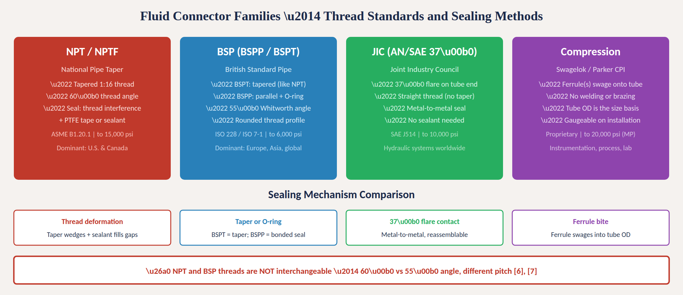
Fluid connector families and sealing methods
Fig. 3: Four major fluid connector families with thread standards, pressure ratings, and sealing mechanisms
MINES | Capstone Design
Notes:
Figure 3 compares the four major fluid connector families side by side. NPT uses a 60-degree tapered thread sealing by thread deformation plus sealant, rated to 15,000 psi per ASME B1.20.1. BSP uses a 55-degree Whitworth thread in either tapered BSPT or parallel BSPP form per ISO 228 and ISO 7-1. JIC uses a 37-degree flare with straight threads for a metal-to-metal seal per SAE J514, rated to 10,000 psi. Compression fittings use ferrules that bite into the tube OD, used for instrumentation and process systems. The sealing mechanism comparison shows each approach, and the warning reinforces that NPT and BSP are not interchangeable.

Slide 13
MINES | Capstone Design
Key fluid connector specifications
When specifying a fluid connector, define these parameters in your design documentation:
Working Pressure
Rated max continuous operating pressure (psi or bar). Always specify working pressure, not burst. Burst is typically 4× working (hydraulic) or 3× (pneumatic). Never operate above 25% of burst pressure [8].
Temperature Range
Affects seal material choice. Buna-N nitrile rubber (–40 to 250°F general purpose), Viton fluoroelastomer (–20 to 400°F chemical resistance), PTFE (–100 to 500°F widest range). Always verify seal compatibility [8].
Fluid Compatibility
Verify fitting body and seal materials against the working fluid using chemical compatibility charts. Stainless steel resists most chemicals; brass is common for water and air; carbon steel for hydraulic oil [8].
Thread / Tube Size
Nominal pipe size (NPS) for threaded fittings — note NPS ≠ actual OD. Tube OD for compression and JIC fittings. Common sizes: 1/4", 3/8", 1/2". Always measure with calipers and thread gauges — never assume [5], [6].
End Configuration
Straight, elbow (45° or 90°), tee, cross, union, reducer, bulkhead. Select to minimize the number of fittings in the line — every joint is a potential leak point. Avoid street elbows stacked in series [8].
MINES | Capstone Design
Notes:
Five critical specifications for fluid connectors. Working pressure is the rated maximum continuous operating pressure. Always specify working pressure, not burst — burst is typically four times working for hydraulic systems and three times for pneumatic. Temperature range affects seal material selection: Buna-N for general purpose to 250 degrees Fahrenheit, Viton for chemical resistance to 400 degrees, and PTFE for the widest range to 500 degrees. Fluid compatibility must be verified — check fitting body and seal materials against the working fluid. Thread and tube size require careful measurement — nominal pipe size does not equal actual outside diameter, which is a common source of confusion. Always use calipers and thread gauges; never assume. End configuration includes straight, elbow, tee, cross, union, reducer, and bulkhead types. Minimize the number of fittings in any line because every joint is a potential leak point.

Slide 14
MINES | Capstone Design
Fluid connector failure modes
Cross-Threading
Forcing NPT into BSP (or vice versa) destroys threads and causes immediate or delayed leaks under pressure. Always verify thread standard with a thread gauge before assembly. NPT has 60° pointed threads; BSP has 55° rounded threads [6], [7].
Over-Tightening
Cracks port bosses (especially aluminum and cast iron), deforms ferrules, splits flare cones. Always use manufacturer-specified torque values. The instinct to "just a little more" destroys more fittings than under-tightening [5].
Seal Degradation
O-rings and gaskets age, swell, or harden from chemical attack, UV exposure, or thermal cycling. Establish replacement intervals based on seal material and service conditions. Keep spare seal kits on hand [8].
Vibration Fatigue
Cyclic stress at tube-to-fitting junctions nucleates cracks that propagate under pressure. Use proper tube support clamps spaced per manufacturer recommendations. Route tubing to avoid sharp bends and cantilever loads [8].
MINES | Capstone Design
Notes:
Four primary fluid connector failure modes. Cross-threading is the most common disaster — forcing NPT into BSP ports destroys threads and causes leaks that may not appear until the system is pressurized. Always verify the thread standard with a thread gauge before assembly. Over-tightening cracks port bosses, especially in aluminum or cast-iron housings, and deforms ferrules and flare cones. Always use manufacturer-specified torque values. The natural instinct to go just a little tighter destroys more fittings than under-tightening. Seal degradation occurs as O-rings age, swell, or harden from chemical attack, UV exposure, or thermal cycling. Establish replacement intervals and keep spare seal kits available. Vibration fatigue cracks tubes at fitting junctions. Use proper tube support clamps spaced per manufacturer recommendations and route tubing to avoid sharp bends and cantilever loads that amplify vibration stress.

Slide 15
03
Selection &
design practice
Decision frameworks, standards, and capstone application
MINES | Capstone Design
Notes:
Section 3 brings electrical and fluid connectors together into a unified selection framework and covers the standards and practical guidance you need for your capstone projects.

Slide 16
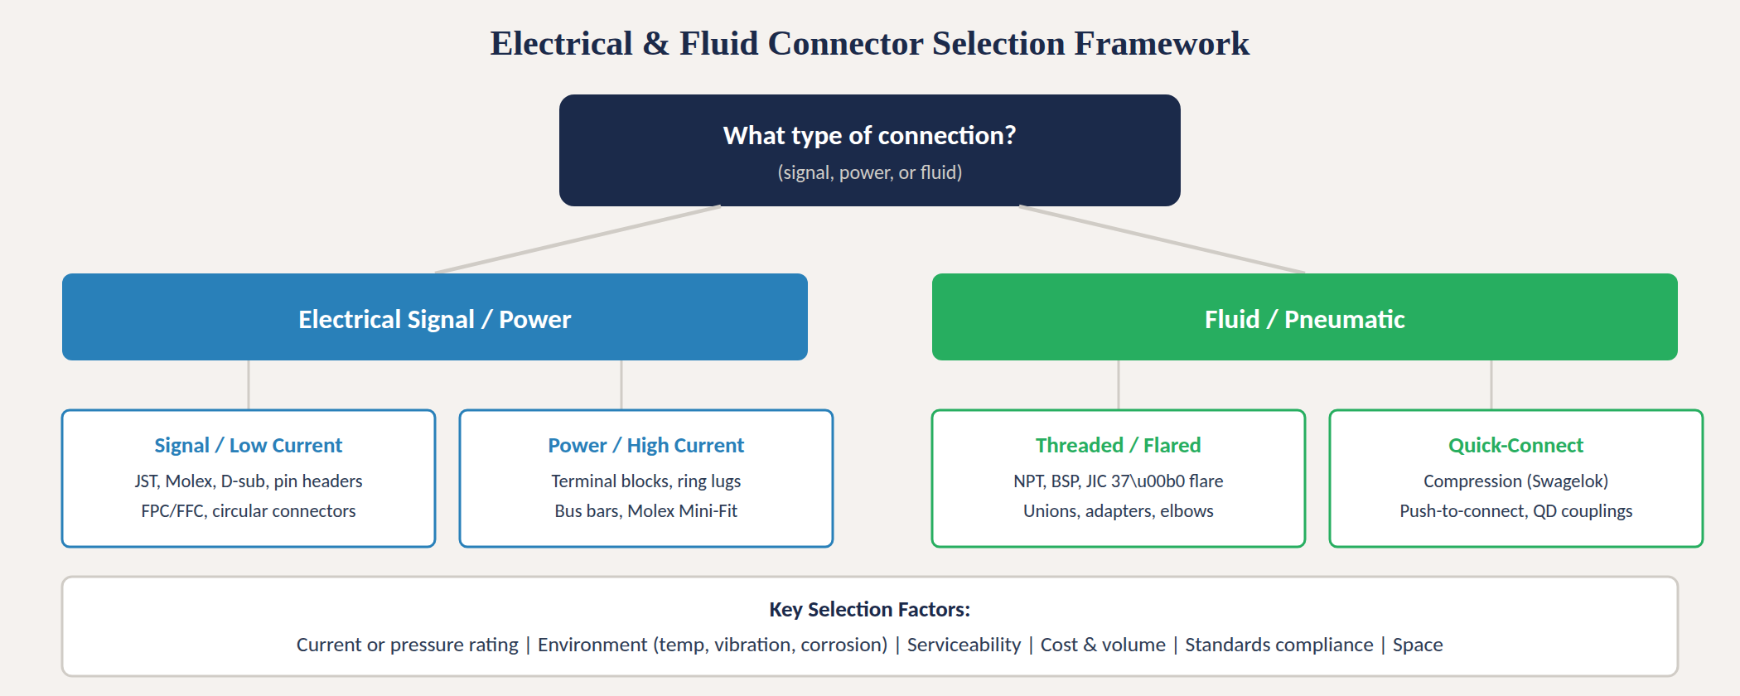
Connector selection decision framework
Fig. 4: Decision tree for electrical and fluid connector selection
MINES | Capstone Design
Notes:
Figure 4 presents the decision framework for connector selection across both domains. Start with: what type of connection do you need — signal, power, or fluid? Electrical connections subdivide into signal or low-current applications using JST, Molex, D-sub, pin headers, and FPC connectors, versus power or high-current applications using terminal blocks, ring lugs, bus bars, and Molex Mini-Fit. Fluid connections subdivide into threaded and flared types including NPT, BSP, and JIC fittings, versus quick-connect types including compression fittings, push-to-connect, and quick-disconnect couplings. The bottom row lists the key selection factors: current or pressure rating, environment, serviceability, cost and volume, standards compliance, and space constraints.

Slide 17
MINES | Capstone Design
Key standards reference
Standard
Org
Scope
IEC 61984 [2]
IEC
Electrical connectors — safety requirements, testing, performance
IEC 60529 [3]
IEC
IP ingress protection rating system (IP67, IP68, IP69K)
MIL-DTL-38999 [4]
U.S. DoD
Military circular connectors — high-performance, harsh environment
UL 486A-486B
UL
Wire connectors — safety certification for crimp, solder, IDC terminations
SAE J514 [5]
SAE
JIC 37° flare hydraulic tube fittings — dimensions and performance
ASME B1.20.1 [6]
ASME
NPT tapered pipe thread form, dimensions, and tolerances
ISO 228 / ISO 7-1 [7]
ISO
BSP parallel (BSPP) and tapered (BSPT) pipe thread standards
ASME B31.3 [8]
ASME
Process piping code — materials, fabrication, inspection, testing
MINES | Capstone Design
Notes:
Standards table covering both domains with IEEE reference numbers. For electrical connectors: IEC 61984 covers safety requirements and testing; IEC 60529 defines the IP ingress protection rating system; MIL-DTL-38999 covers military circular connectors; and UL 486A-486B covers safety certification for wire connectors. For fluid connectors: SAE J514 defines JIC 37-degree flare fittings; ASME B1.20.1 defines NPT tapered pipe threads; ISO 228 and ISO 7-1 define BSP parallel and tapered threads; and ASME B31.3 is the process piping code covering materials, fabrication, inspection, and testing.

Slide 18

MINES | Capstone Design
Practical design tips
Spec the connector before the wire or tube. The connector determines wire gauge, tube OD, termination tool, and housing. Pick the connector family first based on current, voltage, pressure, and environment.
Derate everything. Never run at 100% of rated current, pressure, or temperature. A 25% safety margin is minimum; 50% is professional practice [2], [8].
Design for assembly (DFA). Provide wrench clearance around fittings. Group fluid connections for leak-test access. Use consistent connector families to reduce tool count.
For fluid systems: verify thread standard before assembly with a thread gauge, use manufacturer torque specs, and pressure-test every joint before commissioning [6], [7], [8].
For electrical: pull-test a sample of crimps per IPC/WHMA-A-620, verify contact resistance with a milliohm meter, and document every connector in your wire harness schedule [1], [2].
Document every choice. Record part number, manufacturer, specifications, and rationale in your BOM. Future-you and your teammates will thank you.
MINES | Capstone Design
Notes:
Six practical design tips. First, specify the connector before the wire or tube. Second, derate everything — 25 percent margin minimum, 50 percent for professional practice. Third, design for assembly: provide wrench clearance, group connections for test access, use consistent families. Fourth, for fluid systems: always verify thread standard with a gauge, use manufacturer torque specs, and pressure-test every joint. Fifth, for electrical: pull-test crimps, verify contact resistance, and document every connector in a wire harness schedule. Sixth, document every selection decision with part numbers, specs, and rationale in your bill of materials.

Slide 19
MINES | Capstone Design
Key takeaways
(1)
Electrical connectors are classified by what they connect (wire-to-wire, wire-to-board, board-to-board) and how they terminate (crimp, solder, IDC, screw, press-fit) [1].
(2)
Spec current rating, voltage rating, IP rating, contact resistance, and mating cycles for every electrical connection. Derate for temperature [2], [3].
(3)
Fluid connectors require matching thread standards — NPT ≠ BSP. JIC 37° flare and compression fittings avoid taper-thread pitfalls [5], [6], [7].
(4)
Failure modes differ: electrical joints fail from fretting corrosion and overheating; fluid joints fail from cross-threading and seal degradation [1], [8].
(5)
Every connector spec follows the same logic: rating → environment → serviceability → cost → standards → space. Document everything in your BOM.
MINES | Capstone Design
Notes:
Five key takeaways. One: electrical connectors are classified by connection type and termination method. Two: specify current, voltage, IP rating, contact resistance, and mating cycles for every electrical connection and derate for temperature. Three: fluid connectors require matching thread standards — NPT and BSP are not interchangeable; JIC and compression fittings avoid taper-thread pitfalls. Four: failure modes differ by domain — fretting and overheating for electrical, cross-threading and seal degradation for fluid. Five: every connector specification follows the same underlying logic regardless of domain.

Slide 20
MINES | Capstone Design
Applying connectors in your capstone
Incorrect connector selection is one of the most common failure modes in student capstone projects.
1
Create a connection schedule early — list every electrical and fluid joint in your design and classify by type
2
For electrical: specify connector family, pin count, current rating, IP rating, termination method, and wire gauge [1], [2]
3
For fluid: specify fitting standard (NPT/BSP/JIC/compression), size, pressure rating, seal material, and torque [5]–[8]
4
Build a complete BOM with part numbers and sources (Digi-Key, Mouser for electrical; Swagelok, Parker, McMaster for fluid)
5
At PDR: show connection schedule. At CDR: show datasheets and torque specs. At FDR: demonstrate assembly and test procedures
6
Test every connection: pull-test electrical crimps, measure contact resistance, pressure-test all fluid joints before commissioning
MINES | Capstone Design
Notes:
Six steps for your capstone. Step 1: create a connection schedule listing every electrical and fluid joint. Step 2: for electrical connections, specify connector family, pin count, current rating, IP rating, termination method, and wire gauge. Step 3: for fluid connections, specify fitting standard, size, pressure rating, seal material, and torque. Step 4: build a complete BOM with specific part numbers — Digi-Key and Mouser for electrical, Swagelok and Parker for fluid, McMaster-Carr for general fittings. Step 5: present connection decisions at every design review. Step 6: test every connection before commissioning — pull-test crimps, measure contact resistance, and pressure-test all fluid joints.

Slide 21
MINES | Capstone Design
References
[1] R. S. Mroczkowski, Electronic Connector Handbook: Theory and Applications. New York: McGraw-Hill, 1998.
[2] IEC, "IEC 61984: Connectors — Safety Requirements and Tests," 3rd ed., 2018.
[3] IEC, "IEC 60529: Degrees of Protection Provided by Enclosures (IP Code)," 3rd ed., 2013.
[4] U.S. Department of Defense, "MIL-DTL-38999: Connectors, Electrical, Circular, Miniature, High-Density, Quick Disconnect," 2019.
[5] SAE International, "SAE J514: Hydraulic Tube Fittings," 2012.
[6] ASME, "ASME B1.20.1: Pipe Threads, General Purpose (Inch)," 2013.
[7] ISO, "ISO 228-1: Pipe Threads Where Pressure-Tight Joints Are Not Made on the Threads — Part 1: Dimensions, Tolerances and Designation," 2003.
[8] ASME, "ASME B31.3: Process Piping," 2022.
MINES | Capstone Design
Notes:
IEEE-format references for this module. Mroczkowski is the definitive reference on electronic connector design and theory. IEC 61984 and IEC 60529 cover electrical connector safety and IP ratings respectively. MIL-DTL-38999 is the military circular connector standard. SAE J514 defines JIC hydraulic tube fittings. ASME B1.20.1 defines NPT pipe threads. ISO 228-1 defines BSP pipe threads. ASME B31.3 is the process piping code.

