Slide 1
MINES | MEGN 301 — Mechanical Integration and Design
Manufacturing Process Design
Designing for
Injection Molding
PROCESS FUNDAMENTALS, DFM RULES, TOOLING, AND ECONOMICS
Notes:
Welcome to the Designing for Injection Molding module, part of MEGN 301 — Mechanical Integration and Design. Injection molding is the dominant manufacturing process for producing plastic parts in quantities from a few thousand to millions. If you design a consumer product, a medical device, an automotive component, or an electronics enclosure, chances are very high that multiple parts will be injection molded. The goal of this module is not to teach you how to operate a molding machine — it is to teach you how to design parts that can be manufactured efficiently, affordably, and without defects. The difference between a part designed with molding in mind and one that ignores the process can be tens of thousands of dollars in tooling cost, weeks of delay for mold rework, and scrap rates that destroy your project economics. Design for Manufacturability — DFM — is not an afterthought; it is a core engineering discipline.
ALIGNMENT NOTE — This module corresponds to the Designing for Injection Molding chapter of your Master Reference Document and directly supports Sprint 3 (CDR — Manufacturing Design Review). All polymer components must be designed for injection molding even if your prototype is 3D-printed.
NOTE ON STEEL SAFE DESIGN — 'Adding plastic' to a part means removing steel from the mold. Removing steel is cheap; adding steel (welding + re-machining) is expensive. Design critical dimensions steel safe — intentionally undersized in the mold — then remove steel to fine-tune after the first trial. Plan for at least one round of mold adjustment.
FINAL NOTES — This module aligns with Chapter 12 of the final compiled document. Key cross-references: (1) DFM review is a CDR deliverable (Part III, Ch 14). (2) Strategic resin selection tip ($15/kg ABS-Like vs $38/kg Nylon-Like) appears in both Ch 3 and this chapter. (3) All polymer components must pass the DFM checklist at CDR even if prototyped via 3D printing. (4) Warpage, surface finish, insert molding, overmolding, living hinges, and snap-fit design sections provide comprehensive coverage beyond basic DFM rules. (5) Glossary defines DFM, SPI, TPE.

Slide 2

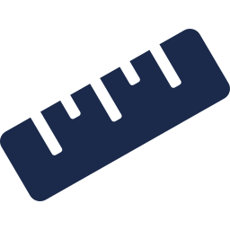




MINES | MEGN 301
Learning outcomes
Describe the four phases of the injection molding cycle and explain how each phase constrains part design
Apply the six critical DFM geometry rules: wall thickness, draft angles, ribs, radii, undercuts, and gate location
Select appropriate thermoplastic materials by matching mechanical, thermal, and chemical properties to application requirements
Identify common molding defects (sink, warp, short shot, flash, weld lines, jetting) and design to prevent them
Evaluate tooling options and cost tradeoffs between prototype and production molds
Apply a DFM checklist to your own part designs before submitting to a molder
MINES | MEGN 301 — Mechanical Integration and Design
Notes:
Six learning outcomes. First, understand the injection molding cycle — clamping, injection, cooling, and ejection — and how each phase creates specific design constraints. Second, apply the six critical DFM geometry rules that determine whether your part can be molded successfully: wall thickness uniformity, draft angles for release, rib and boss proportions, fillet radii for flow and strength, undercut management, and gate location. Third, select the right thermoplastic material by matching properties to your application's mechanical loads, operating temperatures, chemical environment, and aesthetic requirements. Fourth, identify common molding defects — sink marks, warpage, short shots, flash, weld lines, and jetting — and understand the design choices that cause or prevent each one. Fifth, evaluate the cost tradeoffs between rapid-prototype molds in aluminum and full production molds in hardened steel. Sixth, apply a systematic DFM checklist to your own designs before you send them to a molder, catching expensive problems before they are machined into steel.

Slide 3
01
Injection molding
fundamentals
Process cycle, machine anatomy, and material selection
MINES | MEGN 301 — Mechanical Integration and Design
Notes:
Section 1 covers the fundamentals you need to understand before you start designing parts. How the process works, what the machine does, and what materials are available. Every DFM rule we cover later is a direct consequence of the physics of this process — molten plastic flowing into a cold steel cavity under high pressure.

Slide 4
MINES | MEGN 301
How injection molding works
The Machine
An injection molding machine has two units: the injection unit (barrel, screw, heater bands, nozzle) melts plastic pellets and injects them under pressure, and the clamping unit (platens, tie bars, hydraulic or toggle mechanism) holds the mold closed against injection pressure. Machines are rated by clamp force (tons) and shot size (oz or g).
The Mold
A precision steel tool with two halves: the cavity (A-side, stationary, forms the outside surface) and the core (B-side, moving, forms the inside surface). The parting line is where the halves meet. The mold also contains a runner system to distribute plastic, cooling channels for temperature control, and ejector pins to push the part out.
The Cycle
Four phases repeat continuously: (1) Clamping — mold closes under force. (2) Injection — screw pushes melt into cavity at 10,000–30,000 psi, followed by pack-and-hold to compensate for shrinkage. (3) Cooling — plastic solidifies (50–80% of cycle time). (4) Ejection — mold opens, pins push part off core. Total cycle: 15–60 seconds depending on wall thickness and part size.
MINES | MEGN 301 — Mechanical Integration and Design
Notes:
The injection molding machine has two primary subsystems. The injection unit melts plastic pellets using a rotating screw inside a heated barrel, then pushes the molten plastic forward into the mold like a piston. The clamping unit holds the two mold halves together with enough force to resist the injection pressure trying to push them apart. Machines are rated by their clamp force in tons — a 100-ton machine can hold the mold closed with 100 tons of force. The mold itself is a precision-machined steel tool, typically costing $10,000 to $100,000+ for a production mold. It has two halves that define the part geometry. The A-side or cavity half is stationary and forms the outside or cosmetic surface of the part. The B-side or core half moves and forms the inside surface — this is where ejector pins push the part out, leaving small circular marks. Between them is the parting line — the line where the two mold halves meet — which leaves a witness line on the finished part. Inside the mold, a runner system distributes plastic from the machine nozzle to the gate where it enters the cavity. Cooling channels machined into the steel carry water to extract heat. The process cycles continuously. Cooling is the dominant phase — accounting for 50 to 80 percent of cycle time. This is why wall thickness drives cycle time and therefore part cost. Every additional millimeter of wall thickness can add 5 to 15 seconds of cooling time per cycle.

Slide 5
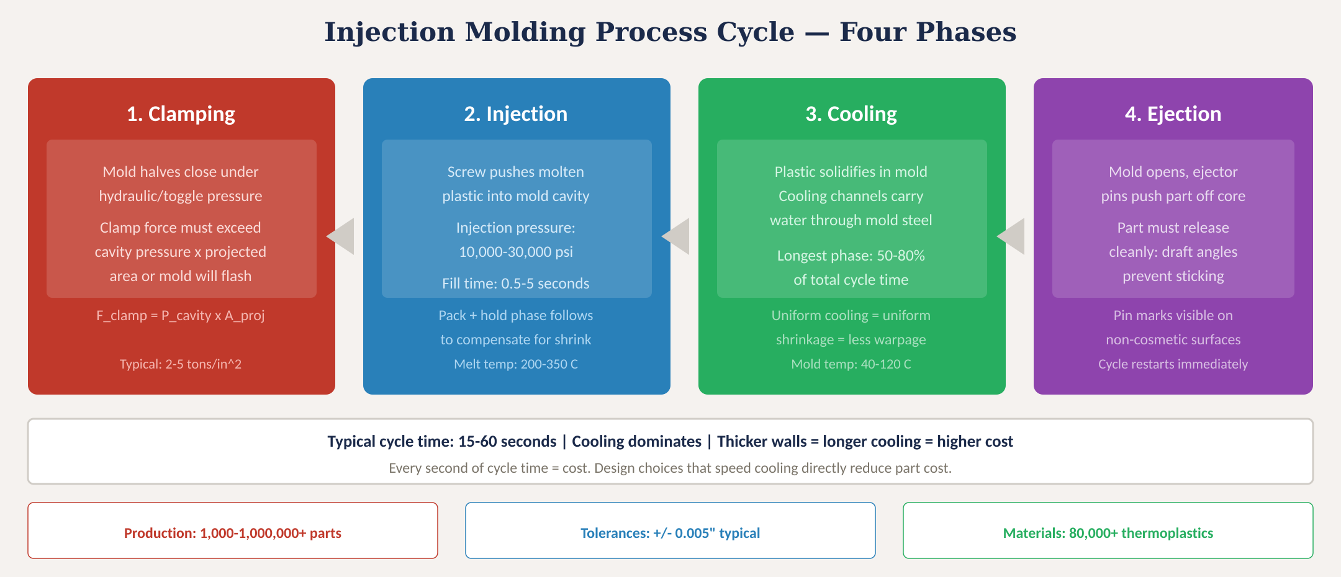
Injection molding process cycle
Fig. 1: Four-phase injection molding cycle with process parameters, timing, and production capabilities
MINES | MEGN 301 — Mechanical Integration and Design
Notes:
Figure 1 shows the four-phase cycle. Clamping: the mold closes under force calculated as cavity pressure times projected area — the projected area is the shadow of your part as seen from the direction the mold opens. A larger part needs more clamp force. Typical cavity pressures of 2 to 5 tons per square inch mean a part with 10 square inches of projected area needs 20 to 50 tons of clamping force. Injection: the screw pushes molten plastic at 10,000 to 30,000 psi in a fill time of typically 0.5 to 5 seconds. The pack-and-hold phase that follows maintains pressure to compensate for volumetric shrinkage as the plastic cools — without adequate packing, the part will have sink marks and be undersized. Melt temperatures range from 200 degrees Celsius for polyethylene to 350 degrees for polycarbonate and nylon. Cooling: the longest phase, consuming 50 to 80 percent of total cycle time. Cooling water flowing through channels in the mold steel extracts heat. Uniform cooling across the part produces uniform shrinkage and minimizes warpage. Non-uniform cooling — caused by varying wall thickness or poor cooling channel placement — is the primary cause of warped parts. Mold temperatures range from 40 to 120 degrees depending on the material. Ejection: the mold opens and ejector pins push the part off the core. The part must have draft angles so it releases cleanly — without draft, the part sticks to the core and ejector pins can push through it. The cycle then restarts immediately, producing one part every 15 to 60 seconds.

Slide 6
MINES | MEGN 301
Common injection molding materials
Material
Trade Names
Key Properties
Shrink
Common Uses
ABS
Cycolac, Terluran
Good impact, easy to mold/paint, moderate heat (80°C)
0.5-0.7%
Enclosures, LEGO, auto trim
Polycarbonate
Lexan, Makrolon
High impact, optical clarity, heat to 130°C, UV-sensitive
0.5-0.7%
Lenses, safety glasses, phone cases
Polypropylene
Pro-fax, Moplen
Chemical resistant, living hinge, low cost, low density
1.0-2.5%
Containers, caps, hinges, auto
Nylon (PA6/66)
Zytel, Ultramid
High strength + stiffness, abrasion resistant, absorbs moisture
0.8-1.5%
Gears, bearings, connectors
POM (Acetal)
Delrin, Celcon
Low friction, dimensional stability, fatigue resistant
1.8-2.5%
Gears, zippers, fuel systems
PC/ABS Blend
Bayblend, Cycoloy
Combines PC toughness with ABS processability
0.5-0.7%
Laptops, power tools, auto
PBT
Valox, Crastin
Good electrical props, chemical resistant, low moisture
1.5-2.0%
Electrical connectors, housings
TPE/TPU
Santoprene, Estane
Flexible, rubber-like, overmoldable, good grip
0.5-2.0%
Grips, seals, overmolded parts
MINES | MEGN 301 — Mechanical Integration and Design
Notes:
Material selection is one of the most consequential design decisions. This table covers the eight most common thermoplastics you will encounter. ABS is the workhorse — good impact resistance, easy to mold and paint, and moderate cost. It is what LEGO bricks are made from. Polycarbonate offers optical clarity and exceptional impact resistance but is sensitive to UV and chemical attack. Polypropylene is the cheapest engineering plastic with outstanding chemical resistance and the unique ability to form living hinges — thin integral hinges that flex millions of cycles. Nylon offers the highest strength and stiffness of common plastics but absorbs moisture that changes its dimensions. POM or acetal is the go-to material for gears and bearings due to its low friction and fatigue resistance. PC/ABS blends combine the best of both materials. PBT is standard for electrical connectors. TPE and TPU are flexible materials that can be overmolded onto rigid substrates to create soft-touch grips and seals. The shrinkage column is critical for dimensional accuracy — when the hot plastic cools, it contracts. Your mold must be cut larger than the finished part by the shrinkage factor. High-shrinkage materials like polypropylene at 1 to 2.5 percent require tighter process control and more generous tolerances than low-shrinkage materials like ABS at 0.5 to 0.7 percent.
AMORPHOUS VS SEMI-CRYSTALLINE — The most important material classification. Amorphous (ABS, PC, PS): randomly oriented chains, lower/uniform shrinkage (0.4-0.8%), better dimensional control, susceptible to stress cracking, poor bearing surfaces. Semi-crystalline (PP, nylon, POM, PE): ordered crystalline regions during cooling, higher shrinkage (1.0-2.5%), greater warp risk, but superior chemical resistance, fatigue life, and wear properties. This choice drives all subsequent DFM decisions.

Slide 7
MINES | MEGN 301
Material selection criteria
Match material properties to your application requirements. The cheapest material that meets ALL requirements is the right choice.
Mechanical
Tensile strength, impact resistance (Izod/Charpy), flexural modulus, fatigue endurance. Glass-fiber reinforcement increases stiffness 2-3× but reduces impact and makes the material abrasive to the mold.
Thermal
Heat deflection temperature (HDT), continuous use temperature, flammability (UL94 V-0/V-2/HB). If your part is near electronics or in an engine bay, thermal rating is often the limiting factor.
Chemical
Resistance to solvents, oils, fuels, cleaning agents, UV radiation. PP and POM are chemically robust; PC is attacked by many solvents. Always check chemical compatibility charts.
Aesthetic
Surface finish (gloss, texture), colorability, transparency. PC and PMMA for optical clarity. ABS and PC/ABS accept paint well. Nylon is difficult to paint without primer.
Processing
Melt flow index (MFI), shrinkage, moisture sensitivity. High-MFI materials fill thin walls easily. Low-shrinkage materials hold tighter tolerances. Nylon and PC must be dried before molding.
Cost & Availability
Resin cost per pound, minimum order quantities, supply chain risk. PP is cheapest (~$0.60/lb). PC is moderate (~$2.00/lb). Specialty resins can exceed $10/lb. Always verify availability.
MINES | MEGN 301 — Mechanical Integration and Design
Notes:
Material selection is a multi-criteria optimization. Mechanical properties define structural capability — tensile and impact strength for load-bearing, flexural modulus for stiffness, and fatigue life for cyclic loading. Glass-fiber reinforcement is common when stiffness is critical — 30 percent glass-filled nylon has two to three times the modulus of unfilled — but the fibers reduce impact resistance and are abrasive to mold steel, increasing maintenance costs. Thermal properties determine operating temperature limits. The heat deflection temperature or HDT is the temperature at which the material deflects a standard amount under load. If your part is near a heat source, this is often the constraint that eliminates cheaper materials. UL94 flammability ratings are mandatory for any part near electronics. Chemical resistance varies enormously — polypropylene resists almost everything but is weak; polycarbonate is strong but is attacked by many solvents including some common cleaners. Always consult the material manufacturer's chemical compatibility chart for your specific environment. Aesthetic requirements drive material choice when appearance matters — PC and PMMA for transparency, ABS for paintability, textured surfaces for hiding flow marks. Processing characteristics affect both part quality and cost — high melt flow index materials fill thin walls more easily, low-shrinkage materials hold tighter tolerances, and moisture-sensitive materials like nylon and PC must be dried in a desiccant dryer for 2 to 4 hours before molding or you get splay marks and degraded properties. Cost is always a factor — the cheapest material that meets all your performance requirements is the right choice.

Slide 8
02
Design for
manufacturing
Wall thickness, draft, ribs, radii, undercuts, and gates
MINES | MEGN 301 — Mechanical Integration and Design
Notes:
Section 2 is the core of this module — the six geometry rules that determine whether your part can be injection molded successfully. These rules are not arbitrary guidelines; each one is a direct consequence of the physics of molten plastic flowing into and cooling inside a steel mold. Violate them and you get defects, rework, or a part that simply cannot be made. Follow them and your molder will thank you, your tooling will cost less, and your parts will come off the machine clean.

Slide 9
MINES | MEGN 301
Rule 1: Uniform wall thickness
Wall thickness is the single most important design parameter in injection molding. It drives cycle time, material usage, defects, and cost.
Recommended Ranges
ABS: 1.5–3.5 mm. PC: 1.5–3.5 mm. PP: 0.8–3.0 mm. Nylon: 1.0–3.0 mm. POM: 1.0–3.0 mm. Thinner walls fill faster, cool faster, use less material, and cost less. But too thin and the mold won't fill (short shot). Find the minimum wall that meets your structural and flow requirements.
Uniformity Rule
Keep wall thickness uniform throughout the part — variation should be less than 10% of nominal. Where thickness transitions are unavoidable, use gradual tapers (3:1 ratio over length) rather than abrupt steps. Abrupt changes cause differential shrinkage, sink marks on the thick side, and stress concentrations at the transition.
Coring Out
Thick sections are the enemy. Instead of a solid block, core out the interior to leave a uniform thin shell. Use ribs for stiffness rather than mass. A ribbed 2mm wall is stiffer than a solid 4mm wall, cools in a quarter of the time, uses half the material, and has no sink marks.
MINES | MEGN 301 — Mechanical Integration and Design
Notes:
Wall thickness is the single most important design parameter because it affects everything. Cooling time scales with the square of wall thickness — doubling the wall from 2mm to 4mm quadruples cooling time, which can double your cycle time and therefore your part cost. Material usage scales linearly with wall thickness, so thicker walls also cost more in resin. And thicker walls are more prone to sink marks, voids, and warpage because the interior cools more slowly than the skin, creating internal stresses. The recommended range varies by material but generally falls between 1 and 3.5 millimeters. The target is the thinnest wall that meets your structural requirements and can be filled by the melt. Thin-wall molding below 1mm requires higher injection pressures and faster fill speeds but produces the fastest cycles. Uniformity is critical because non-uniform cooling causes differential shrinkage, which manifests as sink marks on the surface opposite a thick section, internal voids, and warpage. Where you must transition between thicknesses, do it gradually with a 3-to-1 taper ratio — transition over a length at least 3 times the thickness difference. Coring out means removing interior material from thick sections to leave a uniform shell, then adding ribs where stiffness is needed. A ribbed thin wall outperforms a solid thick wall on every metric: stiffness, weight, cycle time, and surface quality.

Slide 10
MINES | MEGN 301
Rule 2: Draft angles
Draft is the slight taper on vertical walls that allows the part to release from the mold. Without draft, the part sticks to the core.
Draft Requirements
Common Mistakes
Minimum: 0.5° per side (tight tolerance)
Standard: 1–2° per side (recommended)
Generous: 3–5° per side (easy release)
Rules of thumb:
• All surfaces parallel to the mold opening direction need draft
• More draft = easier ejection = less wear on mold
• Deep draws need more draft
• Core side may need more draft than cavity side (part shrinks onto core as it cools)
Texture adds friction:
• Add 1° per 0.001" (0.025mm) of texture depth
• SPI D-3 bead blast (~0.003"): add 3° beyond standard draft
Zero-draft walls: Part sticks to core, ejector pins push through the wall, mold wears rapidly. This is the #1 student DFM error.
Insufficient draft on textured surfaces: Texture acts like sandpaper during ejection. Drag marks ruin the finish and gouge the mold.
Forgetting draft on internal features: Internal ribs, bosses, and walls all need draft, not just the outer shell.
Draft in wrong direction: Draft must taper in the direction of mold opening. Analyze the mold open direction first, then apply draft.
Fix: In CAD, apply draft last — after all features are modeled. Most CAD tools have automatic draft analysis to check.
MINES | MEGN 301 — Mechanical Integration and Design
Notes:
Draft angles are the slight taper on walls parallel to the direction the mold opens. When plastic cools, it shrinks onto the core — the part literally grips the core. Without draft, the ejector pins have to push the part off by friction, which can distort the part, leave deep pin marks, or crack thin sections. With even half a degree of draft, the part begins releasing the instant the mold opens. One to two degrees is standard for most applications. The draft requirement increases with texture depth because textured surfaces have higher friction. The rule is 1 degree per 0.001 inch of texture depth — so an SPI D-3 bead-blast finish at approximately 0.003 inches depth needs 3 degrees of additional draft on top of the standard draft. This means a textured surface might need 4 to 5 degrees total, which noticeably tapers the wall. Design for this early. The most common student mistake is designing with zero-draft vertical walls. This either makes the part impossible to eject or requires expensive mold features to compensate. The second most common mistake is forgetting draft on internal features — ribs, bosses, and internal walls all need draft, not just the outer shell. In your CAD workflow, model the part geometry first, then apply draft as one of the last operations. Most CAD systems have a draft analysis tool that color-maps surfaces by their draft angle relative to a pull direction — use it before sending your model to a molder.

Slide 11
MINES | MEGN 301
Rule 3: Ribs and bosses
Ribs add stiffness without adding mass or cycle time. Bosses provide mounting points for screws and inserts. Both follow strict proportional rules.
Rib Design Rules
Boss Design Rules
Rib thickness: 50–70% of adjoining wall
(thicker ribs → sink marks on opposite surface)
Rib height: max 3× wall thickness
(taller ribs → difficult to fill, ejection problems)
Rib draft: min 0.5° per side (1° preferred)
Rib spacing: min 2× wall thickness apart
(prevents cooling interference between ribs)
Base radius: 0.25–0.5 × wall thickness
(too small → stress crack; too large → thick spot → sink)
Multiple thin ribs > one thick rib
(better stiffness-to-weight, no sink marks)
Boss OD: 2.0–2.5 × screw/insert hole ID
Boss wall: 0.6 × nominal wall thickness
(thicker → sink on outside surface)
Freestanding bosses: connect to nearest wall with a rib (prevents knit lines and aids filling)
Boss height: max 2.5 × OD
(taller → difficult to cool and fill)
Draft: 0.5° on outside, 0.25° on inside hole
For self-tapping screws:
• Hole ID = screw major dia – 1 thread depth
• Use thread-forming (not cutting) in ABS/PC
For heat-set inserts:
• Hole ID per insert manufacturer spec
• Brass inserts: strongest, most reliable
MINES | MEGN 301 — Mechanical Integration and Design
Notes:
Ribs and bosses are the two most common reinforcement features in injection-molded parts, and both follow strict proportional rules tied to the adjoining wall thickness. For ribs, the critical ratio is rib thickness to wall thickness. If the rib is thicker than about 60 percent of the wall, the thick section at the rib-wall intersection cools more slowly than the surrounding wall, causing a visible sink mark on the opposite surface. The 50 to 70 percent rule prevents this. Rib height is limited to about 3 times the wall thickness because taller ribs are difficult to fill with plastic and hard to eject. Multiple short ribs are always better than one tall rib. The base radius at the junction between rib and wall is a balance: too small and you get a stress concentration that cracks under impact; too large and you create a thick spot that sinks. Target 0.25 to 0.5 times the wall thickness. Rib spacing should be at least 2 times the wall thickness to prevent cooling interference between adjacent ribs. Bosses follow similar logic. The outside diameter should be 2 to 2.5 times the hole inside diameter, and the boss wall thickness should be about 60 percent of the nominal wall. Freestanding bosses — bosses in the middle of a flat panel not connected to a wall — are problematic because the plastic must flow around them, creating weld lines. Connect freestanding bosses to the nearest wall with a rib. For fastening, self-tapping screws work well in ABS and PC but require specific hole sizing. Heat-set brass inserts provide the strongest, most reliable threaded connection and are standard for production assemblies.
WARPAGE SCIENCE — Warpage results from differential shrinkage caused by: (1) Material type — semi-crystalline shrinks more and more anisotropically. (2) Fiber/molecular orientation — molecules align with flow, creating directional shrinkage differences. (3) Varying wall thickness — thick sections cool slower, shrink differently. (4) Mold constraint — steel surfaces restrain shrinkage while in mold, creating frozen-in stresses that release after ejection. (5) Gate location — density gradient from gate to end of fill. Design to minimize: uniform walls, amorphous materials when possible, flow simulation, stiffening features.

Slide 12
MINES | MEGN 301
Rules 4-6: Radii, undercuts, and gates
Rule 4: Radii & Fillets
Sharp inside corners create stress concentrations (up to 3× stress multiplier at zero radius), impede melt flow, and cause sink marks. Inside radius: minimum 0.5× wall thickness (1× preferred). Outside radius: inside radius + wall thickness. This maintains uniform wall thickness through the corner. Apply radii to every inside corner without exception.
Rule 5: Undercuts
Any feature that prevents straight-pull separation from the mold is an undercut: side holes, snap hooks, internal threads, louvers. Each undercut requires a side action (cam, lifter, or collapsing core) that adds $5,000–$25,000 to tooling cost plus maintenance complexity. Redesign first: can a pass-through hole, a snap-fit aligned to pull direction, or a secondary operation eliminate the undercut?
Rule 6: Gate Location
The gate is where plastic enters the cavity. Place it at the thickest section so melt flows from thick to thin (ensures packing). Gate types: edge gate (simple, visible vestige), sub gate (auto-trimmed, tunnel entry), pin gate (small mark, requires 3-plate mold), hot runner (no runner waste, highest tooling cost). Never gate on a cosmetic surface. Flow analysis (Moldflow) predicts fill pattern and weld line locations.
MINES | MEGN 301 — Mechanical Integration and Design
Notes:
Rules 4 through 6 complete the geometry guidelines. Radii: a sharp inside corner in an injection-molded part is a triple problem — it creates a stress concentration that can be 3 times the nominal stress at zero radius, it impedes melt flow because plastic does not turn sharp corners easily, and it creates a thick spot if the outside corner is also radiused but the inside is not. The minimum inside radius is half the wall thickness; the outside radius should equal the inside radius plus the wall thickness, maintaining uniform wall section through the corner. Apply radii to every inside corner — there is no valid reason for a sharp inside corner in an injection-molded part. Undercuts are features that prevent the part from pulling straight out of the mold. Every undercut requires a mechanical action in the mold — a side-pull cam, a lifter, or a collapsing core — each adding $5,000 to $25,000 to tooling cost plus ongoing maintenance. Before accepting an undercut, always explore redesign options. Can a side hole be replaced with a pass-through slot aligned to the pull direction? Can a snap hook be oriented along the mold-open axis? Can an internal thread be replaced with a heat-set insert installed after molding? Gate location determines how the cavity fills. The fundamental rule is to gate at the thickest section so that melt flows from thick to thin — this ensures that the thick section, which shrinks the most, remains connected to the runner for packing pressure the longest. Gate type affects surface appearance, cycle time, and tooling cost. Hot runners eliminate runner waste and reduce cycle time but add significant tooling cost.
SURFACE FINISH — SPI/PIA standards: A-grades (diamond buff) for optical/mirror finish; B-grades (paper polish) for semi-gloss; C-grades (stone polish) for matte; D-grades (dry blast) for textured. Higher grades cost more. Different finishes on different surfaces is common — show side textured, B-side rougher.
TEXTURED SURFACES AND DRAFT — Aggressive textures act as microscopic undercuts. Add 1° of draft per 0.001 in (0.025 mm) of texture depth, in addition to baseline draft. A surface with 0.003 in texture needs +3° additional draft.

Slide 13
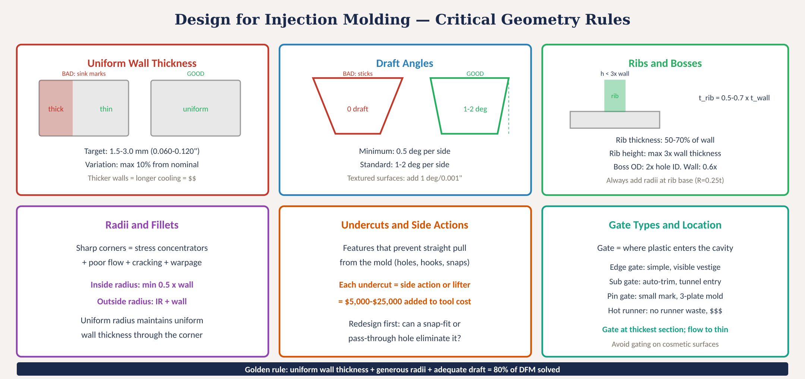
Critical DFM geometry rules
MINES | MEGN 301 — Mechanical Integration and Design
Notes:
Figure 2 consolidates all six DFM geometry rules into a single visual reference. Upper left: uniform wall thickness with the good and bad examples side by side, showing the 1.5 to 3.0 mm target range and the 10 percent maximum variation. Upper center: draft angles showing the zero-draft sticking problem versus proper 1 to 2 degree draft, with the texture-depth rule. Upper right: rib and boss proportional rules — rib thickness at 50 to 70 percent of wall, height at 3 times wall maximum, and boss OD at 2 times hole ID. Lower left: radii and fillets showing the stress concentration problem at sharp corners and the inside/outside radius relationship. Lower center: undercuts and side actions with the cost impact. Lower right: gate types and the thick-to-thin flow rule. The golden rule at the bottom summarizes: uniform wall thickness plus generous radii plus adequate draft solves 80 percent of DFM problems.
INSERT MOLDING — Place a pre-formed metal component (typically brass) in the mold before injection. Knurled surfaces and undercuts provide mechanical interlocking. Alternative: heat-set inserts pressed into pre-molded holes after molding — simpler, no mold modification needed, standard for 3D-printed and low-volume parts.
OVERMOLDING — Molding soft TPE over rigid substrate (ABS, PC, nylon). Material compatibility is critical — check manufacturer bonding charts. Design through-holes in substrate for flow path.
LIVING HINGES — PP is the gold standard (millions of flex cycles). Hinge section 0.2-0.4 mm thick. Gate material flow perpendicular to hinge. NEVER place weld line at hinge. Flex immediately after molding while plastic is warm.
SNAP-FIT CLIPS — Cantilever deflection: ε_max = 3·y·t / (2·L²). Allowable strain: PP up to 5%, ABS up to 2%, PC up to 1.5%. Design pass-through holes to avoid side actions in the mold.

Slide 14
MINES | MEGN 301
Common molding defects and design fixes
Every defect has a root cause in part geometry, material, or process. Good design eliminates most defects before the mold is ever cut.
Sink Marks
Depressions on the surface opposite thick sections. The interior cools slowly, shrinks, and pulls the surface inward. Fix: uniform walls, core out thick areas, rib thickness at 60% of wall.
Warpage
Part bows or twists after ejection due to non-uniform shrinkage from uneven cooling. Fix: uniform wall thickness, symmetric geometry, balanced gate location, even cooling channels.
Short Shot
Cavity doesn't fill completely — part is incomplete. Caused by inadequate venting, too-thin walls, insufficient injection pressure, or cold material. Fix: vent at end-of-fill locations, increase wall thickness in thin areas.
Flash
Thin film of plastic at the parting line. Caused by insufficient clamp force, worn mold surfaces, or excessive injection pressure. Fix: minimize projected area, maintain mold, optimize process.
Weld Lines
Visible lines where two melt fronts meet — cosmetically undesirable and structurally weak (50-90% of base strength). Fix: relocate gate to push weld to non-critical area, increase melt temperature.
MINES | MEGN 301 — Mechanical Integration and Design
Notes:
Five of the most common defects that students encounter. Sink marks are the poster child for non-uniform wall thickness — the thick section cools last, the interior shrinks as it solidifies, and the still-soft surface gets pulled inward forming a dimple. The fix is always the same: make the wall uniform, core out thick sections, and keep rib thickness at 60 percent of the wall. Warpage is caused by differential shrinkage from non-uniform cooling. One side of the part cools faster than the other, shrinks more, and bows the part. The fix is geometric symmetry, uniform walls, and a balanced gate location that fills the cavity evenly. Short shots mean the cavity did not fill completely. Common in thin-wall parts or when venting is inadequate — air trapped in the cavity blocks the advancing melt front. Adding thin vents at the end-of-fill location allows trapped air to escape. Flash is excess plastic that squeezes out at the parting line, appearing as a thin film that must be trimmed. It is caused by insufficient clamping force or worn mold surfaces. Weld lines form wherever two melt fronts meet — typically behind holes, bosses, or any obstacle the melt flows around. They are both cosmetically undesirable and structurally weak, retaining only 50 to 90 percent of the base material's strength. Gate location is the primary design tool for controlling where weld lines end up — move the gate so that weld lines fall on non-critical, non-cosmetic surfaces.

Slide 15
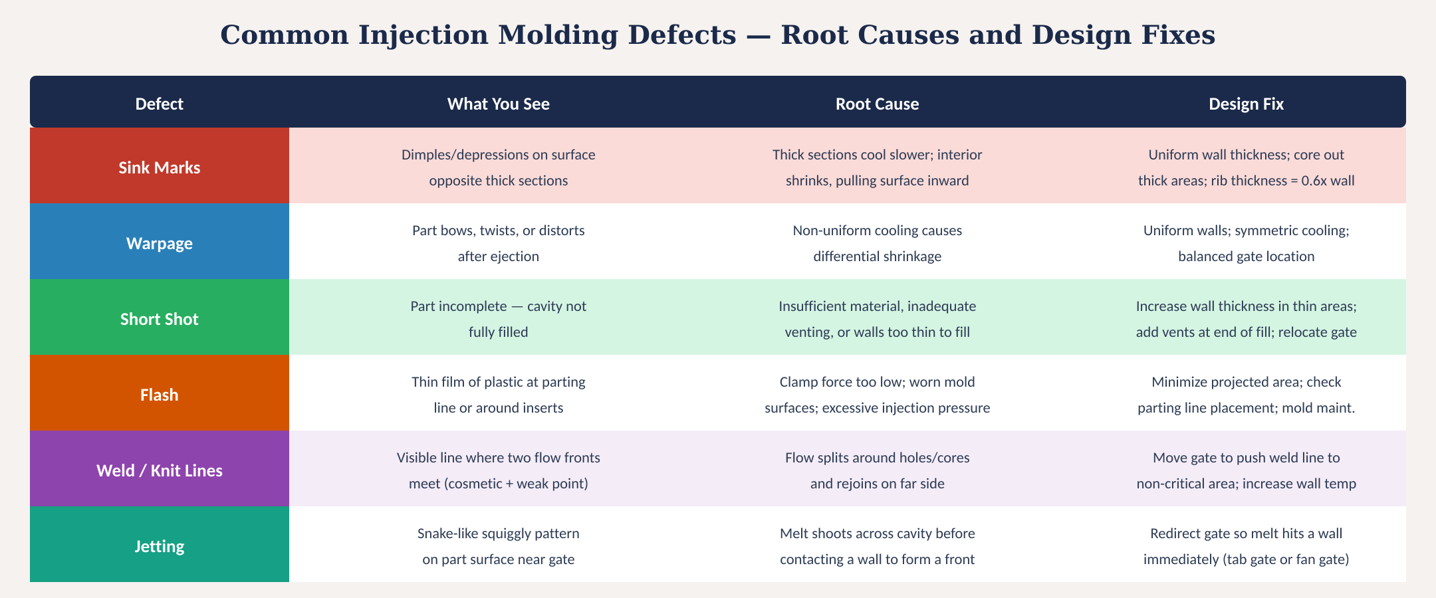
Defect identification and design fixes
Fig. 3: Six common injection molding defects with visual description, root cause, and design fix for each
MINES | MEGN 301 — Mechanical Integration and Design
Notes:
Figure 3 provides a quick-reference defect identification table. For each of six common defects, the table shows what the defect looks like, its root cause, and the design fix. This is the table to keep on your desk when reviewing part designs — if you can predict which defects a particular geometry will produce, you can fix them in CAD before the mold is ever cut.

Slide 16
03
Tooling and
economics
Mold construction, steel selection, cost drivers, and break-even analysis
MINES | MEGN 301 — Mechanical Integration and Design
Notes:
Section 3 covers the tooling side — how molds are built, what they cost, and how to think about the economics of injection molding versus other processes.

Slide 17
MINES | MEGN 301
Mold construction and anatomy
A-Side (Cavity)
Stationary half, bolted to the machine platen. Forms the outside (cosmetic) surface of the part. Contains the sprue bushing (where plastic enters from the nozzle), the runner system that distributes melt to the gate(s), and the locating ring that aligns the mold to the nozzle. Cavity surfaces are polished to SPI specifications — from mirror finish (A-1) to matte bead-blast (D-3).
B-Side (Core)
Moving half that travels on the machine tie bars. Forms the inside surface of the part — this is where ejector pin marks appear. Contains the core pins that form holes and bosses, the ejector plate and return springs, and any side actions or lifters for undercut features. All core surfaces need draft angles for part release.
Support Systems
Cooling channels: water lines machined through both mold halves to extract heat uniformly. Conformal cooling (3D-printed channels that follow the cavity shape) can reduce cycle time 20–40%. Venting: thin slots (0.001–0.002") at the parting line and at end-of-fill locations allow trapped air to escape. Ejection: pins, sleeves, blades, and stripper plates push the part off the core.
MINES | MEGN 301 — Mechanical Integration and Design
Notes:
The mold is the most expensive component of an injection molding project and the one that is hardest to change once it is built. Understanding its anatomy helps you design parts that are easier and cheaper to tool. The A-side or cavity half is stationary and forms the outside surface. Because it forms the cosmetic surface, it receives the highest-quality finish — mirror polish for glossy parts, or controlled texture for matte finishes. The sprue bushing connects the machine nozzle to the runner system, which distributes melt to one or more gates. The B-side or core half moves and forms the inside surface. The part shrinks onto the core as it cools, which is why the ejector system is on the B-side. Ejector pins leave small circular marks — always on non-cosmetic surfaces. Core pins form holes and bosses. Side actions for undercut features are typically on the B-side. Support systems include cooling channels that carry water or oil through the mold steel to extract heat. Cooling uniformity directly determines whether the part warps. Conformal cooling channels — machined or 3D-printed to follow the cavity shape — can reduce cycle time by 20 to 40 percent compared to straight-drilled channels. Venting is critical: trapped air at the end of fill causes burns, short shots, and high injection pressures. Vents are thin slots typically 0.001 to 0.002 inches at the parting line.

Slide 18
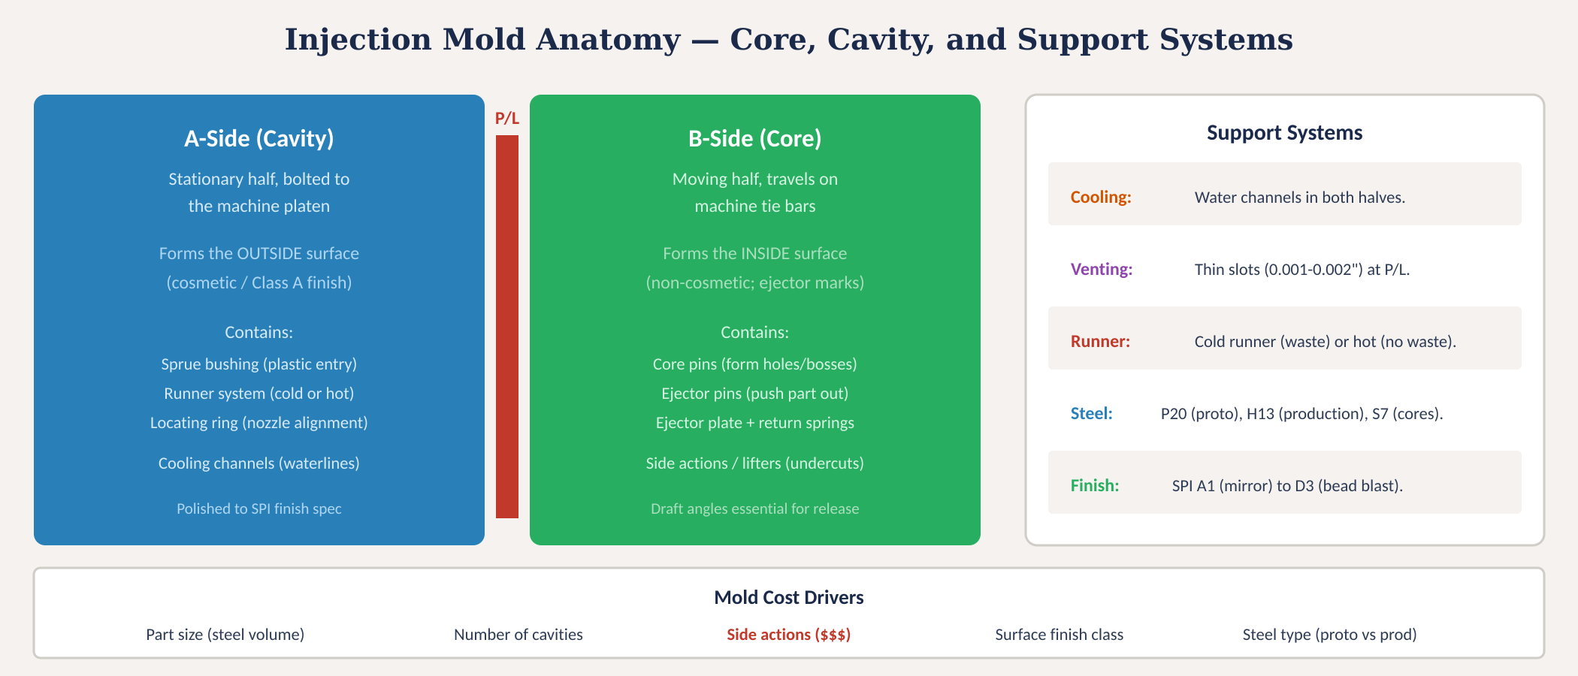
Injection mold anatomy
Fig. 4: Mold anatomy showing A-side (cavity), B-side (core), parting line, support systems, and cost drivers
MINES | MEGN 301 — Mechanical Integration and Design
Notes:
Figure 4 shows the mold anatomy with the A-side cavity half on the left, B-side core half in the center, and support systems on the right. The parting line between the two halves is highlighted in red — this is where flash occurs if clamp force is insufficient. The support systems section lists the five key sub-systems: cooling channels for heat extraction, venting for trapped air, the runner system for melt distribution, the mold steel type, and surface finish specification. The bottom row identifies the five primary cost drivers: part size determines steel volume, number of cavities determines complexity and cycle economics, side actions for undercuts are the single largest cost adder, surface finish class affects machining time, and steel type trades upfront cost against mold life.

Slide 19
MINES | MEGN 301
Tooling cost and economics
Mold Classification (SPI)
Part Cost Economics
Class 105 — Prototype
• Aluminum or soft steel, <500 cycles
• $5,000–$15,000
• 2–4 week lead time
• For design validation only
Class 104 — Low Production
• P20 pre-hardened steel, <100K cycles
• $15,000–$50,000
• 6–8 week lead time
Class 103 — Medium Production
• H13 hardened steel, <500K cycles
• $30,000–$80,000
• 10–14 week lead time
Class 101 — High Production
• Premium hardened steel, 1M+ cycles
• $50,000–$200,000+
• 14–20 week lead time
Part cost = material + cycle time + amortized tooling
Material: weight (g) × resin cost ($/g)
Cycle cost: cycle time (s) × machine rate ($/hr) / 3600
Tooling: mold cost / expected lifetime parts
Example (small ABS enclosure):
• Part weight: 30g at $0.002/g = $0.06
• Cycle: 25s at $60/hr = $0.42
• Tool: $25,000 / 50,000 parts = $0.50
• Total part cost: $0.98
At 500,000 parts:
• Tool amortization: $0.05/part
• Total: $0.53/part
Injection molding breaks even vs. 3D printing at ~100–500 parts depending on size.
MINES | MEGN 301 — Mechanical Integration and Design
Notes:
Tooling economics are the key to understanding when injection molding makes sense. The SPI mold classification system defines five classes from prototype to high-production. Class 105 prototype molds in aluminum can be built in 2 to 4 weeks for $5,000 to $15,000 but only survive a few hundred cycles — use these for design validation and pilot production. Class 101 high-production molds in premium hardened steel cost $50,000 to $200,000 or more but survive over a million cycles. The part cost equation has three components. Material cost is the weight of the part times the resin cost per gram — typically a few cents per part. Cycle cost is the machine time divided by the hourly rate — with a 25-second cycle on a $60-per-hour machine, each part costs about $0.42 in machine time. Tooling amortization is the mold cost divided by the expected number of parts. At 50,000 parts, a $25,000 mold adds $0.50 per part. At 500,000 parts, it adds only $0.05 per part. This is why injection molding has a high upfront cost but the lowest per-part cost at volume. The break-even point versus 3D printing typically falls between 100 and 500 parts depending on part size and complexity — below that, 3D printing is cheaper; above that, injection molding wins dramatically.

Slide 20
04
Design practice
& application
DFM checklist, part design workflow, and project application
MINES | MEGN 301 — Mechanical Integration and Design
Notes:
Section 4 brings everything together with a practical DFM checklist and workflow guidance for applying these principles in your projects.

Slide 21

MINES | MEGN 301
DFM checklist for injection molding
Review every item before sending your CAD model to a molder. Fixing problems in CAD costs minutes; fixing them in steel costs thousands.
Wall thickness uniform (±10%)? Recommended range for material?
Draft angles applied to ALL surfaces parallel to pull direction? Texture draft added?
Ribs at 50-70% of wall? Height ≤ 3× wall? Base radii present?
Bosses at 2× hole ID? Connected to walls with ribs? Boss wall ≤ 0.6× nominal?
All inside corners radiused (min 0.5× wall)? Outside radius = inside + wall?
Undercuts identified? Side actions justified or redesigned out?
Gate location at thickest section? Not on cosmetic surface?
Parting line location acceptable on finished part?
Ejector pin locations on non-cosmetic surfaces? Adequate draft for release?
Shrinkage accounted for in critical dimensions? Tolerances achievable?
Material selected? Properties verified against operating conditions?
Moldflow or fill analysis run? Weld lines and air traps identified?
MINES | MEGN 301 — Mechanical Integration and Design
Notes:
This 12-item DFM checklist covers every critical design decision for injection molding. Go through it line by line before sending your CAD model to a molder. Items 1 and 2 cover wall thickness and draft — the two most fundamental rules. Items 3 and 4 cover reinforcement features. Items 5 and 6 cover corners and undercuts. Items 7 and 8 cover gate and parting line — these determine where vestige marks appear on the finished part. Items 9 and 10 cover ejection and dimensional accuracy. Items 11 and 12 cover material and analysis. The key mindset: fixing a problem in CAD takes minutes. Finding the same problem after the mold is cut costs $5,000 to $20,000 in mold modifications and 2 to 4 weeks of delay. Run this checklist at your CDR before committing to tooling.

Slide 22
MINES | MEGN 301
Key standards and resources
Standard / Resource
Description
SPI Mold Classification (101-105)
Industry standard for mold construction quality and expected cycle life
SPI Surface Finish Standards
A-1 to D-3 finish classifications for cavity surface quality
ASTM D638 (Tensile)
Standard test for tensile properties of plastics — basis for material datasheets
ASTM D256 (Izod Impact)
Notched Izod impact test — critical for material impact resistance comparison
UL 94 Flammability
Vertical burn classification (V-0, V-1, V-2, HB) for plastics near electronics
ISO 294 (Test Specimens)
Standard for injection molding test specimens for property measurement
Protolabs, Xometry, Fictiv
On-demand manufacturing platforms with instant DFM feedback on uploaded CAD
Autodesk Moldflow / Solidworks Plastics
Mold-fill simulation software for predicting defects before cutting steel
MINES | MEGN 301 — Mechanical Integration and Design
Notes:
Standards and resources for injection molding design. SPI mold classifications define the five tiers from prototype to production. SPI surface finish standards specify how the cavity surface is finished — from diamond-buffed mirror polish to bead-blasted matte. ASTM D638 and D256 are the tensile and impact tests that form the basis of every material datasheet. UL 94 flammability ratings are mandatory for any plastic part near electronics. For student projects, on-demand manufacturing platforms like Protolabs and Xometry are invaluable — they provide instant automated DFM feedback when you upload a CAD file, highlighting problems before you commit to tooling. Mold-fill simulation software like Autodesk Moldflow predicts how the melt fills the cavity, where weld lines form, where air gets trapped, and where the part will warp.

Slide 23



MINES | MEGN 301
Practical design tips
Design the wall thickness first. Everything else — ribs, bosses, draft, radii — is proportional to the wall. Get the wall right and 80% of DFM is solved.
Apply draft in CAD as one of the last operations — after all features are modeled. Use your CAD tool's draft analysis to verify before export.
Think about the parting line from the start. It determines which surfaces are A-side (cosmetic) and B-side (ejector marks), and where flash might appear.
Eliminate undercuts by redesigning. Every side action adds $5K-$25K to tooling. Challenge every undercut: can it be a pass-through, a snap along pull, or a post-mold operation?
Get quotes early. Upload your CAD to Protolabs or Xometry for instant DFM feedback and pricing. Do this at your CDR, not after — it changes your design.
Consider end-of-life. Avoid mixing material families (e.g., ABS snap onto PC housing) — it prevents recycling. Single-material design is a competitive advantage.
MINES | MEGN 301 — Mechanical Integration and Design
Notes:
Six practical tips. First, design the wall thickness before anything else — every other feature dimension is a ratio of the wall. Second, apply draft as one of the last CAD operations and always run a draft analysis before exporting. Third, think about the parting line from the beginning of your design — it determines which surfaces get the nice finish and which get the ejector marks and parting-line witness. Fourth, challenge every undercut — the cost impact on tooling is enormous and most undercuts can be eliminated through creative redesign. Fifth, get manufacturing quotes early in the design process. On-demand platforms give you instant DFM feedback for free — use them at CDR to catch problems before you commit to a final design. Sixth, consider end-of-life design for recycling — avoid designs that permanently bond different material families together, because mixed-material assemblies cannot be recycled.

Slide 24
MINES | MEGN 301
Key takeaways
(1)
The injection molding cycle (clamp → inject → cool → eject) directly constrains part geometry. Cooling dominates cycle time; wall thickness drives cooling time and therefore cost.
(2)
Six DFM rules govern part design: uniform wall thickness (1.5–3mm), draft angles (1–2° per side), rib proportions (50–70% of wall), generous radii (0.5× wall minimum), undercut avoidance, and gate-at-thickest placement.
(3)
Material selection must match mechanical, thermal, chemical, aesthetic, and processing requirements. The cheapest material that meets ALL requirements is the right choice.
(4)
Every defect has a design root cause: sink marks from thick sections, warpage from non-uniform cooling, short shots from inadequate venting, flash from projected area, weld lines from flow splitting.
(5)
Tooling is the largest upfront cost ($5K–$200K+). Eliminate undercuts, use the DFM checklist, and get quotes early. Fixing problems in CAD costs minutes; fixing them in steel costs thousands.
References: [1] Malloy, Plastic Part Design for Injection Molding, 2nd ed., Hanser, 2010. [2] Bryce, Plastic Injection Molding, SME, 1996. [3] Rosato & Rosato, Injection Molding Handbook, 3rd ed., Springer, 2000. [4] Protolabs Design Guide, protolabs.com.
MINES | MEGN 301 — Mechanical Integration and Design
Notes:
Five key takeaways. One: the injection molding cycle directly constrains your geometry — cooling dominates cycle time and wall thickness drives cooling time. Two: six DFM rules cover the vast majority of design decisions — master these and you can design moldable parts. Three: material selection is a multi-criteria optimization that must satisfy mechanical, thermal, chemical, aesthetic, and processing requirements simultaneously. Four: every common defect has a design root cause that you can prevent with proper geometry. Five: tooling is the largest cost and the hardest to change — use the DFM checklist, eliminate undercuts, and get quotes early.

