Slide 1
MINES | MEGN 301 — Mechanical Integration and Design
Systems Engineering Foundations
Operations &amp;
Maintenance
LIFECYCLE THINKING, SERVICEABILITY, MAINTENANCE PLANNING, AND END-OF-LIFE
Notes:
Welcome to Operations and Maintenance for MEGN 301. This module covers what happens AFTER your system is delivered — the 50-70% of lifecycle cost that students rarely think about during design. Operations and maintenance is where design decisions come home to roost: a system that is easy to design but hard to maintain will cost the stakeholder far more than one that was designed for the full lifecycle. We cover design for serviceability, maintenance planning, user documentation, training, spare parts logistics, and end-of-life disposal.
ALIGNMENT NOTE — This module corresponds to Chapter 6 of your Master Reference Document and supports the Final Design Report and FDR deliverables. This content extends beyond the V-Model into the operational lifecycle.
BOTTOM LINE: O&M is 50-70% of lifecycle cost, and 80% is locked by early design decisions. Design for Access, Modularity, Diagnostics, and Standardization during Chapters 2-3. Use FMECA to justify maintenance strategies. For your Final Report, your Quick-Start Guide should enable your instructor to operate the system.
FINAL NOTES — Key updates in the final compiled document: (1) Quick-Start Guide template with six required elements (unbox, setup, power up, configure, operate, verify). (2) Five-nines availability context (99% vs 99.999% is an entirely different class of engineering). (3) Final Design Report mapping tip. (4) MTTR reduction example demonstrating that reducing repair time from 10hr to 1hr boosts availability more than doubling MTBF.

Slide 2






MINES | MEGN 301
Learning outcomes
Explain the system lifecycle and why operations/maintenance dominates total cost (50-70%)
Apply design-for-serviceability principles: access, modularity, diagnostics, and standardization
Develop a maintenance plan covering preventive schedules, spare parts lists, and calibration requirements
Write user documentation including operating manuals, quick-start guides, and troubleshooting procedures
Plan for operator training, knowledge transfer, and ongoing technical support
Address end-of-life considerations: disassembly, recycling, hazardous materials, and data sanitization
MINES | MEGN 301 — Mechanical Integration and Design
Notes:
Six learning outcomes.

Slide 3
01
Lifecycle
thinking
Total lifecycle cost, design influence, and operational context
MINES | MEGN 301 — Mechanical Integration and Design
Notes:
Section 1: lifecycle thinking.

Slide 4
MINES | MEGN 301
Total lifecycle cost
The 80/20 Rule
80% of a system's total lifecycle cost is determined by decisions made during the first 20% of development (concept and preliminary design). By the time detailed design begins, most cost-driving decisions are locked in. This is why design-for-serviceability, maintainability, and disposability must be considered DURING design, not after.
Operations Dominates
Operations and maintenance typically accounts for 50-70% of total lifecycle cost — far more than development. A system that costs $10K to develop but $50K to maintain over 10 years has a true cost of $60K. Designing for 5 minutes of maintenance savings per week saves 43 hours over 10 years.
Design Drives O&M Cost
Every design choice affects O&M: material selection determines corrosion and replacement frequency; modularity determines repair time; diagnostic capability determines troubleshooting time; documentation quality determines training cost.
MINES | MEGN 301 — Mechanical Integration and Design
Notes:
Total lifecycle cost perspective. 80% locked by early design. O&M dominates at 50-70%.

Slide 5
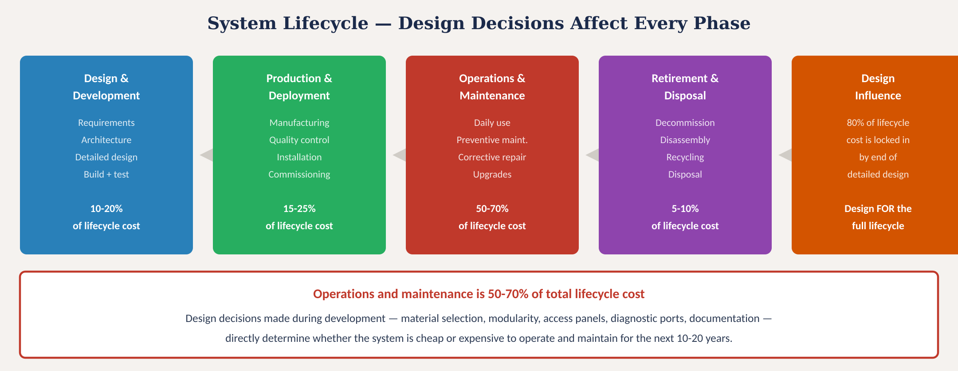
System lifecycle
Fig. 1: System lifecycle phases with cost distribution — O&M is 50-70% of total cost
MINES | MEGN 301 — Mechanical Integration and Design
Notes:
Figure 1: lifecycle phases with cost distribution.
THE BATHTUB CURVE — Failure rate follows three phases: (1) Infant Mortality — decreasing rate from manufacturing defects, assembly errors, weak components. Address with burn-in testing. (2) Useful Life — constant, low rate described by MTBF. Random failures; preventive replacement is wasteful here. (3) Wear-Out — increasing rate from component degradation. Bearings wear, seals degrade, capacitors dry out. Address with scheduled preventive replacement.

Slide 6
02
Design for
serviceability
Access, modularity, diagnostics, standardization, and reliability
MINES | MEGN 301 — Mechanical Integration and Design
Notes:
Section 2: design for serviceability.
FIVE-NINES CONTEXT — 98.8% availability (MTBF=2000, MTTR=24) means ~105 hours downtime per year. 99.9% ('three nines') = ~9 hours/year. 99.999% ('five nines') = less than 6 minutes/year — requiring redundant hardware, automatic failover, and 24/7 monitoring. The distance between 99% and 99.999% is not a minor improvement; it is an entirely different class of engineering. For MEGN 301 projects, target 95-99% availability.
FMECA AND RPN — For each failure mode: RPN = Severity (1-10) × Occurrence (1-10) × Detection (1-10). Range 1-1000. Action threshold: RPN ≥ 100. Any failure with Severity ≥ 8 gets mandatory mitigation regardless of RPN. The FMECA provides mathematical justification for maintenance strategy and spare parts.

Slide 7
MINES | MEGN 301
Design for serviceability — four principles
Access
Every component that might need replacement, adjustment, or inspection must be physically reachable without disassembling unrelated parts. Use access panels, hinged covers, and quick-release fasteners. Provide tool clearance — a screw that can only be reached with a 90° offset driver is poorly designed.
Modularity
Design subsystems as self-contained modules with standardized connectors. A failed module should be swappable in the field without special tools or skills. Connectorized wiring harnesses (not hard-soldered) are essential. Each module should be independently testable.
Diagnostics
Build diagnostic capability into the system. Status LEDs show power/communication/fault state at a glance. Test points allow oscilloscope or DMM access to critical signals. Error codes displayed on an LCD or transmitted via serial. Built-in self-test (BIST) routines that run at power-on.
Standardization
Use standard fastener sizes (pick 2-3 and use them throughout). Use standard connectors. Use components that are available from multiple suppliers. Avoid proprietary or sole-source parts. Every non-standard part is a maintenance headache and supply-chain risk.
MINES | MEGN 301 — Mechanical Integration and Design
Notes:
Four serviceability principles: access, modularity, diagnostics, standardization.

Slide 8
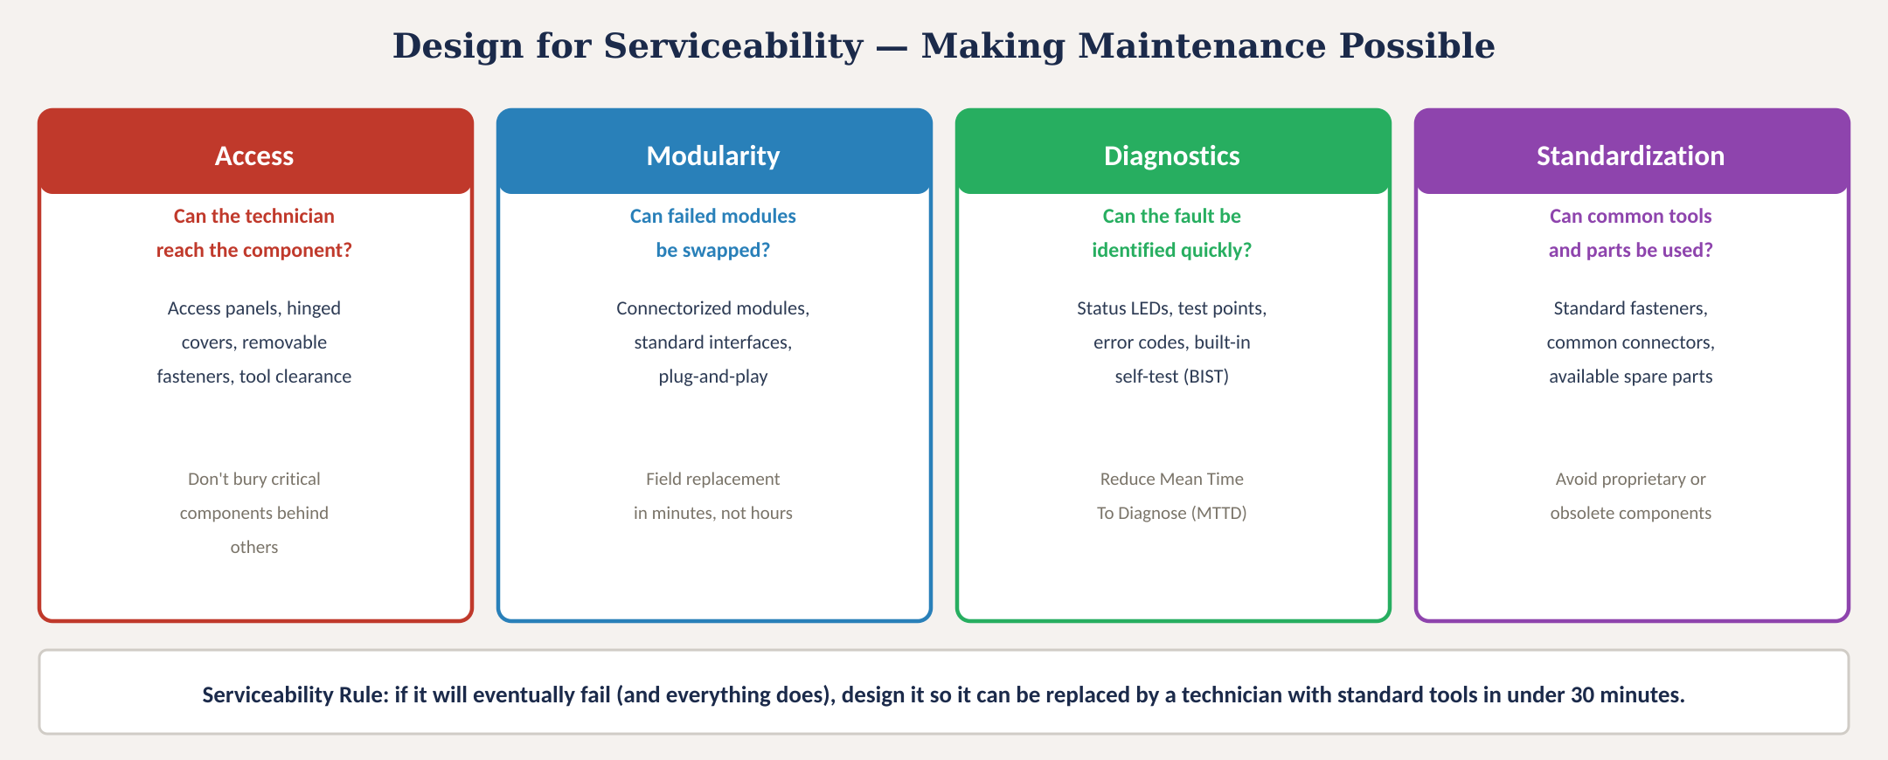
Design for serviceability
Fig. 2: Four serviceability principles — access, modularity, diagnostics, standardization
MINES | MEGN 301 — Mechanical Integration and Design
Notes:
Figure 2: serviceability principles.

Slide 9
MINES | MEGN 301
Reliability and maintainability metrics
MTBF
Mean Time Between Failures — average operating time between failures. Higher is better. For electronics, typically 10,000-100,000 hours. Calculated from component failure rates (MIL-HDBK-217 or field data). MTBF is a statistical measure, not a guarantee.
MTTR
Mean Time To Repair — average time to diagnose and fix a failure. Lower is better. Directly affected by design-for-serviceability: access, modularity, diagnostics, and documentation quality. Target: field-replaceable modules in under 30 minutes.
Availability
The fraction of time the system is operational: A = MTBF / (MTBF + MTTR). A system with MTBF=1000hr and MTTR=10hr has 99% availability. Improving MTTR (through better design) is often cheaper than improving MTBF (through better components).
FMEA
Failure Mode and Effects Analysis — systematic identification of how each component can fail, the effect on the system, and the severity/probability/detectability of each failure. Used to prioritize design improvements and maintenance activities. Present at CDR.
MINES | MEGN 301 — Mechanical Integration and Design
Notes:
Reliability metrics: MTBF, MTTR, availability, and FMEA.
MAPPING TO YOUR FINAL DESIGN REPORT — Section 1 (Design Requirements): reference SDRD and VCRM results. Section 2 (Design Process): design evolution with photos. Section 3 (Hazards): FMEA results and risk mitigations. Section 4 (Future Work): maintenance recommendations. Appendix: Quick-Start Guide, spare parts list, FMECA, test data. Write these as you go — do not reconstruct the night before submission.

Slide 10
03
Maintenance
planning
Maintenance strategies, schedules, spare parts, and calibration
MINES | MEGN 301 — Mechanical Integration and Design
Notes:
Section 3: maintenance planning.

Slide 11
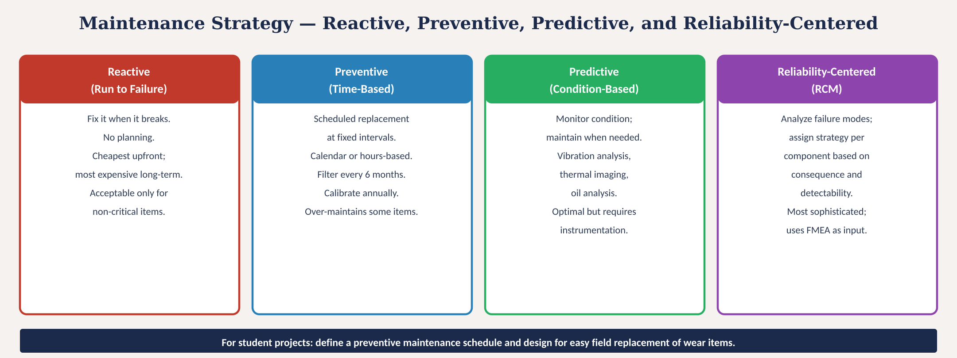
Maintenance strategies
Fig. 3: Four maintenance strategies from reactive through reliability-centered
MINES | MEGN 301 — Mechanical Integration and Design
Notes:
Figure 3: four maintenance strategies.

Slide 12
MINES | MEGN 301
Building a maintenance schedule
Identify Wear Items
List every component that degrades with use or time: filters, seals, bearings, belts, batteries, lamps, contact surfaces, calibration standards. These are your scheduled replacement items. Consult manufacturer datasheets for replacement intervals.
Define Intervals
Based on manufacturer recommendations, industry standards, and operating conditions. Express as calendar time (monthly, quarterly, annually) or operating hours (every 1000 hrs). More demanding environments require shorter intervals.
Spare Parts List
For every wear item, specify: part number, quantity to stock, supplier, lead time, and cost. Stock at least 2× the expected first-year consumption. Identify single-source items and qualify alternates.
Calibration Schedule
Any measurement instrument needs periodic calibration traceable to a national standard (NIST). Define: what is calibrated, how often, to what standard, by whom, and what records are kept. Typical: annually or after any event that might affect accuracy.
MINES | MEGN 301 — Mechanical Integration and Design
Notes:
Building a maintenance schedule: identify wear items, define intervals, create spare parts list, set calibration schedule.

Slide 13
04
Documentation,
training, & EOL
User manuals, operator training, knowledge transfer, and end-of-life
MINES | MEGN 301 — Mechanical Integration and Design
Notes:
Section 4: documentation, training, and end-of-life.

Slide 14
MINES | MEGN 301
User documentation
Documentation is written for the USER — not for the engineer who designed the system. If the user cannot understand it, it does not exist.
Quick-Start Guide
One page. Gets the user from unpacking to first operation in under 10 minutes. Numbered steps with photos. No background theory. The document 90% of users will actually read.
Operating Manual
Complete reference for all features, modes, settings, and procedures. Organized by task, not by component. Include safety warnings, environmental limits, and troubleshooting flowcharts.
Maintenance Manual
Step-by-step procedures for every scheduled maintenance task. Include photos, tool lists, torque specs, and replacement part numbers. Written for a technician, not an engineer.
Troubleshooting Guide
Symptom-based diagnostic flowcharts: 'System does not power on → Check fuse → Check battery voltage → Check power switch.' Each path ends with a specific corrective action. Include error codes and their meanings.
MINES | MEGN 301 — Mechanical Integration and Design
Notes:
Four types of user documentation. Quick-start is the most important — it is the only document most users will read.

Slide 15
MINES | MEGN 301
Training and knowledge transfer
Who Needs Training?
Operators (daily use), maintainers (repair and calibration), administrators (configuration and data management), and trainers (who will teach the next generation of users). Each audience needs different content and depth.
Training Methods
Hands-on demonstration is most effective for physical systems. Written procedures for reference. Video recordings for remote support. Supervised first-use before independent operation. Competency assessment to confirm readiness.
Knowledge Transfer
The design team holds critical knowledge that must be transferred to the operations team. This includes: design rationale (why decisions were made), known limitations, failure modes and workarounds, calibration procedures, and software update processes. Document everything; team members graduate.
Ongoing Support
Define the support model: who does the operator call when something goes wrong? Is there a warranty period? Is there a service contract? For student projects, the 'support plan' might be a detailed handoff package to the next year's team or the project sponsor.
MINES | MEGN 301 — Mechanical Integration and Design
Notes:
Training and knowledge transfer. Critical for student projects where the design team graduates.

Slide 16
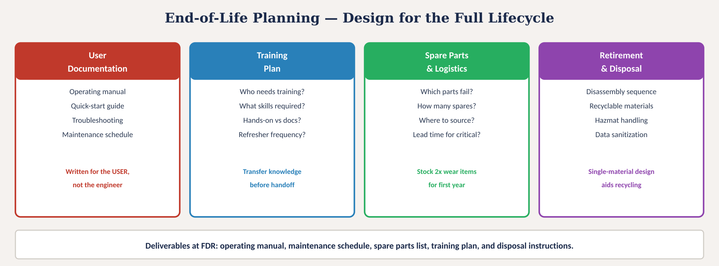
End-of-life planning
Fig. 4: Four end-of-life deliverables: documentation, training, spare parts, and disposal planning
MINES | MEGN 301 — Mechanical Integration and Design
Notes:
Figure 4: end-of-life deliverables.

Slide 17

MINES | MEGN 301
Operations & maintenance checklist
Address ALL items before system handoff.
Quick-start guide written and tested with a naive user?
Operating manual complete with all modes, features, and safety warnings?
Maintenance schedule defined with intervals, procedures, and part numbers?
Spare parts list with quantities, vendors, and lead times?
Troubleshooting guide with symptom-based flowcharts?
Calibration schedule with standards, intervals, and record-keeping?
Training plan with audience, content, and delivery method?
Knowledge transfer documentation (design rationale, known issues, workarounds)?
Support model defined (who to call, warranty, service contract)?
Design for serviceability verified (access, modularity, diagnostics, standard fasteners)?
FMEA completed for critical failure modes with mitigations?
End-of-life plan (disassembly, recycling, hazmat, data sanitization)?
MINES | MEGN 301 — Mechanical Integration and Design
Notes:
Twelve-item O&M checklist.

Slide 18


MINES | MEGN 301
Practical tips
Design the access panel and test points DURING architecture, not as an afterthought. If the PCB layout is done, it is too late to add diagnostic headers.
Write the quick-start guide first — before the full manual. It forces you to identify the minimum steps for operation and reveals usability problems.
Have a naive user (someone who did NOT design the system) follow your quick-start guide. If they cannot get it working in 10 minutes, rewrite it.
Pick 2-3 fastener sizes and use them everywhere. Every additional tool the technician needs is a maintenance burden. Ideally, one hex key services the entire system.
Design with a single material family where possible. A polycarbonate enclosure with polycarbonate clips is recyclable; a PC enclosure with ABS clips is not.
Include a maintenance log in the system documentation — a simple table for the operator to record date, action performed, findings, and next scheduled action.
MINES | MEGN 301 — Mechanical Integration and Design
Notes:
Six practical tips for O&M design.

Slide 19

MINES | MEGN 301
Common mistakes
'It's a prototype, it doesn't need a manual.' Every system handed to someone else needs documentation. At minimum: quick-start, maintenance schedule, and troubleshooting guide.
'I'll write the docs at the end.' Documentation written during design is better and faster. Waiting until the end means rushing, forgetting details, and producing poor documentation.
'The user will figure it out.' They won't. If the system is not intuitive AND documented, it will be used incorrectly, break prematurely, or be abandoned.
'Soldered wires save money.' Maybe in production — never in a prototype or low-volume system. Connectorized modules save hours of maintenance time over the system's life.
'We don't need spare parts.' You do. Identify wear items and stock spares. A system waiting for a $2 part to arrive from overseas is a $50,000 paperweight.
'Disposal isn't our problem.' It is. RoHS, WEEE, and lithium battery regulations apply. Design for disassembly and document the disposal procedure.
MINES | MEGN 301 — Mechanical Integration and Design
Notes:
Six common O&M mistakes.

Slide 20
MINES | MEGN 301
Applying in your projects
1
During concept design: consider serviceability requirements. Include access, modularity, and diagnostics in trade study criteria.
2
At PDR: present maintainability analysis. Identify wear items. Show access panel locations on concept sketches.
3
During detailed design: design diagnostic test points, connectorized modules, and standard fasteners into the physical layout.
4
At CDR: present maintenance schedule, spare parts list, and preliminary troubleshooting guide. Show FMEA for critical items.
5
During build: write the quick-start guide. Test it with a naive user. Write the operating manual section by section as you build.
6
At FDR: deliver complete documentation package: quick-start, operating manual, maintenance manual, troubleshooting guide, spare parts list, training plan.
MINES | MEGN 301 — Mechanical Integration and Design
Notes:
Six-step O&M workflow aligned to design reviews.

Slide 21
MINES | MEGN 301
System handoff and transition to operations
The Handoff Package
Everything the operator needs to independently operate, maintain, and troubleshoot the system: all documentation, spare parts, tools, calibration records, software source code, CAD files, BOM, and vendor contacts. If the design team disappears tomorrow, the operator should have everything.
Acceptance Testing
The stakeholder witnesses verification testing and confirms the system meets their operational needs (validation). This is the formal handoff point. Document what was demonstrated, who accepted, and any conditions or limitations.
Warranty and Support
Define what is covered (defects vs wear vs misuse), for how long, and who provides support. For student projects, this might be a commitment to answer questions for one semester after delivery, or a detailed handoff to the next team.
Lessons Learned Report
A candid assessment of what worked, what didn't, and what future teams should know. Include: design decisions you would change, components that underperformed, tools that were invaluable, and process improvements. This is your legacy to the next team.
MINES | MEGN 301 — Mechanical Integration and Design
Notes:
System handoff: package, acceptance, warranty, lessons learned.

Slide 22
MINES | MEGN 301
Sustainability and responsible engineering
Design for Disassembly
Use fasteners (not adhesives) for structural joints. Label material types on components. Minimize material mixing. Design so components can be separated into recyclable streams at end of life.
Material Selection
Prefer recyclable materials (metals, single-polymer plastics) over composites. Avoid hazardous substances (RoHS compliance). Consider bio-based or recycled-content materials where performance allows.
Energy Efficiency
Minimize operating power through efficient components, sleep modes, and power management. Every watt saved over a 10-year operating life translates to significant energy and cost reduction.
Longevity
Design for a long, useful life: durable materials, replaceable wear items, firmware update capability, and modular architecture that allows upgrades without full replacement. The most sustainable product is one that doesn't need to be replaced.
MINES | MEGN 301 — Mechanical Integration and Design
Notes:
Sustainability: disassembly, materials, energy, longevity.

Slide 23
MINES | MEGN 301
Key takeaways
(1)
Operations and maintenance is 50-70% of total lifecycle cost. 80% of that cost is locked in by decisions made during early design. Design for the full lifecycle, not just the demo.
(2)
Four serviceability principles: access (can you reach it?), modularity (can you swap it?), diagnostics (can you find the fault?), standardization (can you get the parts and tools?).
(3)
Maintenance planning includes: wear-item identification, replacement intervals, spare parts list with vendors, calibration schedule, and troubleshooting flowcharts.
(4)
Documentation is a deliverable, not an afterthought. Quick-start guide, operating manual, maintenance manual, and troubleshooting guide — written for the USER, not the engineer.
(5)
The handoff package must enable independent operation: all documentation, spare parts, tools, source code, CAD files, and vendor contacts. If the team disappears, the system must still be supportable.
References: [1] Blanchard, Logistics Engineering and Management, 6th ed., 2004. [2] MIL-HDBK-472, Maintainability Prediction. [3] ISO 14040, Life Cycle Assessment. [4] IEC 60300, Dependability Management.
MINES | MEGN 301 — Mechanical Integration and Design
Notes:
Five key takeaways.

Slide 24
Operations & Maintenance
"A system that is easy to design but hard to maintain
will cost the stakeholder far more than one that was
designed for the full lifecycle."
Design for the person who fixes it at 2 AM.
MINES | MEGN 301 — Mechanical Integration and Design
Notes:
Closing slide. Design for the maintainer.

