Slide 1
MINES | MEGN 301 — Mechanical Integration and Design
Electromechanical System Design
Power Supplies,
Motors & Pumps
SELECTION, SPECIFICATION, AND INTEGRATION FOR ENGINEERING DESIGN
Notes:
Welcome to Part 1 of the Electromechanical System Design series for MEGN 301 — Mechanical Integration and Design. This module covers the three core electromechanical components you will need to select and specify in nearly every integrated design project: power supplies, motors, and pumps. By the end of this module, you should be able to select the appropriate power supply topology for your application, choose and size a motor to meet your torque and speed requirements, select a pump type matched to your flow and pressure needs, and specify all three in your Bill of Materials with the correct ratings and derating margins. A companion module covers power architecture and safety — protection circuits, grounding, and safe integration of these components into a complete system.
ALIGNMENT NOTE — This module corresponds to Chapter 8 (Power Supplies, Motors & Pumps) of your Master Reference Document. Component selections from this chapter appear in your trade studies (Chapter 3) and Bill of Materials. Specifications flow into subsystem requirements (Chapter 2) and are verified in your test plan (Chapter 4).
FINAL NOTES — This module aligns with Chapter 8 of the final compiled document. Key cross-references: (1) Motor/transmission sizing now covered comprehensively in the new Mechanical Power Transmission chapter (Ch 11) with decision tree and sourcing guide. (2) Power budget analysis feeds into Ch 9 (power architecture). (3) Component selections appear in trade studies (Ch 3) and BOM (CDR deliverable). (4) Glossary defines LDO, BLDC, PWM, ESC, and other electrical terms.

Slide 2
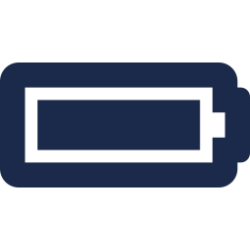




MINES | MEGN 301
Learning outcomes
Select between linear, switching, and AC-DC power supply topologies based on voltage, current, efficiency, and noise requirements
Classify DC motors by type (brushed, BLDC, stepper, servo) and match motor specifications to mechanical load requirements
Distinguish between positive displacement and dynamic pump types and select based on flow rate, pressure, and fluid properties
Specify appropriate motor drive electronics (H-bridges, ESCs, stepper drivers) for each motor type
Apply systematic derating and selection criteria to specify power supplies, motors, and pumps for your design projects
MINES | MEGN 301 — Mechanical Integration and Design
Notes:
Five learning outcomes for this module. First, select between linear regulators, switching regulators, and AC-DC power supplies based on your voltage conversion needs, current requirements, efficiency constraints, and noise sensitivity. Second, classify DC motors by their four major types — brushed DC, brushless DC, stepper, and servo — and match the motor's torque-speed characteristics to your mechanical load. Third, distinguish between positive displacement pumps like gear, diaphragm, and peristaltic types versus dynamic pumps like centrifugal, and select based on flow rate, pressure, fluid compatibility, and whether self-priming is needed. Fourth, specify the appropriate motor drive electronics — H-bridge for brushed DC, ESC for BLDC, and step/direction driver for steppers — because the motor alone cannot function without its driver circuit. Fifth, apply systematic derating practices and selection frameworks to size and specify all three component types in your Bill of Materials with adequate safety margins.

Slide 3
01
Power supply
selection
Linear regulators, switching converters, and AC-DC topologies
MINES | MEGN 301 — Mechanical Integration and Design
Notes:
Section 1 covers power supplies — the component that converts raw electrical energy from your source into the regulated voltage and current your circuits and actuators need. This is the foundation of every electromechanical system. If the power supply is wrong, nothing downstream works reliably. We will cover three major categories: linear regulators for simple, low-noise applications; switching regulators for efficient DC-to-DC conversion; and AC-DC power supplies for systems that plug into the wall.

Slide 4
MINES | MEGN 301
Power supply fundamentals
What a Power Supply Does
Converts electrical energy from a source (AC mains, battery, solar panel, USB) into one or more regulated DC voltage rails that your circuits and actuators require. Every component in your design — microcontroller, sensors, motor drivers, LEDs — has a specific voltage and current requirement that the power supply must meet simultaneously.
Linear Regulators (LDO)
Dissipate excess voltage as heat: V_drop × I_load = waste power. Simple, low noise, no switching artifacts. Ideal when V_in is only slightly above V_out (low dropout) and current is modest (<1A). Common devices: LM7805 (5V/1A), AMS1117-3.3 (3.3V/1A), MCP1700 (3.3V/250mA ultra-low quiescent). Efficiency = V_out / V_in — a 5V LDO from 12V is only 42% efficient.
When to Use Linear
Use LDOs when: (1) voltage drop is small (<2V), (2) current is under ~1A, (3) noise matters (analog sensors, audio, ADCs), (4) simplicity matters (2 capacitors, no inductor). Avoid when: high current, large V_in–V_out gap (excessive heat), or battery life is critical.
MINES | MEGN 301 — Mechanical Integration and Design
Notes:
Every electromechanical system needs at least one power supply, and most need multiple voltage rails — 3.3V for the microcontroller, 5V for sensors, 12V or 24V for motors and solenoids. Understanding the fundamental tradeoff between simplicity and efficiency is the key to selecting the right topology. Linear regulators are the simplest power supply — they are essentially a controllable resistor that drops the input voltage to the desired output. The excess energy is dissipated as heat, calculated by V-drop times load current. An LM7805 producing 5V from a 12V input wastes 7V times the load current as heat — at 1 amp, that is 7 watts of waste heat in a tiny TO-220 package. The efficiency is simply V-out divided by V-in, which for this example is only 42 percent. Low-dropout regulators or LDOs improve this by requiring only a small voltage differential — some modern LDOs need as little as 200 millivolts of headroom. This makes them excellent when your input is a 5V USB supply and you need 3.3V for a microcontroller — the dropout is only 1.7V and efficiency climbs to 66 percent. The big advantage of linear regulators is noise — they produce clean, ripple-free output with no switching artifacts. This matters for analog sensor circuits, audio systems, and precision ADCs. The AMS1117-3.3 is probably the most common regulator in student projects. The MCP1700 is excellent for battery-powered applications because its quiescent current — the current it draws just to regulate, even with no load — is only 1.6 microamps.

Slide 5
MINES | MEGN 301
Switching regulators (DC-DC converters)
Switching regulators chop the input voltage at high frequency (100 kHz–2 MHz) and use an inductor to transfer energy efficiently.
Buck (Step-Down)
Boost (Step-Up)
Buck-Boost
V_out < V_in
The workhorse of DC-DC conversion. Uses a switching FET + inductor + capacitor to step voltage down efficiently.
• 85–95% typical efficiency
• Common: LM2596 (3A), MP1584 (3A), TPS54302 (3A)
• Module boards available for <$2
Example: 12V battery → 5V at 2A
Efficiency: ~90% → only 1.1W waste (vs 14W for linear!)
V_out > V_in
Stores energy in an inductor during the switch-on phase, then releases it at higher voltage during switch-off.
• 80–93% typical efficiency
• Common: MT3608 (2A), TPS61088 (10A), XL6009
• Cannot disconnect load from input
Example: 3.7V LiPo → 5V for USB
Example: 5V → 12V for a relay coil
V_out ≷ V_in
Handles input voltage that swings above and below the output — essential for battery applications where V_in decays.
• 80–90% typical efficiency
• Common: TPS63020 (3.6A), LTC3780
• SEPIC is a non-inverting variant
Example: LiPo (3.0–4.2V) → 3.3V
The battery voltage crosses 3.3V during discharge — only buck-boost works.
⚠ Switching regulators generate EMI. Use proper layout (short traces, ground plane) and add input/output capacitors per datasheet.
MINES | MEGN 301 — Mechanical Integration and Design
Notes:
Switching regulators solve the fundamental efficiency problem of linear regulators. Instead of burning excess voltage as heat, they rapidly switch the input on and off — typically at 100 kilohertz to 2 megahertz — and use an inductor and capacitor to smooth the output. This energy-transfer mechanism can achieve 85 to 95 percent efficiency, meaning far less waste heat and dramatically better battery life. The buck or step-down converter is the most common topology in student projects. It outputs a voltage lower than the input. The LM2596 and MP1584 are widely available as pre-built module boards for under two dollars — these are the recommended starting point for student projects because the critical layout is already done. For a 12V battery supplying 5V at 2 amps, a buck converter wastes only about 1.1 watts compared to 14 watts for a linear regulator. The boost or step-up converter outputs a voltage higher than the input. Common use cases include stepping a 3.7V lithium polymer battery up to 5V for USB, or stepping 5V up to 12V for a relay coil or solenoid. One important limitation: most boost converters cannot fully disconnect the load from the input because the inductor provides a DC path. The buck-boost converter handles the case where the input voltage may be above or below the output. This is essential for battery applications where the cell voltage decays during discharge. A lithium polymer cell ranges from 4.2V fully charged to 3.0V depleted — if your circuit needs 3.3V, the input crosses the output during discharge. Only a buck-boost topology can regulate through that transition. The critical design consideration for all switching regulators is electromagnetic interference or EMI. The high-frequency switching generates noise that can couple into sensitive analog circuits. Always follow the datasheet layout recommendations: keep switching traces short, use a continuous ground plane, and place input and output capacitors as close to the regulator as physically possible.

Slide 6
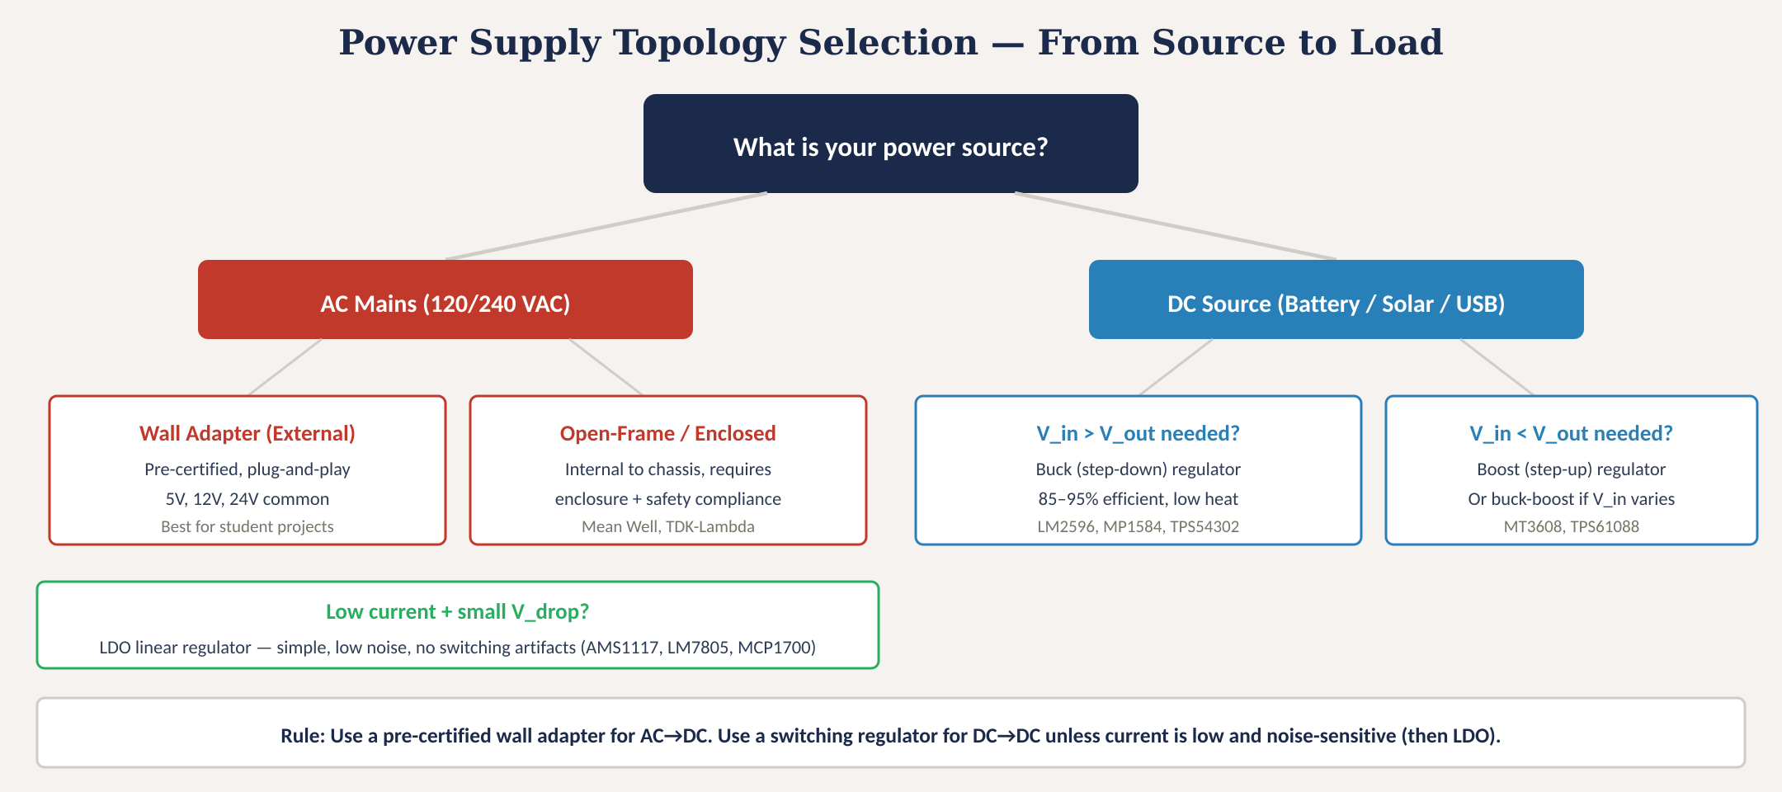
Power supply topology selection
Fig. 1: Power supply topology decision tree — from source type through voltage conversion to specific regulator selection
MINES | MEGN 301 — Mechanical Integration and Design
Notes:
Figure 1 presents the power supply selection decision tree. Start with your power source: AC mains or DC. For AC mains, the safest approach for student projects is a pre-certified wall adapter — these are UL or CE listed, fully enclosed, and provide a regulated DC output. Common outputs are 5V, 12V, and 24V. You plug them in and get clean DC power with no safety certification burden on you. Open-frame and enclosed power supplies like Mean Well or TDK-Lambda units mount inside your chassis but require proper enclosure design and safety compliance — use these only if a wall adapter cannot meet your power or form-factor requirements. For DC sources — batteries, solar panels, USB — the choice depends on whether you need to step voltage down or up. If your input is higher than your output, use a buck converter. If lower, use a boost. If the input varies across the output voltage, use a buck-boost. The green box at the bottom covers the special case of low-current, noise-sensitive loads where a simple LDO linear regulator is the best choice despite lower efficiency. The golden rule at the bottom: use a pre-certified wall adapter for AC-to-DC conversion in student projects — do not design your own AC-DC circuit.

Slide 7
MINES | MEGN 301
Key power supply specifications
When specifying a power supply, define these parameters in your design documentation:
Output Voltage
Nominal output (e.g., 5.0V ±2%). Must match the voltage rail required by your load. Multiple outputs may be needed — 3.3V for MCU, 5V for sensors, 12V for motors.
Output Current
Maximum continuous current the supply can deliver. Must exceed the sum of all load currents on that rail with ≥20% margin. Specify both continuous and peak (inrush) ratings.
Regulation
Line regulation: output change when input varies. Load regulation: output change when load varies. Expressed as % or mV. Tighter regulation = more stable voltage.
Ripple & Noise
Peak-to-peak voltage variation on the output, in mV. Switching supplies: 20–100 mV typical. LDOs: <1 mV. Critical for analog circuits and ADCs.
Efficiency
P_out / P_in × 100%. Determines waste heat. LDO: 40–80%. Buck: 85–95%. Affects thermal design and battery life. Low efficiency = needs heatsink.
Isolation & Safety
Galvanic isolation separates input from output (critical for AC-DC). Look for UL/CSA/CE marks. Class II = double-insulated, no earth ground required.
MINES | MEGN 301 — Mechanical Integration and Design
Notes:
Six critical specifications for any power supply. Output voltage must match your load requirements — and most real systems need multiple rails. A typical student project might need 3.3V for the microcontroller, 5V for sensors and logic, and 12V or 24V for motors and solenoids. Output current must exceed the total current draw of all devices on that rail, with at least a 20 percent design margin. This means you need to calculate your total power budget: add up every device's current consumption from its datasheet, include peak and inrush currents for motors, and add 20 percent. Regulation describes how stable the output voltage remains when conditions change — line regulation measures the effect of input voltage variation, and load regulation measures the effect of load current changes. Switching regulators typically achieve 1 to 3 percent regulation. Ripple and noise is the AC component riding on the DC output. Switching regulators inherently produce ripple at their switching frequency — typically 20 to 100 millivolts peak-to-peak. LDOs produce less than 1 millivolt. If you are driving analog sensors or precision ADCs, ripple matters enormously. Efficiency determines waste heat and battery life. An 85 percent efficient buck converter delivering 10 watts wastes 1.8 watts; a 50 percent efficient linear regulator delivering the same 10 watts wastes 10 watts of heat. That heat has to go somewhere, which directly affects your thermal design. Isolation and safety: AC-DC supplies must provide galvanic isolation between the lethal mains voltage and the safe low-voltage output. Pre-certified wall adapters handle this for you. Look for UL, CSA, or CE safety marks.

Slide 8
MINES | MEGN 301
Power supply derating and failure modes
Overcurrent / Overload
Drawing more current than the supply is rated for. Causes: voltage droop, overheating, shutdown, or destruction. Motor inrush can be 6–10× running current. Always size for peak, not average.
Thermal Failure
Insufficient cooling causes the supply to derate or shut down. Every power supply has a derating curve — output current decreases with ambient temperature. At 50°C, a supply rated 10A at 25°C may only deliver 7A.
Input Transients
Voltage spikes from motor switching, load dumps, or noisy mains. Can damage the supply's input stage. Mitigation: input capacitors, TVS diodes, and proper decoupling.
Capacitor Aging
Electrolytic capacitors in switching supplies dry out over time, increasing ripple and reducing regulation. Typical lifetime: 5,000–10,000 hours at rated temperature. Use 105°C rated caps.
MINES | MEGN 301 — Mechanical Integration and Design
Notes:
Four major power supply failure modes to design against. Overcurrent is the most common in student projects, almost always caused by underestimating motor inrush current. A DC motor draws 6 to 10 times its running current at startup — a motor that draws 2 amps running may pull 15 amps for the first 100 milliseconds. If your power supply cannot handle this inrush, it will either droop the voltage — causing the microcontroller to brown-out and reset — or shut down entirely on overcurrent protection. Always size your power supply for peak current, not average. Thermal failure occurs when the supply overheats due to insufficient cooling. Every power supply has a derating curve in its datasheet showing how the maximum output current decreases as ambient temperature rises. A supply rated at 10 amps at 25 degrees Celsius might only deliver 7 amps at 50 degrees — and the inside of your enclosure under a hot motor driver can easily reach 50 degrees. Input transients are voltage spikes that propagate backward from your load through the supply. Motor switching, solenoid activation, and relay contact bounce all generate transients. Proper input decoupling with ceramic capacitors close to the supply input is essential. Capacitor aging is a long-term reliability concern — electrolytic capacitors lose capacitance as they age, degrading the supply's ripple filtering. Use 105-degree-rated capacitors and provide adequate ventilation.

Slide 9
02
DC motors
Brushed DC, brushless DC, stepper, and servo motor selection
MINES | MEGN 301 — Mechanical Integration and Design
Notes:
Section 2 covers DC motors — the electromechanical actuators that convert electrical energy into rotational motion. As a mechanical engineer, you must be able to select the right motor type, size it for your load, and specify the drive electronics. We will cover four major motor types: brushed DC for simplicity, brushless DC for performance, stepper for precision positioning, and servo for closed-loop control.

Slide 10
MINES | MEGN 301
Motor fundamentals and brushed DC motors
How DC Motors Work
A current-carrying conductor in a magnetic field experiences a force (Lorentz force). In a motor, windings on a rotor interact with permanent magnets on the stator to produce torque. The fundamental equation: τ = K_t × I (torque is proportional to current) and V_back-EMF = K_e × ω (back-EMF is proportional to speed).
Brushed DC Motors
Simplest motor type. Commutation is mechanical — carbon brushes sliding on a copper commutator reverse current direction as the rotor turns. Apply voltage, it spins. Reverse polarity, it reverses. Speed control via PWM. Advantages: cheap, simple to drive, widely available. Limitations: brush wear limits lifetime (1,000–5,000 hours), EMI from brush arcing, lower efficiency (70–85%).
The Torque-Speed Tradeoff
Every brushed DC motor has a linear torque-speed curve: maximum torque at zero speed (stall) and maximum speed at zero torque (no-load). Your operating point is somewhere on that line. Critical rule: never operate near stall continuously — stall current causes rapid overheating and winding failure. Design at 50–75% of continuous rated torque.
MINES | MEGN 301 — Mechanical Integration and Design
Notes:
Every DC motor operates on the same fundamental principle: the Lorentz force on a current-carrying conductor in a magnetic field. Two equations govern motor behavior. First, torque equals the torque constant K-t times current — this means torque is directly proportional to how much current you push through the motor. Second, back-EMF equals the voltage constant K-e times angular velocity — as the motor spins faster, it generates a voltage that opposes the supply voltage. These two relationships define the motor's torque-speed curve and are the basis for all motor sizing. Brushed DC motors are the simplest type and the recommended starting point for student projects. Mechanical commutation through carbon brushes on a copper commutator automatically reverses current in the rotor windings as it turns. You apply voltage, it spins; reverse the polarity, it reverses. Speed control is as simple as pulse-width modulation on the supply voltage. The tradeoff is lifetime and maintenance — brushes wear out, typically after 1,000 to 5,000 hours of operation. Brush arcing also generates electromagnetic interference that can disrupt nearby electronics. Efficiency is moderate at 70 to 85 percent. The critical design concept is the torque-speed tradeoff. At stall — zero speed — the motor develops maximum torque but draws maximum current because there is no back-EMF to limit current flow. At no-load speed, the motor spins freely with maximum speed but produces zero useful torque. Your design operating point must be on this line, well away from stall. The rule: design at 50 to 75 percent of the motor's continuous rated torque to avoid overheating.

Slide 11
MINES | MEGN 301
Brushless DC (BLDC) motors
BLDC motors move the commutation from mechanical brushes to electronic switching — same physics, better performance.
How BLDC Works
BLDC Advantages
Permanent magnets on the rotor, three-phase windings on the stator. An electronic speed controller (ESC) or driver sequentially energizes the stator phases to rotate the magnetic field.
Hall sensors or back-EMF sensing (sensorless) detect rotor position for commutation timing.
Three wires from the motor connect to the ESC. The ESC handles all commutation logic.
Key: the motor is inseparable from its driver. A BLDC motor without an ESC is a paperweight.
• Higher efficiency: 85–95%
• Longer life: no brushes to wear (10,000+ hrs)
• Higher power density (more torque per kg)
• Flat torque curve at low-to-mid speeds
• Lower EMI (no brush arcing)
• Better thermal: heat on stator (easier to cool)
Limitations:
• Requires ESC (adds cost + complexity)
• Cannot be driven directly from DC
• Tuning and commutation timing matter
Common in: drones, EV drivetrains, CNC spindles, high-performance robotics
MINES | MEGN 301 — Mechanical Integration and Design
Notes:
Brushless DC motors solve the two fundamental limitations of brushed motors — brush wear and efficiency — by replacing mechanical commutation with electronic commutation. The permanent magnets are on the rotor instead of the stator, and three-phase windings on the stator are energized in sequence by an electronic speed controller. The ESC uses either Hall-effect sensors embedded in the motor or back-EMF sensing to determine the rotor's position and time the phase switching accordingly. This electronic commutation eliminates brush wear, extending motor life to 10,000 hours or more. Efficiency climbs to 85 to 95 percent because there is no resistive brush-commutator interface. The heat is generated in the stator windings, which are in direct thermal contact with the motor housing — this makes cooling much more effective than in brushed motors where the heat is on the spinning rotor. BLDC motors also have a much flatter torque-speed curve than brushed DC, maintaining nearly constant torque from zero speed up through the mid-range before falling off at high speed. The critical limitation is that a BLDC motor cannot function without its ESC. Unlike a brushed motor where you can connect two wires to a battery and it spins, a BLDC motor has three phase wires that must be energized in a precise six-step or sinusoidal sequence. The motor and ESC are a system — specify and purchase them together. BLDC motors dominate drones, electric vehicle drivetrains, CNC spindle motors, and high-performance robotics where efficiency and lifetime matter.

Slide 12
MINES | MEGN 301
Stepper and servo motors
Stepper Motors
Servo Motors
Rotate in discrete angular steps (typically 1.8° = 200 steps/rev). Each step is a precise, repeatable angular increment.
Open-loop positioning: count steps = know position (no encoder needed).
Two types: bipolar (4 wires, stronger) and unipolar (5-6 wires, simpler). NEMA 17 is the most common frame size for student projects.
Driver: step/direction interface. A4988 and TMC2209 are popular driver boards. Microstepping divides each step into 16–256 substeps for smoother motion.
Strengths: precise positioning, high holding torque at rest, no encoder needed.
Limitations: torque drops rapidly with speed, runs hot (always energized), can skip steps under overload.
A servo is a motor + encoder + controller in a closed-loop system. The controller continuously adjusts current to match the commanded position, speed, or torque.
Two categories:
• Hobby servos (PWM signal, ~180° range, integrated gearbox). Common: SG90, MG996R. Easy to use but limited.
• Industrial servos (BLDC or AC motor + high-res encoder + separate controller). High bandwidth, high precision.
Strengths: precise closed-loop control, high dynamic response, recovers from disturbances.
Limitations: most expensive option, requires tuning (PID gains), more complex wiring.
Use when: position accuracy matters, loads vary, or the system must respond to disturbances in real time.
MINES | MEGN 301 — Mechanical Integration and Design
Notes:
Stepper motors move in discrete angular increments — typically 1.8 degrees per step, giving 200 steps per revolution. This makes them naturally suited for open-loop positioning: if you command 400 steps, the motor rotates exactly two revolutions. No encoder or feedback is needed for position control, which dramatically simplifies the control system. The NEMA 17 frame size — 42mm square — is the de facto standard for student projects, 3D printers, CNC machines, and small robotics. Common driver boards like the A4988 and TMC2209 accept simple step and direction signals from any microcontroller and handle the complex current-switching pattern internally. Microstepping divides each full step into smaller increments for smoother motion and lower vibration. The major limitation is that torque drops rapidly with speed — the torque-speed curve falls off much faster than brushed DC or BLDC. Steppers also run hot because they are always energized to maintain position, even at rest. And if you overload a stepper, it skips steps silently — there is no feedback to detect the error. Servo motors solve the feedback problem by adding an encoder and closed-loop controller to a motor. The term servo comes from servomechanism — a feedback control system. Hobby servos like the SG90 and MG996R are self-contained units with a DC motor, gearbox, potentiometer, and simple controller in a small package, controlled by a PWM signal. They are limited to about 180 degrees of rotation and modest torque but are extremely easy to use. Industrial servos pair a BLDC or AC motor with a high-resolution encoder and a dedicated controller running a PID control loop at kilohertz rates. They offer the highest dynamic performance but are the most complex and expensive option.

Slide 13
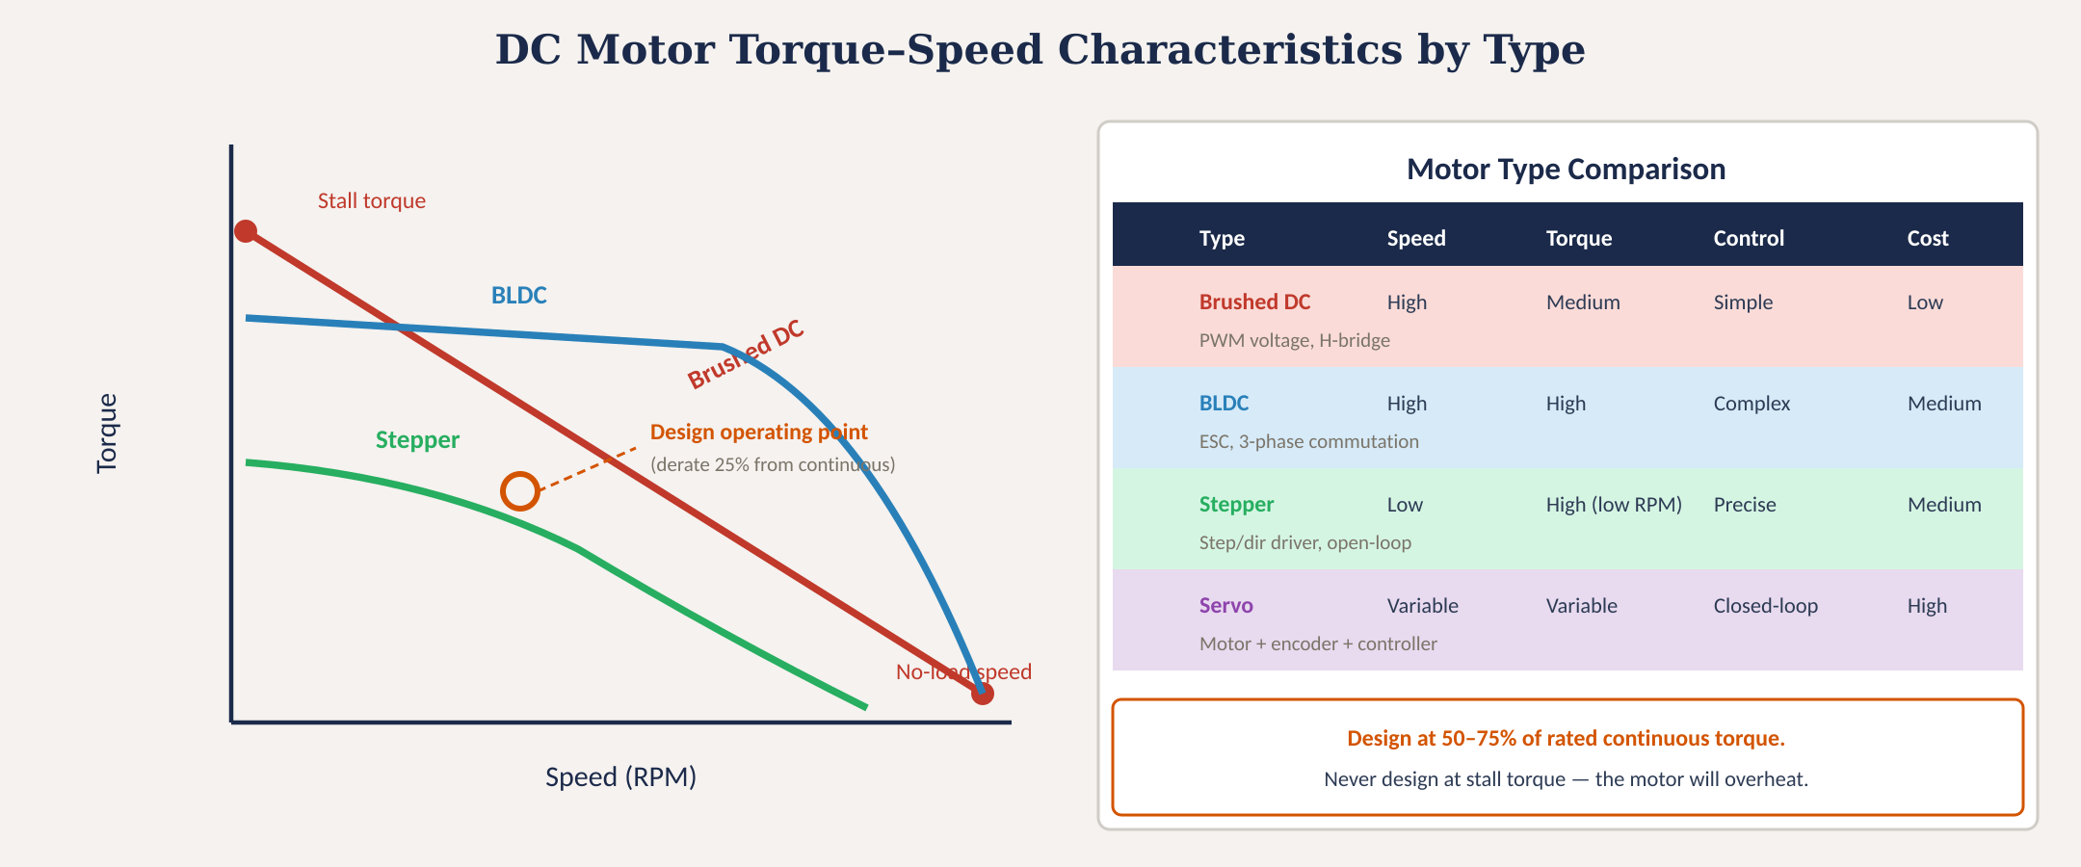
Motor torque–speed characteristics by type
Fig. 2: Torque–speed curves for brushed DC (linear), BLDC (flat mid-range), and stepper (high-torque at low RPM) with comparison table
MINES | MEGN 301 — Mechanical Integration and Design
Notes:
Figure 2 shows the characteristic torque-speed curves for the three primary motor types, along with a comparison table. The brushed DC curve is a straight line from stall torque at zero speed to no-load speed at zero torque — this linear relationship is the simplest to analyze and predict. The BLDC curve is flatter in the low-to-mid speed range, maintaining nearly constant torque before falling off at high speeds. This flat region is the useful operating range and represents a significant advantage over brushed DC for applications that need consistent torque across a speed range. The stepper curve starts with high holding torque at zero speed but drops off rapidly as speed increases. This is why steppers are best for low-speed, high-torque applications like positioning systems and not for high-speed continuous rotation. The design operating point callout in the center is critical: always design at 50 to 75 percent of the motor's continuous rated torque. Designing at or near the stall point guarantees overheating and premature failure. The comparison table on the right summarizes the four types across speed capability, torque capability, control complexity, and relative cost.

Slide 14
MINES | MEGN 301
Key motor specifications
When specifying a motor, define these parameters in your design documentation:
Rated Voltage
Nominal operating voltage. Must match your power supply rail. Running above rated voltage increases speed but risks insulation breakdown and overheating.
No-Load Speed
Maximum speed with no mechanical load (RPM). Your actual speed under load will be lower — read the torque-speed curve.
Stall Torque
Maximum torque at zero speed. This is NOT your design point — stall current will overheat the motor in seconds. Use for worst-case mechanical analysis only.
Rated / Continuous Torque
Torque the motor can deliver indefinitely without overheating. This IS your design ceiling. Derate to 50–75% for margin.
Rated Current
Current at rated torque. This determines your driver and power supply sizing. Stall current = rated voltage / winding resistance — often 6–10× rated current.
Torque Constant (K_t)
Torque per ampere (N·m/A or oz·in/A). Allows you to calculate required current from your load torque: I = τ_load / K_t.
MINES | MEGN 301 — Mechanical Integration and Design
Notes:
Six critical motor specifications. Rated voltage must match your power supply rail — running a 12V motor from a 24V supply doubles the speed and current, likely burning out the windings. No-load speed is the datasheet headline number but is misleading — your actual operating speed under load is always lower. Always read the torque-speed curve to find your actual operating point. Stall torque is the maximum torque at zero speed. Students often see this number and think 'great, my motor can deliver 5 newton-meters.' But stall current — calculated as rated voltage divided by winding resistance — is enormous, typically 6 to 10 times the rated running current. At stall, all electrical energy converts to heat in the windings. A motor will overheat and fail in seconds to minutes at stall. Never design for stall torque. Rated or continuous torque is your real design ceiling — this is the torque the motor can deliver indefinitely at rated voltage without exceeding its temperature rating. Derate to 50 to 75 percent of this value for your design operating point. Rated current is the current at rated torque — this number sizes your motor driver, wiring, and power supply. The torque constant K-t relates current to torque: if your load needs 0.5 newton-meters and K-t is 0.05 Nm/A, you need 10 amps through the motor.

Slide 15
MINES | MEGN 301
Motor drive electronics
The motor alone cannot function — every motor type needs a driver circuit matched to its commutation and control requirements.
H-Bridge (Brushed DC)
Four transistors arranged in an 'H' pattern. Allows bidirectional current flow for forward/reverse. PWM on the enable pin controls speed. L298N (2A, dual), BTS7960 (43A), DRV8871 (3.6A). Always include flyback diodes — the H-bridge will be destroyed by back-EMF without them.
ESC (BLDC)
Electronic Speed Controller. Converts DC input + throttle signal into three-phase AC to drive the motor. Handles commutation timing. Drone ESCs (30–60A) are cheap and widely available. For reversing, use a bidirectional or 4-quadrant ESC.
Stepper Driver
Converts step + direction signals into the complex current-switching pattern the motor needs. A4988 (2A, 1/16 microstep), DRV8825 (2.5A, 1/32), TMC2209 (2A, silent). Set the current limit potentiometer before powering on — too high = overheated motor; too low = skipped steps.
Servo Controller
Hobby servos: PWM signal (1–2 ms pulse, 50 Hz). No external driver needed. Industrial servos: dedicated controller (CANopen, EtherCAT) handling PID position/velocity loops at kHz rates. Tuning is required.
MINES | MEGN 301 — Mechanical Integration and Design
Notes:
Every motor type requires a matched driver circuit — this is a concept students often miss. You cannot just wire a BLDC motor to a battery, and even a brushed DC motor needs an H-bridge if you want bidirectional control. The H-bridge uses four transistors to route current through the motor in either direction. The L298N is the classic student project driver but is old and inefficient. Modern alternatives like the BTS7960 handle much higher currents. The critical safety requirement is flyback diodes — when you switch off current to an inductive load like a motor, the collapsing magnetic field generates a voltage spike that will destroy your transistors. The driver must include freewheeling diodes. For BLDC motors, the ESC handles three-phase commutation automatically. Drone-grade ESCs are inexpensive and handle high currents but typically only support one direction. For bidirectional control, specify a 4-quadrant ESC. Stepper drivers convert simple step and direction logic signals into the precise current-switching pattern the motor requires. The A4988 is the standard for student projects. A critical setup step: set the current limit potentiometer before powering the motor. Too high and the motor overheats; too low and it skips steps under load. The TMC2209 adds silent operation through StealthChop mode. Hobby servos need only a PWM signal — no external driver — making them the easiest motor to control for student projects.

Slide 16
03
Pumps
Positive displacement, centrifugal, and specialty pump selection
MINES | MEGN 301 — Mechanical Integration and Design
Notes:
Section 3 covers pumps — the components that move fluids through your system. Pump selection is driven by four questions: how much fluid do you need to move, at what pressure, what fluid properties must you handle, and does flow need to be smooth or is pulsation acceptable? We will cover both positive displacement pumps, which trap and move a fixed volume per cycle, and dynamic or centrifugal pumps, which impart velocity to the fluid.

Slide 17
MINES | MEGN 301
Pump fundamentals
Positive Displacement (PD)
Traps a fixed volume of fluid per cycle and forces it into the discharge. Flow is proportional to speed and nearly independent of pressure. Inherently self-priming. Produces pulsating flow. Types: gear, diaphragm, peristaltic, piston, vane.
Dynamic (Centrifugal)
Imparts kinetic energy to the fluid via an impeller, then converts velocity to pressure in a volute casing. Flow varies with discharge pressure (operates on a pump curve). Smooth, continuous flow but NOT self-priming — requires a flooded suction. Best for high-volume, lower-pressure applications.
Key Selection Question
Do you need precise flow control? → PD pump. Do you need high volume at low pressure? → Centrifugal. Must the pump handle viscous or abrasive fluids? → Gear or diaphragm. Does the fluid absolutely cannot contact pump internals? → Peristaltic. Need to pump against high head? → Multistage centrifugal or piston.
MINES | MEGN 301 — Mechanical Integration and Design
Notes:
The fundamental distinction in pump technology is between positive displacement and dynamic or centrifugal types. Positive displacement pumps trap a fixed volume of fluid in a sealed chamber and physically push it from the suction side to the discharge side. This means flow is essentially proportional to pump speed and nearly independent of discharge pressure — the pump delivers the same volume per revolution regardless of how much back-pressure it faces, up to its mechanical limit. This makes PD pumps inherently good at metering precise volumes. They are also self-priming because they can draw fluid up from below by creating suction. The downside is pulsating flow — each displacement cycle creates a pressure pulse. Dynamic or centrifugal pumps work by spinning an impeller that flings fluid outward at high velocity, then converting that velocity into pressure in a volute or diffuser casing. The key behavioral difference is that flow and pressure are interdependent — as discharge pressure increases, flow decreases along the pump curve. This means centrifugal pumps are NOT suitable for precise flow metering, but they excel at moving large volumes at moderate pressures with smooth, non-pulsating flow. They are not self-priming because they need the impeller submerged in fluid to function. The selection decision tree: if you need precise flow control, choose a positive displacement pump. If you need high volume at moderate pressure with smooth flow, choose centrifugal. If the fluid is viscous, abrasive, or corrosive, a gear or diaphragm pump handles it. If the fluid absolutely must not contact pump internals — such as in biomedical or food applications — a peristaltic pump isolates the fluid in a replaceable tube.

Slide 18
MINES | MEGN 301
Pump types for design projects
Gear Pumps
Two meshing gears trap fluid between teeth and housing wall. Self-priming, handles viscous fluids well (oil, glycol). Constant flow rate. Used in hydraulic systems, lubrication circuits. Wear from particle contamination is the primary failure mode — always use inline filtration.
Diaphragm Pumps
A flexible diaphragm oscillates to create suction and discharge strokes. Seal-less design — the diaphragm isolates the fluid from all moving parts. Self-priming, handles corrosive and abrasive fluids. Pulsating flow requires dampeners for smooth delivery. Used in chemical dosing and water treatment.
Peristaltic Pumps
Rollers compress a flexible tube, pushing fluid forward — the fluid only contacts the tube. Zero contamination risk. Easy maintenance: swap the tube. Gentle on shear-sensitive fluids (blood, cell cultures). Pulsating flow and limited pressure (~30 psi). Tube fatigue limits life.
Centrifugal / Impeller Pumps
Spinning impeller accelerates fluid radially. Smooth, high-volume flow. Requires primed (flooded) suction. Poor with viscous fluids. Common for cooling loops, water circulation, HVAC. Small 12V DC impeller pumps are widely available for student projects.
MINES | MEGN 301 — Mechanical Integration and Design
Notes:
Four pump types most commonly encountered in student design projects. Gear pumps use two meshing gears — an externally driven gear and an idler — that trap fluid in the spaces between the gear teeth and the housing wall. As the gears rotate, fluid is carried from the suction port to the discharge port. They handle viscous fluids exceptionally well because the thick fluid helps seal the clearances between gears and housing. The primary failure mode is wear from particulate contamination — always protect gear pumps with inline filtration. Diaphragm pumps use a flexing membrane to alternately expand and compress a pump chamber. They are inherently seal-less because the diaphragm separates the fluid from all moving parts. This makes them excellent for corrosive or abrasive fluids. Self-priming capability makes them versatile. The downside is pulsating flow — if your downstream process needs steady flow, you will need a pulsation dampener or accumulator. Peristaltic pumps are the gentlest and most contamination-free type. A rotor with rollers progressively squeezes a flexible tube, pushing the fluid forward. The fluid only ever contacts the inside of the tube, which can be replaced in minutes. This makes peristaltic pumps the standard in biomedical, pharmaceutical, and food-processing applications. Pressure capability is limited — typically under 30 psi — and tube fatigue is the primary maintenance concern. Centrifugal impeller pumps are the workhorses of high-volume fluid handling. Small 12V DC impeller pumps are widely available and inexpensive for student cooling loops and water circulation projects. They provide smooth, non-pulsating flow but cannot self-prime and struggle with viscous fluids.

Slide 19
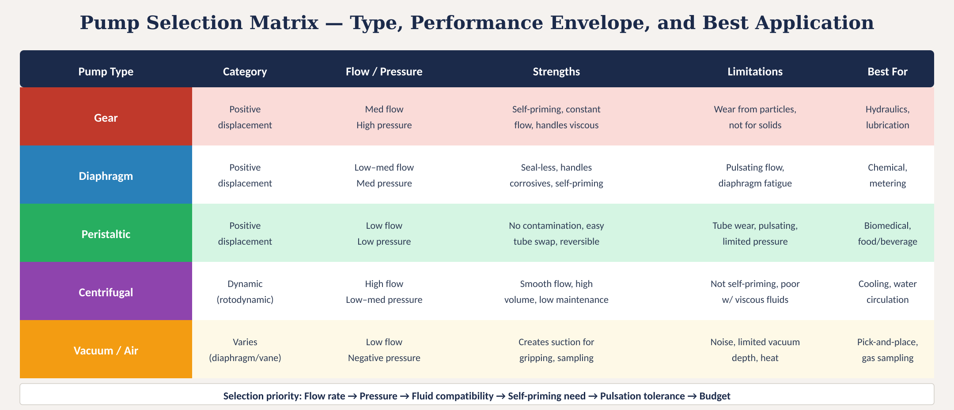
Pump selection matrix
Fig. 3: Pump selection matrix — type, performance envelope, strengths, limitations, and best applications
MINES | MEGN 301 — Mechanical Integration and Design
Notes:
Figure 3 presents the pump selection matrix comparing five pump families across their performance envelopes, strengths, limitations, and best applications. Gear pumps handle medium flow at high pressure for hydraulic and lubrication systems. Diaphragm pumps handle low-to-medium flow at medium pressure for chemical metering applications. Peristaltic pumps handle low flow at low pressure where contamination-free operation is critical — biomedical and food service. Centrifugal pumps deliver high flow at low-to-medium pressure for water circulation and cooling. Vacuum and air pumps create negative pressure for pick-and-place systems, gas sampling, and suction grippers. The selection priority at the bottom guides the decision sequence: start with flow rate, then pressure, then fluid compatibility, then whether self-priming is needed, then pulsation tolerance, then budget.

Slide 20
MINES | MEGN 301
Key pump specifications
When specifying a pump, define these parameters in your design documentation:
Flow Rate
Volume per unit time: L/min, mL/min, GPM. Must meet your system demand with ≥25% margin. For PD pumps, flow ≈ displacement × speed. For centrifugal, read the pump curve at your system pressure.
Discharge Pressure / Head
Maximum pressure the pump can deliver (psi or bar) or total dynamic head (feet or meters of fluid). Must exceed your system losses (pipe friction + elevation + fittings) with margin.
Fluid Compatibility
Wetted materials (housing, seals, impeller) must be chemically compatible with the pumped fluid. Check compatibility charts for seal materials (Viton, EPDM, PTFE). Temperature affects material ratings.
Self-Priming
Can the pump draw fluid up from below its inlet? PD pumps: yes. Centrifugal: no (must be flooded). If your tank is below the pump, you need a self-priming type or a foot valve.
Motor Integration
Many small pumps come with integrated motors (12V or 24V DC). Specify the pump-motor assembly together. For separate pump heads, match the pump shaft to your motor + coupling.
MINES | MEGN 301 — Mechanical Integration and Design
Notes:
Five critical pump specifications. Flow rate is your primary sizing parameter — you need to know how much fluid your system demands per unit time. Always add at least 25 percent margin to your calculated requirement to account for system losses, aging, and fouled filters. For positive displacement pumps, flow equals displacement per revolution times speed. For centrifugal pumps, you must read the pump curve — a graph that shows how flow decreases as discharge pressure increases. Discharge pressure or head must exceed the total resistance of your piping system: friction losses through pipes and fittings, elevation changes, and any back-pressure from downstream equipment. If you undersize the pump pressure, the flow rate will be lower than expected or zero. Fluid compatibility is non-negotiable — every wetted material must be checked against the pumped fluid using chemical compatibility charts. This includes the pump housing, seals, impeller, and any O-rings. Temperature matters because many seal materials lose chemical resistance at elevated temperatures. Self-priming determines your installation options. If your fluid reservoir is below the pump, you need a pump that can create suction to draw fluid up — positive displacement types do this inherently. Centrifugal pumps must be installed below the fluid level or have a foot valve and check valve on the suction line. Motor integration: most small pumps for student projects come as complete pump-motor assemblies with 12V or 24V DC motors. Specify the entire assembly including voltage, current draw, and connector type in your BOM.

Slide 21
04
Selection &
design practice
Unified framework, integration checklist, and project application
MINES | MEGN 301 — Mechanical Integration and Design
Notes:
Section 4 brings power supplies, motors, and pumps together into a unified selection framework and addresses the integration challenges that arise when these components must work together in a single system. The key insight: these are not independent selections. Your power supply must handle the combined load of all motors and pumps, including inrush and transients. Your motor must match both the mechanical load and the available power supply rail. Your pump motor adds to the total current budget.

Slide 22
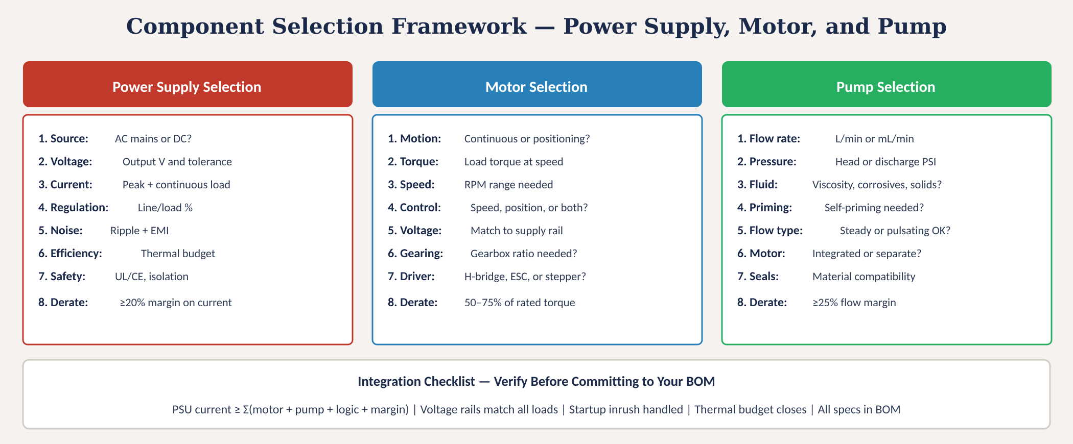
Component selection framework
Fig. 4: Parallel selection flows for power supply, motor, and pump with integration verification checklist
MINES | MEGN 301 — Mechanical Integration and Design
Notes:
Figure 4 shows the three parallel selection processes for power supply, motor, and pump, each following an eight-step specification flow. For power supplies, start with your source type, then define output voltage, current, regulation, noise, efficiency, safety certification, and derating margin. For motors, start with your motion type, then define torque, speed, control method, voltage, gearing, driver type, and derating margin. For pumps, start with flow rate, then define pressure, fluid compatibility, self-priming need, flow smoothness, motor integration, seal materials, and derating margin. The critical integration checklist at the bottom ties all three together: your power supply current must be greater than or equal to the sum of all motor currents, pump currents, logic circuit currents, and a safety margin. Voltage rails must match all loads. The power supply must handle startup inrush without drooping below the minimum operating voltage of your microcontroller. The thermal budget must close — total waste heat must be manageable within your enclosure. And every specification must be documented in the BOM.

Slide 23


MINES | MEGN 301
Practical design tips
Build a power budget spreadsheet first. List every component, its voltage rail, continuous current, and peak current. Sum the columns. Add 25% margin. This determines your power supply.
Calculate your mechanical load torque before selecting a motor. τ = F × r for linear-to-rotary conversion. Include friction, inertia, and acceleration torque. Then select a motor with rated torque ≥ 1.5× your load.
For fluid systems, map your complete flow circuit — pipe lengths, fittings, elevation changes, and filters — to calculate total system head loss. Then select a pump whose curve crosses your system curve with margin.
Motor inrush current is the #1 cause of power supply problems in student projects. A motor rated at 2A running may draw 15A at startup. Size your supply for inrush, or use soft-start circuits.
Separate power and signal grounds. Run motor power on dedicated wires back to the supply — never share ground wires between motors and sensitive electronics like ADCs or microcontrollers.
Document everything in your BOM: part number, manufacturer, voltage, current, torque, flow rate, and where you plan to buy it. At PDR: show your power budget. At CDR: show datasheets. At FDR: demonstrate operation.
MINES | MEGN 301 — Mechanical Integration and Design
Notes:
Six practical design tips. First, build a power budget spreadsheet before selecting any components. List every electrical device in your design with its voltage rail, continuous current consumption, and peak current. Sum each column and add 25 percent margin — this number directly determines your power supply rating. Second, calculate your mechanical load torque analytically before selecting a motor. Use the equation torque equals force times radius for linear-to-rotary conversion. Include friction losses, rotational inertia contributions during acceleration, and gravity loads. Then select a motor whose continuous rated torque is at least 1.5 times your calculated load torque. Third, for fluid systems, map the complete flow circuit before selecting a pump. Calculate total system head loss including pipe friction from the Darcy-Weisbach equation, fitting losses from K-factors, and elevation changes. Fourth, motor inrush is the number one power supply problem in student projects. A motor rated at 2 amps continuous may draw 15 amps for the first 100 milliseconds at startup. If your supply cannot handle this, the voltage droops, the microcontroller resets, and the system fails. Size your supply for inrush or implement soft-start circuits that ramp motor voltage gradually. Fifth, separate power and signal grounds — motor switching currents flowing through shared ground wires create voltage drops that corrupt sensor readings and cause microcontroller glitches. Sixth, document everything in your BOM and present it at every design review.

Slide 24
MINES | MEGN 301
Key takeaways
(1)
Power supplies: use pre-certified wall adapters for AC-DC. Use switching regulators for efficient DC-DC conversion. Use LDOs only for low-current, noise-sensitive loads.
(2)
Motors: match type to your control need — brushed DC for simple speed control, BLDC for efficiency, stepper for open-loop positioning, servo for closed-loop precision. Every motor needs a driver.
(3)
Pumps: positive displacement for precise flow and self-priming, centrifugal for high-volume smooth flow. Match wetted materials to your fluid.
(4)
Derating is non-negotiable: 20% current margin on power supplies, 25–50% torque margin on motors, 25% flow margin on pumps. Never design at the component's maximum rating.
(5)
Integration: build a power budget first, size for inrush, separate power and signal grounds, and document every selection in your BOM.
References: [1] Mohan, Undeland, Robbins, Power Electronics, 3rd ed., Wiley, 2003. [2] Hughes & Drury, Electric Motors and Drives, 5th ed., Elsevier, 2019. [3] Karassik et al., Pump Handbook, 4th ed., McGraw-Hill, 2008. [4] Horowitz & Hill, The Art of Electronics, 3rd ed., Cambridge, 2015.
MINES | MEGN 301 — Mechanical Integration and Design
Notes:
Five key takeaways. One: for power supplies, always use pre-certified wall adapters for AC-to-DC conversion — never design your own AC-DC circuit in a student project. Use switching regulators for efficient DC-to-DC conversion, and reserve LDOs for low-current, noise-sensitive applications where simplicity and clean output matter more than efficiency. Two: match your motor type to your control requirement. Brushed DC for simple speed control, BLDC for high efficiency and long life, stepper for open-loop positioning, servo for closed-loop precision. Every motor type requires a matched driver circuit. Three: positive displacement pumps for precise flow control and self-priming capability, centrifugal pumps for high-volume smooth flow. Always verify that all wetted materials are compatible with your fluid. Four: derating is non-negotiable — 20 percent current margin on power supplies, 25 to 50 percent torque margin on motors, 25 percent flow margin on pumps. Designing at maximum rating guarantees premature failure. Five: integration requires a power budget, inrush current analysis, proper ground separation, and complete BOM documentation.

