Slide 1
MINES | MEGN 301 — Mechanical Integration and Design
Electromechanical System Design
Power Architecture
& Circuit Safety
PROTECTION CIRCUITS, GROUNDING, AND SAFE SYSTEM INTEGRATION
Notes:
Welcome to Part 2 of the Electromechanical System Design series for MEGN 301. This module covers the safety and integration side: how to architect a power system that protects itself and its users, how to safely integrate wall power and batteries with motors and actuators, and how to protect circuits against overvoltage, undervoltage, overcurrent, reverse polarity, and transient voltage spikes. Part 1 covered component selection — power supplies, motors, and pumps. This module assumes you have selected your components and now need to wire them together safely and reliably. The central theme is defense in depth: no single protection device guards against all threats, so we layer protections from the power input through to each load.
ALIGNMENT NOTE — This module corresponds to Chapter 9 (Power Architecture & Circuit Safety) of your Master Reference Document. Your power architecture is a key CDR deliverable. Protection circuit choices should be documented in your FMEA (Chapter 3) and verified during integration (Chapter 5). The grounding strategy affects every interface in your N² diagram.
FINAL NOTES — Key updates in the final compiled document: (1) Gear reduction content has been moved from this chapter to the new Mechanical Power Transmission chapter (Ch 11). This chapter now focuses purely on electrical safety: grounding, protection circuits, and safe integration. (2) The 'Integration Rule: Start from the Load' concept box is retained as the bridge between electrical and mechanical. (3) The Brown-Out Blues case study in Ch 5 directly demonstrates what happens when power architecture principles from this chapter are violated.

Slide 2



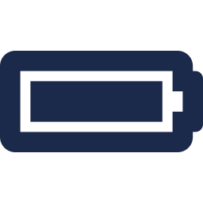


MINES | MEGN 301
Learning outcomes
Design a system-level power architecture with proper grounding, rail separation, and protection at each stage
Specify overvoltage (OVP) and undervoltage (UVP) protection using Zener clamps, TVS diodes, crowbar circuits, and voltage supervisors
Implement overcurrent protection (OCP) using fuses, PTC devices, circuit breakers, and electronic fuses
Protect against reverse polarity and back-current using series diodes, P-FET circuits, and ideal diode ICs
Suppress transient voltages from inductive loads using flyback diodes, snubber circuits, and TVS devices
Integrate motors with mechanical systems (gears, linkages, couplings) and verify power flow from source to load
MINES | MEGN 301 — Mechanical Integration and Design
Notes:
Six learning outcomes. First, design a complete power architecture — from source through regulation to loads — with proper ground separation between signal, power, and safety earth. Second, specify overvoltage and undervoltage protection appropriate to your application. Third, implement overcurrent protection on every power rail and at every load. Fourth, protect against reverse polarity from miswired batteries or connectors and back-current from regenerative loads. Fifth, suppress the transient voltage spikes that motors, solenoids, and relays generate when switched. Sixth, close the loop between electrical and mechanical — verify that your motor, gearing, and mechanism actually deliver the force and speed your load requires, and that the power supply can support the entire chain.

Slide 3
01
Power
architecture
System-level design, grounding strategy, and battery integration
MINES | MEGN 301 — Mechanical Integration and Design
Notes:
Section 1 covers the system-level power architecture — how all the electrical pieces fit together. This is the blueprint that determines where power enters, how it is converted and distributed, where protection lives, and how grounds are managed. A good architecture prevents 90% of the noise and reliability problems students encounter.

Slide 4
MINES | MEGN 301
System-level power architecture
Input Stage
Power enters through a single point: wall adapter jack, battery connector, or USB port. This is where you place your first line of defense: reverse polarity protection, input fuse, and transient voltage suppression. A keyed connector prevents miswiring; a TVS diode catches spikes; a fuse limits fault current.
Regulation Stage
One or more voltage regulators convert the input to the rails your loads need. Common architecture: 24V input → buck to 12V (motor rail) → buck to 5V (sensor rail) → LDO to 3.3V (MCU rail). Each conversion step should have its own input and output capacitors and its own enable/shutdown control.
Distribution Stage
Each output rail feeds its loads through individual protection — per-rail fuses or electronic current limiters. Star-topology wiring from the supply to each load minimizes shared-impedance coupling. Separate power and signal grounds, joining them at a single star point near the supply.
MINES | MEGN 301 — Mechanical Integration and Design
Notes:
A well-designed power architecture has three stages. The input stage is where all power enters the system through a single, well-defined entry point. This is where you place your first-line protections: a keyed connector to prevent miswiring, reverse polarity protection to survive a backwards battery connection, a fuse to limit fault current, and a TVS diode to clamp input transients. Think of this as the front door with a deadbolt, security camera, and chain lock — multiple layers. The regulation stage converts the raw input voltage into the specific rails your system needs. A typical student project architecture cascades from the highest voltage down: 24V input to 12V motor rail via a buck converter, 12V to 5V sensor rail via another buck, and 5V to 3.3V MCU rail via an LDO. Each converter needs its own input and output capacitors placed as close to the IC as possible. The distribution stage delivers regulated power to each load through individual protection. Per-rail fuses or electronic current limiters prevent a fault in one subsystem from taking down the entire system. Star-topology wiring — where each load has its own pair of wires running back to the supply rather than daisy-chaining — minimizes the noise coupling between loads. Ground architecture is critical: run separate ground conductors for signal circuits and power circuits, joining them at a single star point near the main supply.

Slide 5
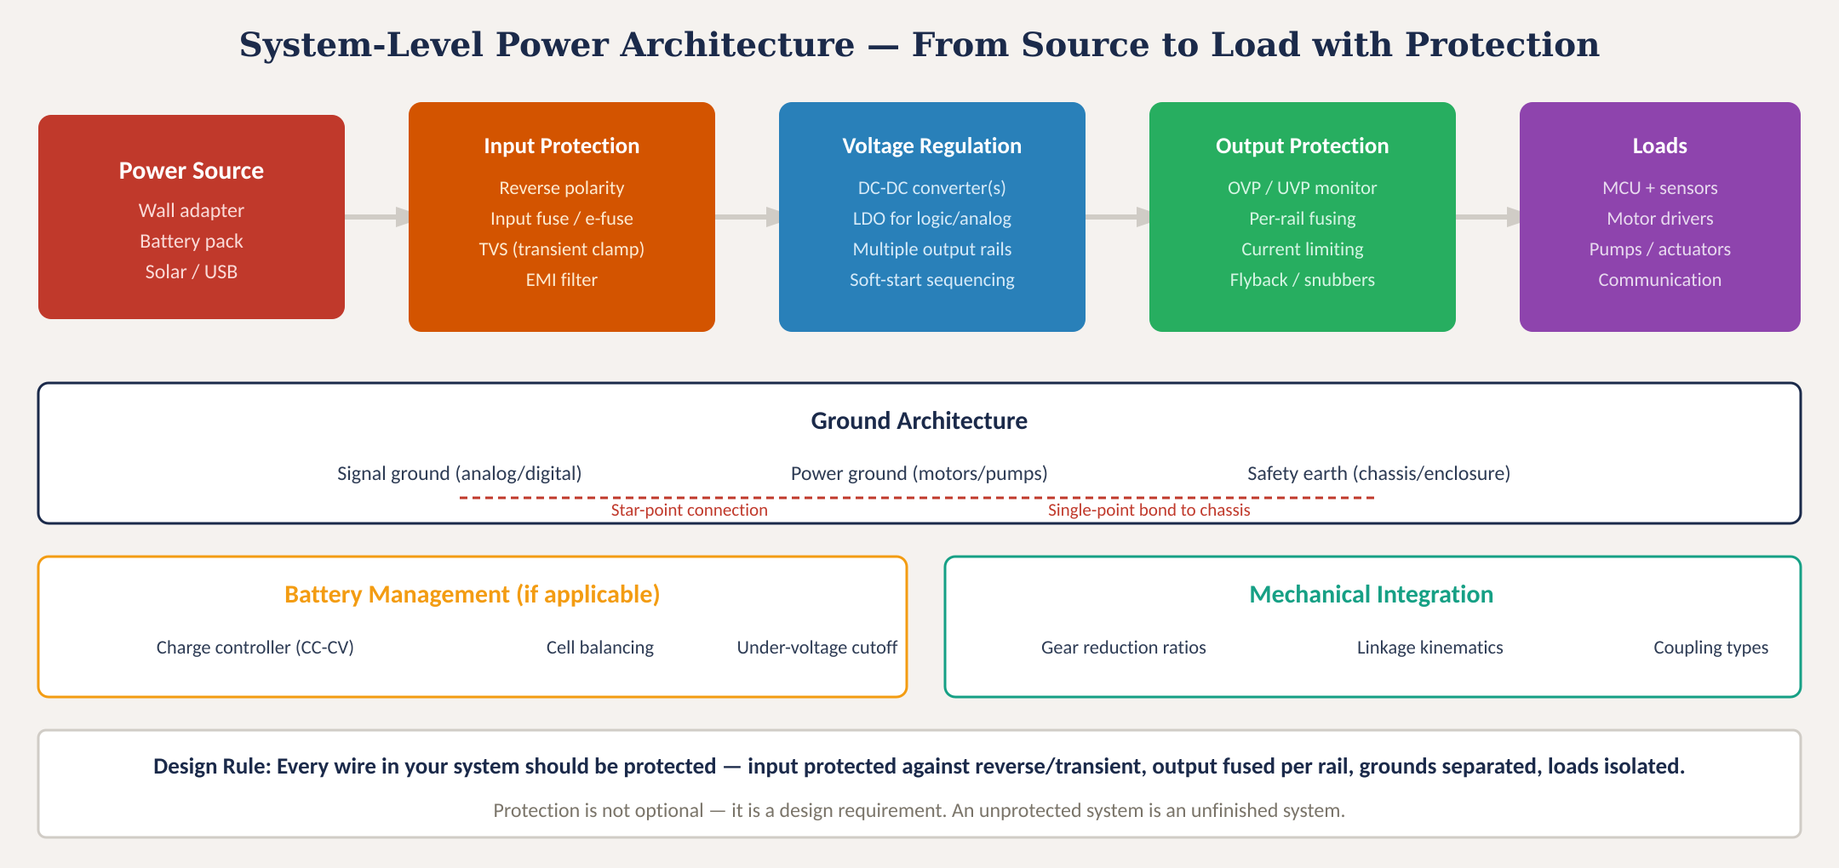
System-level power architecture
MINES | MEGN 301 — Mechanical Integration and Design
Notes:
Figure 1 shows the complete system-level power architecture from source to load. Power flows left to right through four functional blocks: the source, input protection, voltage regulation, output protection, and finally the loads. Below the main signal path, the ground architecture shows three distinct ground domains: signal ground for analog and digital circuits, power ground for motors and pumps, and safety earth bonded to the chassis or enclosure. These grounds connect at a single star point near the main power supply — never daisy-chain grounds or let motor return currents flow through signal ground traces. The battery management block applies when your system uses rechargeable cells: you need a charge controller implementing constant-current then constant-voltage charging, cell balancing for multi-cell packs, and an undervoltage cutoff to prevent deep discharge that damages lithium cells. The mechanical integration block on the right reminds us that the electrical architecture must support the mechanical system — gear ratios, linkage kinematics, and coupling types all affect the torque and speed demands that ultimately size your motors and power supply.

Slide 6
MINES | MEGN 301
Grounding strategy and isolation
Why Grounding Matters
Ground is not a magical zero-volt reference — it is a real conductor with real resistance and inductance. Motor currents flowing through shared ground traces create voltage drops (V = I × R) that appear as noise on your sensor readings and can cause microcontroller resets. The #1 debugging time sink in student projects is ground-related noise.
Star-Point Grounding
Run separate ground wires from each subsystem back to a single point near the power supply. Motor ground, sensor ground, and MCU ground each get their own conductor. They meet at one star point. This prevents motor return current from flowing through your sensor ground path.
AC Mains Safety
If your system uses wall power (even through a wall adapter), the enclosure must be safe to touch. Use a Class II (double-insulated) adapter — no earth ground needed. If using an internal open-frame supply, bond the metal enclosure to earth ground and use a 3-prong inlet with proper strain relief. Never defeat a ground prong.
Isolation Between Domains
Use optocouplers or digital isolators (Si8620, ADUM1201) to pass signals between high-voltage and low-voltage domains. This prevents fault currents from reaching your MCU. Essential when controlling AC loads (relays, triacs) from a microcontroller.
MINES | MEGN 301 — Mechanical Integration and Design
Notes:
Grounding is the most underappreciated topic in student project design, and poor grounding is the number one cause of difficult-to-diagnose intermittent failures. The key insight is that ground is not a perfect zero-volt reference — it is a physical conductor with resistance and inductance. When a motor draws 5 amps through a ground trace that has 50 milliohms of resistance, there is a 250 millivolt drop along that trace. If your ADC's ground reference shares that same trace, your sensor readings are corrupted by 250 millivolts of motor noise. Star-point grounding solves this by giving each subsystem its own ground conductor running back to a single connection point near the power supply. Motor ground, sensor ground, and MCU ground each have dedicated paths. They converge at one star point so that motor return current never flows through sensor ground. For AC mains safety, the simplest approach is a Class II double-insulated wall adapter — no earth ground connection is needed because the adapter's double insulation provides the safety barrier. If you must use an internal power supply, the enclosure must be bonded to earth ground through a 3-prong inlet with proper strain relief on all wires entering the enclosure. Signal isolation using optocouplers or digital isolators is essential whenever your microcontroller needs to control or monitor a circuit in a different voltage domain — for example, switching AC loads with a relay.

Slide 7
MINES | MEGN 301
Battery and DC generation integration
Lithium Battery Safety
DC Generation (Solar, Alternator)
Lithium cells (LiPo, Li-ion, LiFePO4) store enormous energy density and can cause fire or explosion if mishandled.
Mandatory protections:
• Battery Management System (BMS) with:
— Overcharge cutoff (4.2V/cell max)
— Deep-discharge cutoff (3.0V/cell min)
— Overcurrent / short-circuit shutoff
— Cell balancing (multi-cell packs)
• Charge with a proper CC-CV charger matched to your cell chemistry
• Never charge unattended without a BMS
• Store in a LiPo-safe bag during development
• Fuse the battery output at the connector
Common modules: TP4056 (single-cell charger), BQ25895 (buck-boost charger), BQ76940 (multi-cell BMS).
DC generation sources (solar panels, wind turbines, alternators) produce variable voltage that must be regulated before use.
Solar integration:
• MPPT charge controller extracts maximum power from the panel's I-V curve
• Panel voltage varies with illumination and temperature — use a buck-boost regulator
• Blocking diode prevents battery from discharging back through the panel at night
Alternator/generator:
• Rectify AC output (bridge rectifier)
• Regulate with a voltage regulator or charge controller
• Load-dump protection: TVS or MOV to absorb voltage spike if the battery disconnects while the alternator is running
Key: all DC generation sources need reverse-current blocking and transient suppression at the input.
MINES | MEGN 301 — Mechanical Integration and Design
Notes:
Battery integration demands respect — lithium cells store enough energy to cause serious fires if mistreated. A lithium polymer cell at 4.2 volts contains roughly 40 kilojoules per cell, enough to ignite nearby materials. A Battery Management System or BMS is mandatory, not optional. The BMS monitors every cell in the pack and provides four critical protections: overcharge cutoff to prevent cells from exceeding 4.2 volts, deep-discharge cutoff to prevent cells from dropping below 3.0 volts where irreversible damage occurs, overcurrent and short-circuit protection, and cell balancing to ensure all cells in a multi-cell pack charge and discharge evenly. The TP4056 module is the standard single-cell lithium charger for student projects — it implements the required constant-current then constant-voltage charging profile. For multi-cell packs, dedicated BMS ICs like the BQ76940 are necessary. During development, always store and charge lithium batteries in a fireproof LiPo-safe bag. Solar and other DC generation sources present a different challenge: variable output voltage. A solar panel's voltage varies with illumination intensity and temperature, so a Maximum Power Point Tracking charge controller dynamically adjusts the operating point to extract maximum power. A blocking diode prevents the battery from discharging backward through the panel at night. For alternators and generators, the AC output must be rectified and regulated. The critical hazard is load dump — if the battery disconnects while the alternator is running, the voltage spikes dramatically. A TVS diode or MOV at the alternator output absorbs this spike.

Slide 8
02
Protection
circuits
OVP, UVP, OCP, reverse polarity, and transient suppression
MINES | MEGN 301 — Mechanical Integration and Design
Notes:
Section 2 is the core of this module — the five categories of protection circuits that make the difference between a system that works once on the bench and a system that survives real-world operation. We will cover overvoltage and undervoltage protection, overcurrent protection, reverse polarity protection, and transient voltage suppression. The philosophy is defense in depth: layer multiple protections so that each catches what the previous one missed.

Slide 9
MINES | MEGN 301
Overvoltage and undervoltage protection
Overvoltage destroys components by exceeding their absolute maximum ratings. Undervoltage causes unpredictable behavior — brown-outs, data corruption, and latch-up.
Zener Clamp
A Zener diode across the supply rail clamps voltage at its breakdown value. Simple and cheap but limited power handling — the Zener must dissipate the excess power as heat. Best for low-power, low-duty-cycle transients. Select: V_zener slightly above your nominal rail (e.g., 5.6V Zener for a 5V rail).
TVS Diode
Transient Voltage Suppressor — a heavy-duty bidirectional Zener optimized for high peak power. Responds in less than 1 nanosecond. The primary defense against ESD, inductive spikes, and power supply transients. Select by: standoff voltage ≥ operating voltage, clamping voltage < component abs max. SMAJ, SMBJ, 1.5KE series.
Voltage Supervisor IC
Monitors the supply rail and asserts a reset or shutdown signal when voltage goes out of range. TPS3808 (adjustable OVP/UVP), MAX6495 (OVP with FET control), TLV803 (simple reset). Essential for microcontroller brown-out protection. Does not clamp — it shuts the system down gracefully.
Crowbar Circuit
An SCR (thyristor) fires when voltage exceeds a threshold, shorting the supply to ground and blowing the upstream fuse. Irreversible — the fuse must be replaced. Used when the overvoltage source has enough energy to overwhelm a clamp. Last-resort protection for expensive loads.
MINES | MEGN 301 — Mechanical Integration and Design
Notes:
Overvoltage and undervoltage are complementary threats. Overvoltage pushes components beyond their absolute maximum voltage ratings — a 5V microcontroller exposed to 8V will suffer gate oxide breakdown and permanent damage. Undervoltage is more insidious: it does not destroy components but causes them to behave unpredictably. A microcontroller running at 2.5V instead of 3.3V may execute instructions incorrectly, corrupt flash memory, or enter a latch-up state that draws excessive current. Four protection approaches, in order of increasing severity. The Zener clamp is simplest: a Zener diode across the rail conducts when voltage exceeds its breakdown voltage, clamping the rail. Limited by the Zener's power dissipation — typically a few watts. Best for low-energy transients. The TVS diode is the workhorse protection device. It is essentially a high-power bidirectional Zener optimized for absorbing transient energy in nanoseconds. Every power input in a professional design has a TVS diode. Select the TVS so its standoff voltage is above your normal operating voltage and its clamping voltage is below the absolute maximum rating of your most sensitive component. The voltage supervisor IC does not clamp voltage — instead it monitors the rail and takes action when voltage is out of range. For microcontrollers, this means asserting a hardware reset to prevent corrupted operation during brown-outs. The TPS3808 provides both overvoltage and undervoltage monitoring with adjustable thresholds. The crowbar circuit is the nuclear option: an SCR fires and shorts the supply rail to ground, sacrificing the upstream fuse to protect the downstream load. This is irreversible — the fuse must be replaced. Used only when the overvoltage source has enough sustained energy to overwhelm a TVS clamp.

Slide 10
MINES | MEGN 301
Overcurrent protection
Every power rail must have current limiting. A short circuit without protection delivers the full energy of the supply into the fault — melting wires, starting fires, and destroying components.
Fuses (One-Shot)
A fuse element melts at its rated current, permanently breaking the circuit. Fast-blow for sensitive electronics; slow-blow (time-delay) for motor circuits where inrush exceeds steady-state. Select: rated current ≥ normal operating current; fuse must blow before the wire or component is damaged. Fuse must be accessible for replacement.
PTC Resettable Fuses
Polymer PTC (positive temperature coefficient) device. Resistance increases dramatically when current exceeds the trip point, limiting current to a trickle. Self-resets when current is removed and the device cools. Slower trip time than fuses — not suitable for fast short-circuit protection. Best for USB ports and sensor circuits.
Electronic Fuses (eFuse)
A MOSFET in series with the load, controlled by a current-sense amplifier and comparator. Programmable trip point, fast response, automatic retry or latched shutdown. TPS2596, LTC4368, MAX14690. The most sophisticated option — provides current limiting (not just cutting), telemetry via I²C, and soft-start capability.
Circuit Breakers
Thermal or magnetic trip mechanism. Manual reset via switch or button. Common for AC branch circuits (15A, 20A per NEC). In DC systems, used for battery main disconnect. Must be rated for DC voltage — an AC breaker may not safely interrupt DC arcs.
MINES | MEGN 301 — Mechanical Integration and Design
Notes:
Overcurrent protection is the most fundamental safety requirement. Without it, a short circuit delivers the entire energy capacity of your power source into the fault. A fully charged lithium battery can deliver hundreds of amps into a short — enough to melt copper wire, vaporize solder joints, and start fires in milliseconds. Traditional fuses are the simplest and most reliable protection. The element melts at its rated current, permanently breaking the circuit. The critical design choice is fast-blow versus slow-blow. Fast-blow fuses trip quickly at their rated current and are appropriate for sensitive electronics. Slow-blow or time-delay fuses allow brief current surges — like motor inrush — without tripping, but still blow under sustained overcurrent. For motor circuits, always use slow-blow fuses rated above the inrush current. PTC resettable fuses are convenient for development because they automatically recover after the fault is removed. The trip time is slower than traditional fuses, making them less suitable for protecting against fast short circuits. They are excellent for USB ports and sensor inputs where the fault is likely intermittent. Electronic fuses represent the state of the art. A series MOSFET controlled by current-sense circuitry provides programmable trip points, fast response, and the ability to limit current rather than simply cut it. This means the eFuse can hold the current at a safe level during motor inrush rather than tripping. Some eFuse ICs provide telemetry over I2C, allowing the microcontroller to monitor current draw and detect developing faults before they become critical.

Slide 11
MINES | MEGN 301
Reverse polarity and back-current protection
A battery connected backwards will destroy everything downstream instantly. Reverse polarity protection is mandatory for any system with a detachable power source.
Series Diode
P-Channel MOSFET
Ideal Diode IC
A diode in series with the positive supply rail blocks current when polarity is reversed.
Schottky diode: ~0.3V drop
Silicon diode: ~0.7V drop
Power loss = V_f × I_load
At 5A with a Schottky: 1.5W lost as heat in the diode.
Pros: Simplest, cheapest
Cons: Permanent voltage drop, power waste, needs heatsinking at high current
Best for: Low-current circuits (<2A) where the voltage drop is acceptable.
A P-FET in the high-side power path conducts when polarity is correct (gate pulled low by load ground) and blocks when reversed.
Voltage drop: I × R_DS(on)
Typical R_DS(on): 10–50 mΩ
At 5A with 20mΩ: only 0.1V drop → 0.5W loss
Pros: Very low loss, no heatsink needed for most applications
Cons: Slightly more complex circuit, needs proper gate drive
Best for: Battery-powered systems, moderate-to-high current.
Common: Si2301, IRLML6402, DMG2307L
An IC that controls an external N-FET to emulate a perfect diode with near-zero forward voltage drop.
Voltage drop: ~20mV
Reverse blocking: guaranteed by IC control logic
LTC4357: single supply
LTC4359: with reverse current blocking
MAX40200: integrated FET
Pros: Lowest loss, fast reverse blocking
Cons: Highest cost, more complex BOM
Best for: High-efficiency systems, OR-ing redundant supplies, solar/battery combining.
MINES | MEGN 301 — Mechanical Integration and Design
Notes:
Reverse polarity protection prevents catastrophic damage when a battery or power connector is attached backwards. Without it, a reversed battery forward-biases the body diodes of every downstream MOSFET and IC, often destroying the entire circuit board in milliseconds. Three approaches in increasing sophistication. The series diode is simplest: place a diode in the positive power rail. When polarity is correct, the diode conducts; when reversed, it blocks. The penalty is a permanent forward voltage drop — 0.3 volts for a Schottky, 0.7 volts for silicon — which wastes power as heat. At 5 amps through a Schottky, you lose 1.5 watts continuously. This is acceptable for low-current circuits but problematic for battery-powered systems where efficiency matters. The P-channel MOSFET approach provides much lower loss. When polarity is correct, the MOSFET's body diode initially conducts, pulling the gate low through the load, which fully turns on the FET. The voltage drop is now just I times R-DS-on — at 5 amps through a 20 milliohm FET, the drop is only 100 millivolts and the loss is 0.5 watts. When polarity reverses, the gate goes high relative to source, turning the FET off. The ideal diode IC is the premium solution. It uses control circuitry to drive an external N-channel MOSFET, achieving forward drops as low as 20 millivolts while guaranteeing fast reverse blocking. The LTC4357 and LTC4359 from Analog Devices are the industry standards. These are also used for OR-ing redundant power supplies and combining solar panels with battery backup.

Slide 12
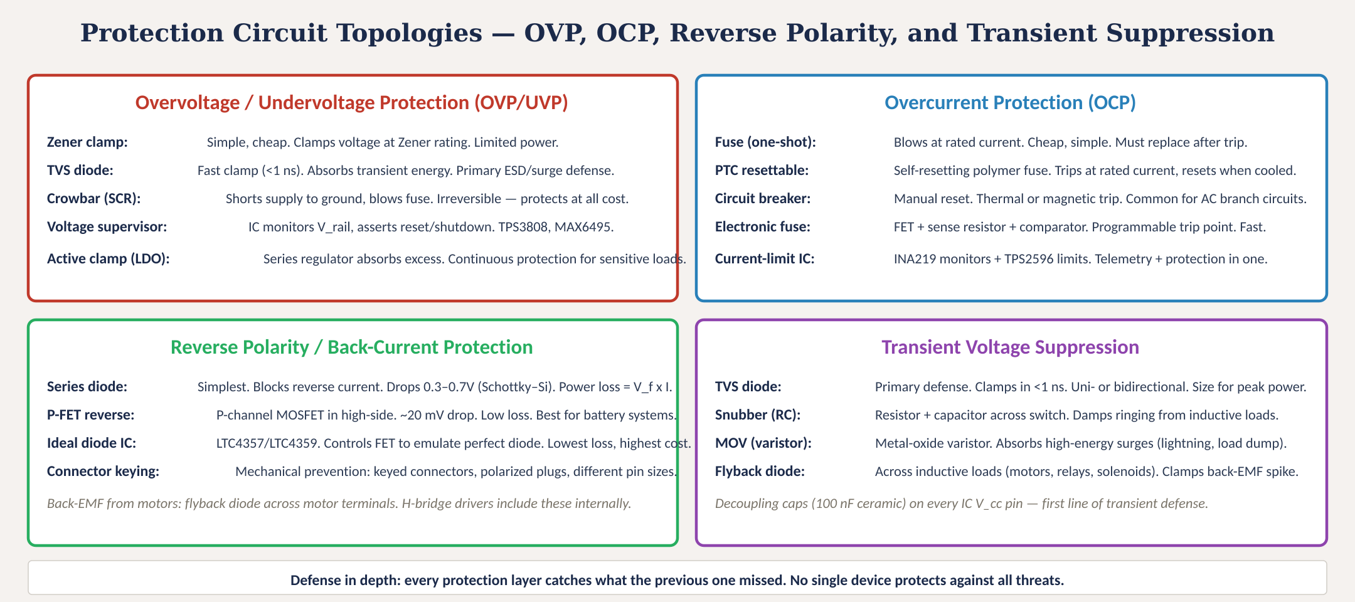
Protection circuit topologies
Fig. 2: Four protection categories — OVP/UVP, OCP, reverse polarity/back-current, and transient suppression with specific device options
MINES | MEGN 301 — Mechanical Integration and Design
Notes:
Figure 2 organizes all protection circuit topologies into four quadrants. Upper left: overvoltage and undervoltage protection, from simple Zener clamps through TVS diodes and voltage supervisor ICs to crowbar circuits. Upper right: overcurrent protection, from traditional fuses through PTC resettable devices and circuit breakers to sophisticated electronic fuses with telemetry. Lower left: reverse polarity and back-current protection, from series diodes through P-FET circuits to ideal diode ICs, with a note on flyback diodes for motor back-EMF. Lower right: transient voltage suppression, from TVS diodes through RC snubbers and MOVs to flyback diodes, with the reminder that 100 nanofarad ceramic decoupling capacitors on every IC power pin are the first line of defense against high-frequency transients. The bottom message reinforces defense in depth: no single device protects against all threats, so layer your protections.

Slide 13
MINES | MEGN 301
Transient voltage suppression in detail
Every time you switch an inductive load — motor, relay, solenoid — you create a voltage transient. Unmanaged transients destroy semiconductors and corrupt data.
Flyback Diode
The most critical protection for inductive loads. A diode placed across the motor, relay, or solenoid (cathode to V+) provides a current path when the switch opens. Without it, the collapsing magnetic field generates V = -L × dI/dt — potentially hundreds of volts from a 12V motor. Use a fast-recovery or Schottky diode. Every H-bridge driver IC includes these internally, but if you are driving a relay with a bare MOSFET, you must add one.
TVS Diode (Board-Level)
Place a TVS diode across each power rail at the board edge — where external cables connect. The TVS absorbs energy from ESD events, cable transients, and motor switching spikes that propagate through the power bus. Bidirectional TVS for signal lines; unidirectional for power rails. Select: V_standoff > V_operating, V_clamp < V_abs_max of protected component.
RC Snubber
A resistor-capacitor network across a switch or relay contact. The capacitor absorbs the initial voltage spike; the resistor dissipates the energy and damps oscillation. Typical starting values: 100Ω + 100nF for relay contacts. Tune by observing the transient on an oscilloscope. Essential for mechanical relay contacts that arc on opening.
Decoupling Capacitors
Place 100nF ceramic capacitors on every IC's V_cc pin, as close to the pin as possible. These absorb high-frequency transients before they reach the IC. For power regulators, add bulk capacitance (10–100µF electrolytic or ceramic) per the datasheet. Decoupling is not optional — it is a fundamental design requirement.
MINES | MEGN 301 — Mechanical Integration and Design
Notes:
Transient suppression is where the rubber meets the road in electromechanical design. Every motor, solenoid, and relay is an inductive load, and every inductive load generates a voltage spike when switched. The physics is simple: current through an inductor cannot change instantaneously, so when you open the switch, the inductor's magnetic field collapses and generates a voltage spike proportional to the rate of current change: V equals negative L times dI/dt. A 12-volt DC motor with even modest inductance can generate spikes of 50 to 200 volts when switched off abruptly. The flyback diode is the essential first defense. Placed across the inductive load with cathode toward the positive supply, it provides a path for the decaying current when the switch opens. Without it, the current has nowhere to go and the voltage rises until something breaks — usually the MOSFET driving the load. H-bridge driver ICs include these diodes internally, but if you are driving a relay or solenoid with a bare MOSFET, you must add an external flyback diode. Board-level TVS diodes protect against transients that propagate through the power bus. Place them at every cable entry point and across each power rail. RC snubbers are specifically for mechanical relay contacts, which arc and ring when opening. Decoupling capacitors on every IC power pin are non-negotiable — they are the first line of defense against high-frequency transients reaching sensitive circuitry.

Slide 14
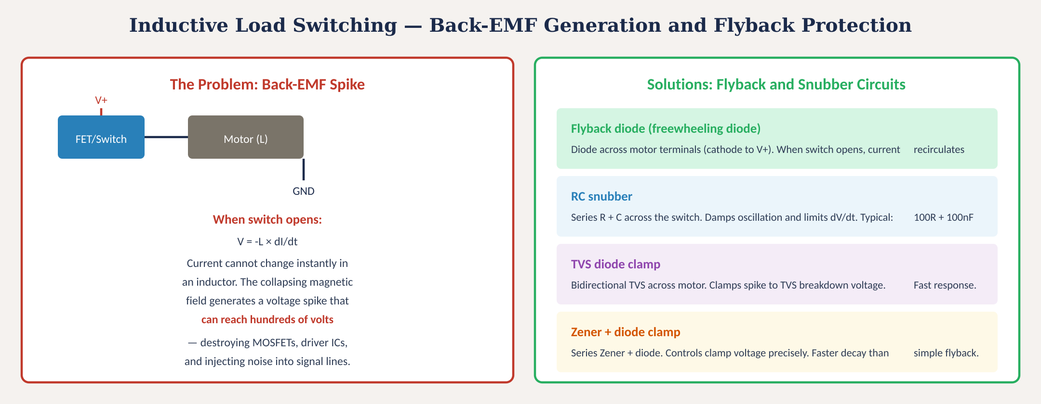
Inductive load switching and flyback protection
Fig. 3: Back-EMF generation from inductive loads and four protection solutions: flyback diode, RC snubber, TVS clamp, Zener+diode
MINES | MEGN 301 — Mechanical Integration and Design
Notes:
Figure 3 illustrates the back-EMF problem and its solutions. On the left, the problem: when a switch or MOSFET opens, cutting current to an inductive load like a motor, the collapsing magnetic field generates a voltage spike described by V equals negative L times dI/dt. Because current cannot change instantaneously in an inductor, the voltage theoretically rises to whatever level is needed to maintain current flow — often hundreds of volts — which exceeds the breakdown voltage of the switching device and destroys it. On the right, four solutions. The flyback or freewheeling diode is the most common and most important — it provides a low-impedance path for the decaying current to circulate through the motor and diode loop rather than generating a voltage spike. The tradeoff is that the motor current decays slowly through the low-resistance diode, which can be a problem if you need fast motor braking. The RC snubber uses a resistor and capacitor across the switch to absorb the initial spike and damp ringing. The TVS diode clamp provides fast, high-energy absorption. The Zener plus diode combination offers a controlled clamp voltage and faster current decay than a simple flyback diode because the higher clamp voltage drives the current down more quickly.

Slide 15
03
Electromechanical
integration
Gears, linkages, couplings, and power flow verification
MINES | MEGN 301 — Mechanical Integration and Design
Notes:
Section 3 closes the loop between electrical and mechanical. A motor is useless without a mechanism to deliver its torque and speed to the load. Gears reduce speed and multiply torque. Linkages convert rotary motion to linear or other complex paths. Couplings connect shafts while accommodating misalignment. And lead screws, belt drives, rack-and-pinion systems, and cams translate motor output into the specific motion your design requires. The integration rule: always start from the load and work backward to the motor, then size the power supply.

Slide 16
MINES | MEGN 301
Gear reduction and power transmission
Why Gears?
Motors are efficient at high speed and low torque. Loads typically need low speed and high torque. A gearbox trades speed for torque: τ_out = τ_motor × N × η, where N is the gear ratio and η is the gearbox efficiency. A 10:1 gearbox at 90% efficiency multiplies torque by 9× while dividing speed by 10.
Spur Gears
Simplest and cheapest. External mesh between two parallel-axis gears. Efficiency: ~95–98%. Noise increases with speed. Available from McMaster, SDP-SI, and stock gearmotor assemblies. Most student projects use pre-integrated gearmotor units.
Planetary Gearboxes
Sun gear + planet gears + ring gear in a compact coaxial package. High torque density, 3:1 to 100:1 ratios in a small envelope. Efficiency: ~85–95% per stage. Used in robotics, electric vehicles, and precision positioning.
Worm Gears
Worm drives the worm gear at right angles. Very high ratios (20:1 to 300:1) in a single stage. Self-locking at high ratios — the load cannot backdrive the motor. Efficiency varies widely: 40–90% depending on lead angle. Used in hoists, positioning tables, and applications needing holding torque without a brake.
MINES | MEGN 301 — Mechanical Integration and Design
Notes:
Gears are the fundamental mechanical advantage device in electromechanical systems. Motors are most efficient operating at high speed and moderate torque — a typical small DC motor might spin at 12,000 RPM with 0.05 Newton-meters of torque. But your load might need 100 RPM at 4 Newton-meters. A gearbox bridges this gap. The gear ratio N is the ratio of input speed to output speed, or equivalently the ratio of output teeth to input teeth. Output torque equals input torque times the ratio times the gearbox efficiency. At a 100:1 ratio with 90% efficiency, 0.05 Nm becomes 4.5 Nm at 120 RPM. Spur gears are the simplest: two parallel-axis gears meshing externally. They are cheap, widely available, and efficient at 95 to 98 percent. Most student projects use pre-integrated gearmotor assemblies from suppliers like Pololu or Banebots, which combine a DC motor with a spur gearbox in a single package. Planetary gearboxes pack high gear ratios into a compact coaxial package using a sun gear, multiple planet gears, and a ring gear. They are used in robotics and electric vehicles where space is at a premium. Worm gears provide very high ratios in a single stage and offer the unique advantage of self-locking — at high ratios, the load cannot backdrive the motor, which provides free holding torque without an electric brake. The tradeoff is efficiency, which can be as low as 40 percent for high-ratio worm drives.

Slide 17
MINES | MEGN 301
Linkages, couplings, and output mechanisms
Shaft Couplings
Connect motor shaft to load shaft while accommodating misalignment. Rigid couplings: precise but zero tolerance for misalignment. Flexible couplings (jaw, Oldham, bellows, beam): accommodate angular, parallel, and axial misalignment. Always spec by torque rating and bore sizes. Beam couplings are the standard for stepper motor applications.
Lead / Ball Screws
Convert rotary motion to linear. Lead screws: simple, cheap, self-locking, but lower efficiency (~40–80%). Ball screws: recirculating balls reduce friction, 85–95% efficient, but not self-locking. F = 2π × τ × η / lead. Common leads: 2mm, 4mm, 8mm. Select lead for your speed/force tradeoff — larger lead = faster travel, lower force.
Belt and Chain Drives
Transmit power between non-coaxial shafts. Timing belts (GT2, HTD) provide positive engagement — no slip — essential for CNC and 3D printers. V-belts for high power, allow slip. Chain drives for high torque (bicycle, motorcycle). Belt ratio = driven pulley / driver pulley.
Linkages (4-bar, Crank-Slider)
Convert continuous rotation into complex output motion. Crank-slider: rotary to reciprocating linear (pistons, stamping). Four-bar linkage: programmable output path by varying link lengths. Cam mechanisms: precise motion profiles. Linkages introduce position-dependent torque variation — the motor load is not constant through the cycle.
MINES | MEGN 301 — Mechanical Integration and Design
Notes:
Output mechanisms convert motor rotation into the specific motion your load requires. Shaft couplings are the first connection point — they link the motor shaft to the load shaft. Never use a rigid coupling unless you can guarantee perfect shaft alignment; thermal expansion, manufacturing tolerances, and assembly errors all create misalignment that rigid couplings transfer as stress to the motor bearings. Flexible couplings like jaw, Oldham, bellows, and beam types accommodate these misalignments while transmitting torque. Beam couplings are the default for stepper motor applications because they handle the step-induced torque pulses without backlash. Lead screws and ball screws convert rotation to linear motion. Lead screws are simple and self-locking but have moderate efficiency. Ball screws are highly efficient but not self-locking — the load will backdrive the motor unless held. The force equation is F equals 2-pi times torque times efficiency divided by lead. Timing belt drives with GT2 or HTD profile teeth provide positive engagement without slip — they are the standard for CNC machines and 3D printers. V-belts are used for higher power applications where some slip is acceptable. Linkages like four-bar mechanisms and crank-sliders convert continuous rotation into complex output paths. The important design consideration is that linkages create position-dependent torque loading — the motor torque required varies through the cycle, so you must size the motor for the peak torque point, not the average.

Slide 18
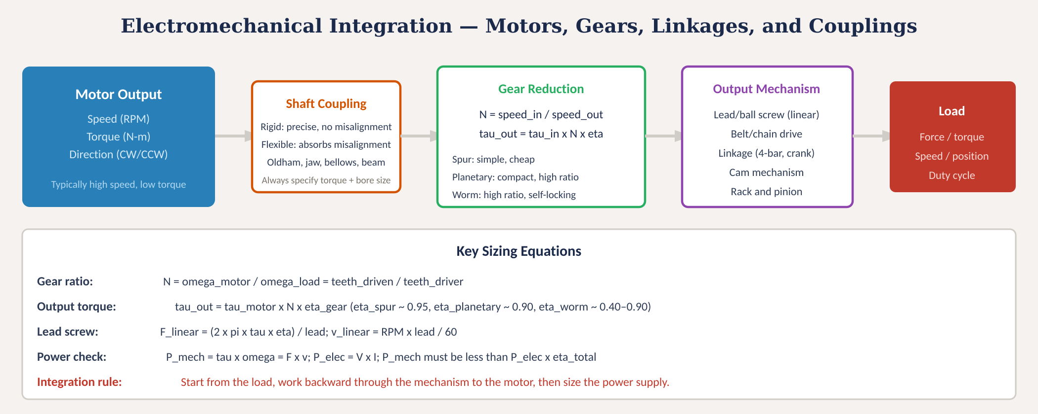
Electromechanical integration
Fig. 4: Motor-to-load power flow through coupling, gear reduction, and output mechanism with key sizing equations
MINES | MEGN 301 — Mechanical Integration and Design
Notes:
Figure 4 traces the power flow from motor output through the mechanical system to the load. The motor provides high-speed, low-torque rotation. A shaft coupling connects the motor to the gear reduction stage, accommodating misalignment. The gear reduction multiplies torque and reduces speed according to the gear ratio and efficiency. The output mechanism converts the geared rotation into the specific motion the load requires — linear via lead screw, rotary via belt drive, or complex path via linkage. The load defines the endpoint requirements: force, torque, speed, position, and duty cycle. The key sizing equations at the bottom are the essential calculations for electromechanical design. Gear ratio N equals motor speed divided by load speed, or equivalently driven teeth divided by driver teeth. Output torque equals motor torque times N times gearbox efficiency. For lead screws, linear force equals 2-pi times torque times efficiency divided by lead, and linear velocity equals RPM times lead divided by 60. The power check verifies energy conservation: mechanical power at the load must be less than electrical power at the motor times the total system efficiency. The integration rule at the bottom is the most important takeaway: start from the load requirements and work backward through the mechanism to the motor, then size the power supply last.

Slide 19
04
Design practice
& standards
Safety checklist, standards reference, and project application
MINES | MEGN 301 — Mechanical Integration and Design
Notes:
Section 4 brings everything together with practical design checklists, relevant standards, and guidance for applying these concepts in your projects.

Slide 20

MINES | MEGN 301
Electromechanical safety design checklist
Every item on this list must be addressed in your design before commissioning.
Input has reverse polarity protection (P-FET or series diode)
Input has a fuse or electronic current limiter rated for the expected peak current
TVS diode on every power input where external cables connect
Voltage supervisors on MCU power rail (brown-out reset)
Flyback diode on every inductive load (motor, relay, solenoid) not protected by the driver IC
Per-rail fusing — each output rail has its own current protection
100 nF decoupling capacitor on every IC V_cc pin, as close to the pin as possible
Signal and power grounds separated, joined at a single star point
Enclosure bonded to earth ground (if using internal AC-DC supply)
All wire gauges sized for their maximum current with appropriate derating
MINES | MEGN 301 — Mechanical Integration and Design
Notes:
This checklist represents the minimum set of safety measures for any electromechanical system. Every item should be verified before your system is powered for the first time. Input protection: reverse polarity protection and an input fuse are non-negotiable. A TVS diode on every external power connection catches spikes from cable plugging, ESD, and upstream transients. Voltage supervisors hold the MCU in reset during power-up and brown-out events. Every inductive load needs a flyback diode — if your driver IC does not include them internally, add external diodes. Each output rail should have its own current protection so that a fault on one subsystem does not cascade to others. Decoupling capacitors on every IC are a fundamental design requirement, not an optimization. Ground separation prevents motor noise from corrupting sensor readings. Enclosure grounding provides the safety barrier for AC-powered systems. Wire sizing must be verified against the maximum current each conductor will carry, with appropriate derating for ambient temperature and bundling.

Slide 21
MINES | MEGN 301
Key standards reference
Standard
Org
Scope
NEC (NFPA 70)
NFPA
National Electrical Code — wiring, overcurrent protection, grounding
UL 60950 / 62368
UL
Safety of IT and AV equipment — power supply and enclosure requirements
IEC 61010
IEC
Safety of lab/measurement equipment — relevant to student projects
NFPA 70E
NFPA
Standard for Electrical Safety in the Workplace — arc flash, PPE
UL 2054
UL
Household and commercial battery safety — lithium cell requirements
IPC-A-610
IPC
Acceptability of Electronic Assemblies — solder, crimp, and wiring quality
IEC 61000-4
IEC
EMC testing — ESD immunity, surge immunity, conducted emissions
ANSI/AGMA 2015
AGMA
Gear accuracy and rating standards for gear reduction systems
MINES | MEGN 301 — Mechanical Integration and Design
Notes:
Standards table for power architecture and safety. The NEC governs all electrical wiring including overcurrent protection and grounding. UL 60950 and its successor UL 62368 define safety requirements for information technology equipment including power supplies and enclosures. IEC 61010 covers laboratory and measurement equipment safety — directly relevant to student projects that will be used in a lab environment. NFPA 70E addresses electrical safety in the workplace including arc flash hazards. UL 2054 covers battery safety requirements for lithium cells. IPC-A-610 defines workmanship standards for electronic assembly — relevant when your project involves soldering and wire crimping. IEC 61000-4 series covers electromagnetic compatibility testing including ESD immunity and surge immunity. ANSI/AGMA 2015 provides gear accuracy and rating standards for gear reduction systems.

Slide 22


MINES | MEGN 301
Practical design tips
Layer your protections: TVS at input, fuse per rail, flyback on each inductive load, decoupling on each IC. No single device catches everything.
Size wires and fuses together: the fuse must blow before the wire overheats. Use NEC Table 310.16 or AWG ampacity charts as your reference.
Work backward from the load: calculate required force/torque → select mechanism → calculate motor torque → select motor → calculate power → size supply.
Test protection circuits before they are needed: deliberately reverse the input polarity (with a current-limited supply), inject a transient, and verify the protection responds correctly.
Never charge lithium batteries without a BMS. Never leave charging batteries unattended during development. Use a LiPo-safe bag on the bench.
Document your power architecture as a block diagram showing every rail, its voltage, max current, protection devices, and ground routing. Review at CDR.
MINES | MEGN 301 — Mechanical Integration and Design
Notes:
Six practical tips. First, layer protections — defense in depth is the core philosophy. A TVS catches fast transients, a fuse catches sustained overcurrent, a flyback diode catches inductive spikes, and decoupling caps catch high-frequency noise. Each layer handles what the previous one cannot. Second, size wires and fuses together using the same reference table. The fuse must blow at a current that the wire can safely carry — this means the fuse rating must be below the wire's ampacity. Third, work backward from the load for mechanical design. Start with the force and speed the load requires, work back through the mechanism efficiency to find motor torque, then select the motor and size the power supply to support it. Fourth, test your protection circuits before you need them. Connect a current-limited bench supply backwards to verify reverse polarity protection works. Inject a transient to verify TVS clamping. These tests are cheap during development and invaluable in the field. Fifth, lithium battery safety cannot be overstated — always use a BMS, never leave charging batteries unattended, and keep a LiPo-safe bag on your workbench. Sixth, document your power architecture as a block diagram and review it at every design review.

Slide 23
MINES | MEGN 301
Key takeaways
(1)
Power architecture flows from source → input protection → regulation → output protection → loads. Every stage has a job; skip none.
(2)
Ground separation is the #1 noise prevention technique. Run separate signal, power, and safety earth conductors joined at a single star point.
(3)
Protection is defense in depth: OVP (TVS/Zener), OCP (fuses/eFuse), reverse polarity (P-FET), transient suppression (flyback + decoupling). No single device covers all threats.
(4)
Every inductive load (motor, relay, solenoid) generates back-EMF when switched. Flyback diodes are non-negotiable.
(5)
Electromechanical integration: start from the load, work backward through gears and mechanisms to the motor, then size the electrical system to support the mechanical chain.
References: [1] Horowitz & Hill, The Art of Electronics, 3rd ed., 2015. [2] Pressman, Billings, Morey, Switching Power Supply Design, 3rd ed., 2009. [3] Williams, Analog Circuit Design, Newnes, 2011. [4] NEC (NFPA 70), 2023 ed.
MINES | MEGN 301 — Mechanical Integration and Design
Notes:
Five key takeaways. One: power architecture is a deliberate design — source through input protection through regulation through output protection to loads. Every stage serves a specific purpose and skipping any one creates a vulnerability. Two: ground separation is the single most effective noise prevention technique in electromechanical systems. Separate signal, power, and safety earth grounds and join them at one star point. Three: protection is defense in depth. OVP with TVS and Zener diodes, OCP with fuses and electronic current limiters, reverse polarity with P-FETs, and transient suppression with flyback diodes and decoupling capacitors. No single device protects against all threats, so layer them. Four: every inductive load generates back-EMF when switched. Flyback diodes are mandatory — this is not optional or nice-to-have. Five: electromechanical integration works backward from the load: calculate the force and speed the load needs, work back through the mechanism to the motor, then size the power supply to support the full chain.

Slide 24
MINES | MEGN 301
Applying safety design in your projects
An unprotected electromechanical system is an unfinished system — protection is a design requirement, not an afterthought.
1
Draw a power architecture block diagram showing every rail, its voltage, current, and protection devices
2
Create a protection matrix: list every power rail and load, then check off OVP, OCP, reverse, flyback, and decoupling for each
3
Verify ground routing: signal and power grounds separated, star-point connection identified on schematic
4
Calculate mechanical power chain: load → mechanism → gear ratio → motor torque → motor current → supply current
5
Build a complete BOM with every protection component: TVS part numbers, fuse ratings, diode types, capacitor values
6
At PDR: present power architecture diagram. At CDR: present protection matrix + BOM. At FDR: demonstrate fault testing results
MINES | MEGN 301 — Mechanical Integration and Design
Notes:
Six steps for applying safety design in your projects. Step 1: draw a power architecture block diagram before you start designing circuits. This diagram shows every voltage rail, its source, regulation method, protection devices, and the loads it feeds. Step 2: create a protection matrix — a table listing every rail and load across the top, with protection categories down the side. Check off each cell: does this rail have OVP? OCP? Reverse protection? Does this load have a flyback diode? Does this IC have decoupling caps? Empty cells are design gaps that need to be filled. Step 3: verify ground routing on your schematic. Identify the star point. Trace every return current path — motor current must return through power ground, not signal ground. Step 4: calculate the mechanical power chain from load backward to the power supply. This is the integration verification that ensures your electrical system can actually drive your mechanical system. Step 5: build a complete BOM listing every protection component with specific part numbers, ratings, and values. Generic entries like 'fuse' are insufficient — specify '5A 32V 5x20mm slow-blow glass fuse, Littelfuse 0215005.MXP.' Step 6: present your safety design at every review. The power architecture diagram goes to PDR. The protection matrix and BOM go to CDR. Demonstrated fault testing results — showing that your protections actually work — go to FDR.

