Slide 1
MINES | MEGN 301 — Mechanical Integration and Design
Systems Engineering Foundations
Problem Definition &
Stakeholder Engagement
DEFINING THE RIGHT PROBLEM, IDENTIFYING STAKEHOLDERS, AND CAPTURING NEEDS
Notes:
Welcome to Problem Definition and Stakeholder Engagement for MEGN 301. This is where every project begins — or should begin. Before you write a single requirement, select a component, or open CAD, you need to answer two fundamental questions: What problem are we solving, and who cares about the answer? These sound simple, but the majority of engineering project failures trace back to getting these wrong. A well-defined problem steers the entire project. A poorly defined problem — or worse, a solution masquerading as a problem — leads to elegant engineering that solves the wrong problem. This module covers how to write a rigorous problem statement, how to identify and engage all stakeholders, how to elicit their actual needs, and how to translate those needs into a Concept of Operations that bridges to formal requirements.
ALIGNMENT NOTE — This module corresponds to Chapter 1 of your Master Reference Document and supports Sprint 1 deliverables (Market Analysis, Customer Needs, SDRD, and Test Plan). The V-Model places this content at the top-left: stakeholder needs and ConOps. Every artifact you produce here — problem statement, stakeholder registry, ConOps — feeds directly into the requirements you write in Chapter 2.
BOTTOM LINE: Before you design anything, make sure you are solving the right problem for the right people. Every hour spent here saves ten hours of rework later.
FINAL NOTES — This module now aligns with the final compiled document (v1.0, 171 pages). Key updates since last revision: (1) ConOps artifact handoff now explicitly states instructor approval as sponsor. (2) AI persona section includes GenAI Policy Boundary warning. (3) Market analysis examples cover all six Spring 2026 projects. (4) The complete Artifact Progression table in Part III shows how every Chapter 1 deliverable evolves across PDR → CDR → FDR. (5) A comprehensive Glossary is available in the back matter for all acronyms (ConOps, SDRD, MoSCoW, etc.).

Slide 2






MINES | MEGN 301
Learning outcomes
Write a rigorous problem statement using the five-element framework (Who, What, Where, Why It Matters, Constraints)
Identify all stakeholders using a systematic checklist and classify them using a power/interest grid
Apply appropriate needs-elicitation techniques — interviews, observation, surveys, workshops, prototyping — matched to stakeholder type
Distinguish between needs (must-have) and wants (nice-to-have) and prioritize accordingly
Develop a Concept of Operations (ConOps) with use cases, operational scenarios, and environmental context
Execute the complete problem-to-requirements pipeline: problem definition → stakeholder ID → needs elicitation → ConOps → formal requirements
MINES | MEGN 301 — Mechanical Integration and Design
Notes:
Six learning outcomes. Write a problem statement with all five elements. Identify and classify stakeholders. Apply elicitation techniques matched to stakeholder type. Distinguish needs from wants. Develop a ConOps. Execute the complete pipeline from problem to requirements.
NEW IN 2026 — Two additional competencies are expected this semester. First, you will conduct a Market Analysis (competitive product survey and patent search) to understand the landscape before defining your problem. Second, you will perform AI Customer Discovery using Gemini Pro personas, developing your Entrepreneurial Mindset through the KEEN 3 C's: Curiosity, Connections, and Creating Value.

Slide 3
01
Defining the
problem
Problem vs. solution, the five-element framework, scope and boundaries
MINES | MEGN 301 — Mechanical Integration and Design
Notes:
Section 1 covers the art and discipline of defining the right problem — the single most important step in any engineering project.

Slide 4
MINES | MEGN 301
Problem vs. solution thinking
Engineers are trained to solve problems. The danger is jumping to solutions before the problem is understood.
The Problem Space
The problem space describes the current unsatisfactory state: what is wrong, who is affected, and what the consequences are. It is solution-agnostic — it does not mention specific technologies, components, or approaches. Living in the problem space forces you to understand the real need before committing to any particular implementation.
The Solution Space
The solution space describes possible implementations: technologies, architectures, components, and designs. You enter the solution space only after the problem is fully defined and stakeholder needs are captured. Premature entry into the solution space is the #1 cause of solving the wrong problem.
The Critical Test
Ask: 'Could someone read this statement and propose a fundamentally different solution?' If yes, you are in the problem space. If the statement implies only one approach, you have prematurely entered the solution space. 'We need to monitor greenhouse temperature' (problem). 'We need an Arduino with a DHT22 sensor' (solution).
Why It Matters
A solution-as-problem statement closes the design space before trade studies can explore alternatives. It prevents innovation, eliminates potentially better approaches, and produces requirements that are really design decisions. The cost of solving the wrong problem is always greater than the cost of taking time to define the right one.
MINES | MEGN 301 — Mechanical Integration and Design
Notes:
The distinction between problem space and solution space is the most important intellectual discipline in systems engineering. Engineers are wired to solve — give us a problem and we immediately start generating solutions. This instinct is powerful during design but dangerous during problem definition. When a student says 'we need to build an Arduino-based temperature monitoring system,' they have skipped the problem space entirely. They cannot tell you why temperature monitoring matters, who needs it, what accuracy is required, or what the consequences of failure are. They have jumped to a specific implementation without exploring whether a completely different approach might be better, cheaper, or more reliable. The critical test: can someone read your problem statement and propose a fundamentally different solution? If the answer is yes, you are in the problem space — good. If the statement constrains the solution to a single approach, you have prematurely entered the solution space and need to back up. The cost asymmetry is stark: spending an extra week in the problem space saves months of building the wrong thing.

Slide 5
MINES | MEGN 301
The five-element problem statement
WHO
Who experiences the problem? The primary user, the beneficiary, and anyone affected by the current state. Be specific — 'greenhouse operators in small-scale farms' not 'people.'
WHAT
What is the gap between the current state and the desired state? Describe observable symptoms and measurable shortcomings. 'Cannot maintain temperatures above 5°C during winter nights' — specific and measurable.
WHERE
In what context, environment, or situation does the problem occur? Physical setting, operational conditions, geographic constraints. 'In unheated hoop houses on the Colorado Front Range.'
WHY IT MATTERS
What are the consequences of NOT solving this problem? Cost, safety, health, environmental, or competitive impact. 'Results in $12,000/season crop losses and limits growing season to 5 months.' This justifies the project.
CONSTRAINTS
What boundaries limit the solution space? Budget, schedule, technology, regulations, existing infrastructure, team capability. '$500 budget, solar/battery power only, must be installable by one person.' These become NFRs.
MINES | MEGN 301 — Mechanical Integration and Design
Notes:
Five elements of a rigorous problem statement. WHO identifies the people affected — be specific about their role, context, and relationship to the problem. WHAT describes the measurable gap between current and desired states — avoid vague descriptions like 'not good enough' in favor of specific, observable symptoms. WHERE places the problem in its operational context — the physical environment, conditions, and geographic constraints that shape the solution space. WHY IT MATTERS quantifies the consequences of inaction — this is your project's justification. Without this element, you cannot answer the question 'why should we spend money solving this?' CONSTRAINTS bound the solution space — budget, timeline, technology limitations, regulatory requirements, and existing infrastructure. These elements directly become non-functional requirements. A problem statement with all five elements is a complete project charter in miniature.

Slide 6
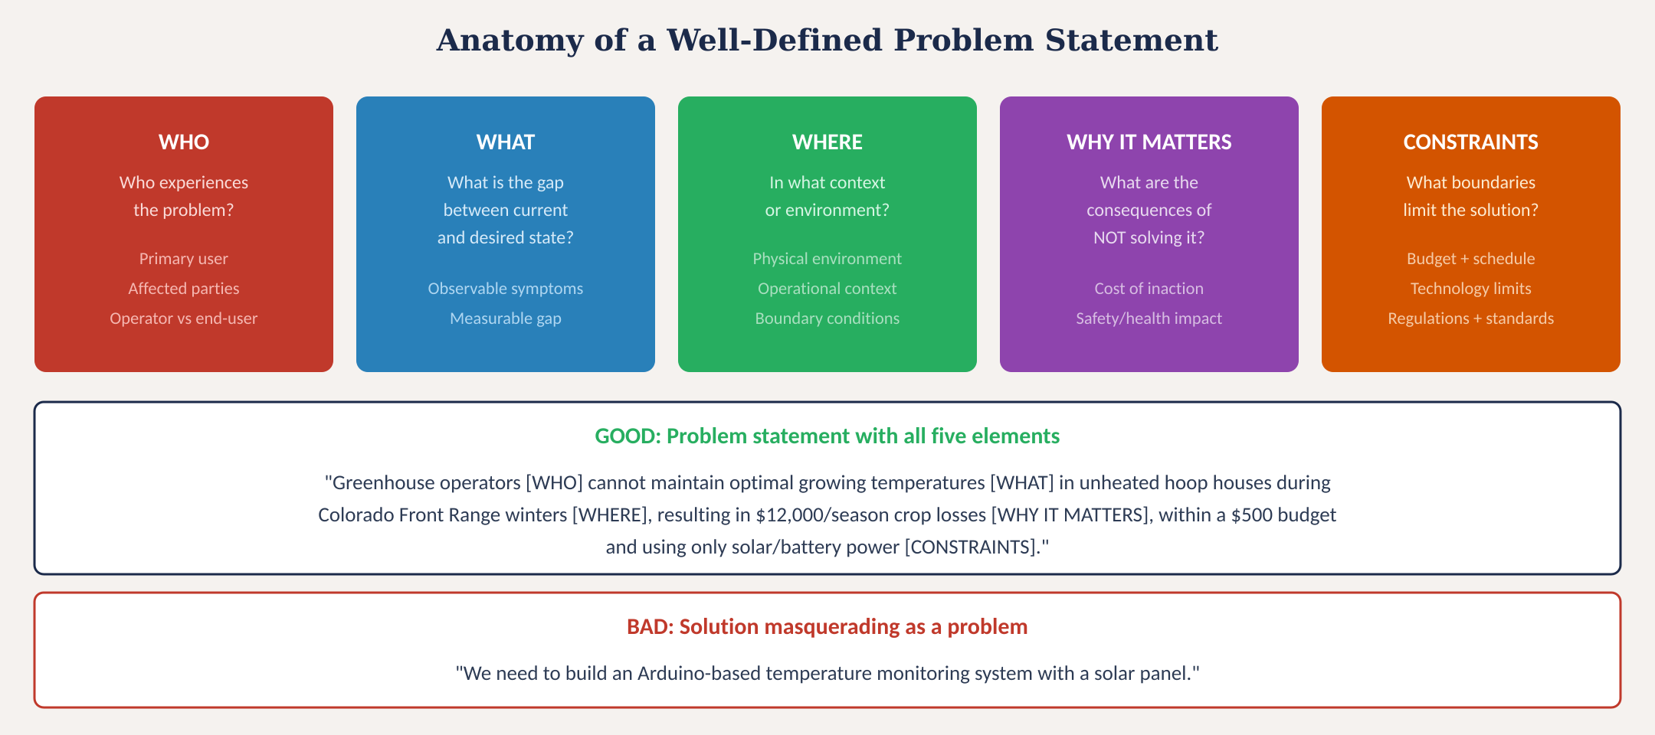
Problem statement anatomy
Fig. 1: Five-element framework with good and bad examples — a solution masquerading as a problem closes the design space prematurely
MINES | MEGN 301 — Mechanical Integration and Design
Notes:
Figure 1 shows the five-element framework with a good example that includes all elements and a bad example that jumps directly to a solution. The good example names the stakeholder, quantifies the gap, specifies the context, states the consequence, and bounds the solution. The bad example specifies Arduino and DHT22 — closing the design space before any analysis.

Slide 7
MINES | MEGN 301
Scope, boundaries, and problem framing
Scope Definition
Scope answers: what is INSIDE the project and what is OUTSIDE? Draw a clear boundary. 'We will design the monitoring and alerting system; we will NOT design the greenhouse structure, heating system, or irrigation.' Without scope, projects expand indefinitely (scope creep).
System Boundary
The system boundary defines what YOU build versus what the ENVIRONMENT provides. Power from the grid is outside your boundary; your power supply is inside. The greenhouse structure is outside; your sensor mounting bracket is inside. Draw this as a context diagram.
Context Diagram
A simple block diagram showing your system as a single box with all external interfaces labeled: power in, data out, user interface, environmental inputs, mechanical mounting. This is the most important diagram at the beginning of any project — it defines what crosses your boundary.
Problem Reframing
If the problem seems too large, reframe by narrowing scope. If too small, expand context. 'Reduce crop losses' is too vague. 'Provide automated frost alerts to greenhouse operators' is well-scoped. The right scope is achievable within your constraints while still meaningful.
MINES | MEGN 301 — Mechanical Integration and Design
Notes:
Scope definition is where you draw the line between what your project will and will not do. Without explicit scope boundaries, projects expand indefinitely — every stakeholder adds 'one more thing' until the project is too large to complete. The system boundary distinguishes your system from the environment. A context diagram captures this visually — your system is a single block, and every arrow crossing the boundary represents an interface you must design, document, and test. This diagram should be the first thing you draw. Problem reframing is the skill of adjusting scope to match your constraints. A problem that is too broad cannot be solved within a semester; a problem that is too narrow may not be meaningful. The sweet spot is a problem that is achievable with your team, budget, and timeline while still delivering real value to the stakeholder.
MARKET ANALYSIS — Before writing your problem statement, conduct a competitive product survey. Identify at least three competing products, document their features, strengths, weaknesses, and price points. Then synthesize: what features are table stakes? What is missing or poorly executed? What do customers complain about? For the Sol-Mate Purification Pal, look at backpacking water filters, UV sterilization pens, and solar pumps. For the Intelligent Workshop Air Scrubber, look at solder fume extractors like Hakko and smart HEPA purifiers. For the Caffeinated Creatures project, look at electric burr grinders like Baratza and Fellow Ode. Focus on why the CUSTOMER will care about the gaps you find.
PATENT SEARCH — Identify two relevant utility patents. Record: (1) filing date (expired after 20 years = public domain), (2) abstract, and (3) claims (the actual protected subject matter, typically at the end). You do not need to read the entire patent. The purpose is to establish freedom to operate: can your design avoid infringing active claims?

Slide 8
02
Stakeholder
engagement
Identification, analysis, elicitation techniques, and managing conflicts
MINES | MEGN 301 — Mechanical Integration and Design
Notes:
Section 2 covers stakeholders — the people whose needs, constraints, and expectations shape your system. A missed stakeholder is a missed set of requirements, which means an integration surprise at the worst possible time.
CUSTOMER DISCOVERY AND THE ENTREPRENEURIAL MINDSET — In MEGN 301, you practice customer discovery using AI-generated personas via Gemini Pro (log in with your Mines email). Interview at least 3 personas. The process develops the KEEN 3 C's:
Curiosity: Ask open-ended questions that reveal unstated needs. 'Tell me about the last time you had this problem' yields far richer insight than 'Would you use a product that does X?'
Connections: Link what you learn across interviews. If three different personas mention the same pain point, that is a strong signal.
Creating Value: Translate insights into requirements that deliver measurable value.
CRITICAL GenAI POLICY BOUNDARY — While this specific assignment requires you to use GenAI for persona interviews, the course's strict academic integrity policy remains in full effect. You may NOT use GenAI to write your SDRD requirements, generate your test plan, compose your FMEA, write your retrospectives, or produce your final report. GenAI is the subject of this interview exercise — it is not your co-author. Any unapproved use is an honor code violation.

Slide 9
MINES | MEGN 301
Identifying stakeholders
A stakeholder is anyone who affects, is affected by, or has an interest in the project outcome. Missing a stakeholder = missing requirements.
Primary Users
People who directly operate or interact with the system. Their workflow, skill level, and environment define usability requirements.
Beneficiaries
People who benefit from the system's output without directly operating it. The greenhouse owner benefits from crop protection even if a farm worker operates the system.
Sponsor / Funder
The person or organization paying for the project. They define budget and schedule constraints and have approval authority over scope changes.
Maintainers
People who service, repair, and upgrade the system after delivery. Their needs drive Design for Serviceability requirements — access panels, diagnostic ports, modular components.
Regulators
Government agencies, standards bodies, and certification authorities. Their requirements are non-negotiable NFRs (FCC, UL, OSHA, ADA).
Adjacent Systems
Systems that interface with yours — data feeds, power sources, communication networks, mechanical mounting structures. Their owners are stakeholders.
Adversaries
People negatively affected — neighbors impacted by noise, competitors, or users of systems being replaced. Their concerns may generate constraints.
MINES | MEGN 301 — Mechanical Integration and Design
Notes:
Seven stakeholder categories to consider systematically. Primary users define usability. Beneficiaries define value. Sponsors define constraints. Maintainers define serviceability. Regulators define compliance. Adjacent systems define interfaces. Adversaries define risks. Students consistently miss maintainers, regulators, and adjacent systems — yet these stakeholders generate critical requirements that surface painfully during integration testing if not captured early.
INSTRUCTOR AS SPONSOR — In MEGN 301, your section instructor acts as the key stakeholder and sponsor. They hold final authority on project-scope decisions when the team cannot resolve a conflict internally. Document all conflict resolutions and the rationale for the final decision.

Slide 10
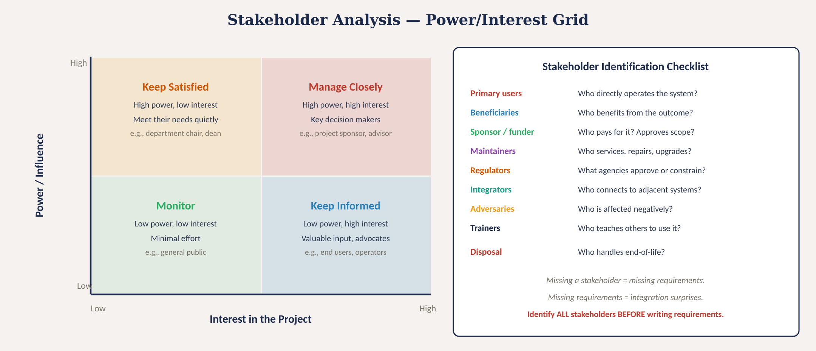
Stakeholder analysis — power/interest grid
Fig. 2: Power/interest grid for classifying stakeholders with engagement strategies and identification checklist
MINES | MEGN 301 — Mechanical Integration and Design
Notes:
Figure 2 shows the power/interest grid. High-power, high-interest stakeholders must be managed closely — they are your key decision makers. High-power, low-interest stakeholders must be kept satisfied — they can block the project if ignored. Low-power, high-interest stakeholders should be kept informed — they are valuable sources of requirements and potential advocates. Low-power, low-interest stakeholders require only monitoring. The checklist on the right systematically prompts for nine stakeholder categories that students commonly miss.

Slide 11
MINES | MEGN 301
Needs elicitation techniques
Use 2-3 techniques. Single-method elicitation misses needs. Interviews + observation + prototyping is the strongest combination.
Interviews
Structured one-on-one conversations with prepared open-ended questions. Best for deep understanding. Prepare 10-15 questions covering current process, pain points, success criteria, and constraints. Record and transcribe. Follow up on surprises.
Observation
Watch users perform their actual tasks in their real environment. Reveals workarounds, undocumented processes, and pain points users do not think to mention. 'People don't do what they say they do.' Shadow for at least one full operational cycle.
Surveys / Questionnaires
Structured questions distributed to many stakeholders. Best for quantifying preferences and priorities across a large group. Use when you have 10+ stakeholders. Include Likert scales for prioritization and open-ended questions for discovery.
Workshops / Focus Groups
Facilitated group sessions. Best for building consensus, resolving conflicting needs, and brainstorming. Use a neutral facilitator. Establish ground rules. Document disagreements — they reveal hidden requirements.
Prototyping
Build quick models — paper mockups, foam models, 3D prints, wireframes — to get tangible feedback. Stakeholders respond better to something they can see and touch than to abstract descriptions. Critical for validating ergonomics, form factor, and UI concepts.
MINES | MEGN 301 — Mechanical Integration and Design
Notes:
Five elicitation techniques, each with different strengths. Interviews provide depth — you can probe, follow up on surprises, and build rapport. Observation reveals actual behavior versus stated behavior — users often do not realize their own workarounds and adaptations until you watch them work. Surveys quantify preferences across large groups. Workshops surface and resolve conflicting needs. Prototyping provides tangible artifacts that elicit concrete feedback instead of abstract opinions. The strongest combination for engineering projects is interviews plus observation plus prototyping: interviews capture stated needs, observation captures unstated needs, and prototyping validates assumptions.

Slide 12
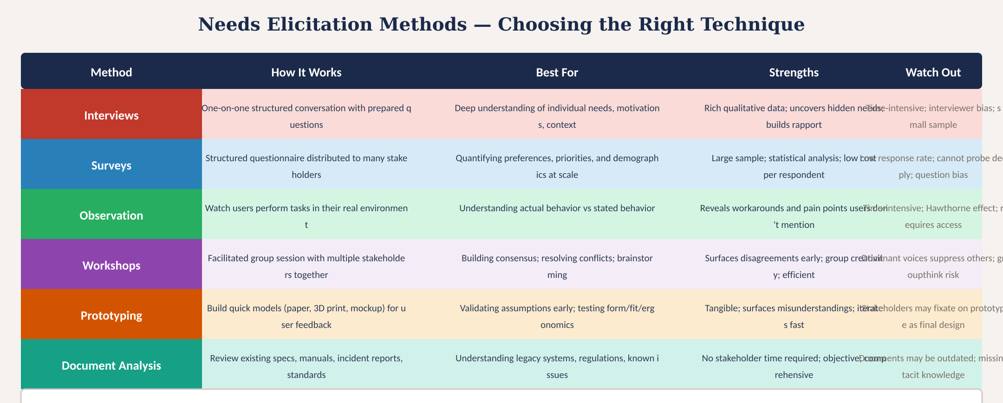
Elicitation methods comparison
Fig. 3: Six elicitation methods with descriptions, best-use cases, strengths, and watch-outs
MINES | MEGN 301 — Mechanical Integration and Design
Notes:
Figure 3 compares six elicitation methods. Note the addition of document analysis — reviewing existing specifications, manuals, incident reports, and standards. This is often overlooked but provides objective data without requiring stakeholder time.

Slide 13
MINES | MEGN 301
Managing conflicting stakeholder needs
Conflicts Are Normal
Different stakeholders have different priorities. The operator wants simplicity; the maintainer wants diagnostic access; the sponsor wants low cost; the regulator wants compliance. These priorities naturally conflict. The engineering team's job is to surface and resolve these conflicts — not to pretend they do not exist.
Needs vs. Wants
Not all stated needs are equal. A NEED is something without which the system fails its mission — it becomes a SHALL requirement. A WANT is something that enhances value but is not essential — it becomes a SHOULD goal that is pursued only if budget and schedule allow. Force-rank needs using MoSCoW: Must, Should, Could, Won't.
Stakeholder Priority
When needs conflict irreconcilably, the sponsor or primary user has final authority — but the decision must be documented with rationale. Record what was decided, who decided it, and why. This prevents revisiting resolved conflicts later.
Design for Compromise
Often a conflict can be resolved through creative design. The operator wants a sealed unit (simplicity); the maintainer wants access panels (serviceability). A sealed unit with a quick-release cover satisfies both — if you surface the conflict early enough to design for it.
MINES | MEGN 301 — Mechanical Integration and Design
Notes:
Conflicting needs are normal and expected. The engineering team's role is to surface these conflicts early — during needs elicitation, not during integration testing — and resolve them through prioritization, design compromise, or stakeholder authority. The MoSCoW framework (Must, Should, Could, Won't) is a practical tool for prioritizing when there are more needs than the budget can accommodate. Must-have needs become SHALL requirements. Should-have needs become SHOULD goals. Could-have needs are pursued only if time and budget allow. Won't-have needs are explicitly excluded — documenting what you will NOT do is just as important as documenting what you will do.

Slide 14
03
From problem
to ConOps
Use cases, operational scenarios, environmental context, and bridging to requirements
MINES | MEGN 301 — Mechanical Integration and Design
Notes:
Section 3 covers the Concept of Operations — the bridge document between stakeholder needs and formal requirements.

Slide 15
MINES | MEGN 301
Concept of operations (ConOps)
The ConOps describes HOW the system will be used from the stakeholder's perspective — before any design work begins.
What It Contains
System mission and purpose. Description of current situation and pain points. Operational scenarios (normal, degraded, emergency, maintenance). User roles and responsibilities. Environmental conditions. Interfaces to external systems. Performance expectations in stakeholder language (not engineering specs).
Use Cases
A use case describes a specific interaction between a user (actor) and the system to achieve a goal. 'The operator receives a frost alert on their phone, views the current temperature, and decides whether to activate the supplemental heater.' Each use case generates functional requirements.
Operational Scenarios
Scenarios extend use cases into narratives: time of day, weather conditions, user state (awake/asleep), system state (normal/degraded). 'At 2:00 AM, temperature drops below 3°C. The system sends an alert. The operator is asleep. The alert must be persistent enough to wake them.' Scenarios reveal requirements that use cases miss.
Why ConOps Before Requirements
The ConOps is written in stakeholder language — no shall-statements, no engineering jargon. It is the document the stakeholder reviews and approves before requirements are written. It confirms that the engineering team understands the problem and the operational context. Misunderstandings caught here cost minutes; caught in requirements, they cost weeks.
MINES | MEGN 301 — Mechanical Integration and Design
Notes:
The Concept of Operations is the bridge between needs and requirements. It describes the system from the stakeholder's perspective — how they will use it, under what conditions, and what they expect to happen. It is deliberately written in non-technical language so the stakeholder can review and approve it. Use cases describe specific user-system interactions. Operational scenarios extend use cases into realistic narratives with environmental context, timing, and system states. Together, they surface requirements that abstract analysis misses — the 2 AM frost alert scenario reveals that the notification must be persistent enough to wake a sleeping operator, which generates a specific requirement for alert modality and duration that might never emerge from a daytime interview.

Slide 16
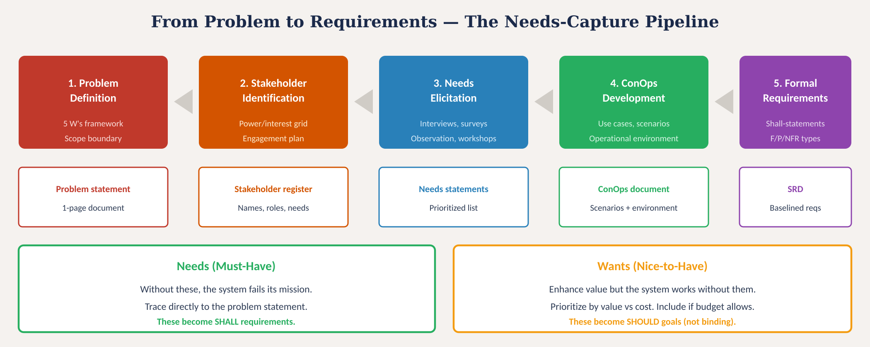
From problem to requirements
Fig. 4: Five-stage needs-capture pipeline with deliverables and needs-vs-wants classification
MINES | MEGN 301 — Mechanical Integration and Design
Notes:
Figure 4 shows the complete pipeline from problem to requirements. Five stages, each producing a specific deliverable. The needs-vs-wants classification at the bottom is critical: needs become SHALL requirements; wants become SHOULD goals.

Slide 17
MINES | MEGN 301
Asking good questions in stakeholder interviews
The quality of your requirements is directly proportional to the quality of your questions.
Open-ended discovery
'Walk me through a typical day in the greenhouse.' 'What is the most frustrating part of temperature management?' 'What happens when it goes wrong?' These questions reveal context, pain points, and unarticulated needs.
Quantifying needs
'What temperature range is critical for your crops?' 'How quickly do you need to respond to a frost event?' 'How often does the current system fail?' These questions generate performance requirements with specific numbers.
Boundary questions
'What would the system absolutely MUST do to be useful?' 'What would make it NOT worth using?' 'What is your budget and timeline?' These questions establish scope and constraints.
Scenario probing
'What happens at 2 AM when the temperature drops?' 'What if the power goes out?' 'What if two alerts happen simultaneously?' These questions uncover edge cases and degraded-mode requirements.
Validation questions
'If I built a system that does X, Y, and Z — would that solve your problem?' 'What am I missing?' 'Is there anything else I should have asked?' These questions catch gaps before you leave the room.
MINES | MEGN 301 — Mechanical Integration and Design
Notes:
Five categories of interview questions. Open-ended discovery questions get the stakeholder talking about their real experience. Quantifying questions extract the specific numbers that become performance requirements. Boundary questions establish what is in scope and what is not. Scenario probing questions uncover edge cases and failure modes. Validation questions check your understanding before you leave the room. Always end an interview with 'what should I have asked that I didn't?' — this single question has saved more projects from missing critical requirements than any structured technique.

Slide 18
04
Practice &
application
Checklists, common pitfalls, and project application
MINES | MEGN 301 — Mechanical Integration and Design
Notes:
Section 4 applies everything with checklists and guidance for your projects.

Slide 19

MINES | MEGN 301
Problem definition checklist
Complete ALL items before writing any requirements.
Problem statement written with all five elements (WHO, WHAT, WHERE, WHY, CONSTRAINTS)?
Problem is solution-agnostic — does not specify technology or implementation?
Scope defined — what is IN and what is OUT?
System boundary drawn — context diagram with all external interfaces?
All stakeholders identified using the nine-category checklist?
Stakeholders classified on power/interest grid with engagement strategy?
At least two elicitation methods used (interviews + one other)?
Needs prioritized: Must-have vs Should-have vs Could-have?
Conflicting needs surfaced and resolved (or escalated to sponsor)?
ConOps written in stakeholder language with use cases and scenarios?
ConOps reviewed and approved by primary stakeholder?
Problem statement and ConOps formally baselined before requirements begin?
MINES | MEGN 301 — Mechanical Integration and Design
Notes:
Twelve-item checklist covering the complete problem definition process. Every item must be completed before requirements writing begins.

Slide 20

MINES | MEGN 301
Common pitfalls to avoid
'Solution as problem' — 'We need to build an Arduino system' is not a problem statement. Back up: what problem does the Arduino solve? Rewrite in the problem space.
'Missing stakeholders' — forgetting the maintainer, the regulator, or the person who installs the system. Every missed stakeholder is a set of missing requirements.
'Stated vs actual needs' — users say 'I need a temperature display' when they actually need a frost alert. Observation reveals what interviews miss.
'Scope creep' — every stakeholder adds 'just one more feature.' Without a baselined scope document, the project expands until it cannot be completed.
'Confirmation bias' — hearing what you expect instead of what stakeholders actually say. Have a second team member take notes. Review transcripts, not memories.
'Skipping ConOps' — jumping directly from interviews to requirements. The ConOps catches misunderstandings before they become expensive specification errors.
MINES | MEGN 301 — Mechanical Integration and Design
Notes:
Six common pitfalls. Solution-as-problem is the most frequent. Missing stakeholders generates the most expensive downstream rework. Stated versus actual needs is caught by observation. Scope creep is prevented by baselining. Confirmation bias requires deliberate mitigation. Skipping the ConOps creates a gap between what you think you heard and what you actually write in requirements.

Slide 21
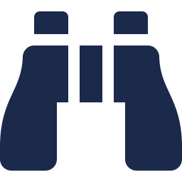

MINES | MEGN 301
Practical tips
Write the problem statement in week 1 — before anything else. Revise it after stakeholder interviews. Baseline it at PDR. Everything flows from this document.
Interview at least 3 stakeholders individually before any group session. Individual interviews surface honest opinions; group sessions surface consensus.
Spend at least 2 hours observing the user in their actual environment. You will discover at least 3 needs that never came up in interviews.
End every interview with: 'What should I have asked that I didn't?' This single question catches more missing requirements than any structured technique.
Write a 1-2 page ConOps in plain language. Have the stakeholder read it and mark anything that does not match their understanding. Fix it before writing requirements.
Document everything: interview notes, observation photos, survey results, workshop outcomes. This evidence justifies your requirements when reviewers ask 'where did this come from?'
MINES | MEGN 301 — Mechanical Integration and Design
Notes:
Six practical tips. Write the problem statement first. Interview individuals before groups. Observe users in their real environment. End every interview with the gap-catching question. Write a plain-language ConOps for stakeholder review. Document all evidence.

Slide 22
MINES | MEGN 301
Applying in your projects
1
Week 1: Write initial problem statement (5 elements). Identify initial stakeholder list using the 9-category checklist.
2
Week 1-2: Conduct 3+ individual stakeholder interviews using the 5-question-category framework. Record and transcribe.
3
Week 2: If possible, observe the user in their operational environment for 2+ hours. Document pain points and workarounds.
4
Week 2-3: Classify stakeholders on power/interest grid. Develop engagement plan. Resolve any conflicting needs.
5
Week 3: Write 1-2 page ConOps with use cases and operational scenarios. Have primary stakeholder review and approve.
6
Week 3-4: Revise problem statement and ConOps based on feedback. Baseline both documents. Begin formal requirements.
MINES | MEGN 301 — Mechanical Integration and Design
Notes:
A practical 3-4 week workflow for the problem definition phase of your project.

Slide 23
MINES | MEGN 301
Key takeaways
(1)
A problem statement defines the gap between current and desired states using five elements: WHO, WHAT, WHERE, WHY IT MATTERS, CONSTRAINTS. It must be solution-agnostic.
(2)
Stakeholders are everyone who affects or is affected by the project. Use the 9-category checklist and power/interest grid. Missing a stakeholder = missing requirements.
(3)
Use 2-3 elicitation methods. Interviews capture stated needs; observation captures unstated needs; prototyping validates assumptions. Always ask 'what should I have asked?'
(4)
Needs (must-have) become SHALL requirements. Wants (nice-to-have) become SHOULD goals. Separate them early using MoSCoW prioritization.
(5)
The ConOps bridges stakeholder needs to formal requirements. Write it in plain language, have the stakeholder approve it, then baseline it before requirements begin.
References: [1] INCOSE SE Handbook, 4th ed., 2015. [2] Kotonya & Sommerville, Requirements Engineering, Wiley, 1998. [3] Robertson & Robertson, Mastering the Requirements Process, 3rd ed., 2012. [4] Nuseibeh & Easterbrook, Requirements Engineering: A Roadmap, ICSE 2000.
MINES | MEGN 301 — Mechanical Integration and Design
Notes:
Five key takeaways for problem definition and stakeholder engagement.

Slide 24
Problem Definition &
Stakeholder Engagement
"A problem well-defined is a problem half-solved."
— Charles Kettering
Spend the time upfront. Understand the problem.
Talk to the stakeholders. Watch them work.
Then — and only then — start engineering.
MINES | MEGN 301 — Mechanical Integration and Design
Notes:
Closing slide. The Kettering quote captures the central message: the time invested in problem definition and stakeholder engagement is the highest-leverage activity in any engineering project.

