Slide 1
MINES | MEGN 301 — Mechanical Integration and Design
Systems Engineering Foundations
Writing Requirements
& Defining Architecture
REQUIREMENTS HIERARCHIES, FUNCTIONAL DECOMPOSITION, AND TRADE STUDIES
Notes:
Welcome to the Requirements and Architecture module for MEGN 301. This module covers the front end of the systems engineering process — the work you do before you start designing hardware. Requirements define WHAT your system must do. Architecture defines HOW it will be organized to do it. Getting these right is the single highest-leverage activity in engineering — a requirement error caught in the requirements phase costs one unit to fix; the same error caught during integration testing costs 100 to 1,000 times more. We will cover how to write good requirements, the three requirement types, hierarchical decomposition, functional analysis, trade studies with decision matrices, and how to let function drive design rather than jumping to physical solutions.
ALIGNMENT NOTE — This module corresponds to Chapter 2 of your Master Reference Document and supports Sprint 1 (SDRD) and Sprint 2 (PDR) deliverables. The V-Model places this content on the middle-left: system requirements and architecture. Your SDRD uses a three-level hierarchy: Goal → Objectives → Requirements.
BOTTOM LINE: Transform stakeholder needs into numbered, testable SHALL statements organized in an RTM. Then decompose those requirements into functions before choosing components. Your SDRD and architecture block diagram define your project's scope — everything downstream flows from them.
FINAL NOTES — Key updates in the final compiled document: (1) RTM Discipline reframed as 'Your Central Nervous System' — a professional aspiration rather than a warning. (2) Compound requirement warning expanded with full traceability nightmare example (measure AND display → two TAID methods → untestable at FDR). (3) RSS error budget example retained in practice questions with worked solution. (4) Environmental/regulatory constraints section strengthened. (5) Glossary defines all key terms: SDRD, RTM, ICD, NFR, TAID.

Slide 2






MINES | MEGN 301
Learning outcomes
Write well-formed requirements using shall-statements with measurable acceptance criteria
Distinguish between functional, performance, and non-functional requirements and explain how they relate
Build a requirements hierarchy from stakeholder needs through system, subsystem, and component levels with full traceability
Perform functional decomposition to let function drive design before committing to physical implementation
Conduct trade studies using Pugh matrices and weighted decision matrices to make traceable, defensible design decisions
Map the complete requirements-to-architecture flow and produce the key deliverables at each stage
MINES | MEGN 301 — Mechanical Integration and Design
Notes:
Six learning outcomes for this module. First, write requirements that are specific, measurable, achievable, relevant, and testable — using the standard shall-statement format with quantitative acceptance criteria. Second, distinguish between functional requirements that define what the system does, performance requirements that define how well it does it, and non-functional requirements that constrain how it must be built. Third, build a requirements hierarchy that traces from stakeholder needs down through system-level requirements to subsystem and component specifications, with every child requirement traceable to a parent. Fourth, perform functional decomposition — breaking the system mission into progressively smaller functions — before assigning functions to physical components. Fifth, conduct trade studies using Pugh matrices for screening and weighted decision matrices for final selection, producing documented, defensible decisions. Sixth, understand the complete flow from stakeholder needs through requirements, functional decomposition, trade studies, and architecture definition.

Slide 3
01
Writing
requirements
Shall-statements, requirement types, hierarchies, and traceability
MINES | MEGN 301 — Mechanical Integration and Design
Notes:
Section 1 covers the fundamentals of writing requirements — the formal statements that define what your system must do and how well it must do it. Requirements are the contract between the design team and the stakeholder. If a requirement is ambiguous, untestable, or missing, the system will fail — not because the engineering is bad, but because nobody agreed on what success looks like.

Slide 4
MINES | MEGN 301
What is a requirement?
Definition
A requirement is a formal statement of a capability or constraint that the system must satisfy. It is the foundation of the engineering contract — if the requirement is met and verified, the system is accepted. If it is not met, the system fails, regardless of how elegant the engineering is.
The Shall Statement
Every requirement uses the word 'shall' to indicate mandatory compliance. 'The system SHALL measure ambient temperature.' 'Should' and 'will' are non-binding and must never appear in requirements. 'Shall' means: this is not optional; if this is not met, the system does not pass.
Anatomy of a Good Requirement
A well-formed requirement has: (1) a unique ID for traceability (SYS-REQ-042), (2) a single shall-statement (one testable condition per requirement), (3) a measurable acceptance criterion with units and tolerance, (4) a rationale explaining WHY it exists, and (5) a verification method (test, analysis, inspection, or demonstration).
Common Failures
Bad requirements are vague ('shall be fast'), compound ('shall measure and display'), untestable ('shall be user-friendly'), or gold-plated (specifying implementation: 'shall use an Arduino'). Each failure mode produces rework downstream.
MINES | MEGN 301 — Mechanical Integration and Design
Notes:
A requirement is a formal, testable statement of what the system must do. It is not a wish, a goal, or a design idea — it is a binding contract. The shall-statement is the standard format used across aerospace, defense, automotive, and medical industries. The word 'shall' is legally and contractually significant — it means mandatory. 'Should' means desirable but not required. 'Will' describes expected behavior but is not a binding commitment. In MEGN 301, use 'shall' for all requirements. A well-formed requirement has five elements. A unique identifier like SYS-REQ-042 that enables traceability — you can trace from any test result back to the specific requirement it verifies. A single shall-statement containing exactly one testable condition — compound requirements that combine multiple conditions with 'and' are untestable because a partial pass is ambiguous. A measurable acceptance criterion with specific numbers, units, and tolerances — 'accurate' is not measurable; 'within plus or minus 0.5 degrees Celsius' is. A rationale explaining why the requirement exists — this prevents requirements from surviving after their justification has changed. And a verification method specifying how compliance will be demonstrated. The four common failure modes are vagueness, compounding, untestability, and implementation prescription. Each one causes downstream rework that costs orders of magnitude more than getting the requirement right in the first place.
THE SDRD FORMAT — In MEGN 301, your requirements are captured in a System Design Requirements Document (SDRD) with three levels:
Level 1 — Goal Statement: One or two sentences capturing the system's mission and purpose. Solution-agnostic.
Level 2 — Objectives: Qualitative statements of what the design needs to do to achieve the goal. Complete, clear, spanning the entire system function.
Level 3 — Design Requirements: Quantitative, measurable, testable SHALL statements organized under their parent objective.
This Goal → Objectives → Requirements hierarchy maps to the SE hierarchy: Goal = mission (ConOps), Objectives = stakeholder needs, Requirements = formal SHALL statements with verification methods.
COMPOUND REQUIREMENT EXPANDED — 'The system shall measure and display ambient temperature' looks innocent but creates a traceability nightmare. If the sensor works but the display is broken, does the requirement PASS or FAIL? You cannot assign a single TAID method because measuring requires Test while displaying requires Inspection. Split it into two requirements. One compound requirement in the SDRD can cascade into untestable verification at FDR.

Slide 5
MINES | MEGN 301
Functional, performance, and non-functional requirements
Functional Requirements
Performance Requirements
Non-Functional Requirements
What the system SHALL DO
Define the capabilities, behaviors, and transformations the system performs.
Examples:
• 'The system shall measure ambient temperature.'
• 'The system shall transmit data to a base station.'
• 'The system shall alert the operator when pressure exceeds the setpoint.'
Functional requirements describe actions — sense, compute, transmit, actuate, store, display.
Every function in the functional decomposition generates at least one functional requirement.
How WELL it shall do it
Quantify the quality, speed, accuracy, range, and capacity of each function.
Examples:
• '...with accuracy of ±0.5°C over -20 to 60°C range.'
• '...at a data rate of ≥1 Hz.'
• '...within 500 ms of event detection.'
Performance requirements are always numeric with units and tolerance. They make functional requirements testable.
A functional requirement without a paired performance requirement is incomplete.
Constraints on HOW it is built
Define constraints, standards, environmental conditions, and qualities.
Categories:
• Environmental: 'Shall operate at -20 to 60°C.'
• Reliability: 'Shall operate for ≥1000 hrs MTBF.'
• Regulatory: 'Shall comply with FCC Part 15.'
• Material: 'Shall use only RoHS-compliant components.'
• Interface: 'Shall communicate via CAN 2.0B.'
NFRs constrain the solution space — they limit your design choices.
Often come from standards, regulations, or organizational policy.
MINES | MEGN 301 — Mechanical Integration and Design
Notes:
Three requirement types work together. Functional requirements define WHAT the system does — the verbs. Performance requirements define HOW WELL it does it — the numbers. Non-functional requirements constrain HOW it must be built — the boundaries. A complete system specification has all three types. A functional requirement without a performance requirement is incomplete because you cannot test it. 'The system shall measure temperature' — to what accuracy? Over what range? At what update rate? The performance requirement provides the acceptance criteria. Non-functional requirements are often overlooked by students but are critical. They come from the operating environment (temperature, humidity, vibration), from regulations and standards (FCC, UL, RoHS), from organizational policy (preferred vendor lists, design standards), and from interface requirements with other systems. NFRs constrain your design space — they eliminate options that might otherwise be attractive. For example, 'shall comply with UL94 V-0 flammability' eliminates most commodity plastics and forces you toward more expensive flame-retardant grades.

Slide 6
MINES | MEGN 301
Requirements hierarchy and traceability
Top-Down Decomposition
Requirements flow top-down: stakeholder needs → system requirements → subsystem requirements → component specifications. Each level adds detail and specificity. A system requirement like 'shall measure temperature to ±0.5°C' decomposes into subsystem requirements for the sensor, ADC, calibration algorithm, and display.
Traceability
Every child requirement must trace to a parent. This means you can follow any component specification upward to the system requirement it supports and ultimately to the stakeholder need it addresses. An 'orphan' requirement — one with no parent — has no justification and should be questioned or removed.
Bidirectional Traceability
Trace forward (parent → children) to verify completeness — every system requirement is decomposed. Trace backward (child → parent) to verify justification — every specification has a reason. Use a requirements traceability matrix (RTM) to track these relationships.
Derived Requirements
Sometimes decomposition reveals requirements not explicitly stated by the stakeholder. A power system requirement may derive from a sensor accuracy requirement (the ADC needs clean power). Derived requirements must still be traced to their origin and justified in the rationale field.
MINES | MEGN 301 — Mechanical Integration and Design
Notes:
Requirements hierarchies are how large systems manage complexity. You cannot write 500 component specifications directly from stakeholder needs — the gap is too large. Instead, you decompose in layers. The stakeholder says 'I need to monitor environmental conditions in my greenhouse.' The system requirement says 'The system shall measure ambient temperature.' The subsystem requirement says 'The sensor module shall output a calibrated temperature signal with ±0.5°C accuracy.' The component specification says 'The sensor shall be a Pt100 RTD with Class A tolerance per IEC 60751.' Each layer adds specificity while maintaining traceability upward to the original need. Traceability is the mechanism that holds the hierarchy together. Forward traceability asks: is every system requirement fully decomposed into subsystem requirements? If a system requirement has no children, it means nobody is responsible for implementing it. Backward traceability asks: does every component specification trace to a justified need? If a specification is an orphan — it has no parent requirement — it is either unnecessary work or a missing parent that needs to be identified. The requirements traceability matrix is a table that maps these relationships and is a core deliverable at every design review. Derived requirements are requirements discovered during decomposition that the stakeholder did not explicitly state. They are real requirements that must be documented and traced.
THE REQUIREMENTS TRACEABILITY MATRIX (RTM) — The RTM is the bookkeeping tool that implements bidirectional traceability. It links every requirement to its parent need, child allocations, verification method, and current status. Start maintaining it the day you write your first requirement.
Minimum RTM columns: Req ID | Parent | Requirement Text | Type (F/P/NFR) | V-Method (T/A/I/D) | Status
The RTM evolves: before PDR, Status is mostly 'Open.' By CDR, subsystem requirements should be allocated. By FDR, every row should show Verified, Waived, or Deferred. The RTM is the single artifact that tells the complete project story at any point.

Slide 7
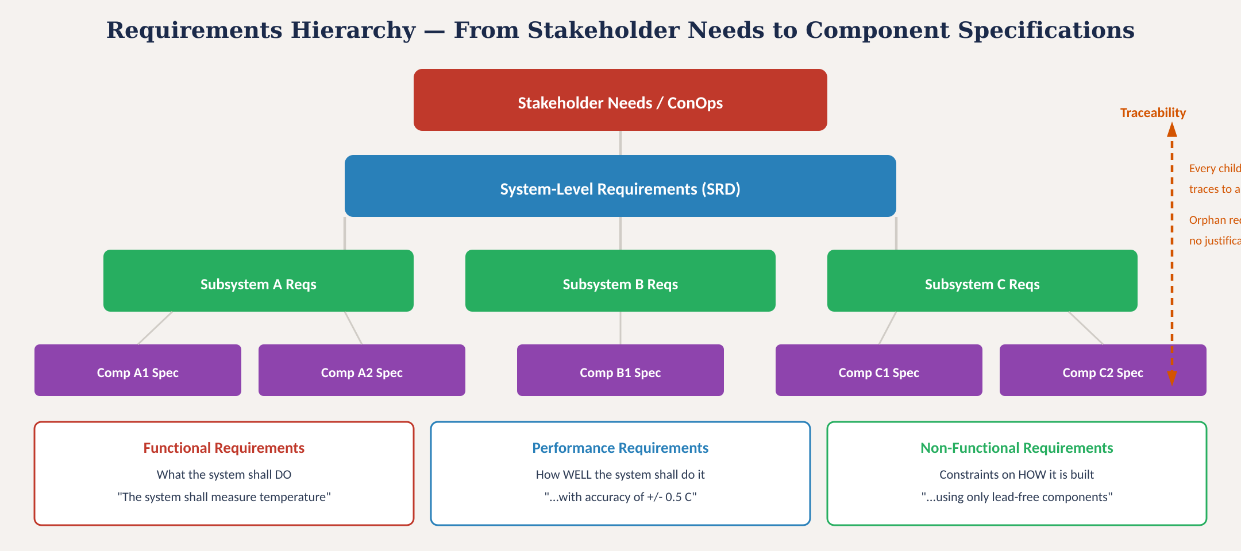
Requirements hierarchy
Fig. 1: Requirements flow from stakeholder needs through system, subsystem, and component levels with traceability and three requirement types
MINES | MEGN 301 — Mechanical Integration and Design
Notes:
Figure 1 shows the requirements hierarchy from stakeholder needs at the top through system requirements, subsystem requirements, and component specifications at the bottom. The traceability column on the right emphasizes that every child requirement must trace to a parent — orphan requirements have no justification. The bottom row shows the three requirement types: functional requirements defining what the system does, performance requirements quantifying how well it does it, and non-functional requirements constraining how it must be built. All three types exist at every level of the hierarchy.

Slide 8
MINES | MEGN 301
How to write good requirements
Good: 'SYS-REQ-003: The system shall measure ambient temperature with accuracy of ±0.5°C over the range -20°C to +60°C at an update rate of ≥1 Hz.'
Bad: 'The system shall accurately measure temperature quickly.'
One shall per requirement
Compound requirements are untestable. 'Shall measure AND display' — what if it measures correctly but the display is wrong? Split into two requirements.
Quantitative criteria
Every performance claim needs a number with units and tolerance. 'Fast' is not a requirement. '< 500 ms response time' is a requirement.
Testable as written
If you cannot write a test procedure for it, it is not a requirement. 'Shall be easy to use' — how do you test that? 'Shall be operable by a trained user within 30 seconds of instruction' — that is testable.
Implementation-free
Requirements define WHAT, not HOW. 'Shall use an Arduino Mega' is a design decision, not a requirement. 'Shall have ≥12 analog input channels' is a requirement that an Arduino Mega happens to satisfy.
Include rationale
Every requirement needs a WHY. Rationale prevents zombie requirements that persist after their justification disappears. 'Rationale: greenhouse plants suffer tissue damage above 40°C; ±0.5°C provides adequate margin.'
MINES | MEGN 301 — Mechanical Integration and Design
Notes:
Five rules for writing good requirements. One shall per requirement prevents ambiguity in testing — if a compound requirement partially passes, the result is undefined. One requirement, one test, one pass/fail verdict. Quantitative criteria mean every performance claim has a number with units and tolerance. This is what makes a requirement testable rather than aspirational. Testable as written means you can envision the test procedure from reading the requirement. If you cannot, the requirement is too vague. Implementation-free means requirements describe the problem, not the solution. Specifying an Arduino is a design decision that belongs in the architecture, not in the requirements. Specifying the number of analog inputs is a requirement that constrains the architecture. Including rationale is often overlooked but critically important. Requirements have a tendency to persist long after their original justification has changed. The rationale field allows future engineers to evaluate whether the requirement is still valid when circumstances change.

Slide 9
02
Defining
architecture
Functional decomposition, interface definition, and letting function drive design
MINES | MEGN 301 — Mechanical Integration and Design
Notes:
Section 2 covers architecture — how you organize your system to satisfy the requirements. The key principle is function-driven design: define what the system must do before deciding how to build it. Functions are stable; implementations change. By decomposing the system into functions first, you create flexibility to explore multiple physical implementations through trade studies.

Slide 10
MINES | MEGN 301
Functional decomposition
Define WHAT the system must do (functions) before deciding HOW to do it (physical components).
What Is It?
Breaking the system's mission into progressively smaller functions until each function can be allocated to a single component or module. The result is a function tree: top-level mission → primary functions → sub-functions → leaf functions that map directly to requirements.
Why Functions First?
Functions are stable across implementations. 'Sense temperature' is the same function whether you use a thermocouple, RTD, or thermistor. By decomposing functionally first, you separate the problem space (what) from the solution space (how), enabling trade studies to objectively compare physical options.
How to Decompose
Start with the system mission. Ask: 'What functions must the system perform to accomplish its mission?' List them. For each function, ask: 'What sub-functions compose this function?' Repeat until each leaf function can be assigned to a single physical element. Use verb-noun naming: Sense Temperature, Process Data, Transmit Report, Provide Power.
MINES | MEGN 301 — Mechanical Integration and Design
Notes:
Functional decomposition is the bridge between requirements and architecture. It answers the question: what functions must the system perform to satisfy the requirements? You start with the system mission and progressively break it down into smaller functions until each leaf function can be allocated to a physical component. The key principle is to resist the urge to jump to physical solutions. Students naturally think in hardware — 'we need a temperature sensor' — rather than functions — 'we need to sense temperature.' The difference matters because the functional statement opens the design space to all possible implementations, while the hardware statement closes it prematurely. By decomposing functionally first, you create a clean structure for trade studies. Each function becomes a decision point: what is the best way to implement this function given our requirements and constraints? This is where trade studies with decision matrices generate objective, traceable selections. Use verb-noun naming for all functions: Sense Temperature, Process Data, Transmit Report, Store Configuration, Provide Power. This discipline keeps the decomposition in the functional domain rather than drifting into the physical domain.
ENVIRONMENTAL AND REGULATORY CONSTRAINTS — Environmental requirements define operating conditions (temperature range, humidity, vibration, IP ratings, UV exposure). Regulatory requirements are non-negotiable (UL, FCC Part 15, RoHS). Each generates at least one requirement with specific standard references.
'The system shall work outdoors' is NOT a requirement. 'The system shall operate continuously at ambient temperatures from -20 to +60°C with relative humidity up to 95% non-condensing' IS a requirement — and it is testable.

Slide 11
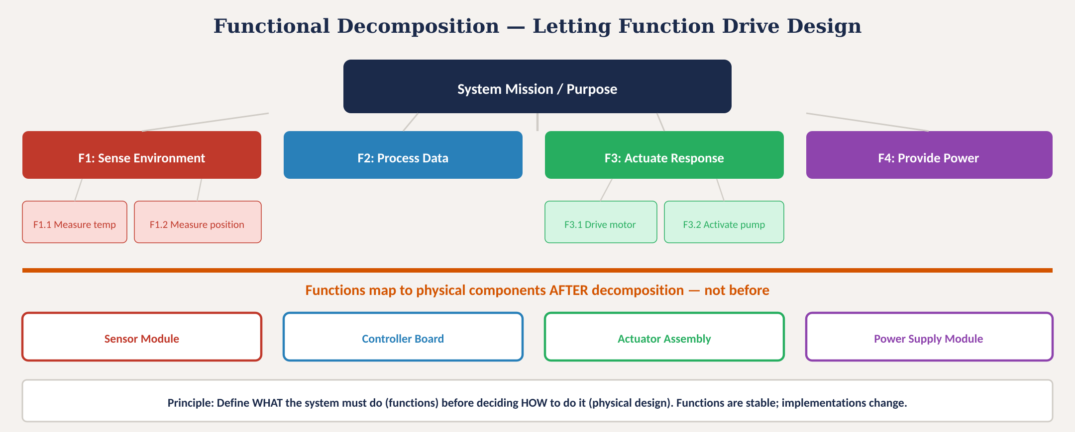
Functional decomposition — function drives design
Fig. 2: Functions decomposed from mission, then mapped to physical components — define WHAT before HOW
MINES | MEGN 301 — Mechanical Integration and Design
Notes:
Figure 2 illustrates functional decomposition. The system mission at the top decomposes into four primary functions: Sense Environment, Process Data, Actuate Response, and Provide Power. Each primary function further decomposes into sub-functions — Sense Environment splits into Measure Temperature and Measure Position; Actuate Response splits into Drive Motor and Activate Pump. The orange line in the middle represents the critical boundary: above the line is the functional domain (what), below is the physical domain (how). Functions map to physical components only after decomposition is complete. The Sense Environment function maps to a Sensor Module; Process Data maps to a Controller Board; Actuate Response maps to an Actuator Assembly; Provide Power maps to a Power Supply Module. The principle at the bottom reinforces: define what the system must do before deciding how to do it. Functions are stable; implementations change.

Slide 12
MINES | MEGN 301
Interface definition and architecture patterns
Interface Control Documents
Once functions are allocated to physical modules, define the interfaces between them. An ICD specifies: what crosses the interface (signals, power, data, fluid, mechanical loads), in what format (voltage levels, protocols, connector types), and with what constraints (bandwidth, latency, impedance). ICDs prevent integration surprises.
Architecture Patterns
Centralized: one controller manages everything — simple but single point of failure. Distributed: multiple controllers communicate via a bus (CAN, I²C, SPI) — more robust and scalable. Hierarchical: layered control with supervisory and local controllers. Choose based on reliability, complexity, and communication needs.
Block Diagrams
The system architecture is captured in a block diagram showing every module, every interface, and every external connection. This is the single most important artifact at PDR. It answers: what are the pieces, how do they connect, and where are the boundaries? Every wire, every signal, every data flow must appear.
Design for Integration
Define integration sequence early: which modules can be tested independently? What is the order of assembly? What test equipment is needed at each stage? Architecture decisions that enable parallel development and independent testing reduce schedule risk dramatically.
MINES | MEGN 301 — Mechanical Integration and Design
Notes:
Once you have allocated functions to physical modules, the next critical step is defining the interfaces between them. This is where most integration problems originate — two teams design modules independently, assume different things about the interface, and discover the mismatch during integration when it is expensive to fix. Interface Control Documents specify exactly what crosses each boundary: signal types and voltage levels, communication protocols and data formats, power rails and current limits, mechanical mounting and thermal paths. The architecture pattern you choose — centralized, distributed, or hierarchical — affects reliability, development parallelism, and communication complexity. For student projects, a centralized architecture with one microcontroller is usually appropriate. For larger systems, a distributed architecture with a communication bus allows teams to develop and test modules independently. The system block diagram is the primary architecture artifact. It shows every module, every interface, every external connection, and every power rail. It is the first thing reviewers look at during PDR. A good block diagram lets any engineer on the team understand the complete system in under two minutes.

Slide 13
03
Trade studies &
decision making
Pugh matrices, weighted decision matrices, and traceable decisions
MINES | MEGN 301 — Mechanical Integration and Design
Notes:
Section 3 covers trade studies — the systematic process for making design decisions. Every time the functional decomposition identifies a function that can be implemented in multiple ways, a trade study evaluates the options and selects the best one. The key word is systematic — gut feelings and default choices are not engineering decisions. A trade study produces a documented, traceable, defensible selection that can be reviewed and challenged.

Slide 14
MINES | MEGN 301
The trade study process
1. Define the Decision
State explicitly what you are choosing: 'Select the motor type for the drive subsystem.' Define the evaluation criteria derived from your requirements and constraints. Weight criteria by importance (sum to 1.0).
2. Identify Candidates
Research 3-5 viable options. Do not include a straw-man option that obviously fails — it wastes time and undermines credibility. Each option must be a plausible implementation.
3. Evaluate Objectively
Rate each option against each criterion on a consistent scale (1-5 or 1-10). Use data from datasheets, analysis, prototyping, or expert judgment — not preference. Document the evidence for each rating.
4. Score and Select
Multiply each raw rating by the criterion weight. Sum the weighted scores. The highest total wins — but examine sensitivity: if changing one weight by ±0.05 changes the winner, the decision is fragile and needs more analysis.
5. Document and Defend
Record the decision matrix, all data sources, the rationale for each weight, and any dissenting opinions. This becomes a permanent project record reviewed at PDR/CDR. A good trade study can be understood and challenged by anyone.
MINES | MEGN 301 — Mechanical Integration and Design
Notes:
Five steps for a rigorous trade study. Step 1: explicitly state the decision and define evaluation criteria from your requirements. Weight the criteria by importance — this forces the team to agree on what matters most before evaluating options. Weights must sum to 1.0. Step 2: identify 3 to 5 viable candidates through research. Every option should be a plausible choice — including obviously bad options wastes time and makes the study look rigged. Step 3: rate each option against each criterion using a consistent scale and data-driven evidence. This is where datasheets, analysis, prototyping, and expert consultation come in. Avoid preference bias — the ratings should be defensible to a skeptical reviewer. Step 4: compute weighted scores and identify the winner. Then do a sensitivity check: vary each weight by plus or minus 0.05 and see if the winner changes. If it does, the decision is sensitive to that criterion and needs more analysis or a tighter weight. Step 5: document everything. The trade study report is a permanent project record that will be reviewed at design reviews. It must be complete enough that someone who was not in the room can understand the decision and evaluate whether it was sound.

Slide 15
MINES | MEGN 301
Pugh matrix vs. weighted decision matrix
Pugh Matrix (Screening)
Weighted Decision Matrix
Purpose: Quickly screen a large number of options down to 2-3 finalists.
Method: Choose one option as the 'datum' (baseline). Rate every other option against the datum for each criterion: better (+), same (S), or worse (-).
Sum the pluses and minuses. Options with net positive scores advance; net negative are eliminated.
Advantages:
• Fast — no numerical ratings needed
• Forces comparison against a known baseline
• Good for early-stage screening of 5-10 options
Limitations:
• Does not weight criteria
• Cannot differentiate 'slightly better' from 'much better'
• Best as a first pass before a weighted matrix
Purpose: Make a rigorous, quantitative final selection from 2-4 finalists.
Method: Define criteria with numerical weights (sum to 1.0). Rate each option on a 1-5 scale. Multiply raw × weight. Sum weighted scores.
Advantages:
• Weights capture stakeholder priorities
• Quantitative — enables sensitivity analysis
• Fully traceable and defensible
• The standard tool for CDR-level decisions
Limitations:
• Requires effort to set weights and rate options
• Garbage-in, garbage-out — ratings must be data-driven
• Weight selection can be contentious
Best practice: Use Pugh to screen → Weighted matrix to select. Two-stage process gives the best results.
MINES | MEGN 301 — Mechanical Integration and Design
Notes:
Two complementary trade study tools. The Pugh matrix is a fast screening tool for narrowing a large number of options. You choose one option as the datum — typically the current baseline or the most obvious choice — and rate every other option as better, same, or worse relative to the datum for each criterion. Options with net positive scores advance to the next round. The Pugh matrix is intentionally crude — it does not weight criteria or quantify how much better one option is — because its purpose is to eliminate clearly inferior options quickly. The weighted decision matrix is the rigorous final-selection tool. Criteria have explicit numerical weights that reflect stakeholder priorities. Options are rated on a numerical scale with documented evidence for each rating. The mathematics of weighted scoring produce a clear winner and enable sensitivity analysis — you can test whether the result changes if you adjust weights slightly, which reveals fragile decisions that need more investigation. Best practice is a two-stage process: use a Pugh matrix to screen 5 to 10 initial options down to 2 to 4 finalists, then use a weighted decision matrix to make the final selection. This combines the speed of Pugh with the rigor of the weighted matrix.

Slide 16
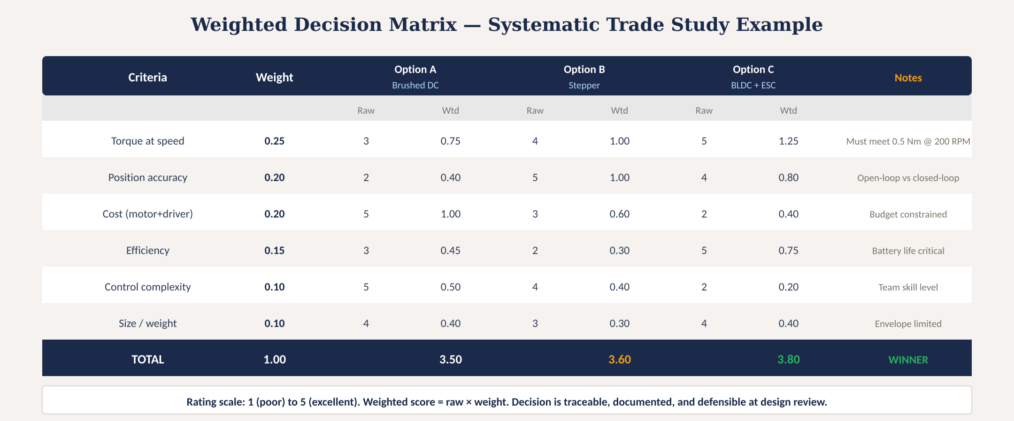
Weighted decision matrix — worked example
Fig. 3: Motor selection trade study — six weighted criteria, three options, with BLDC winning at 3.80 vs stepper at 3.60
MINES | MEGN 301 — Mechanical Integration and Design
Notes:
Figure 3 shows a complete weighted decision matrix for selecting a motor type. Six criteria are weighted by importance: torque at speed and position accuracy each at 0.20-0.25, cost at 0.20, efficiency at 0.15, and control complexity and size at 0.10 each. Three options are evaluated: brushed DC, stepper, and BLDC with ESC. Each option receives a raw rating of 1 to 5 for each criterion, then the weighted score is computed. BLDC wins with 3.80 total, beating stepper at 3.60 and brushed DC at 3.50. The margin between BLDC and stepper is only 0.20, which means this decision is somewhat sensitive — a small change in weights could change the winner. This would prompt further investigation, perhaps prototyping both options. The notes column documents the rationale for each criterion weight. The bottom row emphasizes that the decision is traceable, documented, and defensible at design review.

Slide 17
04
Design flow &
practice
Complete requirements-to-architecture workflow and project application
MINES | MEGN 301 — Mechanical Integration and Design
Notes:
Section 4 ties everything together with the complete requirements-to-architecture flow and practical guidance for applying these concepts in your projects.

Slide 18
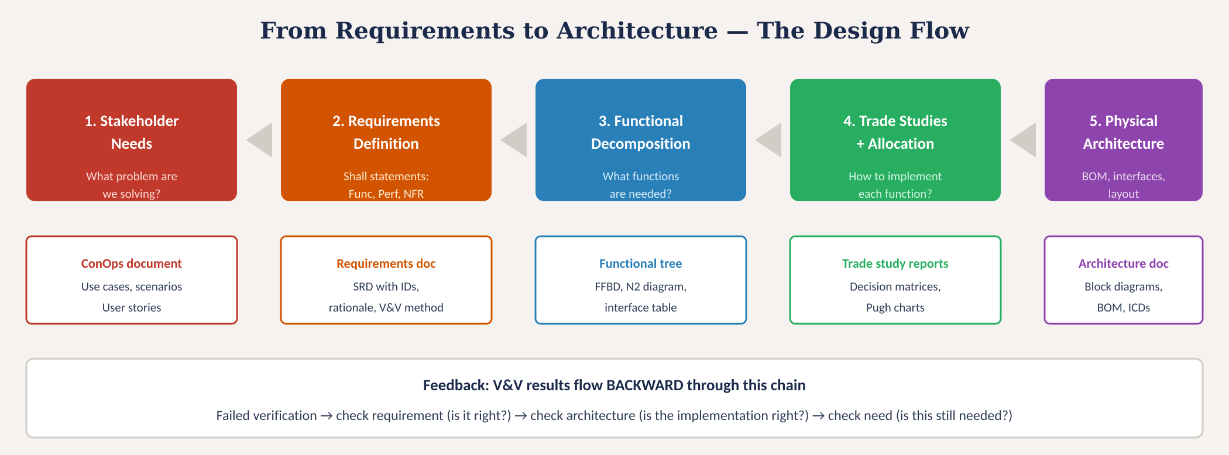
From requirements to architecture
Fig. 4: Five-stage design flow from stakeholder needs through architecture with key deliverables and V&V feedback loop
MINES | MEGN 301 — Mechanical Integration and Design
Notes:
Figure 4 shows the complete five-stage design flow. Stage 1: capture stakeholder needs through interviews, use cases, and concept of operations documents. Stage 2: translate needs into formal shall-statement requirements with IDs, criteria, rationale, and verification methods. Stage 3: decompose requirements into functions using a function tree. Stage 4: conduct trade studies to select physical implementations for each function, then allocate functions to components. Stage 5: define the physical architecture with block diagrams, interface control documents, and a bill of materials. Each stage has a key deliverable. The bottom row shows the V&V feedback loop: when verification fails, trace backward through the chain. Is the test wrong? Is the requirement wrong? Is the architecture wrong? Is the original need still valid? This backward tracing is how the system self-corrects.

Slide 19

MINES | MEGN 301
Requirements writing checklist
Every requirement must pass ALL of these checks before it is baselined.
Uses 'shall' — mandatory language, not 'should' or 'will'
Contains exactly ONE testable condition — no compound 'and' statements
Has a unique ID (SYS-REQ-nnn) for traceability
Includes measurable acceptance criteria with numbers, units, and tolerance
Is implementation-free — states WHAT, not HOW
Traces to a parent requirement or stakeholder need
Has a verification method specified (Test, Analysis, Inspection, Demonstration)
Includes a rationale statement explaining WHY it exists
Is achievable within project constraints (budget, schedule, technology)
Is free of ambiguous terms (fast, easy, reliable, adequate, sufficient)
Has been reviewed by at least one other team member
Is consistent with all other requirements — no contradictions
MINES | MEGN 301 — Mechanical Integration and Design
Notes:
This 12-item checklist covers every quality attribute of a well-formed requirement. Mandatory shall language, single testable condition, unique ID, measurable criteria, implementation-free statement, parent traceability, verification method, rationale, achievability, no ambiguous terms, peer review, and consistency with other requirements. At PDR, the review team will evaluate your requirements against these criteria. Requirements that fail any check must be reworked before baselining.

Slide 20

MINES | MEGN 301
Common anti-patterns to avoid
'Gold plating' — specifying implementation in requirements. 'Shall use Arduino' is not a requirement. It removes trade study opportunities and locks the design prematurely.
'Compound requirements' — 'Shall measure AND display AND log temperature.' Three requirements hidden in one. When it partially fails, what is the verdict?
'Untestable aspirations' — 'Shall be user-friendly' or 'shall be reliable.' These feel like requirements but cannot be verified. Rewrite with measurable criteria.
'Missing requirements' — skipping NFRs is the most common gap. Environmental conditions, safety, regulatory compliance, interfaces — these are requirements, not afterthoughts.
'Jumping to hardware' — buying components before requirements are written. You cannot select a motor if you do not know the torque requirement. Requirements → functions → trade studies → selection.
'No traceability' — requirements without IDs cannot be traced, verified, or managed. Even in a student project, number your requirements and maintain an RTM.
MINES | MEGN 301 — Mechanical Integration and Design
Notes:
Six anti-patterns that derail student projects. Gold plating: specifying implementation in requirements removes the opportunity for trade studies and locks the design before alternatives are explored. Compound requirements: cramming multiple conditions into one statement makes testing ambiguous. Untestable aspirations: requirements that feel good but cannot be verified — rewrite with measurable criteria. Missing requirements: students consistently underspecify non-functional requirements for environmental conditions, safety, regulatory compliance, and interfaces. Jumping to hardware: buying components before writing requirements is backwards — you cannot select a motor if you do not know the required torque. No traceability: even in a student project, numbering requirements and maintaining a simple RTM prevents requirements from getting lost and enables verification tracking.

Slide 21



MINES | MEGN 301
Practical design tips
Start with 15-25 system requirements. More indicates over-specification; fewer indicates gaps. Each should generate 2-4 subsystem requirements through decomposition.
Draw the functional decomposition tree on a whiteboard BEFORE opening CAD. This 30-minute exercise prevents weeks of rework from a bad architecture.
Run trade studies for every major component selection — motor, sensor, MCU, material, power supply. Document in a standard template. Present at PDR.
Build your requirements traceability matrix in a spreadsheet: columns for ID, text, parent, type (F/P/NFR), verification method, and status. Update it weekly.
Write the verification method when you write the requirement. If you cannot envision a test, the requirement needs rewriting. This is the single best quality check.
Present requirements at PDR, architecture at CDR, and verification results at FDR. This cadence ensures problems are caught at the right time.
MINES | MEGN 301 — Mechanical Integration and Design
Notes:
Six practical tips for your projects. Aim for 15 to 25 system-level requirements — this is the right granularity for a student project. Draw the functional decomposition tree on a whiteboard before opening CAD — this 30-minute exercise is the highest-leverage activity in the entire project. Run trade studies for every major component selection and document them in a standard template. Build and maintain a requirements traceability matrix as a simple spreadsheet. Write the verification method at the same time you write the requirement — this is the single best quality check because if you cannot envision a test, the requirement is not well-formed. Present requirements at PDR, architecture at CDR, and verification results at FDR.

Slide 22
MINES | MEGN 301
Applying in your projects
The complete workflow from day one to CDR:
1
Week 1-2: Capture stakeholder needs. Interview your customer/advisor. Write a 1-page ConOps describing what the system does, who uses it, and in what environment.
2
Week 2-3: Write 15-25 system requirements in shall-statement format. Include functional, performance, and non-functional types. Assign unique IDs. Specify verification method for each.
3
Week 3-4: Build the functional decomposition tree. Identify primary functions, sub-functions, and interfaces. This IS your architecture at the functional level.
4
Week 4-5: Conduct trade studies for each major design decision. Use Pugh to screen, weighted matrix to select. Document results with evidence.
5
Week 5-6: Allocate functions to physical components. Define interfaces. Draw the system block diagram with every module, connection, and power rail.
6
Week 6-7: Build the RTM. Verify completeness (every requirement decomposed) and justification (every spec traces to a need). Present at PDR.
MINES | MEGN 301 — Mechanical Integration and Design
Notes:
A practical week-by-week workflow for applying this module in your capstone or design project. Weeks 1-2 are about understanding the problem — interview stakeholders and write a concept of operations document. Weeks 2-3 are about formalizing the requirements. Weeks 3-4 are about functional decomposition. Weeks 4-5 are about trade studies and selection. Weeks 5-6 are about physical architecture definition. Week 6-7 is about verification of the requirements set and presentation at PDR. This cadence ensures that you have a solid foundation before starting detailed design.

Slide 23
MINES | MEGN 301
Key takeaways
(1)
Requirements define WHAT the system must do using shall-statements with measurable criteria, unique IDs, rationale, and verification methods. One testable condition per requirement.
(2)
Three types work together: functional (what it does), performance (how well), and non-functional (constraints). A complete specification has all three at every hierarchy level.
(3)
Requirements decompose top-down (needs → system → subsystem → component) with bidirectional traceability. Orphan requirements have no justification; undecomposed requirements have no implementation.
(4)
Function-driven design: decompose into functions BEFORE selecting physical components. Functions are stable; implementations change. Trade studies objectively select the best implementation.
(5)
Trade studies use Pugh matrices to screen and weighted decision matrices to select. Every major design decision must be documented, traceable, and defensible at design review.
References: [1] INCOSE SE Handbook, 4th ed., 2015. [2] NASA Systems Engineering Handbook (SP-2016-6105), 2016. [3] Blanchard & Fabrycky, Systems Engineering and Analysis, 5th ed., 2011. [4] Kossiakoff et al., Systems Engineering Principles and Practice, 3rd ed., 2020.
MINES | MEGN 301 — Mechanical Integration and Design
Notes:
Five key takeaways. One: requirements use shall-statements with measurable criteria, unique IDs, rationale, and verification methods — one testable condition per requirement. Two: three types work together at every level. Three: requirements decompose top-down with bidirectional traceability. Four: decompose functionally before selecting physical solutions. Five: trade studies with decision matrices produce documented, defensible decisions.

Slide 24
Requirements & Architecture
A requirement error caught during requirements costs 1× to fix.
The same error caught during integration costs 100× to fix.
Get the requirements right. Everything else follows.
MINES | MEGN 301 — Mechanical Integration and Design
Notes:
Closing slide reinforcing the central message: requirements errors caught early are cheap to fix; the same errors caught during integration testing are catastrophically expensive. Invest the time upfront to write good requirements, decompose functions, and conduct rigorous trade studies. Everything downstream depends on getting this right.

