Slide 1
MINES | MEGN 301 — Mechanical Integration and Design
Systems Engineering Foundations
Subsystem
Integration
INTEGRATION STRATEGY, INTERFACE MANAGEMENT, DEBUGGING, AND CONFIGURATION CONTROL
Notes:
Welcome to Subsystem Integration for MEGN 301. Integration is where individually verified components come together as a system — and where the majority of project failures occur. Eighty percent of integration problems are interface problems: mismatched voltages, incompatible protocols, misaligned mounting holes, and timing conflicts. This module teaches you how to plan integration systematically, manage interfaces rigorously, debug problems efficiently, and maintain configuration control so you always know what you built.
ALIGNMENT NOTE — This module corresponds to Chapter 5 of your Master Reference Document and supports Sprints 4-5 (subsystem demonstrations and complete system demonstration). The V-Model places integration at the vertex and ascending right side.
BOTTOM LINE: Never big-bang. Add one element at a time, test at every stage. When something breaks, use the five-step debug process. 80% of integration failures are at interfaces — write ICDs during architecture, not during integration. Use an N² diagram to find every interface. Change one variable at a time.
FINAL NOTES — Key updates in the final compiled document: (1) NEW 'Diagnosing the Brown-Out Blues' case study — complete five-step debugging walkthrough of MCU reset during motor start, caused by star grounding violation. The most common student integration failure, fixed with a $0.50 capacitor. (2) Integration checklist expanded to five entry criteria. (3) Version control tip with GitHub Desktop recommendation and CAD naming convention. (4) Regression testing warning strengthened.

Slide 2






MINES | MEGN 301
Learning outcomes
Plan a bottom-up integration sequence with test gates at each stage
Identify and specify all interface types (electrical, mechanical, thermal, software, fluid, human) using ICDs
Apply systematic debugging techniques: reproduce, isolate, characterize, root-cause, verify fix
Implement configuration management with version control, baselines, and change control
Conduct integration testing and update the VCRM with results
Produce CDR/FDR-ready integration evidence packages
MINES | MEGN 301 — Mechanical Integration and Design
Notes:
Six learning outcomes covering integration planning, interface management, debugging, configuration management, testing, and documentation.

Slide 3
01
Integration
strategy
Bottom-up assembly, test gates, and integration sequencing
MINES | MEGN 301 — Mechanical Integration and Design
Notes:
Section 1 covers integration strategy — how to plan the assembly sequence to catch problems early.

Slide 4
MINES | MEGN 301
Integration approaches
Big-Bang (Don't Do This)
Assemble everything at once, power on, and hope. When it fails — and it will — you cannot isolate the problem because every interface is suspect simultaneously. Debugging takes 10× longer than incremental integration.
Bottom-Up (Recommended)
Verify components individually → integrate into subsystems → test each subsystem → combine subsystems into system → system test. At each stage, you add ONE new element and test. If something breaks, the new element or its interface is the suspect.
Incremental Build
A variant of bottom-up: start with the most reliable subsystem, verify it works standalone, then add the next subsystem and test the combination. Repeat until the full system is assembled. Each addition is a controlled experiment.
Integration Test Gates
Define entry and exit criteria for each integration stage. Entry: all components from the previous stage verified. Exit: all tests at the current stage pass. Never advance with open failures — they compound.
MINES | MEGN 301 — Mechanical Integration and Design
Notes:
Four integration approaches. Big-bang is the most common student mistake — everything assembled at once, nothing works, and you cannot tell why. Bottom-up is the standard: verify components, integrate into subsystems, test, combine into system, test again. Test gates enforce discipline.
INTEGRATION CHECKLIST — Before connecting subsystem B to subsystem A, verify: (1) Both subsystems individually pass standalone tests. (2) Interface signals measured against ICD (voltage levels, protocol, pinout). (3) Connector polarity confirmed — mark pin 1 on both sides. (4) Power supply can source combined current draw. (5) Known-good rollback point documented and reproducible. If ANY of these are 'no,' stop and fix before proceeding.

Slide 5
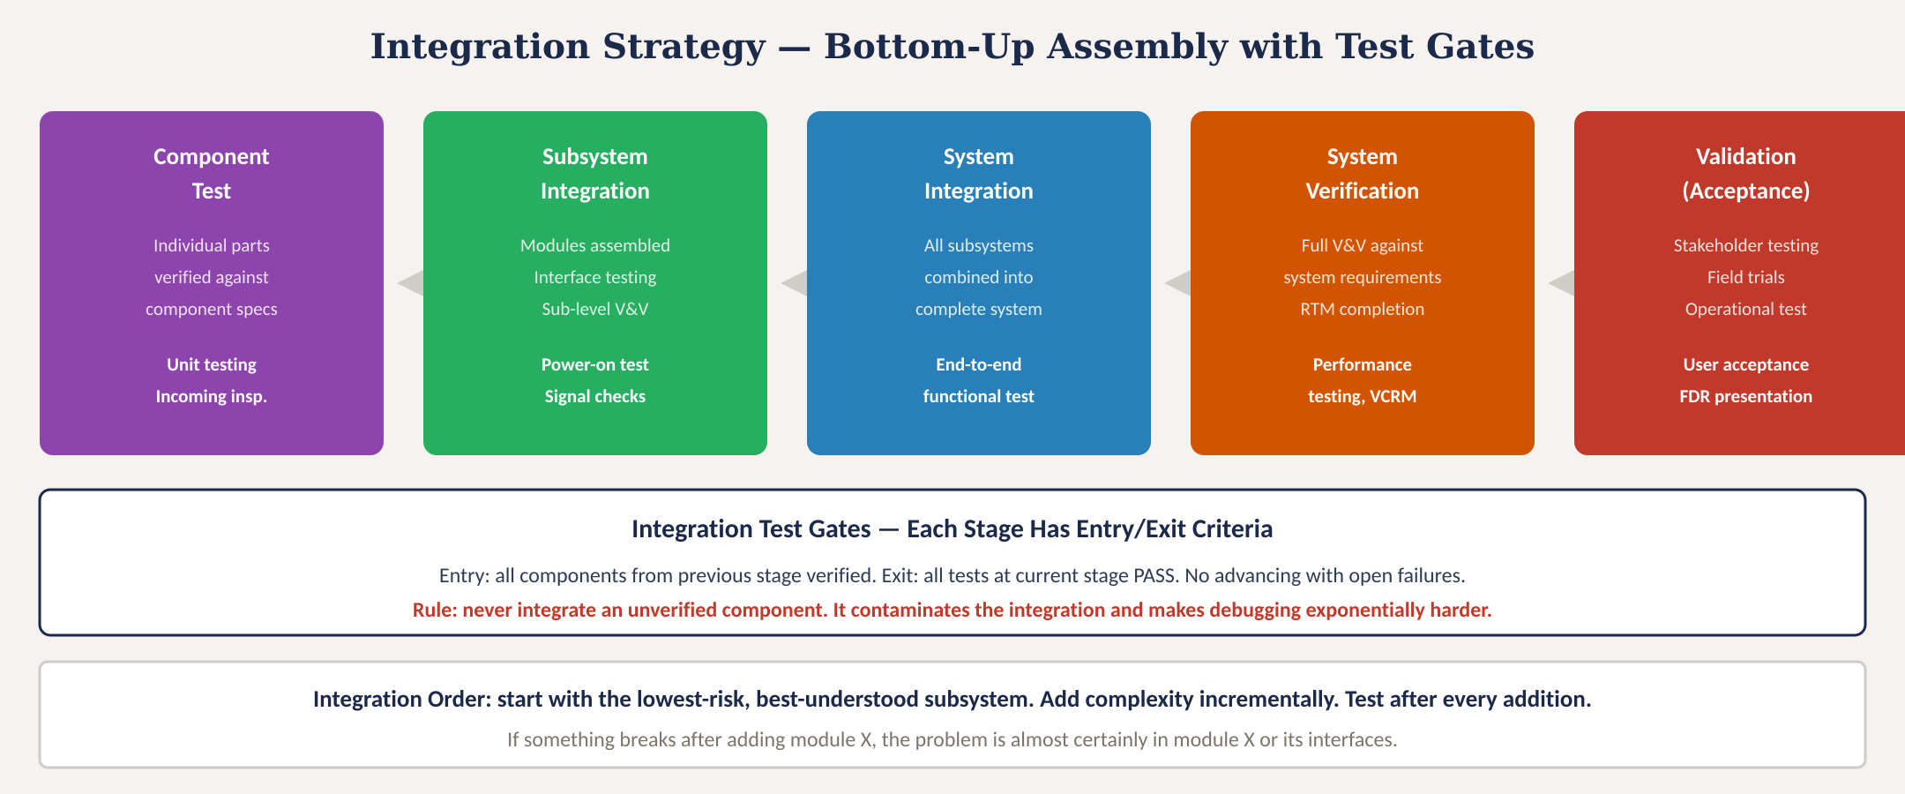
Integration strategy — bottom-up with test gates
MINES | MEGN 301 — Mechanical Integration and Design
Notes:
Figure 1 shows the five-stage bottom-up integration sequence with test gates.
CRITICAL SUBSYSTEM DEMONSTRATIONS (Sprint 4) — Before full system integration, demonstrate your two most critical subassemblies to your instructor. Define: (1) Demonstration goals — specific, measurable outcomes. (2) Required hardware and setup. (3) Binary success criteria from subsystem requirements. (4) Step-by-step procedure. A successful subsystem demo is the ENTRY CRITERION for system integration — do not proceed to full integration until both critical subassemblies work.
THE DEMO TRAP — A subsystem that works once under ideal conditions may fail intermittently under real conditions. Run multiple trials, test at boundary conditions, document actual measured values.

Slide 6
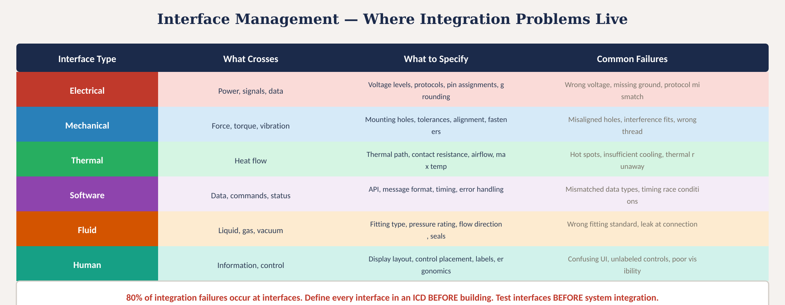
Interface management
Fig. 2: Six interface types with specifications and common failure modes — 80% of integration failures are at interfaces
MINES | MEGN 301 — Mechanical Integration and Design
Notes:
Figure 2 shows six interface types. 80% of integration failures occur at interfaces.
THE N² (N-SQUARED) DIAGRAM — A standard SE tool for systematically identifying all interfaces. Subsystems on the diagonal; off-diagonal cells show what each subsystem sends to each other. Each non-empty cell requires an ICD. Empty cells confirm no interface exists — also valuable information.
ICD TEMPLATE — For each electrical interface, specify at minimum: Interface ID, Subsystems connected, Physical connector (type and P/N), Pinout with signal names, Protocol and data rate, Voltage levels and logic family, Max current per pin, Cable spec and max length, Owner (the sub-team responsible).

Slide 7
MINES | MEGN 301
Interface Control Documents (ICDs)
What an ICD Contains
For every interface: what crosses it (signals, power, data, force, fluid), in what format (voltage, protocol, thread type), with what constraints (max current, tolerance, pressure rating), connector part numbers, pin assignments, and a block diagram of the connection.
When to Write It
Write ICDs DURING architecture definition — not during integration. The ICD is a contract between the teams building each side of the interface. Both teams design to the ICD. If the ICD is wrong, both sides are wrong.
Integration Test from ICD
The ICD defines what to test at each interface: measure actual voltage vs specified, verify protocol communication, check mechanical fit, measure thermal performance. The ICD IS the integration test specification.
One Interface, One Owner
Every interface has a single owner responsible for the ICD. When two teams share an interface, assign ONE person as the owner. Unowned interfaces are where problems hide.
MINES | MEGN 301 — Mechanical Integration and Design
Notes:
ICDs are the contracts between subsystem teams. Write them during architecture, not during integration. Every interface needs a single owner.
NEW CASE STUDY IN COMPILED NOTES — 'Diagnosing the Brown-Out Blues': Your MCU resets every time the motor starts. Five-step diagnosis: (1) Reproduce — 100% reproducible on motor command. (2) Isolate — system works without motor; works with motor on separate supply. (3) Characterize — oscilloscope shows 5V MCU rail dipping to 3.1V for 50ms during 8A motor inrush. (4) Root-cause — star grounding violation; motor return current shares MCU ground wire, creating V=I×R drop below brown-out threshold. (5) Fix — add 1000µF bulk cap on MCU rail + separate power/ground wires for motor (star topology). Cost: $0.50. Time: 10 minutes. But only if you measure with an oscilloscope instead of guessing.

Slide 8
02
Integration
testing & debug
Testing at integration, systematic debugging, and problem isolation
MINES | MEGN 301 — Mechanical Integration and Design
Notes:
Section 2 covers integration testing and systematic debugging.

Slide 9
MINES | MEGN 301
Integration testing
Smoke Test
First power-on of a newly integrated assembly. Check: does anything smoke, overheat, or make unexpected sounds? Monitor voltage rails, current draw, and temperatures. This is a safety check, not a performance test.
Interface Verification
Systematically verify every interface against its ICD: voltage levels correct? Communication protocol working? Mechanical fits within tolerance? Fluid connections leak-free? This catches the 80% of problems that live at interfaces.
Functional Integration Test
Exercise each function end-to-end across the integrated system. Sensor reads → data processes → actuator responds. Verify that the chain works, not just individual links.
Performance Margin Test
Once functional, test against performance requirements with margin. If the spec is ±0.5°C, verify you achieve ±0.3°C. Margin protects against environmental variation, aging, and unit-to-unit differences.
MINES | MEGN 301 — Mechanical Integration and Design
Notes:
Four levels of integration testing: smoke test for safety, interface verification against ICDs, functional integration for end-to-end chains, and performance margin testing.
VERSION CONTROL FOR ME STUDENTS — If the command line is intimidating, use a GUI Git client like GitHub Desktop or Sourcetree. For CAD files, use a naming convention in shared Google Drive: Enclosure_V3-2_2026-04-15.SLDPRT. This is infinitely better than Final_Final_reallyFinal.SLDPRT.
REGRESSION TESTING — Any change to a subsystem may invalidate prior verification. After making a change, re-run all affected tests. Without regression testing, you may fix one problem and silently introduce three others.

Slide 10
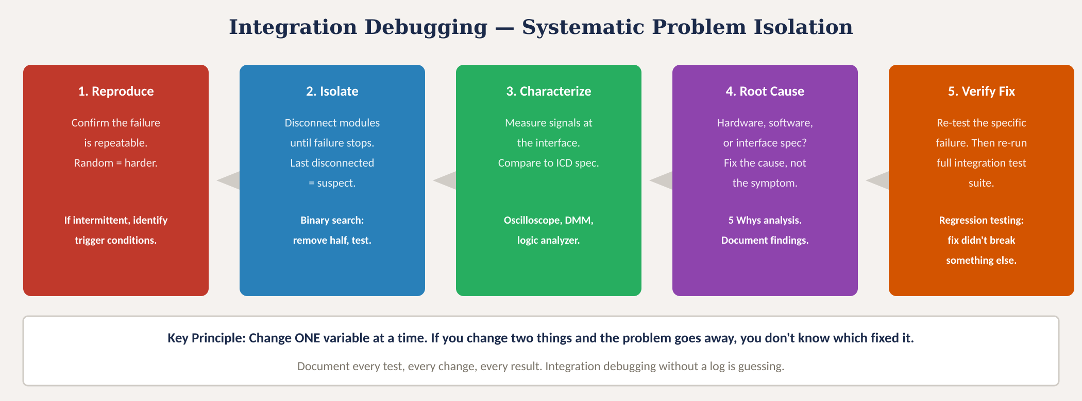
Systematic debugging
Fig. 3: Five-step debugging process — reproduce, isolate, characterize, root-cause, verify fix
MINES | MEGN 301 — Mechanical Integration and Design
Notes:
Figure 3 shows the five-step debugging methodology. The key principle: change ONE variable at a time.

Slide 11

MINES | MEGN 301
Common integration problems
Ground loops and noise coupling — motor currents flowing through signal ground. Fix: star-point grounding, separate power and signal returns.
Voltage level mismatches — 3.3V MCU driving a 5V input or vice versa. Fix: level shifters, voltage dividers, or matching logic families.
Mechanical interference — parts that fit individually but collide when assembled. Fix: assembly-level CAD review, tolerance stack-up analysis.
Timing and sequencing — modules that work individually but fail when operating simultaneously. Fix: defined startup sequence, synchronization protocols.
Thermal crosstalk — heat from one subsystem degrading the performance of an adjacent one. Fix: thermal isolation, directed airflow, layout separation.
Firmware version mismatches — different team members running different code versions. Fix: version control (Git), tagged releases, configuration management.
MINES | MEGN 301 — Mechanical Integration and Design
Notes:
Six common integration problems with fixes.

Slide 12
03
Configuration
management
Version control, baselines, change control, and build records
MINES | MEGN 301 — Mechanical Integration and Design
Notes:
Section 3 covers configuration management — knowing what you built and controlling changes.

Slide 13
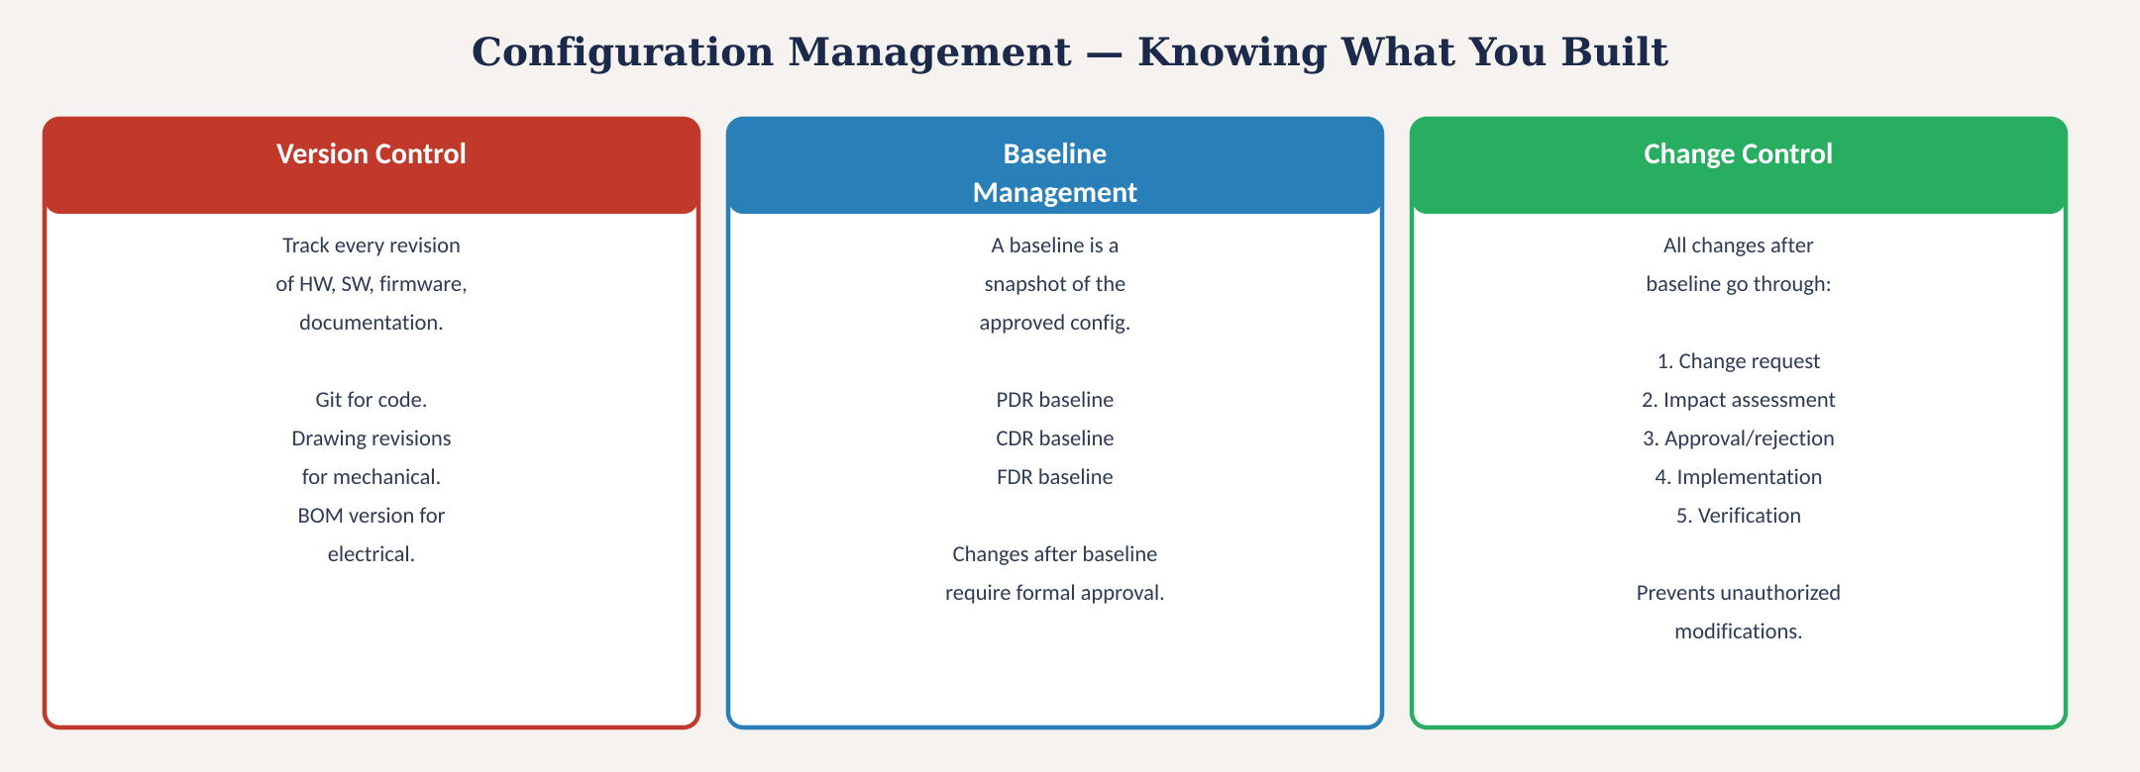
Configuration management
Fig. 4: Version control, baseline management, and change control — knowing what you built
MINES | MEGN 301 — Mechanical Integration and Design
Notes:
Figure 4 shows three pillars of configuration management.

Slide 14
MINES | MEGN 301
Configuration management in practice
Git for Code
Every line of firmware, test scripts, and documentation lives in a Git repository. Commit often with descriptive messages. Tag releases. Branch for experiments. Never work on main/master directly.
BOM Version Control
Your Bill of Materials is a controlled document. When you change a component, increment the BOM revision. Record why the change was made. The BOM at FDR must match what is on the bench.
Drawing Revisions
CAD models and drawings carry revision letters (Rev A, B, C...). Mark what changed between revisions. A drawing without a revision history is uncontrolled and unreliable.
Build Records
For each assembled unit, record: BOM revision, firmware version, component serial numbers, assembly date, and tester name. This is how you trace a field failure back to a specific build.
MINES | MEGN 301 — Mechanical Integration and Design
Notes:
Practical configuration management: Git for code, versioned BOMs, revision-controlled drawings, and build records.

Slide 15
04
Practice &
application
Integration planning, checklists, and project workflow
MINES | MEGN 301 — Mechanical Integration and Design
Notes:
Section 4 applies integration concepts to your projects.

Slide 16

MINES | MEGN 301
Integration plan template
Write your integration plan BEFORE you start building. Present it at CDR.
Integration sequence: which modules integrate first, second, third? (lowest risk first)
Interface list: every interface between every pair of modules, with ICD reference
Test at each stage: what tests pass before proceeding? (entry/exit criteria)
Equipment needed: test instruments, fixtures, cables, adapters, software tools
Schedule: integration milestones mapped to project timeline with buffer
Team assignments: who integrates what? Who runs which tests?
Risk mitigation: what are the highest-risk interfaces? What is the fallback plan?
Configuration control: how will you track versions, revisions, and build records?
Documentation: test logs, photos, data files — where stored, naming convention
Regression plan: after any change, which tests must be re-run to confirm no regressions?
MINES | MEGN 301 — Mechanical Integration and Design
Notes:
Ten-item integration plan template. Write it before building and present at CDR.

Slide 17
MINES | MEGN 301
Practical integration tips
Integrate the lowest-risk subsystem first. Get one thing working, then add complexity. Success builds confidence and provides a known-good baseline for debugging.
Test every interface BEFORE system integration. Wire the two modules together, verify communication, then disconnect and continue building. Interface bugs found early are 10× cheaper.
Keep a detailed integration log: date, what was added, what was tested, what passed, what failed, what was changed. This log is invaluable when debugging and essential at FDR.
Tag working configurations in Git. When something breaks, you can always roll back to the last known-good state. Never develop on an unstable baseline.
Allocate 30-40% of your schedule for integration and testing. Students consistently underestimate this. If you plan 1 week, it will take 2. If you plan 2, it might take 3.
Take photos at every integration milestone. Visual evidence of what the system looked like at each stage is invaluable for documentation and debugging.
MINES | MEGN 301 — Mechanical Integration and Design
Notes:
Six practical integration tips.

Slide 18
MINES | MEGN 301
Integration workflow for your projects
1
Before CDR: Write integration plan with sequence, interfaces, and test criteria. Set up version control.
2
At CDR: Present integration plan. Reviewers verify interface coverage and test completeness.
3
Weeks 1-2 post-CDR: Component-level testing. Verify every incoming component against its specification.
4
Weeks 2-3: Subsystem integration. Test each subsystem against subsystem requirements. Fix issues before proceeding.
5
Weeks 3-4: System integration. Combine subsystems incrementally. Interface verification at each step.
6
Weeks 4-5: System verification testing. Execute all test procedures. Update VCRM. Disposition any failures.
7
Before FDR: Complete VCRM. Compile evidence packages. Prepare integration summary for presentation.
MINES | MEGN 301 — Mechanical Integration and Design
Notes:
Seven-step integration workflow aligned to the design review cadence.

Slide 19
MINES | MEGN 301
Integration readiness checklist
Before you start integrating, verify ALL of the following:
All components received and individually verified against specifications?
ICDs written for every interface with connector part numbers and pin assignments?
Integration sequence defined (which subsystem first, second, third)?
Test procedures written for each integration stage with pass/fail criteria?
Test equipment available and calibrated (oscilloscope, DMM, power supply)?
Version control set up (Git repo, BOM revision, drawing revision)?
Integration log template ready (date, change, test, result columns)?
Team roles assigned (who integrates, who tests, who documents)?
Schedule has 30-40% buffer for unexpected problems?
Backup plan: what if the highest-risk interface fails?
Safety review: any high-voltage, high-pressure, or moving parts require PPE?
Workspace organized: adequate bench space, lighting, tool access?
MINES | MEGN 301 — Mechanical Integration and Design
Notes:
Twelve-item readiness checklist. Complete before starting integration.

Slide 20
MINES | MEGN 301
Integration anti-patterns
'Big-bang assembly' — connecting everything at once. When it doesn't work, you cannot isolate the problem. Add one module at a time and test after each addition.
'It worked on my bench' — a component verified in isolation fails in the system. Cause: shared grounds, timing conflicts, loading effects. Test interfaces, not just components.
'Fix it in software' — using code to work around hardware interface problems. The software fix masks the real issue, creates fragile dependencies, and fails unpredictably.
'Undocumented changes' — modifying the system without updating drawings, BOM, or code. 'I'll fix the docs later' never happens. Change the documentation when you change the system.
'Testing optional' — skipping integration tests because 'we're running out of time.' You're not saving time — you're borrowing it. The bugs will surface during FDR demonstration instead.
'One person integrates alone' — no witness, no documentation, no reproducibility. Integration should always have two people: one to work, one to document and observe.
MINES | MEGN 301 — Mechanical Integration and Design
Notes:
Six integration anti-patterns to avoid.

Slide 21
MINES | MEGN 301
Regression testing and continuous verification
What Is Regression Testing?
After ANY change to the system — hardware, software, firmware, configuration — re-run the tests that previously passed to confirm the change did not break something that was working. A fix that creates a new bug is not a fix.
When to Regress
After every bug fix. After every component substitution. After every firmware update. After every mechanical modification. After every environmental exposure (drop test, thermal cycling). The question is always: did the change affect anything else?
Minimum Regression Suite
Define a 'smoke test' suite of 5-10 critical tests that exercise every major function. This suite runs in 30-60 minutes and catches 80% of regressions. Run it after every change. The full test suite runs at milestones.
Automation
For software-heavy systems, automate regression tests. A script that runs on every Git commit catches bugs within minutes of introduction. For hardware, maintain a checklist that the tester runs through every time.
MINES | MEGN 301 — Mechanical Integration and Design
Notes:
Regression testing is how you prevent fixes from creating new problems.

Slide 22
MINES | MEGN 301
Integration documentation for FDR
Integration Log
Chronological record of every integration step: date, what was added, what was tested, results, anomalies, corrective actions. This is your primary evidence of a systematic process.
Updated VCRM
The verification cross-reference matrix updated with all test results. Every requirement shows: method, test procedure ID, date tested, result, evidence reference. No gaps.
As-Built Documentation
The system as actually delivered — not as designed. Includes final BOM (with actual part numbers and serial numbers), final firmware version, final CAD revision, and any deviations from the design baseline.
Lessons Learned
What worked, what didn't, what you would do differently. This is the document future teams will value most. Be honest about failures — they teach more than successes.
MINES | MEGN 301 — Mechanical Integration and Design
Notes:
Four FDR documentation deliverables.

Slide 23
MINES | MEGN 301
Key takeaways
(1)
Bottom-up integration: verify components → integrate subsystems → combine into system. Add one module at a time and test after each addition. Never big-bang.
(2)
80% of integration failures are interface problems. Define every interface in an ICD before building. Test interfaces before system integration.
(3)
Systematic debugging: reproduce → isolate → characterize → root-cause → verify fix. Change ONE variable at a time. Document every step.
(4)
Configuration management: version-control code (Git), version BOMs, revision drawings, and record build configurations. Know what you built.
(5)
Allocate 30-40% of your schedule for integration and testing. Plan for regression testing after every change. Integration always takes longer than expected.
References: [1] INCOSE SE Handbook, 4th ed., 2015. [2] NASA SP-2016-6105 Rev 2. [3] Pressman, Software Engineering, 9th ed., 2019. [4] IEEE 828: Configuration Management Planning.
MINES | MEGN 301 — Mechanical Integration and Design
Notes:
Five key takeaways for subsystem integration.

Slide 24
Subsystem Integration
"Integration is not assembly — it is verification."
Every module you add is a hypothesis:
'This will work with what's already there.'
Test the hypothesis. Then add the next module.
MINES | MEGN 301 — Mechanical Integration and Design
Notes:
Closing slide. Integration is not assembly — it is verification.

