Slide 1
MINES | MEGN 301 — Mechanical Integration and Design
Systems Engineering Foundations
Verification, Validation
& Test Plans
V&V METHODS, TEST PLAN DEVELOPMENT, AND RESULTS DISPOSITION
Notes:
Welcome to the Verification, Validation, and Test Plans module for MEGN 301. This is the companion to the Requirements and Architecture module — together they form the complete front-end and back-end of the systems engineering process. Requirements define what the system must do; V&V confirms that it actually does it. Without V&V, requirements are just wishes. This module covers the critical distinction between verification and validation, the four verification methods, how to write test plans that produce reliable results, what makes a good test plan, and what to do when you get results — including the often-overlooked cases of failure and partial pass.
ALIGNMENT NOTE — This module corresponds to Chapter 4 of your Master Reference Document and supports Sprints 4-7 (subsystem demos, system demo, external testing, refinement). The V-Model places V&V on the right side, mirroring requirements on the left.
BOTTOM LINE: Verification asks 'did we build it right?' Validation asks 'did we build the right thing?' Assign a TAID method to every requirement when you write it. Maintain a VCRM from day one. Write test procedures another engineer could reproduce. Report measured values, not just PASS/FAIL.
FINAL NOTES — Key updates in the final compiled document: (1) Rule of 10 for measurement uncertainty with concrete example (±0.5°C requirement + 1°C thermometer = invalid test). (2) Root cause analysis reframed as 'Differential Diagnosis' metaphor. (3) Quick-Start Guide template added to Ch 6 with six required elements. (4) Minimum Viable V&V checklist for MEGN 301. (5) Statistical confidence section with practical tips for single-prototype testing.

Slide 2






MINES | MEGN 301
Learning outcomes
Explain the difference between verification (built right) and validation (right system built) and why both are necessary
Apply the four verification methods — Test, Analysis, Inspection, Demonstration (TAID) — and select the appropriate method for each requirement
Write complete test procedures with purpose, setup, preconditions, steps, pass/fail criteria, data recording, and safety precautions
Evaluate test plan quality using a checklist of completeness, reproducibility, and traceability criteria
Disposition verification results correctly: PASS (close), FAIL (root cause + discrepancy report), PARTIAL PASS (risk assessment + stakeholder decision)
Build a verification cross-reference matrix (VCRM) mapping every requirement to its verification method, procedure, and status
MINES | MEGN 301 — Mechanical Integration and Design
Notes:
Six learning outcomes. Understand the verification-validation distinction. Apply TAID methods. Write complete test procedures. Evaluate test plan quality. Disposition results correctly including partial passes. Build a verification cross-reference matrix.

Slide 3
01
Verification &
validation
Built right vs. right system built — two different questions
MINES | MEGN 301 — Mechanical Integration and Design
Notes:
Section 1 covers the fundamental distinction between verification and validation. These are often confused, but they answer fundamentally different questions about your system.

Slide 4
MINES | MEGN 301
Verification vs. validation
Verification
Validation
"Did we build the system RIGHT?"
Does the system meet its requirements as specified? Compares the implemented system against the written specification.
Done by the engineering team throughout development. Each requirement is verified using one of four methods: Test, Analysis, Inspection, or Demonstration.
Result: each requirement is individually marked PASS, FAIL, or PARTIAL.
A system can be fully verified (all requirements met) and still fail validation (wrong requirements).
"Did we build the RIGHT system?"
Does the delivered system satisfy the stakeholder's actual needs? Compares the system against the operational problem it was built to solve.
Done with the stakeholder or end user — typically through acceptance testing, field trials, or user testing at the end of development.
Result: the system either solves the problem or it does not.
Validation catches the case where requirements were wrong, incomplete, or misunderstood — a problem that verification by definition cannot detect.
A verified system can fail validation. A validated system may not be fully verified. You need BOTH.
MINES | MEGN 301 — Mechanical Integration and Design
Notes:
Verification asks: did we build the system right — does it meet the specifications? Verification is done by the engineering team comparing the implementation against written requirements. Each requirement gets a pass or fail verdict. Validation asks: did we build the right system — does it actually solve the stakeholder's problem? Validation is done with the stakeholder, comparing the delivered system against the operational need. The critical insight is that these are independent. A system can pass every verification test — meeting every requirement perfectly — and still fail validation because the wrong requirements were written. Perhaps the stakeholder's needs were misunderstood, or the operating environment was different from what was assumed, or a critical need was simply missed in the requirements. Conversely, a system might satisfy the stakeholder in practice even though some requirements were not fully verified — perhaps an over-specified requirement was never actually critical. In a well-run project, verification catches implementation errors and validation catches requirements errors. You need both.

Slide 5
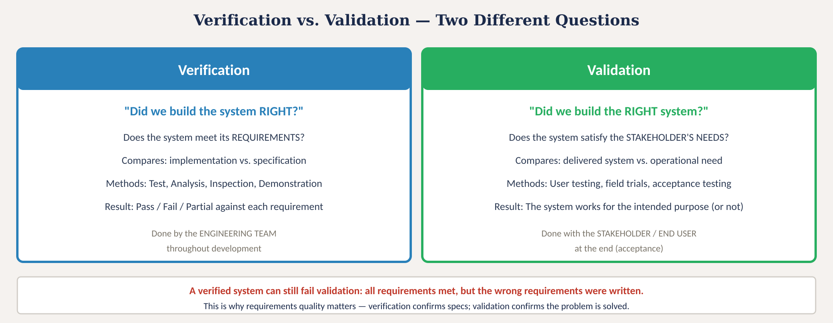
Verification vs. validation
Fig. 1: Verification (meets requirements) vs. validation (meets needs) — two different questions that both must be answered
MINES | MEGN 301 — Mechanical Integration and Design
Notes:
Figure 1 places verification and validation side by side. Verification compares implementation against specification, is done by the engineering team, uses TAID methods, and produces per-requirement pass/fail verdicts. Validation compares the delivered system against operational needs, is done with the stakeholder, uses user testing and field trials, and produces an overall acceptance or rejection. The bottom row highlights the key risk: a fully verified system can still fail validation if the requirements were wrong.

Slide 6
MINES | MEGN 301
Four verification methods — TAID
Every requirement must have a verification method assigned WHEN IT IS WRITTEN — not at the end of the project.
Test (T)
Stimulate the system and measure the response against quantitative criteria. Most rigorous. ~60% of requirements. Example: apply a calibrated reference temperature and measure the DUT reading. Preferred method whenever feasible.
Analysis (A)
Use mathematical models, simulation, or calculation. Used when testing is impractical (structural FEA, thermal simulation, worst-case circuit analysis). ~20% of requirements. Must document model assumptions and validation.
Inspection (I)
Visual or physical examination — confirm presence, labeling, workmanship, material. ~10% of requirements. Example: verify all connectors are keyed per ICD; verify material certificates match specification.
Demonstration (D)
Operate the system under defined conditions and observe behavior. Qualitative — no measurement. ~10% of requirements. Example: demonstrate the system completes a normal power-on sequence. Used when quantitative testing is not needed.
MINES | MEGN 301 — Mechanical Integration and Design
Notes:
TAID: Test, Analysis, Inspection, Demonstration. These are the four standard verification methods used across all engineering disciplines. Test is the most rigorous — you physically stimulate the system and measure its response against quantitative criteria. About 60 percent of requirements should be verified by test. Analysis uses models and calculation when testing is impractical — FEA for structural requirements, thermal simulation for cooling requirements, worst-case circuit analysis for electronic margins. About 20 percent of requirements. Inspection is visual or physical examination — checking that components are present, labeled correctly, and built to workmanship standards. About 10 percent. Demonstration operates the system and observes qualitative behavior without quantitative measurement — showing that it powers on, completes a cycle, or responds to user input. About 10 percent. The critical rule: assign the verification method when you write the requirement, not when you test it. If you cannot identify a method, the requirement is untestable and must be rewritten.

Slide 7
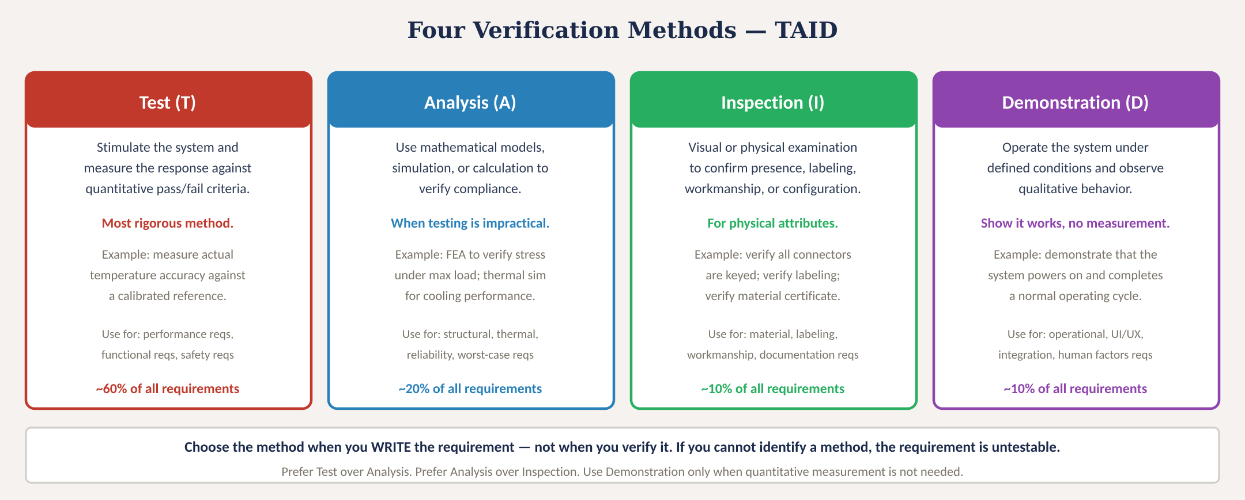
Four verification methods — TAID
Fig. 2: Test, Analysis, Inspection, and Demonstration with typical usage percentages and selection guidance
MINES | MEGN 301 — Mechanical Integration and Design
Notes:
Figure 2 presents the four methods with descriptions, examples, appropriate use cases, and approximate usage percentages.
STATISTICAL CONFIDENCE — Testing a single prototype once does NOT prove a requirement. Even with one prototype, increase confidence by: (1) Repeating measurements at least 3 times — report mean, std dev, and range. (2) Testing at boundary conditions, not just nominal. (3) Reporting margin: 'PASS with 36% margin' is more informative than 'PASS.' (4) Quantifying uncertainty with the Rule of 10: your instrument resolution should be 10× finer than your tolerance. If your requirement is ±0.5°C and your thermometer reads to 1°C, your test is invalid before you run it.

Slide 8
02
Writing
test plans
Test procedure structure, pass/fail criteria, and reproducibility
MINES | MEGN 301 — Mechanical Integration and Design
Notes:
Section 2 covers how to write test plans that produce reliable, reproducible, and defensible results.
EDGE CASE AND BOUNDARY TESTING — Nominal testing (room temperature, no load) is necessary but insufficient. Systems fail at the boundaries. If a requirement specifies -20 to +60°C, test at BOTH extremes. Corner case testing combines multiple boundaries simultaneously. Off-nominal testing explores what happens beyond the specified range — the answer should be 'degrades gracefully,' not 'fails catastrophically.'
THE ROOM-TEMPERATURE TRAP — The most common student testing failure is verifying everything at 22°C on a dry benchtop. Your greenhouse system operates at 3°C at 3 AM with condensation on every surface. If you only tested at room temperature, you have not verified the requirement.

Slide 9
MINES | MEGN 301
What makes a good test plan
The gold standard: another engineer with no project knowledge can pick up your test plan and reproduce your results exactly.
Traceable
Every test maps to specific requirement ID(s). The RTM links requirement → test procedure → result. At FDR, you can trace any requirement to its verification evidence.
Reproducible
Steps are specific enough that any trained engineer gets the same result. 'Apply a reference temperature' fails this test. 'Apply 25.0 ±0.1°C using an NIST-traceable bath' passes.
Binary Pass/Fail
Criteria are quantitative with no judgment calls. The tester does not decide if the result is 'good enough' — the criteria make the decision. Measurable thresholds with units and tolerance.
Complete
Includes setup, preconditions, safety, data recording, and evidence retention. Missing elements create ambiguity that undermines the result. The test record must stand alone.
Executed as Written
Do not deviate from the procedure. If you discover the procedure is wrong during execution, STOP, document the issue, revise the procedure, and restart. Ad-hoc modifications invalidate the test.
MINES | MEGN 301 — Mechanical Integration and Design
Notes:
Five qualities of a good test plan. Traceable: every test links to specific requirements. Reproducible: specific enough for independent replication. Binary: quantitative pass/fail with no judgment calls. Complete: all sections filled in with no ambiguity. Executed as written: no ad-hoc deviations. If the procedure is wrong, stop, revise, and restart — do not improvise.
ROOT CAUSE ANALYSIS AS DIFFERENTIAL DIAGNOSIS — Think of it like a doctor: (1) Is the TEST sick? Check procedure, calibration, equipment before blaming the patient. (2) Is the PATIENT sick? Most common — your implementation has a defect. (3) Is our DEFINITION OF HEALTHY wrong? Rarest but most important — the requirement is based on incorrect assumptions. Always investigate in this order. Jumping to 'the requirement must be wrong' without verifying your test procedure is engineering malpractice.

Slide 10
MINES | MEGN 301
Test procedure structure
1. Purpose
Which requirement(s) this test verifies — list IDs. One test may verify multiple related requirements.
2. Test Setup
Equipment list with model numbers, calibration status, fixtures, software versions, environmental conditions.
3. Preconditions
What must be true before starting: system state, firmware version, warm-up time, ambient conditions verified.
4. Procedure Steps
Numbered steps, each with a single action and expected result. Specific values, not vague instructions.
5. Pass/Fail Criteria
Quantitative thresholds derived directly from requirements. Numbers, units, tolerances. No ambiguity.
6. Data Recording
What to capture, format, resolution. Include a blank data table. Raw data must be retained.
7. Safety Precautions
Hazards, PPE, emergency procedures. Required for high voltage, pressure, heat, or moving parts.
8. Results + Verdict
PASS / FAIL / PARTIAL PASS with data evidence. Document any anomalies even if the test passes.
9. Signatures
Tester, witness, date, equipment serial numbers. Makes the record defensible.
MINES | MEGN 301 — Mechanical Integration and Design
Notes:
Nine sections of a complete test procedure. Purpose ties the test to specific requirements. Setup lists all equipment with calibration status. Preconditions define the starting state. Steps are numbered single-action instructions with expected results. Criteria are quantitative thresholds. Data recording specifies what to capture. Safety precautions address hazards. Results document the verdict with evidence. Signatures authenticate the record.

Slide 11
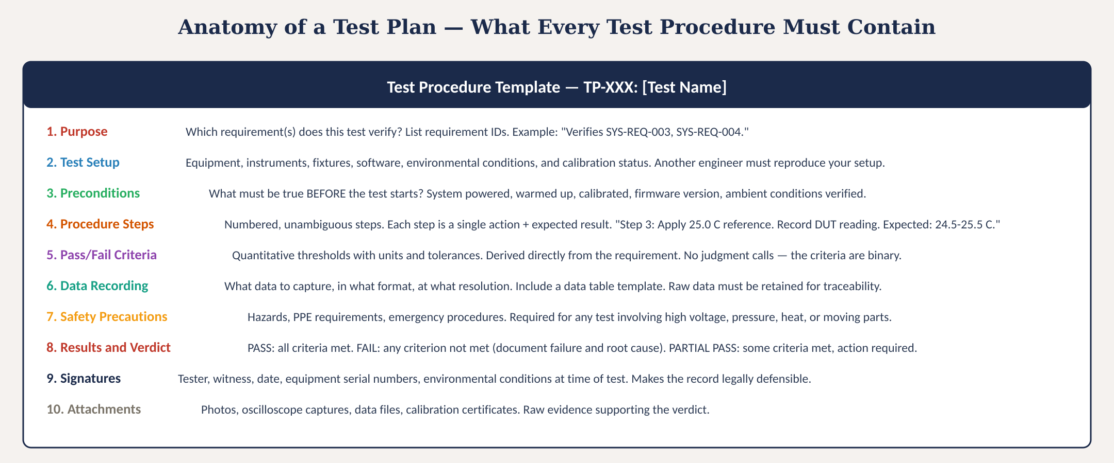
Test procedure template
Fig. 3: Complete test procedure template showing all 10 required sections with descriptions
MINES | MEGN 301 — Mechanical Integration and Design
Notes:
Figure 3 shows the complete test procedure template with all 10 required sections.
EXTERNAL TEAM TESTING (Sprint 6) — Your test plan will be executed by a DIFFERENT project team with no prior knowledge of your system. This mirrors industry acceptance testing. External testing reveals: (1) Procedure ambiguities — steps that assume knowledge the tester doesn't have. (2) Missing preconditions — system states the procedure doesn't specify. (3) Actual defects — the external team operates the system differently and finds failure modes you never encountered.
Before handoff: review every procedure as if you've never seen the system. Ensure all equipment is identified. Provide a quick-start guide. Include clear photographs. Identify safety precautions.
MINIMUM VIABLE V&V FOR MEGN 301 — You need: (1) Complete VCRM linking every requirement to a method and procedure. (2) At least one formal test procedure (all 10 sections) per critical performance requirement — typically 3-5 procedures. (3) Analysis documentation for untestable requirements. (4) Inspection checklist for physical requirements. (5) Test results with actual measured values. (6) Root cause analysis for any FAIL or PARTIAL PASS items.

Slide 12
MINES | MEGN 301
Writing good procedure steps
Good: 'Step 4: Set reference bath to 25.0 ±0.1°C. Wait 5 minutes for stabilization. Record DUT reading. Expected: 24.5–25.5°C.'
Bad: 'Step 4: Check temperature accuracy.'
One action per step
Each step is a single instruction. 'Set the reference AND record the reading' is two steps that should be separated.
Specific values
'Apply 25.0°C' not 'apply a reference temperature.' 'Wait 5 minutes' not 'wait until stable.' 'Expected: 24.5–25.5°C' not 'within spec.'
Expected result for each step
State what should happen. If the expected result does not occur, the tester knows immediately rather than discovering the problem later.
Imperative voice
'Set...' 'Record...' 'Verify...' 'Apply...' — direct commands. Not 'the operator should set...' or 'it is recommended to...'
Include wait times
Thermal stabilization, software boot, sensor warm-up. If the system needs time to reach steady state, the wait must be in the procedure.
MINES | MEGN 301 — Mechanical Integration and Design
Notes:
Five rules for writing procedure steps. One action per step. Specific values, not vague instructions. Expected result stated for each step. Imperative voice. Include all wait times.

Slide 13
03
Handling
results
Pass, fail, partial pass — disposition, root cause, and discrepancy reports
MINES | MEGN 301 — Mechanical Integration and Design
Notes:
Section 3 covers what to do with verification results. Getting a result is only the beginning — the critical work is properly dispositioning failures, conducting root cause analysis, and tracking open items to resolution.

Slide 14
MINES | MEGN 301
Verification results disposition
PASS
FAIL
PARTIAL PASS
All criteria met.
Actions:
• Record results in RTM
• Mark requirement as VERIFIED
• Archive raw data and evidence
• No further action required
At FDR, present with data package as evidence. Include measurement values, not just 'PASS' — the data proves it.
Even on a pass, document any anomalies or observations for future reference.
One or more criteria not met.
Actions:
• Document the failure precisely with data
• Root cause analysis (5 Whys):
1. Is the test procedure wrong?
2. Is the implementation wrong?
3. Is the requirement wrong?
• Open a Discrepancy Report (DR)
• Assign corrective action + owner
• Track to resolution
• Re-test after correction
A failure is not a defeat — it is the system working as designed. V&V exists to find problems.
Some criteria met, some not.
Actions:
• Document which passed + failed
• Assess criticality of the failure
• Three resolution paths:
1. FIX: redesign + re-test
2. WAIVE: stakeholder accepts the deviation (with risk documented)
3. DEFER: postpone resolution with a plan and deadline
• Open DR for failed criteria
• Risk assessment for waiver path
A waiver is not free — it transfers risk to the stakeholder, who must formally accept it.
MINES | MEGN 301 — Mechanical Integration and Design
Notes:
Three possible verdicts. PASS: all criteria met. Document the data, mark the requirement verified, and archive everything. Even on a pass, record actual measurement values, not just the word pass. FAIL: one or more criteria not met. This triggers a root cause analysis: is the test wrong, is the implementation wrong, or is the requirement wrong? Open a discrepancy report, assign corrective action, and track to resolution. The requirement cannot be marked verified until it passes re-test. PARTIAL PASS: some criteria met, some not. This is the most nuanced case. The failed criteria need root cause analysis just like a full fail. But the stakeholder may choose to waive the failed criteria if the risk is acceptable — perhaps the deviation is minor, or the requirement was overly conservative. A waiver is a formal document where the stakeholder accepts the deviation and its associated risk. The third option is deferral — postponing resolution with a documented plan and deadline.

Slide 15
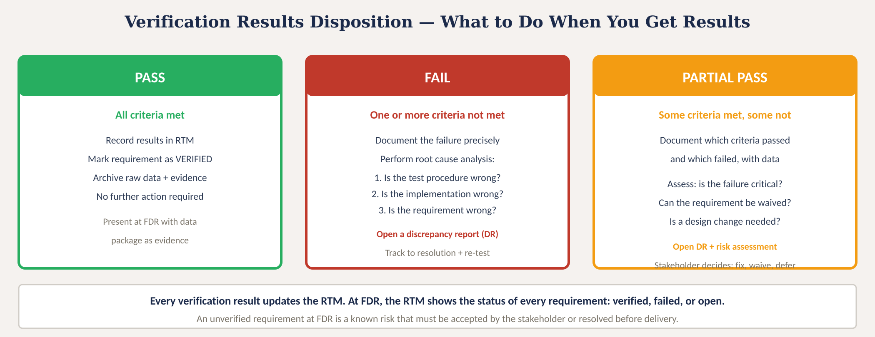
Verification results disposition
Fig. 4: Three verification outcomes with actions: PASS (close), FAIL (root cause + DR), PARTIAL PASS (risk assessment + stakeholder decision)
MINES | MEGN 301 — Mechanical Integration and Design
Notes:
Figure 4 shows the three possible outcomes with their disposition workflows.

Slide 16
MINES | MEGN 301
Root cause analysis for test failures
When a test fails, there are exactly three possible root causes. Investigate in this order:
1. The test is wrong
Did the procedure have an error? Was equipment mis-calibrated? Was the setup incorrect? Was a precondition not met? Check the test first because it is the most recent artifact and the easiest to fix. Re-run with corrected procedure before blaming the design.
2. The implementation is wrong
Does the hardware or software not perform as designed? A wiring error, a software bug, a component out of spec, or a manufacturing defect. This is the most common root cause. Fix the implementation and re-test.
3. The requirement is wrong
Was the requirement unrealistic, overly conservative, based on incorrect assumptions, or no longer applicable? This is discovered when the implementation is correct but the requirement was wrong from the start. Change the requirement through a formal change control process — never silently.
MINES | MEGN 301 — Mechanical Integration and Design
Notes:
Three root causes for test failures, investigated in order. First, check the test itself — procedure errors, calibration issues, and setup mistakes are common and easy to fix. Second, check the implementation — the most common root cause. Third, question the requirement — it may have been wrong from the start. Changing a requirement requires formal change control: document the proposed change, justify it, assess the impact, get stakeholder approval, and update the RTM. Never silently change a requirement.

Slide 17
04
Practice &
application
VCRM, test plan quality checklist, and project application
MINES | MEGN 301 — Mechanical Integration and Design
Notes:
Section 4 covers the practical tools and checklists for applying V&V in your projects.

Slide 18
MINES | MEGN 301
Verification cross-reference matrix (VCRM)
The VCRM is the master document that links every requirement to its verification method, test procedure, and result.
Req ID
Requirement Text
Type
Method
Test Proc
Status
Notes
SYS-REQ-001
Shall measure temperature
Func
T
TP-001
PASS
25.1°C ± 0.3
SYS-REQ-002
...with ±0.5°C accuracy
Perf
T
TP-001
PASS
Max error: 0.3°C
SYS-REQ-003
Shall transmit at ≥1 Hz
Perf
T
TP-002
PARTIAL
0.8 Hz achieved
SYS-REQ-004
Shall comply with FCC 15
NFR
A
AN-001
OPEN
Analysis pending
SYS-REQ-005
Shall operate -20 to 60°C
NFR
T
TP-003
FAIL
Failed at -15°C
At FDR, this matrix tells the full story: every requirement, its verification evidence, and its status. Open and failed items are known risks.
MINES | MEGN 301 — Mechanical Integration and Design
Notes:
The VCRM is the master V&V document. Each row is a requirement. Columns capture: requirement ID and text, type (functional, performance, NFR), verification method (T/A/I/D), test procedure ID, status (PASS/FAIL/PARTIAL/OPEN), and notes with actual data. At FDR, this matrix tells the complete story. All requirements should be PASS or have documented disposition. OPEN items are risks that must be presented to the stakeholder.

Slide 19

MINES | MEGN 301
Test plan quality checklist
Every test procedure must pass ALL of these checks before execution.
Traces to specific requirement ID(s) — purpose section references the RTM
Equipment list complete with model numbers and calibration due dates
Preconditions explicitly stated — nothing assumed
Each step is a single action in imperative voice with specific values
Expected result stated for every step — tester knows immediately if something is wrong
Pass/fail criteria are quantitative with numbers, units, and tolerances — no judgment calls
Data recording format specified — blank table included in the procedure
Safety precautions identified for any hazardous conditions
Procedure reviewed by someone who did NOT write it — fresh eyes catch ambiguity
Results section includes space for actual values, not just PASS/FAIL checkboxes
Signature block for tester, witness, date, and equipment IDs
Procedure has been dry-run (walked through without the DUT) to catch sequence errors
MINES | MEGN 301 — Mechanical Integration and Design
Notes:
12-item test plan quality checklist. Every test procedure should pass all of these before execution. The dry-run check at the bottom is especially valuable — walking through the procedure without the DUT reveals sequence errors, missing steps, and ambiguous instructions before they waste test time.

Slide 20

MINES | MEGN 301
Practical tips for V&V
Write test procedures WHILE writing requirements — they are two sides of the same coin. If you cannot write the test, the requirement needs rewriting.
Test early, test often. Do not save all testing for the end. Verify component-level requirements first, then subsystem, then system. Catch problems when they are small.
Record actual measurements, not just PASS/FAIL. The data proves the result and enables trend analysis across multiple test runs.
A test failure is not a project failure — it is the system working correctly. V&V exists to find problems before the stakeholder does. Celebrate finding failures early.
Maintain the VCRM from day one. Update it after every test. At FDR, it should tell the complete verification story with no gaps.
Plan for re-testing. Budget time and resources for failures. If you assume every test passes first time, your schedule has zero margin for reality.
MINES | MEGN 301 — Mechanical Integration and Design
Notes:
Six practical tips. Write test procedures while writing requirements. Test early and incrementally. Record actual data. Embrace failures as the system working correctly. Maintain the VCRM from day one. Plan for re-testing.

Slide 21
MINES | MEGN 301
Applying V&V in your projects
1
At PDR: present your VCRM with verification methods assigned to every requirement. No test procedures yet — but methods must be identified.
2
Before CDR: write test procedures for all Test-method requirements. Have them peer-reviewed. Dry-run at least the critical ones.
3
During build: verify component-level requirements as components arrive. Record results in the VCRM. Fix problems immediately.
4
At integration: verify subsystem requirements. This is where interface problems surface. Document everything.
5
Before FDR: execute all system-level test procedures. Disposition all results. Update VCRM to final status.
6
At FDR: present the complete VCRM showing every requirement's status. PASS items have evidence packages. FAIL/OPEN items have disposition plans.
MINES | MEGN 301 — Mechanical Integration and Design
Notes:
Six-stage V&V workflow for student projects aligned to the design review cadence.

Slide 22
MINES | MEGN 301
V&V and the V-Model
The V-Model maps each development phase on the left to a corresponding verification phase on the right.
Stakeholder Needs → Validation
The top of the V. Needs are captured at the beginning; validation confirms they are satisfied at the end. Done WITH the stakeholder.
System Requirements → System Verification
System-level test procedures verify that the complete integrated system meets system requirements. Full-system functional and performance testing.
Subsystem Requirements → Integration Testing
Subsystem tests verify that each subsystem meets its allocated requirements. Interface testing confirms subsystems work together.
Component Specifications → Unit Testing
Component-level tests verify individual parts meet their specifications. Incoming inspection, component characterization, acceptance testing.
Implementation (Bottom of V)
The actual build phase. Each component is fabricated, programmed, and assembled. Testing begins immediately as components are completed.
MINES | MEGN 301 — Mechanical Integration and Design
Notes:
The V-Model is the standard systems engineering lifecycle that maps development phases to verification phases. Each level of requirements on the left side of the V corresponds to a level of testing on the right side. The bottom of the V is implementation. The key insight: test planning happens on the LEFT side of the V — you design the tests while writing the requirements, not when you reach the right side.

Slide 23
MINES | MEGN 301
Key takeaways
(1)
Verification confirms the system meets requirements (built right). Validation confirms the system meets stakeholder needs (right system). You need both.
(2)
Four methods — TAID: Test (most rigorous, ~60%), Analysis (~20%), Inspection (~10%), Demonstration (~10%). Assign the method when you WRITE the requirement.
(3)
Good test plans are traceable, reproducible, binary (quantitative pass/fail), complete, and executed as written. Another engineer must be able to reproduce your results.
(4)
Three outcomes: PASS (close and archive), FAIL (root cause → fix → re-test), PARTIAL PASS (risk assessment → fix, waive, or defer with stakeholder approval).
(5)
The VCRM is the master V&V document. Maintain it from day one. At FDR, it tells the complete story: every requirement, its evidence, and its status.
References: [1] INCOSE SE Handbook, 4th ed., 2015. [2] NASA SP-2016-6105 Rev 2. [3] IEEE 1012: V&V of Systems and Software. [4] DO-178C: Software Considerations in Airborne Systems.
MINES | MEGN 301 — Mechanical Integration and Design
Notes:
Five key takeaways for V&V.

Slide 24
Verification, Validation & Test Plans
"An untested requirement is an unverified assumption."
Verification turns requirements from promises into evidence.
Plan the test when you write the requirement.
Execute it rigorously. Document it completely.
MINES | MEGN 301 — Mechanical Integration and Design
Notes:
Closing slide. An untested requirement is an unverified assumption — V&V converts requirements from promises into evidence.

