Slide 1
⚡
Workforce Overview Dashboard
Analyzing 22,214 Employee Records
MySQL · Power Query · DAX · Power BI
PRDA · 03
HR
Analytics
Power BI Dashboard Report
MySQL
Power BI
HR Analytics
FY 2000–2020
Notes:
Title slide – PRDA-03 HR Analytics project using MySQL + Power BI

Slide 2
Introduction
Background & project context
What is HR Analytics?
This Project: PRDA 03
Human Resource (HR) Analytics is the process of collecting, analyzing, and interpreting workforce data to support informed business decisions.
It helps organizations understand employee demographics, workforce trends, hiring patterns, and diversity — improving strategic planning and operational efficiency.
By turning raw HR data into insights, organizations make evidence-based decisions that enhance workforce management and overall performance.
📊
Analyzes employee data using MySQL + Microsoft Power BI
👥
Dataset: 22,214 employees · 14 data attributes
🗓️
Covers age, gender, race, department, hire & term dates
🗺️
Geographic analysis across 7 US states
💡
Provides diversity, hiring trend & workforce insights
🎯
Supports evidence-based HR planning and decisions
Tools Used: MySQL · Microsoft Power BI Desktop · Power Query Editor · DAX (Data Analysis Expressions)

Slide 3




Data Preparation
ETL pipeline — Import → Quality → Transform → Load
1
2
3
4
→
→
→
Data Import
Quality Assessment
Transformation
Data Loading
• Get Data from SQL Database
• Column Quality check
• Text→Date conversion
• Applied all changes
• project_hr_analytics DB
• Column Distribution
• birthdate, hire_date
• Loaded to data model
• ETL via Power Query
• Column Profile
• termdate (strip time/UTC)
• Measures & KPIs ready
• HR table selected
• No errors found
• Date hierarchies enabled
• Visuals activated
✅ No column errors · No duplicate Employee IDs · termdate blanks = active employees (not data quality issues)

Slide 4
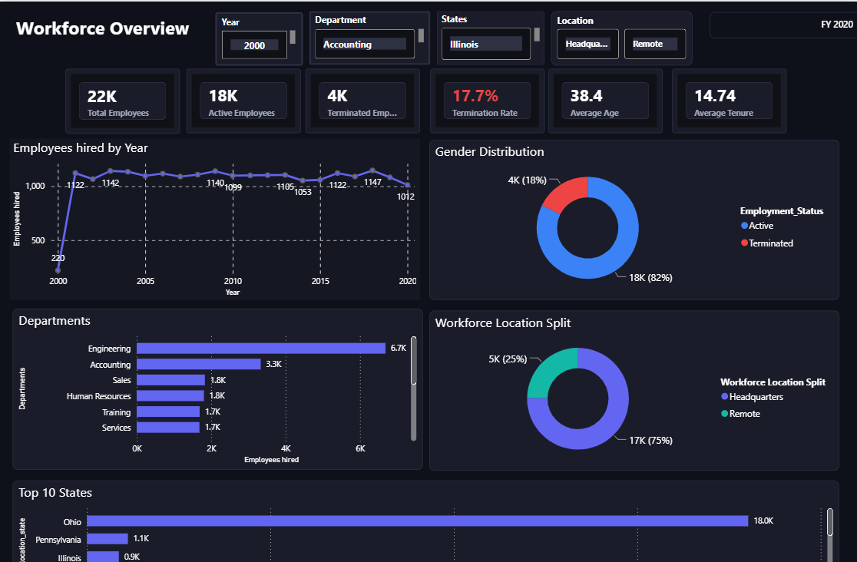
Key Workforce Metrics FY 2020
- Total Employees: 22,000
- Active Employees: 18,000
- Termination Rate: 17.7% (4,000 employees)
- Average Employee Age: 38.4 years
- Average Tenure: 14.74 years
Notes:
Let me begin with our key workforce metrics for FY 2020. We currently have 22,000 total employees across the organization, with 18,000 actively employed. Unfortunately, we've experienced 4,000 terminations, resulting in a termination rate of 17.7%, which is highlighted in red on our dashboard and warrants serious attention. Our workforce has an average age of 38.4 years, indicating a mature and experienced team. The average tenure stands at 14.74 years, demonstrating strong employee retention historically. These metrics provide a foundational understanding of our current workforce state and will be explored in greater detail throughout this presentation.

Slide 5
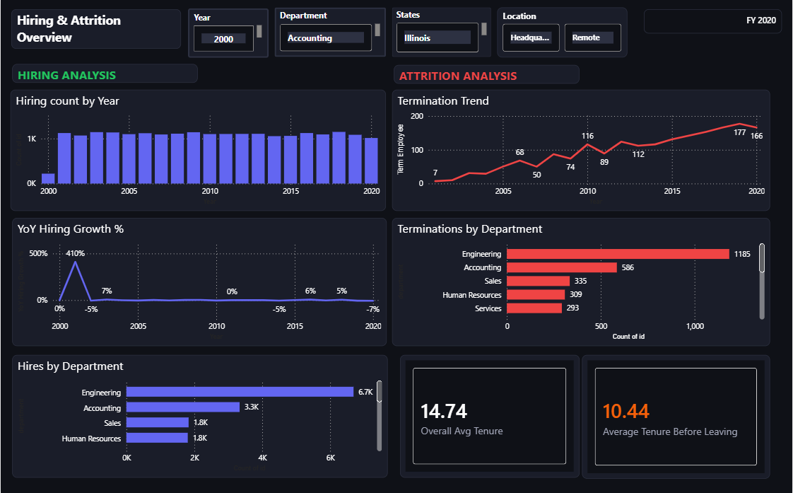
Hiring Trends Analysis
Two Decades of Workforce Growth (2000-2020)
Our organization has experienced significant fluctuations in hiring volume over the past 20 years, ranging from 220 employees in 2000 to peaks exceeding 1,200 annually during growth periods.
Year-over-year growth analysis shows extreme volatility, from 410% growth in early 2000s to negative growth rates of -7% in recent years, indicating inconsistent workforce expansion strategies.
Key Hiring Insights:
  - Peak hiring years: 2002-2015 (1,100-1,200 annually)
  - 2020 hiring: 1,012 new employees
  - Recent trend: Declining hiring rates (-7% YoY growth)
Notes:
Our hiring trends over the past two decades reveal important patterns in organizational growth. Starting in 2000, we had relatively modest hiring of 220 employees. We experienced significant growth in the early 2000s, with a peak of 1,122 employees hired in one year. The hiring numbers fluctuated between approximately 1,100 and 1,200 employees annually from 2002 through 2015, showing consistent organizational expansion. However, by 2020, we see a decline to 1,012 new hires. When we examine year-over-year growth percentages, we notice dramatic fluctuations—starting with 410% growth in the early 2000s, followed by periods of negative growth including minus 5% and minus 7% in recent years. This volatility in hiring patterns suggests we need to develop more consistent workforce planning strategies.

Slide 6

Hiring by Department
- Engineering: 6,700 hires (largest department)
- Accounting: 3,300 hires (focus department)
- Sales: 1,800 hires
- Human Resources: 1,800 hires
- Training & Services: 1,700 hires each
Notes:
Looking at our departmental hiring distribution, Engineering leads significantly with 6,700 hires, representing our largest operational area and a critical investment in technical capabilities. The Accounting department, which is our focus area, has hired 3,300 employees over this period. Sales and Human Resources each brought in 1,800 new hires, while Training and Services departments each added 1,700 employees. This distribution reflects our organizational priorities and the relative size of each functional area. Engineering's dominance in hiring numbers aligns with our technology-driven business model, while the substantial accounting hiring supports our financial operations and compliance requirements across the organization.

Slide 7
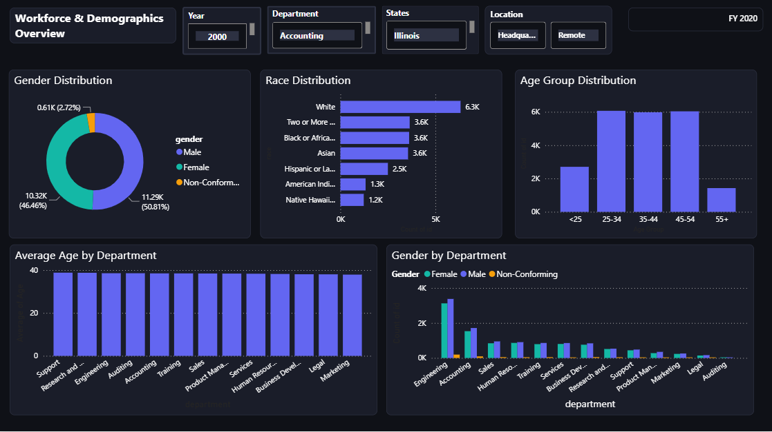
Workforce Demographics
Gender, Race, and Age Distribution
Our organization maintains strong gender balance with 50.81% male and 46.46% female employees, plus 2.72% non-conforming individuals, demonstrating inclusive hiring practices.
Racial diversity is robust across six major categories, with White employees representing the largest group, followed by significant representation from Two or More races, Black or African American, and Asian populations.
Demographic Highlights:
  - Gender: Near-equal male/female split (50.81% / 46.46%)
  - Race: Diverse representation across 6+ categories
  - Age: Concentrated in 25-54 range (mid-career focus)
  - Average age across departments: 35-40 years
Notes:
Our workforce demographics reveal a well-balanced organization. Gender distribution shows 50.81% male employees (11,290 individuals) and 46.46% female employees (10,320 individuals), with 610 employees identifying as non-conforming, representing 2.72% of our workforce. This near-equal gender split demonstrates our commitment to diversity. From a racial perspective, we have strong representation across multiple groups: 63,000 White employees, 36,000 employees identifying as Two or More races, and 36,000 each of Black or African American and Asian employees. Hispanic or Latino employees number 25,000, American Indian employees total 13,000, and Native Hawaiian employees comprise 12,000. Age distribution shows our largest cohort in the 25-34, 35-44, and 45-54 ranges, each with approximately 5,000-6,000 employees, with fewer employees under 25 and over 55. This age distribution suggests a predominantly mid-career workforce.

Slide 8
Attrition Concerns
- Termination trend: 7 (2000) to 166 (2020) employees
- Engineering terminations: 1,185 (highest impact)
- Accounting terminations: 586
- Average tenure before leaving: 10.44 years
- Critical retention gap: 4.3 years before average tenure
Notes:
The attrition analysis presents concerning trends that require immediate attention. Our termination numbers have increased dramatically from just 7 employees in 2000 to 166 employees in 2020, with a peak of 177 in one recent year. This upward trajectory is clearly visible in the red trend line on our dashboard. When examining terminations by department, Engineering has lost 1,185 employees—the highest among all departments—followed by Accounting with 586 terminations. Sales has experienced 335 terminations, Human Resources 309, and Services 293. The overall average tenure is 14.74 years, but the average tenure before leaving is notably lower at 10.44 years, suggesting we're losing employees before they reach their full potential with the organization. These metrics indicate retention challenges that need strategic intervention.

Slide 9
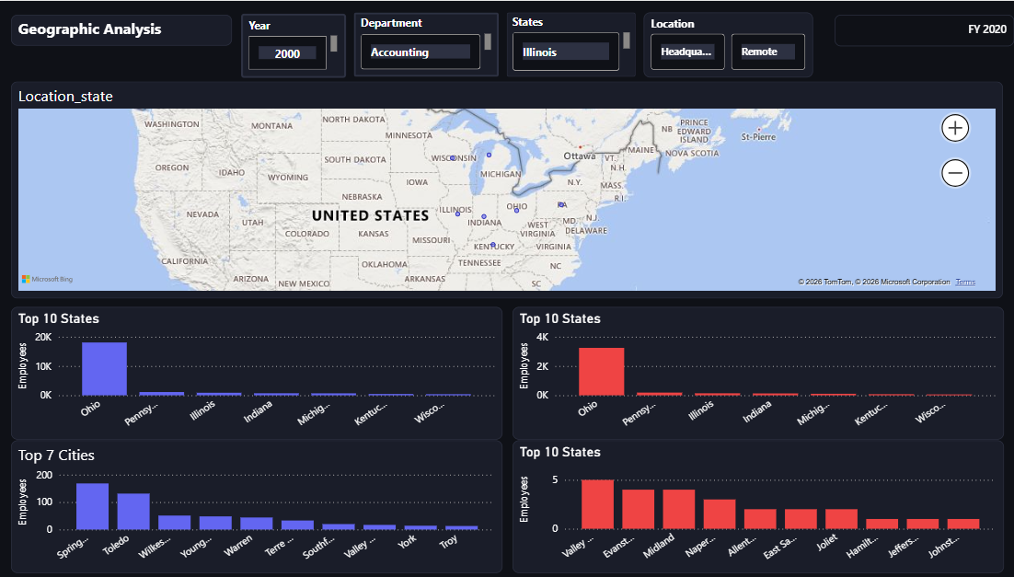
Geographic Distribution
State, City, and Location Analysis
Our workforce is heavily concentrated in Ohio with 18,000 employees, followed by Pennsylvania (1,100) and Illinois (900), creating potential risks from geographic over-concentration.
The headquarters versus remote split shows 75% of employees at physical locations and 25% working remotely, a ratio that may need reassessment given evolving workplace trends.
Geographic Insights:
  - Primary location: Ohio (18,000 employees)
  - Top cities: Springfield, Toledo, Wiltses
  - Headquarters: 17,000 (75%) vs. Remote: 5,000 (25%)
  - Illinois focus: 900 employees in Accounting
Notes:
Our geographic distribution shows significant concentration in specific regions. Ohio dominates with 18,000 employees, representing the vast majority of our workforce. Pennsylvania follows with 1,100 employees, and Illinois—our focus state for this presentation—has 900 employees. When examining the top cities, Springfield leads with approximately 150 employees, followed by Toledo and Wiltses with around 120 employees each. The workforce location split between headquarters and remote work is notable: 75% of employees (17,000 individuals) work at headquarters locations, while 25% (5,000 employees) work remotely. This 3-to-1 ratio of headquarters to remote workers was established before the recent shift toward remote work in many organizations. Understanding this geographic distribution is crucial for resource allocation, facility planning, and considering future workplace flexibility options.

Slide 10

Department Deep Dive
Composition and Demographics by Function
Gender distribution remains remarkably consistent across all departments, with each maintaining close to the 50-50 organizational average, demonstrating equitable hiring practices.
Average employee age across departments clusters tightly between 35-40 years, indicating similar experience levels and career stages regardless of functional area.
Department Analysis:
  - Consistent gender balance across all functions
  - Uniform age distribution (35-40 years average)
  - Engineering largest: ~4,000 employees
  - Accounting second: ~3,500 employees
Notes:
Looking at our departmental workforce composition, we can see how gender distribution varies across functions. Engineering, our largest department, shows approximately 4,000 employees with balanced gender representation. Accounting displays roughly 3,500 employees with similar gender balance. Sales, Human Resources, Training, Services, and other departments each show between 1,000 and 2,000 employees with relatively consistent gender distribution patterns. What's particularly noteworthy is that most departments maintain close to the organizational average of 50-50 gender split, indicating that our diversity efforts are consistently applied across all functional areas rather than concentrated in specific departments. The average age by department clusters around 35-40 years across all functions, suggesting uniform career stage distribution. This consistency indicates effective HR policies that promote similar demographic profiles regardless of department function.

Slide 11

Key Findings & Recommendations
- Strengths: Strong diversity, stable tenure (14.74 years)
- Concern: Rising termination rate (17.7%) requires intervention
- Priority: Retention programs for 7-12 year tenure employees
- Risk: Geographic over-concentration (82% in Ohio)
- Opportunity: Expand remote work beyond current 25%
Notes:
In conclusion, our workforce analysis reveals both strengths and challenges. Our strengths include strong gender and racial diversity, with near 50-50 gender split and representation across multiple racial categories. We maintain a stable, experienced workforce with 14.74 years average tenure and consistent hiring across major departments with Engineering and Accounting as anchors. However, we face significant challenges. The 17.7% termination rate is concerning and trending upward from 7 to 166 annual terminations over 20 years. We're experiencing a declining year-over-year hiring growth rate of negative 7%, and there's a 4.3-year gap between average tenure and tenure before leaving, indicating mid-career attrition. Additionally, we have geographic over-concentration in Ohio with 82% of our workforce. Moving forward, I recommend we implement retention programs targeting the 7-12 year tenure range, diversify geographic presence to reduce Ohio concentration risk, investigate root causes of the increasing termination trend particularly in Engineering, develop succession planning for our aging workforce as the 45-54 cohort nears retirement, and reassess our remote work policies given that only 25% work remotely. Thank you for your attention, and I'm happy to take any questions.

Slide 12
Conclusion
This project successfully developed an interactive HR Analytics Dashboard using Microsoft Power BI, powered by 22,214 employee records from a MySQL database. Through ETL in Power Query, DAX-based KPIs, and rich visualizations, meaningful workforce insights were delivered across demographics, hiring trends, diversity, and geographic distribution.
The Power BI dashboard serves as an ongoing strategic decision-support tool for workforce planning, DEI monitoring, hiring trend analysis, and evidence-based HR management.
SQL · Power Query · DAX · Microsoft Power BI · HR Dark Theme
PRDA – 03 | HR Analytics Project | FY 2000–2020

