Slide 1
CSS3 OVERVIEW
Owen Williams
Owen at dynabooks daht com

Slide 2
RESOURCES
http://www.w3.org/Style/CSS/current-work
http://www.css3.info/
http://www.quirksmode.org/css/contents.html

Slide 3
ELEMENT SELECTORS
http://www.w3.org/TR/css3-selectors/
*
UL
UL LI
UL > LI
UL + LI
UL ~ LI
#id
UL[foo]
UL[foo="bar"]
UL[foo^="bar"]
UL[foo$="bar"]
UL[foo*="bar"]
UL[foo~="bar"]
UL[foo|="en"]
UL:not(s)
A:link
A:visited
A:active
UL:empty
UL:hover
UL:focus
UL:target
UL:enabled
UL:disabled
UL:checked
UL.warning
UL:nth-child(n)
UL:nth-last-child(n)
UL:nth-of-type(n)
UL:nth-last-of-type(n)
UL:first-child
UL:last-child
UL:only-child
UL:first-of-type
UL:last-of-type
UL:only-of-type
UL::before
UL::after
UL::first-line
UL::first-letter

Slide 4
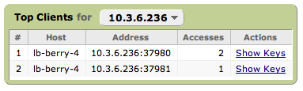

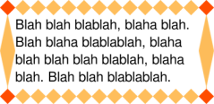
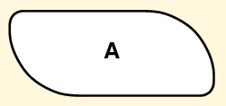

BORDERS AND BACKGROUNDS
http://www.w3.org/TR/css3-background/
Round Corners
border-radius: 4em;
border-top-left-radius: 4em;
border-top-right-radius: 4em;
border-bottom-right-radius: 4em;
border-bottom-left-radius: 4em;
Eliptical Corners
Border Image
border-image: url("border.png") 27 round stretch;
border-image: url(border.png) 27 27 27 27 stretch stretch;

Slide 5
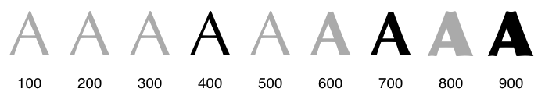

FONTS
http://www.w3.org/TR/css3-fonts/
font-face
@font-face {
font-family: Gentium;
src: url(http://site/fonts/Gentium.ttf);
}
p { font-family: Gentium, serif; }
font-variant
font-variant: [normal|small-caps]
font-weight
font-weight: [100…900];
font-stretch
font-stretch: [ultra-condensed|expanded|etc];

Slide 6
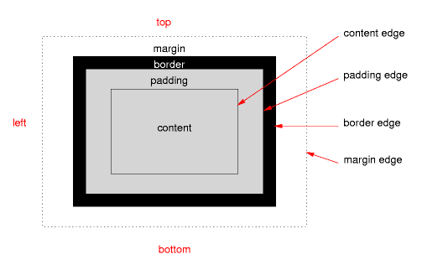
BOX MODEL
http://www.w3.org/TR/css3-box/
Box-sizing
box-sizing: [content-box|border-box];
Element Size
width:
min-width:
max-width:
height:
min-height:
max-height:

Slide 7
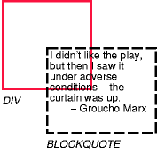

OVERFLOW
http://www.w3.org/TR/css3-box/
overflow: [visible|hidden|scroll|auto|no-display|no-content];
overflow-style: [auto|scrollbar|panner|move|marquee]*
overflow-x:
overflow-y:
overflow:visible
overflow:hidden

Slide 8
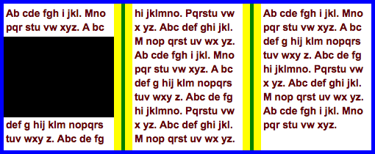
MULTI-COLUMN LAYOUT
http://www.w3.org/TR/css3-multicol/
http://www.alistapart.com/articles/css3multicolumn
column-width: 15em;
column-gap: 2em; /* shown in yellow */
column-rule: 4px solid green;
padding: 5px; /* shown in blue */

Slide 9
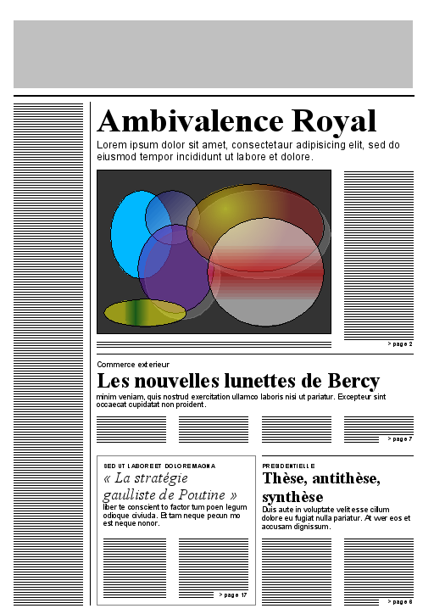
TEMPLATE LAYOUT
http://www.w3.org/TR/css3-layout/
@page :first {
display: "A A A A A A A A A" / 5cm
". . . . . . . . ." / 0.25cm
"B . C C C C C C C" / *
"B . C C C C C C C" / *
"B . C C C C C C C" / *
"B . C C C C C C C" / *
"B . C C C C C C C" / *
"B . D D D D D D D" / *
"B . D D D D D D D" / *
"B . E E E . F F F" / *
"B . E E E . F F F" / *
"B . E E E . F F F" / *
* 3em * 3em * 3em * 3em *
}
h1 {position: a; border-bottom: thick; margin-bottom: 1.5em}
#toc {position: b; margin-right: -1.5em; border-right: thin; padding-right: 1.5em}

Slide 10
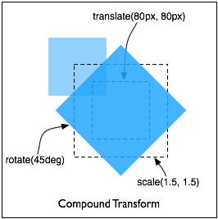
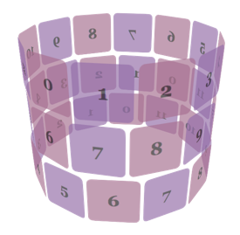
2D AND 3D TRANSFORMS
http://www.w3.org/TR/css3-2d-transforms/
http://www.w3.org/TR/css3-3d-transforms/
2D
div {
height: 100px;
width: 100px;
transform: translate(80px, 80px)
scale(1.5, 1.5)
rotate(45deg);
}
3D
http://webkit.org/blog/386/3d-transforms/

Slide 11
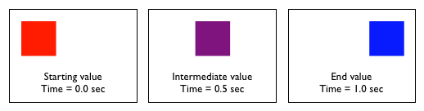
TRANSITIONS AND ANIMATIONS
http://www.w3.org/TR/css3-transitions/
http://www.w3.org/TR/css3-animations/
Transitions
div {
transition-property: color, left;
transition-duration: 1s;
transition-timing: ease-in;
}
var box = document.getElementById("box");
box.style.left = "100px";
box.style.color = "blue";
Animations
@keyframes 'diagonal-slide' {
from {
left: 0; top: 0;
}
to {
left: 100px; top: 100px;
}
}
div {
animation-name: 'diagonal-slide';
animation-duration: 5s;
animation-iteration-count: 10;
}

Slide 12
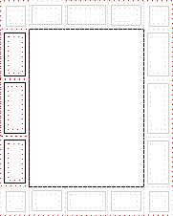
PAGE MEDIA
http://www.w3.org/TR/css3-page/
@page {
size: 8.5in 11in;
margin: 10%;
@top-left {
content: "Hamlet";
}
@top-right {
content: "Page " counter(page);
}
}
/* style sheet for "A4" printing */
@media print and (width: 21cm) and (height: 29.7cm) {
@page {
margin: 3cm;
}
}
/* style sheet for "letter" printing */
@media print and (width: 8.5in) and (height: 11in) {
@page {
margin: 1in;
}
}

Slide 13

WHAT WORKS NOW? WHERE?
http://www.css3.info/preview/
http://www.westciv.com/iphonetests/
border-radius
-moz-border-radius: 5px; /* Firefox */
-webkit-border-radius: 5px; /* Safari / Chrome */
border-radius:5px; /* Opera / MSIE9 */
border-image
-moz-border-image:
-webkit-border-image:
box-shadow
-moz-box-shadow: 10px 10px 5px #888888;
-webkit-box-shadow: 10px 10px 5px #888888;
box-shadow: 10px 10px 5px #888888;
Multiple backgrounds
Box-sizing
-moz-box-sizing: border-box;
-webkit-box-sizing: border-box;
box-sizing: border-box;
Multi-column-layout
-moz-column-width: 13em;
-moz-column-gap: 1em;
-webkit-column-width: 13em;
-webkit-column-gap: 1em;

