Slide 1
CLOUD COMPUTING – II · UNIT IV
Kubernetes & Container
Orchestration
Complete classroom deck · Syllabus topics with subtopics
Architecture · Cluster setup · Deploy · Networking · Scale
GKE · kubectl · Services · Ingress · HPA · exam revision
FIT & CS · Parul University · Weightage 15% · 7 hours

Slide 2
Learning Outcomes
By the end of Unit IV you should be able to…
Define Kubernetes
Draw architecture
Explain why containers need an orchestrator at cluster scale.
Control plane vs worker nodes — API Server, Scheduler, etcd, kubelet.
Set up a cluster
Deploy apps
Create & connect to GKE (Autopilot/Standard); use namespaces.
Image → registry → Deployment → Service; rolling update & rollback.
Expose traffic
Monitor & scale
Service types + Ingress; why Pod IPs are ephemeral.
HPA, cluster capacity, logs/metrics; Practical 4 & 10 mindset.
CC-II · Unit IV · Kubernetes & Container Orchestration · Parul University
2

Slide 3
Unit IV Syllabus — Roadmap
Five syllabus topics · each expanded with subtopics
1
Introduction to Kubernetes & its Architecture
2
Setting Up & Managing Kubernetes Clusters
3
Deploying Applications on Kubernetes
4
Kubernetes Networking & Load Balancing
5
Monitoring & Scaling Kubernetes Workloads
CC-II · Unit IV · Kubernetes & Container Orchestration · Parul University
3

Slide 4
TOPIC 1
Introduction to Kubernetes & Architecture
→ Problem K8s solves · definition · containers vs VMs
→ Control plane + worker nodes
→ Must-know objects · desired vs actual state
→ GKE Autopilot vs Standard
CC-II · Unit IV · Kubernetes & Container Orchestration · Parul University
4

Slide 5
1.1 What problem does Kubernetes solve?
One container is easy — hundreds across machines is not
Without an orchestrator you must manually…
Decide which server runs which container · Restart crashed containers
Scale before traffic spikes · Route users to healthy instances · Roll out without downtime
Placement
Self-healing
Scaling
Which node runs which container?
Restart when a container dies
Add/remove replicas under load
Networking
Updates
Ops at scale
Stable access as Pod IPs change
New version with near-zero downtime
Hundreds of containers, many machines
CC-II · Unit IV · Kubernetes & Container Orchestration · Parul University
5

Slide 6
1.2 What is Kubernetes? (exam definition)
Write this in long answers
Definition
Kubernetes is an open-source container orchestration platform that automates
the deployment, scaling, networking, and management of containerized
applications across a cluster of machines.
One line: “Kubernetes is the operating system for your containers at cluster scale.”
Origin (viva)
Skills transfer
Built by Google, inspired by Borg
Now maintained by the CNCF community
Often abbreviated K8s (K + 8 letters + s)
GKE (GCP) · EKS (AWS) · AKS (Azure)
Same core objects: Pod, Deployment, Service
kubectl works across managed Kubernetes
CC-II · Unit IV · Kubernetes & Container Orchestration · Parul University
6

Slide 7
1.3 Container vs VM vs Kubernetes
Quick orientation for exams
Virtual Machine
Container
Kubernetes
Full OS guest on a hypervisor
Heavier · slower start
Strong isolation
Good for legacy / full OS needs
App + deps share host kernel
Light · fast start
Packaged as an image
Docker / containerd run them
Schedules & manages many
containers across nodes
Self-healing · scale · LB
Containers package; K8s operates
Real life: Exam tip: Containers package the app; Kubernetes runs fleets of them.
CC-II · Unit IV · Kubernetes & Container Orchestration · Parul University
7

Slide 8
1.4 Why Unit IV matters
Course story arc
Unit I–II
Unit III
Unit IV
Design well · recover when infra fails
Create infrastructure as code
Run microservices as containers at scale
Principles · DR · RTO/RPO
Terraform can create GKE too
Orchestration · you are here
CC-II · Unit IV · Kubernetes & Container Orchestration · Parul University
8

Slide 9
1.5 Architecture — Control plane + worker nodes
Draw this in 7-mark answers
Cluster = control plane (brain) + worker nodes (muscle)
Users / kubectl talk to the API Server; controllers keep desired state true on nodes.
API Server
Scheduler
Controller Mgr
etcd
Front door for kubectl / controllers
Picks which node runs a Pod
Reconciles desired vs actual state
Distributed store of cluster state
kubelet
kube-proxy
Runtime
Agent on each node — runs Pods as instructed
Helps implement Service networking / LB rules
containerd / Docker — actually starts containers
CC-II · Unit IV · Kubernetes & Container Orchestration · Parul University
9

Slide 10
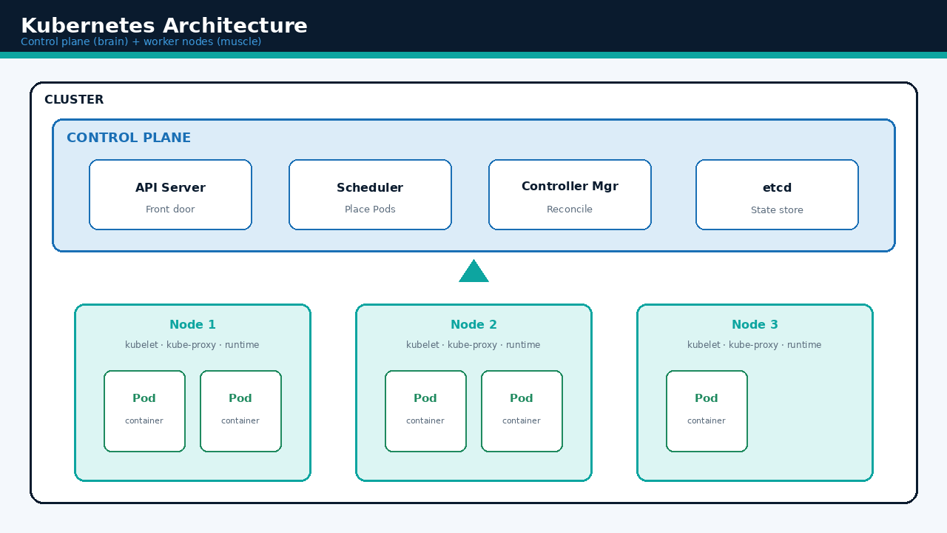
Topic 1 · Architecture diagram
VISUAL
CC-II · Unit IV · Kubernetes & Container Orchestration · Parul University
10

Slide 11
1.6 Must-know objects (vocabulary)
Memorise names + one-line meaning
Pod
Deployment
ReplicaSet
Service
Smallest unit — one+ containers sharing net/volumes
Desired replicas + rolling updates / rollbacks
Keeps N identical Pods (owned by Deployment)
Stable VIP/DNS in front of changing Pods
Namespace
ConfigMap / Secret
Ingress
PV / PVC
Virtual slice for isolation (dev / prod / team)
Non-secret config / sensitive data for Pods
HTTP(S) host/path routing to Services
Durable storage claim for Pods needing disks
CC-II · Unit IV · Kubernetes & Container Orchestration · Parul University
11

Slide 12
1.7 Desired state vs actual state
Same declarative idea as Terraform (Unit III)
You declare
Self-healing
“I want 3 replicas of hello-app image v2”
Stored as Deployment / YAML in Git
Controllers watch and reconcile
If a Pod crashes → replacement appears
Controllers continuously compare
desired state vs actual state
Create / replace / delete until match
Exam phrase: “Desired state reconciled
by controllers (self-healing)”
Real life: Link Unit III: Terraform declares cloud resources; Kubernetes declares app replicas.
CC-II · Unit IV · Kubernetes & Container Orchestration · Parul University
12

Slide 13
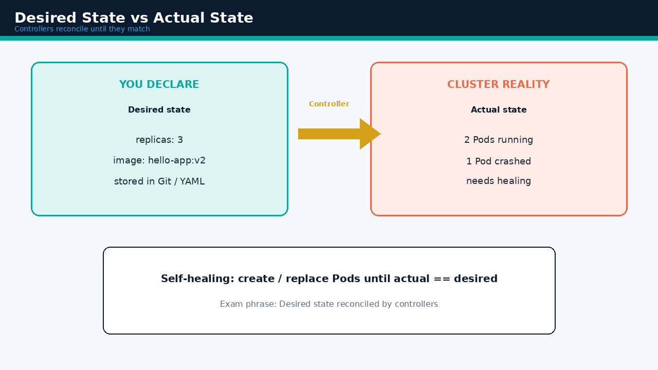
Topic 1 · Desired vs actual
VISUAL
CC-II · Unit IV · Kubernetes & Container Orchestration · Parul University
13

Slide 14
Topic 1 · Self-healing (GIF)
VISUAL
CC-II · Unit IV · Kubernetes & Container Orchestration · Parul University
14

Slide 15
1.8 GKE — managed Kubernetes on Google Cloud
Autopilot vs Standard (exam comparison)
What is GKE?
Google Kubernetes Engine: Google runs the control plane; you deploy workloads.
Open-source Kubernetes skills transfer to EKS / AKS / on-prem.
Autopilot
Standard
Google manages nodes
Pay for Pod resource requests
Opinionated safe defaults
Best for most labs & many prod apps
gcloud container clusters create-auto …
You size / manage node pools
Pay for node VMs
More flexibility (GPUs, custom machines)
Best when you need special hardware
gcloud container clusters create …
CC-II · Unit IV · Kubernetes & Container Orchestration · Parul University
15

Slide 16
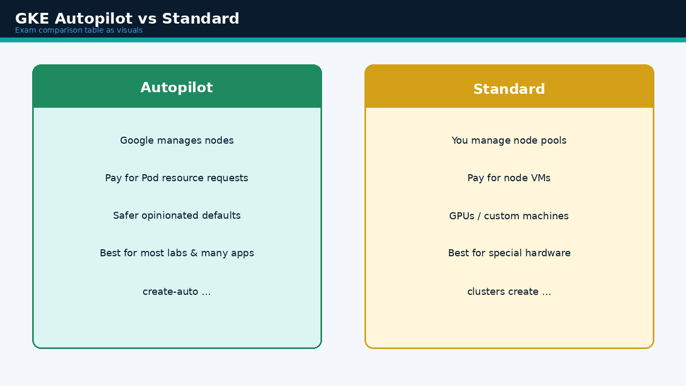
Topic 1 · GKE modes
VISUAL
CC-II · Unit IV · Kubernetes & Container Orchestration · Parul University
16

Slide 17
TOPIC 2
Setting Up & Managing Clusters
→ Big-picture setup steps · prerequisites
→ Create Autopilot / Standard · get-credentials
→ Release channels · namespaces · node ops
→ Security baseline · IaC link (Unit III)
CC-II · Unit IV · Kubernetes & Container Orchestration · Parul University
17

Slide 18
2.1 Cluster setup — big picture
Practical 4 mindset
Step 1
Step 2
Step 3
Project / billing / region
Enable APIs (Compute, GKE, Artifact Registry)
Create cluster (Autopilot or Standard)
Step 4
Step 5
Step 6
get-credentials → kubeconfig
Verify: kubectl get nodes
Namespaces + pull permissions
CC-II · Unit IV · Kubernetes & Container Orchestration · Parul University
18

Slide 19
2.2 Prerequisites (lab / Practical 4)
Tools & APIs before create
You need
Config sketch
Google Cloud project with billing
Tools: gcloud, kubectl, docker
(Cloud Shell already has these)
Enabled APIs:
· Compute Engine
· Kubernetes Engine
· Artifact Registry
export PROJECT_ID=your-project-id
gcloud config set project $PROJECT_ID
gcloud config set compute/region REGION
Then create cluster + get-credentials
Creation takes several minutes while
control plane and nodes become healthy
CC-II · Unit IV · Kubernetes & Container Orchestration · Parul University
19

Slide 20
2.3 Creating a cluster on GKE
Know the idea — exact flags may vary
Autopilot (recommended for labs)
Standard (more control)
gcloud container clusters create-auto
hello-cluster --region=REGION
Google manages nodes for you
Focus on Deployments & Services
gcloud container clusters create
hello-cluster --num-nodes=3
--region=REGION
You choose node count / machine type
Enable node auto-repair / auto-upgrade
Real life: Exam line: Managing a cluster = healthy control plane + nodes + correct credentials + namespaces.
CC-II · Unit IV · Kubernetes & Container Orchestration · Parul University
20

Slide 21
2.4 Connecting kubectl
get-credentials writes kubeconfig
Connect
gcloud container clusters get-credentials hello-cluster --region=REGION
Then: kubectl get nodes · kubectl cluster-info · kubectl get namespaces
What happens?
Verify health
Entry written into kubeconfig
kubectl talks to that cluster’s API Server
All later apply / get / logs use this context
Nodes should show Ready
If Pending Pods later → check capacity
describe / events explain failures
CC-II · Unit IV · Kubernetes & Container Orchestration · Parul University
21

Slide 22
2.5 Release channels & upgrades
Managing versions without surprise downtime
Rapid
Regular
Stable
Latest features — good for testing
Balance of new features & stability (common default)
Slowest, most conservative upgrades
Management practices
Prefer regional clusters for higher control-plane availability
Set maintenance windows so upgrades do not surprise exam / result day
Test on non-prod first · keep kubectl client close to cluster version
CC-II · Unit IV · Kubernetes & Container Orchestration · Parul University
22

Slide 23
2.6 Namespaces & node operations
Organise workloads · maintain nodes
Namespaces
Node ops (Standard)
Virtual areas inside one cluster
kubectl create namespace staging
kubectl create namespace production
kubectl get pods -n staging
kubectl apply -f app.yaml -n production
Separate teams, envs, or noisy tests
drain NODE — evacuate before maintenance
cordon NODE — stop scheduling new Pods
uncordon NODE — accept Pods again
Autopilot: Google handles much of
node repair / scaling for you
CC-II · Unit IV · Kubernetes & Container Orchestration · Parul University
23

Slide 24
2.7 Security baseline & IaC link
Production habits + Unit III connection
Security baseline
IaC link (Unit III)
Least-privilege IAM for get-credentials
Private nodes / authorised networks
Workload Identity (avoid long-lived keys)
NetworkPolicies for Pod-to-Pod limits
Image scanning in Artifact Registry
Prod teams often create GKE with
Terraform (google_container_cluster)
Git is source of truth for cluster shape
Then kubectl/Helm declare apps inside
Two declarative layers: infra + workloads
CC-II · Unit IV · Kubernetes & Container Orchestration · Parul University
24

Slide 25
TOPIC 3
Deploying Applications on Kubernetes
→ Image → registry → Deployment → Service
→ Pods, labels, declarative YAML
→ Rolling updates & rollbacks
→ ConfigMaps, Secrets, health probes
CC-II · Unit IV · Kubernetes & Container Orchestration · Parul University
25

Slide 26
3.1 Deployment pipeline (container path)
Standard path for Practical 4
Write app
Build image
Push registry
Code + Dockerfile
docker build …
Artifact Registry
Deployment
Expose Service
Verify
replicas + template
ClusterIP / LB
pods · logs · IP
CC-II · Unit IV · Kubernetes & Container Orchestration · Parul University
26

Slide 27
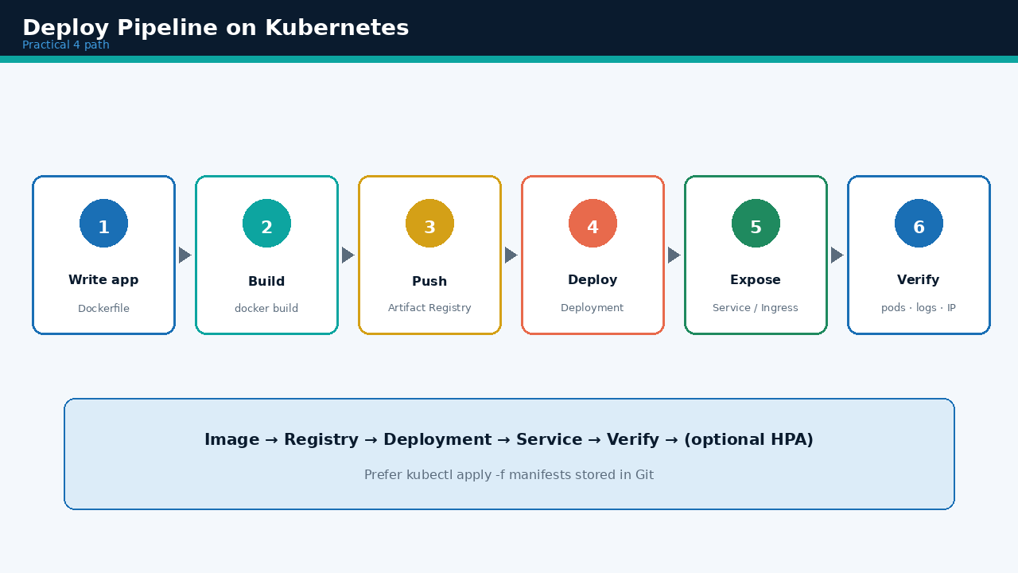
Topic 3 · Deploy pipeline
VISUAL
CC-II · Unit IV · Kubernetes & Container Orchestration · Parul University
27

Slide 28
3.2 Container images & Artifact Registry
GKE pulls images from a registry
On GCP, Artifact Registry is the modern image store
Create repo → docker build/tag → configure-docker → push → grant pull permission
Build & push (conceptual)
Permission tip
docker build -t REGION-docker.pkg.dev/
PROJECT/hello-repo/hello-app:v1 .
gcloud auth configure-docker …
docker push …/hello-app:v1
Grant node / GKE service account
reader role on the repository
Without pull rights → ImagePullBackOff
Check: kubectl describe pod
CC-II · Unit IV · Kubernetes & Container Orchestration · Parul University
28

Slide 29
3.3 Pods & Deployments
How apps are usually run
Pod — smallest unit
Deployment — usual controller
Usually one main container
(sometimes a helper sidecar)
Pods are mortal — if a node dies,
that Pod’s IP is gone
Controllers recreate Pods;
never treat a Pod IP as permanent
Owns Pod template + replica count
Imperative lab:
kubectl create deployment hello-app
--image=…/hello-app:v1
kubectl scale deployment hello-app
--replicas=3
Prefer declarative YAML in Git
CC-II · Unit IV · Kubernetes & Container Orchestration · Parul University
29

Slide 30
3.4 Declarative Deployment YAML
Show this pattern in exams / labs
hello-deployment.yaml (shape)
apiVersion: apps/v1 kind: Deployment metadata.name: hello-app
spec.replicas: 3
spec.selector.matchLabels.app: hello-app
template.metadata.labels.app: hello-app
template.spec.containers[0].image: …/hello-app:v1
template.spec.containers[0].ports.containerPort: 8080
kubectl apply -f hello-deployment.yaml
CC-II · Unit IV · Kubernetes & Container Orchestration · Parul University
30

Slide 31
3.5 Labels, selectors & rolling updates
Services find Pods by labels
Labels & selectors
Rolling update
Labels = key/value tags (app=hello-app)
Deployments & Services use selectors
to find matching Pods
Inconsistent labels → Service finds nothing
Build/push hello-app:v2
kubectl set image deployment/hello-app …
kubectl rollout status deployment/hello-app
Old Pods gradually replaced; Service
sends traffic only to Ready Pods
Rollback if v2 is bad
kubectl rollout undo deployment/hello-app
kubectl rollout history deployment/hello-app · Fast reverse without SSH into machines
CC-II · Unit IV · Kubernetes & Container Orchestration · Parul University
31

Slide 32
Topic 3 · Rolling update (GIF)
VISUAL
CC-II · Unit IV · Kubernetes & Container Orchestration · Parul University
32

Slide 33
3.6 ConfigMaps, Secrets & health probes
Config without rebuild · Ready before traffic
ConfigMap
Secret
Probes
Non-secret config
Feature flags, env vars
nginx snippets
Inject without rebuilding image
Passwords, tokens, keys
Base64 in etcd at rest
Still protect with IAM
Do not commit prod secrets to Git
Liveness → restart if dead
Readiness → remove from Service
until ready
Startup → slow booters
Without readiness, users
may hit booting Pods
CC-II · Unit IV · Kubernetes & Container Orchestration · Parul University
33

Slide 34
3.7 Common kubectl deploy commands
Lab cheat sheet
kubectl apply -f FILE.yaml
Create / update from manifest
kubectl get pods,deploy,svc
List key objects
kubectl describe pod NAME
Events — why Pending / CrashLoop
kubectl logs POD [-c CONTAINER]
Application logs
kubectl exec -it POD -- /bin/sh
Debug shell (use carefully)
kubectl delete -f FILE.yaml
Remove resources in file
CC-II · Unit IV · Kubernetes & Container Orchestration · Parul University
34

Slide 35
TOPIC 4
Kubernetes Networking & Load Balancing
→ Why Pod IPs are not enough
→ Service types (memorise)
→ Ingress HTTP routing
→ NetworkPolicy brief · CE vs GKE comparison
CC-II · Unit IV · Kubernetes & Container Orchestration · Parul University
35

Slide 36
4.1 The core networking problem
Pods change — clients need stability
Problem
Pods get cluster IPs that change when Pods are recreated.
Clients need a stable way to reach “the hello-app” as Pods come and go.
Service
Ingress
Cloud LB
Stable virtual IP + DNS → set of Pods
Must-say: Pod IPs are ephemeral —
Services give stability
HTTP(S) host/path routing → Services
Must-say: Pod IPs are ephemeral —
Services give stability
LoadBalancer type → cloud provisions external LB
Must-say: Pod IPs are ephemeral —
Services give stability
CC-II · Unit IV · Kubernetes & Container Orchestration · Parul University
36

Slide 37
4.2 Cluster DNS & Service types
Memorise the four types
DNS inside the cluster
hello-app.default.svc.cluster.local · same namespace often just: hello-app
ClusterIP
NodePort
LoadBalancer
ExternalName
Internal only (default)
Use: Backend microservices
Node IP + high port
Use: Labs / simple exposure
External IP via cloud LB
Use: Public web / APIs
CNAME to external name
Use: Point outside the cluster
CC-II · Unit IV · Kubernetes & Container Orchestration · Parul University
37

Slide 38
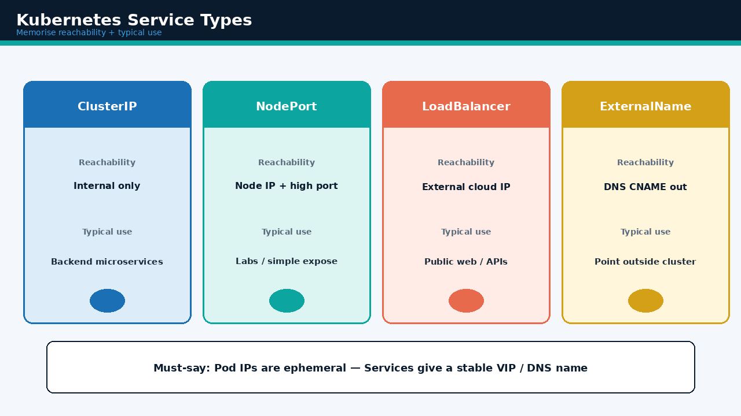
Topic 4 · Service types
VISUAL
CC-II · Unit IV · Kubernetes & Container Orchestration · Parul University
38

Slide 39
4.3 Expose publicly + port mapping
Lab classic LoadBalancer path
Expose (imperative lab)
kubectl expose deployment hello-app --name=hello-app-service
--type=LoadBalancer --port=80 --target-port=8080
kubectl get service → wait until EXTERNAL-IP leaves <pending>
Port mapping mental model
User → LoadBalancer port 80 → Service → Pod targetPort 8080 (container)
Always match containerPort in the Pod with targetPort on the Service
CC-II · Unit IV · Kubernetes & Container Orchestration · Parul University
39

Slide 40
4.4 How load balancing works
Ready endpoints join the pool
Service selects Pods by label
Real-life parallel
kube-proxy / dataplane distributes
connections across Ready endpoints
When HPA adds Pods, they join the pool
once Ready (readiness probes matter)
Unready Pods do not receive traffic
UPI-style stack:
Ingress terminates TLS at the edge
Routes /pay to payments ClusterIP
payments Pods stay private
Only Ingress / LB edge is public
CC-II · Unit IV · Kubernetes & Container Orchestration · Parul University
40

Slide 41
4.5 Ingress — HTTP(S) routing
One entry · many services
Example routes
api.example.com/orders → orders-service
api.example.com/pay → payments-service
Benefits
Exam contrast
One external entry, many services
Host / path based routing
TLS termination with certificates
(production pattern)
Service LoadBalancer → often one
LB per service (simple)
Ingress → shared HTTP routing layer
(microservices friendly)
CC-II · Unit IV · Kubernetes & Container Orchestration · Parul University
41

Slide 42
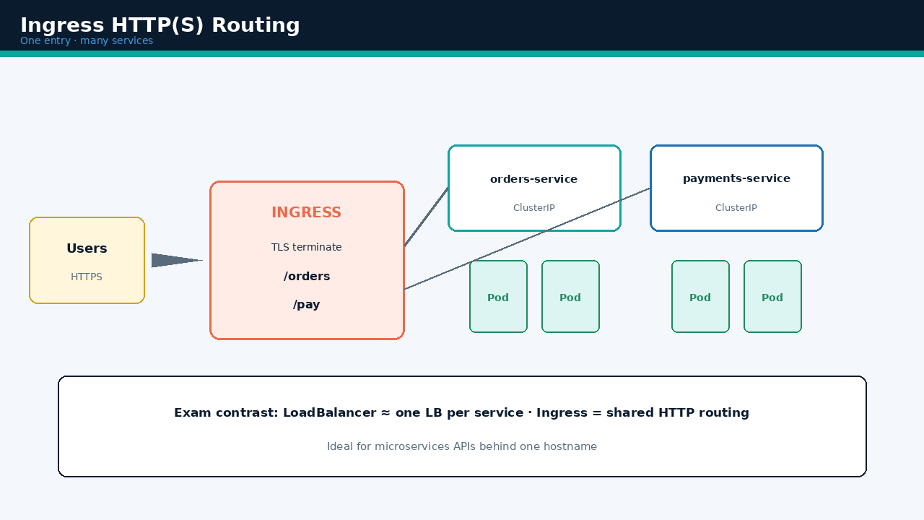
Topic 4 · Ingress routing
VISUAL
CC-II · Unit IV · Kubernetes & Container Orchestration · Parul University
42

Slide 43
4.6 NetworkPolicy & CE vs GKE networking
Brief advanced note + Unit II lab memory
NetworkPolicy (brief)
Compute Engine vs GKE
By default many clusters allow
wide Pod-to-Pod traffic
NetworkPolicy can restrict who may talk
(zero-trust style)
Important for multi-tenant & payments
CE: firewall rules + VM IPs +
HTTP(S) LB + MIG
GKE: Services / Ingress + Pod IPs +
cloud LB via Service type
Same goal (reach healthy backends);
different abstraction level
CC-II · Unit IV · Kubernetes & Container Orchestration · Parul University
43

Slide 44
TOPIC 5
Monitoring & Scaling Workloads
→ Why monitor · metrics / logs / traces
→ HPA (Horizontal Pod Autoscaler)
→ Cluster / node scaling · VPA brief
→ Alerting · logging · peak events
CC-II · Unit IV · Kubernetes & Container Orchestration · Parul University
44

Slide 45
5.1 Why monitoring matters
Orchestration hides machines — you must watch
Restarts
Saturation
Latency
CrashLoopBackOff / restart storms
Practical 10 focus:
monitor & log K8s workloads
CPU & memory pressure
Practical 10 focus:
monitor & log K8s workloads
Request latency & error rate
Practical 10 focus:
monitor & log K8s workloads
Nodes
Rollouts
Capacity
NotReady · disk pressure
Practical 10 focus:
monitor & log K8s workloads
Deployment rollout health
Practical 10 focus:
monitor & log K8s workloads
Pods Pending too long
Practical 10 focus:
monitor & log K8s workloads
CC-II · Unit IV · Kubernetes & Container Orchestration · Parul University
45

Slide 46
5.2 Signals — metrics, logs, traces
Cloud Operations on GKE
Metrics
Logs
Traces
CPU, memory, RPS, latency
Feed HPA and dashboards
kubectl top nodes / pods
(needs metrics-server)
stdout / stderr from containers
kubectl logs · Cloud Logging
12-factor: log to stdout
Filter by labels / namespaces
Request path across
microservices (APM)
Advanced but useful for
payment / checkout flows
CC-II · Unit IV · Kubernetes & Container Orchestration · Parul University
46

Slide 47
5.3 Useful observability commands
Diagnose before you guess
kubectl get pods -o wide
Where Pods run · IPs · nodes
kubectl describe pod NAME
Events explain Pending / OOMKilled
kubectl top nodes / pods
CPU & memory snapshot
kubectl logs deploy/hello-app
App output / errors
kubectl get events --sort-by=…
Recent cluster events
CC-II · Unit IV · Kubernetes & Container Orchestration · Parul University
47

Slide 48
5.4 Horizontal Pod Autoscaler (HPA)
Scale Pods — not VMs (by default)
Command
kubectl autoscale deployment hello-app --cpu-percent=80 --min=1 --max=5
If average CPU > target → add Pods (up to max) · load drops → remove (down to min)
Behaviour
Peak events
Needs metrics (metrics-server /
Cloud Monitoring)
Set resource requests/limits so
scheduler & autoscaler know needs
Analogy: MIG scales VMs; HPA scales Pods
Result day / festival sale:
raise HPA max; ensure cluster
can add nodes; watch error rate
After peak: let HPA scale down
(FinOps — avoid idle spend)
CC-II · Unit IV · Kubernetes & Container Orchestration · Parul University
48

Slide 49
Topic 5 · HPA scaling (GIF)
VISUAL
CC-II · Unit IV · Kubernetes & Container Orchestration · Parul University
49

Slide 50
5.5 Cluster / node scaling & VPA
When Pods are Pending — capacity problem
Node / cluster scaling
Vertical Pod Autoscaler (brief)
Autopilot: Google adds capacity
based on Pod requests
Standard: Cluster Autoscaler /
node auto-provisioning can add nodes
HPA scales Pods;
cluster autoscaler scales nodes
VPA suggests or applies higher/lower
CPU/memory requests
Often combined carefully with HPA
(advanced — know the idea)
Exam: name HPA first; mention VPA
as vertical alternative
CC-II · Unit IV · Kubernetes & Container Orchestration · Parul University
50

Slide 51
5.6 Alerting & logging best practices
Page on symptoms users feel
CrashLoopBackOff / high restart rate
Elevated 5xx at Ingress / Service
Pod Pending too long (capacity)
Node NotReady
Apps log to stdout/stderr → Cloud Logging
Filter by labels / namespaces per team
CC-II · Unit IV · Kubernetes & Container Orchestration · Parul University
51

Slide 52
CASE STUDIES
Real-life examples for 7-mark answers
Quote one case + object (Deployment/Service/HPA) + teaching point
CC-II · Unit IV · Kubernetes & Container Orchestration · Parul University
52

Slide 53
Real-life cases
Use these stories in long answers & viva
Campus result portal on GKE
Container + Deployment + HPA min=2 max=20 + LoadBalancer/Ingress + 5xx alerts.
Teaching point: Scale Pods automatically; rolling update content without overnight downtime.
Food delivery microservices
Many Deployments; ClusterIP between services; Ingress at edge; HPA per service; namespaces.
Teaching point: Networking + independent replica counts fit microservices.
UPI / payments API
Regional GKE; readiness probes; staged rolling update; fast rollout undo; NetworkPolicy.
Teaching point: Orchestration + probes + rollback protect trust-critical traffic.
CC-II · Unit IV · Kubernetes & Container Orchestration · Parul University
53

Slide 54
Real-life cases
Use these stories in long answers & viva
E-commerce festival sale
Same manifests; staging namespace with smaller HPA max; promote image tag after soak.
Teaching point: Declarative deploys make environment parity practical.
Batch analytics on Spot
Jobs/CronJobs on Spot nodes; checkpoint to object storage; notify on failure, not every preempt.
Teaching point: Not every workload needs Hot Standby replicas — choose controllers wisely.
Bad image → CrashLoop
describe/logs diagnose; rollout undo; fix ConfigMap; add readiness probe.
Teaching point: Monitoring commands + rollback are daily Kubernetes operations.
CC-II · Unit IV · Kubernetes & Container Orchestration · Parul University
54

Slide 55
Exam Rapid Revision — Sheet A
Definitions & architecture
Kubernetes = container orchestration across a cluster (deploy, scale, network, heal)
Control plane: API Server · Scheduler · Controller Manager · etcd
Node: kubelet · kube-proxy · container runtime
Pod = smallest unit · Deployment = replicas + rolling updates · Service = stable endpoint
Desired state reconciled by controllers (self-healing)
GKE Autopilot: Google manages nodes, pay per Pod requests · Standard: you manage nodes
Pod IPs ephemeral — Services / Ingress give stability
CC-II · Unit IV · Kubernetes & Container Orchestration · Parul University
55

Slide 56
Exam Rapid Revision — Sheet B
Deploy · network · scale · must-say phrases
Deploy path: Build image → Registry → Deployment → Service → Verify → (HPA)
Rolling update + kubectl rollout undo = safer releases
Service types: ClusterIP · NodePort · LoadBalancer · ExternalName
Ingress = HTTP(S) host/path routing (and TLS) to many Services
HPA scales Pods; cluster autoscaler scales nodes
Must-say: Desired state · ephemeral Pod IPs · Ready before traffic · Practical 4 & 10
Link Unit III: Terraform creates GKE; Kubernetes YAML declares apps inside
CC-II · Unit IV · Kubernetes & Container Orchestration · Parul University
56

Slide 57
Important exam questions map
Q → which topic to revise
Q1
What is Kubernetes? Why needed?
Q2
Explain architecture (control plane & nodes)
Topic 1
Topic 1
Q3
Pod, Deployment, Service definitions
Q4
Set up & connect to a GKE cluster
Topics 1 + 3
Topic 2
Q5
Steps to deploy a containerized app
Q6
Rolling update & rollback
Topic 3
Topic 3
Q7
Service types · when use Ingress?
Q8
HPA + monitoring · Autopilot vs Standard
Topic 4
Topics 1 + 5
CC-II · Unit IV · Kubernetes & Container Orchestration · Parul University
57

Slide 58
Key Takeaways
Operate containers like a fleet — not one-by-one SSH
Declare desired state
Controllers reconcile — self-healing is the product.
Never trust a Pod IP
Expose via Services / Ingress; labels must stay consistent.
Ship with rollouts
Rolling update + undo beat overnight manual upgrades.
Scale with signals
HPA needs metrics; watch Pending Pods for capacity.
Two layers with IaC
Terraform shapes the cluster; YAML shapes the apps (Unit III).
CC-II · Unit IV · Kubernetes & Container Orchestration · Parul University
58

Slide 59
Thank you
Questions · Pick a case · Map it to Pod / Deployment / Service / HPA
Unit IV — Kubernetes & Container Orchestration
Pair with: notes/unit-4/CC-II-Unit-IV-Kubernetes-Container-Orchestration.txt
Lab links: Practical 4 (setup + deploy + scale) · Practical 10 (monitor + log)
FIT & CS, Parul University

