Slide 1
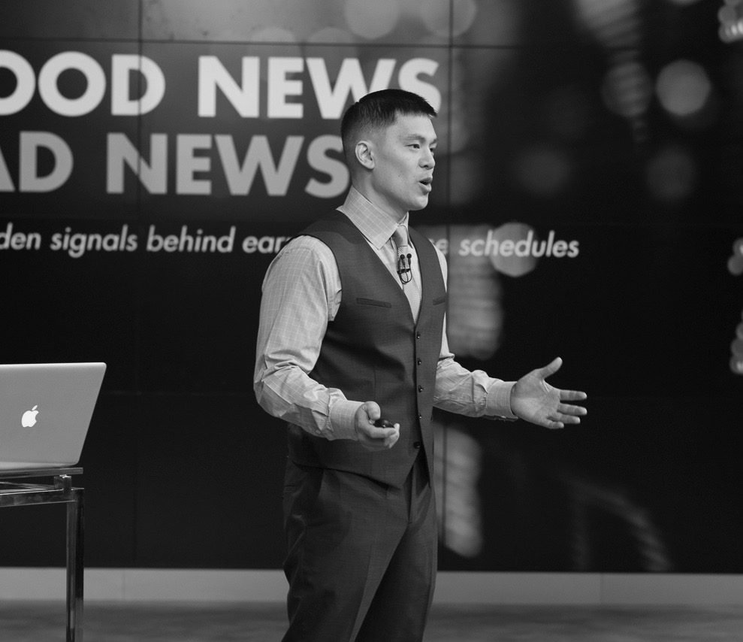

[Note: In place of “SHIFTING BRANDS FROM GIVING UP TO MOVING FORWARD” use “ERIC SO: MIT PROFESSOR OF GLOBAL ECONOMICS AND BEHAVIORAL SCIENCE”]
[Note: In place of “Our work” use “RESEARCH”; in place of “Our Playbook” use “MEDIA + VIDEOS”; in place of “Our Blog” use “THE COLLISION”; in place of “Your Turn” use “DATA + ARTIFACTS”]

Slide 2
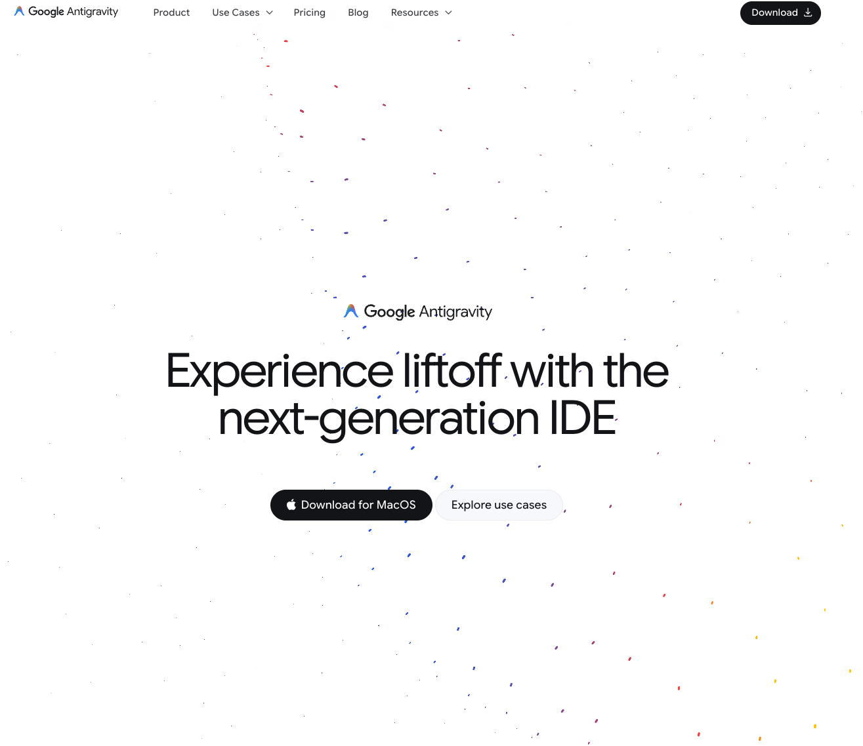
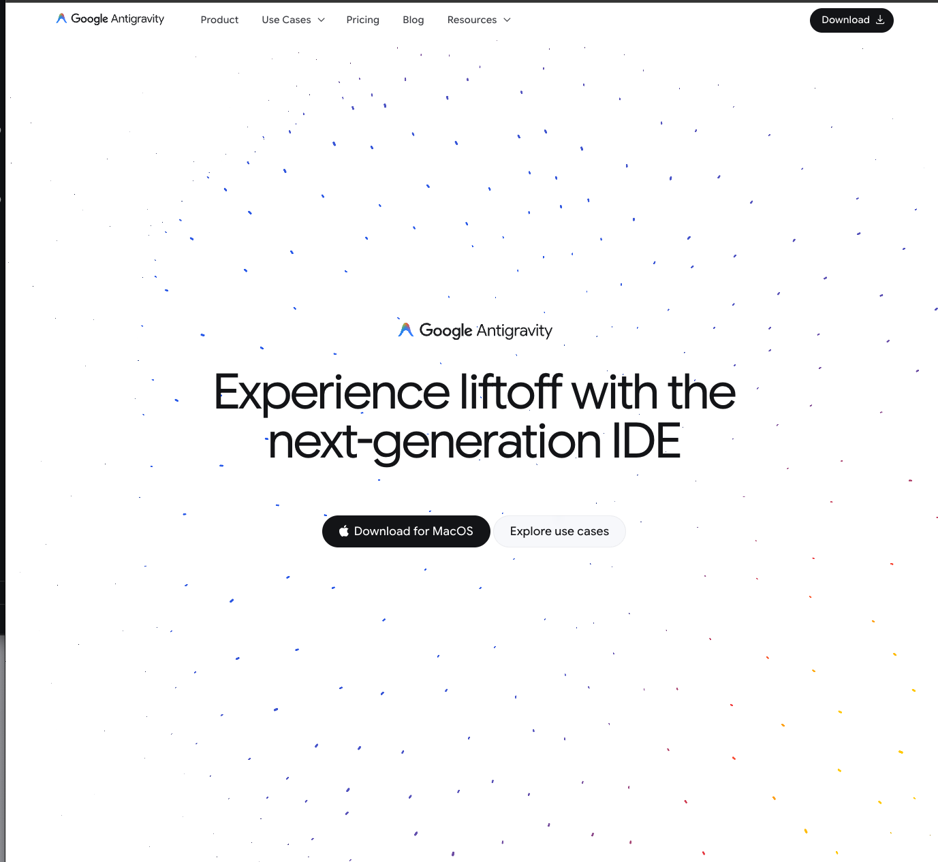
[Note: On the subpages, I want a dynamic background that moves and changes colors to sit behind the text as in the above example]

Slide 3


[Note: when scrolling, the background and text changes colors as in the above example]

