Slide 1
VirFormer
Identify Virus as an Anomaly
Modeling for virus nucleotide sequence prediction
by Qingcheng Zhao, Linshu Yang, Pengyu Long

Slide 2
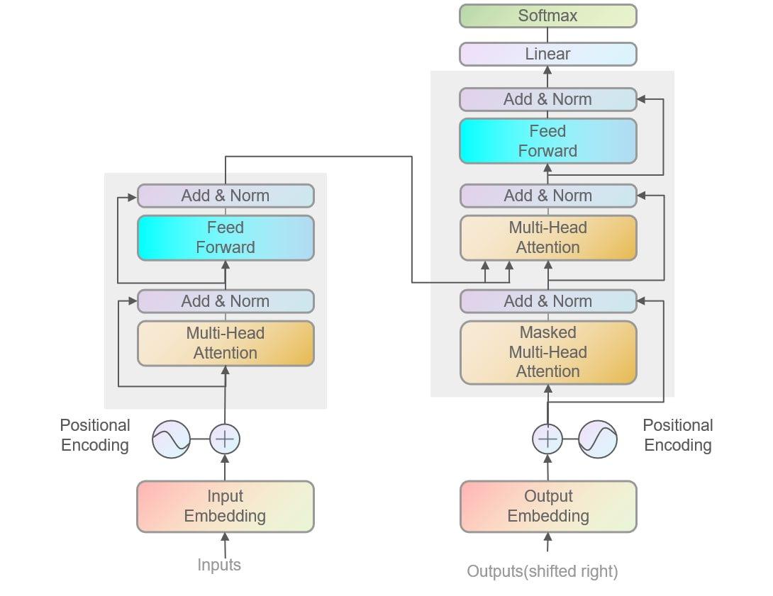
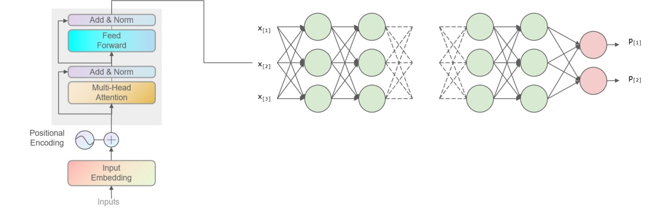
Abstract

Slide 3
Related Works
VirFinder: a novel k-mer based tool for identifying viral sequences from assembled metagenomic data
Deep Virfinder: Identifying viruses from metagenomic data using deep learning
VirSorter2: a multi-classifier, expert-guided approach to detect diverse DNA and RNA viruses
Virtifier: a deep learning-based identifier for viral sequences from metagenomes

Slide 4
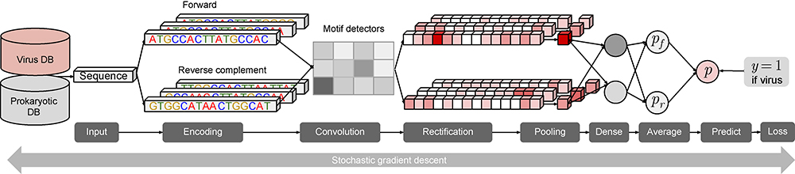
DeepVirFinder
CNN based motif detector
Binary classification
NCBI RefSeq dataset

Slide 5
Dataset
NCBI RefSeq dataset
Same data with DeepVirFinder
Before 2015 May: Training
After 2015 May: Testing
Extend the dataset from NCBI

Slide 6
Why transformer?
Proportion of non-coding DNAs can vary greatly between different organisms.
Coding DNAs may have a higher weight in determining the trait of organisms.
Coding DNAs may distribute discretely in a whole DNA sequence.
Attention is what we need!

Slide 7
Why autoencoder?
Unsupervised learning on big unlabeled data and finetuning on labeled virus data
Enlarging dataset

Slide 8
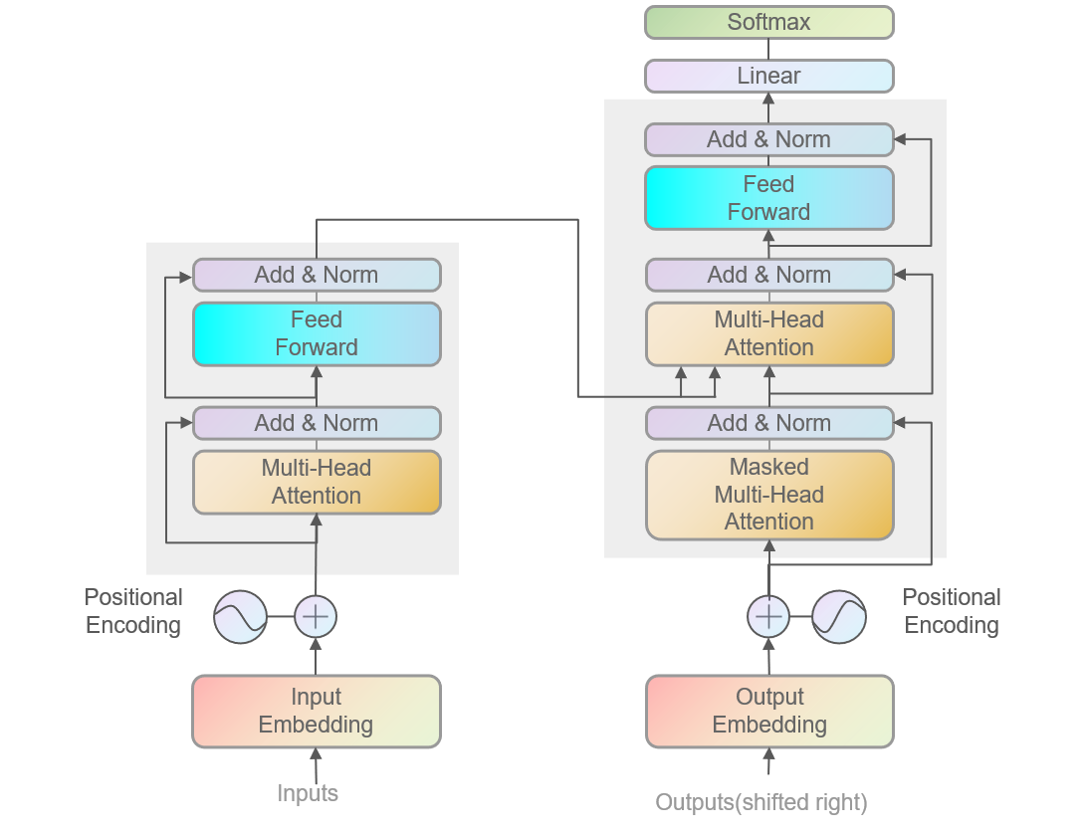
Autoencoder based on Transformer

Slide 9
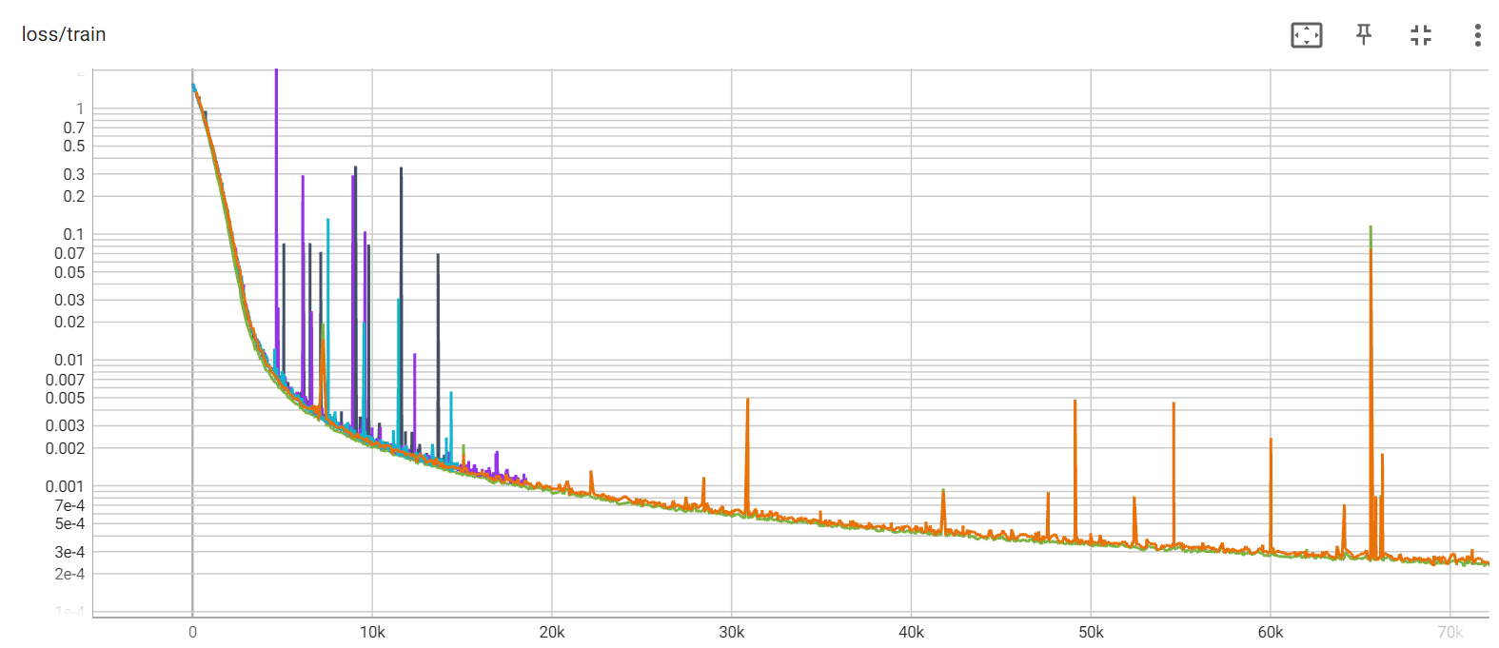
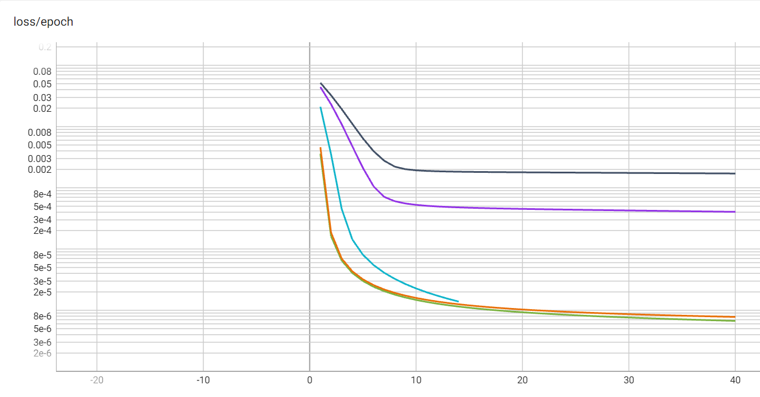
Our trials: various sequence length
1000bp
400bp
250bp

Slide 10
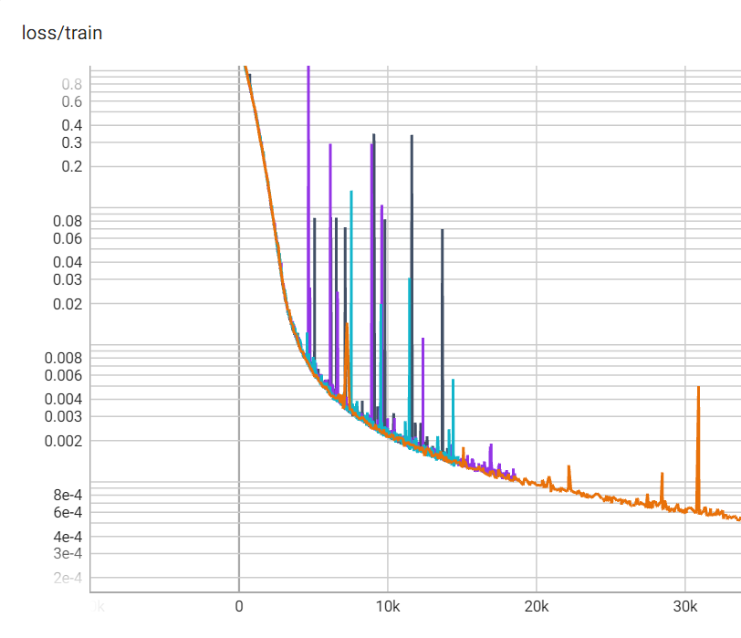
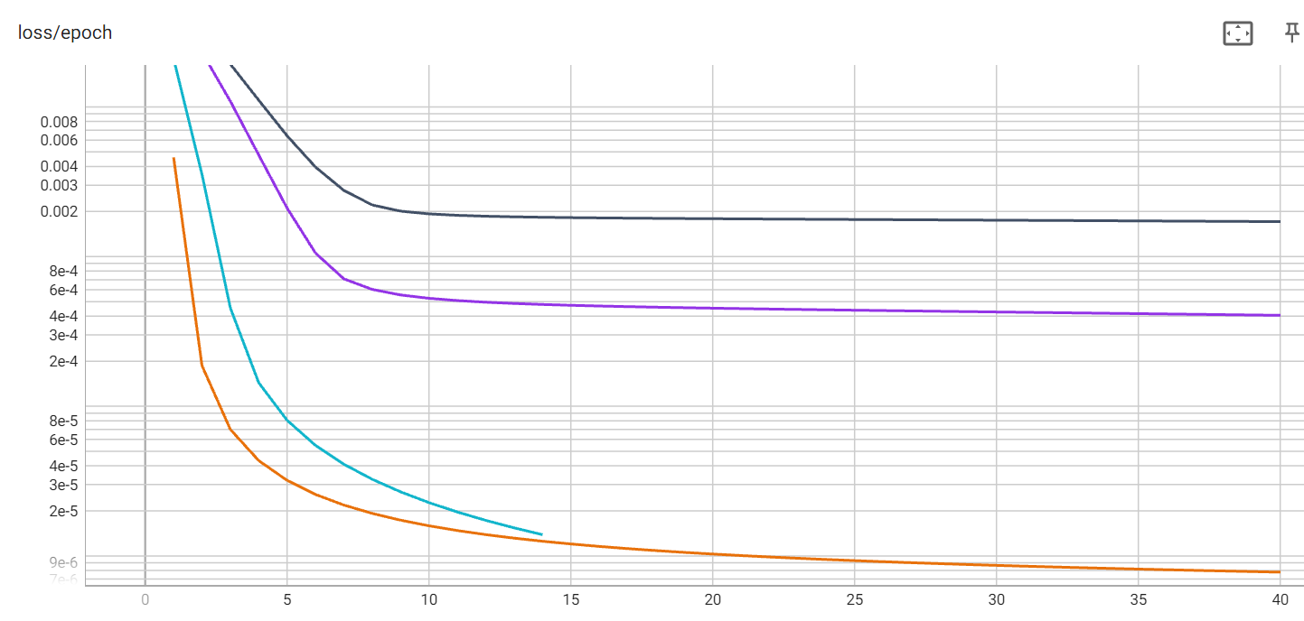
Our trials: various training data
full
non-virus
prokaryote
virus

Slide 11
Training autoencoder on full data
Learning latent space from data including virus
The latent space learn the potential difference between virus and other organism
Using mixed data of virus and non-virus DNA sequence with a proportion 1:9
A naïve thought

Slide 12
Training autoencoder on non-virus data
Learning latent space from data expect virus
The latent space learn pattern of DNA sequence of non-virus organism and consider the task of discriminating virus DNA as Anomaly Detection
Using non-virus DNA sequence, including prokaryote, human ,etc., whose amount is far more higher than virus.
An advanced thought

Slide 13
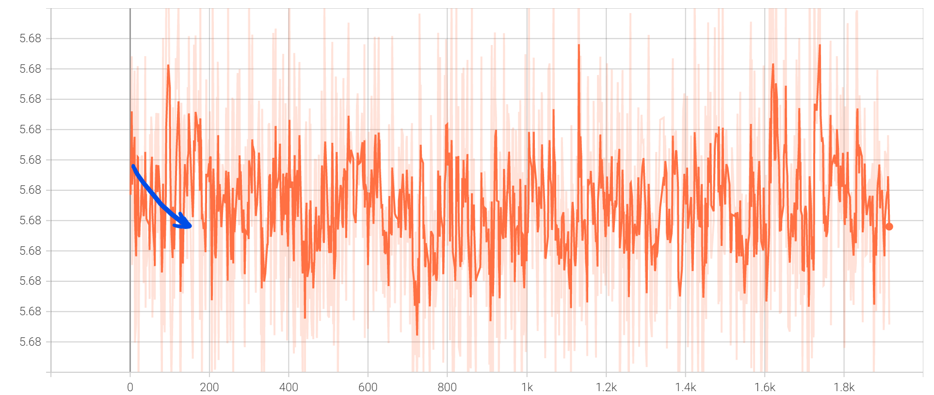
Exploration
Simple linear layer is not as effective as expected

Slide 14
Exploration
CNN can work!
CNNs are designed to exploit the spatial structure of data, while the latent space is in the shape of sequence length and embedding size.
CNNs use convolutional layers, which apply a set of filters to the input data in a sliding window fashion. In Image classification task, CNN can extract features such as edges, corners, and textures. In our task, CNN can extract motifs.
Because convolutional layers share their weights across all spatial positions, CNNs have fewer parameters than DNNs, which makes them more efficient and easier to train.

Slide 15
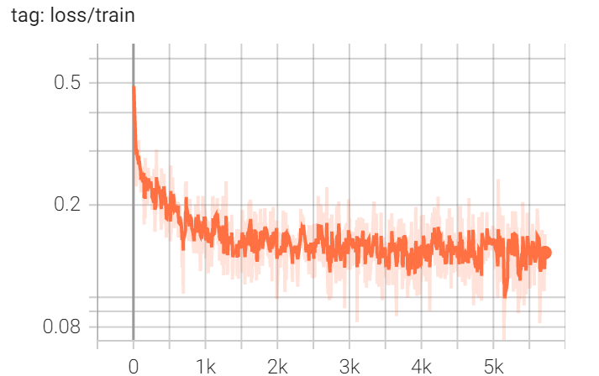
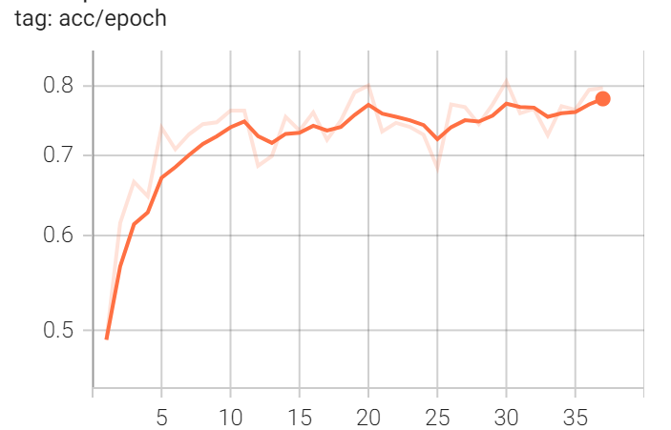
Exploration
CNN

Slide 16
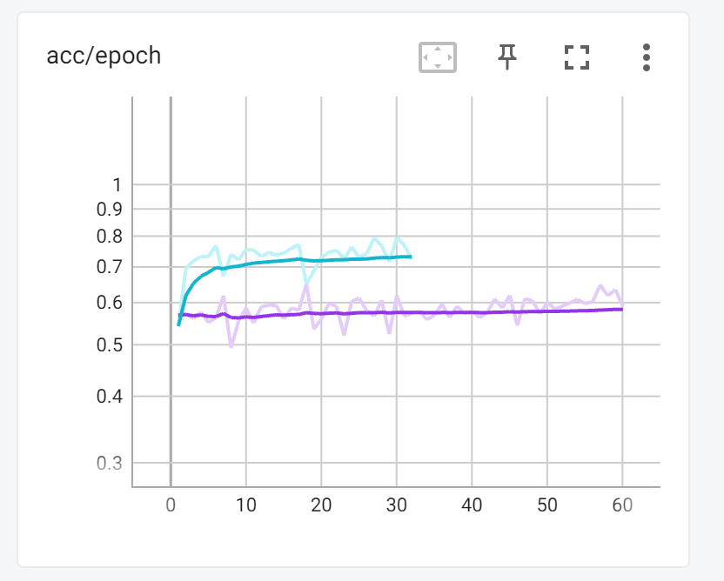
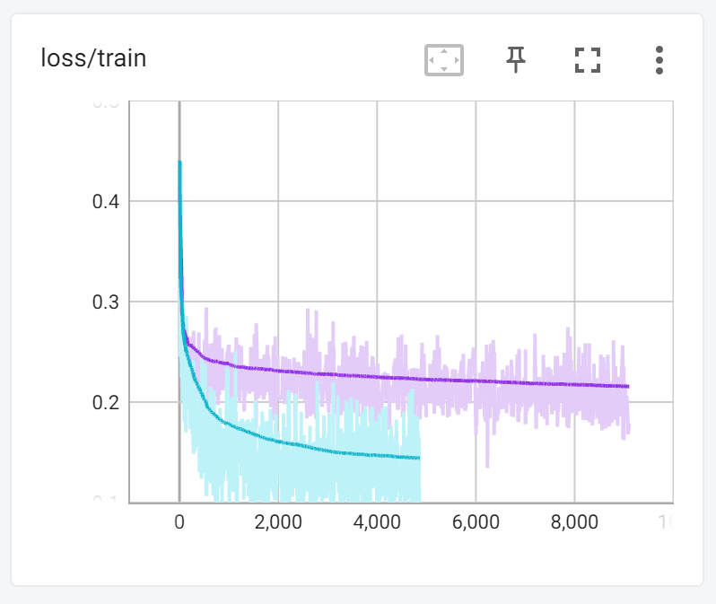
Exploration
CNN
Much better than linear

Slide 17
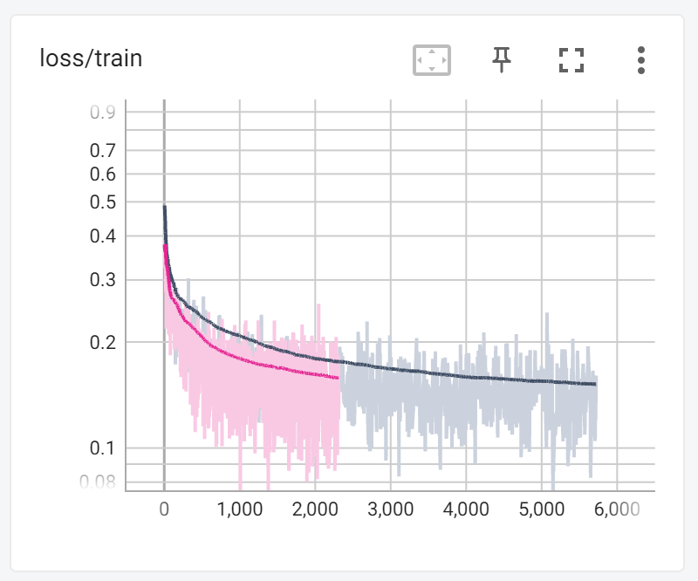
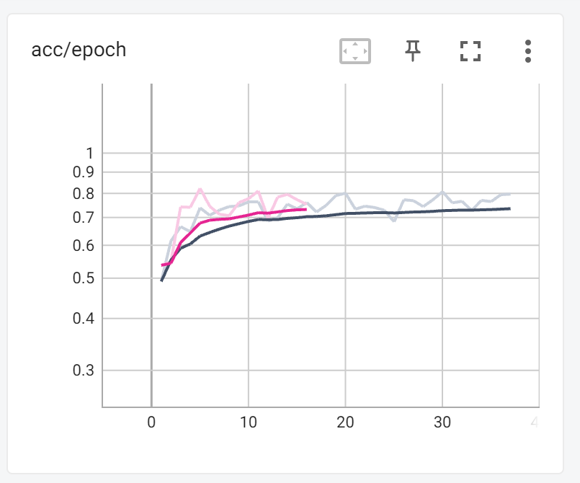
Exploration: Anomaly Detection
Full data is slightly better than non-virus data

Slide 18
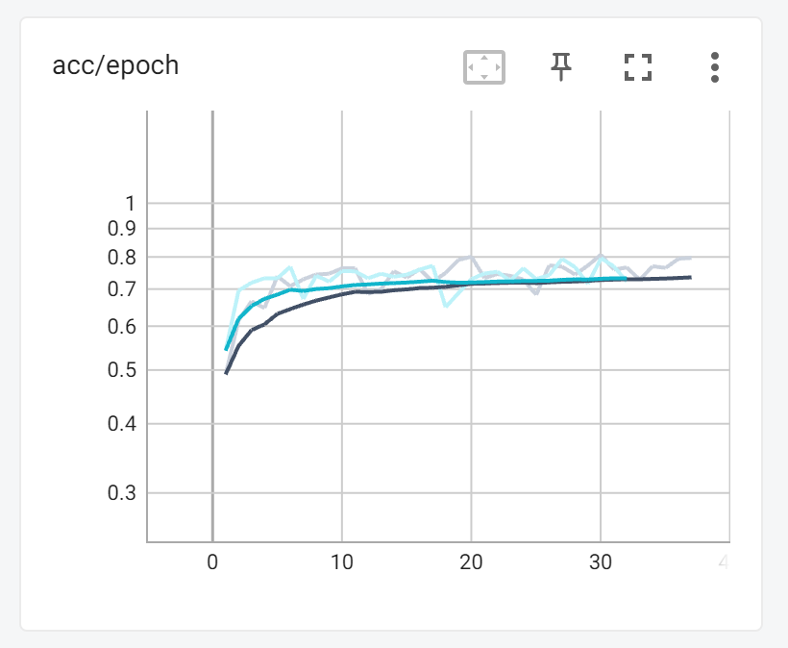
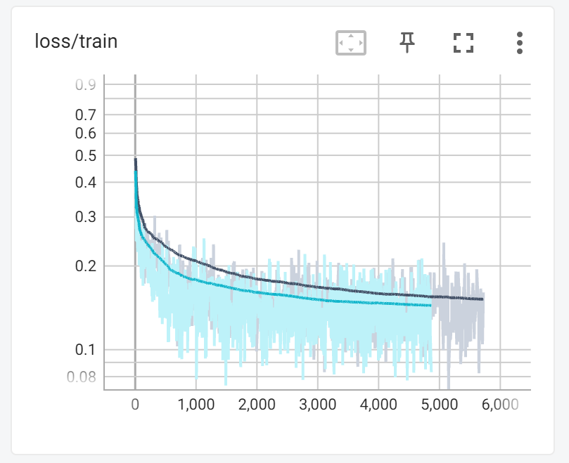
Exploration: Trick or treat?
Let’s test some simpler CNN:
Maybe we can improve the architecture of CNN

Slide 19
Exploration: Trick or treat?
Let’s test some advanced CNN
LeakyReLU
Spectral norm
Bottleneck shaped

Slide 20
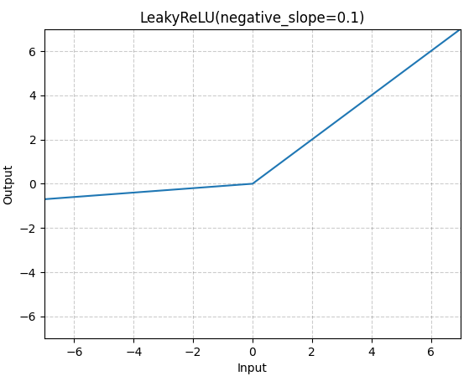
Leaky ReLU
Variant of ReLU
Prevent gradient from dying out
Used in the advanced CNN experiment
KL Loss
LeakyReLU — PyTorch 1.13 documentation

Slide 21
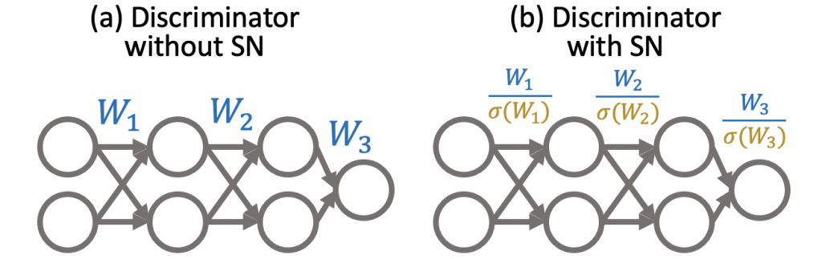
Spectral Normalization
A trick from the training of GAN
Help our Classifier to stabilize
1802.05957.pdf (arxiv.org)
Why Spectral Normalization Stabilizes GANs: Analysis and Improvements – Machine Learning Blog | ML@CMU | Carnegie Mellon University

Slide 22
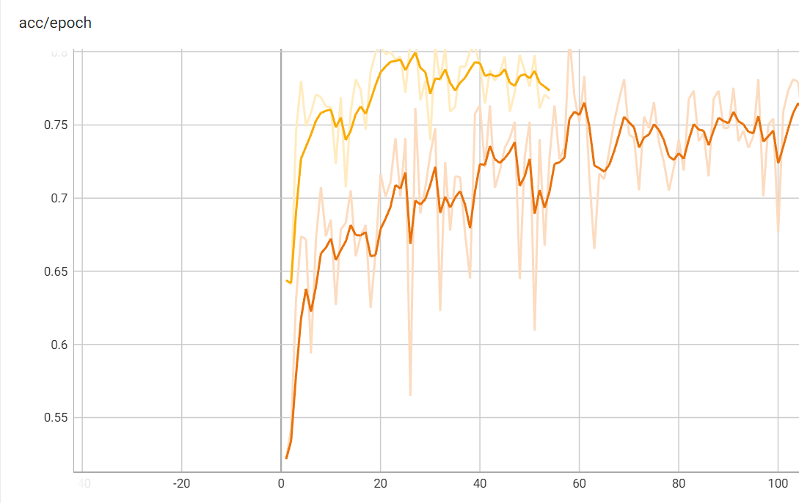
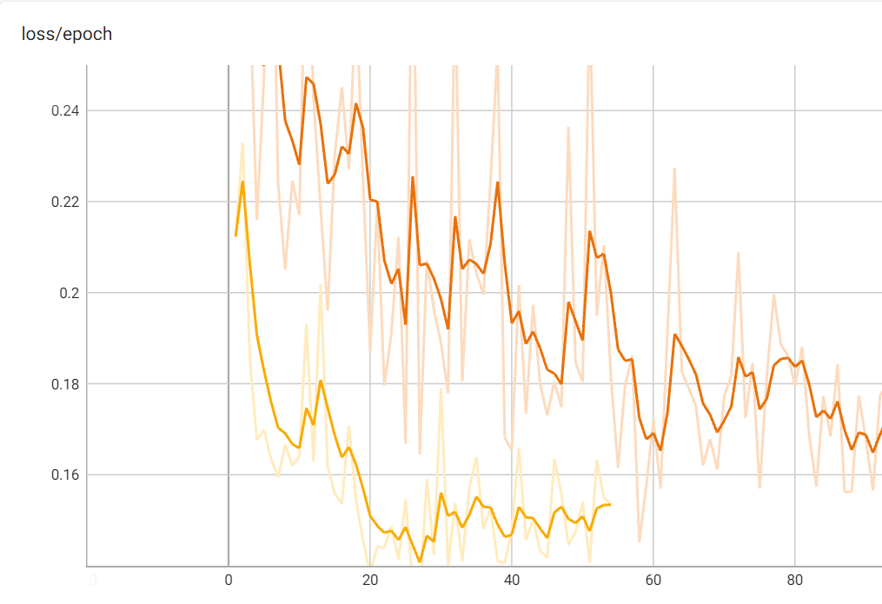
KL loss

Slide 23
Overall

Slide 24
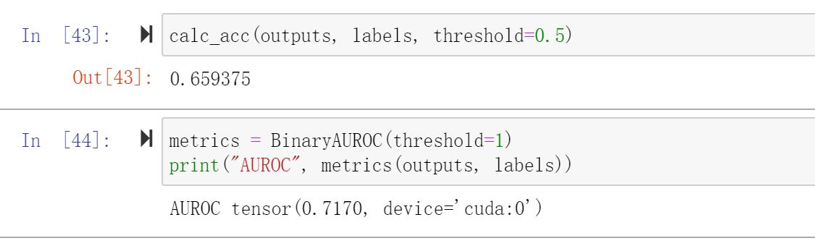
Nonvirusdata linear

Slide 25
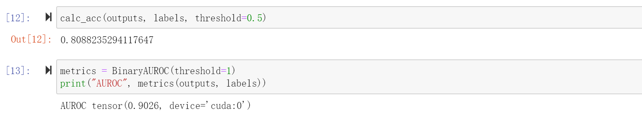
Nonvirusdata clf_simp

Slide 26
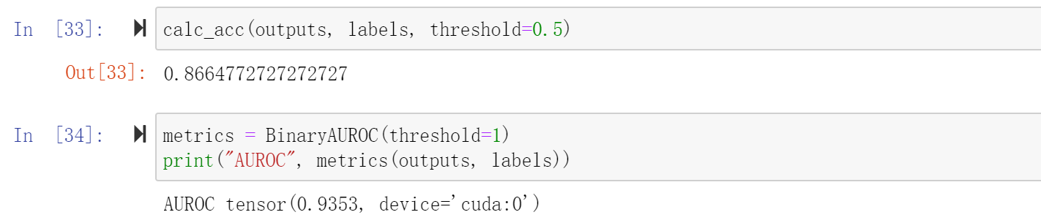
Nonvirusdata clf_new_

Slide 27
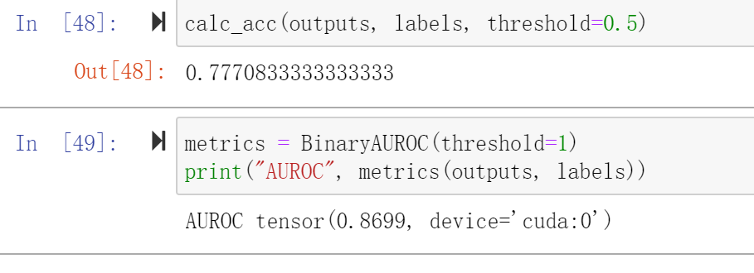
fulldata clf_simp

Slide 28
Further work
Comparison on different sequence length
Longer sequence and linear attention
K-mer encode rather than one-hot vector
More domain knowledge

