Slide 1

S.p.g Sunflower power Generator dIY PROJECT
Sp
Abhishek Kumar
Arpit Bhardwaj
Abhiram Veladineni
Vishwas Jajpura
Group-9

Slide 2
S.P.G-Sunflower power generator
Basic idea about the project
We basically made a model using Arduino UNO R3 ,servos motor, solar panels ,MPPT System and bunch of photo resistors(two actually) .
In this our solar panels is rotating 360 degree according to the direction of the Sun.
Which maximizes the output reducing the power wastage and thus increasing the efficiency.
This energy can be used in various purposes according to the power output .
We also used electronic means to maximize the power generated further more by controlling the panel voltage to maximum power point using MPPT(Maximum power point tracking) device.

Slide 3
Team Members and their roles
Abhishek Kumar
(Team Leader)
Roll.no-21EC30001
presentation designing;
theory and research
21AE10041-
Vishwas Jajpura
Role-Making the main physical model , co-ordination and Team leader
21IM10009-
programming/coding; mathematical research
Arpit Bhardwaj
21EE10002-
representation and vocal explanation ; finalizing the project for presentation/research
Abhiram Veladineni
Firstname Lastname

Slide 4


Total cost and cost per head
Total cost-Rs.1830
*this cost includes all the shipping charges and extra cost involved
Cost Per Head-Rs.457.5
*Following slides will show cost of each part

Slide 5
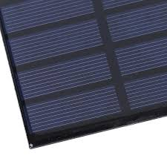
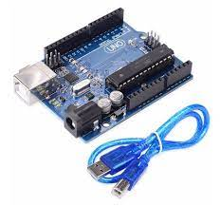
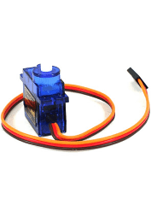
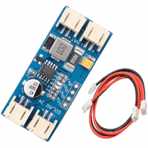
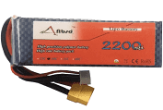
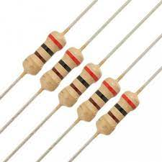
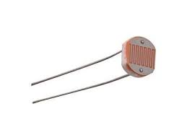
Materials used and their individual cost
1. Arduino Uno R3
Cost –Rs.600
2. Solar panel
Cost-Rs.200
3. Solar MPPT
Cost-Rs.550
4. Servo Motor(SG90)
Cost-Rs.260
5.Battery
Cost-Rs.150
6. Photo resistor and 10K ohm resistor.
Cost-*Negligible

Slide 6
Process through week wise
Week-1 and Week-2
These 2 weeks were dedicated to research/theory for the making of project and proper planning for execution of the project.
We had to figure out which circuit diagram would work and what were the parts required.
After finding out the required parts we ordered them and cost is mentioned before.
4. Best relevant theory was found through the research paper (https://www.hindawi.com/journals/ijp/2010/312580/ )
5. But then we faced certain problems we came Regarding which we have mentioned in the next slide.

Slide 7
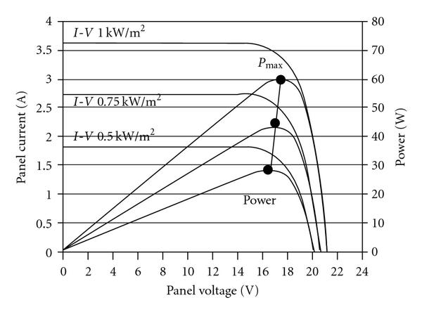
Problems faced during making and its solution.
Problem
Solution
For that we had to use maximum power point tracking systems to gain more generated output power.
So we used a readily available MPPT device(Maximum power point tracking).
This Device will track maxima of the curve and alter the voltage to get us maximum output power.
There are certain problems that we addressed.
When our solar panel rotates according sun ,so even after changing direction the of solar panel we might not get maximum power.
Optimizing power to its maximum point while controlling the output voltage.
Maximum voltage does not implies maximum power.
And designing that kind of system was beyond our current knowledge.
*Values used in graph are not same as in our project

Slide 8
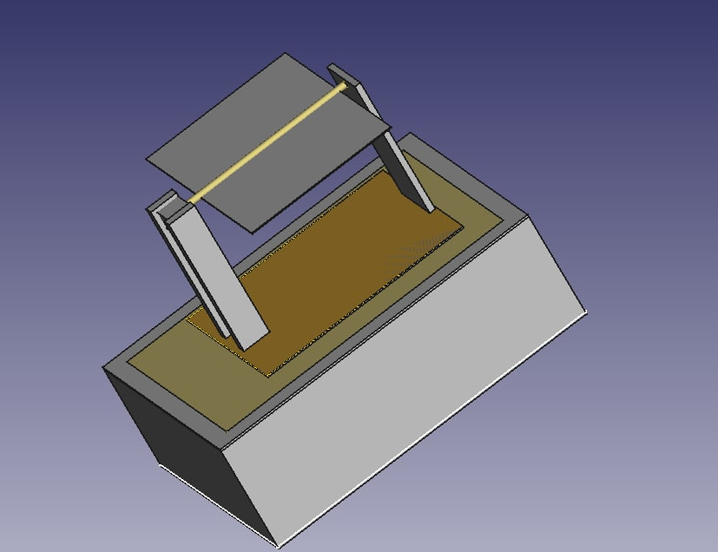
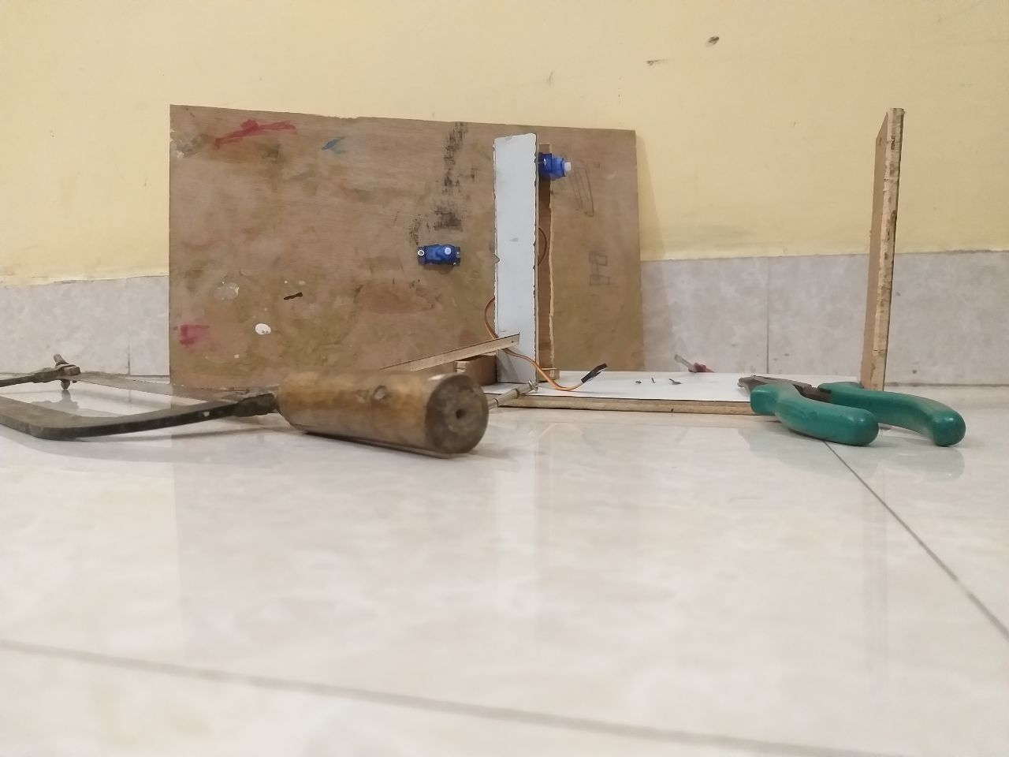
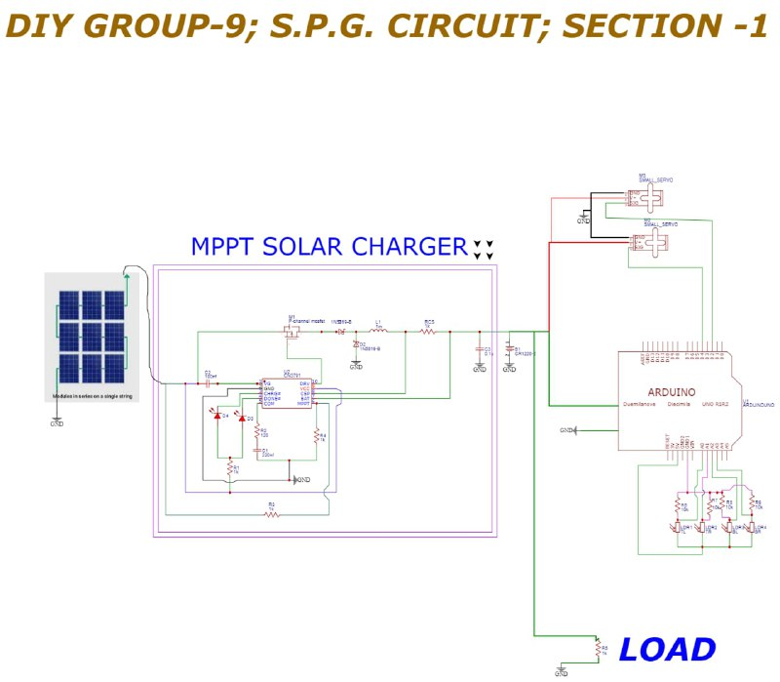
WEEK-3
This was the week when we got most of problems were resolved and now we have to work on code for Arduino.
Code was required for servomotor to rotate according to the intensity of light and now code was no further required for maximum power point tracking as major problem was solved through MPPT device as we mentioned earlier.
And the final circuit diagram was
5. This was the code we came up with ,with some reference.
MPPT System
Next page

Slide 9
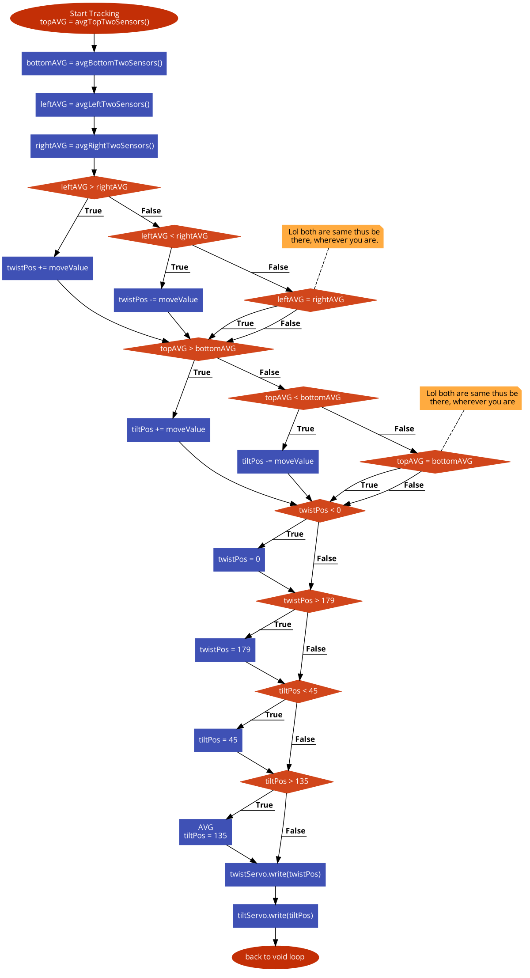
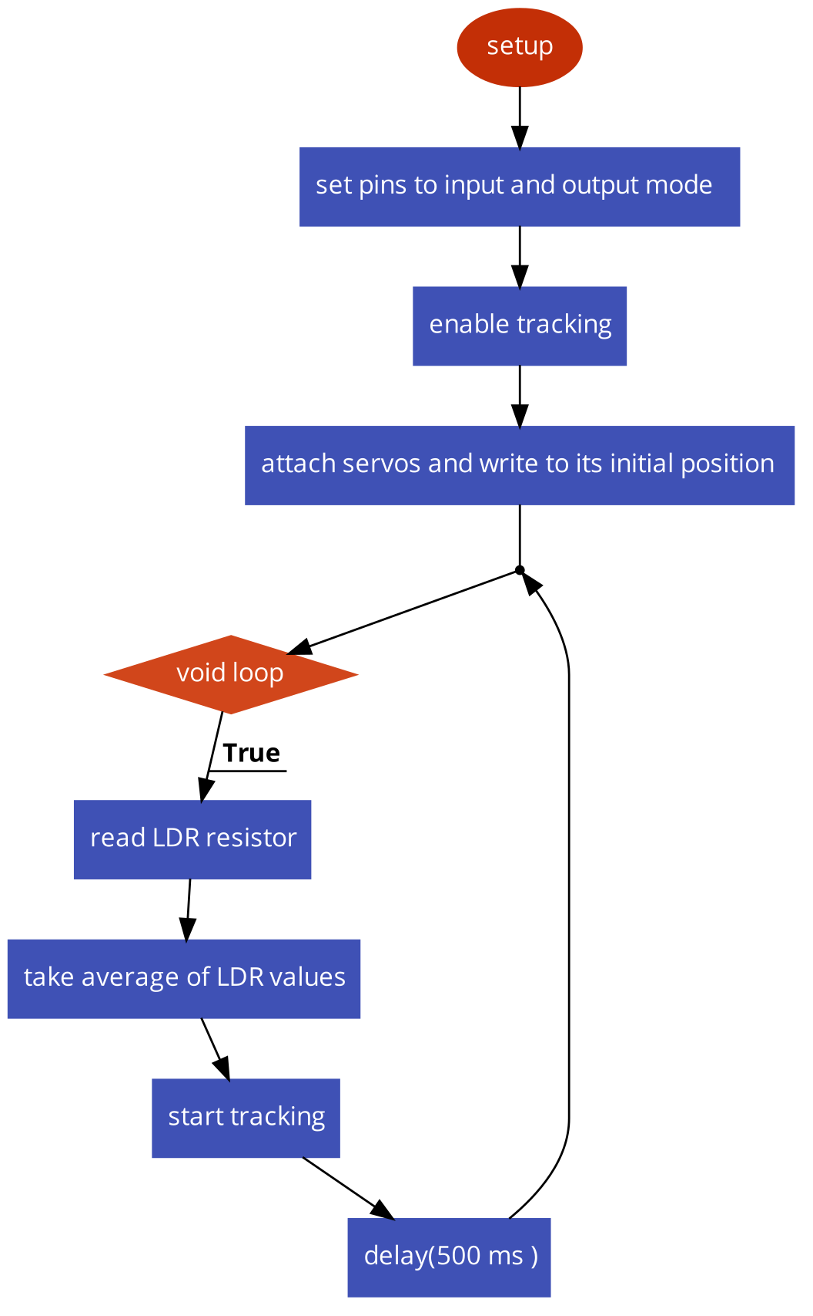

Slide 10
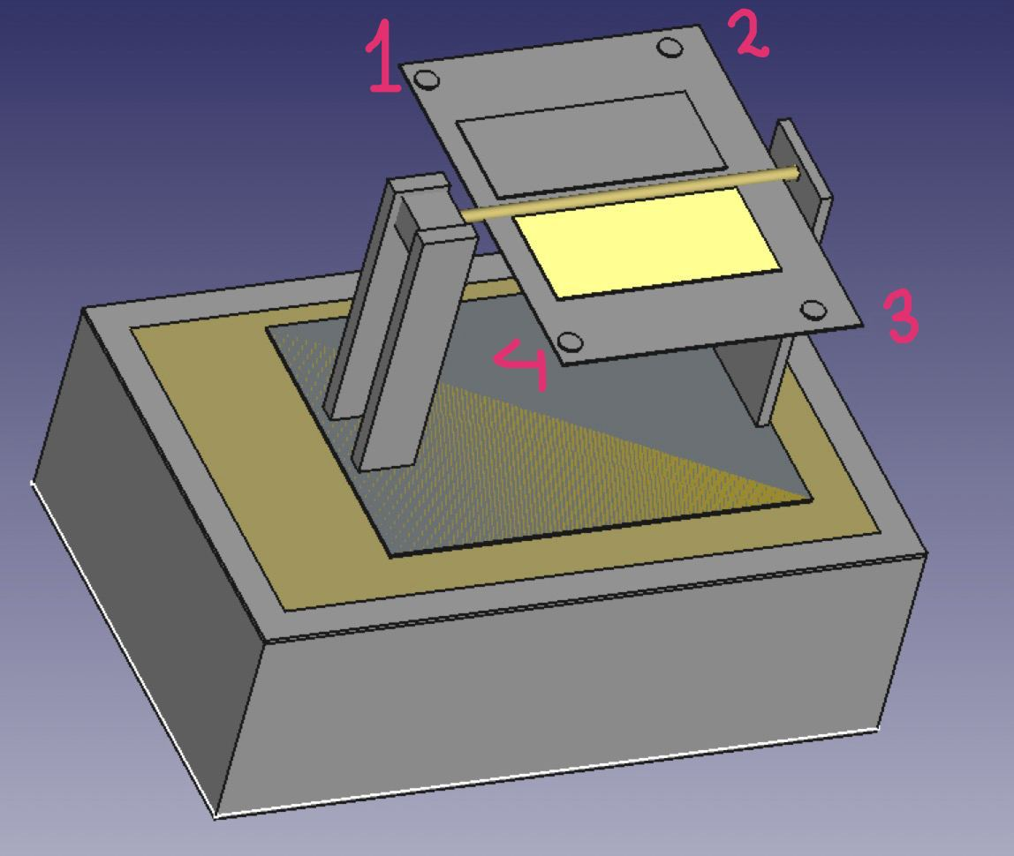
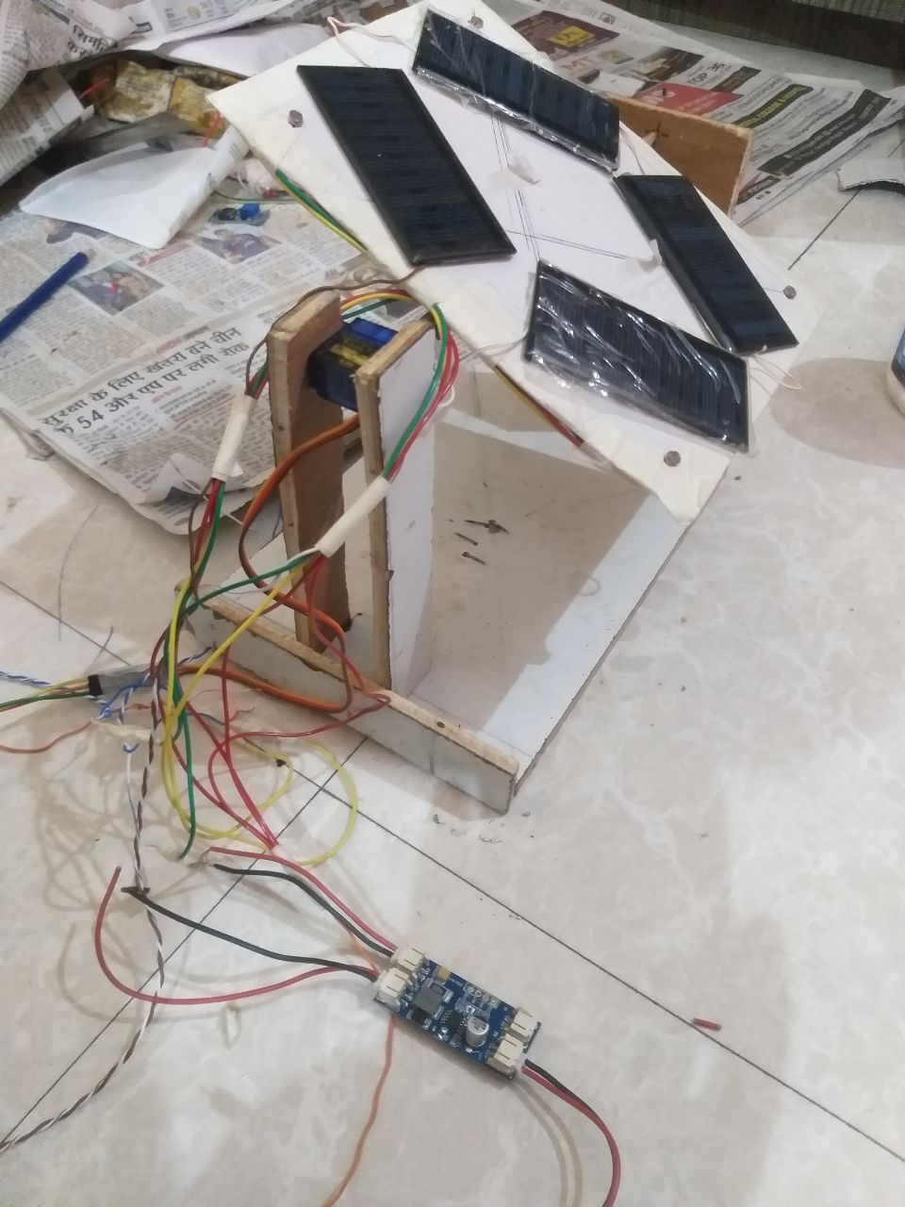
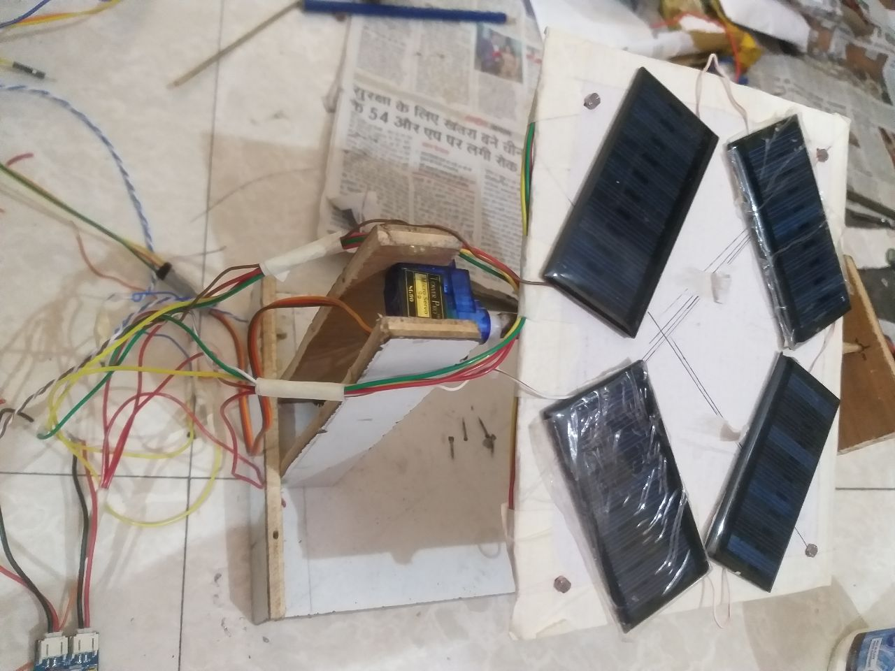
Week -4
We continued with the assembly of our model.
This is the image of completed work.
Initially It was found out that servo motor was rotating by 90 degree only one time during power on, but later on we found out that it was in built on library code.
4. Finalizing of project was done and checked the working of our model as per requirement.

Slide 11
Video of our working model

Slide 12
Thankyou
Thankyou every one and special thanks to Dr. Dipankar Debnath sir for helping us out of the way.

Slide 13
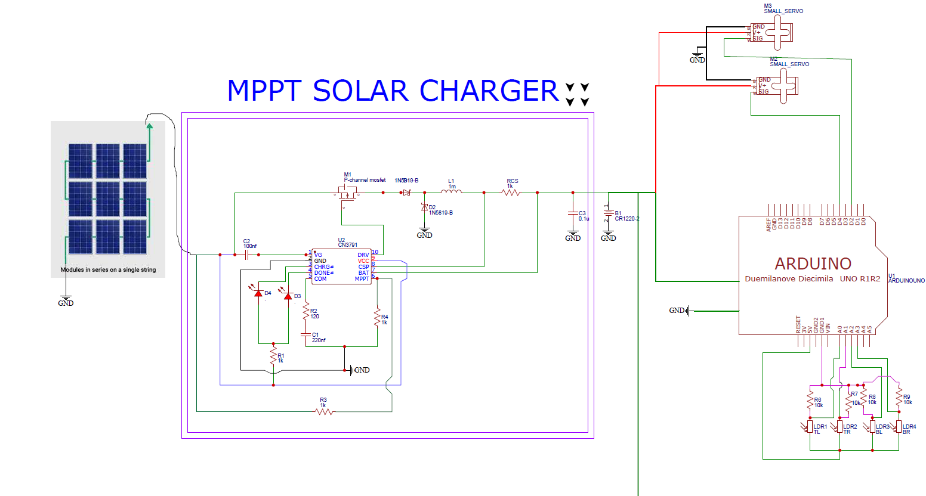
Circuit Diagram
Get back to process

