Slide 1


Expose for Master Thesis
Ant Colony based Optimization for Multi-Robot Task Allocation and Path Planning
Project Supervisors:
Prof. Dr.-Ing. hbil. Sanaz Mostaghim
Dr. Paul Thieme (Fraunhofer IPA)
Project Advisors:
Dr.-Ing. Christoph Steup
Mr Christian Henkel
4/17/19
ACO Planner
‹#›
Notes:
‹#›

Slide 2


Agenda
Problem
Technique
Application Area
Structure
Progress
4/17/19
ACO Planner
‹#›

Slide 3
Problem
Multi-Robot
Task Allocation
Path Planning
4/17/19
ACO Planner
‹#›

Slide 4
Problem
Multi-Robot
Task Allocation &
Path Planning
4/17/19
ACO Planner
‹#›

Slide 5
Problem
Multi-Robot
Task Allocation &
Path Planning
More Ants
4/17/19
ACO Planner
‹#›

Slide 6
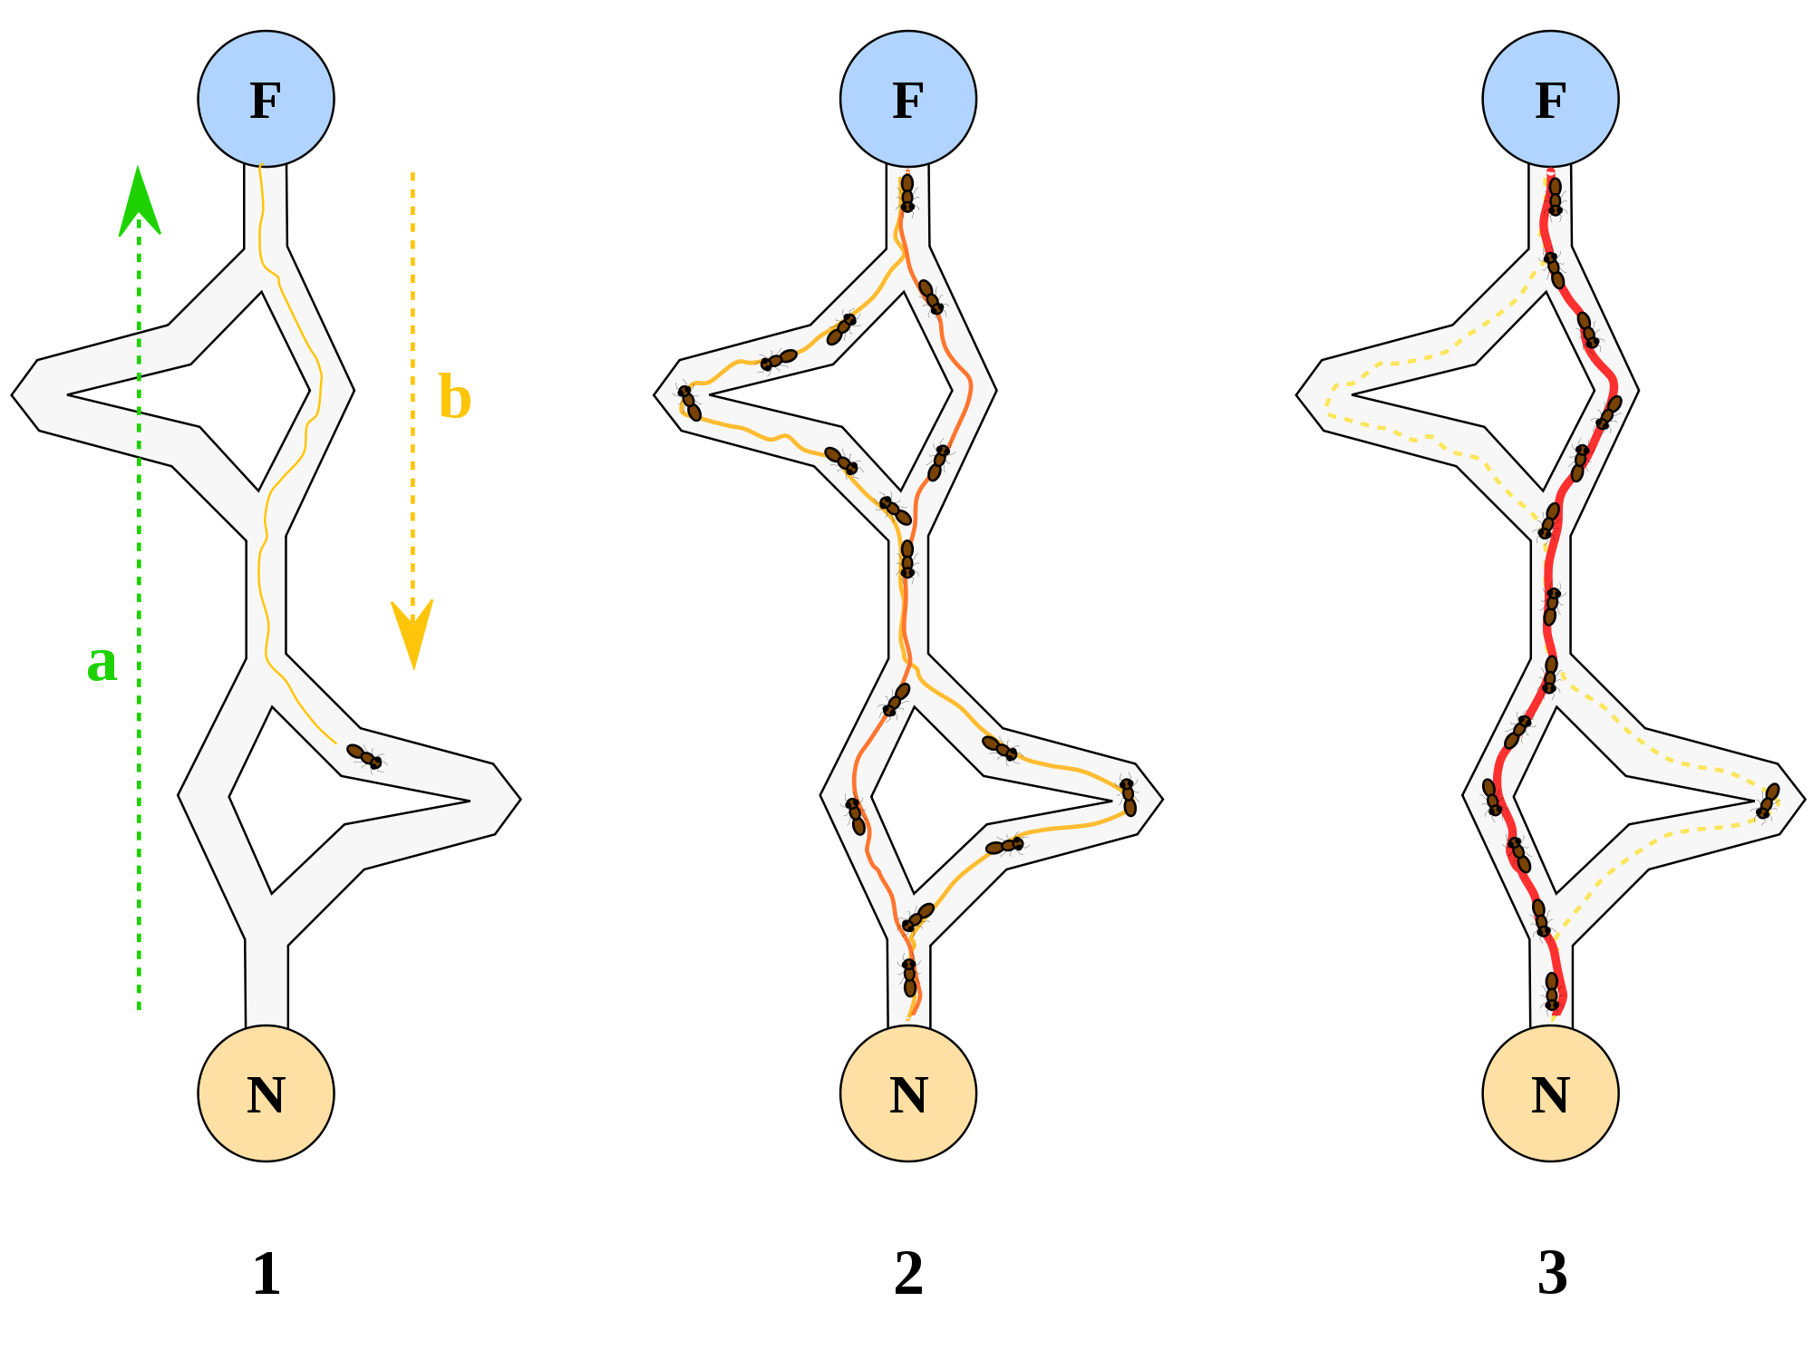
Technique
4/17/19
ACO Planner
‹#›

Slide 7
Technique
Food
4/17/19
ACO Planner
‹#›

Slide 8
Application Area
Industry 4.0 (Fraunhofer IPA)
Cloud Robotics (Fraunhofer IPA)
Educational Research (Publication)
4/17/19
ACO Planner
‹#›

Slide 9
Application Area
Industry 4.0 (Fraunhofer IPA)
Cloud Robotics (Fraunhofer IPA)
Educational Research (Publication)
https://github.com/cch-cs/miriam
4/17/19
ACO Planner
‹#›

Slide 10
Structure
Jobs
(Pickup & Drop Off)
Ant Colony Optimization based Planner
Assignments
(Respective)
Agents
(Robots Start)
Paths
(Collision Free)
Map
(Grid)
4/17/19
ACO Planner
‹#›

Slide 11
Structure
Jobs
(Pickup & Drop Off)
Ant Colony Optimization based Planner
Assignments
(Respective)
Agents
(Robots Start)
Paths
(Collision Free)
Map
(Grid)
Optimizing Total Distance
4/17/19
ACO Planner
‹#›

Slide 12
Progress
Completed:
Structure of Ants traversal and iterations
Pheromone and distance update structure
Optimization of distance for given simple Nodes
Return of optimized selected simple Nodes
In works:
Distance structure for pick up and drop off Nodes
Registering Master Thesis and Expose (Magdeburg)
4/17/19
ACO Planner
‹#›

Slide 13
Progress
Completed:
Structure of Ants traversal and iterations
Pheromone and distance update structure
Optimization of distance for given simple Nodes
Return of optimized selected simple Nodes
In works:
Distance structure for pick up and drop off Nodes
Registering Master Thesis and Expose (Magdeburg)
https://trello.com/b/6P7PgnBf/master-thesis
4/17/19
ACO Planner
‹#›

Slide 14
Expose for Master Thesis
Ant Colony based Optimization for Multi-Robot Task Allocation and Path Planning
Project Supervisors:
Prof. Dr.-Ing. hbil. Sanaz Mostaghim
Dr. Paul Thieme (Fraunhofer IPA)
Project Advisors:
Dr.-Ing. Christoph Steup
Mr Christian Henkel
4/17/19
ACO Planner
‹#›
Notes:
‹#›

