Slide 1
Unit Testing
Please download from my GitHub Account:
http://www.github.com/proffybean

Slide 2
Test Pyramid
Manual Tests?
Selenium UI Tests
JavaScript Unit Tests
REST API (Business Logic)
Unit Tests
Integration Tests
SQL Unit Tests (tSQLt)
Notes:
Rest API ?

Slide 3
Why Review Unit Testing Now?
Un-Readable Unit Tests. I can’t tell what the test is testing
Tests are too long (often code fails to fit on one screen)
Fail to test for specific issues, they simply catch any error
Unit tests are often disorganized

Slide 4
Test Organization

Slide 5
Triple -A Pattern (or test flow)
Setup
// Arrange
// Act
// Assert
Perform Test
Verify Results
Cleanup
Notes:
Many of the Unit tests I see flow on and on like a bad sentence from an H.P. Lovecraft story. Try and have three distinct sections.
Example?

Slide 6
Attributes MSTest vs. NUnit
MSTest | NUnit
[AssemblyInitialize] | [SetupFixture]
[ClassInitialize] | [TestFixtureSetup] (renamed to OneTimeSetup)
[TestClass] | [TestFixture]
[Test Initialize] | [Setup]
[TestMethod] | [Test]
[TestCleanup] | [TearDown]
[ClassCleanup] | [TestFixtureTearDown] (renamed OneTimeTearDown)
[AssemblyCleanup] | (?)
Notes:
Most Tests lack Test Setup and Fixture Setup. Much of the test code is repeated in each case.
In addition, most fixtures lack cleanup methods to “undo” their database changes.

Slide 7
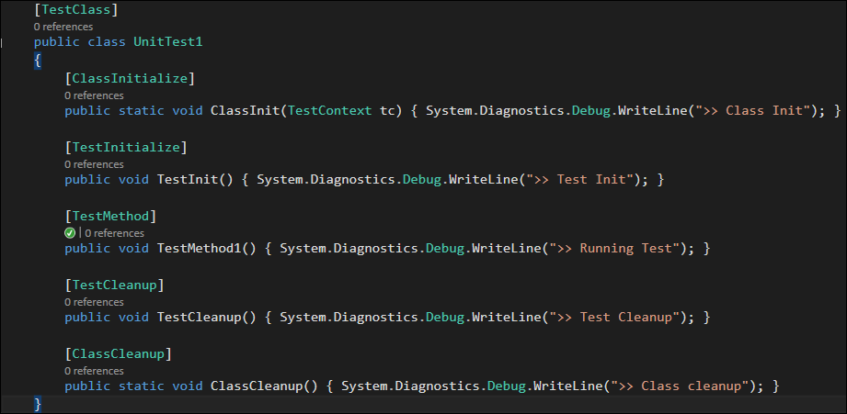
Test Organization
Notes:
Here is my Unit test fixture skeleton That I like to see in each test class/fixture.
This is MS Test.

Slide 8
Test Setup & Cleanup
[ClassInitialize]
Data Creation for entire test class(ADO.net, execute sprocs)
Settings (Column mapping, etc…)
[TestInitialize]
Creating objects
Resetting variables
[TestCleanup]
Reset objects back to null
Resetting SQL connections
[ClassCleanup]
Cleanup all data and settings created
Remove records added to database
Rollback any settings that were changed
Notes:
I try and move as much as I can out of each testcase.

Slide 9

Asserting
I see too much misuse of the IsTrue method
Assert.IsTrue(myString == "apple");
Which leads to ambiguous errors:

Slide 10
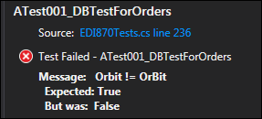
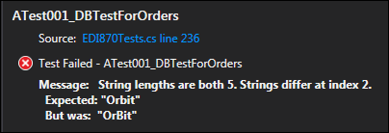
Asserting (Cont)
Always put comments when using IsTrue
Assert.IsTrue(myString == "apple", $"The string {myString} != {apple}");
Use AreEqual in place of IsTrue if appropriate:
Assert.AreEqual(myString, "apple");
https://jimsrulesregardingeverything.com/2017/03/21/finally-proper-exception-assertion-in-mstest/
https://msdn.microsoft.com/library/jj159340.aspx

Slide 11
Asserting (Cont)
Asserting an exception:
Assert.ThrowsException<TExType>(Func<object>);
Assert.ThrowsException<Exception>(() => Math.Log(-1));
Collection Asserts:
List<int> xmasSkus2018 = GetSkusOnSale();
CollectionAssert.AllItemsAreUnique( xmasSkus2018 );
CollectionAssert.DoesNotContain( xmasSkus2018, 970014 );
CollectionAssert.IsSubsetOf( xmasSkus2018, All2018SaleSkus );
Notes:
Nilepta recently wrote a method to scrape Tracking numbers from a larger number. If I passed null, I wanted it to throw an error.

Slide 12
Asserting (Cont)
Fluent Assertions
https://jimsrulesregardingeverything.com/2017/03/21/finally-proper-exception-assertion-in-mstest/
https://msdn.microsoft.com/library/jj159340.aspx

Slide 13
Naming conventions
<SUT>_Should<do something>_When<something> Pattern
Bad (Actual Tests)
PoTest1()
A0001_DateRangeTest01()
SendEDI_Test_01()
Good
PurchaseOrder_ShouldWriteToOrderIdColumn_WhenOrderShips()
GetShipDetails_ShouldReturnAnOrder_WhenInsideDateRange()
EDI850Ctor_ShouldThrowAnError_WhenEdiStringIdNull()

Slide 14
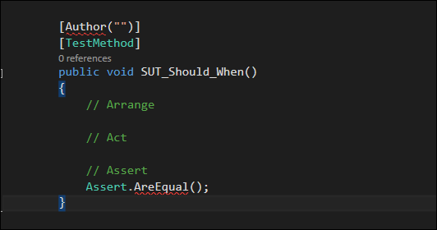
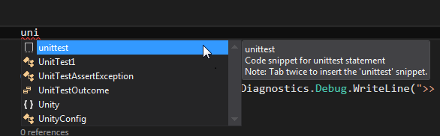
Code Snippets
https://msdn.microsoft.com/en-us/library/ms242312.aspx
<?xml version="1.0" encoding="utf-8" ?>
<CodeSnippets xmlns="http://schemas.microsoft.com/VisualStudio/2005/CodeSnippet">
<CodeSnippet Format="1.0.0">
<Header>
<Title>foo</Title>
<Shortcut>foo</Shortcut>
<Description>Code snippet for foo statement</Description>
<Author>Mr Cheese</Author>
<SnippetTypes>
<SnippetType>Expansion</SnippetType>
<SnippetType>SurroundsWith</SnippetType>
</SnippetTypes>
</Header>
<Snippet>
<Code Language="csharp"><![CDATA[
[TestMethod]
public void SUT_Should_When()
{
// Arrange
// Act
// Assert
Assert.AreEqual();
}]]>
</Code>
</Snippet>
</CodeSnippet>
</CodeSnippets>

Slide 15
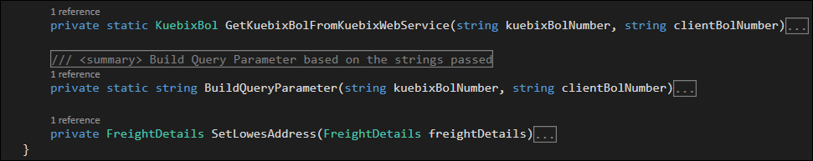
Unit testing private methods
If class methods are private, they can’t be unit tested.
Ex:
We can’t call the SetLowesAddress() method from our UnitTest Project

Slide 16
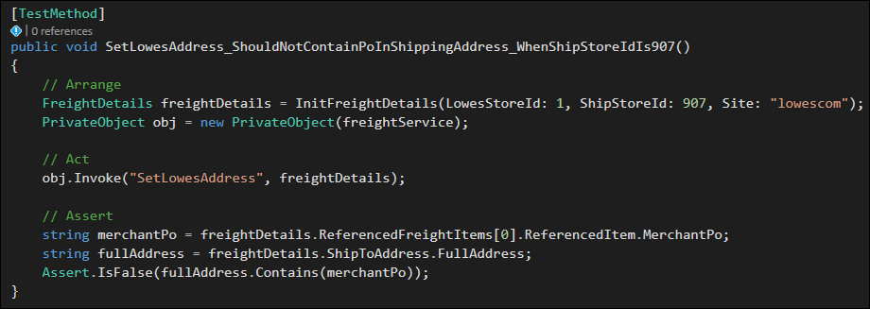
Unit testing private methods (cont…)
Solution:
Declare a PrivateObject object

Slide 17
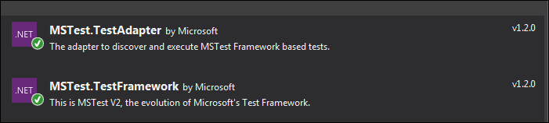
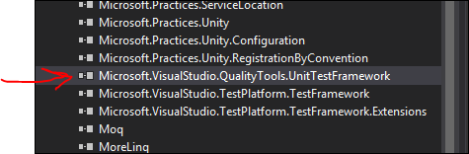
Data Driven Tests (Test parameters)
Install MSTest V2 via Nuget:
Remove the UnitTestFramework Reference

Slide 18
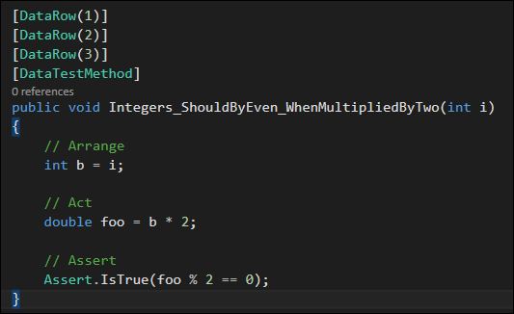
Data Driven Tests (cont…)
Use the [DataTestMethod] attribute to decorate a Data Driven Test

Slide 19
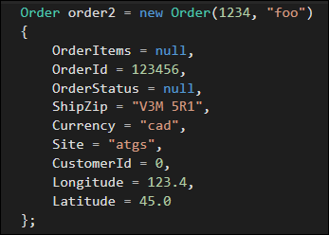
Test Data Setup: The Builder Pattern
Don’t set up your data explicitly:
Notes:
C:\Users\jbalsley\Repos\BusinessLogic\Tests\Builders\OrderBuilder.cs

Slide 20
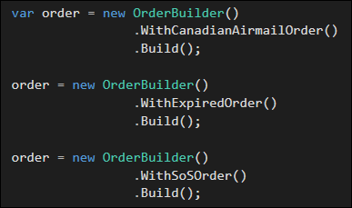
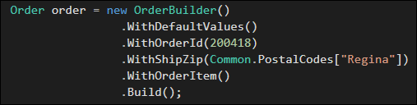
TestData Setup: The Builder Pattern (Cont…)
Instead, use the Builder Pattern:
Notes:
C:\Users\jbalsley\Repos\BusinessLogic\Tests\Builders\OrderBuilder.cs

Slide 21
TestData Setup: The Builder Pattern (cont…)
Create Builder Objects Programmatically:
https://github.com/proffybean/BuilderBuilder
Demo…
BusinessLogic Repo
LookupLiveInventoryTests.cs

Slide 22
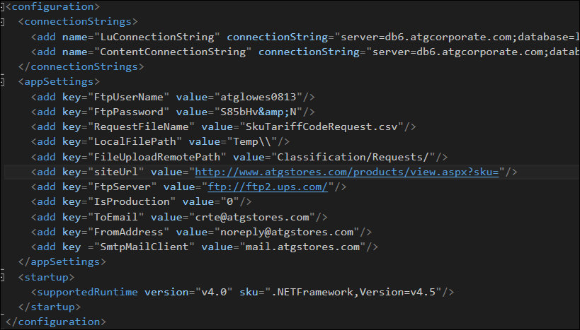
External Dependencies on App.config file
Often, much of our code directly access the app.config file
In order to test these parameters, such as ToEmail we have the edit the config file and recompile.

Slide 23
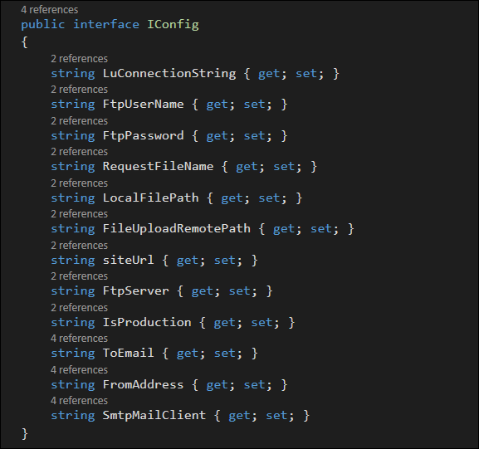
Abstract out the config file with Interface

Slide 24
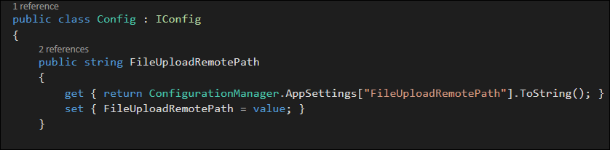
Abstract out the config file with Interface (cont…)

Slide 25
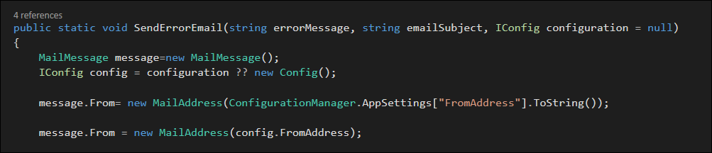
Abstract out the config file with Interface (cont…)

Slide 26
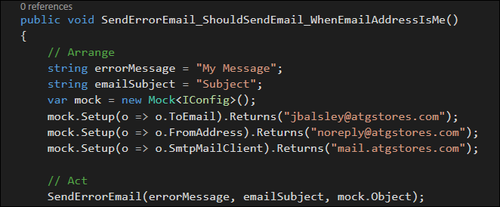
Testing the config file with Moq

Slide 27
Dos & Don’t

Slide 28
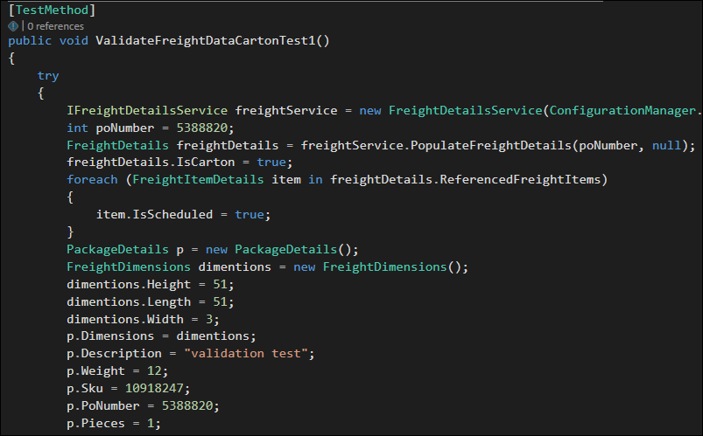
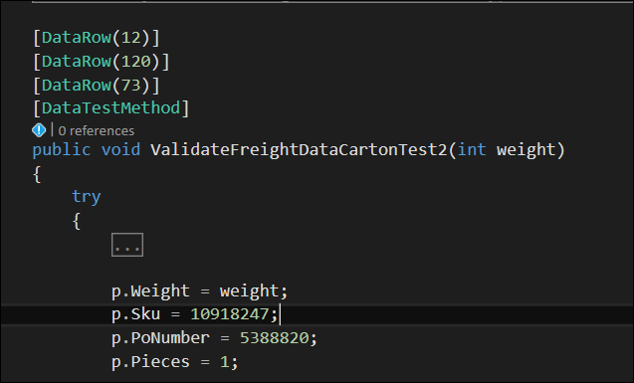
Dos & Don’t (Examples)
Code Duplication
From FreightService, the ServiceTests.cs
ValidateFreightDataCartonTest1() ValidateFreightDataCartonTest2()

Slide 29
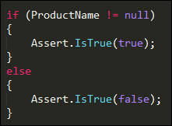
Dos & Don’t (Examples cont…)
Asserting:

Slide 30
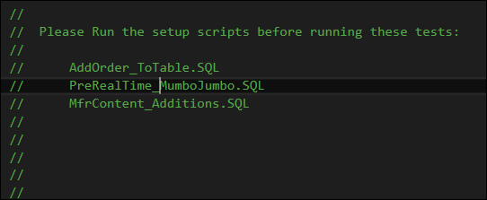
Dos & Don’t (Examples cont…)
SQL setup scripts ?

Slide 31
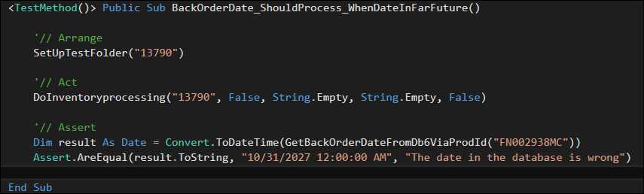
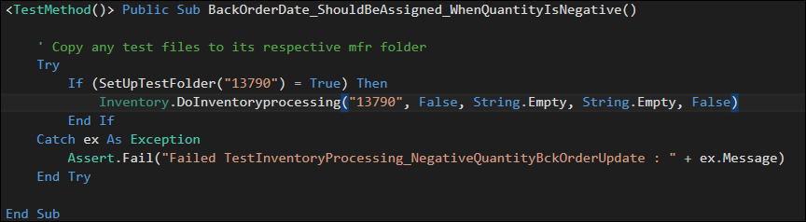
Dos & Don’t: Don’t: Use Try Catch

