Slide 1

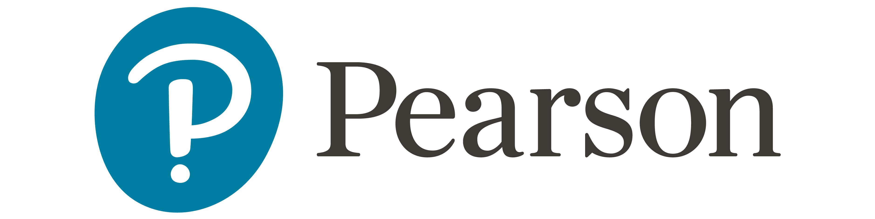
Accounting Information Systems
Sixteenth Edition
Chapter 8
Fraud and Errors
Copyright © 2024, 2021, 2018 Pearson Education, Inc. All Rights Reserved
Notes:
If this PowerPoint presentation contains mathematical equations, you may need to check that your computer has the following installed:
1) MathType Plugin
2) Math Player (free versions available)
3) NVDA Reader (free versions available)

Slide 2
https://www.visualcapitalist.com/sp/ranked-americas-most-common-financial-crimes-in01/
https://www.visualcapitalist.com/sp/the-most-costly-financial-crimes-in-2024-in01/
https://informationisbeautiful.net/visualizations/most-common-pin-codes/?fbclid=IwQ0xDSwLMonBleHRuA2FlbQIxMQABHhmDMQa5xjhqga9Y3UVeJ7K6g0fb8mELXWK7-N6pIGUHYlUOVCRM6YrEcwCh_aem_mHroACuf0fIQKVsqM5hwsg
https://www.visualcapitalist.com/sp/tracking-the-3-1-trillion-financial-crime-pandemic-in01/
https://www.visualcapitalist.com/5-facts-you-need-to-know-about-financial-fraud/

Slide 3
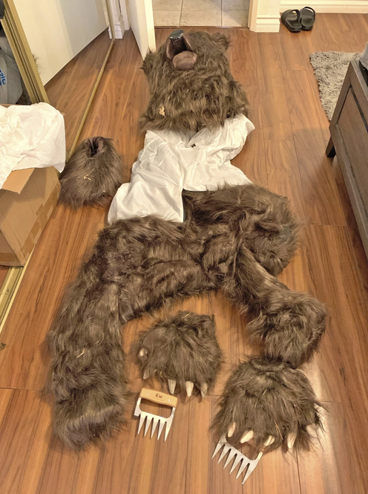
Insurers say bear that damaged luxury cars was actually a person in a costume
https://apnews.com/article/bear-costume-insurance-fraud-vehicles-california-791f330b81d0ef627caf1b00a6daf69f
Notes:
In what it has dubbed “Operation Bear Claw,” the California Insurance Department said four Los Angeles residents were arrested Wednesday, accused of defrauding three insurance companies out of nearly $142,000 by claiming a bear had caused damage to their vehicles.
The group is accused of providing video footage from the San Bernardino Mountains in January of a bear moving inside a Rolls-Royce and two Mercedes to the insurance companies as part of their damage claims, the department said. Photos provided by the insurance department show what appeared to be scratches on the seats and doors.
The company viewing video of the Rolls-Royce suspected it was not a bear inside, but someone in a bear costume.
Detectives found two additional claims and with two different insurance companies for the four with the same date of loss and at the same location. Similar video was provided of the “bear” inside the Mercedes vehicles.
The department had a biologist from the California Department of Fish and Wildlife review the three videos, who concluded it was “clearly a human in a bear suit,” the insurance department said.

Slide 4
Links
https://arstechnica.com/gadgets/2025/03/ceo-of-ai-ad-tech-firm-pledging-world-free-of-fraud-sentenced-for-fraud/
https://www.reddit.com/r/Slack/comments/1jeen0t/hr_company_says_it_caught_an_internal_spy_with_a/?share_id=XCFaGglOu7El25z7wLkpb
https://blog.cloudflare.com/password-reuse-rampant-half-user-logins-compromised/
https://www.cnn.com/2024/02/04/asia/deepfake-cfo-scam-hong-kong-intl-hnk/index.html
https://www.consumerreports.org/electronics/identity-theft/voice-cloning-apps-let-criminals-easily-steal-your-voice-a6024784872/
https://www.reddit.com/r/Accounting/comments/1j2q1ax/citibank_accidentally_transferred_81_trillion_to/?share_id=f6Z2-H0zSYu30yzZM4MMm
https://www.consumerreports.org/money/scams-fraud/new-scams-to-watch-out-for-a9334297641/
https://www.visualcapitalist.com/ranked-most-common-types-of-fraud-in-america/

Slide 5
Learning Objectives
Explain the threats faced by modern information systems.
Define fraud and describe both the different types of fraud and the auditor’s responsibility to detect fraud.
Discuss who perpetrates fraud and why it occurs, including the pressures, opportunities, and rationalizations that are present in most frauds.
Define computer fraud and discuss the different computer fraud classifications.
Explain how to prevent and detect computer fraud and abuse.

Slide 6
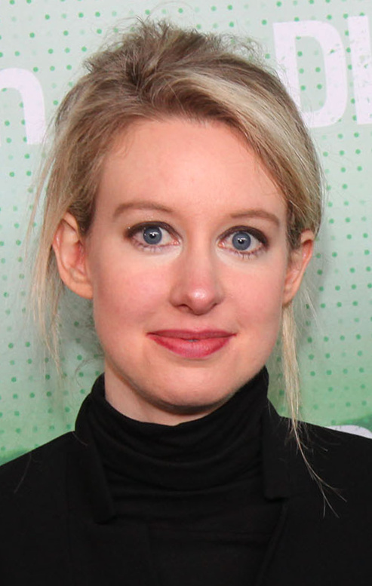
Elizabeth Anne Holmes (born February 3, 1984) is an American biotechnology entrepreneur who was convicted of fraud in connection to her blood-testing company, Theranos.^{[2]} The company's valuation soared after it claimed to have revolutionized blood testing by developing methods that needed only very small volumes of blood, such as from a fingerprick.^{[3][4]} In 2015, Forbes had named Holmes the youngest and wealthiest self-made female billionaire in the United States on the basis of a $9-billion valuation of her company.^{[5]}
In the following year, as revelations of fraud about Theranos's claims began to surface, Forbes revised its estimate of Holmes's net worth to zero,^{[6]} and Fortune named her in its feature article on "The World's 19 Most Disappointing Leaders".^{[7]}
https://en.wikipedia.org/wiki/Elizabeth_Holmes
Notes:
After dropping out of Stanford, Holmes used the money her parents had saved for her education as seed money for Theranos. She convinced her Stanford professor, Channing Robertson, of her idea and recruited him as the first board member. Robertson put Holmes in touch with venture capitalists and she had raised $6 million in capital by the end of 2004. Initially, the company operated in “stealth mode” without a corporate website or press releases. Although Holmes entered the limelight in 2013 and quickly turned into a media star, the aura of mystery surrounding Theranos would persist until the company’s fall.
Holmes is said to have worshipped and emulated Apple founder Steve Jobs. She hired Apple designers for the product design of the laboratory’s “Edison” device and she soon appeared wearing only black turtlenecks. Holmes also began to speak with a deeper voice.
She went public with this image in 2013. Two years later, the company entered into a partnership with US drugstore chain “Walgreens” whereby the company’s tests would be offered in more than 40 shops. Holmes promised that Theranos blood tests would soon be available within 5 miles of every American household. She claimed to investors and business partners that the tests were being used by the US military in their medivac helicopters, a claim she only recanted when questioned by investigators under oath.
Holmes became a media star and celebrated visionary, appearing on the cover of Fortune, Forbes and Inc. In 2015, Theranos was valued at $9 billion and with Holmes considered the youngest self-made billionaires in the US, she landed on Time magazine’s list of the 100 most influential people. That same year, then Vice President Joe Biden visited the Theranos lab in Palo Alto and praised Holmes as an inspiration.
===
Theranos claimed to be able to perform numerous tests for indications of diseases such as diabetes or cancer with just a few drops of blood. In the interviews with company founder Elizabeth Holmes, the number of tests that could supposedly be carried out varied: there was often talk of over 200 and a company profile in US business magazine Inc. in 2015 even spoke of more than 250. However, the “Edison” – the device supposed to carry out the tests – did not deliver what Theranos promised right to the very end, providing unreliable or false results. Only the test for the herpes virus was recognised as reliable by the US Food and Drug Administration (FDA) that July. In order to be able to perform the large number of advertised tests, Theranos obtained third-party equipment from Siemens but this was concealed from patients, business partners and investors. A 2015 FDA inspection also revealed shortcomings in the tests which Theranos only made public a few weeks later.
Employees in the laboratory drew attention to the problems with “Edison” and documented them in error reports. Those tips were ignored by company management. Instead of working on a solution to the problem, only the correct data was filtered out of the results of the test runs in the company and further evaluated. The wrong results were ignored. Holmes’ parter Balwani allegedly pressured doubting or critical employees. Former staff members describe the Theranos company culture as a mixture of distrust, psychological pressure and lies. Holmes herself allegedly lied to her co-workers about even minor details, claiming in emails, for example, to be out of the office even though she was still sitting at her desk just a few feet away. Numerous employees resigned or were fired if they asked too many questions or were too critical.
The whistleblowers
Tyler Shultz started working for Theranos in 2013 and he was an enthusiastic follower of Holmes’ vision. He was given a full-time position on the diagnostic team and he soon encountered problems with test results. Despite the erroneous results, reports were being documented in the internal statistics department while data was being altered. Shultz noticed that no one was exactly aware of the way “Edison” worked. Even inspectors were denied access to the laboratory where the machines were installed. This was because blood tests there were not run through Theranos’ own devices but through third-party equipment.
Lab assistant Erika Cheung also joined the company because she was excited by Holmes’ vision. Cheung worked in the Theranos lab for six months in 2013 and 2014 before also discovering that faulty test results were bring erased. When she had her own blood tested by a Theranos machine, the results indicated a vitamin D deficiency that conventional tests disproved. She brought the problems to the attention of Balwani but he questioned her competence. After six months at the company, Cheung was so alarmed by what was happening that she resigned. Theranos then began harassing Cheung, hiring private investigators who followed her. She later said she felt so threatened and monitored that she changed residence several times and got a prepaid phone so her calls could not be monitored.
Shultz also drew attention to the problems internally. He sought a conversation with Holmes but his concerns were not taken seriously. She refused to grant him a second discussion and asked him to summarise his observations in an email. The reply did not come from Holmes but from her partner Balwani who insulted and threatened Shultz in the email. He then turned to his grandfather, former Secretary of State George Shultz who sat on the board of Theranos, who refused to believe him at first. Tyler Shultz was advised to quit the company by his family and the situation culminated in a meeting at his grandfather’s house where Theranos lawyers urged him to sign a confidentiality agreement. He refused.
Like Shultz, Cheung was also pressured by company lawyers. After a Wall Street Journal reporter named John Carreyrou contacted her, she received a threatening legal action from Theranos’ high-profile corporate lawyer.
In 2015, Cheung wrote a letter to the Centers for Medicare & Medicaid Services (CMS), the regulatory agency, exposing the problems at the Theranos lab. The agency then undertook a surprise inspection of the start-up’s labs which uncovered numerous violations. Tyler Shultz, meanwhile, did not turn to the authorities but to reporter Carreyrou. With the help of Shultz’s information and his own research, Carreyrou published an internal article in October 2015 revealing that Theranos was not using its own machines for the blood tests and that the “Edison” device provided unreliable results. Theranos denied all the allegations as false while threatening Carreyrou and Shultz with lawsuits.
The drugstore chain Walgreens temporarily stopped working with Theranos. In January 2016, after unreliable results in the detection of a blood thinner, the state regulator CMS warned that Theranos tests endangered patient health. Three months later, law enforcement and the Financial Industry Regulatory Authority (SEC) began investigating Theranos. Balwani, who had run the company’s day-to-day operations, left the organisation.
Walgreens and other partners sued Theranos and the case ended in a settlement in 2017. In early 2018, the SEC announced charges against Elizabeth Holmes and her business partner Balwani. Holmes had to resign from her position as CEO and she was banned from running a publicly traded company for the next ten years. In June 2018, California law enforcement filed charges against both Holmes and Balwani. Theranos was shut down in September of the same year.

Slide 7
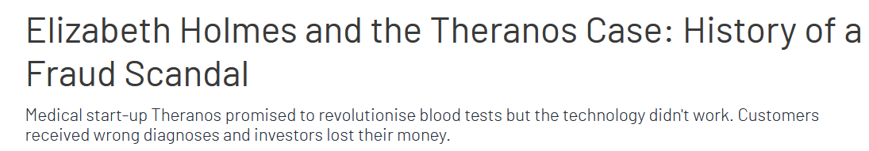
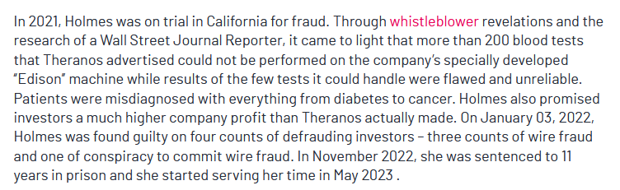
https://www.integrityline.com/expertise/blog/elizabeth-holmes-theranos/
Notes:
After dropping out of Stanford, Holmes used the money her parents had saved for her education as seed money for Theranos. She convinced her Stanford professor, Channing Robertson, of her idea and recruited him as the first board member. Robertson put Holmes in touch with venture capitalists and she had raised $6 million in capital by the end of 2004. Initially, the company operated in “stealth mode” without a corporate website or press releases. Although Holmes entered the limelight in 2013 and quickly turned into a media star, the aura of mystery surrounding Theranos would persist until the company’s fall.
Holmes is said to have worshipped and emulated Apple founder Steve Jobs. She hired Apple designers for the product design of the laboratory’s “Edison” device and she soon appeared wearing only black turtlenecks. Holmes also began to speak with a deeper voice.
She went public with this image in 2013. Two years later, the company entered into a partnership with US drugstore chain “Walgreens” whereby the company’s tests would be offered in more than 40 shops. Holmes promised that Theranos blood tests would soon be available within 5 miles of every American household. She claimed to investors and business partners that the tests were being used by the US military in their medivac helicopters, a claim she only recanted when questioned by investigators under oath.
Holmes became a media star and celebrated visionary, appearing on the cover of Fortune, Forbes and Inc. In 2015, Theranos was valued at $9 billion and with Holmes considered the youngest self-made billionaires in the US, she landed on Time magazine’s list of the 100 most influential people. That same year, then Vice President Joe Biden visited the Theranos lab in Palo Alto and praised Holmes as an inspiration.
===
Theranos claimed to be able to perform numerous tests for indications of diseases such as diabetes or cancer with just a few drops of blood. In the interviews with company founder Elizabeth Holmes, the number of tests that could supposedly be carried out varied: there was often talk of over 200 and a company profile in US business magazine Inc. in 2015 even spoke of more than 250. However, the “Edison” – the device supposed to carry out the tests – did not deliver what Theranos promised right to the very end, providing unreliable or false results. Only the test for the herpes virus was recognised as reliable by the US Food and Drug Administration (FDA) that July. In order to be able to perform the large number of advertised tests, Theranos obtained third-party equipment from Siemens but this was concealed from patients, business partners and investors. A 2015 FDA inspection also revealed shortcomings in the tests which Theranos only made public a few weeks later.
Employees in the laboratory drew attention to the problems with “Edison” and documented them in error reports. Those tips were ignored by company management. Instead of working on a solution to the problem, only the correct data was filtered out of the results of the test runs in the company and further evaluated. The wrong results were ignored. Holmes’ parter Balwani allegedly pressured doubting or critical employees. Former staff members describe the Theranos company culture as a mixture of distrust, psychological pressure and lies. Holmes herself allegedly lied to her co-workers about even minor details, claiming in emails, for example, to be out of the office even though she was still sitting at her desk just a few feet away. Numerous employees resigned or were fired if they asked too many questions or were too critical.
The whistleblowers
Tyler Shultz started working for Theranos in 2013 and he was an enthusiastic follower of Holmes’ vision. He was given a full-time position on the diagnostic team and he soon encountered problems with test results. Despite the erroneous results, reports were being documented in the internal statistics department while data was being altered. Shultz noticed that no one was exactly aware of the way “Edison” worked. Even inspectors were denied access to the laboratory where the machines were installed. This was because blood tests there were not run through Theranos’ own devices but through third-party equipment.
Lab assistant Erika Cheung also joined the company because she was excited by Holmes’ vision. Cheung worked in the Theranos lab for six months in 2013 and 2014 before also discovering that faulty test results were bring erased. When she had her own blood tested by a Theranos machine, the results indicated a vitamin D deficiency that conventional tests disproved. She brought the problems to the attention of Balwani but he questioned her competence. After six months at the company, Cheung was so alarmed by what was happening that she resigned. Theranos then began harassing Cheung, hiring private investigators who followed her. She later said she felt so threatened and monitored that she changed residence several times and got a prepaid phone so her calls could not be monitored.
Shultz also drew attention to the problems internally. He sought a conversation with Holmes but his concerns were not taken seriously. She refused to grant him a second discussion and asked him to summarise his observations in an email. The reply did not come from Holmes but from her partner Balwani who insulted and threatened Shultz in the email. He then turned to his grandfather, former Secretary of State George Shultz who sat on the board of Theranos, who refused to believe him at first. Tyler Shultz was advised to quit the company by his family and the situation culminated in a meeting at his grandfather’s house where Theranos lawyers urged him to sign a confidentiality agreement. He refused.
Like Shultz, Cheung was also pressured by company lawyers. After a Wall Street Journal reporter named John Carreyrou contacted her, she received a threatening legal action from Theranos’ high-profile corporate lawyer.
In 2015, Cheung wrote a letter to the Centers for Medicare & Medicaid Services (CMS), the regulatory agency, exposing the problems at the Theranos lab. The agency then undertook a surprise inspection of the start-up’s labs which uncovered numerous violations. Tyler Shultz, meanwhile, did not turn to the authorities but to reporter Carreyrou. With the help of Shultz’s information and his own research, Carreyrou published an internal article in October 2015 revealing that Theranos was not using its own machines for the blood tests and that the “Edison” device provided unreliable results. Theranos denied all the allegations as false while threatening Carreyrou and Shultz with lawsuits.
The drugstore chain Walgreens temporarily stopped working with Theranos. In January 2016, after unreliable results in the detection of a blood thinner, the state regulator CMS warned that Theranos tests endangered patient health. Three months later, law enforcement and the Financial Industry Regulatory Authority (SEC) began investigating Theranos. Balwani, who had run the company’s day-to-day operations, left the organisation.
Walgreens and other partners sued Theranos and the case ended in a settlement in 2017. In early 2018, the SEC announced charges against Elizabeth Holmes and her business partner Balwani. Holmes had to resign from her position as CEO and she was banned from running a publicly traded company for the next ten years. In June 2018, California law enforcement filed charges against both Holmes and Balwani. Theranos was shut down in September of the same year.

Slide 8

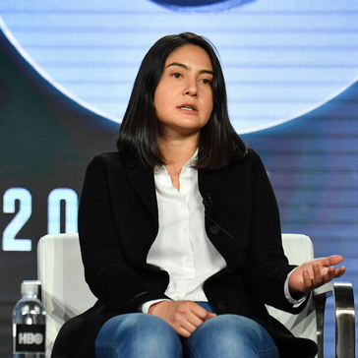
Tyler Shultz
Erika Cheung
Notes:
George Shultz was on the Theranos Board of Directors and had asked Holmes to offer Tyler Shultz a job opportunity. Shortly afterward, Tyler Shultz joined Theranos as an intern and was soon working full-time as a research engineer.
During his eight months at Theranos, he worked closely with Erika Cheung.
Together, they discovered Theranos had been removing outliers from its data, and therefore not producing accurate results and running blood samples in a secret lab, using commercially available machines, not the Theranos Edison Machine it had told investors and patients it was using.
As seen in The Dropout, Tyler Shultz did tell Holmes about what he witnessed but it fell on deaf ears. He resigned from Theranos soon after and would become one of the company's biggest whistleblowers, at just 22 years old.
Using an alias, Shultz also contacted New York state regulators about the failures of Theranos' blood-testing device.
He also contacted John Carreyrou of the Wall Street Journal, and became a key source in exposing Theranos' failings. Carreyrou's 2015 article and several articles thereafter served as the catalyst for bringing down Theranos.
===
Erika Cheung
But Ms. Cheung’s excitement faded after she witnessed actions she disagreed with in Theranos’s lab, she said. In some cases, outlier results of the blood tests were deleted to ensure that Theranos’s technology passed quality control tests. Ms. Cheung was also alarmed when she donated her own blood to Theranos and tests on the company’s machines said she had a vitamin D deficiency but traditional tests did not, she testified.
Ms. Cheung, who viewed a menu of around 90 blood tests offered by Theranos, said that despite Ms. Holmes’s promises about the Edison machines, they could process only a handful of the tests listed. The rest had to be done by traditional blood analyzers or sent out to a diagnostic company, she said.
Ultimately, Ms. Cheung resigned over her misgivings about Theranos’s testing services.
“I was uncomfortable processing patient samples,” she said. “I did not think the technology we were using was adequate enough to be engaging in that behavior.”
Lab assistant Erika Cheung also joined the company because she was excited by Holmes’ vision. Cheung worked in the Theranos lab for six months in 2013 and 2014 before also discovering that faulty test results were bring erased. When she had her own blood tested by a Theranos machine, the results indicated a vitamin D deficiency that conventional tests disproved. She brought the problems to the attention of Balwani but he questioned her competence. After six months at the company, Cheung was so alarmed by what was happening that she resigned. Theranos then began harassing Cheung, hiring private investigators who followed her. She later said she felt so threatened and monitored that she changed residence several times and got a prepaid phone so her calls could not be monitored.

Slide 9
How bad is it?
67% of companies had a security breach.
More than 45% were targeted by organized crime.
60% reported financial losses.
The Association of Certified Fraud Examiners (https://www.acfe.com/) estimates total yearly global fraud losses to be over $3.7 trillion a year.

Slide 10
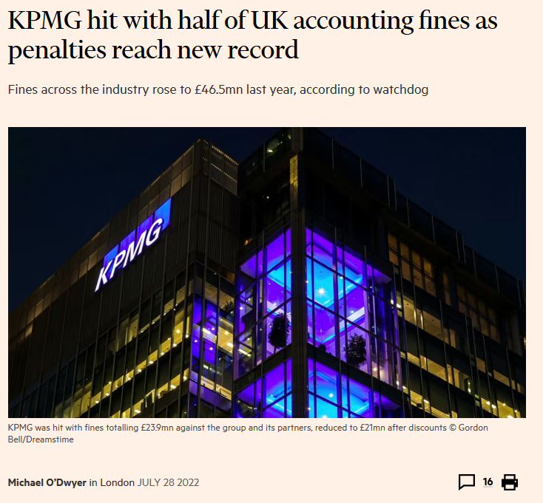
Notes:
https://www.ft.com/content/73e48574-673a-4725-9b78-ba940a8060f5
Please use the sharing tools found via the share button at the top or side of articles. Copying articles to share with others is a breach of FT.com T&Cs and Copyright Policy. Email licensing@ft.com to buy additional rights. Subscribers may share up to 10 or 20 articles per month using the gift article service. More information can be found here.
https://www.ft.com/content/73e48574-673a-4725-9b78-ba940a8060f5
UK accountancy firms were fined a record £46.5mn last year, according to data released on Thursday, with more than half of the total levied against KPMG after its involvement in a series of audit failures and misconduct scandals. The figures underline the depth of the problems at KPMG, which audits more FTSE 100 companies than any other firm and has been battling to clear a backlog of investigations into its work. Fines across the industry rose to £46.5mn before discounts for admissions and settlements compared with £16.7mn a year earlier, according to data from the Financial Reporting Council. This eclipsed the previous record of £42.9mn from the year up to March 2019. The level of fines after discounts, which are granted by the FRC to encourage firms to co-operate with its investigations, set a new high of £34.6mn. KPMG received four fines, more than any other firm, resulting in penalties of £23.9mn against the group and its partners, reduced to £21mn after discounts. It was also ordered to pay millions of pounds to cover the costs of the FRC’s investigations. The largest penalty against KPMG was a £13mn fine over a conflict of interest when it advised on the restructuring and sale of mattress company Silentnight in 2011 to a private equity group that it was trying to attract as a client. It was also fined over its audits of Rolls-Royce, Conviviality and Revolution Bars. The figures exclude the £14.4mn fine imposed on KPMG this week, its largest ever in the UK, after an industry tribunal found its auditors had misled inspectors examining its audit of the 2016 accounts of Carillion, the collapsed outsourcer, and the 2014 accounts of UK company Regenersis. KPMG said last week that a sharp improvement in its scores in the FRC’s annual inspections of audit quality showed its strategy was working. The watchdog welcomed the improvement but said it was “not yet a trend”. Among the other firms, Grant Thornton was fined three times, including over its auditing of Patisserie Valerie, the café chain that collapsed due to a suspected fraud in 2019. The UK’s sixth-largest audit firm by revenue was also fined over its audits of failed government contractor Interserve and retailer Sports Direct, now called Frasers Group. PwC was fined over its audits of construction groups Kier and Galliford Try, while EY and Deloitte were penalised once each. All of the firms to receive fines reported increased profits in their most recent results, helped by booming demand for consulting and deals advice and rising audit prices. The number of non-financial sanctions imposed by the FRC such as reprimands, exclusion from the profession or remedial actions, more than doubled to 62 in the year to March. Recommended Helen Thomas The rising risk of ‘audit orphans’ in a dysfunctional UK market Pastries on display in the window of a Patisserie Valerie cake store “High-quality financial reporting and audit are vital to provide users of financial statements with confidence in the accuracy of those statements and to uphold trust in corporate Britain,” said Elizabeth Barrett, FRC executive director of enforcement. The increase in non-financial sanctions “reflects the ongoing emphasis placed on identifying the underlying causes of failure and effecting long-term positive change”, she said. The number of people working in the FRC’s enforcement division rose by more than a fifth to 64 in the year to March. The regulator has expanded rapidly in anticipation of being renamed the Audit, Reporting and Governance Authority and gaining new powers under long-awaited reforms of the sector.

Slide 11
Threats to A I S
Natural and political disasters
Software errors and equipment malfunctions
Unintentional acts
  80% of security problems are human error
Intentional acts
Notes:
This is a good chapter that can be applied to current events locally, nationally, or internationally as many times in the news there are headlines that relate to computer fraud, computer errors, or some sort of natural or political disaster that has an impact on the AIS. Do a quick search on Google for computer fraud or computer error and see if you can categorize some of those news articles in the four different threats to AIS.
Natural disasters that often occur in the United States can be flooding from storms or hurricanes, the threat of tornadoes, and earthquakes. That is why many of the companies that do business on the Internet will have facilities that have redundancies in different parts of the United States and the world. For example, Google is headquartered in Silicon Valley but has many server farm locations around the world to ensure that the website is always up and running (http://www.google.com/about/datacenters/inside/locations/index.html). Could you imagine that if an earthquake hit Silicon Valley and a popular Internet company did not have this policy in place and their website went down? This would be a great risk to those companies with a loss of revenues.
Software errors which are often called software bugs can cause damage to a company’s ability to conduct business, have an impact on customer satisfaction, and damage an organization’s reputation.
Equipment malfunctions are another reason that companies such as Google have server farms located all over the world. If a server goes down in one location, the data can be rerouted to another server that is up and running.
Unintentional acts are caused by human error. As humans, we make honest mistakes. That is why it’s important as an accountant to pay attention to details, check your work, and have good controls in place (we will discuss this in subsequent chapters).
Intentional acts include computer crime, fraud, or intentional sabotage on an information system. A great resource to find out more information about intentional acts is a blog written by Brian Krebs who was a writer for the Washington Post (http://krebsonsecurity.com/).

Slide 12
Fraud
Any means a person uses to gain an unfair advantage over another person; includes: Fraud is white-collar crime
  A false statement, representation, or disclosure
  A material fact, which induces a victim to act
  An intent to deceive
  Victim relied on the misrepresentation
  Injury or loss was suffered by the victim
  Fraud is white-collar crime
  5% of typical organization’s revenue is lost to fraud
Notes:
Scanning the headlines or doing a simple Google search can show many news articles at your local or regional level, as well as national and international fraud.
Because fraud is often perpetrated by knowledgeable insiders, it is important for accountants to maintain the highest level of professional ethics and this is a good time to remind students about their commitment to professional ethics.

Slide 13
Two Categories of Fraud
Misappropriation of assets
  Theft of company assets which can include physical assets (e.g., cash, inventory) and digital assets (e.g., intellectual property such as protected trade secrets, customer data)
  Median loss $125,000 and 83% of total cases
Fraudulent financial reporting
  “cooking the books” (e.g., booking fictitious revenue, overstating assets, etc.)
  Median loss $975,000, <10% total cases
  Undetected fraud is a factor in over half of lawsuits against auditors

Slide 14
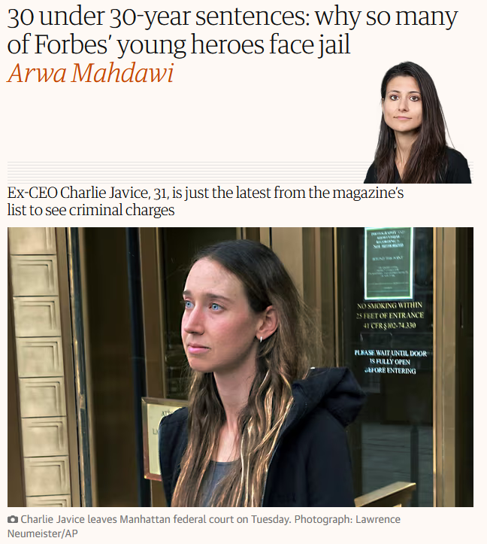
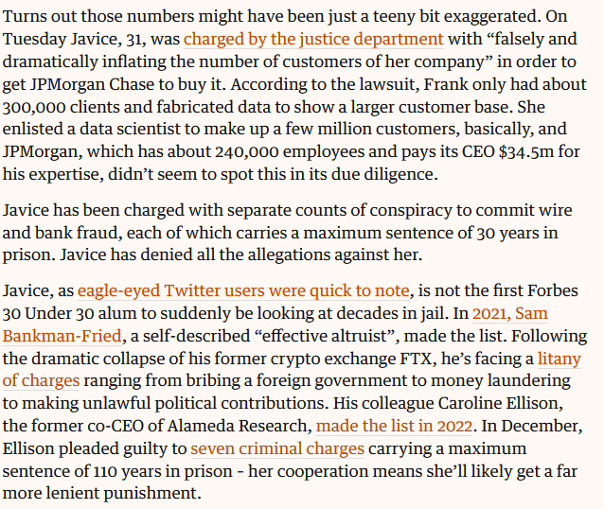
https://www.theguardian.com/business/2023/apr/06/forbes-30-under-30-tech-finance-prison
Notes:
ust a few years ago, Charlie Javice was riding high. In 2019 the tech CEO landed a spot on Forbes’s 30 Under 30 list for her work on a startup called Frank, which she described as “Amazon for higher education”. What does that catchy but completely empty phrase mean? It means Frank helped students navigate the financial aid process. It was apparently so successful at doing this that JPMorgan Chase acquired the company for $175m in 2021 and Javice was made a managing director at the bank. The entrepreneur shared the news on LinkedIn, boasting that in just four years Frank had grown to serve “over 5 million students at over 6,000 colleges”.

Slide 15
Fraud statistics
Small companies more vulnerable than larger
75% of in accounting, operations, sales, upper management, customer service, purchasing, and finance.
41% not reported to police
79% of cases had warning behavior (living beyond means, financial difficulties, family problems)
Most are first-time offenders
Owner/Executive fraud 4x Manager fraud
Manager fraud 11x costly as employee fraud

Slide 16
Auditor’s Responsibility
S A S No. 99 (A U-C Section 240) requires auditors to:
Understand fraud
Discuss the risks of material fraudulent misstatements
Obtain information
Identify, assess, and respond to risks
Evaluate the results of their audit tests
Document and communicate findings
Incorporate a technology focus
Notes:
Statement of auditing standards SAS 99 (now referred to as auditing standards AU-C section 240) discusses the responsibility auditors have in detecting fraud:
First auditors must understand fraud and how/why it is committed in order to detect fraud
During audit planning, auditors should discuss the risk of material fraudulent misstatements among themselves and where the company’s financial statements are susceptible to fraud
The audit team gathers evidence by looking for fraud risk factors: testing company records, many frauds use revenue recognition, auditors exercise special care (although not comprehensive this is a good resource: http://www2.deloitte.com/content/dam/Deloitte/in/Documents/risk/Corporate%20Governance/Audit%20Committee/in-gc-fraud-schemes-questions-to-consider-noexp.pdf.
Evidence is used to identify, assess, and respond to risks
Auditors must evaluate if identified financial misstatements indicate the presence of fraud and the impact on the financial statements and the audit
Auditors must document their findings and communicate them to management and the audit committee
Technology has an impact on fraud risks; there is an opportunity for auditors to use technology to design fraud auditing procedures

Slide 17
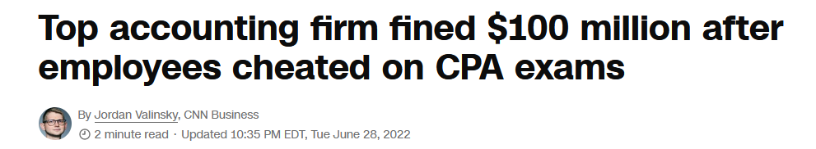
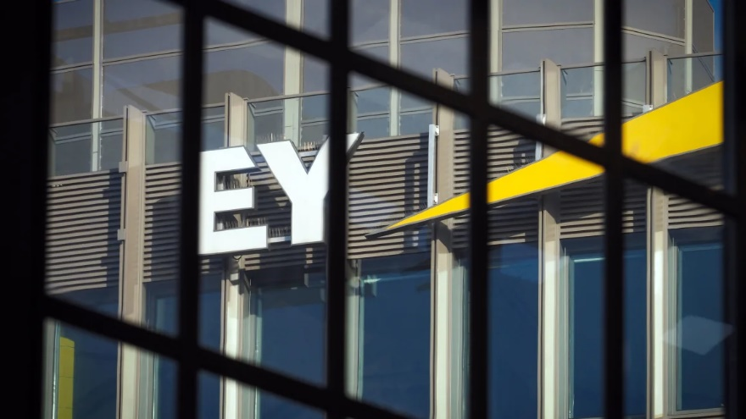
New York CNN Business —
Ernst & Young has been slapped with a record $100 million fine from the US government after regulators discovered that the company knew some of its auditors were cheating on exams for several years and did nothing to stop it.
The Securities and Exchange Commission said Tuesday that a “significant number” of the accounting firm’s auditors cheated on the ethics portion of the Certified Public Accountant test and other courses needed to maintain the licenses. Perhaps more stunningly, the SEC said that Ernst & Young “made a submission” that it didn’t have “current issues with cheating when, in fact, the firm had been informed of potential cheating on a CPA ethics exam.”

Slide 18
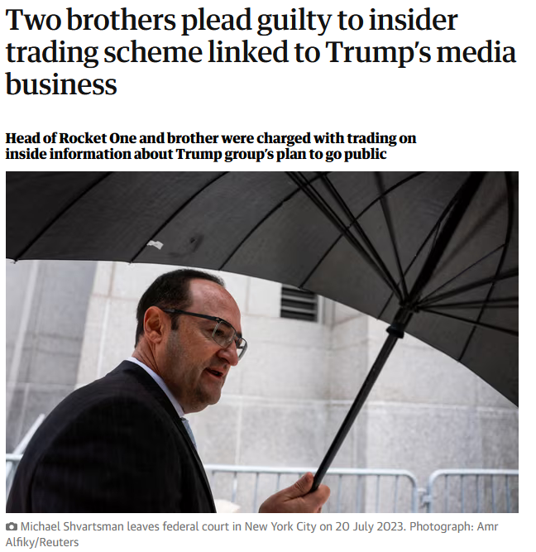
Two men pleaded guilty on Wednesday to insider trading in securities in the company that ultimately took Donald Trump’s media business public.
Prosecutors charged the trio last year with illegally trading on inside information about Trump Media & Technology Group’s (TMTG) plan to go public through a merger with a blank-check company. TMTG operates Truth Social, Trump’s main social media platform.
Prosecutors said the trio signed confidentiality agreements in June 2021 when they were approached to become early investors in Digital World Acquisition, the blank-check company. The agreements required them to keep information they learned confidential and not trade the company’s securities in the open market, prosecutors said.
After hearing the company was in merger talks with TMTG, prosecutors said the trio tipped others and bought Digital World securities, selling them after the deal was announced on 20 October 2021, to make a total of $22m in illegal profit.
Michael and Gerald Shvartsman said in court that they knew what they were doing was wrong when they traded on nonpublic information.
https://www.theguardian.com/us-news/2024/apr/03/trump-media-inside-trading-guilty-plea

Slide 19
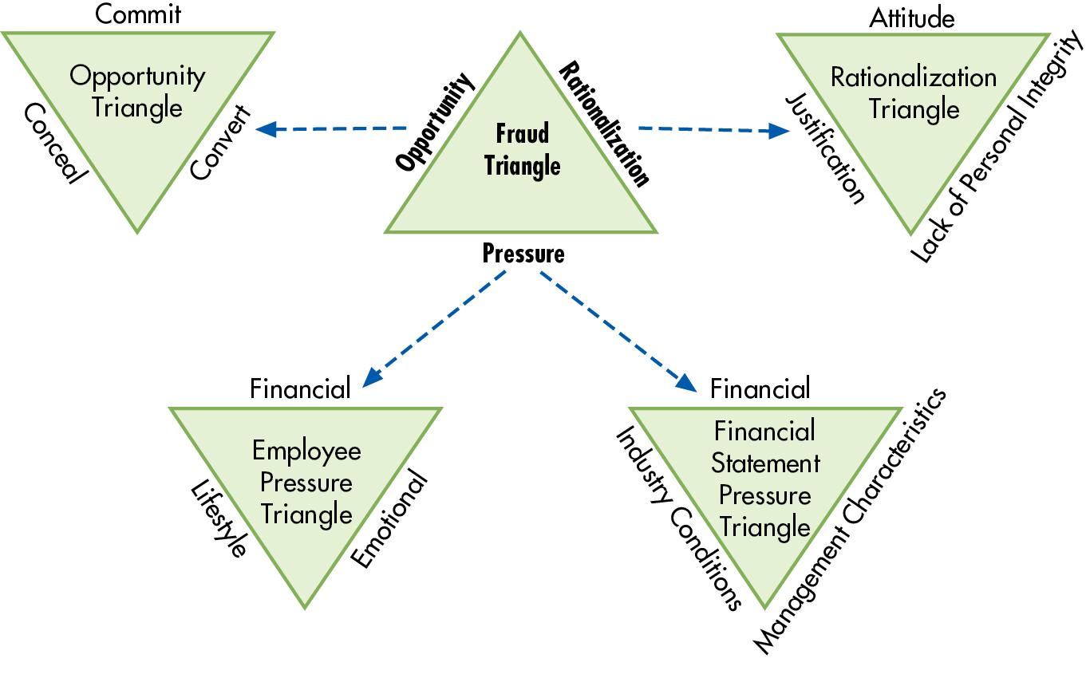
Figure 8.1 Fraud Triangle
Notes:
Figure 8.1 in the text is a good visualization of the Fraud Triangle and the detailed components of the two major types of pressure, the 3 C’s needed for opportunity and types of rationalization. It is noted that committing a fraud requires that all three components occur: opportunity to commit the fraud, conceal the fraud, and then convert it.
Long Description:
The sides making each of these triangles are as follows:
Opportunity Triangle: Commit, Conceal, and Convert
Rationalization Triangle: Lack of Personal Integrity, Justification, and Attitude
Employee Pressure Triangle: Financial, Emotional, and Lifestyle
Financial Statement Pressure Triangle: Industry Conditions, Management Characteristics, and Financial

Slide 20
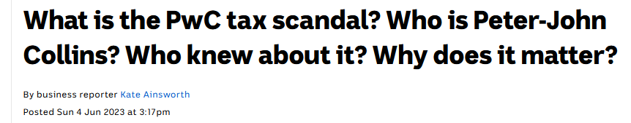
Opportunity
Opportunity to:
  Commit
  Conceal
  Convert to personal gain
https://www.abc.net.au/news/2023-06-05/pwc-pricewaterhousecoopers-government-tax-leak-scandal-explained/102409528
About a decade ago, the federal government asked PwC's international tax expert Peter-John Collins to help them design laws that would solve a problem: getting big overseas companies like Google, Facebook and Apple to pay their fair share of tax in Australia.
That legislation was known as the Multinational Anti-Avoidance Law (MAAL) and was a major strategy of the then-treasurer Joe Hockey under the Coalition government, based on the Organisation for Economic Cooperation and Development (OECD)'s Base Erosion Profit Shifting project.
In his dealings with the government and designing the tax laws, Mr Collins was required to sign multiple confidentiality agreements which specifically stated that the knowledge could not be disclosed.
But the Tax Practitioners Board found Mr Collins shared that secret knowledge with people within PwC, which gave the firm an advantage by being able to come up with ways for companies to get around paying the new tax.
PwC then used this inside information to get new clients and make money. They were even boasting about it internally, and all of this was happening without the government's knowledge until earlier this year.
Notes:
From your accounting coursework in your program, it is important to understand why internal controls are so important. In this book, we will cover many internal controls that will prevent and detect these two categories of fraud. In your financial accounting coursework, it is important to understand why transactions should be recorded correctly and in the proper time period. Inappropriate transactions recorded in the accounting system can be indicators of covering up misappropriation of assets or management’s intent to “cook the books.”
That is why for fraud to occur there must be:
Pressure or incentive to commit the fraud
Opportunity to commit the fraud
Rationalization of the person committing the fraud as to why it’s ok that they committed the fraud
With articles that you find in the news on fraud, see if you can identify the pressure, opportunity, and rationalization as to how the person committed the fraud and why they did it.

Slide 21
Pressures
Financial
  Living beyond one’s means
  High personal debt/expenses
  Inadequate salary
  Poor credit
  Heavy losses / bad investments
  Unreasonable goals/quotas
Emotional
  Greed, pride, ego
  Performance not being recognized
  Fear of losing job
  Challenge, envy, need to win
  Coercion by bosses
Lifestyle: Gambling, drug, sex, family

Slide 22
Rationalizations
I am only “borrowing” the money (or asset) and will repay my “loan.”
You would understand if you knew how badly I needed it.
What I did was not that serious.
It was for a good cause (the Robin Hood syndrome, robbing from the rich to give to the poor).
I occupy a very important position of trust. I am above the rules.
Everyone else is doing it, so it is not that wrong.
No one will ever know.
The company owes it to me, and I am taking no more than is rightfully mine.

Slide 23
Stopped 4/7/26

Slide 24
Missing Wirecard Money
https://www.youtube.com/watch?v=EdYpXuwGVFg

Slide 25
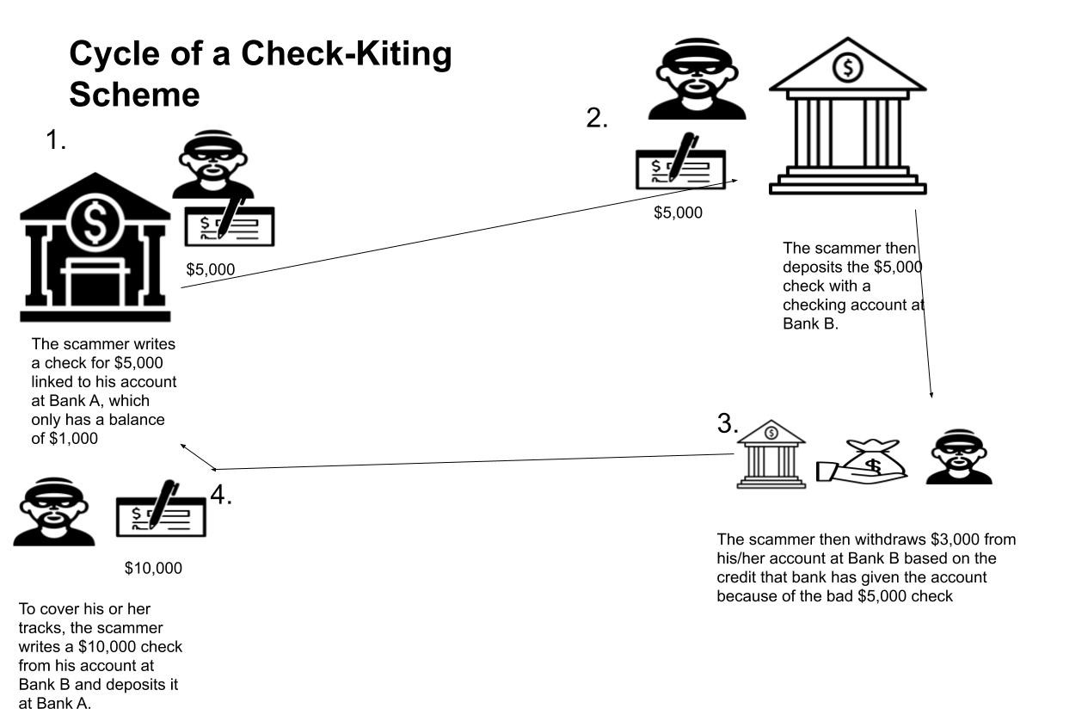
Check Kiting
https://www.depositaccounts.com/blog/check-kiting.html

Slide 26
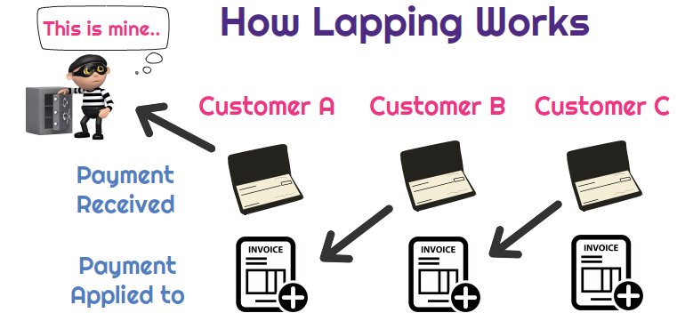
https://www.depositaccounts.com/blog/check-kiting.html

Slide 27
Computer Fraud
If a computer is used to commit fraud, it is called computer fraud.
Computer fraud is classified as:
  Input
  Processor
  Computer instruction
  Data
  Output
Notes:
Using the data processing diagram model that we discussed in Chapter 2, computer fraud is classified using this structure:
From the processing cycle of the DP model, it would include processor and computer instruction fraud.
The best way to learn about the computer fraud classifications is to talk about stories that occurred within these classifications. The book does a good job at describing many stories within these classifications.
If you are a movie fan, there are many movies out there that use computer fraud as a storyline in the plot. For example, the movie Office Space is about a group of guys at a company that are unhappy with the company management. They change the computer code (computer instruction fraud) to divert fractions of pennies to an account that they own. You will have to watch the movie yourself to see if you can identify the components of fraud.
A good example of output fraud is someone stealing the company trash to examine the reports generated and placed in the trash from a computer system. That is why many companies now have shredding policies.
Although not a complete list, here are some favorites (you can find many more just by going to the web and looking for movies with fraud in the plot):
Office Space
Catch Me If You Can
The Informant!

Slide 28
How is fraud caught?
Most common through anonymous tips (phone email, online form)
Typical misappropriation:
  Gains trust, uses misleading information
  Falsifies records to hide
  Rarely stops on their own
  Escalating, stopping will usually result in discovery
  Spends gains (not investing/saving)

Slide 29
Preventing and Detecting Fraud 1. Make Fraud Less Likely to Occur
Organizational
  Systems
Create a culture of integrity
Adopt structure that minimizes fraud, create governance (e.g., Board of Directors)
Assign authority for business objectives and hold them accountable for achieving those objectives, effective supervision and monitoring of employees
Communicate policies
Develop security policies to guide and design specific control procedures
Implement change management controls and project development acquisition controls
Notes:
Table 8.5 is a long list for students to remember; it may be simpler to break the list down into categories that would be general for the organization and those that are specific from a systems perspective.
These details are discussed more in Chapters 10 through 13 in the text.

Slide 30
Preventing and Detecting Fraud 2. Make It Difficult to Commit
Organizational
  Systems
Develop strong internal controls
Segregate accounting functions
Use properly designed forms
Require independent checks and reconciliations of data
Restrict access
System authentication
Implement computer controls over input, processing, storage, and output of data
Use encryption
Fix software bugs and update systems regularly
Destroy hard drives when disposing of computers

Slide 31
Preventing and Detecting Fraud 3. Improve Detection
Organizational
  Systems
Assess fraud risk
External and internal audits
Fraud hotline
Audit trail of transactions through the system
Install fraud detection software
Monitor system activities (user and error logs, intrusion detection)

Slide 32
Preventing and Detecting Fraud 4. Reduce Fraud Losses
Organizational
  Systems
Insurance
Business continuity and disaster recovery plan
Store backup copies of program and data files in secure, off-site location
Monitor system activity

Slide 33
Using Data Analytics to Prevent and Detect Fraud (1 of 2)
Fraud detection is much more effective when data analytics software tools are used to examine an entire data population.
  Using data analytics software, every transaction or item in the data can be compared against selected criteria and any items identified as anomalies, unusual, or unexpected could be tagged for human examination.
Data analytics don’t directly detect fraud.
  Experienced humans are needed to examine and understand any suspicious activities identified and to determine if fraud is involved.

Slide 34
Using Data Analytics to Prevent and Detect Fraud (2 of 2)
There are benefits as well as challenges when using data analytics to prevent and detect fraud.
There are many data analytics techniques to detect fraud:
  Outliner detection, anomaly detection using trends and patterns, regression analysis, semantic modeling, and Benford’s Law.

Slide 35
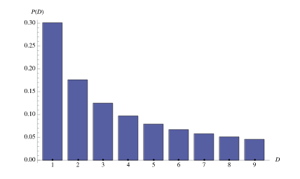
Benford’s Law
A phenomenological law also called the first digit law, first digit phenomenon, or leading digit phenomenon. Benford's law states that in listings, tables of statistics, etc., the digit 1 tends to occur with probability ∼30%, much greater than the expected 11.1% (i.e., one digit out of 9). Benford's law can be observed, for instance, by examining tables of logarithms and noting that the first pages are much more worn and smudged than later pages (Newcomb 1881). While Benford's law unquestionably applies to many situations in the real world, a satisfactory explanation has been given only recently through the work of Hill (1998).
https://mathworld.wolfram.com/BenfordsLaw.html

Slide 36
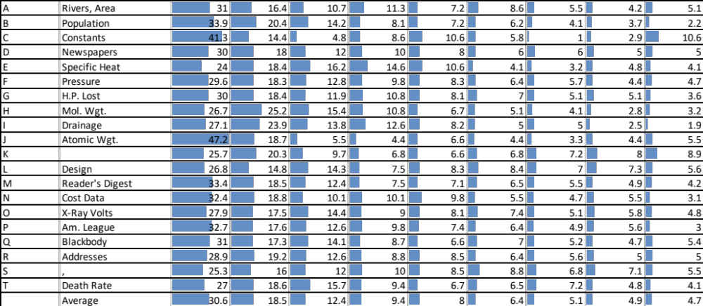
Benford’s Law
https://mathworld.wolfram.com/BenfordsLaw.html

Slide 37
Key Terms
Sabotage
Cookie
Fraud
White-collar criminals
Corruption
Investment fraud
Misappropriation of assets
Fraudulent financial reporting
Pressure
Opportunity
Lapping
Check kiting
Rationalization
Computer fraud

Slide 38
Copyright
This work is protected by United States copyright laws and is provided solely for the use of instructors in teaching their courses and assessing student learning. Dissemination or sale of any part of this work (including on the World Wide Web) will destroy the integrity of the work and is not permitted. The work and materials from it should never be made available to students except by instructors using the accompanying text in their classes. All recipients of this work are expected to abide by these restrictions and to honor the intended pedagogical purposes and the needs of other instructors who rely on these materials.

