Slide 1
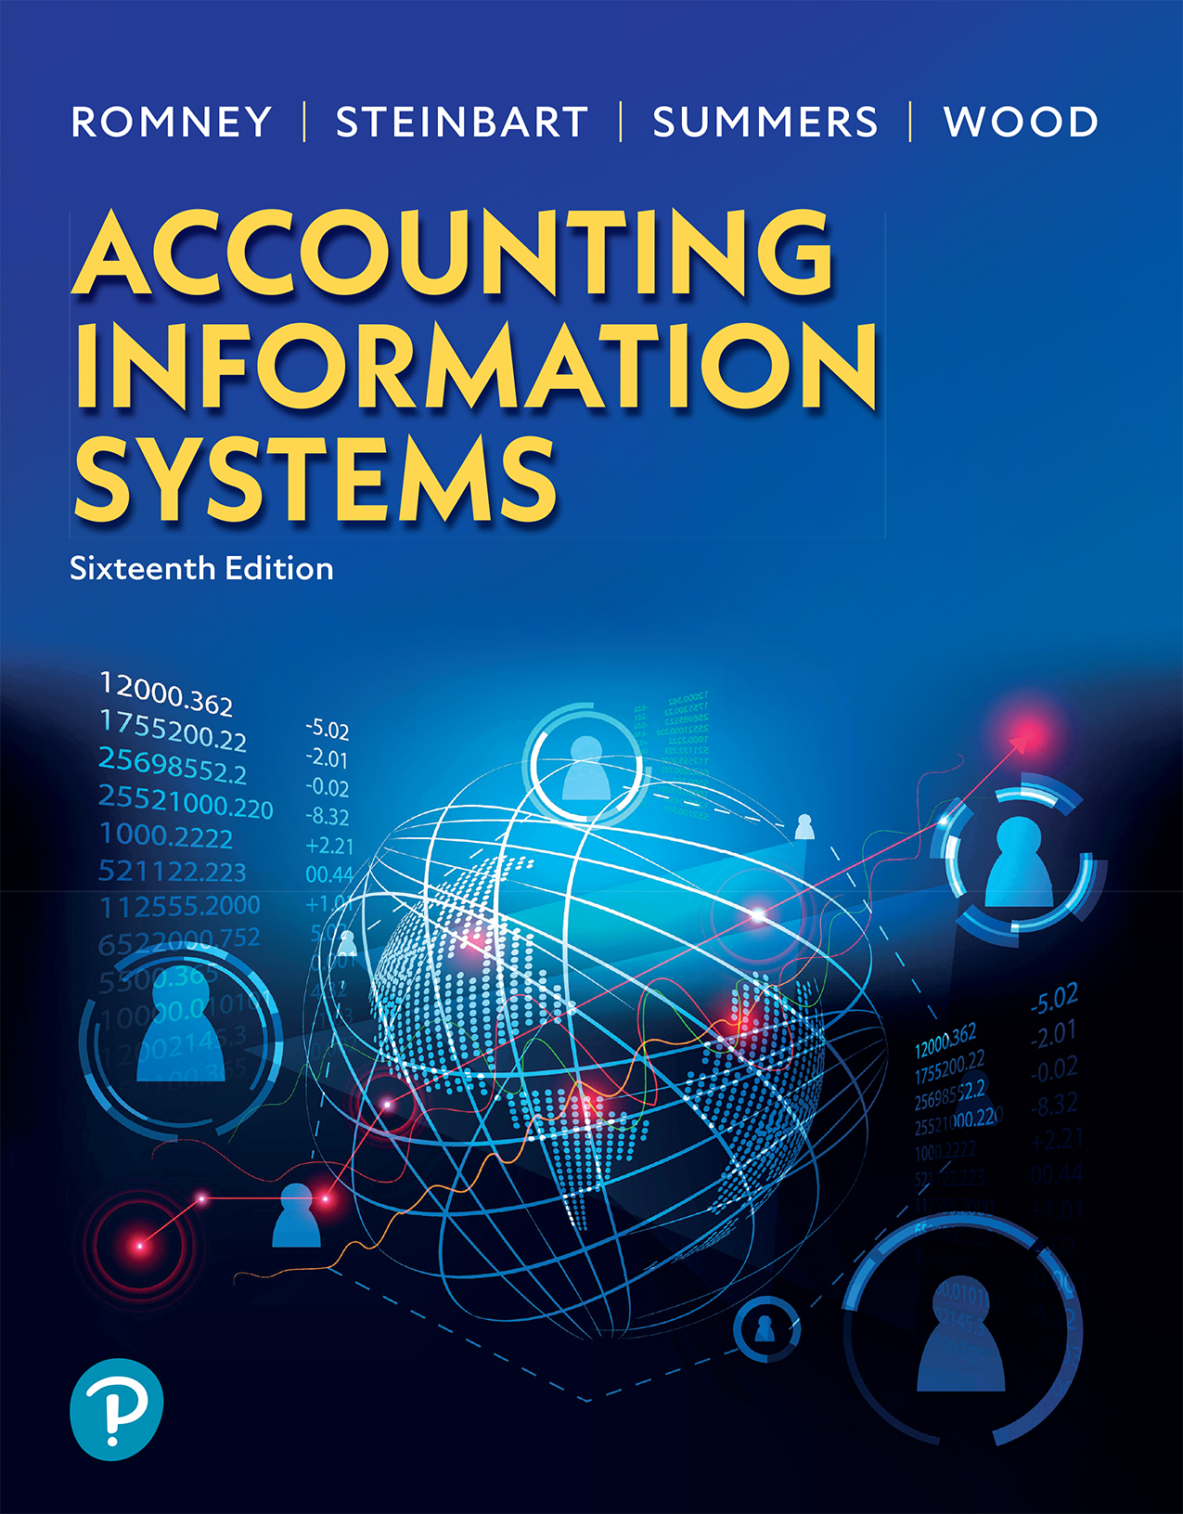

Accounting Information Systems
Sixteenth Edition
Chapter 9
Computer Fraud and Abuse Techniques
Copyright © 2024, 2021, 2018 Pearson Education, Inc. All Rights Reserved
Notes:
If this PowerPoint presentation contains mathematical equations, you may need to check that your computer has the following installed:
1) MathType Plugin
2) Math Player (free versions available)
3) NVDA Reader (free versions available)

Slide 2
Learning Objectives
Compare and contrast computer attack and abuse tactics.
Explain how social engineering techniques are used to gain physical or logical access to computer resources.
Describe the different types of malware used to harm computers.

Slide 3
Computer Attacks and Abuse
There are six steps that many criminals use to attack information systems:
  Conduct reconnaissance
  Attempt social engineering
  Scan and map the target
  Research
  Execute the attack
  Cover tracks

Slide 4
Types of Attacks
Hacking
  Unauthorized access, modification, or use of an electronic device or some element of a computer system
Social Engineering
  Techniques or tricks on people to gain physical or logical access to confidential information
Malware
  Software used to do harm
Notes:
Table 9.1 provides an extensive list of these different types of attacks.

Slide 5
Hacking
  Hijacking
    Gaining control of a computer to carry out illicit activities
  Botnet (robot network)
    Zombies
    Denial of Service (DoS) attack
    Brute force attack
    Password cracking
    Dictionary attack
    Spamming
    Spoofing – Makes the communication look as if someone else sent it so as to gain confidential information

Slide 6
Forms of Spoofing
E-mail spoofing
Caller I D spoofing
I P address spoofing
S M S spoofing
Web-page spoofing (phishing)
Notes:
Why is there spoofing? Well, it’s because the perpetrator of the fraud wants you to think that they are someone else that you’d trust. For example:
E-mail spoofing allows you to think that the e-mail you received is from someone you know. This type of attack is often combined with a social engineering technique called phishing. For example, perpetrators will send an e-mail, spoofing the sender’s address from your bank. Inside the e-mail they will embed a link, which they hope you will click on and use your login and password, basically giving them access to your bank account.
Caller ID spoofing will display the wrong number on your phone, hoping that you think it’s from a trusted source (e.g., bank).
IP address spoofing is used to conceal the identity of a sender of DoS attacks.
SMS spoofing is falsifying the sender of a text message (it can also be used in phishing scams).

Slide 7
Hacking with Computer Code
Cross-site scripting (X S S)
  Uses vulnerability of Web application that allows the Web site to get injected with malicious code. When a user visits the Web site, that malicious code is able to collect data from the user.
Buffer overflow attack
  Large amount of data sent to overflow the input memory (buffer) of a program, causing it to crash and replacing it with attacker’s program instructions.
S Q L injection (insertion) attack
  Malicious code inserted in place of a query to get to the database information

Slide 8
Hacking Used for Embezzlement
Salami technique:
  Taking small amounts at a time
    Round-down fraud
Economic espionage
  Theft of information, intellectual property, and trade secrets
Cyber-extortion
  Threats to a person or business online through e-mail or text messages unless money is paid

Slide 9
Hacking Used for Fraud
Internet misinformation
E-mail threats
Internet auction
Internet pump and dump
Cryptocurrency fraud
Click fraud
Software piracy
Notes:
Internet misinformation is used to spread false or misleading information.
E-mail threats that require an action by the victim causing them great expense.
Internet auction fraud can unfairly bid up the price, deliver inferior products, or not deliver anything at all, or the buyer fails to make a payment.
Internet pump and dump uses the Internet to inflate the price of the stock and then sell it. Usually occurs with penny stocks buying large volumes of the stock, then posts false information to drive up the stock, and sells shares to pocket profit before the price falls back down.
Click fraud uses botnets to click on ads to get Web click-through commissions.
Cryptocurrency fraud involves defrauding investors in a variety of cryptocurrency-related fraud schemes, such as fake initial coin offerings and fake exchanges and wallets.
Software piracy is unauthorized copying or distribution of copyrighted software. This can occur by:
selling a computer preloaded with unauthorized software, installing single license software on more than one computer, and loading software on a server allowing unrestricted access.

Slide 10
Social Engineering Techniques
Identity theft
  Assuming someone else’s identity
Phishing
  Sending an e-mail asking the victim to respond to a link that appears legitimate that requests sensitive data
U R L hijacking
  Takes advantage of typographical errors entered in for websites and user gets invalid or wrong website
Scavenging
  Searching trash for confidential information
Shoulder surfing
  Snooping (either close behind the person) or using technology to snoop and get confidential information
Skimming
  Double swiping credit card

Slide 11
Why People Fall Victim
Compassion
  Desire to help others
Greed
  Want a good deal or something for free
Sex appeal
  More cooperative with those that are flirtatious or good looking
Sloth
  Lazy habits
Trust
  Will cooperate if trust is gained
Urgency
  Cooperation occurs when there is a sense of immediate need
Vanity
  More cooperation when appeal to vanity

Slide 12
Minimize the Threat of Social Engineering
Never let people follow you into restricted areas
Never log in for someone else on a computer
Never give sensitive information over the phone or through e-mail
Never share passwords or user I Ds
Be cautious of someone you don’t know who is trying to gain access through you

Slide 13
Types of Malware
Spyware
  Secretly monitors and collects information
  Can hijack browser, search requests
  Adware, scareware
Cyber-extortion
  Threatening to harm a company or a person if a specified amount of money is not paid
Keylogger
  Software that records user keystrokes
Trojan Horse
  Malicious computer instructions in an authorized and properly functioning program
Virus
  A section of self-replicating code that attaches to a program or file requiring a human to do something so it can replicate itself

Slide 14
Key Terms (1 of 3)
Hacking
Hijacking
Botnet
Zombies
Bot herder
Denial-of-service (DoS) attack
Brute force attack
Password cracking
Dictionary attack
Spamming
Spoofing
E-mail spoofing
Caller I D spoofing
I P address spoofing
S M S spoofing
Web-page spoofing
Vulnerabilities
Zero-day attack
Patch
Cross-site scripting (X S S)
Buffer overflow attack
S Q L injection (insertion) attack
Man-in-the-middle (M I T M) attack
Masquerading/impersonation
Piggybacking
War dialing
War driving
Phreaking
Podslurping

Slide 15
Key Terms (2 of 3)
Salami technique
Round-down fraud
Economic espionage
Cyber-bullying
Sexting
Internet misinformation
E-mail threats
Internet auction fraud
Internet pump-and-dump fraud
Cryptocurrency fraud
Click fraud
Software piracy
Social engineering
Identity theft
Pretexting
Posing
Phishing
Vishing
Carding
Pharming
Evil twin
Typosquatting/U R L hijacking
Scavenging/dumpster diving
Shoulder surfing
Lebanese looping
Skimming
Chipping
Eavesdropping

Slide 16
Key Terms (3 of 3)
Spyware
Adware
Torpedo software
Scareware
Cyber-extortion
Ransomware
Keylogger
Trojan horse
Time bomb/logic bomb
Trap door/back door
Packet sniffers
Steganography program
Rootkit
Virus
Worm
Bluesnarfing
Bluebugging

Slide 17
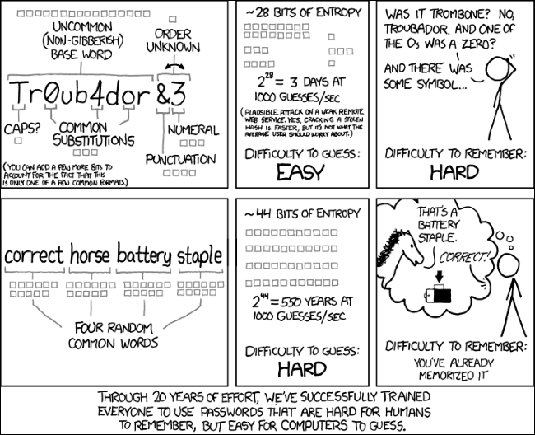
https://xkcd.com/936/

Slide 18
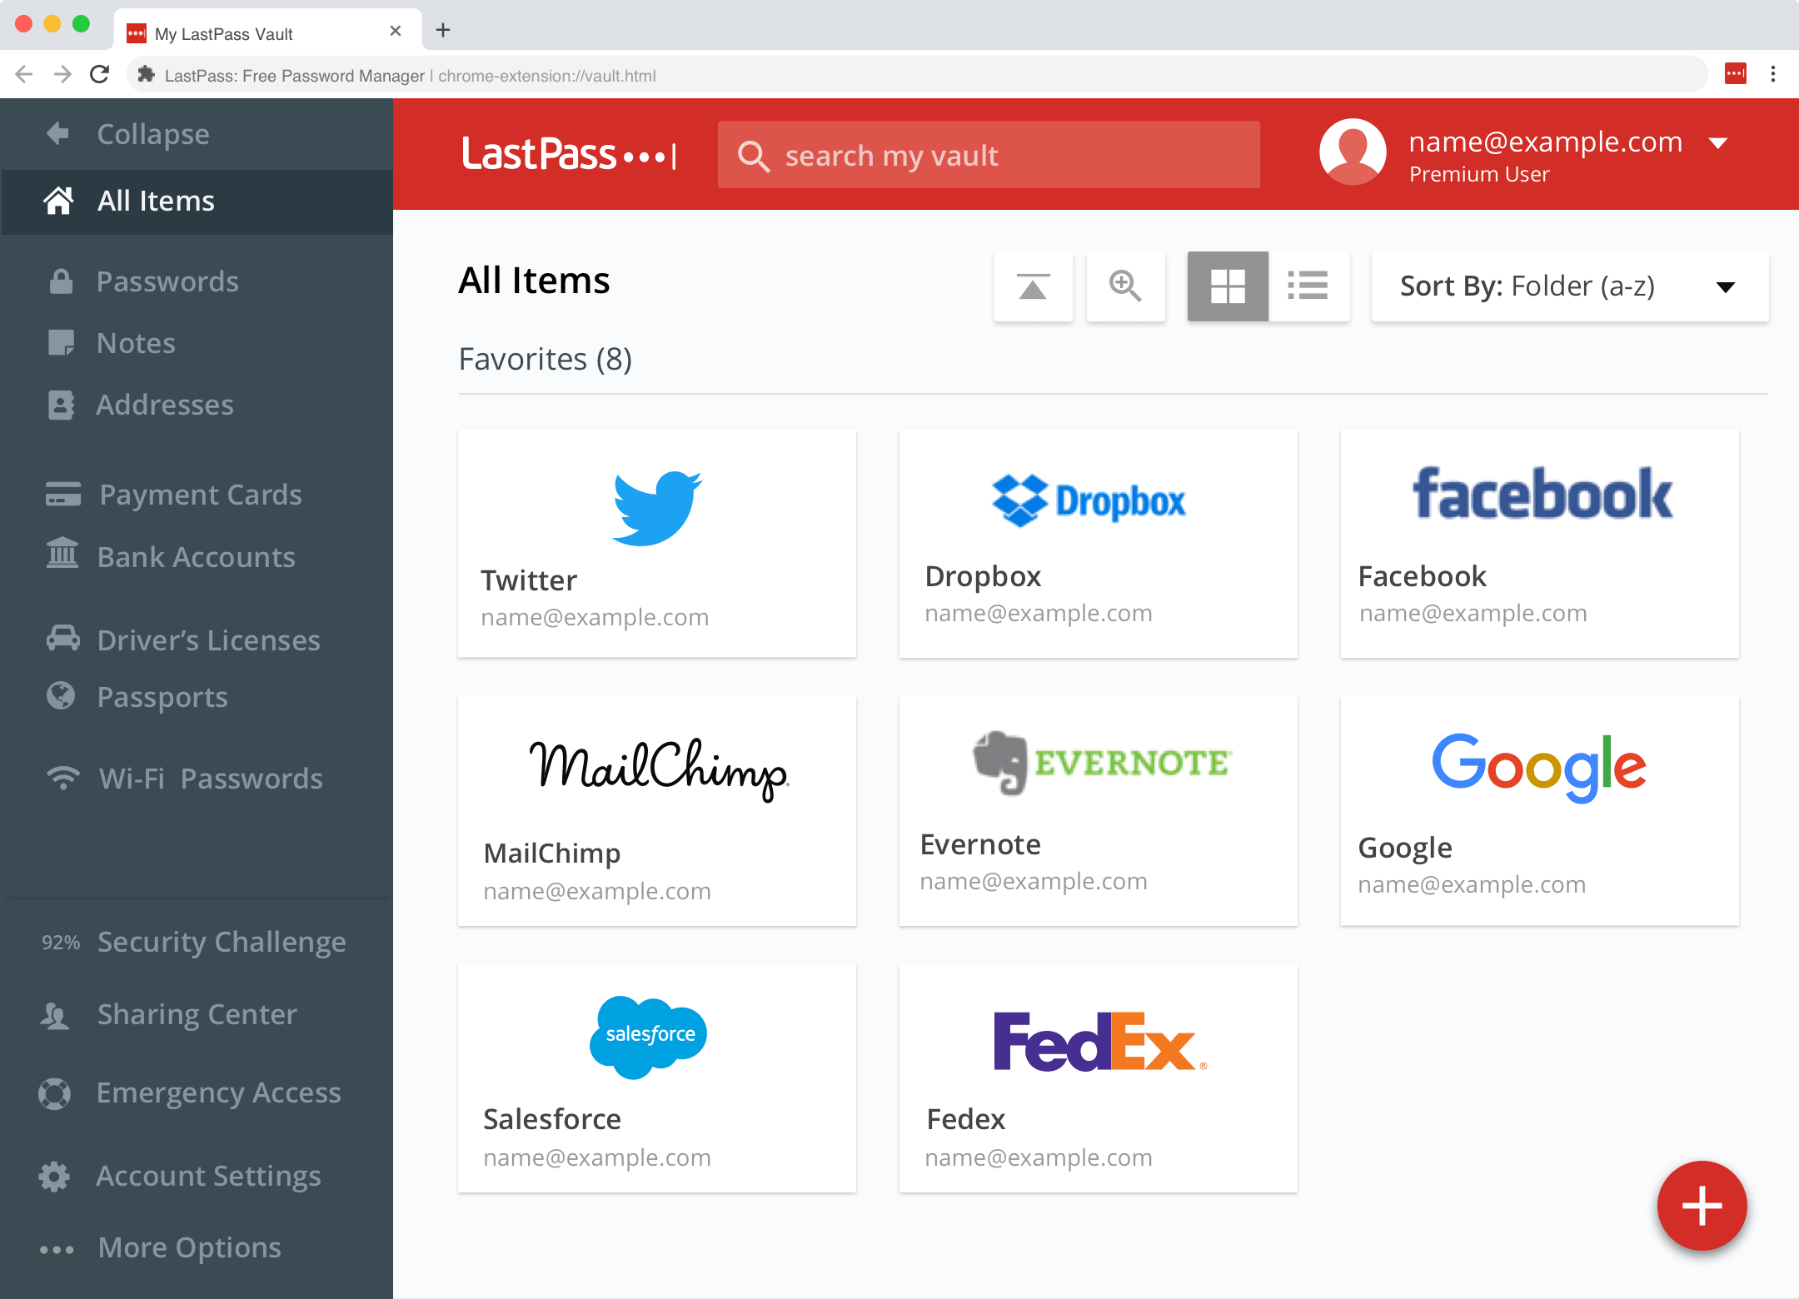

Slide 19
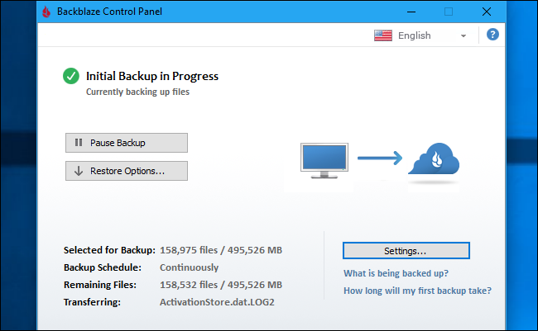
Online backup

Slide 20
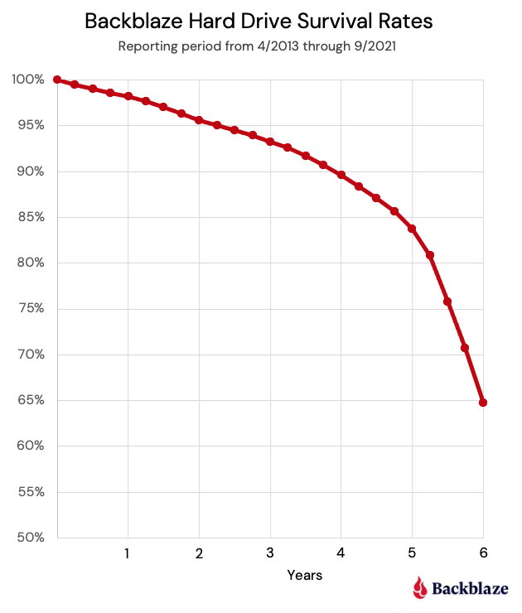
https://www.backblaze.com/blog/backblaze-drive-stats-for-q3-2021/

Slide 21
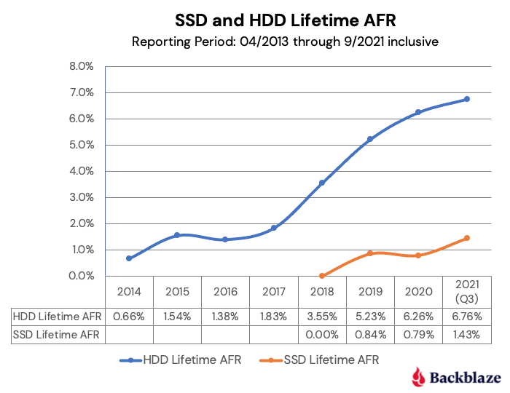

Slide 22
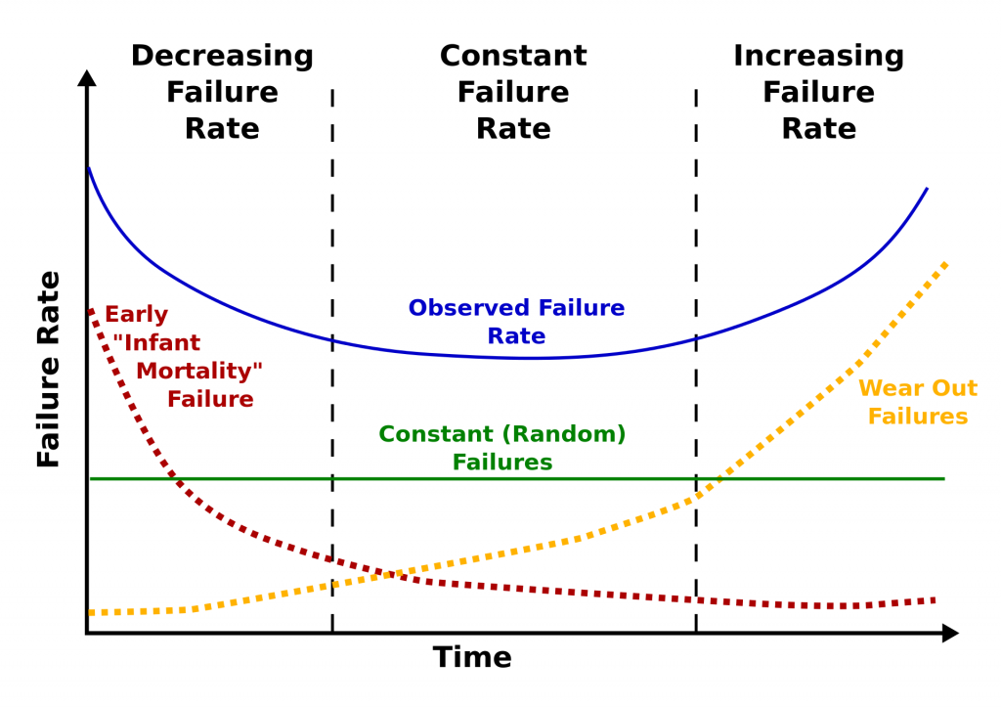

Slide 23
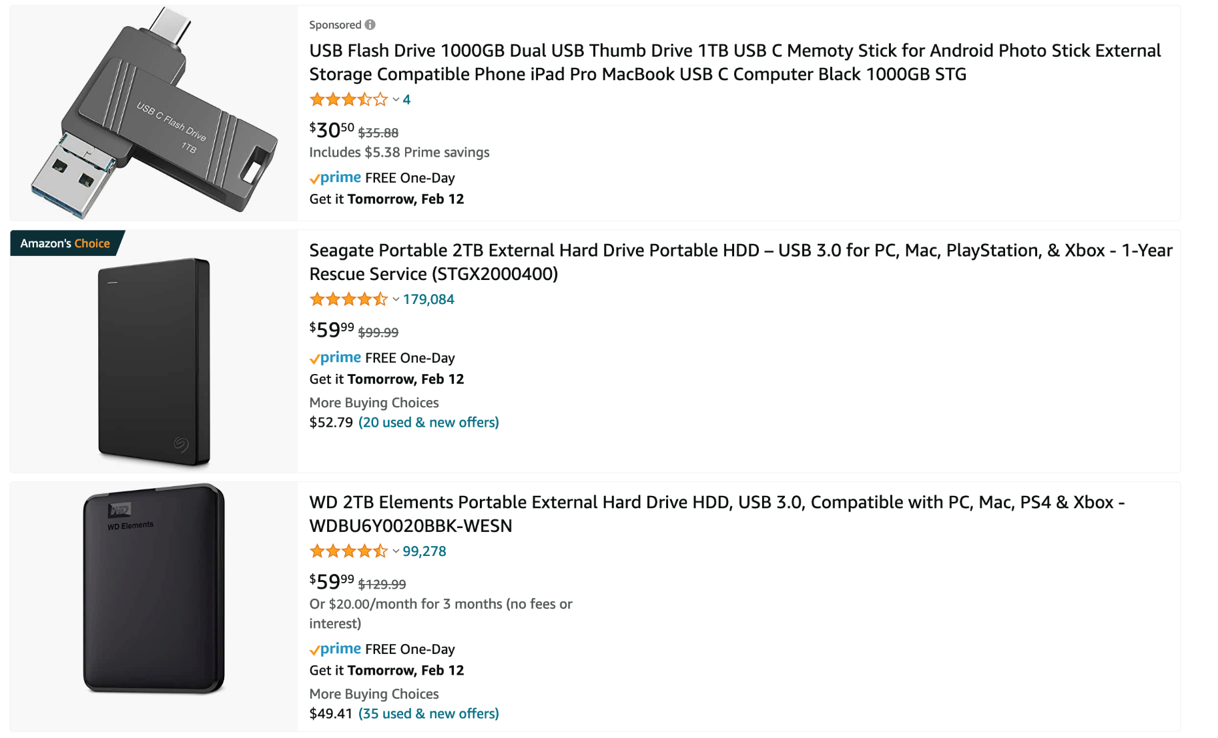
Disk backup

Slide 24

Copyright
This work is protected by United States copyright laws and is provided solely for the use of instructors in teaching their courses and assessing student learning. Dissemination or sale of any part of this work (including on the World Wide Web) will destroy the integrity of the work and is not permitted. The work and materials from it should never be made available to students except by instructors using the accompanying text in their classes. All recipients of this work are expected to abide by these restrictions and to honor the intended pedagogical purposes and the needs of other instructors who rely on these materials.

