Slide 1
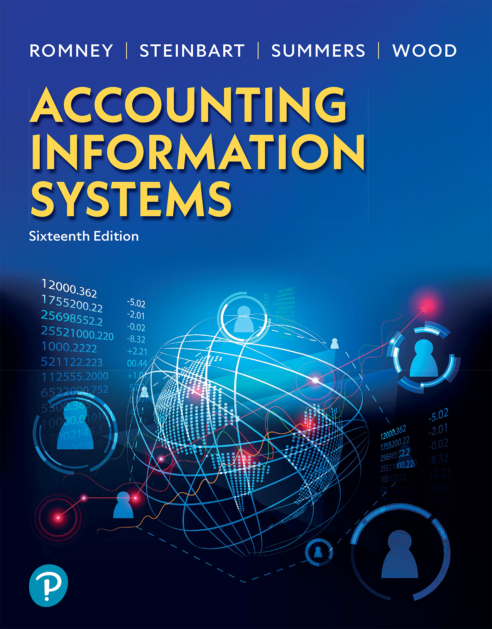
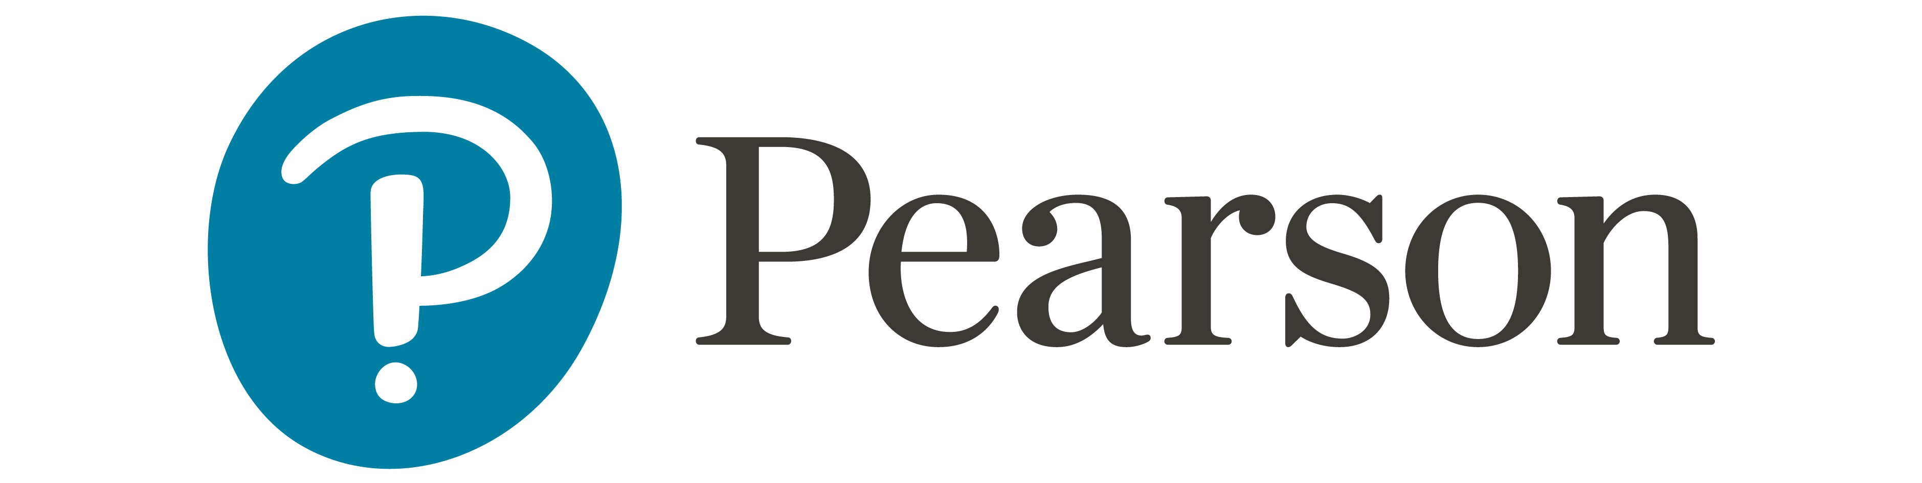
Accounting Information Systems
Sixteenth Edition
Chapter 11
Controls for Information Security
Copyright © 2024, 2021, 2018 Pearson Education, Inc. All Rights Reserved
Notes:
If this PowerPoint presentation contains mathematical equations, you may need to check that your computer has the following installed:
1) MathType Plugin
2) Math Player (free versions available)
3) NVDA Reader (free versions available)

Slide 2
https://quizlet.com/653918458/ais-chapter-11-terms-flash-cards/
https://www.theregister.com/2024/09/29/interview_with_a_social_engineering/
https://www.theregister.com/2024/10/29/macron_location_strava/
https://www.theguardian.com/uk-news/2020/nov/06/companies-house-forces-business-name-change-to-prevent-security-risk

Slide 3
Learning Objectives (1 of 2)
Explain how security and the other four principles in the Trust Services Framework affect systems reliability.
Explain three fundamental concepts: why information security is a management issue, how people’s behaviour impacts security, and the time-based model of information security.
Describe the controls that can be used to protect an organization’s information.

Slide 4
Learning Objectives (2 of 2)
Describe the controls that can be used to timely detect that an organization’s information system is under attack.
Discuss how organizations can timely respond to attacks against their information system.
Explain how virtualization, cloud computing, and the Internet of Things affect information security.

Slide 5
Trust Services Framework
Security,
  Access to the system and data is controlled and restricted to legitimate users.
Confidentiality
  Sensitive organizational data is protected.
Privacy
  Personal information about trading partners, investors, and employees is protected.
Processing integrity
  Data are processed accurately, completely, in a timely manner, and only with proper authorization.
Availability
  System and information are available.
Notes:
The trust services framework is a means to organize IT controls to help ensure systems reliability. At the foundation of this framework is security, which is absolutely necessary for success and for achieving the other four principles.
Security procedures:
Restrict access to authorized users only, which protects confidentiality of sensitive organizational data and the privacy of personal data collected from customers, suppliers, employees, and so on.
Security protects the processing integrity by preventing submission of unauthorized transactions or unauthorized changes to the data.
Security provides protection from unwanted attacks that could bring down the system and make it unavailable.

Slide 6
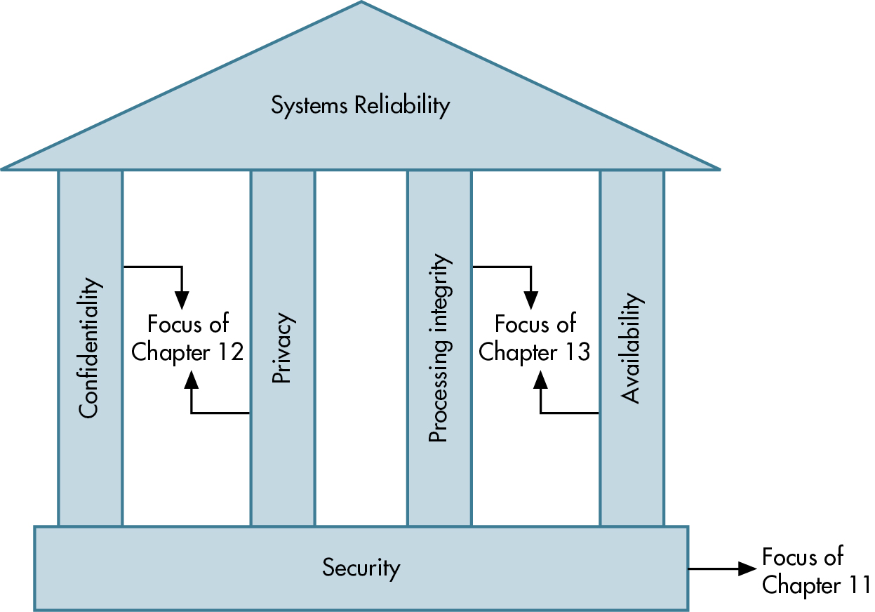
Figure 11.1 Relationships Among the Five Trust Services Principles for Systems Reliability
Notes:
This is a good visual of the Trust Services Framework.
Using an analogy of building a house, you need a good foundation; otherwise the house will fall apart. Then to keep the roof over your head, you need to have well-constructed walls.
Similarly, for good systems reliability, you need a good foundation of security. The walls are the four pillars focused on maintaining good systems reliability.
Long Description:
The diagram shows the five principles of system reliability as security, confidentiality, privacy, processing integrity, and availability. Illustrated as a building, the security is shown as the foundation of systems reliability (Focus of Chapter 11) at the bottom. Confidentiality (Focus of Chapter 12), privacy (Focus of Chapter 12), processing integrity (Focus of Chapter 13), and availability (Focus of Chapter 13) make four pillars holding up systems reliability, shown as the roof of the building.

Slide 7
Three Fundamental Information Security Concepts (1 of 2)
Security is a management issue
  Senior management involvement and support throughout all phases of the security life cycle is absolutely essential.
People are the critical factor
  People can either be the “weakest link” in security or an important asset.

Slide 8

https://thecyphere.com/blog/examples-of-phishing-emails/

Slide 9
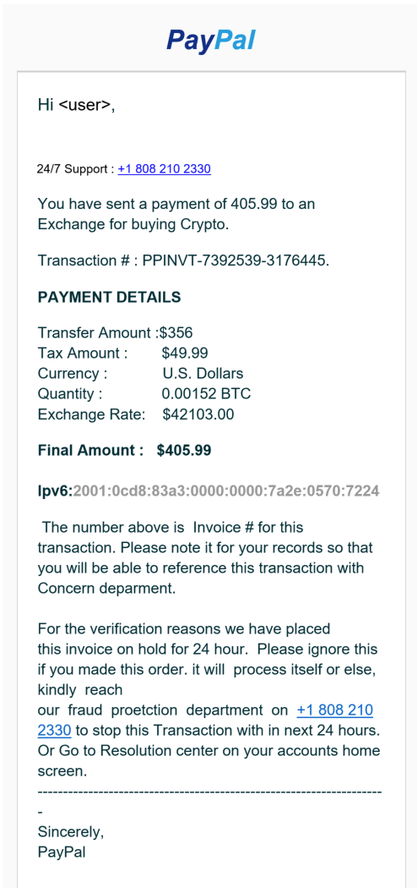

Slide 10
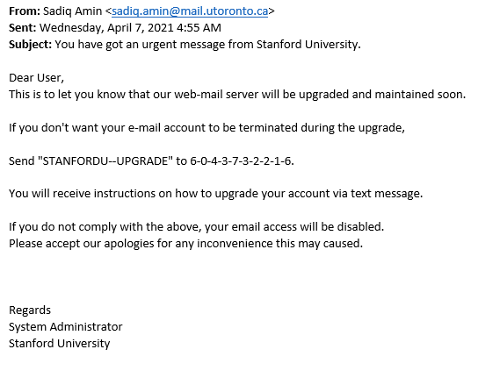
https://uit.stanford.edu/phishing

Slide 11
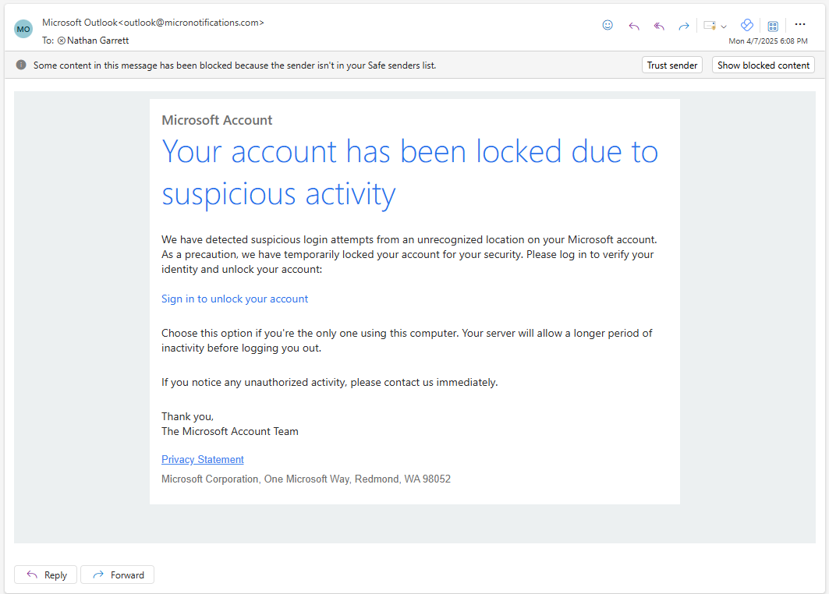

Slide 12
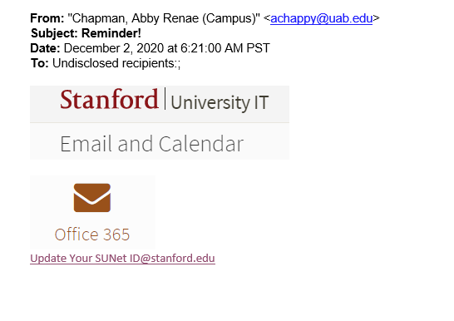

Slide 13
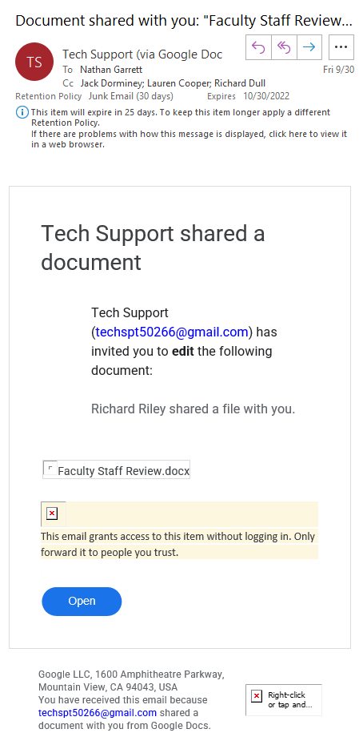

Slide 14
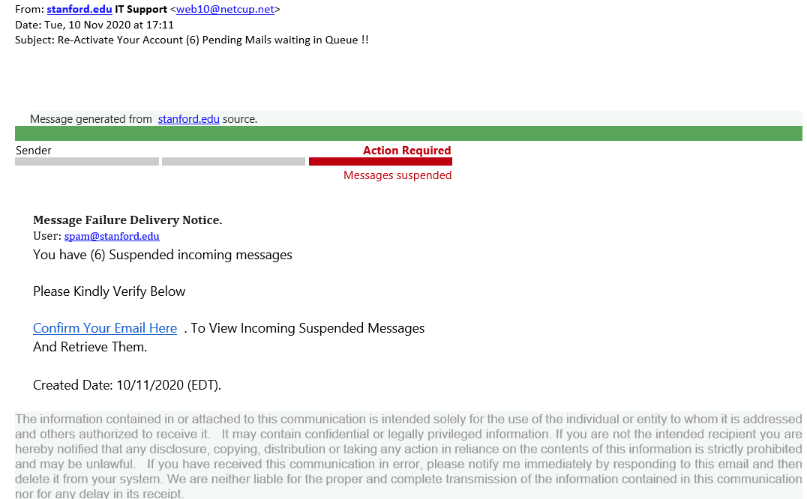

Slide 15
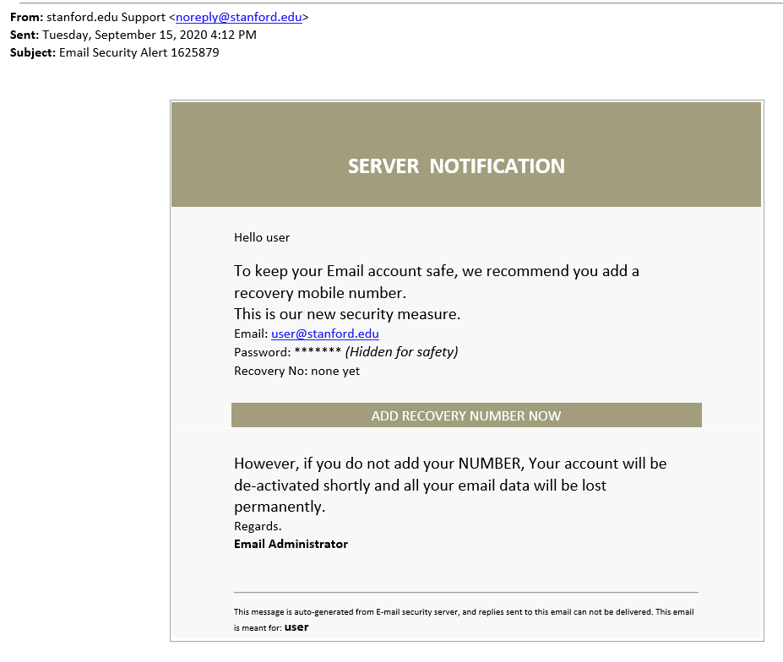

Slide 16
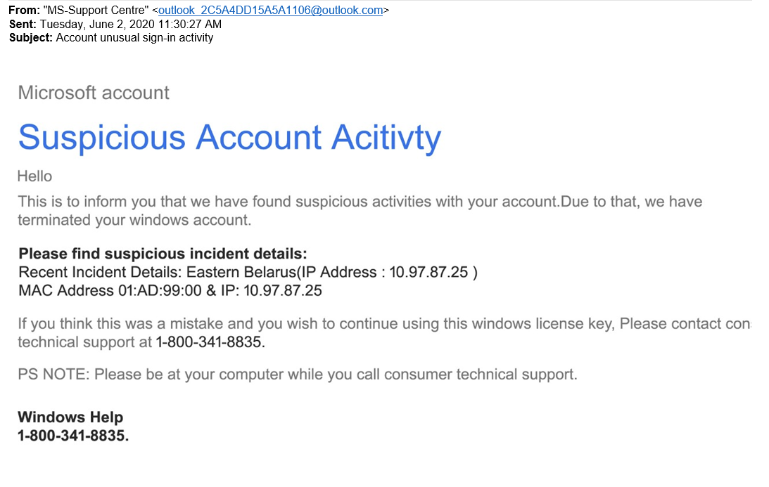

Slide 17
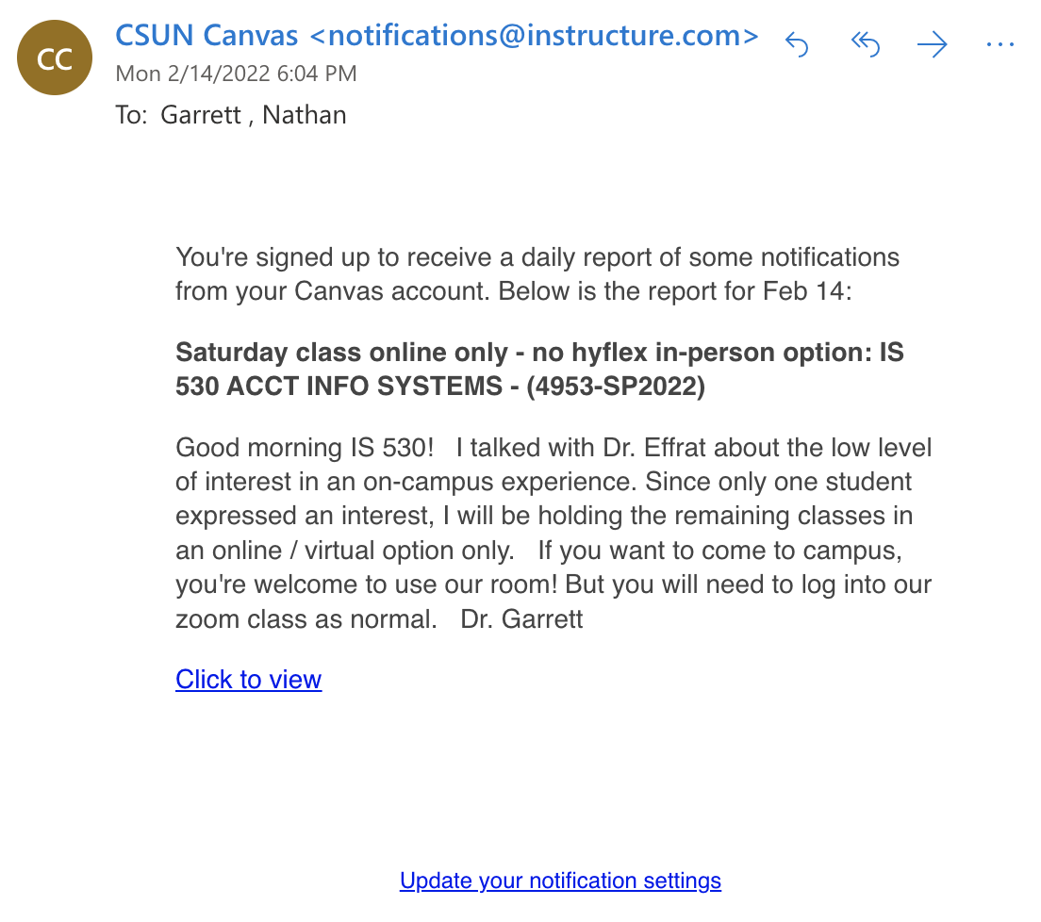
How easy is it to setup a phishing site?

Slide 18
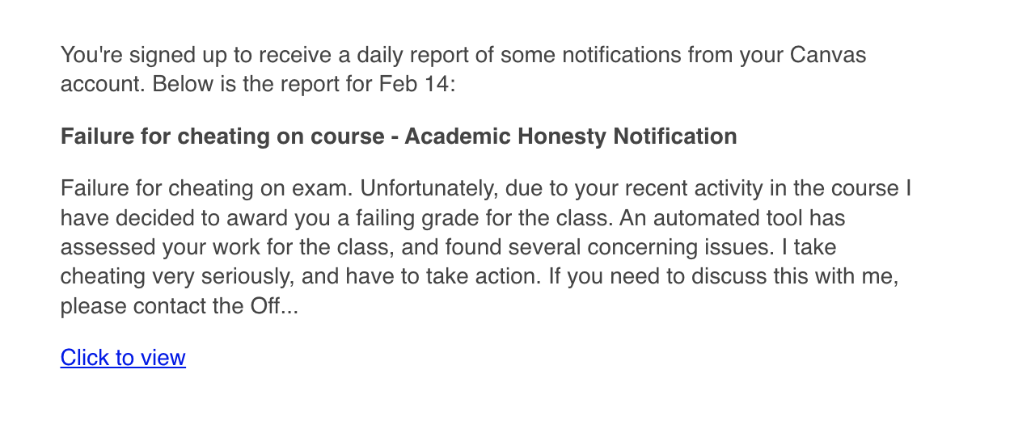
How easy is it to setup a phishing site?
<notifications@instrcture.com>

Slide 19
How to Mitigate Risk of Attack
Preventive Controls
Detective Controls
Physical security
Process
IT solutions
Log analysis
Intrusion detection systems
Honeypots
Continuous monitoring
Response
Computer Incident Response Teams (C I R T)
Chief Information Security Officer (C I S O)

Slide 20
Preventive: Physical Security: Access Controls
Physical security access controls
  Limit entry to building
  Restrict access to network and data

Slide 21
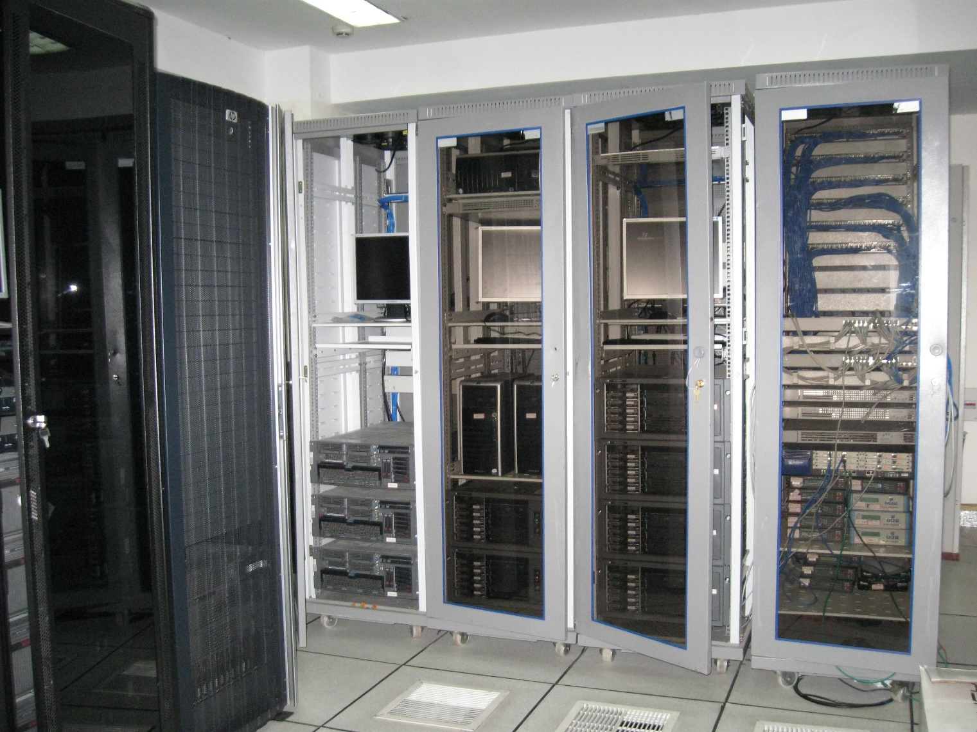
Server Room
https://commons.wikimedia.org/wiki/File:139_Server_Room_01.jpg

Slide 22
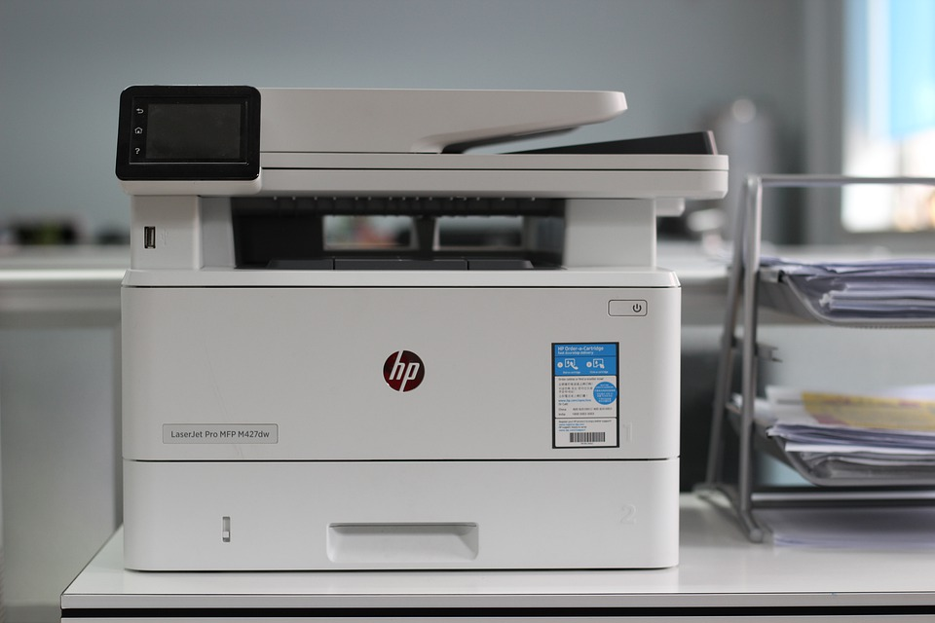

Slide 23
Preventive Process: User Access Controls
Authentication—verifies the person
  Something person knows
  Something person has
  Some biometric characteristic
  Combination of all three
Authorization—determines what a person can access
Notes:
These two concepts are related, to get into a system, you need to be authenticated, then authorization is where you are allowed to go once you are in the system.

Slide 24
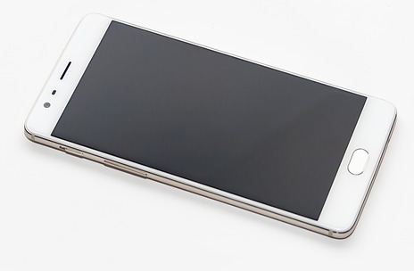
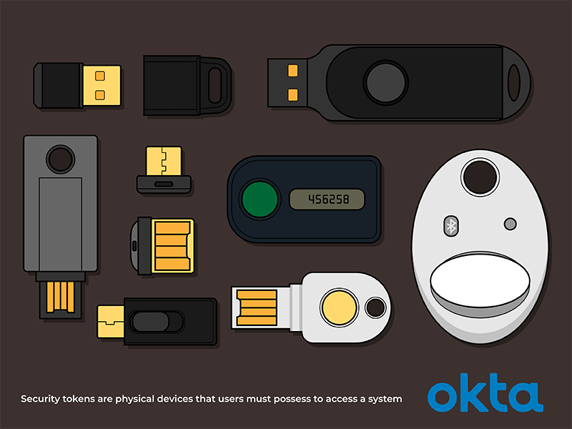
https://www.okta.com/identity-101/security-token/

Slide 25
Access Control Matrix
Username | File Share Accounting | File Share Production | Quickbooks
Bob | Yes | Yes | No
Sarah | Readonly | No | Yes
Tim | No | Yes | No
…

Slide 26
Preventive: IT Solutions
Antimalware controls
Network access controls
Device and software hardening controls
Encryption

Slide 27
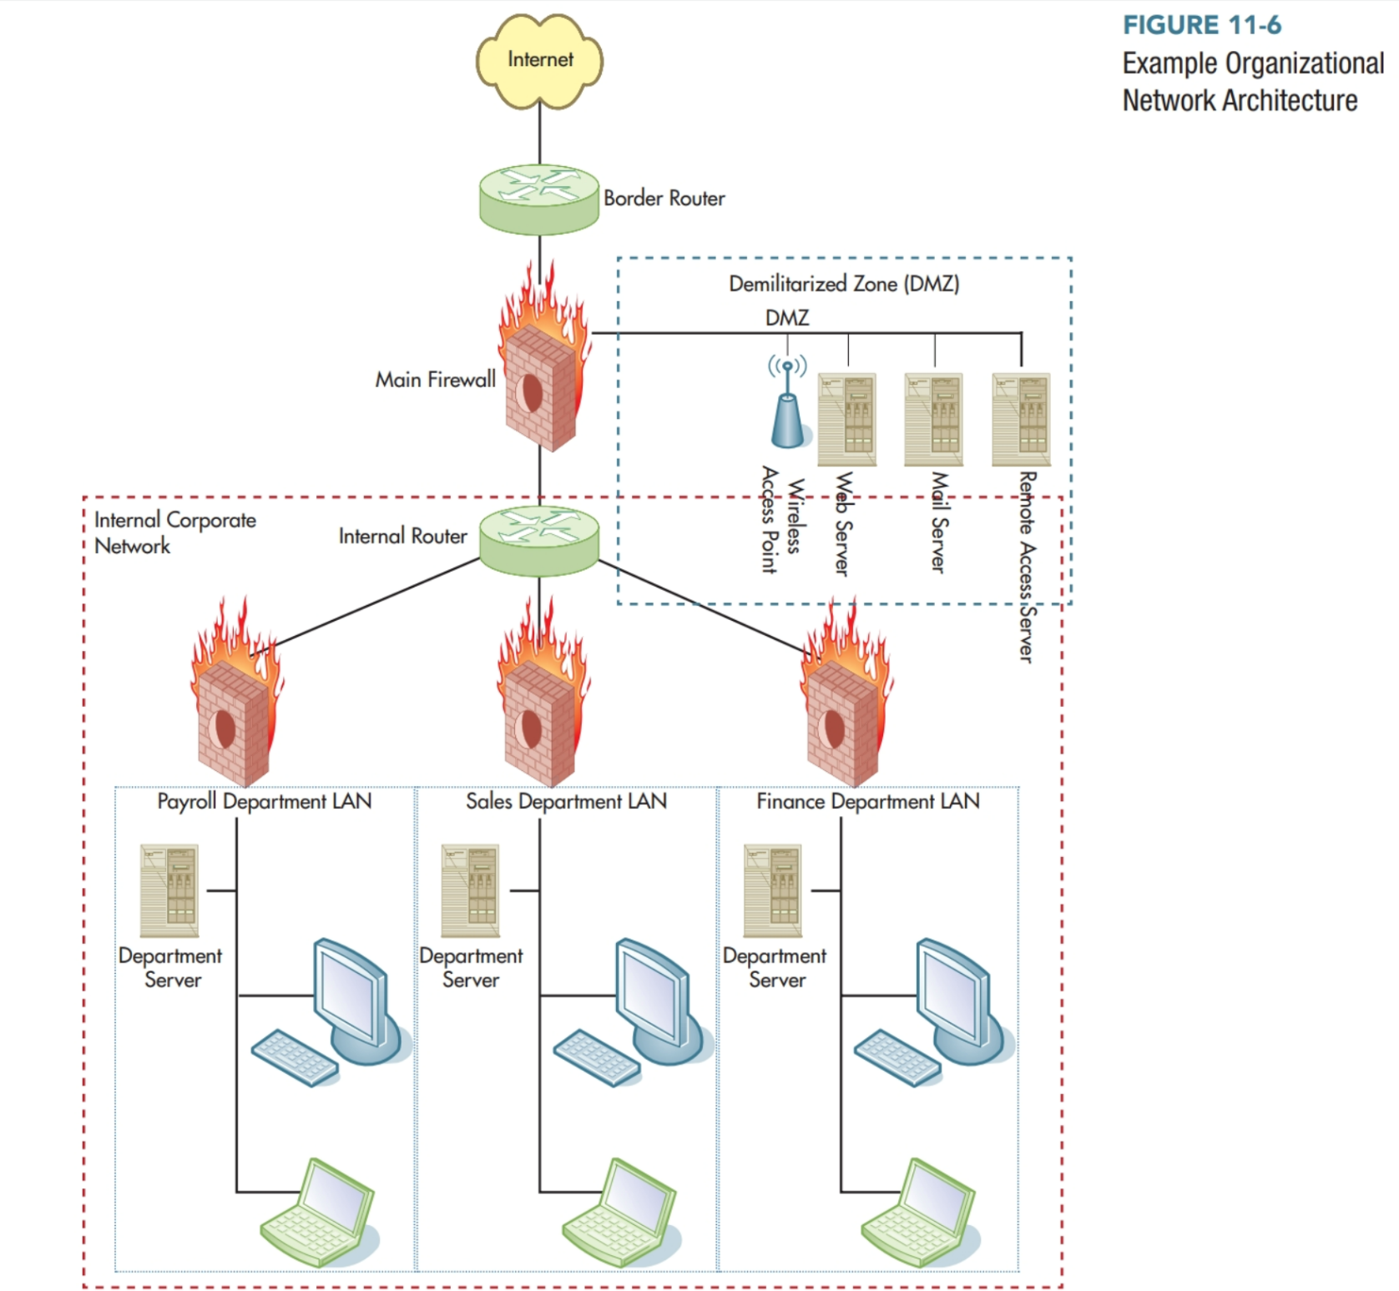
Firewall & DMZ

Slide 28
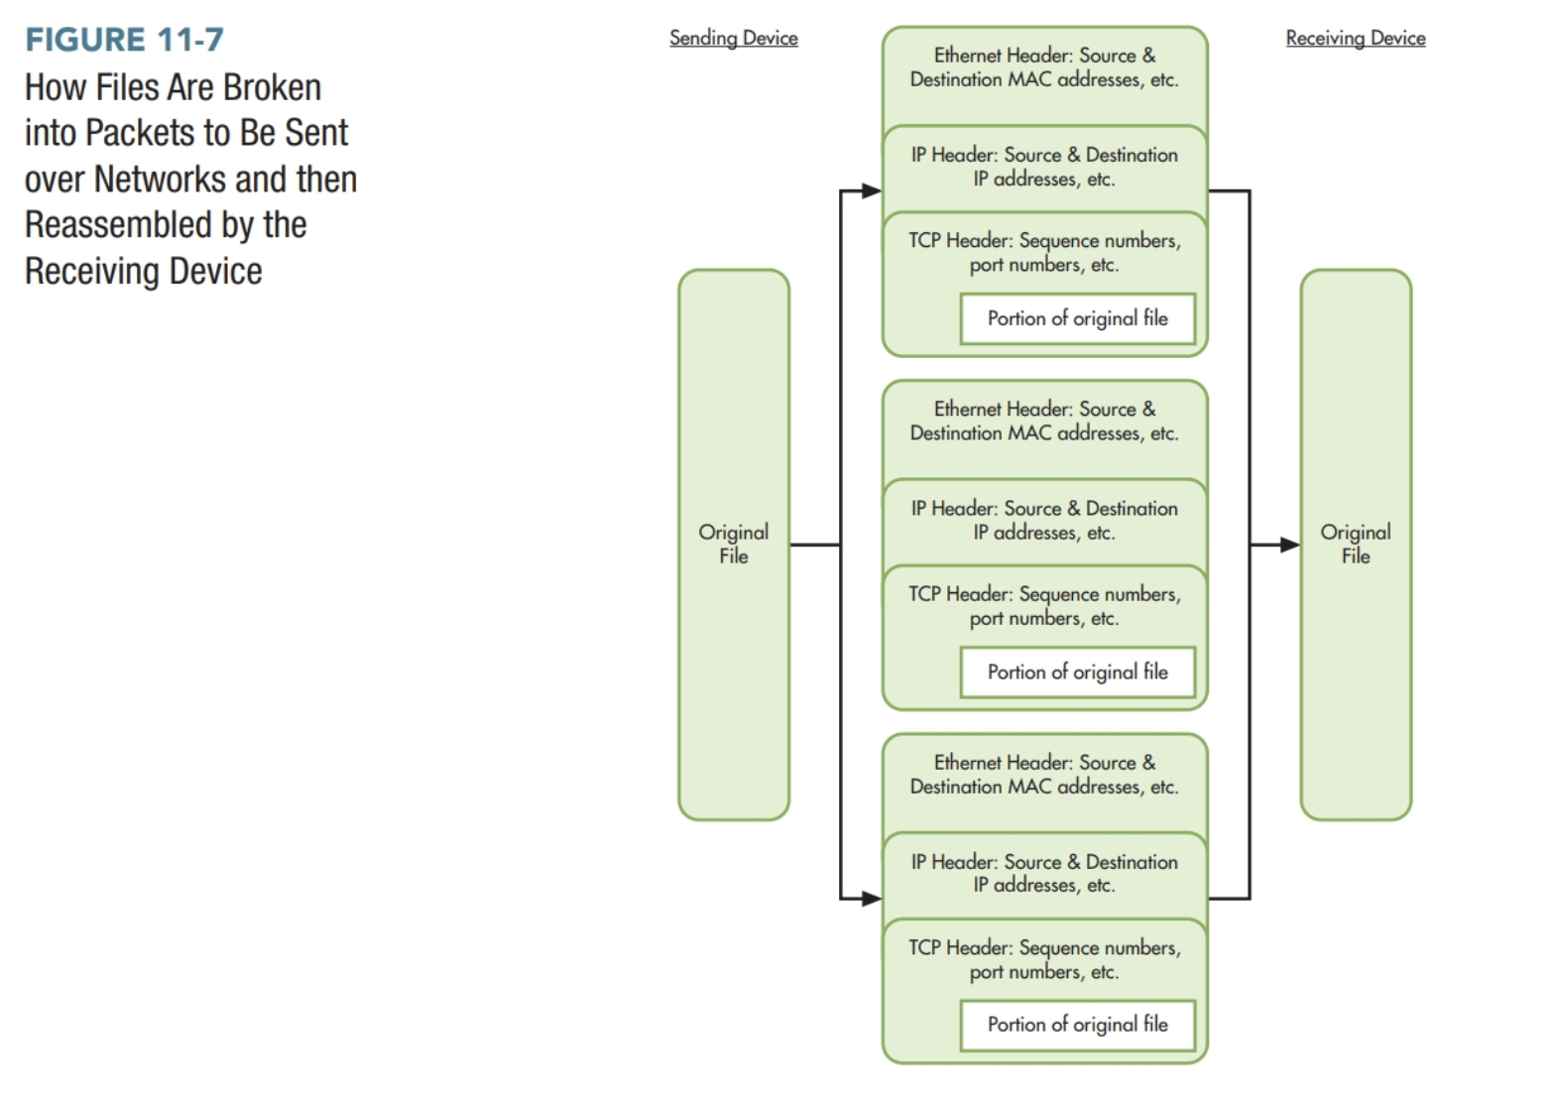
Packet Filtering

Slide 29
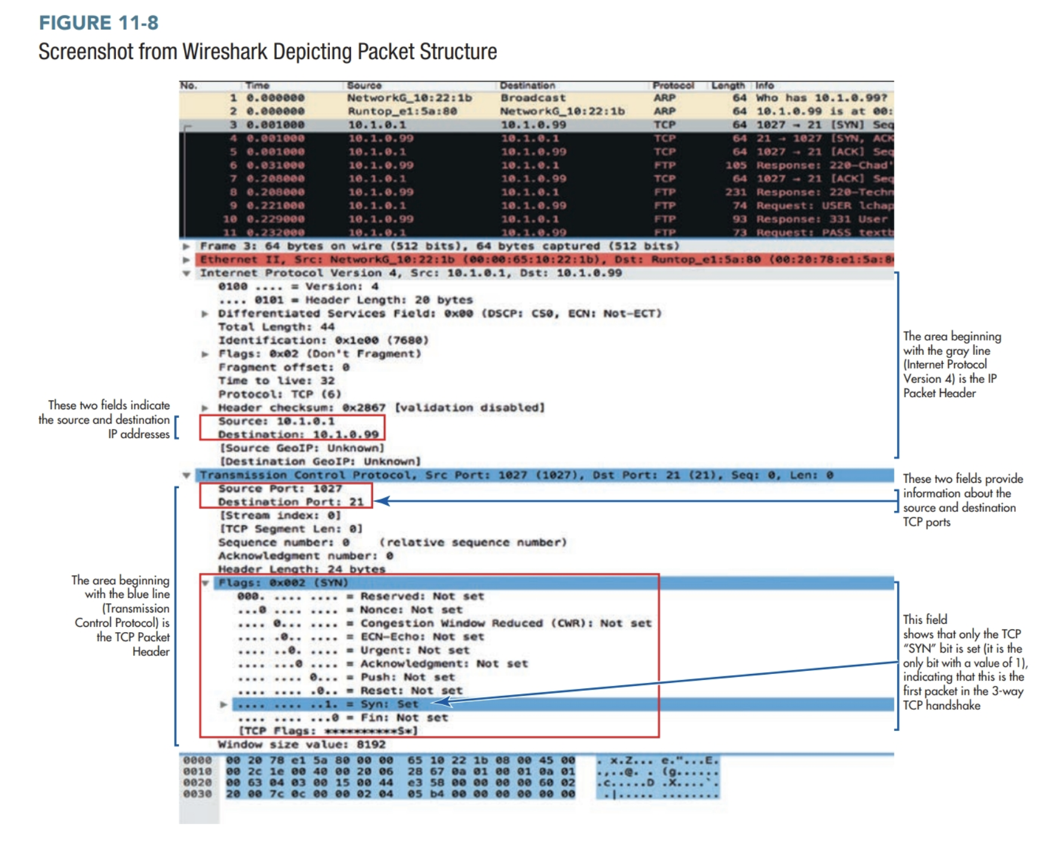

Slide 30
Detecting Attacks (1 of 2)
Log Analysis—examining logs to identify evidence of possible attacks
Intrusion Detection Systems (IDSs)—system that creates logs of network traffic that was permitted to pass the firewall and then analyzes those logs for signs of attempted or successful intrusions

Slide 31
Logging Example
Activity Monitor (Mac) or Task Manager (PC)

Slide 32
Detecting Attacks (2 of 2)
Honeypots—A decoy system used to provide early warning that an insider or outsider is attempting to search for confidential information
Continuous Monitoring—employee compliance with organization’s information security policies and overall performance of business processes

Slide 33
Responding to Attacks
Computer Incident Response Team (C I R T)
Chief Information Security Officer (C I S O)

Slide 34
Monitor and Revise Security Solutions
Penetration Test–An authorized attempt to break into the organization’s information system
Change Control and Change Management–the formal process used to ensure that modifications to hardware, software, or processes do not reduce systems reliability

Slide 35
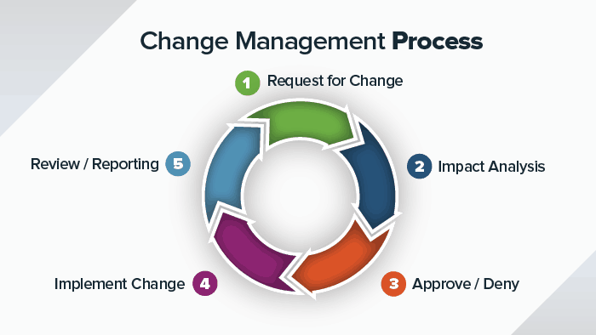
Change Control Process
https://www.smartsheet.com/8-elements-effective-change-management-process

Slide 36
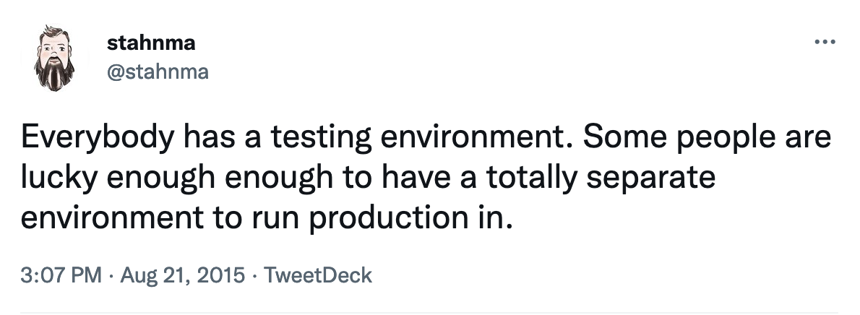

Slide 37
Security Implications of Virtualization, Cloud Computing, and the Internet of Things
Virtualization and Cloud Computing
  Positive impact on security
    Implementing strong access controls is good security over all the systems
  Negative impact on security
    Reliability issues
    Risk of theft or destruction if unsupervised physical access
Notes:
Virtualization and Cloud computing can increase risks possibly by:
Unsupervised physical access in virtualization environment exposes the entire virtual network to risk of theft or destruction
Public clouds may have reliability issues because the organization is outsourcing control of its data and computing resources to a third party
However, there are opportunities to improve overall security by:
Implementing strong access controls in the cloud and using multifactor authentication.
Internet of Things (IoT) refers to embedding sensors in a multitude of devices so they can connect to the Internet. Again there is a net effect of positive and negative effects.
The major issue is that since these devices are connected to the Internet, there are more ways to gain access to the corporate network and they must be secured.

Slide 38
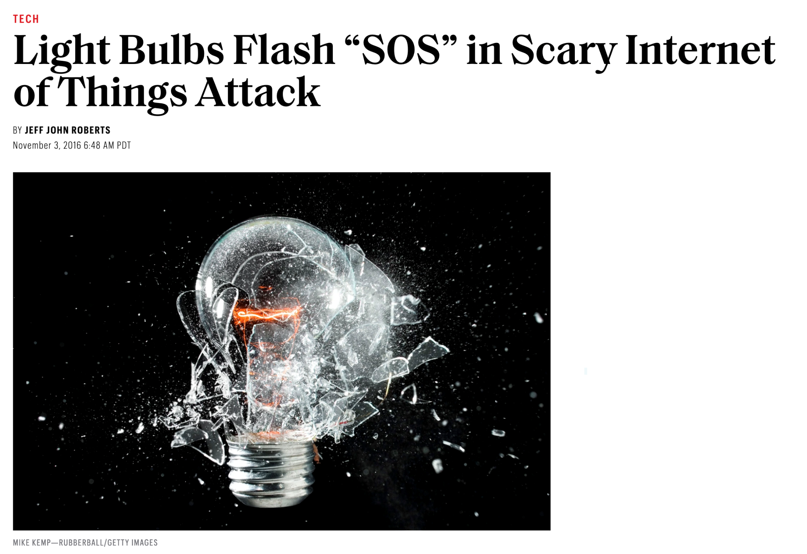
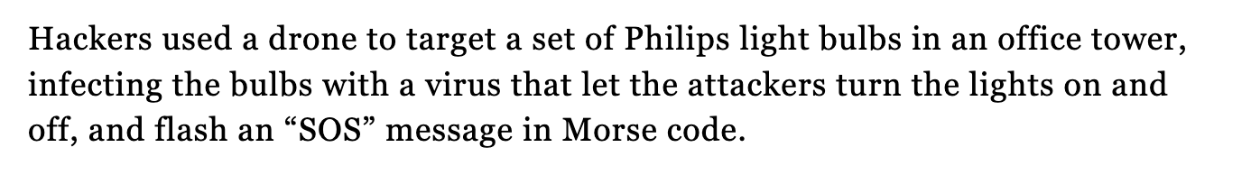
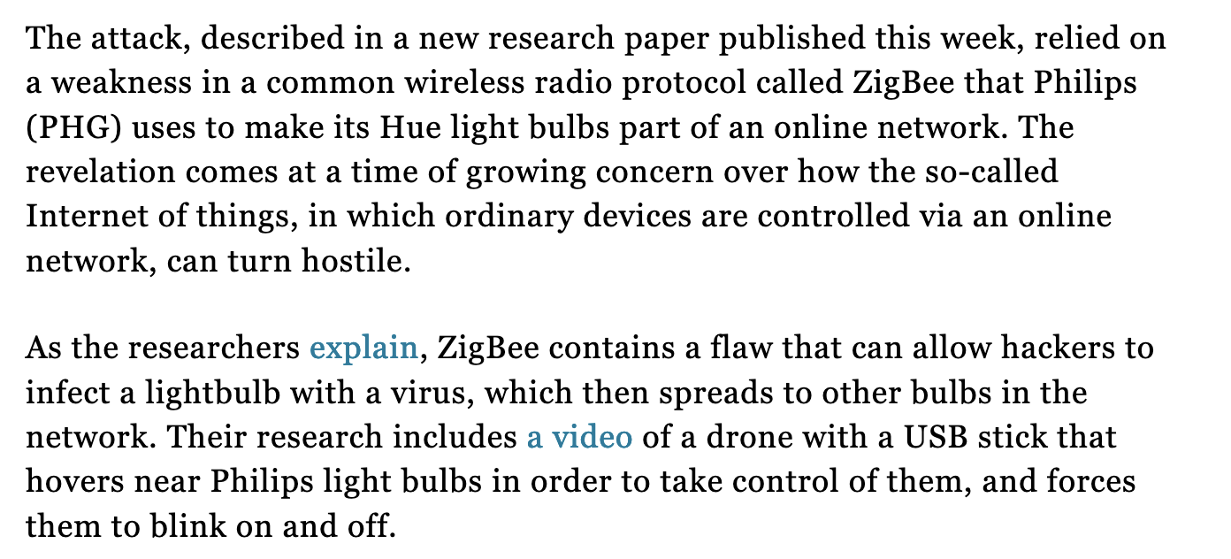
https://fortune.com/2016/11/03/light-bulb-hacking/

Slide 39
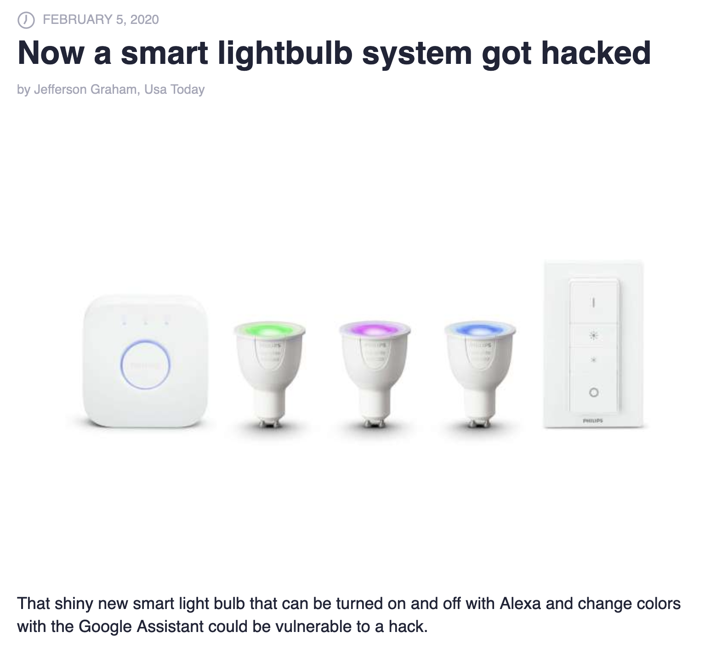

Slide 40
Update your stuff!

Slide 41
Key Terms
Time-based model of information security
Defense-in-depth
Authentication
Biometric identifier
Multifactor authentication
Multimodal authentication
Authorization
Access control matrix
Compatibility test
Border router
Firewall
Demilitarized zone (D M Z)
Routers
Access control lists (A C Ls)
Packet filtering
Deep packet inspection
Intrusion prevention system (I P S)
Endpoints
Vulnerability scanners
Exploit
Patch
Patch management
Hardening
Log analysis
Intrusion detection system (I D S)
Honeypot
Computer incident response team (C I R T)
Penetration test

Slide 42
Application Problems
11.4 Which preventive, detective, and/or corrective controls would best mitigate the following threats?
An employee’s laptop was stolen at the airport. The laptop contained personally identifying information about the company’s customers that could potentially be used to commit identity theft.
A salesperson successfully logged into the payroll system by guessing the payroll supervisor’s password.
A criminal remotely accessed a sensitive database using the authentication credentials (user ID and strong password) of an IT manager. At the time the attack occurred, the IT manager was logged into the system at his workstation at company headquarters.
An employee received an email purporting to be from her boss informing her of an important new attendance policy. When she clicked on a link embedded in the email to view the new policy, she infected her laptop with a keystroke logger.

Slide 43
Application Problems
11.4 Which preventive, detective, and/or corrective controls would best mitigate the following threats?
A company’s programming staff wrote custom code for the shopping cart feature on its web site. The code contained a buffer overflow vulnerability that could be exploited when the customer typed in the ship-to address.
A company purchased the leading “off-the-shelf” e-commerce software for linking its electronic storefront to its inventory database. A customer discovered a way to directly access the back-end database by entering appropriate SQL code.
Attackers broke into the company’s information system through a wireless access point located in one of its retail stores. The wireless access point had been purchased and installed by the store manager without informing central IT or security.
An employee picked up a USB drive in the parking lot and plugged it into their laptop to “see what was on it,” which resulted in a keystroke logger being installed on that laptop.

Slide 44
Application Problems
11.4 Which preventive, detective, and/or corrective controls would best mitigate the following threats?
Once an attack on the company’s website was discovered, it took more than 30 minutes to determine who to contact to initiate response actions.
To facilitate working from home, an employee installed a modem on his office workstation. An attacker successfully penetrated the company’s system by dialing into that modem.
An attacker gained access to the company’s internal network by installing a wireless access point in a wiring closet located next to the elevators on the fourth floor of a high-rise office building that the company shared with seven other companies.

Slide 45

Copyright
This work is protected by United States copyright laws and is provided solely for the use of instructors in teaching their courses and assessing student learning. Dissemination or sale of any part of this work (including on the World Wide Web) will destroy the integrity of the work and is not permitted. The work and materials from it should never be made available to students except by instructors using the accompanying text in their classes. All recipients of this work are expected to abide by these restrictions and to honor the intended pedagogical purposes and the needs of other instructors who rely on these materials.

