Slide 1
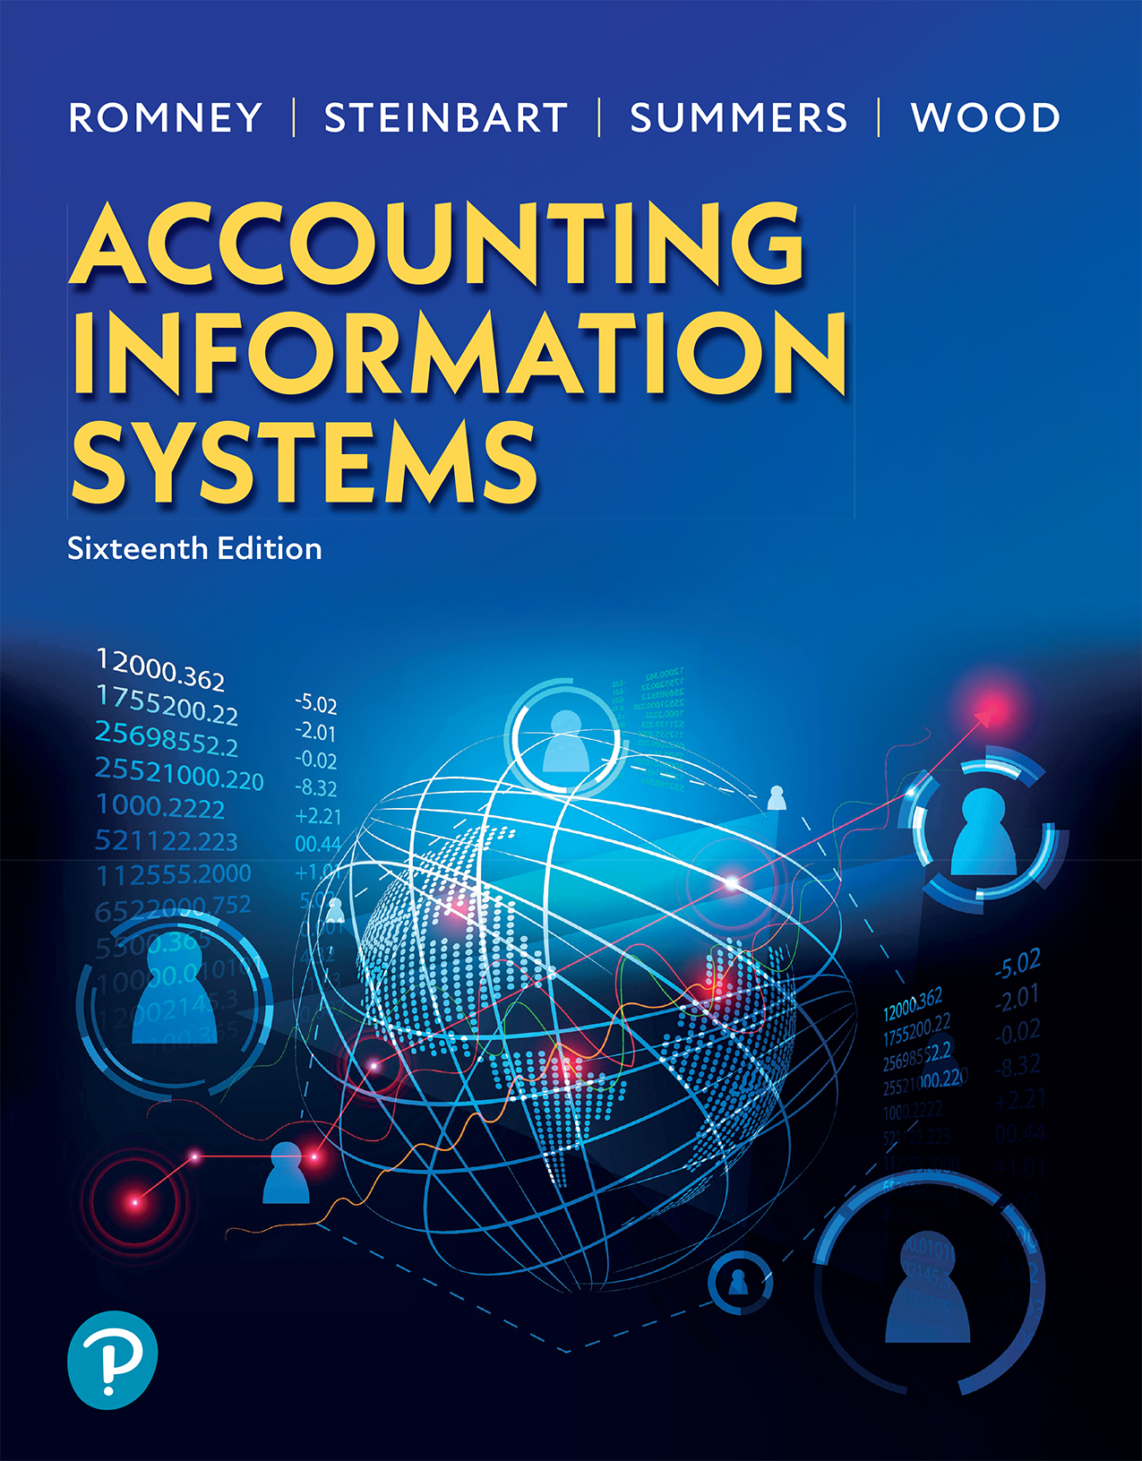

Accounting Information Systems
Sixteenth Edition
Chapter 12
Confidentiality and Privacy Controls
Copyright © 2024, 2021, 2018 Pearson Education, Inc. All Rights Reserved
Notes:
If this PowerPoint presentation contains mathematical equations, you may need to check that your computer has the following installed:
1) MathType Plugin
2) Math Player (free versions available)
3) NVDA Reader (free versions available)

Slide 2
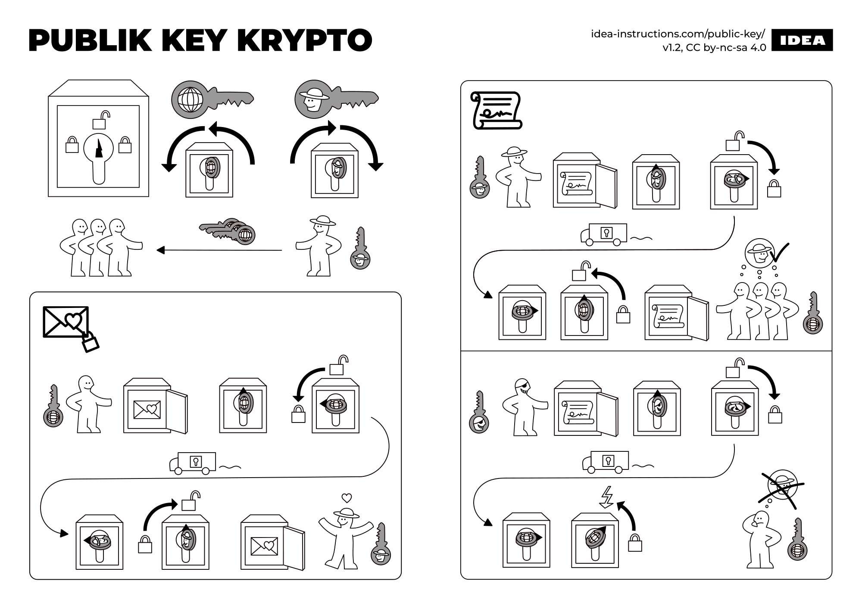
https://idea-instructions.com/public-key/

Slide 3
Learning Objectives (1 of 2)
Describe the controls that can be used to protect the confidentiality of an organization’s information and the privacy of personal information collected from customers, suppliers, and employees.
Discuss how the Generally Accepted Privacy Principles (G A P P) framework provides guidance in developing a comprehensive approach to protecting privacy that satisfies the requirements of privacy regulations such as the E U’s General Data Privacy Regulation.

Slide 4
Learning Objectives (2 of 2)
Discuss how different types of encryption systems work, and explain the difference between encryption and hashing.
Explain how to create a digital signature and how it provides a means to create legally enforceable contracts.
Discuss how blockchain works.

Slide 5
Protecting Confidentiality and Privacy (1 of 2)
Identify and classify information to be protected
  Where is it located and who has access?
  Classify value of information to organization
Protecting sensitive information with encryption
  Protect information in transit and in storage
  You can not protect information in use with encryption
Notes:
Confidentiality relates to organizational intellectual property, which includes strategic plans, trade secrets, cost information, legal documents, and so on.
Privacy focuses on protecting personal information on customers, vendors, employees, and business partners (it does not apply to organizational data, i.e., confidentiality).
It is worthwhile to note that encryption is good to use for data storage and transmission; however, it cannot be useful for data processing as data must be decrypted to be processed. That is why a “defense in depth” approach is needed by supplementing encryption with access controls and training.

Slide 6
Protecting Confidentiality and Privacy (2 of 2)
Controlling access to sensitive information
  Information Rights Management (I R M)
  Data loss prevention (D L P)
  Digital watermarks
  Data masking
  Tokenization
Training

Slide 7
Privacy Regulations
The European Union’s General Data Privacy Regulation
  The G D P R imposes huge fines (up to 4% of global revenues) for issues such as not properly obtaining consent to collect and use personal information or not being able to document that the organization has taken a proactive approach to protecting privacy.
Other regulations include:
  California Consumer Privacy Act (C C P A) of 2018
  Health Insurance Portability and Accountability Act (H I P A A)
  Health Information Technology for Economic and Clinical Health Act (H I T E C H)
  Financial Services Modernization Act

Slide 8
Generally Accepted Privacy Principles
Management
  Procedures and policies with assigned responsibility and accountability
Notice
  Provide notice of privacy policies and practices prior to collecting data
Choice and consent
  Opt-in versus opt-out approaches
Collection
  Only collect needed information
Use, retention, and disposal
  Use information only for stated business purpose. When no longer useful, dispose in a secure manner.
Access
  Customer should be able to review, correct, or delete information collected on them
Disclosure to third parties
Security
  Protect from loss or unauthorized access
Quality
Monitoring and enforcement
  Procedures in responding to complaints
  Compliance
Notes:
Generally Accepted Privacy Principles (GAPP) are 10 best practices recommended for protecting privacy of customer’s personal information.

Slide 9
Encryption
Preventative control
Factors that influence encryption strength:
  Key length (longer = stronger)
  Algorithm
  Management policies
    Stored securely

Slide 10
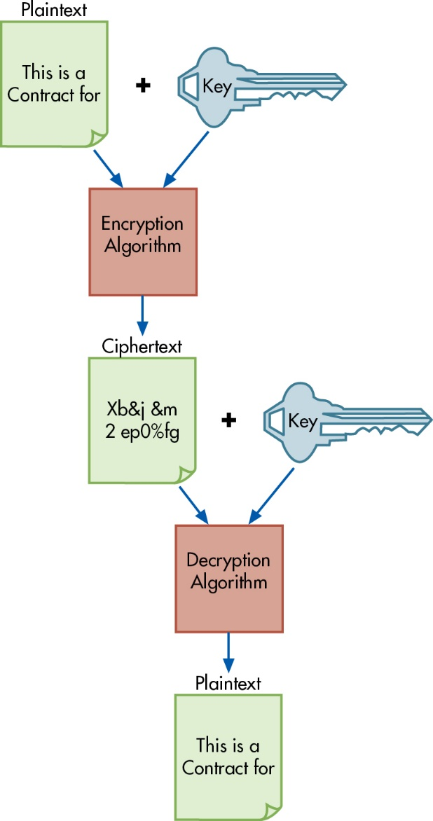
Figure 12.2 Steps in the Encryption and Decryption Process
Takes plain text and with an encryption key and algorithm, converts to unreadable ciphertext (sender of message)
To read ciphertext, encryption key reverses process to make information readable (receiver of message)
Notes:
There are many reasons why organizations continue to change their information systems, whether it’s a full systems replacement or an upgrade to an existing system. This can be due to technology changes, to become more effective and efficient in the organization (productivity gains), improve business processes, or for competitive advantage reasons.
Because of an organization’s desire to change an information system, it’s best to proceed using the following five steps known as the systems development lifecycle (SDLC):
Systems analysis: feasibility of the proposed project occurs. What is actually needed and when will it be done (scope of the project)? If it is feasible, then identify system requirements with an analysis report provided to the steering committee.
Conceptual design: determine how to meet user needs. Does project involve purchasing software, developing program in-house, or outsourcing?
Physical design: translates broad conceptual design into the specific code, input and output source documents, and building the database.
Implementation and conversion: install and test new hardware and software, train employees after which conversion to the new system will be complete.
Operations and maintenance: ongoing reviews of the system with improvements and modifications made if necessary.
Long Description:
The steps in the encryption and decryption process are as follows:
Plaintext: This is a Contract for plus key
Encryption Algorithm
Ciphertext: code (X b epsilon j epsilon m 2 e p 0 percent f g) plus key
Decryption Algorithm
Plaintext: This is a Contract for

Slide 11
Types of Encryption
Symmetric
Asymmetric
Uses one key to encrypt and decrypt
Both parties need to know the key
  Need to securely communicate the shared key
  Cannot share key with multiple parties, they get their own (different) key from the organization
Uses two keys
  Public—everyone has access
  Private—used to decrypt (only known by you)
  Public key can be used by all your trading partners
Can create digital signatures
Notes:
The text refers to examples of symmetric and asymmetric encryption algorithms:
Examples of symmetric encryption are DES (data encryption standard), which was superseded by AES (advanced encryption standard).
Examples of asymmetric encryption are RSA (Rivest-Shamir-Adleman) and PGP (Pretty Good Privacy).
A good example for understanding asymmetric encryption is this:
I want to buy a book online; this purchase information with my credit card uses the online bookstore’s public key to encrypt the information. Only the online bookstore can decrypt this information using their private key which is known to them. That way, I can feel safe when purchasing online with the bookstore.
Now that we understand encryption better and that information is encrypted in transit, why is it that hackers can get credit card data?
It’s usually due to the fact that the private encryption key is stolen because it is not secured properly. Many times the private key is stored on the same server as the data itself, so when hackers gain access to the server, they are able to decrypt the data!

Slide 12
Virtual Private Network (V P N)
Securely transmits encrypted data between sender and receiver
  Sender and receiver have the appropriate encryption and decryption keys.

Slide 13
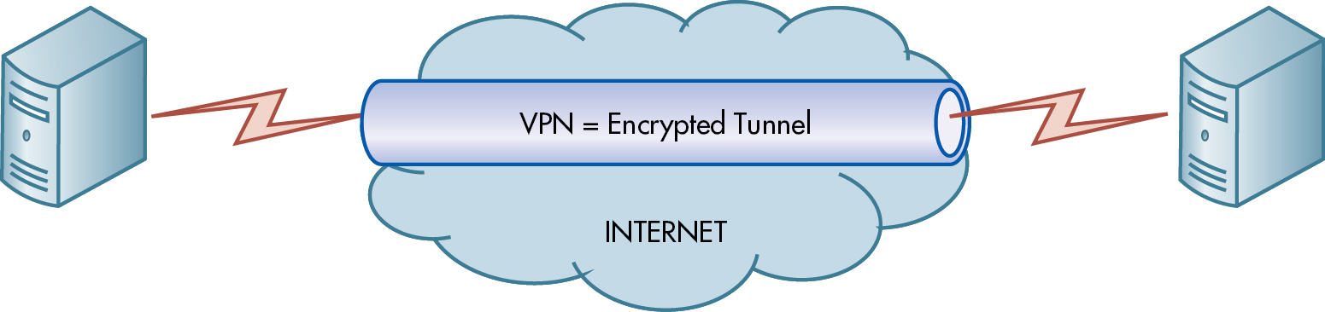
Figure 12.3 Virtual Private Networks [V P Ns]

Slide 14
Hashing
Hashing is a process that takes plaintext of any length and creates a short code called a message digest, popularly referred to as a hash.
Hashing algorithms provide a means to test the integrity of a document, to verify whether two copies of a document, each stored on a different device, are identical.
  It plays an important role in creating legally binding digital signatures and is an essential component underlying blockchains.

Slide 15
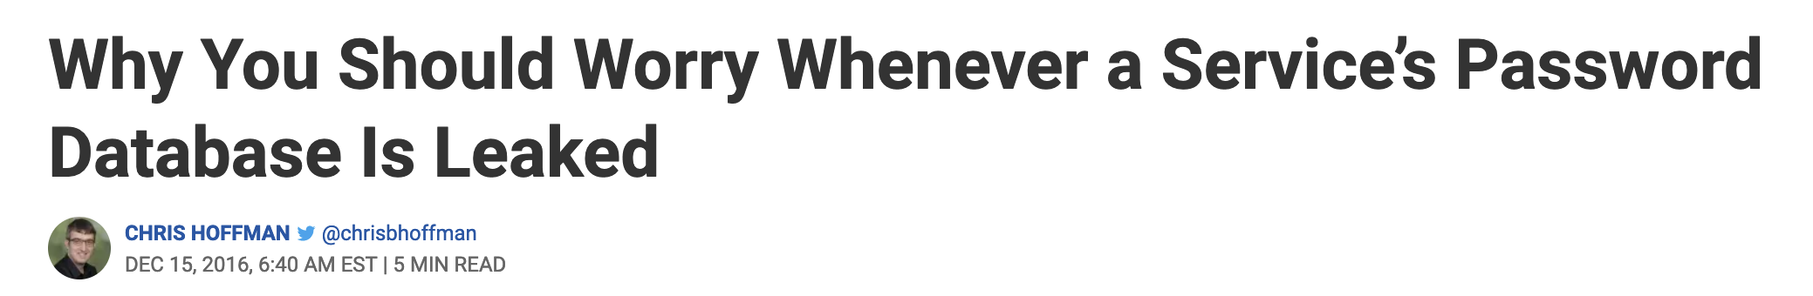
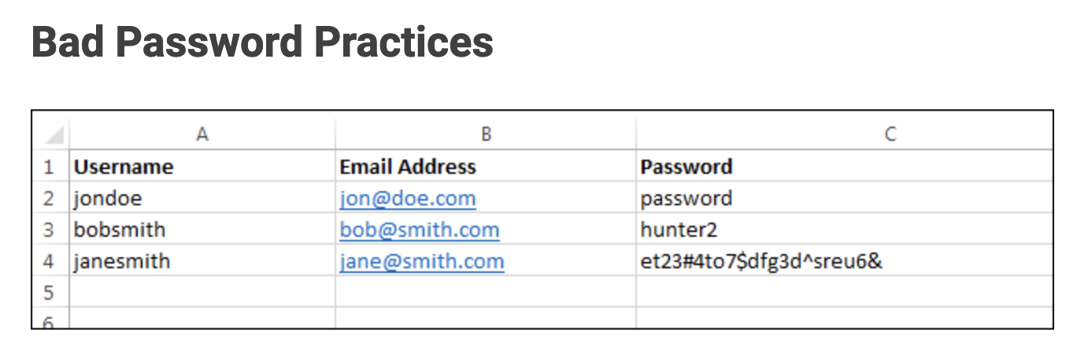
https://www.howtogeek.com/171236/why-you-should-worry-whenever-a-services-password-database-is-leaked/

Slide 16
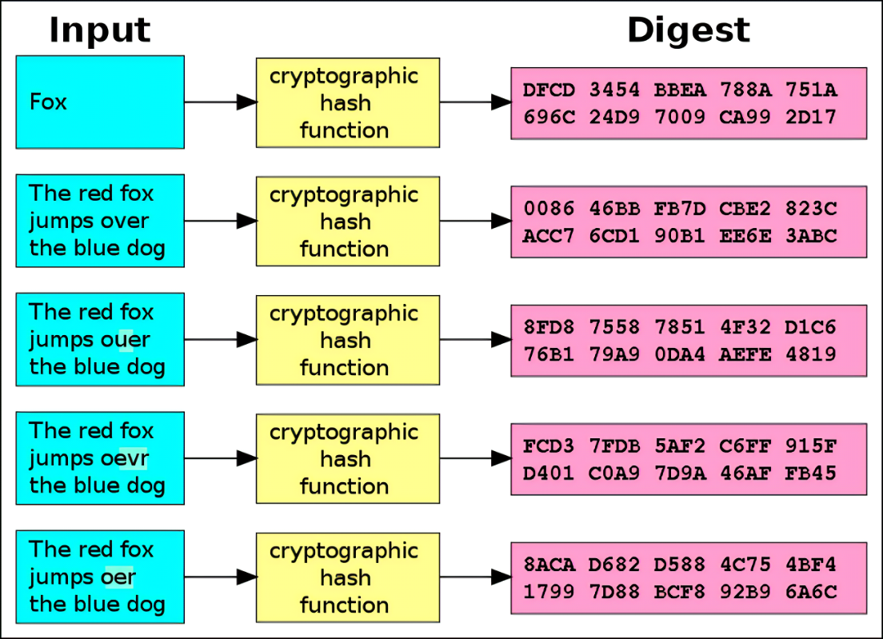
Password submitted by user
Server runs password through the function, and only stores the hash (digest) and not the original password
Password 1
Password 2
Password 3
Password 4
Password 5

Slide 17
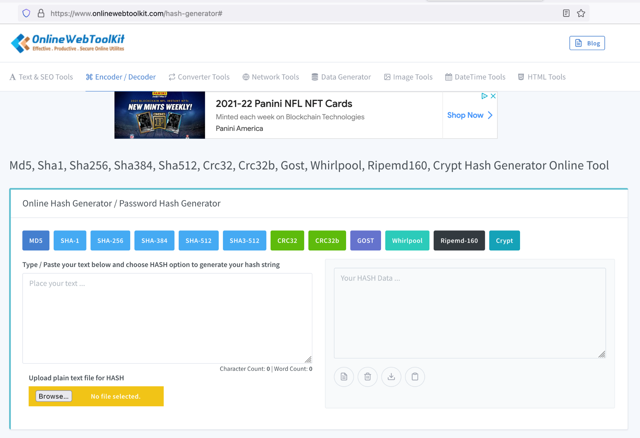
https://www.onlinewebtoolkit.com/hash-generator

Slide 18
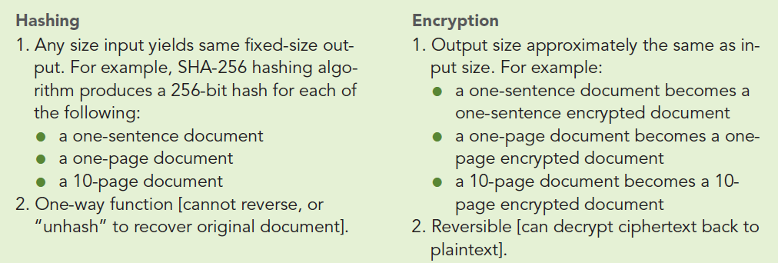
Table 12.2 Comparison of Hashing and Encryption
Notes:
Long Description:
Hashing:
Any size input yields same fixed-size output. For example, SHA-256 hashing algorithm produces a 256-bit hash for each of the following:
A one-sentence document
A one-page document
A 10-page document
One-way function; cannot reverse, or “unhash” to recover original document.
Encryption:
Output size approximately the same as input size. For example:
A one-sentence document becomes a one-sentence encrypted document.
A one-page document becomes a onepage encrypted document.
A 10-page document becomes a 10- page encrypted document.
Reversible; can decrypt ciphertext back to plaintext.

Slide 19
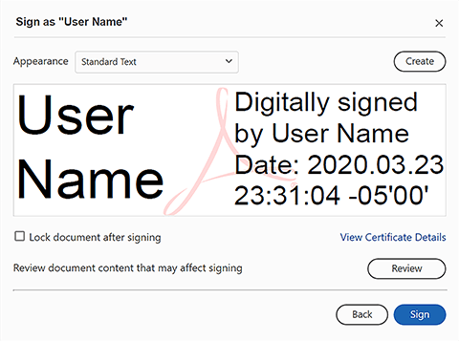

Digital Signatures
Used to create legally binding agreements (two steps to create)
Document creator uses a hashing algorithm to generate a hash of the original document
Document creator uses private key to encrypt step 1 above
Notes:
The digital hash created in step 1 provides assurance that someone cannot enter into a digital transaction and then subsequently deny they had done so and refuse to fulfill their side of the contract.
The comparison of the hash created to the hash generated from the receiver of the document after the document was opened by the creator’s public key and then saved using the same hashing algorithm. Figure 12-5 provides an excellent example.

Slide 20
Blockchain
Blockchain technology was originally developed to support the crypto-currency Bitcoin to prevent “double-spending” the same coin, but it has since been adopted for use in a variety of industries to create reliable audit trails for any business process.
A blockchain is a distributed ledger of hashed documents with copies stored on multiple computers.
https://www.youtube.com/watch?v=SSo_EIwHSd4

Slide 21
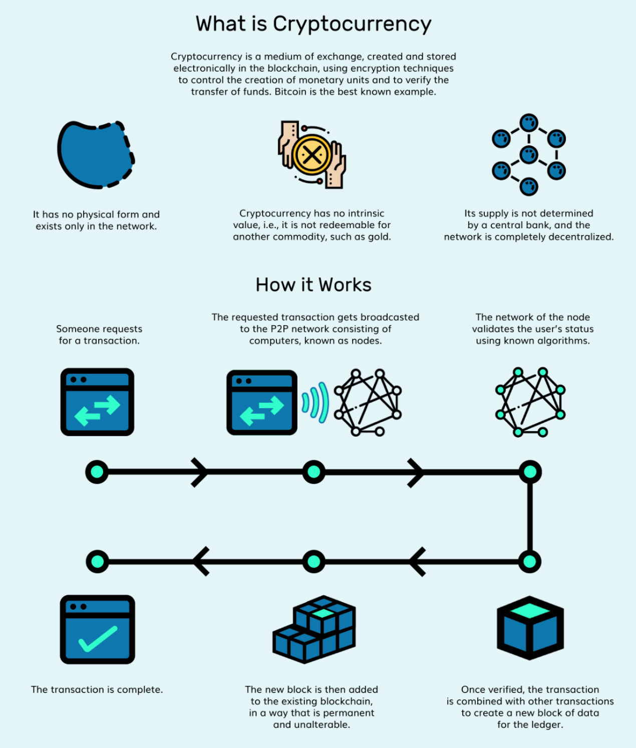
https://innovationincubator.com/infographic-how-cryptocurrency-works/

Slide 22
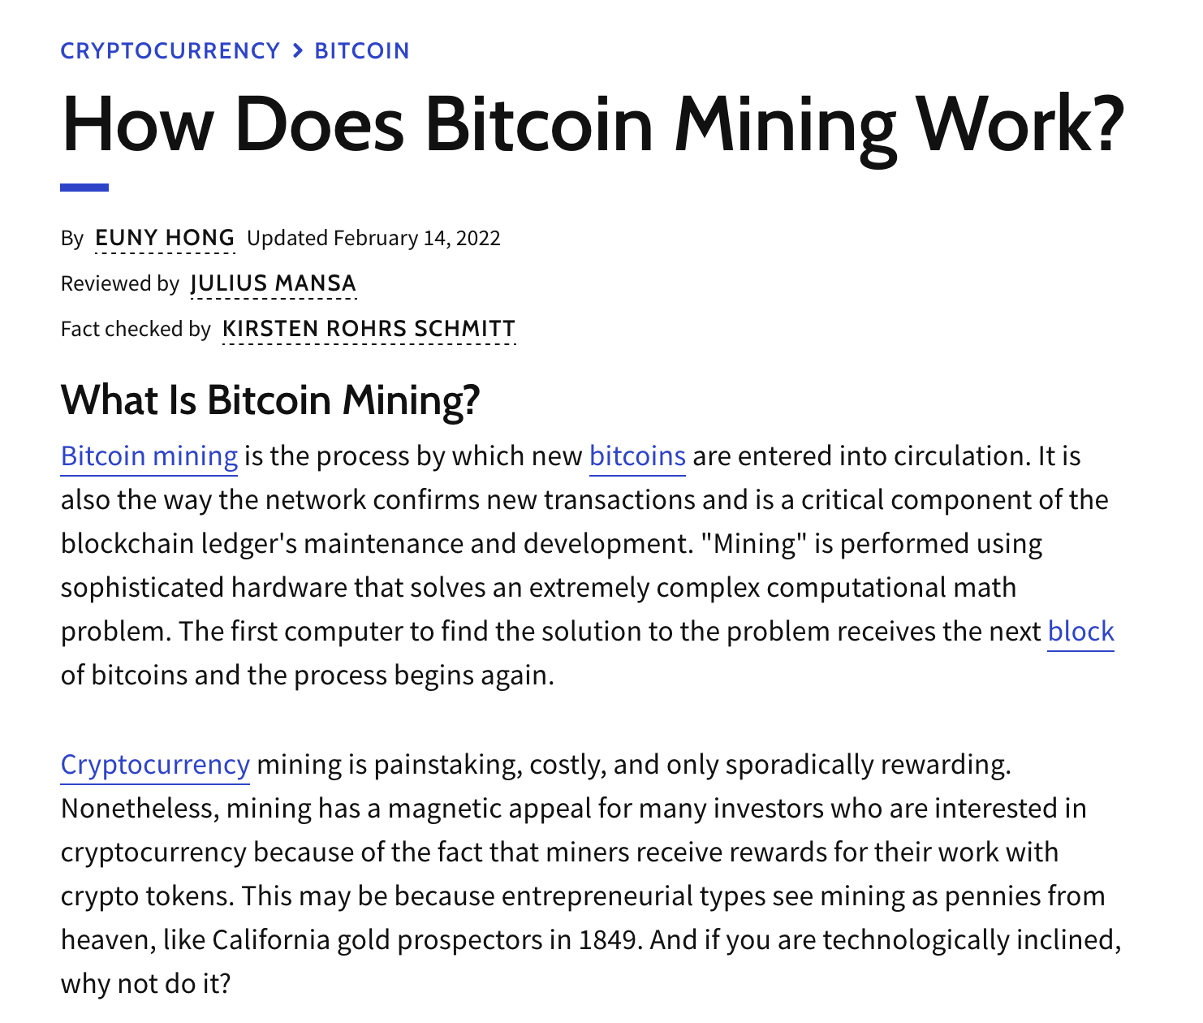
https://www.investopedia.com/tech/how-does-bitcoin-mining-work/#toc-what-is-bitcoin-mining

Slide 23
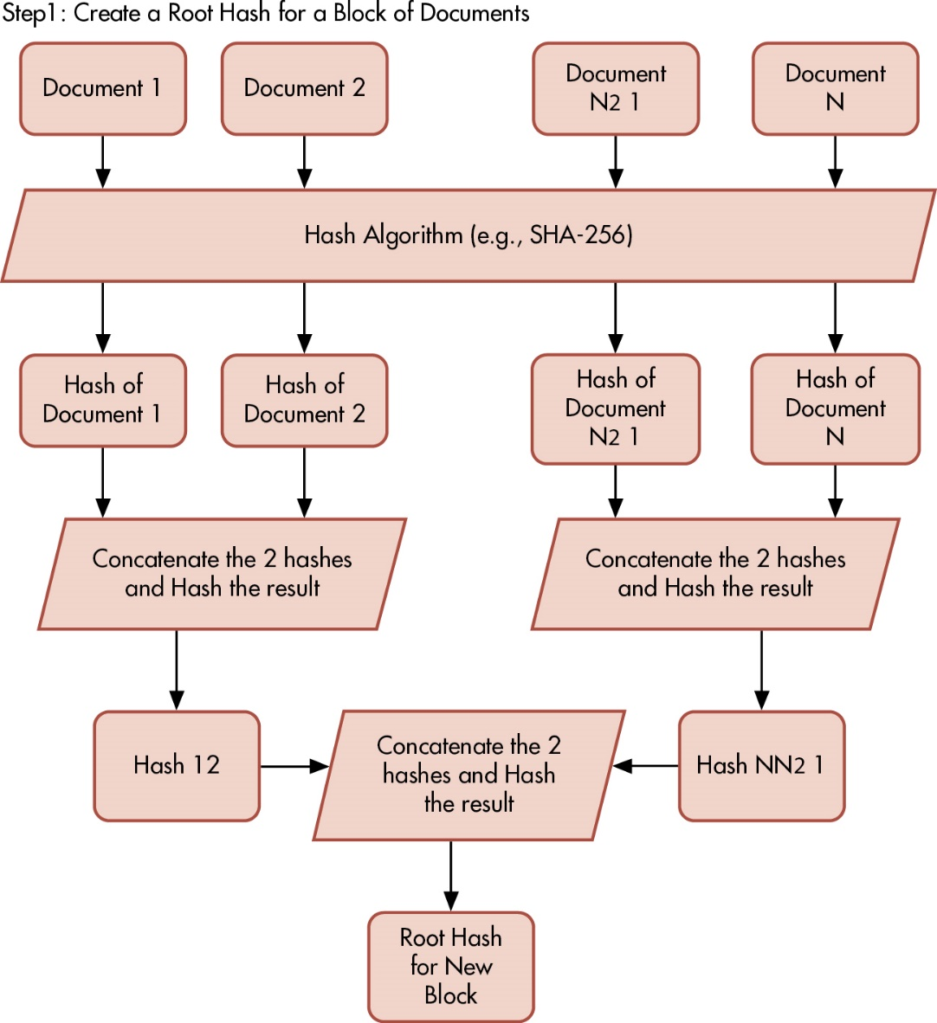
Figure 12.6 How Hashing Updates a Blockchain (1 of 3)
Notes:
Long Description:
The flow diagram showing Step 1 of the process on how hashing updates a blockchain appears as follows:
Step 1: Create a Root Hash for a Block of Documents
Document 1, Document 2, Document N minus 1, Document N
Hash Algorithm (example, S H A – 2 5 6
Hash of Document 1, Hash of Document 2
Concatenate the 2 hashes and Hash the result
Hash 12
Hash of Document N minus 1, Hash of Document N
Concatenate the 2 hashes and Hash the result
Hash N minus 1
Concatenate the 2 hashes and Hash the result
Root Hash for New Block

Slide 24
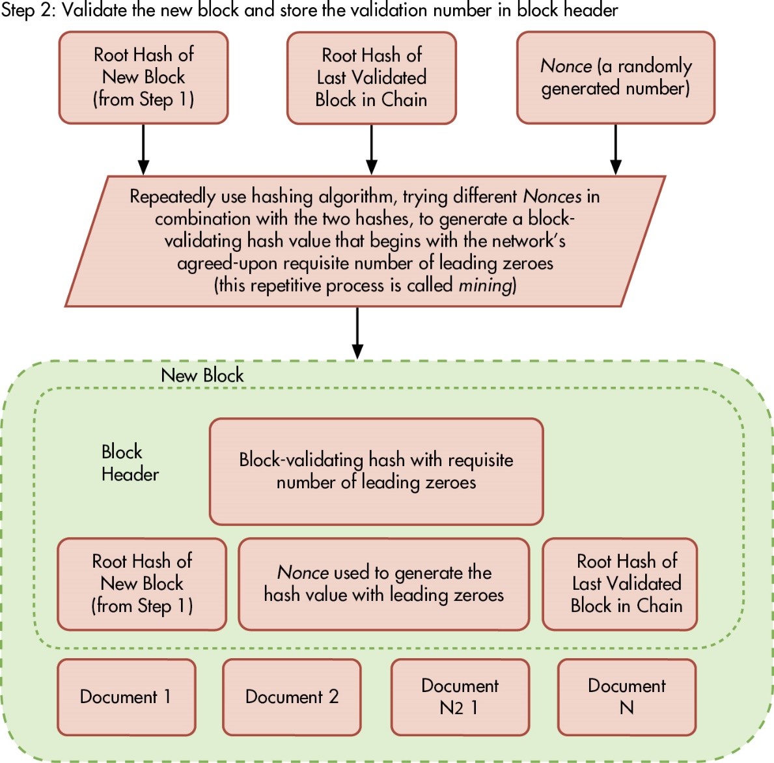
Figure 12.6 How Hashing Updates a Blockchain (2 of 3)
Notes:
Long Description:
The flow diagram showing Step 2 of the process on how hashing updates a blockchain appears as follows:
Step 2: Validate the new block and store the validation number in block header
Root Hash of New Block (from Step 1)
Root Hash of Last Validated Block in Chain
Nonce (a randomly generated number)
Repeatedly use hashing algorithm, trying different Nonces in combination with the two hashes, to generate a block validating hash value that begins with the network’s agreed-upon requisite number of leading zeroes (this repetitive process is called mining)
New Block
Block Header (Block-validating hash with requisite number of leading zeroes)
Root Hash of New Block (from Step 1)
Nonce used to generate the hash values with leading zeroes
Root hash of Last Validated Block in Chain
Document 1, Document 2, Document N minus 1, Document N

Slide 25
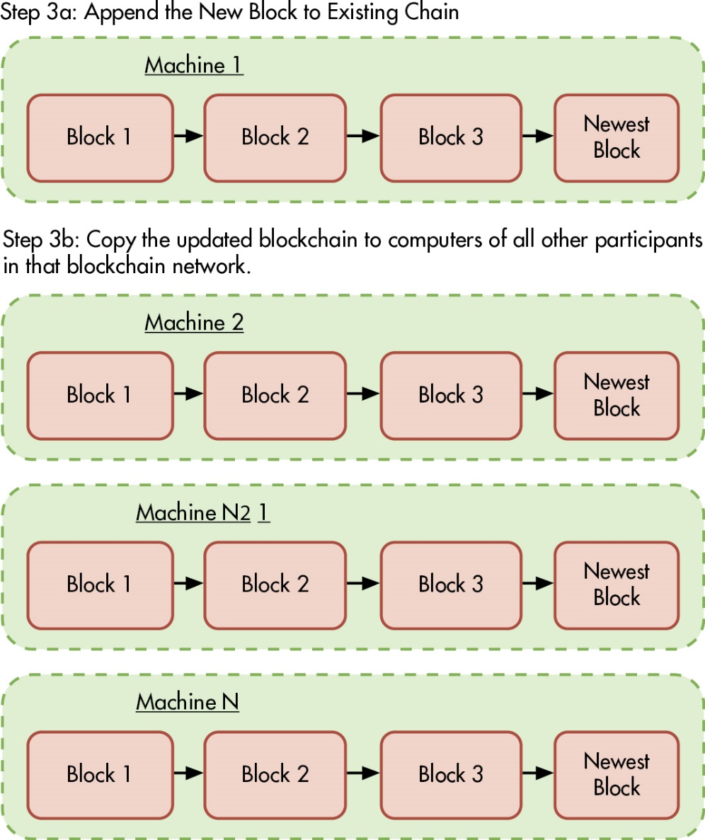
Figure 12.6 How Hashing Updates a Blockchain (3 of 3)
Notes:
Long Description:
The flow diagram of Step 3 a of the process on how hashing updates a blockchain appears as follows:
Step 3 a: Append the New Block to Existing Chain
Machine 1
Block 1
Block 2
Block 3
Newest Block

Slide 26
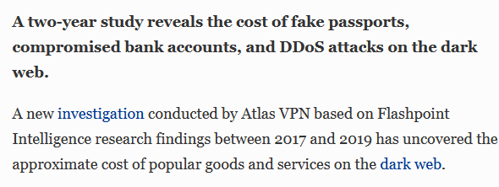
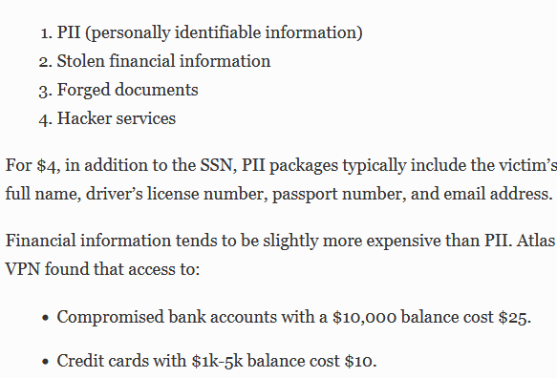
https://www.forbes.com/sites/jessedamiani/2020/03/25/your-social-security-number-costs-4-on-the-dark-web-new-report-finds/?sh=3c4dc65413f1

Slide 27
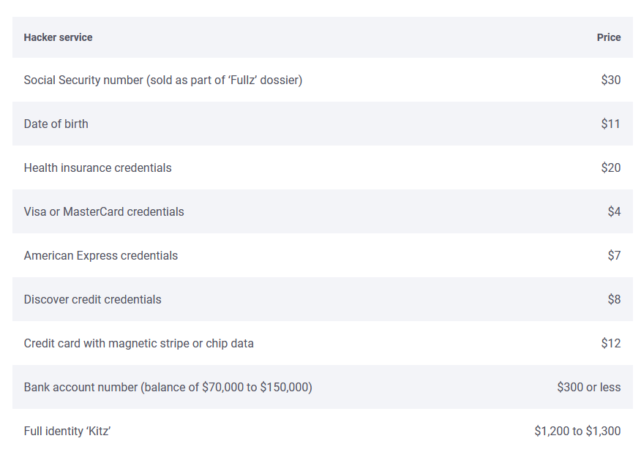
https://www.bankrate.com/personal-finance/credit/what-your-identity-is-worth-on-black-market/

Slide 28
The department of taxation in your state is developing a new computer system for processing individual and corporate income-tax returns.
Identification of taxpayers is provided by using the Social Security number for individuals and federal tax identification number for corporations. The new system will serve three primary purposes:
1 . Tax return data will either be automatically input directly into the system if the taxpayer files electronically or by a clerk at central headquarters scanning a paper return received in the mail.
2. The returns will be processed using the main computer facilities at central headquarters. Processing will include four steps: (a) verifying mathematical accuracy, (b) auditing the reasonableness of deductions, tax due, and so on, through the use of edit routines, which also include a comparison of current and prior years’ data, (c) identifying returns that should be considered for audit by department revenue agents, and (d) issuing refund checks to taxpayers.
3. Inquiry services. A taxpayer will be allowed to determine the status of his or her return or get information from the last three years’ returns by calling or visiting one of the department’s regional offices, or by accessing the department’s web site and entering their social security number.
The state commissioner of taxation and the state attorney general are concerned about protecting the privacy of personal information submitted by taxpayers.
Describe the potential privacy problems that and recommend corrective action(s)

Slide 29
Problem | Controls
Unauthorized employee accessing paper returns submitted by mail. | Restrict physical access to room used to house paper returns and scanning equipment by Using ID badges or biometric controls Logging all people who enter.
Unauthorized employee accessing the electronic files. | Multi-factor authentication of all employees attempting to access tax files.
Interception of tax information submitted electronically. | Encrypt all information submitted to the tax website.
Operator intervention to input data or to gain output from files. | Limit operator access to only that part of the documentation needed for equipment operation. Prohibit operators from writing programs and designing the system. Daily review of console log messages and/or run times. Encryption of data by the application program.
Attempts to screen individual returns on the basis of surname, sex, race, etc., rather than tax liability. | Training about proper procedures Multi-factor authentication to limit access to system. Encrypt of tax return data stored in system
Unauthorized access to taxpayer information on web site | Strong authentication of all people making inquiries via the web site using something other than social security numbers – preferably multi-factor, not just passwords. Encryption of all tax return data while in storage Encryption of all traffic to/from the web site
Unauthorized release of information in response to telephone inquiry | Training on how to properly authenticate taxpayers who make telephone inquiries Strong authentication of taxpayers making telephone inquiries
Disclosure of taxpayer information through improper disposal of old files | Training on how to shred paper documents prior to disposal Training on how to wipe or erase media that contained tax return information prior to disposal

Slide 30
Key Terms
Information rights management (I R M)
Data loss prevention (D L P)
Digital watermark
Data masking
Tokenization
Opt-out
Opt-in
Cookie
Identity theft
Encryption
Plaintext
Ciphertext
Decryption
Symmetric encryption systems
Asymmetric encryption systems
Public key
Private key
Key escrow
Virtual private network (V P N)
Hashing
Hash
Nonrepudiation
Digital signature
Digital certificate
Certificate authority
Public key infrastructure (P K I)
Blockchain
Nonce

Slide 31
Copyright
This work is protected by United States copyright laws and is provided solely for the use of instructors in teaching their courses and assessing student learning. Dissemination or sale of any part of this work (including on the World Wide Web) will destroy the integrity of the work and is not permitted. The work and materials from it should never be made available to students except by instructors using the accompanying text in their classes. All recipients of this work are expected to abide by these restrictions and to honor the intended pedagogical purposes and the needs of other instructors who rely on these materials.

