Slide 1
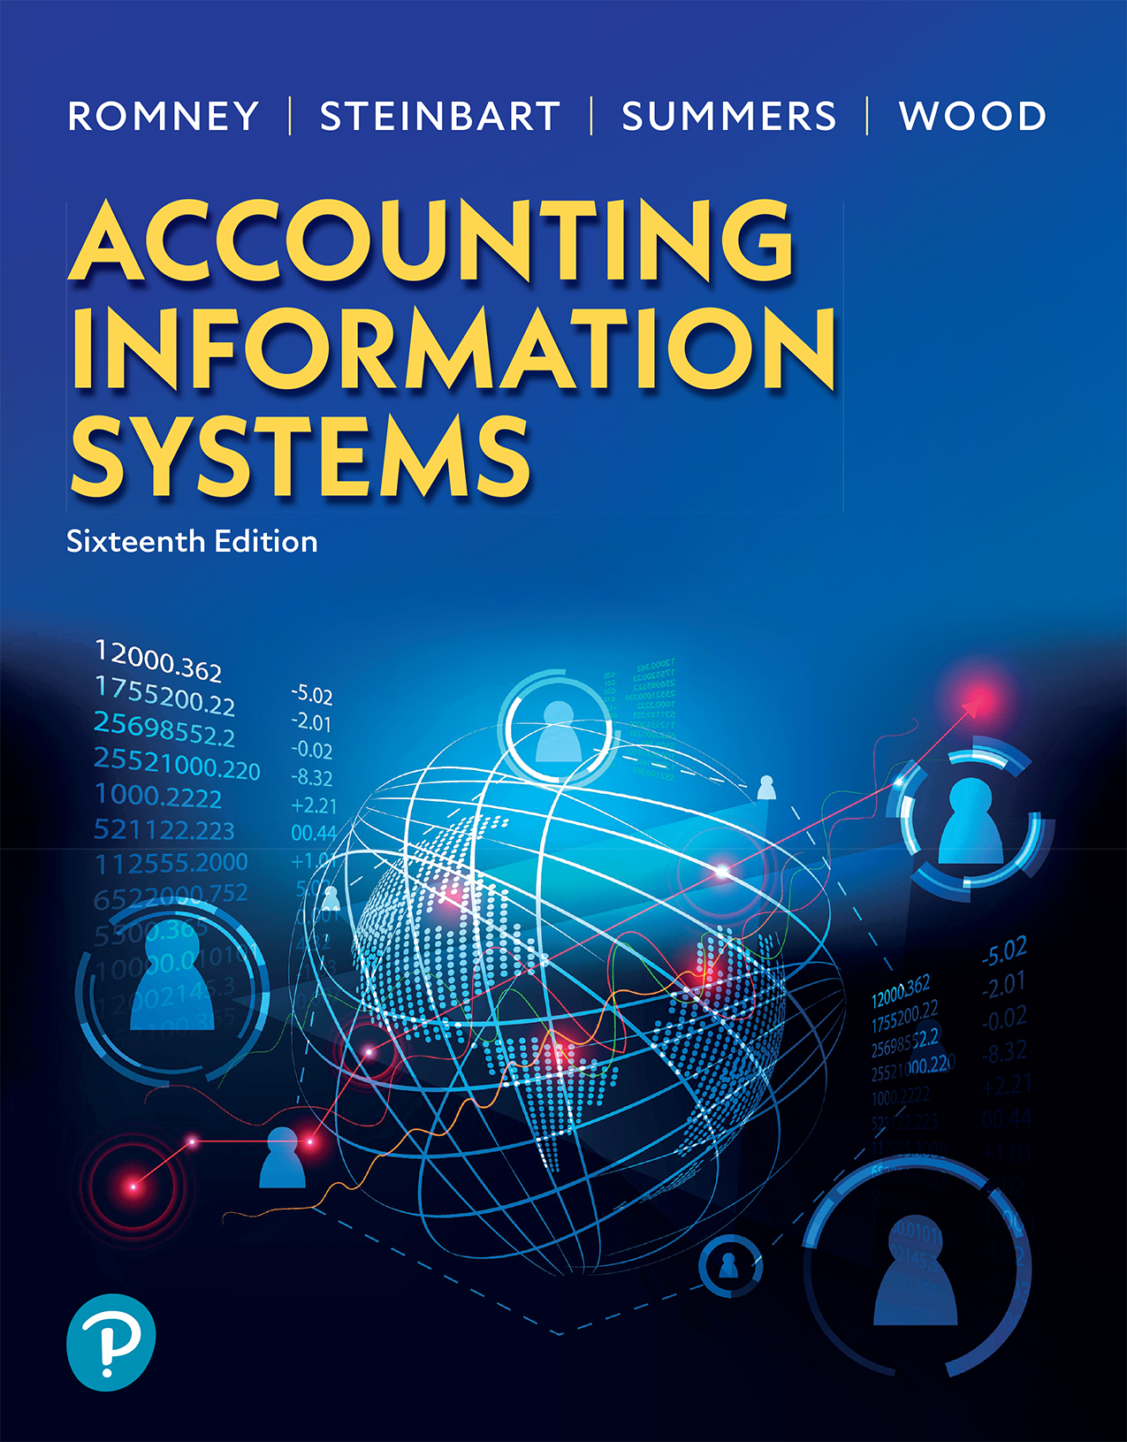

Accounting Information Systems
Sixteenth Edition
Chapter 13
Processing Integrity and Availability Controls
Copyright © 2024, 2021, 2018 Pearson Education, Inc. All Rights Reserved
Notes:
If this PowerPoint presentation contains mathematical equations, you may need to check that your computer has the following installed:
1) MathType Plugin
2) Math Player (free versions available)
3) NVDA Reader (free versions available)

Slide 2
Learning Objectives
Identify and explain the input, processing, and output controls designed to ensure processing integrity.
Identify and explain controls designed to ensure systems availability by minimizing the risk of system downtime and enabling efficient recovery and resumption of operations.

Slide 3
Processing Integrity Controls
Input Process Stage
  Forms design
    Sequentially prenumbered
  Turnaround documents
  Cancelation and storage of source documents
  Data entry controls
Notes:
This chapter covers the last two principles of the Trust Services Framework.
Processing integrity consists of input-processing-output controls. Input controls should prevent inaccurate data from getting into the system.
Good forms design can minimize the chance for errors and having prenumbered documents in sequence allows you to know if a transaction is missing. For example, how do you know if you have billed the customers for all sales in a month? You would first see if the sales orders are invoiced; if a sales order is not in sequence, follow up to see if the goods have shipped or if it’s on backorder.
Turnaround documents are a good input control (an example is your credit card bill; when you pay the bill you tear off a portion of the front page of the bill; it already has your account number preprinted on it) because they make processing more efficient and eliminate potential errors in input (can you imagine having to read someone’s handwriting on a credit card account number?).
Processing controls ensure that data is processed correctly. Output controls are additional controls over processing integrity.

Slide 4
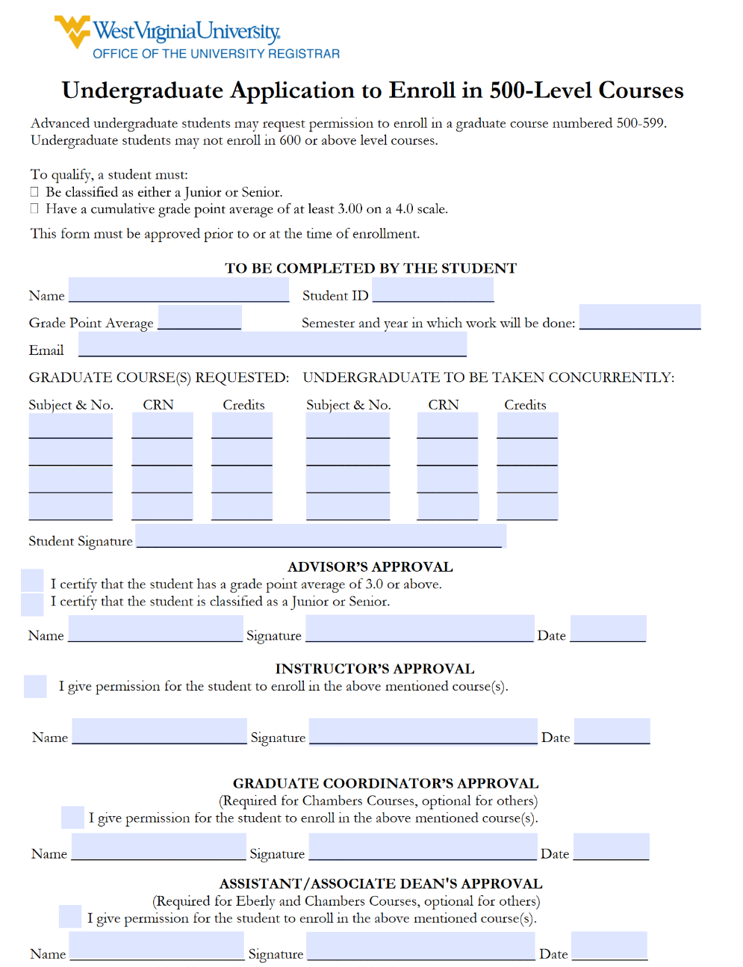
What processing controls are missing/present in this form?
https://registrar.wvu.edu/files/d/25914eab-6382-42e1-adb6-17059a60d157/ug-application-to-enroll-in-500-level-course_updated_062524.pdf

Slide 5
Processing Integrity: Data Entry Controls
Field check
  Characters in a field are proper type
Sign check
  Data in a field is appropriate sign (positive/negative)
Range check
  Tests numerical amount against lower and upper limits
Size check
  Input data fits into the field
Completeness check
  Verifies that all required data is entered
Validity check
  Compares data from transaction file to that of master file to verify existence
Reasonableness test
  Correctness of logical relationship between two data items
Check digit verification
  Recalculating check digit to verify data entry error has not been made

Slide 6
Additional Data Entry Controls
Batch processing
  Sequence check
    Test of batch data in proper numerical or alphabetical sequence
  Batch totals
    Summarize numeric values for a batch of input records
      Financial total
      Hash total
      Record count

Slide 7
Processing Controls
Data matching
  Two or more items must be matched before an action takes place
File labels
  Ensures correct and most updated file is used
Cross-footing
  Verifies accuracy by comparing two alternative ways of calculating the same total
Zero-balance tests
  For control accounts (e.g., payroll clearing)
Write-protection mechanisms
  Protect against overwriting or erasing data
Concurrent update controls
  Prevent error of two or more users updating the same record at the same time

Slide 8
Output Controls
User review of output
Reconciliation procedures
  Procedures to reconcile to control reports (e.g., general ledger A/R account reconciled to Accounts Receivable Subsidiary Ledger)
  External data reconciliation
Data transmission controls
  Checksums
  Parity bits
  Blockchain

Slide 9
Availability Key Objectives
Minimize risk of system downtime
Quick and complete recovery and resumption of normal operations

Slide 10
Availability Controls
Preventive maintenance
Fault tolerance
  Use of redundant components
Data center location and design
  Raised floor
  Fire suppression
  Air conditioning
  Uninterruptible power supply (U P S)
  Surge protection
Training
Patch management and antivirus software
Backup procedures
  Incremental
    Copies only items that have changed since last partial backup
  Differential backup
    Copies all changes made since last full backup
Disaster recovery plan (D R P)
  Procedures to restore organization’s I T function
    Cold site
    Hot site
Business continuity plan (B C P)
  How to resume all operations, not just I T
Notes:
The main objective of availability controls is to minimize the risk of downtime and to quickly recover and resume normal operations.
To minimize the risk of downtime, controls include:
Preventive maintenance
Fault tolerance
Use of redundant components
Data center location and design
Raised floor
Fire suppression
Air conditioning
Uninterruptible power supply (UPS)
Surge protection
Training
Patch management and antivirus software
For quick and complete recovery and resumption of normal processing controls include:
Backup procedures
Incremental
Copies only items that have changed since last partial backup
Differential backup
Copies all changes made since last full backup
Disaster recovery plan (DRP)
Procedures to restore organization’s IT function
Cold site
Hot site
Business continuity plan (BCP)
How to resume all operations, not just IT

Slide 11
Problem 13.7
13.7 Which control(s) would best mitigate the following threats?
The hours worked field in a payroll transaction record contained the value 400 instead of 40. As a result, the employee received a paycheck for $6,257.24 instead of $654.32.
The accounts receivable file was destroyed because it was accidentally used to update accounts payable.
During processing of customer payments, the digit 0 in a payment of $204 was mistakenly typed as the letter “O.” As a result, the transaction was not processed correctly and the customer erroneously received a letter that the account was delinquent.
A salesperson mistakenly entered an online order for 50 laser printers instead of 50 laser printer toner cartridges.
A 20-minute power brownout caused a mission-critical database server to crash, shutting down operations temporarily.
A fire destroyed the data center, including all backup copies of the accounts receivable files.

Slide 12
Problem 13.7
13.7 Which control(s) would best mitigate the following threats?
After processing sales transactions, the inventory report showed a negative quantity on hand for several items.
A customer order for an important part did not include the customer’s address. Consequently, the order was not shipped on time and the customer called to complain.
When entering a large credit sale, the clerk typed in the customer’s account number as 45982 instead of 45892. That account number did not exist. The mistake was not caught until later in the week when the weekly billing process was run. Consequently, the customer was not billed for another week, delaying receipt of payment.
A visitor to the company’s Web site entered 400 characters into the five-digit Zip code field, causing the server to crash.

Slide 13
Problem 13.7
13.7 Which control(s) would best mitigate the following threats?
Two traveling sales representatives accessed the parts database at the same time. Salesperson A noted that there were still 55 units of part 723 available and entered an order for 45 of them. While salesperson A was keying in the order, salesperson B, in another state, also noted the availability of 55 units for part 723 and entered an order for 33 of them. Both sales reps promised their customer next-day delivery. Salesperson A’s customer, however, learned the next day that the part would have to be back-ordered. The customer canceled the sale and vowed to never again do business with the company.
The warranty department manager was upset because special discount coupons were mailed to every customer who had purchased the product within the past 3 years, instead of to only those customers who had purchased the product within the past 3 months.
The clerk entering details about a large credit sale mistakenly typed in a nonexistent account number. Consequently, the company never received payment for the items.

Slide 14
Problem 13.7
13.7 Which control(s) would best mitigate the following threats?
A customer filled in the wrong account number on the portion of the invoice being returned with payment. Consequently, the payment was credited to another customer’s account.
A batch of 73 time sheets was sent to the payroll department for weekly processing. Somehow, one of the time sheets did not get processed. The mistake was not caught until payday, when one employee complained about not receiving a paycheck.
Sunspot activity resulted in the loss of some data being sent to the regional office. The problem was not discovered until several days later when managers attempted to query the database for that information.

Slide 15
Key Terms (1 of 2)
Field check
Sign check
Limit check
Range check
Size check
Completeness check (or test)
Validity check
Reasonableness test
Check digit
Check digit verification
Sequence check
Batch totals
Financial total
Hash total
Record count
Prompting
Closed-loop verification
Header record
Trailer record
Transposition error
Cross-footing balance test
Zero-balance test
Concurrent update controls
Checksum
Parity bit
Parity checking
Fault tolerance

Slide 16
Key Terms (2 of 2)
Redundant arrays of independent drives (R A I D)
Uninterruptible power supply (U P S)
Backup
Recovery point objective (R P O)
Recovery time objective (R T O)
Real-time mirroring
Full backup
Incremental backup
Differential backup
Deduplication
Archive
Disaster recovery plan (D R P)
Cold site
Hot site
Real-time mirroring
Business continuity plan (B C P)

Slide 17
How to debug a spreadsheet?
Panko’s work
  88% of spreadsheets contain errors
  Error of 5%-0.5% per action for humans
  Key problem is developer overconfidence
  Auditing by one person finds only around half of errors
  Best case 80%

Slide 18
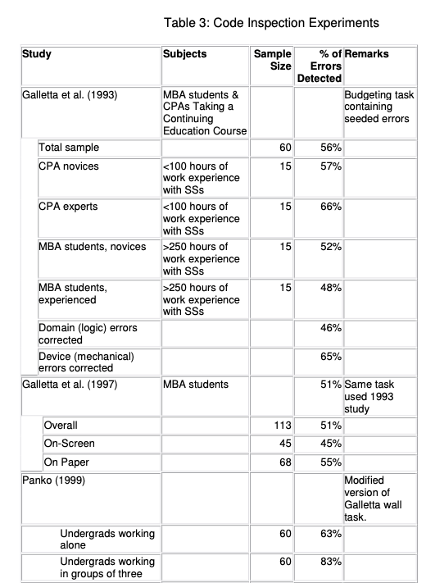
How well does auditing find errors?

Slide 19
How to design a spreadsheet?
Structuring
  Input / Calculations / Output
  Consistent row/columns
    Use bottom row to carry forward.
    Copy down values used in current block
  Top to bottom, left to right
References
  Naming, tables
Versioning (date, v1, …)
Labeling units (days, months, thousands, units, etc…)
Use negative sign on negative cash flows

Slide 20
How to design a spreadsheet?
Visual cues
  Solid borders for input cells
  Avoid merge+center
  Appropriate number formatting
  Colors for meaning
  Solid top + double-bottom border
  Align titles center, text left, numbers right
  Use *highlight* colors for errors

Slide 21
How to debug a spreadsheet?
Debug Process
  Show formulas (or find and format)
  #Errors
    Find precedents/dependents
    Circular references
  For each formula
    See if there are hard-coded values AND pull out to an input cell
    Check for inconsistent rows/columns AND make consistent
    Check ranges for adjacent values AND use a named range
    Split overly-complex formulas apart for auditing
  Bad Values
    Numbers stored as text
    Blanks used instead of zeros (or text values)

Slide 22

Copyright
This work is protected by United States copyright laws and is provided solely for the use of instructors in teaching their courses and assessing student learning. Dissemination or sale of any part of this work (including on the World Wide Web) will destroy the integrity of the work and is not permitted. The work and materials from it should never be made available to students except by instructors using the accompanying text in their classes. All recipients of this work are expected to abide by these restrictions and to honor the intended pedagogical purposes and the needs of other instructors who rely on these materials.

