Slide 1


Accounting Information Systems
Sixteenth Edition
Chapter 14
The Revenue Cycle: Sales to Cash Collections
Copyright © 2024, 2021, 2018 Pearson Education, Inc. All Rights Reserved
Notes:
If this PowerPoint presentation contains mathematical equations, you may need to check that your computer has the following installed:
1) MathType Plugin
2) Math Player (free versions available)
3) NVDA Reader (free versions available)

Slide 2
Learning Objectives
Explain the sales order entry process
Explain the shipping process
Explain the billing process
Explain the cash collections process

Slide 3
Revenue Cycle Artifacts
Sales
Shipping
Billing
Cash collection
Buy X for $
Deliver X
Send invoice
Get $
Sales Offer
Purchase Order
Bill of lading
Invoice
Remittance
Orders
Inventory
A/R
Cash
Notes:
At each of these four activity stages in the revenue cycle, many specific accounting information items are affected. These informational items may be directly related to the general ledger account, or just be informational only.
It is important to note that the revenue cycle is a transaction cycle from which the organization conducts business with its customers.
General threats to the revenue cycle.

Slide 4
Revenue Cycle Activities
Sales
Shipping
Billing
Cash collection
Buy X for $
Deliver X
Send invoice
Get $
Notes:
At each of these four activity stages in the revenue cycle, many specific accounting information items are affected. These informational items may be directly related to the general ledger account, or just be informational only.
It is important to note that the revenue cycle is a transaction cycle from which the organization conducts business with its customers.
General threats to the revenue cycle.

Slide 5
Buyer
Can you sell us x?
Sales Department
Sales Quote
Yes, price is $40
Sell us X
Purchase Order
Stuff
Shipping Dept
Packing Slip / Bill of Lading
Stuff
Shipper
Sales Invoice
AR
Please pay us
This is for order #5
Remittance Memo
Check
Cashier
Notes:
At each of these cycle activity levels, accounting information may be affected as well as general ledger account information.
The expenditure cycle is concerned with transacting business between the organization and its suppliers (vendors) for goods and services.
Sometimes students can get confused in understanding if they are answering questions about the revenue or the expenditure cycle. Table 15-1 in the book is a good reference as it shows the comparison between the two cycles.
The primary objective of the expenditure cycle is to minimize the total cost of acquiring and maintaining inventories, supplies, and various services the organization needs to function.

Slide 6
General Threats and Controls to Revenue Cycle
Threats
Controls
Inaccurate or invalid master data
Unauthorized disclosure of sensitive information
Loss or destruction of data
Poor performance
a. Data processing integrity controls
b. Restrict access to master data
c. Review of all changes to master data
a. Access controls
b. Encryption
c. Tokenization of customer personal information
a. Backup and disaster recovery procedures
a. Managerial reports

Slide 7
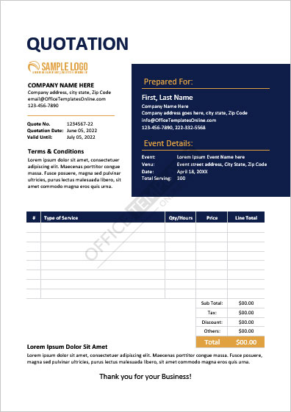
Sales Order Entry Processing Steps
Take the customer order
  Source document: sales quote
Approve customer credit
Check inventory availability
Respond to customer inquiries
https://officetemplatesonline.com/free-quotation-templates-for-businesses-and-individuals/
Notes:
Key objective of the sales order processing step is to make sure that the customer sale is legitimate (authorized) and accurate.
Key information collected at this stage is information about the availability of goods, the customer sales order information, and the customer’s credit information. At this stage, no general ledger accounts (e.g., sales and inventory) are affected.

Slide 8
Sales Order Entry Processing
Threats
Controls
Incomplete/inaccurate orders
Invalid orders
Uncollectible accounts
Stockouts and excess inventory
Loss of customers
a. Data entry edit controls
b. Restrict access to master data to maintain accuracy
a. Signature to authorize sale
a. Credit limits checked and if sale exceeds limit, specific authorization needed
b. Aging of accounts receivable
a. Perpetual inventory system
b. RFID or bar code technology
c. Physical inventory counts
d. Sales forecast and activity reports
Notes:
Controls to mitigate loss of customers include
CRM systems, self-help websites, and proper evaluation of customer service ratings

Slide 9
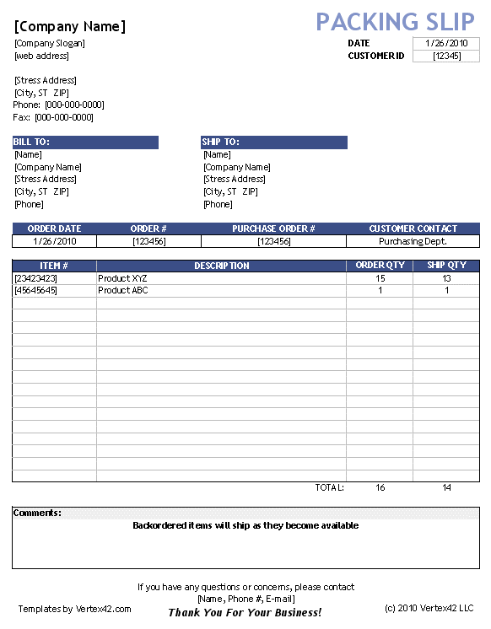
Shipping Process (1 of 2)
Pick and pack the order
  Source documents: picking ticket
Ship the order
  Source documents:
  Packing slip (contents of shipment)
  Bill of lading (legal transfer of ownership)
https://www.vertex42.com/ExcelTemplates/packing-slip.html
Notes:
Key objective is to make sure that the customer order has the correct inventory item and the correct quantity.
At this stage, because inventory is leaving the warehouse, the general ledger account is affected (inventory is decreased once it is shipped). The other side of the entry of course is that the cost of sales general ledger account has increased.
At this point, it may be interesting to examine the source documents from the first two stages: sales order, picking list, packing slip, and bill of lading. What information is similar, and what informational elements are unique to the source documents?

Slide 10
Shipping Process (2 of 2)
Threats
Controls
Picking wrong item or quantity to ship
Theft of inventory
Shipping errors (fail to ship the goods, wrong quantities, wrong items, ship to wrong address, duplication)
a. Bar code technology
b. Reconcile picking list to sales order
a. Restrict physical access to inventory
b. Document inventory transfers
c. Physical counts of inventory and reconcile to quantities recorded
a. Reconcile shipping documents to sales orders, picking lists, and packing slips
b. Data entry edit controls

Slide 11
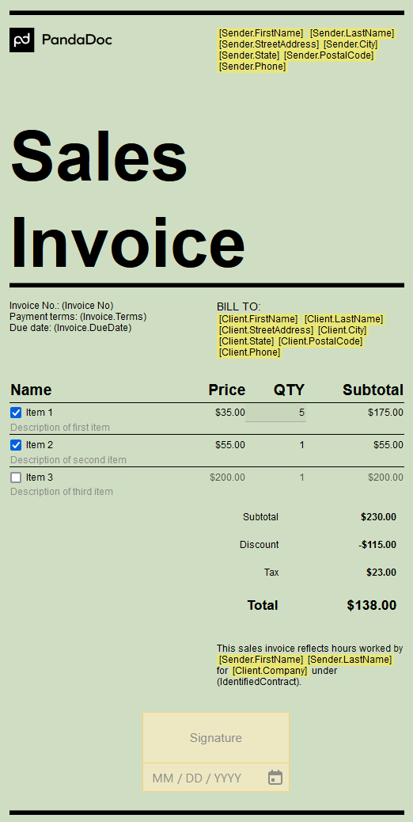
Billing Process (1 of 2)
Invoicing the customer
  Source document: sales invoice
Updating accounts receivable
  Source document: credit memo and monthly statements
https://www.pandadoc.com/invoice-templates/
Notes:
Key objective here is to make sure that the customer is invoiced for items shipped and that the invoice is accurate (customer is billed only for those items ordered and shipped as well as quantity).

Slide 12
Billing Process (2 of 2)
Threats
Controls
Failure to bill customer
Billing errors
Posting errors in accounts receivable
Inaccurate or invalid credit memos
a. Reconcile invoices with sales orders and shipping documents
b. Separate shipping and billing functions
a. Data entry edit controls
b. Configure system to automatically enter price data
c. Data entry edit controls
d. Reconciliation of shipping documents to sales orders
a. Reconcile subsidiary accounts receivable balance to the amount for accounts receivable in the general ledger
b. Mail monthly statements to customers
a. Segregation of authorization and recording function for credit memos

Slide 13
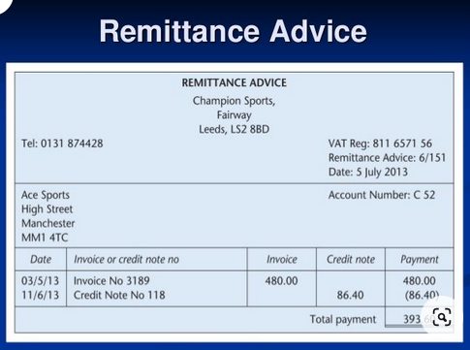
Cash Collection Process (1 of 2)
Process customer payment and update their account balance
  Remittance
Deposit payments to the bank
https://www.wordstemplates.org/remittance-advice-template/
Notes:
Key objective for this activity is to reduce the risk of theft and to make sure that the customer account is properly updated with the payment.

Slide 14
Cash Collection Process (2 of 2)
Threats
Controls
Theft of cash
Cashflow problems
a. Proper segregation of cash handling and posting to customer accounts, authorize credit memos, or reconcile bank account
b. Use lockbox
c. Immediately open mail,
prompt
endorsement and deposit all cash
receipts daily
d. Use cash registers
a. Lockbox
b. Discounts for early payment
c. Cash flow budgeting

Slide 15
Key Terms
Revenue cycle
Sales order
Electronic data interchange (E D I)
Credit limit
Accounts receivable aging report
Back order
Picking ticket
Customer relationship management systems (C R M)
Packing slip
Bill of lading
Sales invoice
Open-invoice method
Remittance advice
Balance-forward method
Monthly statement
Cycle billing
Credit memo
Remittance list
Lockbox
Electronic lockbox
Electronic funds transfer (E F T)
Financial electronic data interchange (F E D I)
Universal payment identification code (U P I C)
Cash flow budget

Slide 16

Copyright
This work is protected by United States copyright laws and is provided solely for the use of instructors in teaching their courses and assessing student learning. Dissemination or sale of any part of this work (including on the World Wide Web) will destroy the integrity of the work and is not permitted. The work and materials from it should never be made available to students except by instructors using the accompanying text in their classes. All recipients of this work are expected to abide by these restrictions and to honor the intended pedagogical purposes and the needs of other instructors who rely on these materials.

