Slide 1
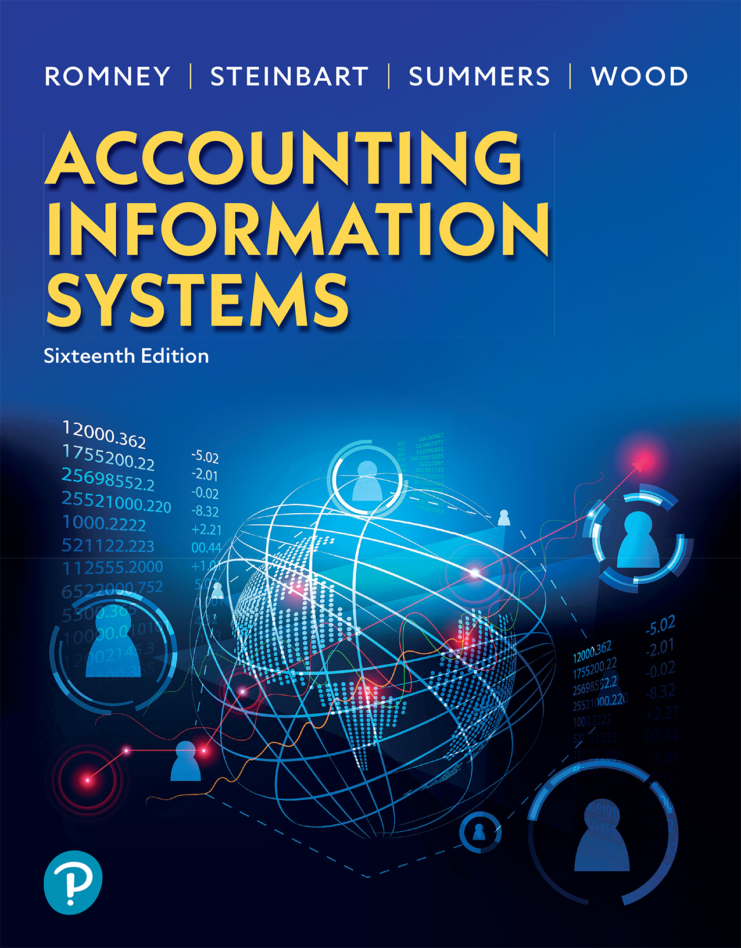
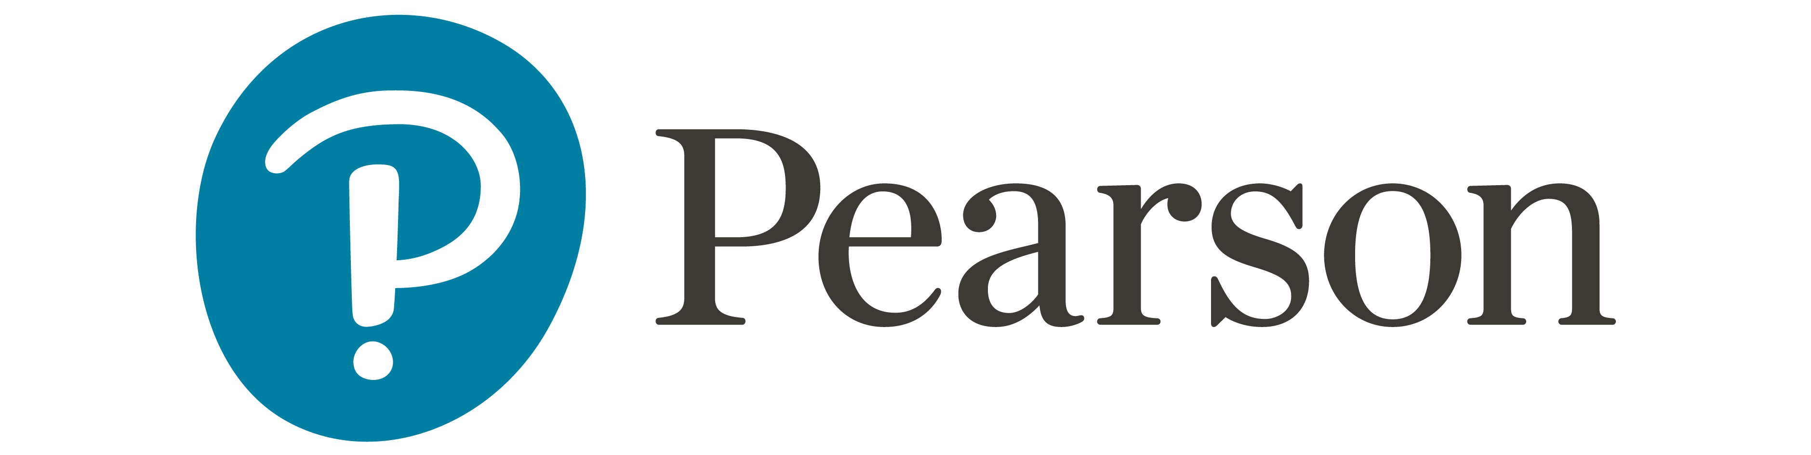
Accounting Information Systems
Sixteenth Edition
Chapter 15
The Expenditure Cycle: Purchasing to Cash Disbursements
Copyright © 2024, 2021, 2018 Pearson Education, Inc. All Rights Reserved
Notes:
If this PowerPoint presentation contains mathematical equations, you may need to check that your computer has the following installed:
1) MathType Plugin
2) Math Player (free versions available)
3) NVDA Reader (free versions available)

Slide 2
Learning Objectives (1 of 2)
Discuss the basic business activities and related information processing operations in the expenditure cycle, explain the general threats to those activities, and describe the controls that can mitigate those threats.
Explain the process and key decisions involved in ordering goods and services, identify the threats to those activities, and describe the controls that can mitigate those threats.
Explain the process and key decisions involved in receiving goods and services, identify the threats to those activities, and describe the controls that can mitigate those threats.

Slide 3
Learning Objectives (2 of 2)
Explain the process and key decisions involved in approving supplier invoices for goods and services, identify the threats to those activities, and describe the controls that can mitigate those threats.
Explain the process and key decisions involved in making cash disbursements to suppliers, identify the threats to those activities, and describe the controls that can mitigate those threats.

Slide 4
Basic Expenditure Cycle Activities
Order materials, supplies, and services
Receive materials, supplies, and services
Approve supplier (vendor) invoice
Cash disbursement
Notes:
At each of these cycle activity levels, accounting information may be affected as well as general ledger account information.
The expenditure cycle is concerned with transacting business between the organization and its suppliers (vendors) for goods and services.
Sometimes students can get confused in understanding if they are answering questions about the revenue or the expenditure cycle. Table 15-1 in the book is a good reference as it shows the comparison between the two cycles.
The primary objective of the expenditure cycle is to minimize the total cost of acquiring and maintaining inventories, supplies, and various services the organization needs to function.

Slide 5
Production Department
Ask for X
CFO
Can you sell us x?
Can we pay?
Purchasing Dept
Yes, price is $40
Supplier
Sell us X
It is ok to pay Supplier
Please pay us
Stuff
We got X
AP
Receiving Dept
Stuff
Shipper
Check + Remittance Memo
Notes:
At each of these cycle activity levels, accounting information may be affected as well as general ledger account information.
The expenditure cycle is concerned with transacting business between the organization and its suppliers (vendors) for goods and services.
Sometimes students can get confused in understanding if they are answering questions about the revenue or the expenditure cycle. Table 15-1 in the book is a good reference as it shows the comparison between the two cycles.
The primary objective of the expenditure cycle is to minimize the total cost of acquiring and maintaining inventories, supplies, and various services the organization needs to function.

Slide 6
Production Department
Purchase Requisition
Ask for X
CFO
Can you sell us x?
Can we pay?
Purchasing Dept
Sales Quote
Yes, price is $40
Voucher Package
Supplier
Purchase Order
Sell us X
It is ok to pay Supplier
Please pay us
Sales Invoice
Stuff
We got X
AP
Receiving Report
Bill of Lading
Receiving Dept
Stuff
Shipper
Remittance
Check + Remittance Memo
Notes:
At each of these cycle activity levels, accounting information may be affected as well as general ledger account information.
The expenditure cycle is concerned with transacting business between the organization and its suppliers (vendors) for goods and services.
Sometimes students can get confused in understanding if they are answering questions about the revenue or the expenditure cycle. Table 15-1 in the book is a good reference as it shows the comparison between the two cycles.
The primary objective of the expenditure cycle is to minimize the total cost of acquiring and maintaining inventories, supplies, and various services the organization needs to function.

Slide 7
Key Decisions
What is the optimal level of inventory?
Which suppliers provide the best quality at the best price?
How can IT be used to improve efficiency and accuracy of logistics?
How can we take advantage of vendor discounts?
How can we maximize cash flow?
Notes:
Overall key decisions related to the expenditure cycle involve getting the inventory needed at a good price when the organization needs it.
Basically, the organization does not want to tie up too much money in inventory that will take a long time to use up; this is why logistics is so important and why IT can leverage this for companies to save money by not overbuying inventory, purchasing inventory of poor quality, or paying too much for inventory.

Slide 8
General Threats and Controls
Threats
Controls
Inaccurate or invalid master data
Unauthorized disclosure of sensitive information
Loss or destruction of data
Poor performance
a. Data processing integrity controls
b. Restriction of access to master data
c. Review of all changes to master data
a. Access controls
b. Encryption
a. Backup and disaster recovery procedures
a. Managerial reports

Slide 9
Order Goods (Materials/Supplies) or Services Processing Steps
Identify what, when, and how much to purchase
  Source document: purchase requisition
Get the price / availability / terms
  Source document: sales quote
Authorize the purchase
  Source document: purchase order
Notes:
At this activity stage of the expenditure cycle, the key objective is to identify exactly what to order, how much you need, and when you need it. It is essential in managing a supply chain that raw materials are accurately ordered and received in time; otherwise, these will cause issues and added expenses in the supply chain. There are three approaches to ordering:
Economic quantity ordered (EOQ) is used to minimize costs and stockouts. For example, stores may identify certain inventory items that are sold frequently and may have an EOQ that is different than an inventory item that is not sold as frequently.
Materials requirements planning (MRP) is based on forecast sales.
Just-in-time inventory (JIT) responds to actual sales (demand).
The key objective is to make sure that the purchase is authorized, that you receive what you ordered when you want it, and that the goods are of good quality.

Slide 10
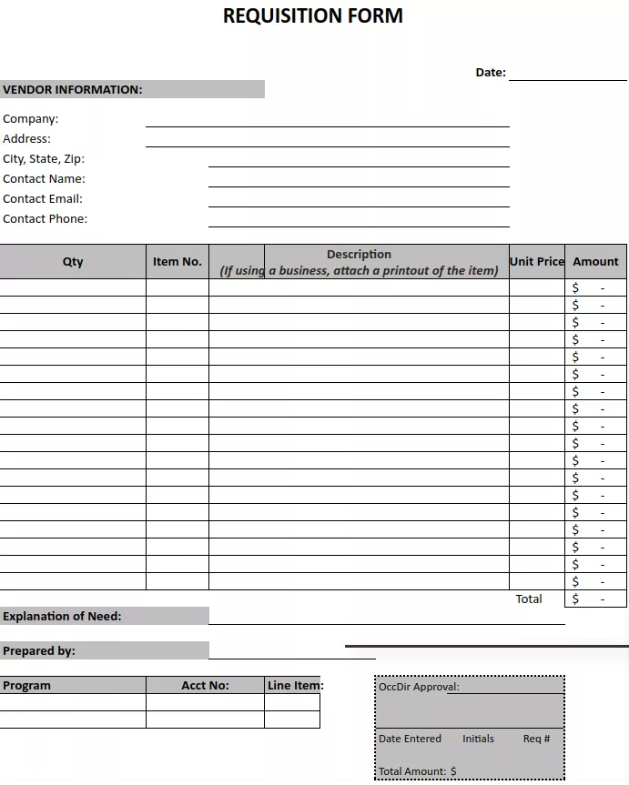
Purchase Requisition
From: Production
To: Purchasing
Key: explanation / justification for need
Notes:
https://www.investopedia.com/terms/r/requisition.asp

Slide 11
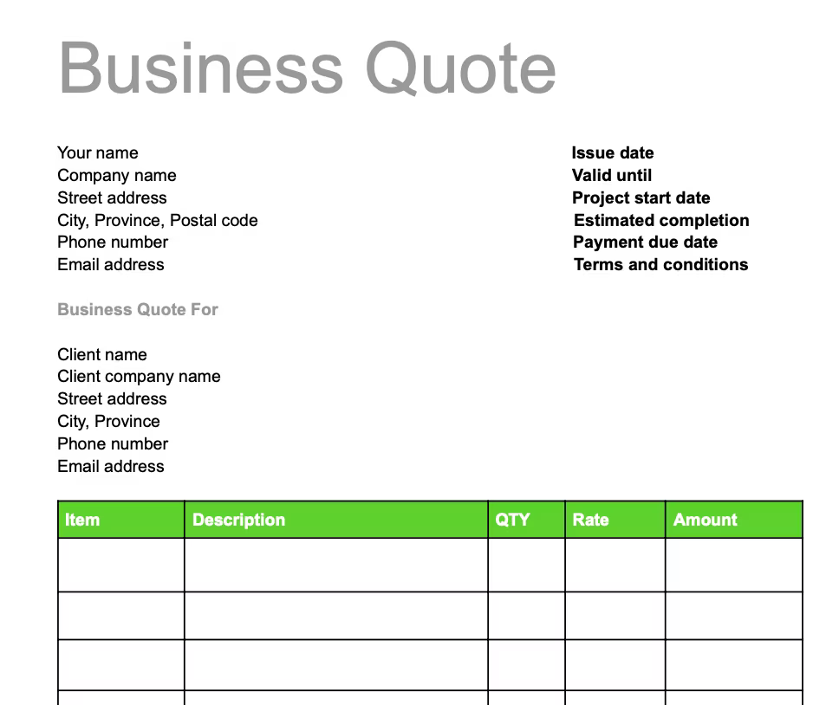
Sales Quote
From: Supplier
To: Purchasing
Key: pricing, delivery, availability
Notes:
https://quickbooks.intuit.com/ca/resources/invoicing/how-to-write-business-quotes-with-template/

Slide 12
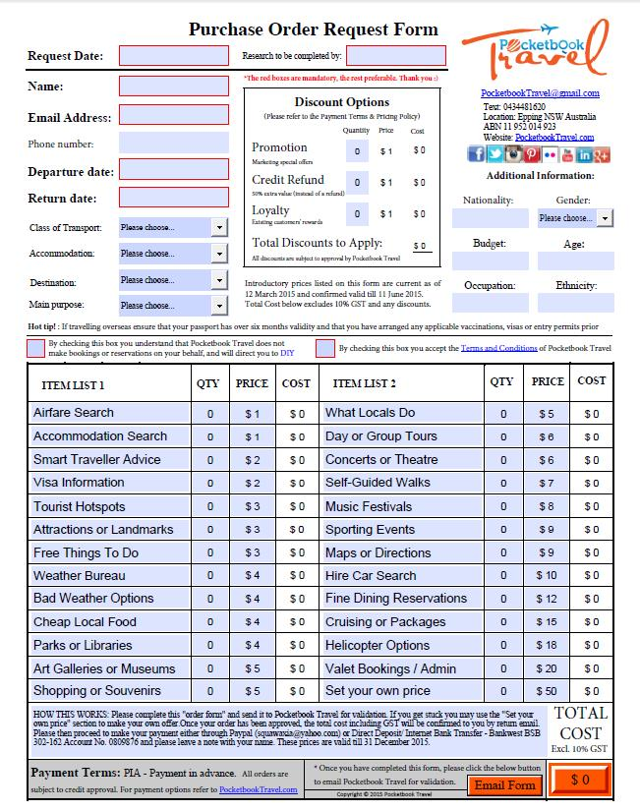
Purchase Order
From: Purchasing
To: Supplier
Key: Promise to pay after delivery of item
Notes:
https://en.wikipedia.org/wiki/Purchase_order

Slide 13
Ordering Goods/Services (1 of 2)
Threats
Controls
Stockouts and excess inventory
Purchasing items not needed
Purchasing items at inflated prices
Purchasing goods of poor quality
a. Perpetual inventory system
b. Bar-coding, R F I D
c. Periodic physical counts
a. Perpetual inventory systems
b. Review and approval of purchase requisitions
c. Centralized purchasing
a. Price lists
b. Competitive bids
c. Review purchase orders
a. Use approved suppliers
b. Review and approve purchases from new suppliers
c. Monitor product quality by supplier
d. Hold purchasing managers responsible for rework and scrap cost

Slide 14
Ordering Goods/Services (2 of 2)
Threats
Controls
Unreliable suppliers
Purchasing from unauthorized suppliers
Kickbacks
a. Monitor supplier performance
b. Require quality certification
a. Purchase from approved suppliers
b. Review approval from purchases of new suppliers
c. E D I specific controls
a. Supplier audits
b. Prohibit gifts
c. Job rotation & mandatory vacations
d. Required disclosure of financial and personal interests in suppliers

Slide 15
Receiving Process
Goods arrive
  Verify goods ordered against the purchase order (what, how much, quality)
  Source document: receiving report
  Source document: bill of lading
Notes:
At this stage, when the goods are received into the warehouse, the company has a legal obligation to pay the vendor. That is why it is so important to make sure that:
The goods were authorized (check against a Purchase Order).
The goods received are what was ordered and in the correct quantity.
The goods are of good quality.
If there are problems in step 2, then there may be a back-order situation. For example, if five items were ordered but only three are received, then there is a backorder of two items. You would only want to pay the vendor for the items received. So if there is a back-order situation, the warehouse would need to make sure that this is documented for the accounting department (this would be shown on the packing slip of the quantity received as well as the receiving report normally).
If there is a problem with step 3, the goods are of poor quality, the merchandise should not be received, and the vendor should be contacted to return the items.
At this stage, you would see an increase in the inventory general ledger account and the obligation (accounts payable) increase.

Slide 16
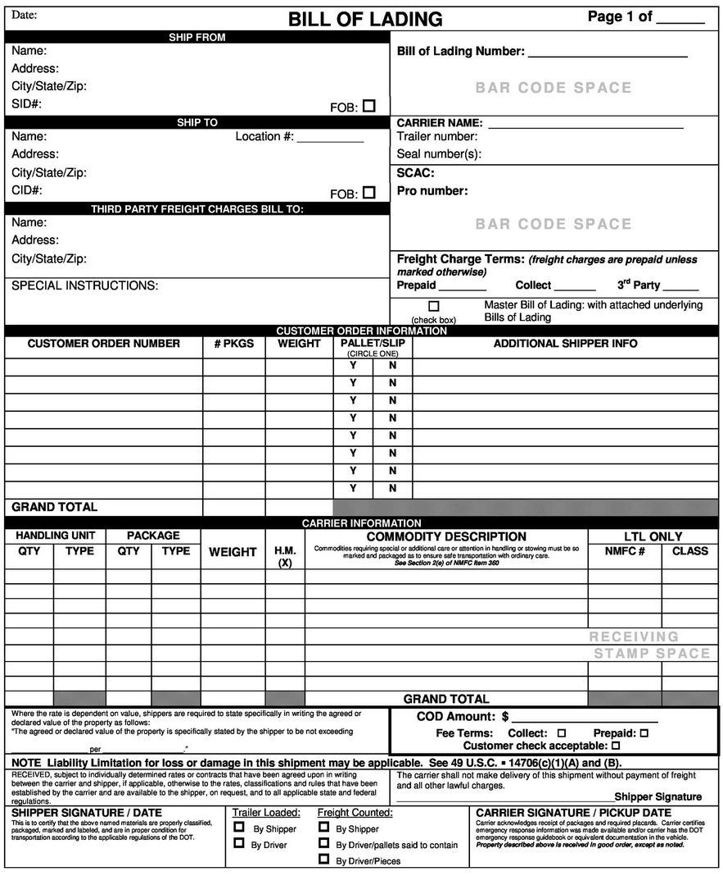
Bill of Lading
From: Supplier
To: Receiving
Key: What is supposed to be on the truck?

Slide 17
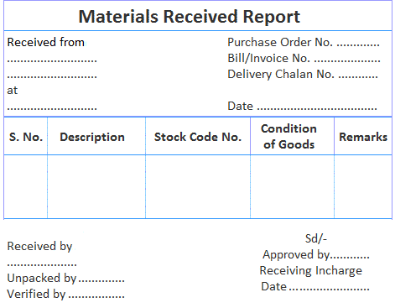
Receiving Report
From: Receiving
To: Purchasing
Key: What did we actually receive?
Notes:
https://www.financestrategists.com/accounting/cost-accounting/material-costing/procedure-for-receiving-of-materials/

Slide 18
Receiving Goods or Services
Threats
Controls
Accepting unordered items
Mistakes in counting
Verifying receipt of services
Inventory theft
a. Authorized purchase orders needed before receiving goods
a. Bar codes or R F I D
b. Receiving employees sign receiving report
c. Do not inform receiving of quantity ordered
a. Budget controls and audits
a. Restrict physical access to inventory
b. Document all inventory transfers
c. Segregate custody vs. receiving of inventory

Slide 19
Approve Supplier Invoice and Cash Disbursements
Match the supplier invoice to:
  Purchase order
  Receiving report
supplier invoice + purchase order + receiving report = voucher
Approve supplier invoice for payment
Source document:
  disbursement voucher
Pay vendor

Slide 20
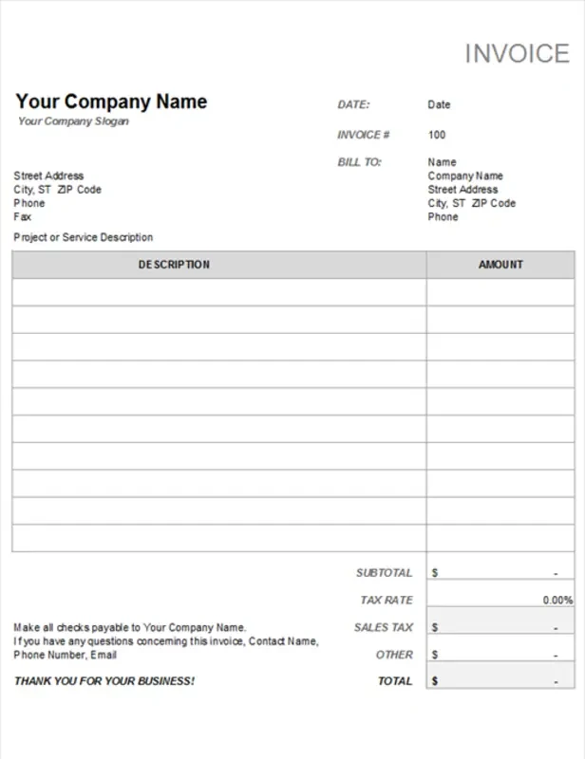
Invoice
From: Supplier
To: Purchasing
Key: Please pay us
Notes:
https://create.microsoft.com/en-us/templates/invoices

Slide 21
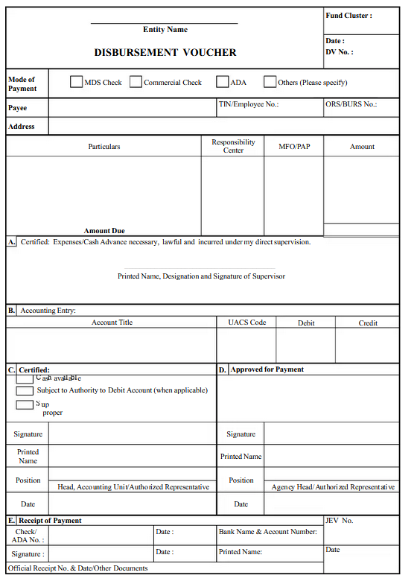
Voucher
From: Purchasing
To: CFO and AP
Key: Send a check
Notes:
https://www.academia.edu/33515851/Disbursement_Voucher_32

Slide 22
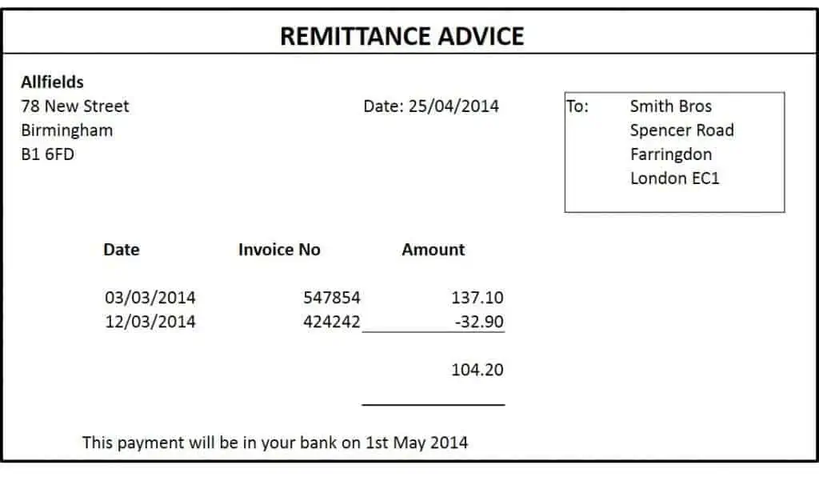
Remittance
From: AP
To: Supplier
Key: Apply this payment to these invoices
Notes:
https://www.docspile.com/remittance-template/

Slide 23
Payment Package
Check (signed by CFO)
Purchase Order (what we ordered)
Receiving Report(what we received)
Invoice (what they are billing us for)

Slide 24
Approve Supplier Invoice
Threats
Controls
Errors in supplier invoice
Mistakes in posting to accounts payable
a. Verify invoice accuracy
b. Require detailed receipts for p-cards
c. Restrict access to supplier master data
a. Data entry edit controls
b. Reconcile detailed accounts payable records to the general ledger accounts payable account
Notes:
P-cards are procurement cards that departments will sometimes use

Slide 25
Cash Disbursements
Threats
Controls
Failure to take discounts
Pay for items not received
Duplicate payments
Theft of cash
Check alteration
Cash flow problems
a. File invoices by due date to take advantage of discounts
a. Match supplier invoice to supporting documents (purchase order, receiving report)
a. Pay only original invoices
b. Cancel supporting document when payment is made
a. Physical security of checks
b. Separation of duties
c. Reconcile bank accounts
a. Check protection machines
b. Special inks / papers
a. Cash flow budget

Slide 26
Key Terms
Expenditure cycle
Economic order quantity (E O Q)
Reorder point
Materials requirement planning (M R P)
Just-in-time (J I T) inventory system
Purchase requisition
Purchase order
Blanket purchase order/blanket order
Vendor-managed inventory (V M I)
Kickbacks
Receiving report
Debit memo
Voucher package
Nonvoucher system
Voucher system
Disbursement voucher
Evaluated receipt settlement (E R S)
Procurement card
Imprest fund

Slide 27

Copyright
This work is protected by United States copyright laws and is provided solely for the use of instructors in teaching their courses and assessing student learning. Dissemination or sale of any part of this work (including on the World Wide Web) will destroy the integrity of the work and is not permitted. The work and materials from it should never be made available to students except by instructors using the accompanying text in their classes. All recipients of this work are expected to abide by these restrictions and to honor the intended pedagogical purposes and the needs of other instructors who rely on these materials.

